Slide 1
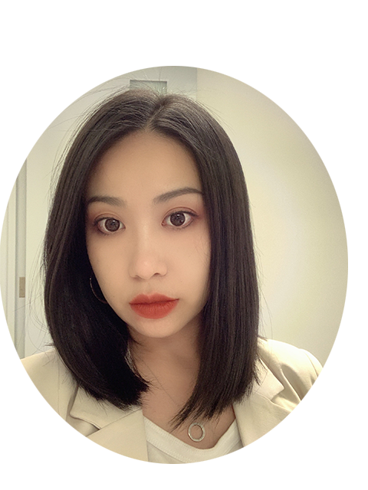
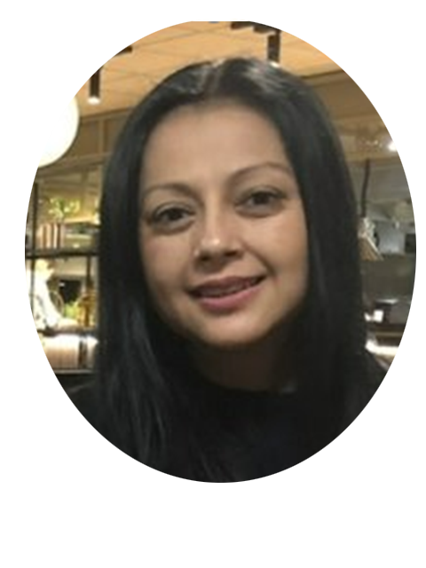
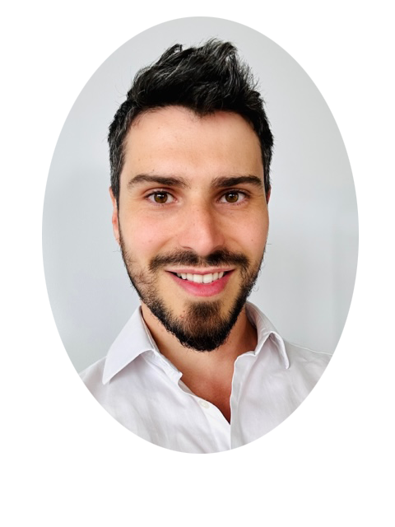
ANU School of Computing
TechLauncher Professional Team
Myo Nguyen,
Student Employability Lead
studentemployability.cecc@anu.edu.au
Jean-Armand Bouthe, Partnership Coordinator
Jean-Armand.Bouthe@anu.edu.au
Christy Chen,
Engagement and Impact Officer
Christy.Chen@anu.edu.au
We are here to facilitate your Work Integrated learning experience!

Slide 2
What you need to do* after the team formation night!
Student
Agreement
*Students working with an External Client**
** excluding CSIRO
Step 1: Wait to receive an email from CECC Student Employability team studentemployability.cecc@anu.edu.au with instructions during Week 2 and Week 3 of the Semester. You will receive agreements to consider.
(We will contact you as soon as the Agreement between your Client (Host) and ANU (ST P01 Industry Project Agreement) and your team's Project Details (ST P023) form are both signed by your Client and ANU.)
Step 2: Review information in the signed ST P01 and ST P03 together with your ST P02 Student Project Agreement. You have 30 days to consider your Student Project Agreement and seek independent Legal Advice.
Step 3: When you accept the terms and conditions, you must first fill out your personal details, sign your ST P02 Student Project Agreement and seek your Client's Signature.
Step 4: You are required to submit a copy of the fully signed ST P02 Student Project Agreement to ANU via CECC Student Employability Office and a copy to your Client by the 7th of April.
Step 5: If you do not wish to proceed with your ST P02 Student Project Agreement, you must inform your decision to your Course Convenor and CECC Student Employability team via an email.

Slide 3
What you need to do* after the team formation night!
Student
Agreement
*Students working with an ANU Internal Client
Step 1: Wait to receive an email from CECC Student Employability team studentemployability.cecc@anu.edu.au with instructions during Week 3 or Week 4 of the Semester. You will receive agreements to consider.
(We will contact you as soon as your Client has advised their preferred Agreement template and signed (if required). We will email you which Internal Student Project Agreement that you need to consider. )
Step 2: Review and Consider your Student Project Agreement. You have 30 days to consider your Student Project Agreement and seek independent Legal Advice.
Step 3: If you accept the terms and conditions, you must first fill out your personal details, sign your Student Project Agreement. and seek your Client's Signature (if required).
Step 4: You are required to submit a copy of the fully signed Student Project Agreement to ANU via CECC Student Employability Office and provide a copy to your Client.
Step 5: If you do not wish to proceed with your ST P02 Student Project Agreement, you must inform your decision to your Course Convenor and ECC Student Employability team via an email.

Slide 4
ANU Insurance
The College will be arranging 'the Group Personal Accident Insurance Cover' for those students who will work on the projects where they will be required to work off-campus or attend some off-campus activities.
Those students will receive an email from studentemployability.cecc@anu.edu.au confirming that their insurance is in place.
If your group project has any off-campus activities, you should receive an email about the insurance cover by the Week 3 of the Semester.
What you need to do:
Step 1: Wait for the email about the insurance cover from CECC Student Employability team studentemployability.cecc@anu.edu.au.
Step 2: If you do not receive any email about the insurance cover by the end of Week 3, contact CECC Student Employability
team studentemployability.cecc@anu.edu.au .

Slide 5
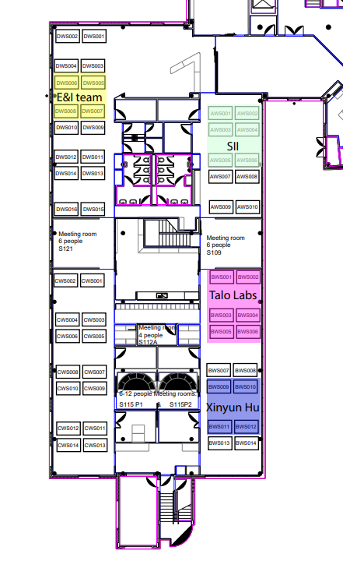
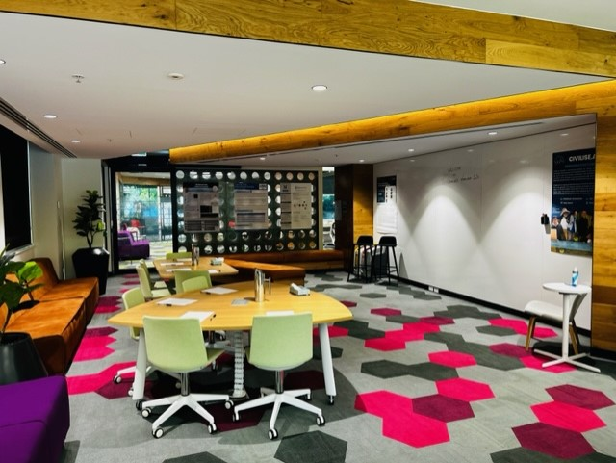
ANU School of computing offers you to conduct your TechLaucher project in the HIVE, located on the groundfloor of the CSIT. You can book a hot desk and a meeting room and invite your client to work with you.
HIVE SPACE
Hot desk / meeting room booking system

Slide 6
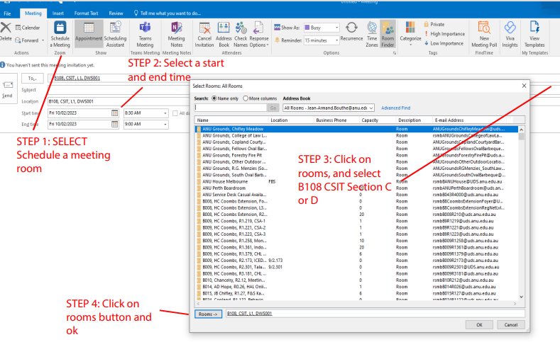
HIVE SPACE
Hot desk / meeting room booking system
STEP 1: Go on your ANU Outlook, click on calendar
STEP 2: Select Schedule a meeting > select a start and end time* > click on rooms > select B108 CSIT CWS / DWS (AWS AND BWS are reserved for other activities) > click on rooms insert > ok > send
*Please note that:
-Maximum Duration: 4 hours (possibility to renew if availability) - Duration for workspaces: 1 to 4 hours - Duration for meeting room: 1 to 4 hours -WorkDays: Monday to Friday -WorkingHoursStartTime: 08:00:00 -WorkingHoursEndTime: 18:00:00
Don't forget to put the location and select the desk or meeting room you want to book.
STEP 5:
SEND

Slide 7
HEX Singapore
concept ideation, startup mentality,funding & finance, market research & validation, startup culture and tours plus an intro to branding and marketing.
Learn about growth hacking, pitching 101, UI and prototyping, product design, financial modelling, tech tours and finally your pitches to investors, CEOs and government legends.
Apply before the 9th of April on HEX International: Singapore (startwithhex.com)
https://youtu.be/wqY-kzjz0qI

