Slide 1
Programming as Problem Solving
COMP 1100

Slide 2
Acknowledgement of Country
I wish to acknowledge the traditional custodians of the land we are meeting on, the Ngunnawal people. I wish to acknowledge and respect their continuing culture and the contribution they make to the life of this city and this region. I would also like to acknowledge and welcome any other Aboriginal and Torres Strait Islander people who are enrolled in our courses.

Slide 3
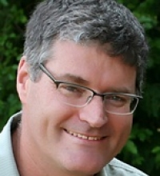
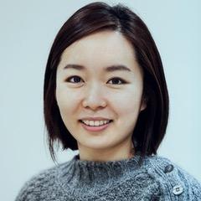
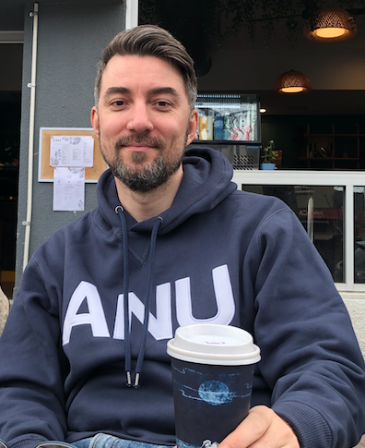
COMP1100 Team
Course convener and lecturer
Artem Lenskiy
Second examiners
Tony Hosking, Jooyoung Lee
Tutors
David Quarel
Nicholas Miehlbradt
Madeleine Stewart
Cassandra Chun-Crogan
Debashish Chakraborty
Elise Palethorpe
James Bacon
Joshua Corner
Yihan Zhou (Allie)

Slide 4
Part One What is this course ?

Slide 5
I. What is this course
The entry point for study in Computer Science.
A broad course aimed at many different backgrounds and destinations.
Teaching the fundamentals of algorithms and programming as means of solving problems.
Introduces many concepts that will be revisited in more depth later in the CS curriculum.
Uses the programming language Haskell.

Slide 6
I. Programming Experience
Many of you will have programmed before, e.g. in high school, or as a hobby.
Many of you will not have.
Prior programming is not expected in this course.
Nor, in our experience, is it a major advantage: we focus on the principles and foundations of programming in a way that is very different from most students’ experience.

Slide 7
I. Mathematical Maturity
We do expect students to be comfortable with mathematical thinking
– abstraction, algorithms, attention to detail
Building these mathematical skills at the same time as picking up programming skills can be a challenge for some students.
Students who lack confidence in their mathematics should consider delaying COMP1100 by one semester, to take a course like MATH1005 (Discrete Mathematical Models).

Slide 8
I. Ongoing vs One-Off study
COMP1100 is designed to be an introduction to a broader course of learning in computer science.
May also be used as a 'taster' of what computer science is like.
But not recommended for students who intend to only do one computer science course to get useful programming skills.
We recommend COMP1730 (Programming for Scientists) for such students.

Slide 9
I. Programming vs Other IT Skills
COMP1100 completely focused on programming.
Other information technology skills (spreadsheets, presentation tools, word processing, website design…) are not covered.
We offer COMP1710 (Web Development and Design) and COMP1720 (Art & Interaction in New Media).

Slide 10
I. Exiting the Course
Easy to do in the first week, picking another course up.
31 August ‘Census date’ deadline for withdrawal without fees.
The Withdrawn with Failure (WN) date has been removed for 2020.
https://www.anu.edu.au/students/program-administration/program-management/census-dates
Visas – it is not always true that withdrawal from a course without replacement will violate your visa; talk to Student Services about this if you need information.

Slide 11
Part Two How do I interact with this course ?

Slide 12
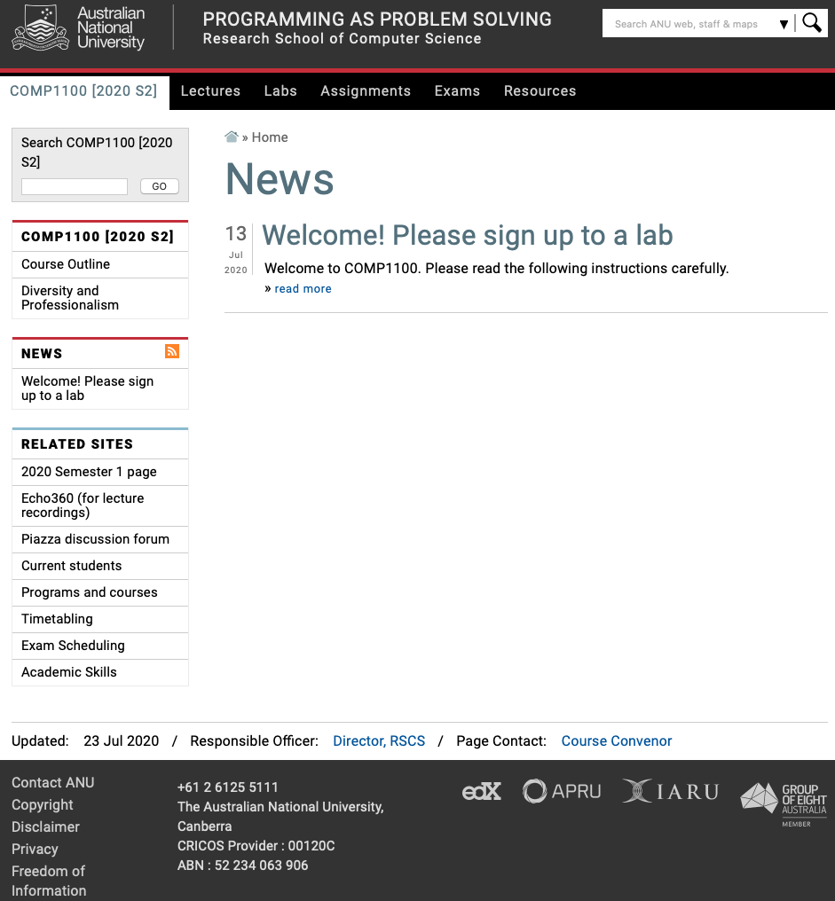
II. Getting information:
https://cs.anu.edu.au/courses/comp1100
Announcements in lectures and on Piazza
forum also.

Slide 13
Getting content: Lectures
Introduces the core concepts of the course, and 'live coding' to show you programming in action.
Lectures are delivered online via Microsoft Teams
Lecture recording will be available via
Microsoft Stream https://www.microsoft.com/en-us/microsoft-365/microsoft-stream
Echo360 https://echo360.org.au
Please inform me urgently if the recording is inadequate.

Slide 14
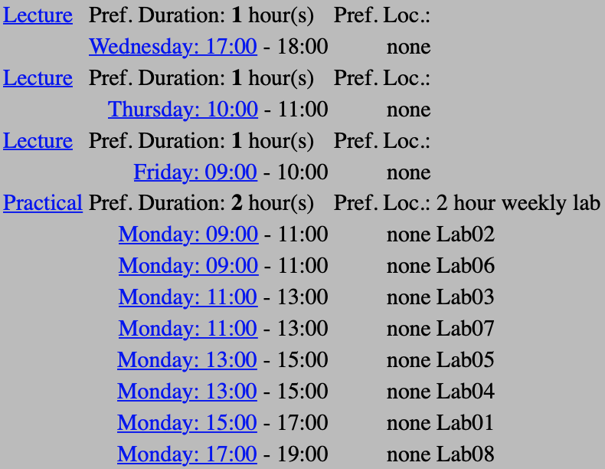
Getting content: Timetable

Slide 15


Getting content: The Textbook
Thompson, Simon
HASKELL: the craft of functional programming
Third edition
Not required
To buy or not to buy? Depends on the student.
Copies in the library.
Supplementary textbook:
https://www.manning.com/books/get-programming-with-haskell?query=haskell#toc

Slide 16
Practicing Skills: Labs
You will learn more, and have more fun, in labs than any other part of the course!
Tutors there to answer questions and guide your learning.
Sign up now at https://cs.anu.edu.au/streams.
3% of the course linked to attendance and participation in the labs, and to submission of attempts at lab exercises.
Based on ten best labs
Engagement hurdle for 1100 can be passed by participating in the labs across the early part of the course.
Participate in four labs out of first five labs.
Show that you can do well without participating in labs (there is a hurdle on mid semester exam)

Slide 17
Practicing Skills: Beyond Labs
Assignments
Hundreds of exercises in the textbook
Past exam question on the website
Warning: the course changes over time. Past exams may contain material you are expected to know, and miss material you are expect to know.

Slide 18
Getting questions answered
Live questions in lectures extremely welcome!
Tutors also there to answer questions in labs.
- But these questions should be related to the current content.
How to get your questions answered?
Piazza Forum
Consultations
Email (in rare circumstances)

Slide 19
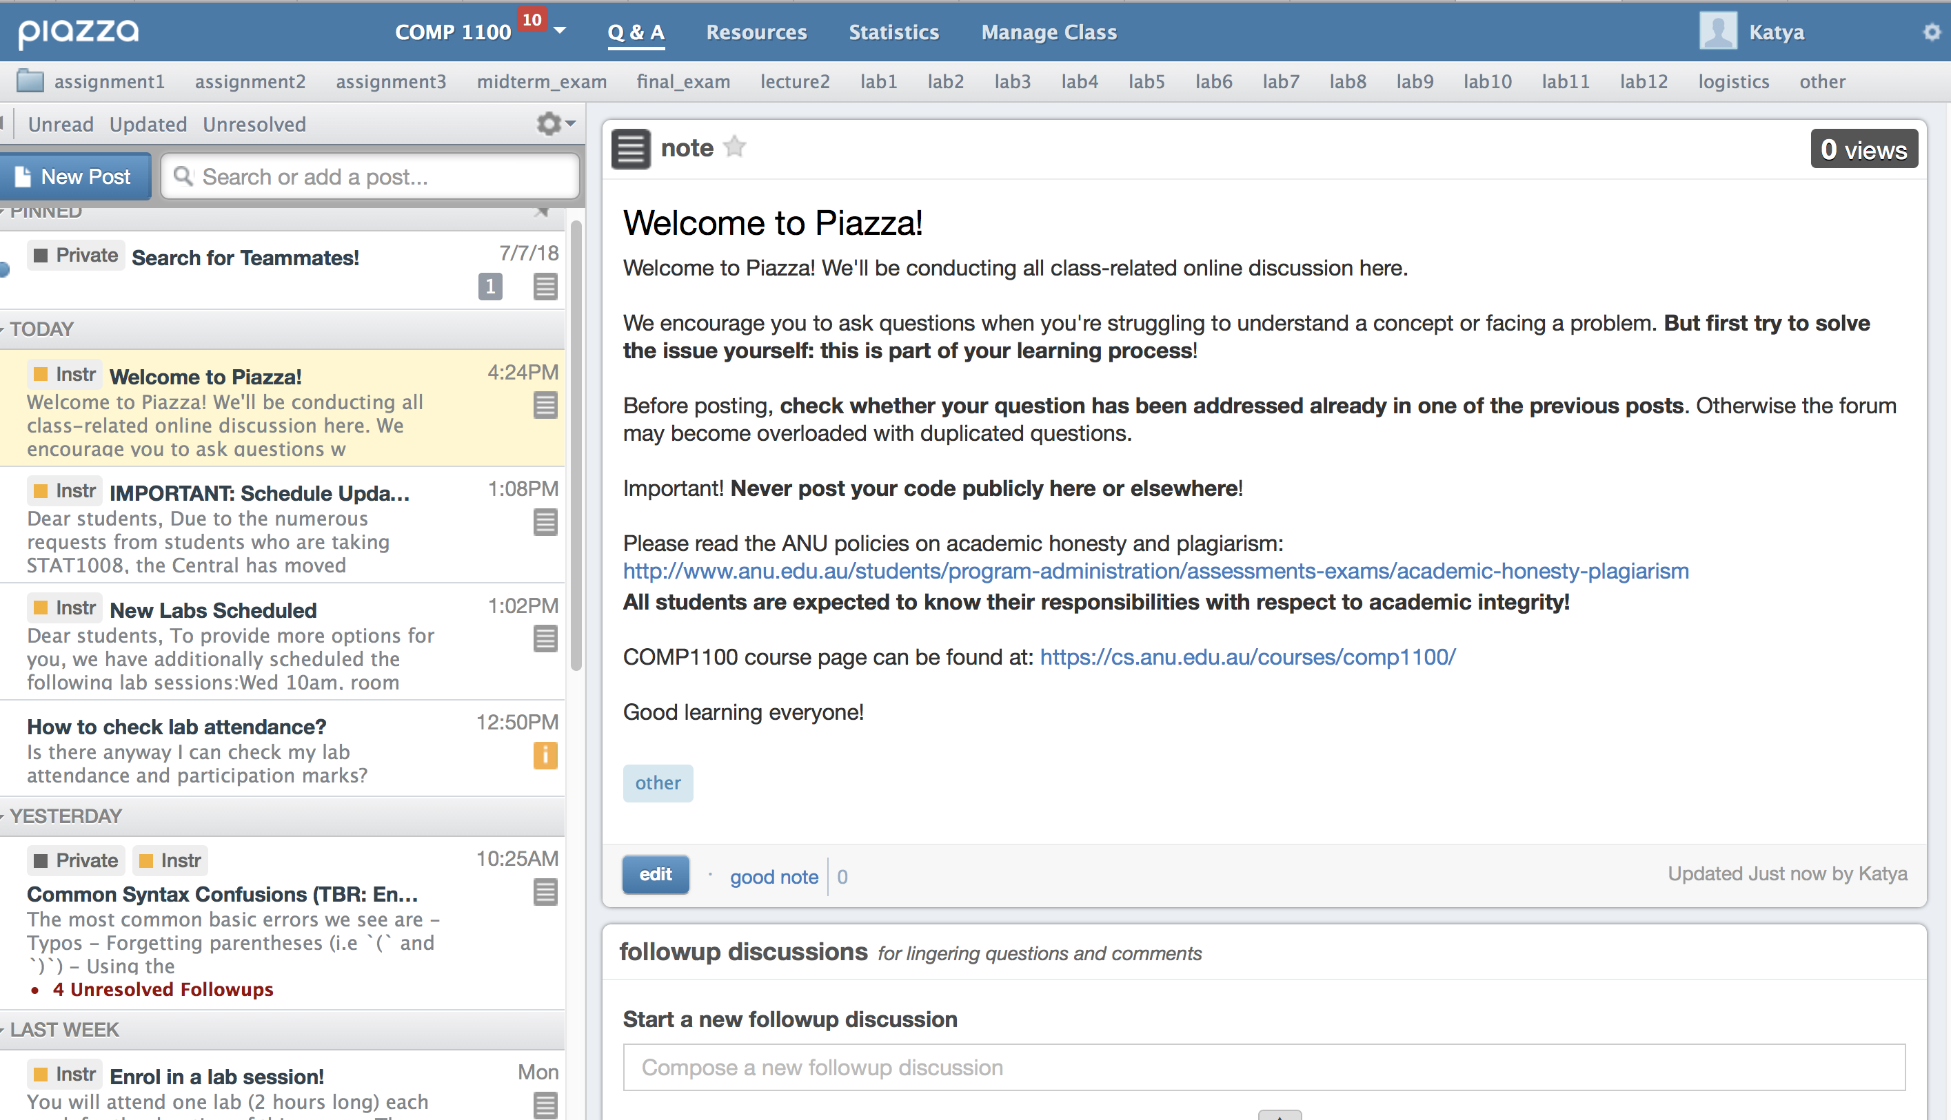
Piazza Forum
https://piazza.com/anu.edu.au/spring2020/comp1100

Slide 20
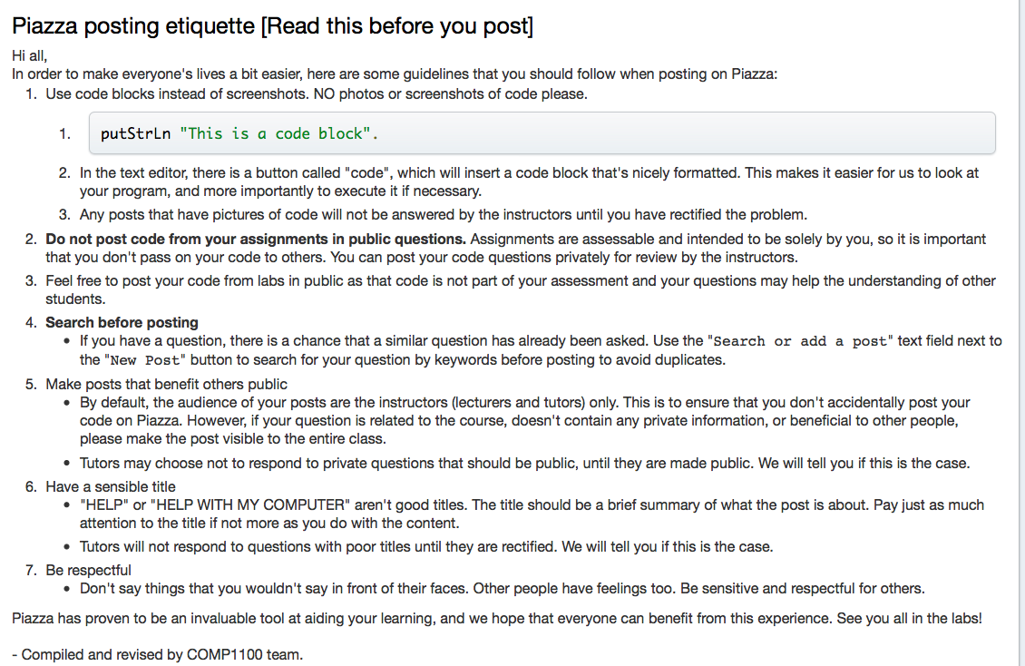

Slide 21
Drop-in consultations
To be announced this Friday.
Supplementary lab this Friday 1 to 3PM (see supplementary lab channel in Teams)

Slide 22
Getting questions answered: Email
Email your tutor only if you have questions specific to your interactions with that tutor (about lab attendance e.g. inability to attend, assignment marking etc.)
Email the lecturers, instead of using Piazza, only if you have an issue that tutors could not help with or should not see.
- Use comp1100@anu.edu.au (read by Artem, Tony, Jooyoung)
- Use your ANU address
For all enquiries not directly related to this course, contact Student Services in person or by email (studentadmin.cecs@anu.edu.au).

Slide 23
Part Three Course Representatives

Slide 24
Course Representatives
Why become a course representative?
Develop skills sought by employers, including interpersonal, dispute resolution, leadership and communication skills.
Become empowered. Play an active role in determining the direction of your education.
Become more aware of issues influencing your University and current issues in higher education.
Ensure students have a voice to their course convener, lecturer, tutors, and college.

Slide 25
Course Representatives
Roles and responsibilities:
Act as the official liaison between your peers and convener.
Be creative, available and proactive in gathering feedback from your classmates.
Attend regular meetings, and provide reports on course feedback to your course convener and the Associate Director (Education).
Close the feedback loop by reporting back to the class the outcomes of your meetings.
More information about roles and responsibilities can contact
ANUSA CECS representative Sophie Burgess via sa.cecs@anu.edu.au, or
ANUSA President, Lachy Day via sa.president@anu.edu.au

Slide 26
Course Representatives
Want to be a course representative? Nominate today!
Please nominate yourself on CECS S2 2020 Course Rep EOI by 3rd August 2020 to nominate yourself as a course representative. You are free to nominate yourself either you are on campus or off-shore.
https://anu.au1.qualtrics.com/jfe/form/SV_8H50LYu50DbvXiR
You will be contacted by CECS Student Services by 7th August with the outcome of your self-nomination.
All the course representative meetings will be held in zoom in S2 2020. There are three meetings this semester. The meeting details will be updated to all the course representatives shortly.

Slide 27
Assessment quiz
https://forms.office.com/Pages/ResponsePage.aspx?id=DQSIkWdsW0yxEjajBLZtrQAAAAAAAAAAAANAAbMEyhpUMlI5VU5BTDg0TjRaSTZGSThTNTFWSDZORC4u

