Slide 1
Lecture 1C
COMP 1100

Slide 2
Acknowledgement of Country
I wish to acknowledge the traditional custodians of the land we are meeting on, the Ngunnawal people. I wish to acknowledge and respect their continuing culture and the contribution they make to the life of this city and this region. I would also like to acknowledge and welcome any other Aboriginal and Torres Strait Islander people who are enrolled in our courses.

Slide 3
Hierarchy of computer memory
CPU registers
Memory between registers and RAM
Cache
RAM
Physical and Virtual
Temporary storage
Primary memory
Storage Device Types
ROM/BIOS, HDD, SSD, Network storage
Secondary memory
Permanent storage
Input Sources
Keyboard, Mouse, Removable Media, Scanner, Camera

Slide 4
Importance of Random-Access Memory (RAM)
When computer is turned on
  The computer loads data from read-only memory (ROM)
    The computer loads the basic input/output system (BIOS) from ROM.
  The computer loads the operating system (OS) from the hard drive into the system's RAM.
  When you open an application, it is loaded into RAM.
  After an application is loaded, any files that are opened for use in that application are loaded into RAM.
RAM is essential part of the computer

Slide 5
Information is measured in bits
When we think about information we think of pictures, symbols, words, sounds, movements, and more.
Memory is a large collection of circuits, each capable of storing bit.
Bit is a binary(base 2) digit: either 0 or 1
Cells (words): manageable units;
  Typical size is 8 bits (1 byte): Example: 01101011b
Some machines are 16 bits (2 bytes) and some are 32 bits or 64 bits
  Byte (8 bits),
  kB (kilobyte, 10³ ≈ 2¹⁰ bytes),
  MB (Megabyte, 10⁶ ≈ 2²⁰ bytes),
  GB (Gigabyte, 10⁹ ≈ 2³⁰ bytes).

Slide 6
Binary data representation
Continuous representation
Digital representation
decimal | binary
0 | 0000
1 | 0001
2 | 0010
3 | 0011
4 | 0100
5 | 0101
6 | 0110
7 | 0111
8 | 1000
…
14 | 1110
15 | 1111
0111:7
0110:6
0101:5
0100:4
0011:3
0010:2
0001:1
0000:0
Storing the signal in the memory
0001 0100 0110 0110
0101 0011 0010 0010
0011 0011 0010 0010
0001 …

Slide 7
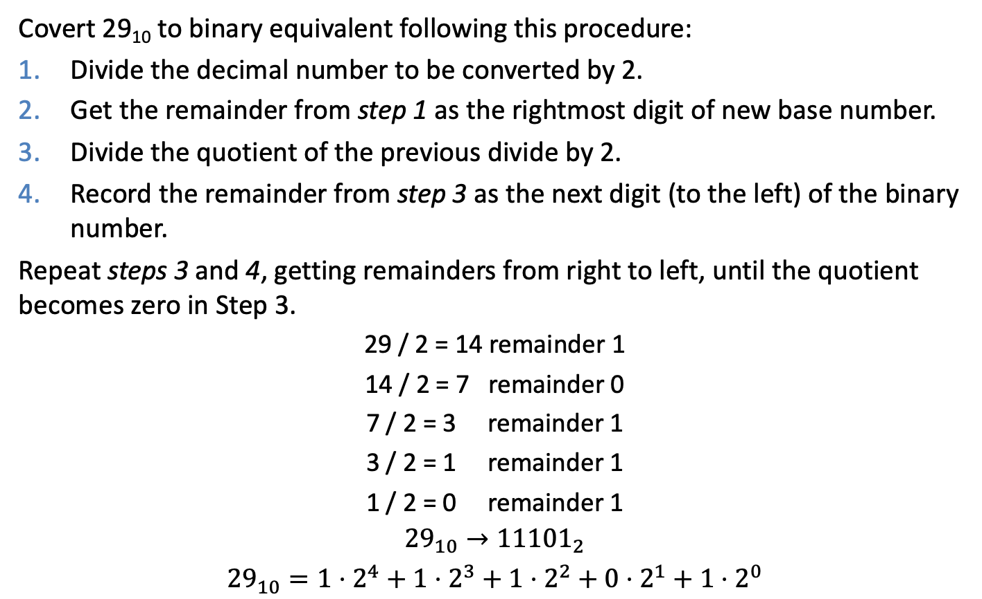
Decimal to binary
Covert 29₁₀ to binary equivalent following this procedure:
Divide the decimal number to be converted by 2.
Get the remainder from step 1 as the rightmost digit of new base number.
Divide the quotient of the previous divide by 2.
Record the remainder from step 3 as the next digit (to the left) of the binary number.
Repeat steps 3 and 4, getting remainders from right to left, until the quotient becomes zero in Step 3.
29 / 2 = 14 remainder 1
14 / 2 = 7 remainder 0
7 / 2 = 3 remainder 1
3 / 2 = 1 remainder 1
1 / 2 = 0 remainder 1
$${29}_{10}→{11101}_{2}$$
$${29}_{10}=1⋅2^{4}+1⋅2^{3}+1⋅2^{2}+0⋅2^{1}+1⋅2^{0}$$

Slide 8
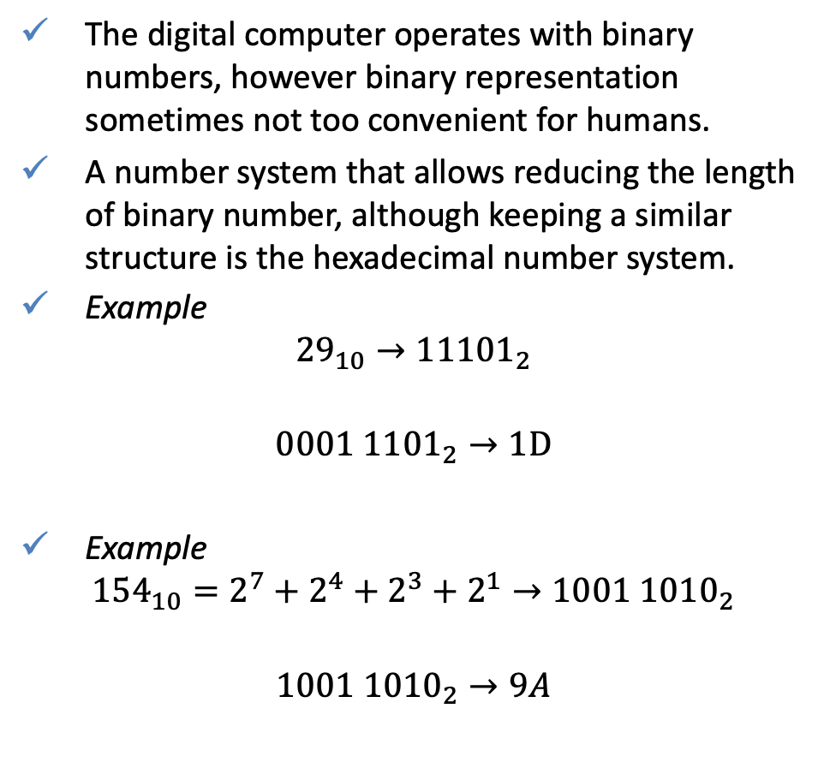
Hexadecimal number system
decimal | binary | hex
0 | 0000 | 0
1 | 0001 | 1
2 | 0010 | 2
3 | 0011 | 3
4 | 0100 | 4
5 | 0101 | 5
6 | 0110 | 6
7 | 0111 | 7
8 | 1000 | 8
9 | 1001 | 9
10 | 1010 | A
11 | 1011 | B
12 | 1100 | C
13 | 1101 | D
14 | 1110 | E
15 | 1111 | F
The digital computer operates with binary numbers, however binary representation sometimes not too convenient for humans.
A number system that allows reducing the length of binary number, although keeping a similar structure is the hexadecimal number system.
Example
$${29}_{10}→{11101}_{2}$$
$${0001 1101}_{2}→1D$$
Example
$${154}_{10}=2^{7}+2^{4}+2^{3}+2^{1}→1001 {1010}_{2}$$
$$1001 {1010}_{2}→9A$$
1
D
9
A

Slide 9
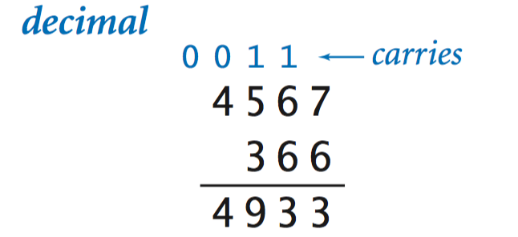
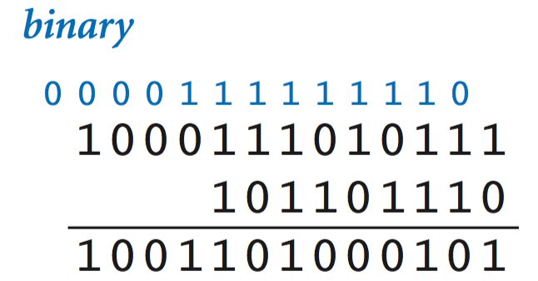
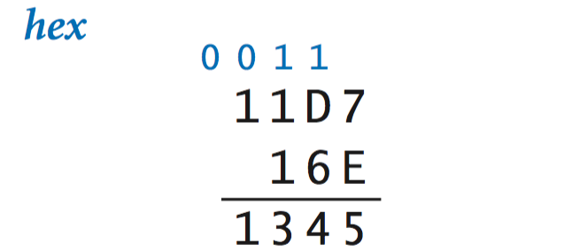
Binary arithmetic
The addition works like normal (base-10) arithmetic,
  where 1 + 1 = 10 (0 with a carry of 1).
Subtraction, multiplication, etc., work this way, too.
It is possible to wire an electrical circuit that mechanically does the addition of the 0s and 1s
A processor uses such a wiring, which operates on binary numbers held in registers, where a register is a sequence of bits .
  Register 1: 3 (0000 0011)
  Register 2: 5 (0000 0101)
  Register 3: 8 (0000 1000)

Slide 10
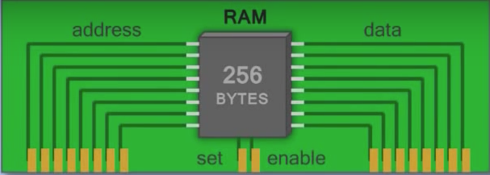
RAM Addressing
Computer memory is comparable to a collection of numbered mailboxes (manageable units). To identify individual cells in a machine’s main memory, each cell is assigned a unique name, called its address.
…
01011011
11100101
01011011
…
control
…
00110101
11110101
01110011
…
(91)
(53)

Slide 11
Stored Program Concept
Instructions are represented as 16/32/64-bit numbers (depends on the CPU)
Programs can be stored in memory
  Can be read/written just like numbers
Memory
Warcraft 2
Warcraft 2 data
Processor
Word processor
Term paper
Haskell compiler
Source codes

Slide 12
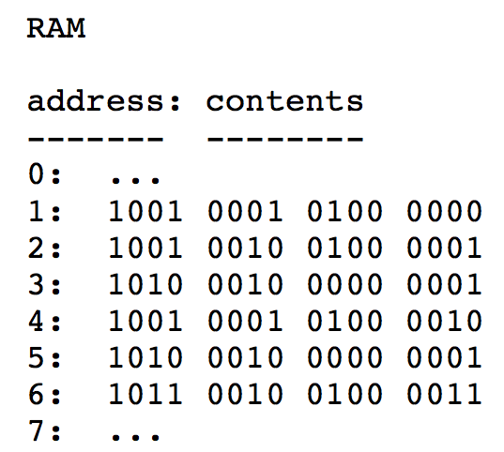
Machine language
Machine language is the lowest-level programming language and the only language understood by the computer.
opcode
operand
Opcode (operation code) is a type of code that tells the machine what operation to perform.
Operands may be register values, memory values, I/O ports etc

Slide 13
Machine language example
Because strings of 0s and 1s are so hard for people to read, assembly languages were invented. An assembly language is essentially a human readable direct translation of machine language.
Example: The program places the values 2 and 5 into memory at locations 13 and 14, then adds the values and places the result at location 15 in memory.
Machine code | Assembly code | Description
001 1 000010 | lw #2 | Load the value 2 into the register
010 0 001101 | sw 13 | Store the value of the register in memory location 13
001 1 000101 | lw #5 | Load the value 5 into the register
010 0 001110 | sw 14 | Store the value of the register in memory location 14
001 0 001101 | lw 13 | Load the value of memory location 13 into the register
011 0 001110 | add 14 | Add the value of memory location 14 to the register
010 0 001111 | sw 15 | Store the value of the register in memory location
111 0 000000 | halt | Stop execution
opcode
operand

Slide 14
Computer Languages
Even small examples are painful to write in assembly language, and people quickly developed simpler notations that could be mechanically converted to assembly (which could itself be mechanically converted into base-2 coding).
High-level Language
temp = v[k];
v[k] = v[k+1];
v[k+1] = temp;
TEMP = V(K)
V(K) = V(K+1)
V(K+1) = TEMP
C/Java Compiler
Fortran Compiler
Assembly Language
lw $t0, 0($2)
lw $t1, 4($2)
sw $t1, 0($2)
sw $t0, 4($2)
assembler
0000 1001 1100 0110 1010 1111 0101 1000
1010 1111 0101 1000 0000 1001 1100 0110
1100 0110 1010 1111 0101 1000 0000 1001
0101 1000 0000 1001 1100 0110 1010 1111
Machine Language
Notes:
The first high level language, Fortran (FORmula TRANslating system) was designed in 1954. Like many developments in computation, it came from someone looking to get out of doing tedious work. Its creator, John Backus, said “Much of my work has come from being lazy... and so, when I was working on the IBM 701, writing programs for computing missile trajectories, I started work on a programming system to make it easier to write programs.”

Slide 15
Assembler vs high level languages
A “semantic gap” exists between the amount of information conveyed in assembly language vs high level languages. Consider the following single statement:
x = x + 3;
This single statement may require many assembly language statements (operations):
Load memory location 24 into accumulator register
Add a constant 3 to the accumulator
Store accumulator in memory location 24
The number of executable statement expands greatly during the translation process from a high level language into assembly language.
Historically, we divide HL languages into a number groups:
  Procedural languages
  Functional languages
  Object-Oriented languages (OOP)

Slide 16
Imperative Languages
Imperative (and procedural) languages are characterized by sequential sets of linear commands and procedures. The focus of such languages is on structure and statements.
Examples
  COBOL (common business-oriented language) was designed with an emphasis on inputs and outputs, whose only data types were numbers and strings of text.
  Fortran (Formula Translation, 1957), developed by IBM for scientific and engineering applications. Dominated, for over half a century, in computationally intensive areas.
  C (1972), C provides constructs that map efficiently to typical machine instructions, and therefore it has found lasting use in applications that had formerly been coded in assembly languages, including OS.
see A genealogy of computer programming languages
http://cdn.oreillystatic.com/news/graphics/prog_lang_poster.pdf

Slide 17
Procedural Languages
High-level(HL) languages represent a giant leap towards easier programming.
The syntax of HL languages is similar to English.
Listing 1C.1
#include <stdio.h>
int main(){
int age;
float salary;
char last_initial;
age = 21;
salary = 29521.12;
last_initial = 'J';
printf("I am %d years old. ", age);
printf("I make %8.2f per year. ", salary);
printf("My last initial is %c.\n", last_initial);
}

Slide 18
Functional languages
Functional languages emphasises on expressions and declarations rather than execution of statements. The focus of such languages is on expressions.
Examples
  LISP (1958), favored programming language for AI. LISP pioneered many ideas in programming languages.
  Clojure(2007) is a modern, dynamic, and functional dialect of the Lisp programming language on the Java platform
  HASKELL(1990) developed to be suitable for teaching, research and industrial application.
Listing 1C.2
module Main where
main :: IO ()
main = putStrLn "Hello, World!"

Slide 19

Imperative vs Functional
Factorial
$$n!=n⋅\left(n−1\right)⋯2⋅1$$
Listing 1C.3
C
Listing 1C.4
Haskell
int main(){
int c, f = 1;
for (c = 1; c <= 5; c++)
f = f * c;
printf("Factorial of 5 = %d\n", f);
return 0;
}
fact :: Int -> Int
fact 0 = 1
fact n = n * fact ( n - 1 )
main :: IO ()
main = do
putStrLn "The factorial of 5 is:"
print (fact 5)

Slide 20
Object-Oriented Languages
Most object-oriented (OO) languages are high-level languages.
The focus of OOP languages is not on structure, but on modeling data.
Programmers code using “blueprints” of data models called classes.
Examples of OOP languages include
  Simula (1965) is the first OO language. Simula 67 introduced, objects, classes, many features of modern OO languages.
  Smalltalk (1972), was designed and created in part for educational purposes.
  C++ (1983), designed with a bias towards system programming, embedded and large systems with performance, efficiency and flexibility of use as its design highlights. Developed as an extension of C.
  Java (1995) designed to have as few implementation dependencies as possible.
  Scala (2004) is a general-purpose programming language providing support for both object-oriented programming and functional programming.

Slide 21
Object-Oriented Languages
C++ example
Listing 1C.5
#include <iostream>
using namespace std;
class Person{
public:
int age;
float salary;
char last_initial;
Person(int a, float s, int l){
age = a;
salary = s;
last_initial = l;
}
};
int main(){
Person Mike(21, 29521.12, 'J');
cout << "I am " << Mike.age << " years old" << endl;
cout << "I make " << Mike.salary << " per year" << endl;
cout << "My last initial is " << Mike.last_initial << endl;
return 0;
}

Slide 22
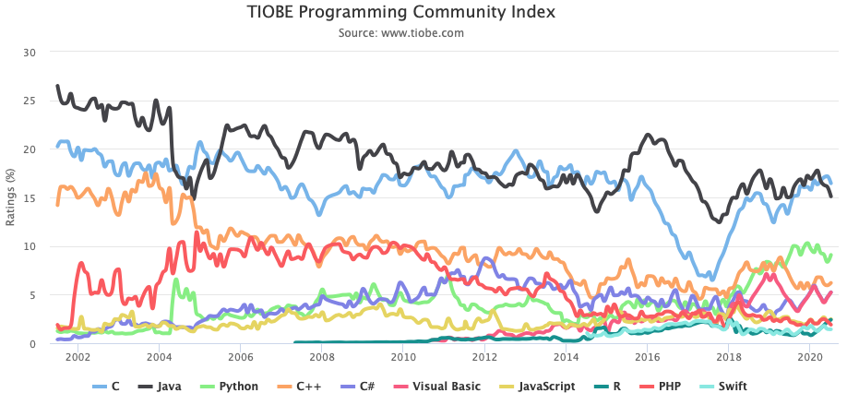
Popularity of programming languages
http://www.tiobe.com/tiobe-index/

Slide 23
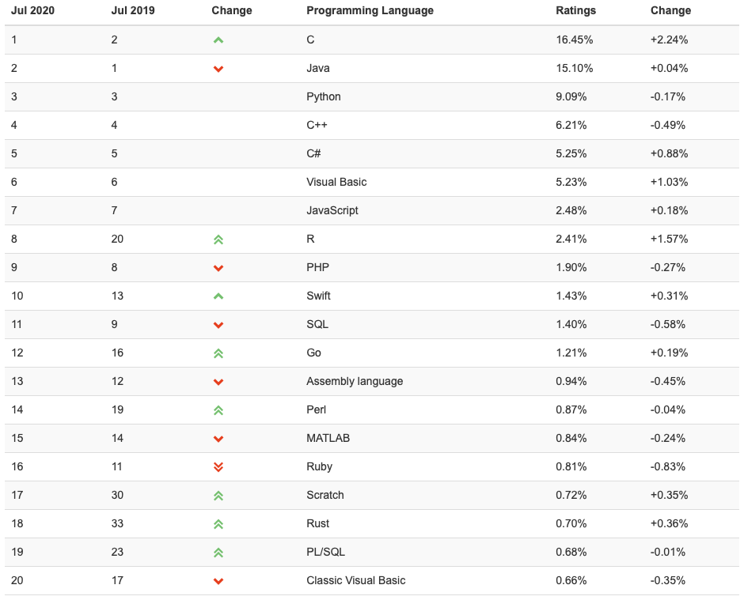
Popularity of programming languages

Slide 24
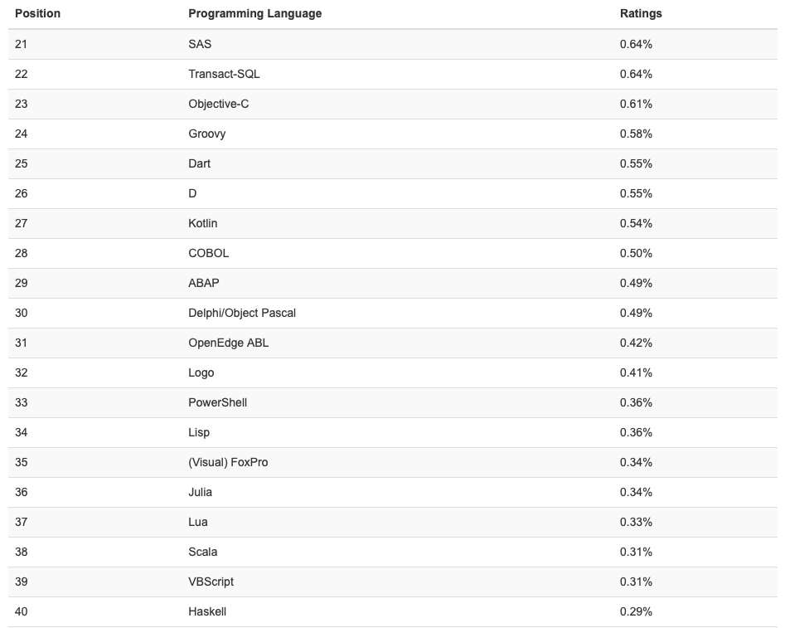
Popularity of programming languages

Slide 25
Generations of Programming Languages
1GL: machine codes (0110 1101 1100 1010, …)
2GL: symbolic assemblers (add A, B)
3GL: (machine-independent) imperative languages (C = A + B). Examples are FORTRAN, Pascal, C, C++ languages
4GL: domain specific application generators (Python, LabVIEW, R, Matlab)
Each generation is at a higher level of abstraction
Notes:
4th generation programming languages are often used for prototyping and evolutionary development of commercial business software

