Slide 1
Lecture 2A
COMP 1100

Slide 2
Acknowledgement of Country
I wish to acknowledge the traditional custodians of the land we are meeting on, the Ngunnawal people. I wish to acknowledge and respect their continuing culture and the contribution they make to the life of this city and this region. I would also like to acknowledge and welcome any other Aboriginal and Torres Strait Islander people who are enrolled in our courses.

Slide 3
Content
Programming as problem solving
Sets and functions overview

Slide 4
Programming as Problem Solving
Problem solving principles
Developing a Program
Understand the problem
Analyze the problem
Devise a plan to solve
Design the program
Carry out the plan
Code the program
Review the results
Test the program

Slide 5

Programming as Problem Solving
Specify the problem requirements
Important questions
What are the inputs? (given data)
What are the outputs? (required data)
How will we calculate the required outputs from the given inputs?
Analyze the problem
Create an outline of the program that solves the problem
An algorithm – a step by step procedure that will provide the required results from the given inputs.
Algorithm Examples:
Instructions on how to make a cake,
How to use the bank’s ATM, etc.
Design the problem
Code the program
Test the program
Once the design is completed, implement the program code.
Testing is done throughout the development cycle
Mental walkthrough
Ultimate test is to run the program to see if the outputs are correct for the given inputs.

Slide 6

Problem classification
A programming language is a notational system for describing computation in a machine-readable and human-readable form.
Types of problems
Functional problems
Decision problems
Search problems
Optimization problems
Notes:
Functional problems A set of arguments a₁,a₂,...,a_{n} constitute the input. Some function f(a₁,a₂,...,a_{n}) of the arguments is calculated and output to the user.
Decision problems These form a special class of functional problems whose outputs are "yes" and "no" (or "true" and "false", or "1" and "0", etc).
Search problems Given an input object, one tries to locate some particular configuration pertaining to the object and outputs the located configuration, or "failure" if no configuration can be located.
Optimization problems Given an object, a configuration and a criterion for goodness, one finds and reports the configuration pertaining to the object, that is best with respect to the goodness criterion. If no such configuration is found, "failure" is to be reported.

Slide 7









Problem examples
Polynomial root finding
Category: Functional problem
Input: A polynomial with real coefficients
Output: One (or all) real roots of the input polynomial
Example: $ax^{2}+bx+c=0$ solver
$$s∷\left(a,b,c\right)→\left(x_{1},x_{2}\right)$$
where
$$x_{1}=\frac{−b−\sqrt{d}}{2a},$$
$$x_{2}=\frac{−b+\sqrt{d}}{2a}$$
$$d=b^{2}−4ac$$
$$a$$
$$s\left(⋅\right)$$
$$x_{1}$$
$$b$$
$$x_{2}$$
$$c$$
-- Quadratic equation solver
-- ax^2 + bx + c = 0
-- INPUT: a, b, c
-- OUTPUT: x1 x2
s :: (Float, Float, Float) -> (Float, Float)
s (a, b, c) = (x1, x2)
where
x1 = ( - b + sqrt d) / (2 * a)
x2 = ( - b - sqrt d) / (2 * a)
d = b * b - 4 * a * c
Is this implementation general enough ?
Notes:
https://hackage.haskell.org/package/diagrams-solve-0.1.0.1/src/src/Diagrams/Solve/Polynomial.hs

Slide 8

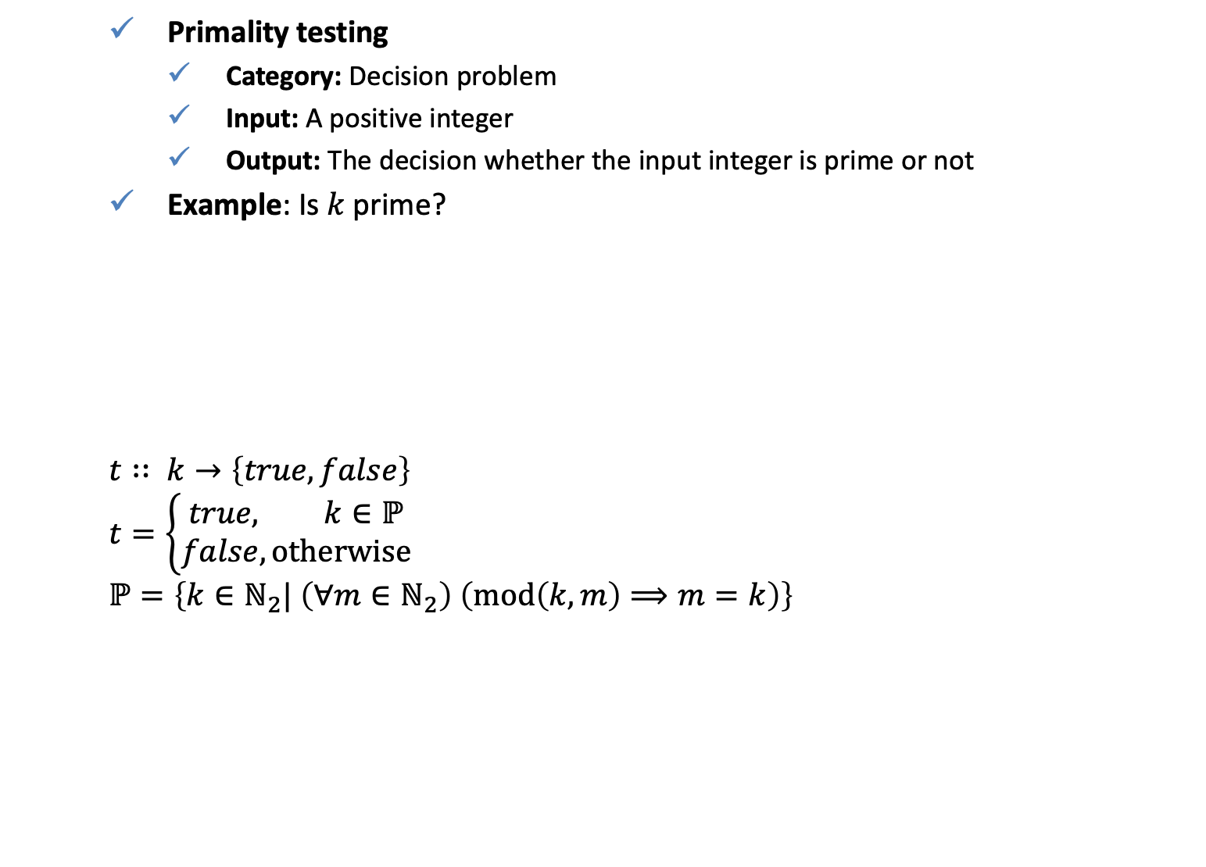



Problem examples
Primality testing
Category: Decision problem
Input: A positive integer
Output: The decision whether the input integer is prime or not
Example: Is $k$ prime?
$$t∷ k→\left\{true,false\right\}$$
$$t=\left\{\begin{aligned}true, k∈ℙ \\ false, otherwise\end{aligned}\right.$$
$$ℙ=\left\{k∈ℕ_{2}| \left(∀m∈ℕ_{2}\right) \left(mod\left(k,m\right)⟹m=k\right)\right\}$$
k = 20
$$t\left(⋅\right)$$
$$true/false$$
[ x | x <- [2..k - 1], mod k x == 0]
$$k$$
[2, 4, 5, 10]
k = 13
[ x | x <- [2..k - 1], mod k x == 0]
[]
-- Primality testing
t :: Integer -> Bool
t k =
if k > 1 then
null [ x | x <- [2..k - 1], mod k x == 0]
else
False
How can this function be speeded up?

Slide 9
Problem examples
Matrix inversion
Category: Functional problem
Input: A square matrix with rational entries
Output: The inverse of the input matrix if it is invertible, or "failure”

Slide 10
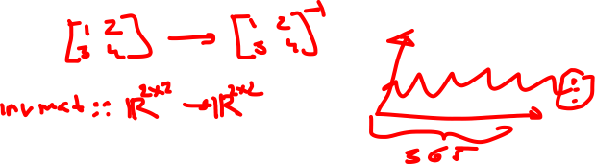
Problem examples
Weather prediction
Category: Functional problem
Input: Records of weather for previous days and years. Possibly also data from satellites.
Output: Expected weather of Canberra for tomorrow
Web browsing
Category: Functional problem
Input: A URL (abbreviation for "Uniform Resource Locator" which is colloquially termed as "Internet site”)
Output: Display (audio and visual) of the file at the given URL

Slide 11
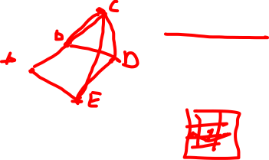
Problem examples
Traveling salesman problem (TSP)
Category: Optimization problem
Input: A set of cities, the cost of traveling between each pair of cities, and the criterion of cost minimization
Output: A route through all the cities with each city visited only once and with the total cost of travel as small as possible
Chess : Can I win?
Category: Search problem
Input: A configuration of the standard 8x8 chess board and the player ("white" or "black") who is going to move next
Output: A winning move for the next player, if existent, or "failure”

Slide 12









Problem examples
Sorting
Category: Functional problem
Input: A list of elements
Output: An ordered list of elements
Example:
$$x$$
$$qsort$$
$$xs:$$
3 | 5 | 1 | 4 | 2
1 | 2 | 3 | 4 | 5
1 | 2 | 3 | 5 | 4
qsort :: [Integer] -> [Integer]
qsort [] = []
qsort (x:xs) = qsort smaller ++ [x] ++ qsort larger
where
smaller = [a | a <- xs, a <= x]
larger = [b | b <- xs, b > x]
$$x$$
$$≤x$$
$$x<$$
1 | 2 | 3 | 4 | 5
$$x$$
$$x<$$
$$≤x$$
$$x$$

Slide 13

QUIZ
Come up with
a search problem,
a functional problem,
an optimization problem,
a decision problem.
So overall present 4 different problems.
For each problem specify
Inputs
Outputs
If possible briefly discuss how inputs are converted to outputs (i.e. give a brief description of the algorithm)

