Slide 1
Lecture 2B
COMP 1100

Slide 2
Acknowledgement of Country
I wish to acknowledge the traditional custodians of the land we are meeting on, the Ngunnawal people. I wish to acknowledge and respect their continuing culture and the contribution they make to the life of this city and this region. I would also like to acknowledge and welcome any other Aboriginal and Torres Strait Islander people who are enrolled in our courses.

Slide 3
Content
Sets
Functions

Slide 4
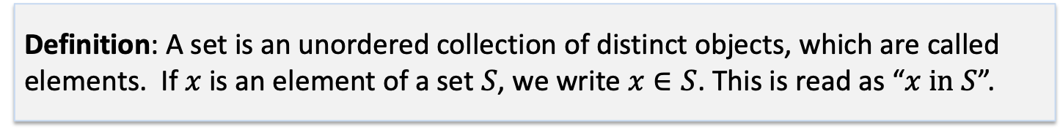
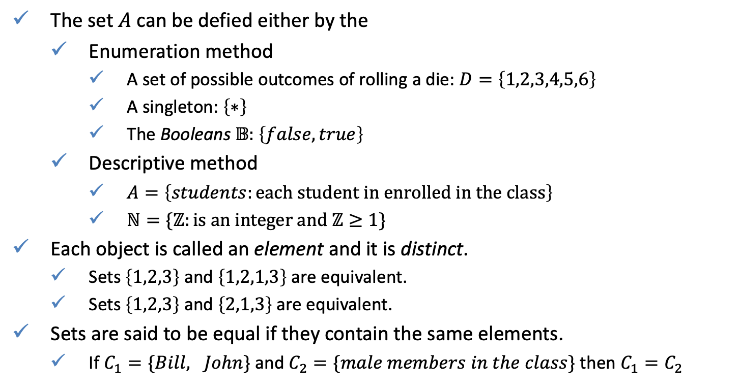

Sets
Definition: A set is an unordered collection of distinct objects, which are called elements. If $x$ is an element of a set $S$, we write $x∈S$. This is read as “$x in S$”.
The set $A$ can be defied either by the
Enumeration method
A set of possible outcomes of rolling a die: $D=\left\{1,2,3,4,5,6\right\}$
A singleton: $\left\{∗\right\}$
The Booleans $𝔹:$ $\left\{false,true\right\}$
Descriptive method
$A=\left\{students:each student in enrolled in the class\right\}$
$ℕ=\{ℤ:is an integer and ℤ≥1\}$
Each object is called an element and it is distinct.
Sets $\left\{1,2,3\right\}$ and $\left\{1,2,1,3\right\}$ are equivalent.
Sets $\left\{1,2,3\right\}$ and $\left\{2,1,3\right\}$are equivalent.
Sets are said to be equal if they contain the same elements.
If $C_{1}=\{Bill, John\}$ and $C_{2}=\{male members in the class\}$ then $C_{1}=C_{2}$

Slide 5
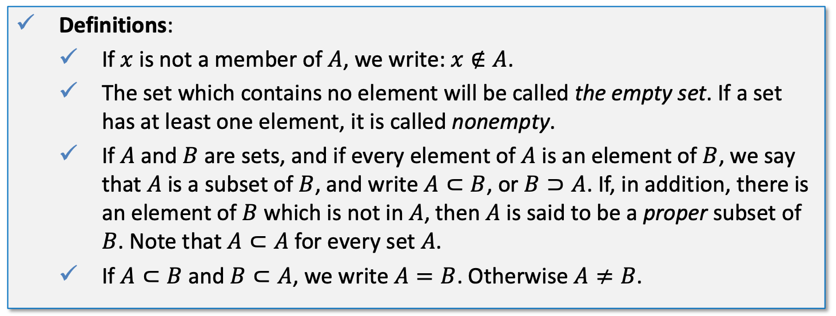
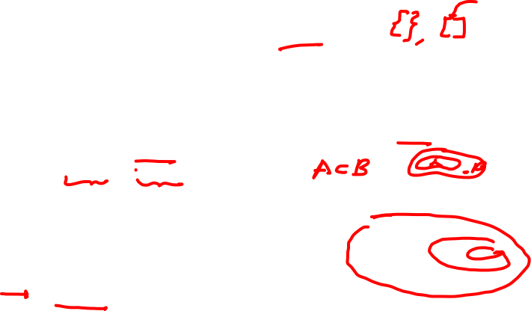
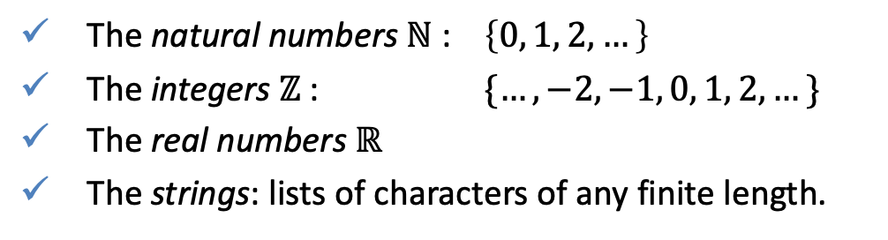
Sets
Definitions:
If $x$ is not a member of $A$, we write: $x∉A$.
The set which contains no element will be called the empty set. If a set has at least one element, it is called nonempty.
If $A$ and $B$ are sets, and if every element of $A$ is an element of $B$, we say that $A$ is a subset of $B$, and write $A⊂B$, or $B⊃A$. If, in addition, there is an element of $B$ which is not in $A$, then $A$ is said to be a proper subset of $B$. Note that $A⊂A$ for every set $A$.
If $A⊂B$ and $B⊂A$, we write $A=B$. Otherwise $A≠B$.
The natural numbers $ℕ$ : $\left\{0, 1, 2, …\right\}$
The integers $ℤ$ : $\{…, −2, −1, 0, 1, 2, …\}$
The real numbers $ℝ$
The strings: lists of characters of any finite length.

Slide 6
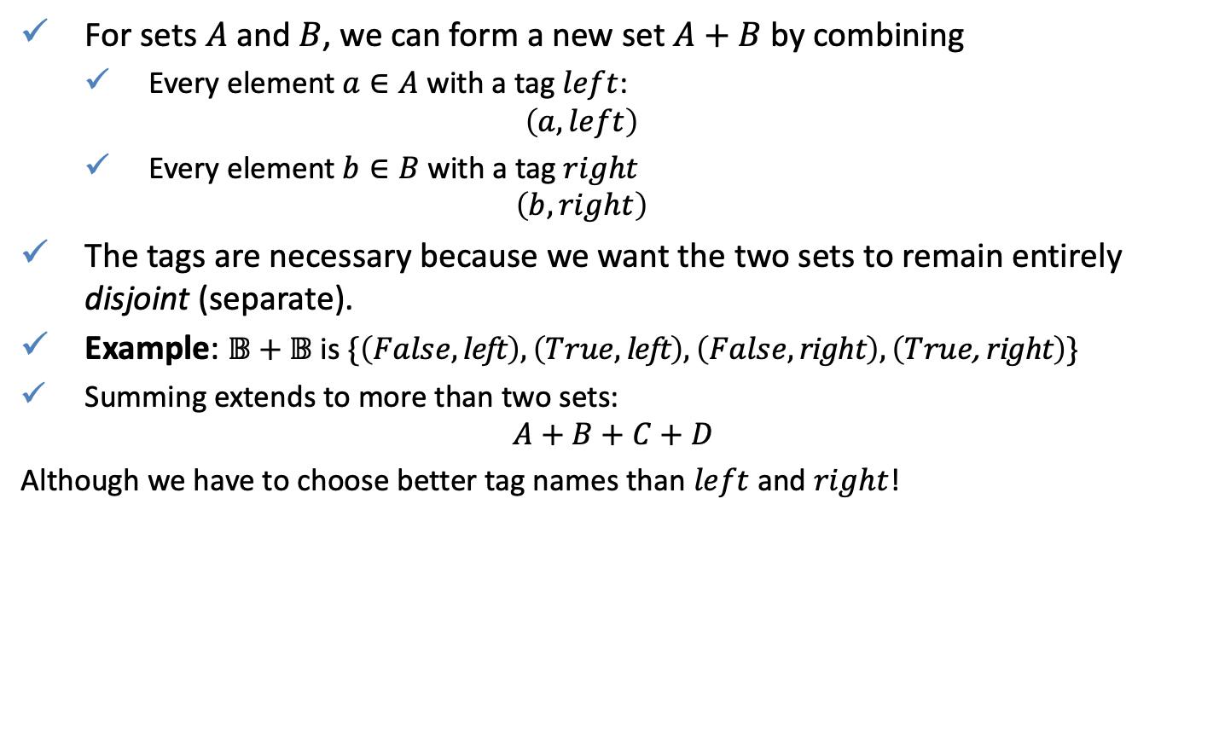
Sum
For sets $A$ and $B$, we can form a new set $A+B$ by combining
Every element $a∈A$ with a tag $left$:
$$\left(a,left\right)$$
Every element $b∈B$ with a tag $right$
$$\left(b,right\right)$$
The tags are necessary because we want the two sets to remain entirely disjoint (separate).
Example: $\text{𝔹}+\text{𝔹}$ is $\{\left(False,\text{left}\right), \left(True,\text{left}\right), \left(False,\text{right}\right), \left(True\text{, }\text{right}\right)\}$
Summing extends to more than two sets:
$$A+B+C+D$$
Although we have to choose better tag names than $left$ and $right$!

Slide 7
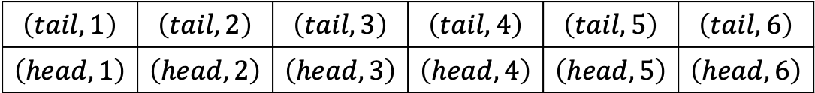

Cartesian product
The Cartesian product of two sets $A$ and $B$, denoted $A×B$, is the set of all possible ordered pairs where the elements of $A$ are first and the elements of $B$ are second.
Example: What are possible outcomes of rolling a die and tossing a coin in one experiment?
Define $𝔹=\left\{tail, head\right\},D=\left\{1,2,3,4,5,6\right\}$, then all possible outcomes are $𝔹×D:$
$$\left(tail,1\right)$$ | $$\left(tail,2\right)$$ | $$\left(tail,3\right)$$ | $$\left(tail,4\right)$$ | $$\left(tail,5\right)$$ | $$\left(tail,6\right)$$
$$\left(head,1\right)$$ | $$\left(head,2\right)$$ | $$\left(head,3\right)$$ | $$\left(head,4\right)$$ | $$\left(head,5\right)$$ | $$\left(head,6\right)$$

Slide 8





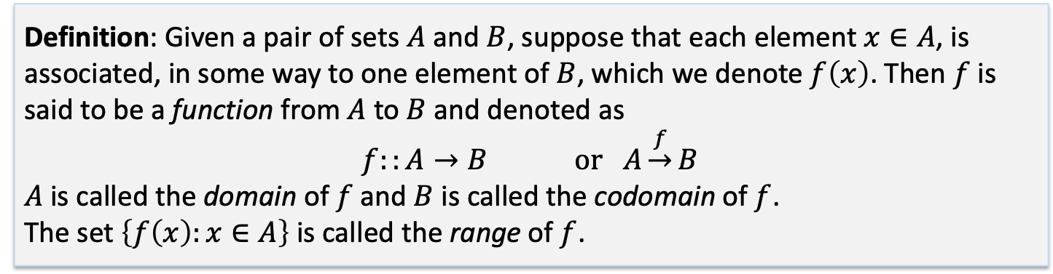

Functions
Definition: Given a pair of sets $A$ and $B$, suppose that each element $x∈A$, is associated, in some way to one element of $B$, which we denote $f\left(x\right)$. Then $f$ is said to be a function from $A$ to $B$ and denoted as
$$f::A→B or A\underset{→}{f}B$$
$A$ is called the domain of $f$ and $B$ is called the codomain of $f$.
The set $\left\{f\left(x\right):x∈A\right\}$ is called the range of $f$.
Example: $y=x^{2}, x∈ℝ,y∈ℝ_{≥0}$
Example:$X∈ℝ^{100×100}−$ images of faces, $Y∈\left\{1,..,N\right\}−$ peoples identifies, $f$ is face recognition mapping.
$$X$$
$$Y$$
Bob
$$f$$
Mark
Alice
Jack
George
Ann
Helen

Slide 9

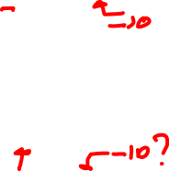
Functions
Identify the domain and range
$y=atan\left(x\right)$
$y=\tan\left(x\right)$

Slide 10


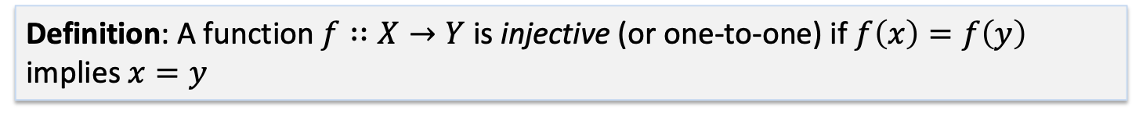







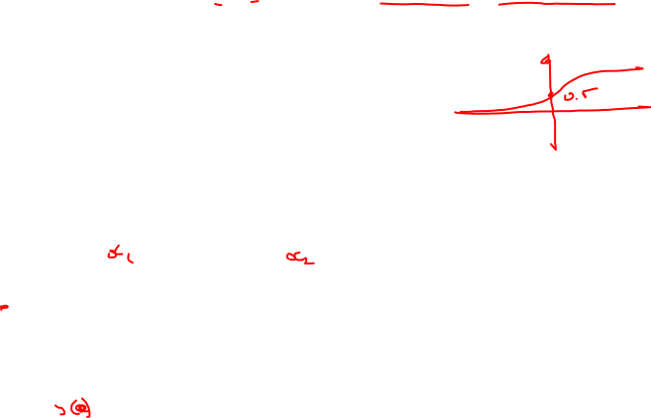



Functions: one-to-one functions
Definition: A function $f∷X→Y$ is injective (or one-to-one) if $f\left(x\right)=f\left(y\right)$ implies $x=y$
$$1$$
$$a$$
$$3$$
$$f$$
$$d$$
$$4$$
$$b$$
$$2$$
$$e$$
$$c$$
$$X$$
$$Y$$
Example
Is $y\left(x\right)=\frac{1}{1+e^{−x}}$ a one-to-one function?

Slide 11




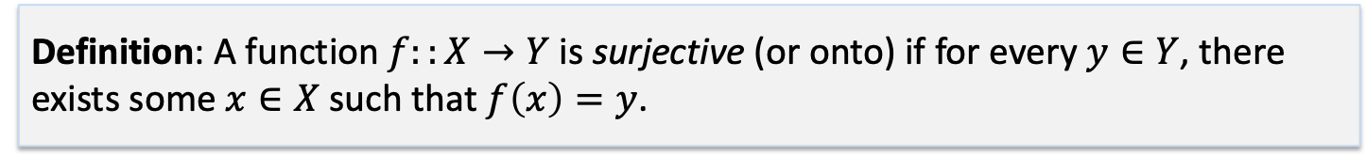







Functions: onto function
Definition: A function $f::X→Y$ is surjective (or onto) if for every $y∈Y$, there exists some $x∈X$ such that $f\left(x\right)=y$.
$$1$$
$$3$$
$$f$$
$$a$$
$$X$$
$$5$$
$$b$$
$$d$$
$$Y$$
$$2$$
$$4$$
$$c$$

Slide 12


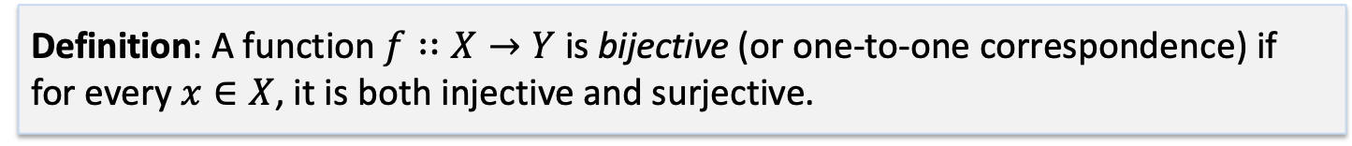


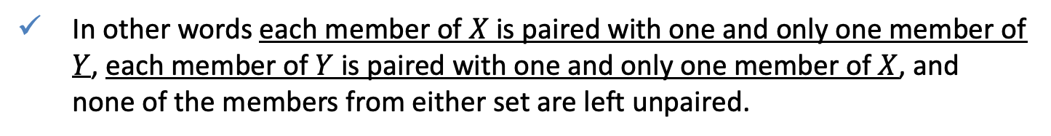









Functions: one-to-one correspondence
Definition: A function $f∷X→Y$ is bijective (or one-to-one correspondence) if for every $x∈X$, it is both injective and surjective.
$$1$$
$$a$$
$$d$$
$$3$$
$$f,f^{−1}$$
$$2$$
$$4$$
$$b$$
$$c$$
$$e$$
$$Y$$
$$X$$
$$5$$
In other words each member of $X$ is paired with one and only one member of $Y$, each member of $Y$ is paired with one and only one member of $X$, and none of the members from either set are left unpaired.

Slide 13
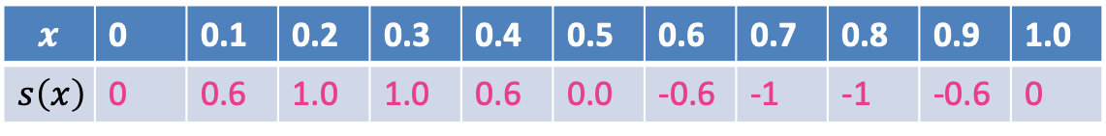
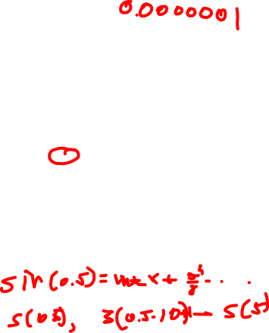
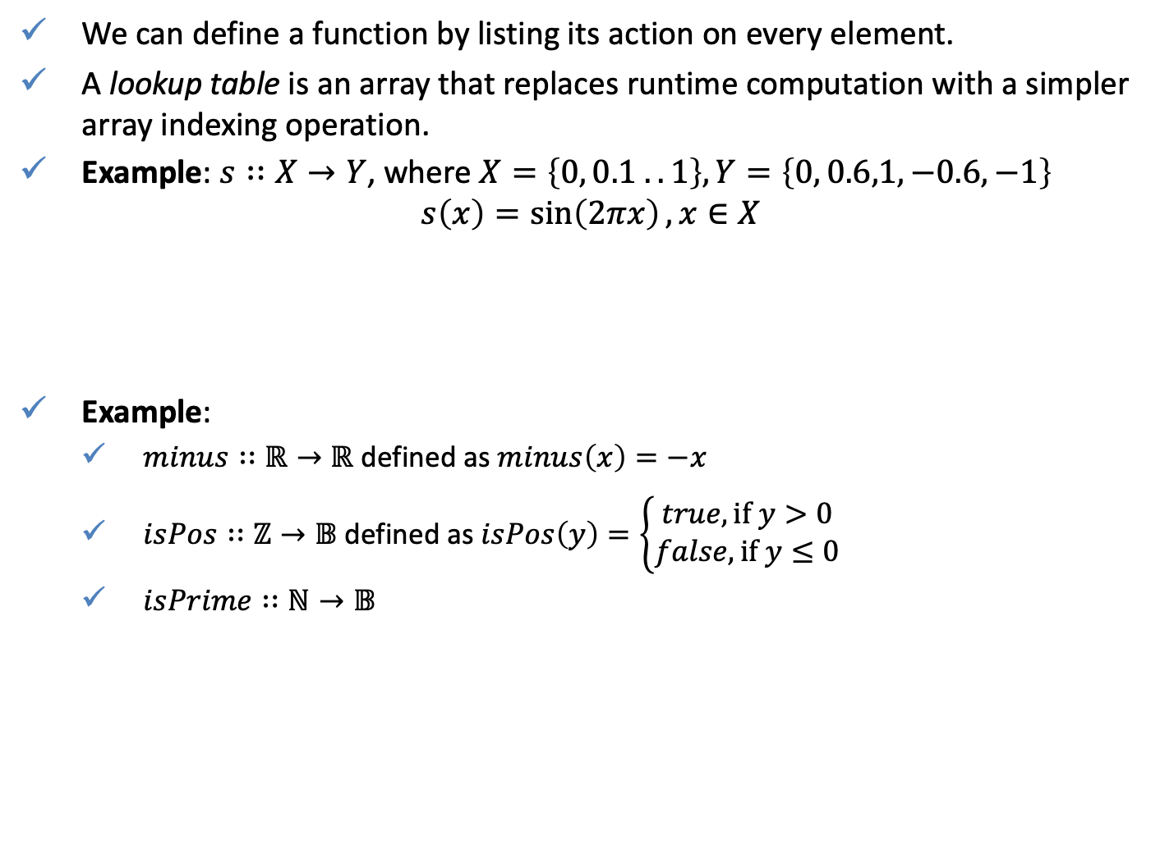
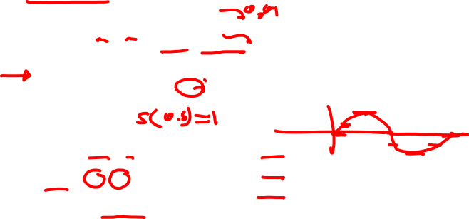
Examples
We can define a function by listing its action on every element.
A lookup table is an array that replaces runtime computation with a simpler array indexing operation.
Example: $s∷X→Y$, where $X=\left\{0, 0.1 .. 1\right\}, Y=\left\{0, 0.6,1,−0.6,−1\right\}$
$$s\left(x\right)=\sin\left(2πx\right), x∈X$$
Example:
$minus∷ℝ→ℝ$ defined as $minus\left(x\right)=−x$
$isPos∷ℤ→𝔹$defined as $isPos\left(y\right)=\left\{\begin{aligned}true, if y>0 \\ false, if y≤0\end{aligned}\right.$
$isPrime∷ℕ→𝔹$
$$x$$ | 0 | 0.1 | 0.2 | 0.3 | 0.4 | 0.5 | 0.6 | 0.7 | 0.8 | 0.9 | 1.0
$$s\left(x\right)$$ | 0 | 0.6 | 1.0 | 1.0 | 0.6 | 0.0 | -0.6 | -1 | -1 | -0.6 | 0

Slide 14

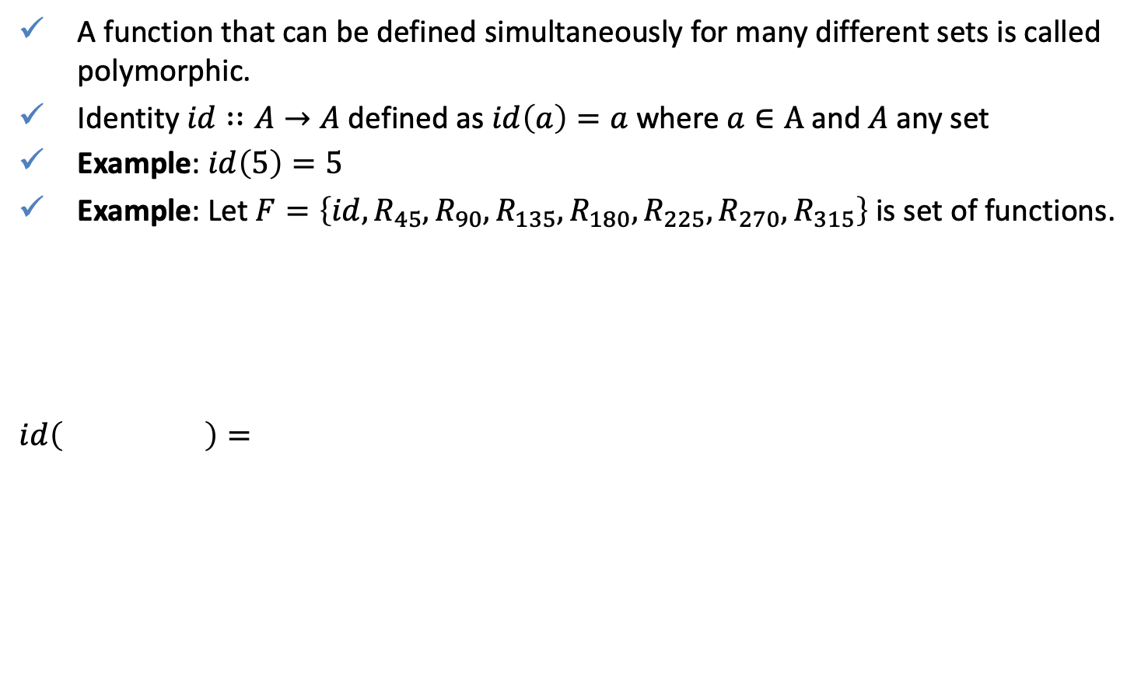
Polymorphic functions
A function that can be defined simultaneously for many different sets is called polymorphic.
Identity $id∷A→A$ defined as $id\left(a\right)=a$ where $a∈A$and $A$ any set
Example: $id\left(5\right)=5$
Example: Let $F=\left\{id,R_{45},R_{90},R_{135},R_{180},R_{225},R_{270},R_{315}\right\}$ is set of functions.
$$id\left( \right)=$$

Slide 15


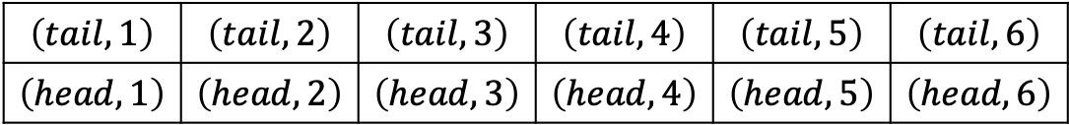


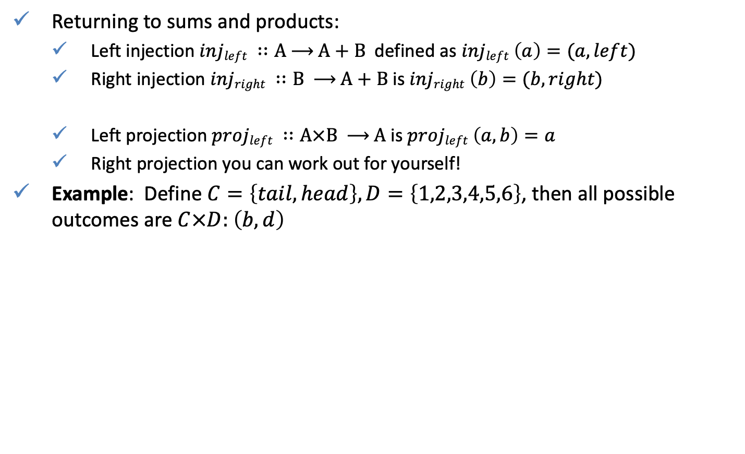






Polymorphic functions
Returning to sums and products:
Left injection $injleft ∷\text{A} \text{⟶ }\text{A}\text{ + }\text{B}$defined as $injleft \left(a\right)=(a,left)$
Right injection $injright ∷\text{B} \text{⟶ }\text{A}\text{ + }\text{B}$ is $injright \left(b\right)=(b,right)$
Left projection $projleft ∷\text{A}×\text{B} \text{⟶ }\text{A}$is $projleft \left(a,b\right)=a$
Right projection you can work out for yourself!
Example: Define $C=\left\{tail, head\right\},D=\left\{1,2,3,4,5,6\right\}$, then all possible outcomes are $C×D:$ $\left(b,d\right)$
$$proj_{coin}\left(b,d\right)=$$
$$\left(tail,1\right)$$ | $$\left(tail,2\right)$$ | $$\left(tail,3\right)$$ | $$\left(tail,4\right)$$ | $$\left(tail,5\right)$$ | $$\left(tail,6\right)$$
$$\left(head,1\right)$$ | $$\left(head,2\right)$$ | $$\left(head,3\right)$$ | $$\left(head,4\right)$$ | $$\left(head,5\right)$$ | $$\left(head,6\right)$$
$$tail$$
$$head$$
$$proj_{die}\left(b,d\right)=$$
$$1$$
$$2$$
$$3$$
$$4$$
$$5$$
$$6$$

Slide 16

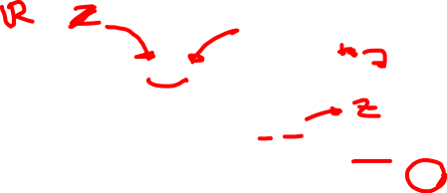
Polymorphic functions
Is this function polymorphic?
$minus ∷\text{A} \text{⟶ }\text{A}$ defined as $minus \left(x\right)=−x$
Not defined for all sets, e.g. 𝔹, ℕ.
But defined for more than one set, e.g. ℤ, ℝ.
Precisely – polymorphic over any set for which ‘$−$’ is defined.

Slide 17



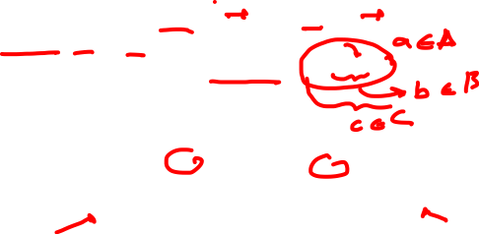





Combining Functions - Composition
If we have functions $f ∷A \text{⟶ }\text{B}$ and $g ∷B \text{⟶ }\text{C}$, we define a new function $g ∘ f ∷A \text{⟶ }\text{C}$ by
$$g∘f\left(a\right)=g\left(f\left(a\right)\right)$$
$$A$$
$$f$$
$$B$$
$$g$$
$$C$$
$$\text{⟶ }$$
$$\text{⟶ }$$

Slide 18

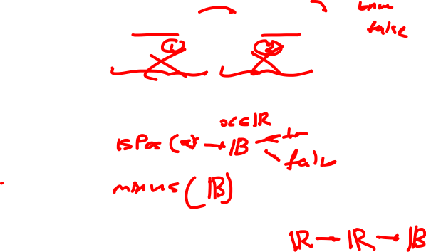
Combining Functions - Composition
We defined earlier $minus ∷ℝ \text{⟶}ℝ$ and$isPos ∷ℝ\text{⟶ }\text{𝔹}$.
Can we define $minus ∘ isPos$ or $isPos∘minus$?
For the one we can define, what is its domain and codomain?
Can you describe in words what this combined function does?

Slide 19



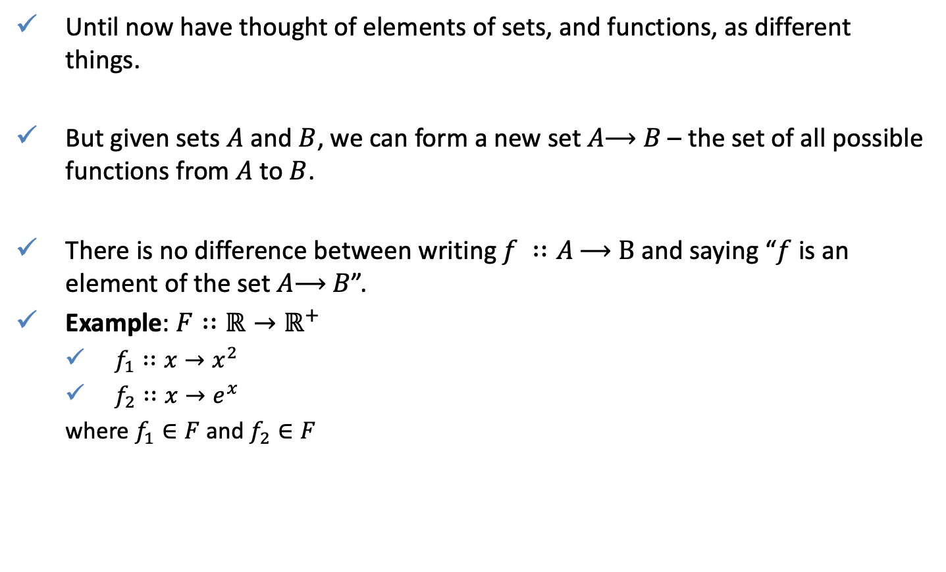



Combining Sets – Set of Functions
Until now have thought of elements of sets, and functions, as different things.
But given sets $A$ and $B$, we can form a new set $A\text{⟶ }B$ – the set of all possible functions from $A$ to $B$.
There is no difference between writing $f ∷A \text{⟶ }\text{B}$ and saying “$f$ is an element of the set $A\text{⟶ }B$”.
Example: $F∷ℝ→ℝ^{+}$
$f_{1}∷x→x^{2}$
$f_{2}∷x→e^{x}$
where $f_{1}∈F$ and $f_{2}∈F$
$$f_{1}$$
$$f_{2}$$
$$ℝ$$
…
$$ℝ^{+}$$
$$f_{n}$$
$$F$$

Slide 20
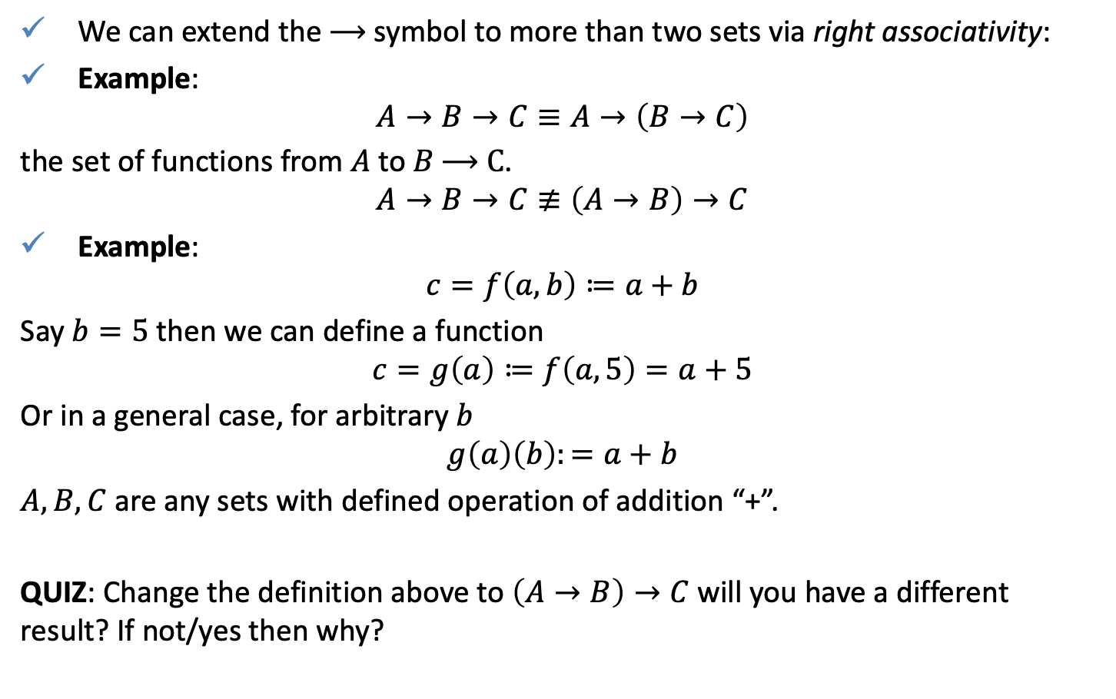
Combining Sets – Sets of Functions
We can extend the $\text{⟶}$ symbol to more than two sets via right associativity:
Example:
$$A→B→C≡A→\left(B→C\right)$$
the set of functions from $A$ to $B \text{⟶ }\text{C}$.
$$A→B→C≢\left(A→B\right)→C$$
Example:
$$c=f\left(a,b\right)≔a+b$$
Say $b=5$ then we can define a function
$$c=g\left(a\right)≔f\left(a,5\right)=a+5$$
Or in a general case, for arbitrary $b$
$$g\left(a\right)\left(b\right):=a+b$$
$A,B,C$ are any sets with defined operation of addition “+”.
QUIZ: Change the definition above to $\left(A→B\right)→C$ will you have a different result? If not/yes then why?

Slide 21



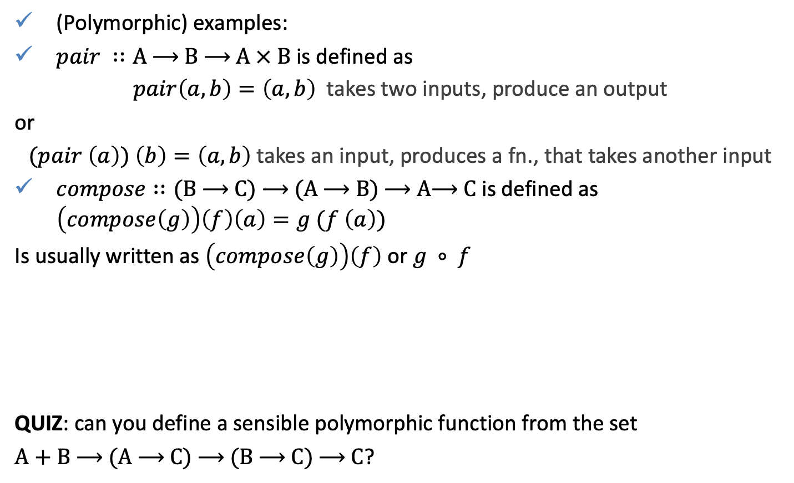




Combining Sets – Sets of Functions
(Polymorphic) examples:
$pair ∷A \text{⟶ }\text{B}\text{ ⟶ }\text{A} × \text{B}$ is defined as
$pair\left(a,b\right)=\left(a, b\right)$ takes two inputs, produce an output
or
$(pair \left(a\right)) \left(b\right)=\left(a, b\right)$ takes an input, produces a fn., that takes another input
$compose∷\text{(}\text{B}\text{ ⟶ }\text{C}\text{) ⟶ (}\text{A}\text{ ⟶ }\text{B}\text{) ⟶ }\text{A}\text{⟶ }\text{C}$ is defined as $\left(compose\left(g\right)\right)\left(f\right)\left(a\right)=g (f \left(a\right))$
Is usually written as $\left(compose\left(g\right)\right)\left(f\right)$ or $g ∘ f$
QUIZ: can you define a sensible polymorphic function from the set
$A+B \text{⟶ (}\text{A}\text{ ⟶ }\text{C}\text{) ⟶ (}\text{B}\text{ ⟶ }\text{C}\text{) ⟶ }\text{C}$?
$$A$$
$$f$$
$$B$$
$$g$$
$$C$$
$$\text{⟶ }$$
$$\text{⟶ }$$

Slide 22
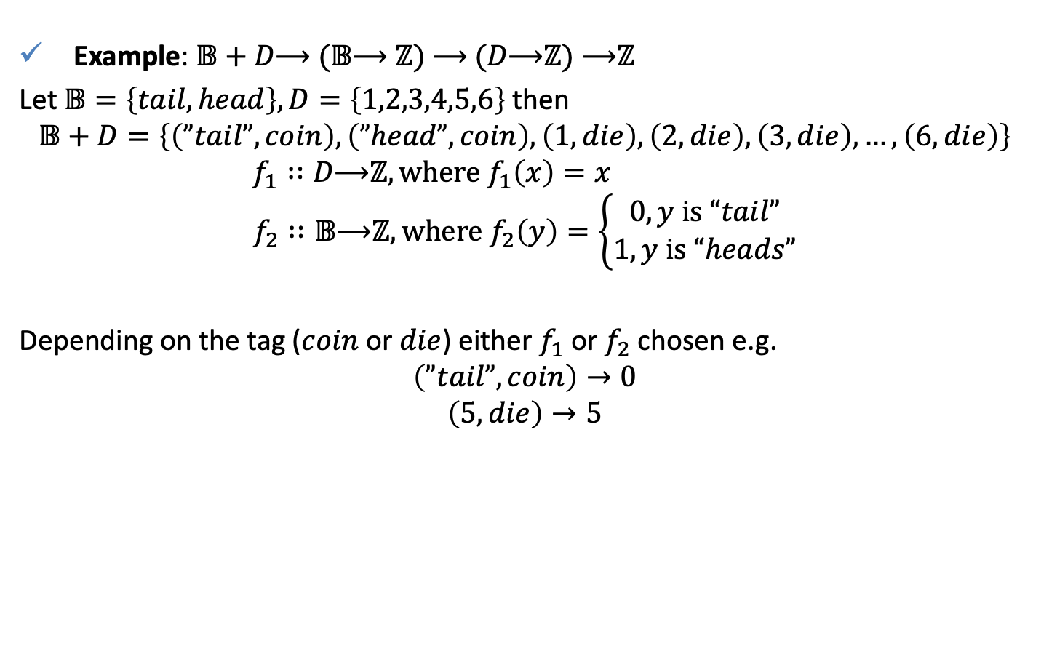
Combining Sets – Sets of Functions
Example: $𝔹+D\text{⟶ (}𝔹\text{⟶ }ℤ\text{) ⟶ (}D\text{⟶}ℤ\text{) ⟶}ℤ$
Let $𝔹=\left\{tail, head\right\},D=\left\{1,2,3,4,5,6\right\}$ then
$$𝔹+D=\left\{\left(”tail”, coin\right),\left(”head”,coin\right),\left(1,die\right),\left(2,die\right),\left(3,die\right),…,\left(6,die\right)\right\}$$
$$f_{1}∷D\text{⟶}ℤ, where f_{1}\left(x\right)=x$$
$$f_{2}∷𝔹\text{⟶}ℤ, where f_{2}\left(y\right)=\left\{\begin{aligned}0, y is “tail” \\ 1, y is “heads”\end{aligned}\right.$$
Depending on the tag ($coin$ or $die$) either $f_{1}$ or $f_{2}$ chosen e.g.
$$\left(”tail”, coin\right)→0$$
$$\left(5, die\right)→5$$

Slide 23
From Mathematics to Functional Programming
All of the mathematics in this lecture relates to concepts you will see (soon!) introduced for programming.
But there are some differences in outlook to keep in mind.

Slide 24
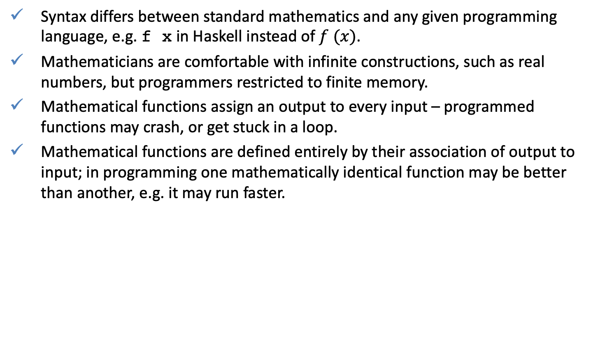

From Mathematics to Functional Programming
Syntax differs between standard mathematics and any given programming language, e.g. f x in Haskell instead of $f (x)$.
Mathematicians are comfortable with infinite constructions, such as real numbers, but programmers restricted to finite memory.
Mathematical functions assign an output to every input – programmed functions may crash, or get stuck in a loop.
Mathematical functions are defined entirely by their association of output to input; in programming one mathematically identical function may be better than another, e.g. it may run faster.

