Slide 1
Lecture 2C
COMP 1100

Slide 2
Acknowledgement of Country
I wish to acknowledge the traditional custodians of the land we are meeting on, the Ngunnawal people. I wish to acknowledge and respect their continuing culture and the contribution they make to the life of this city and this region. I would also like to acknowledge and welcome any other Aboriginal and Torres Strait Islander people who are enrolled in our courses.

Slide 3
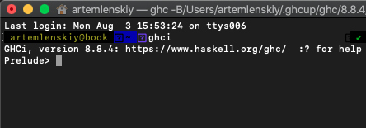
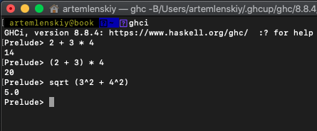
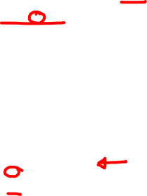
Interactive GHCi system
The interactive GHCI system can be started from the terminal
The GHCI prompt > indicates that the system is now waiting for the user to enter an expression to be evaluated

Slide 4
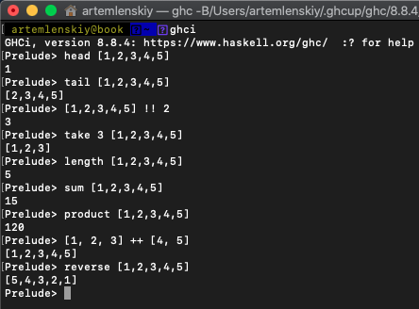
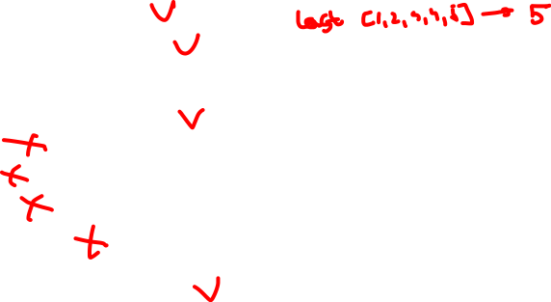
Standard prelude
Haskell comes with a large number of built-in functions

Slide 5
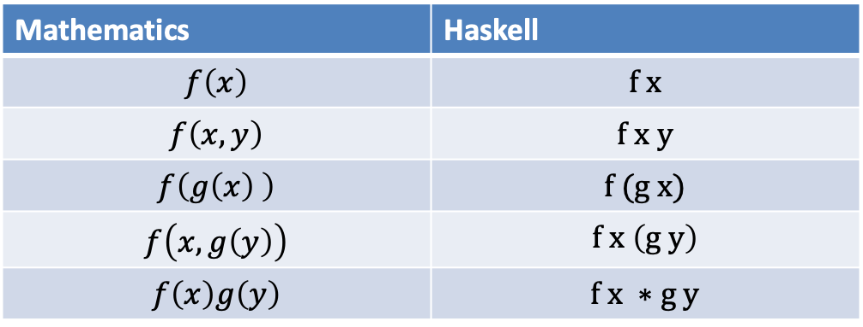


Function application
Mathematical expressions vs Haskell expressions
$$f\left(a,b\right)+cd ⟺ f a b+c∗d$$
Function application in Haskell is denoted silently using spacing, while the multiplication is denoted using the operator *
More example
Note that parentheses are still required e.g. $f x \left(g y\right)$
Mathematics | Haskell
$$f\left(x\right)$$ | $$f x$$
$$f\left(x,y\right)$$ | $$f x y$$
$$f\left(g\left(x\right) \right)$$ | $$f (g x)$$
$$f\left(x, g\left(y\right)\right)$$ | $$f x \left(g y\right)$$
$$f\left(x\right)g\left(y\right)$$ | $$f x ∗g y$$

Slide 6
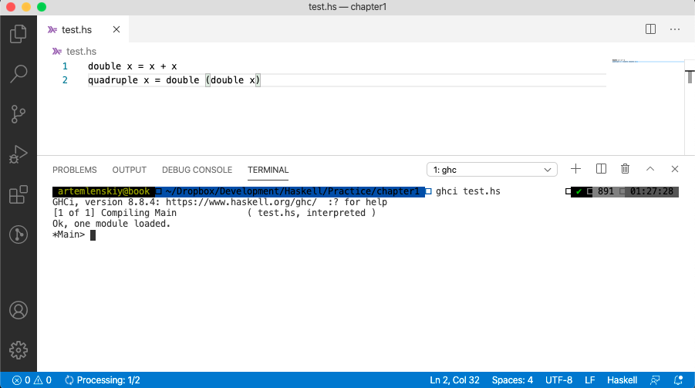
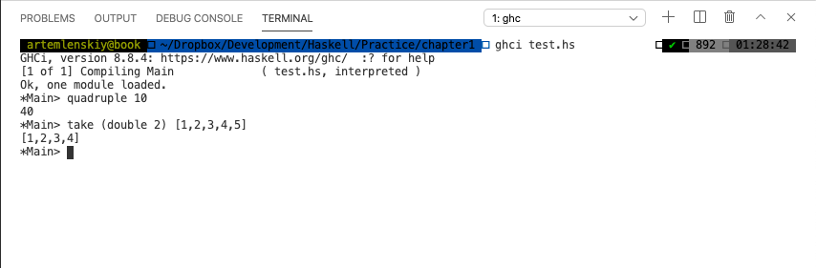
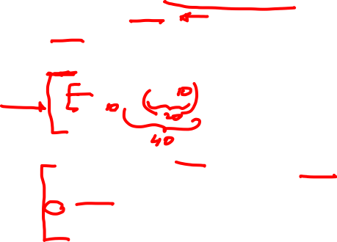
Haskell scripts: setup
When running Haskell, keep two windows open:
  An editor (e.g. VSCode)
  GHCi

Slide 7
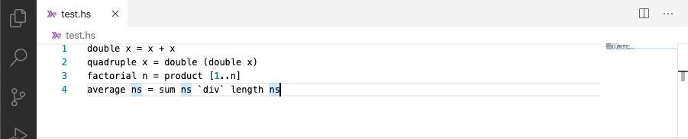
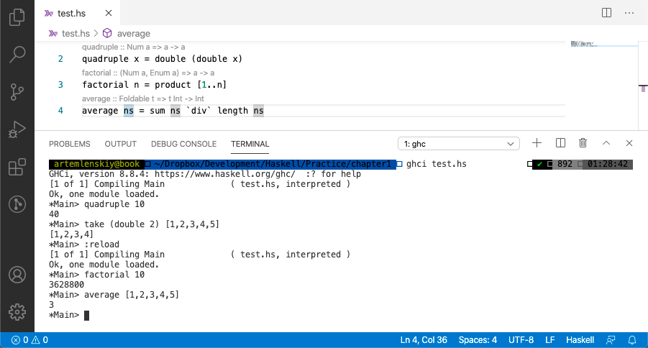
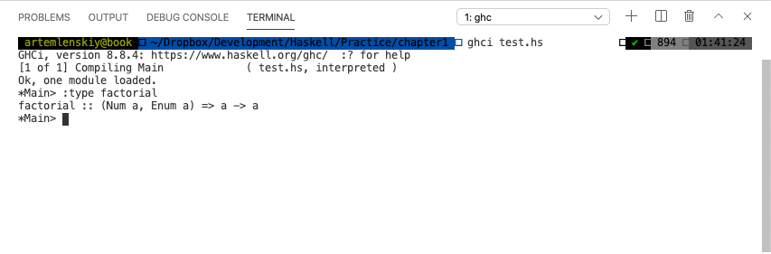
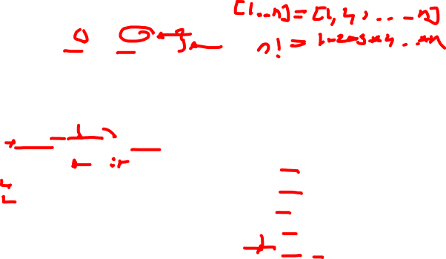
Haskell scripts: commands
command | meaning
:load name | load script name
:reload | reload current script
:edit name | edit script name
:edit | edit current script
:type expr | show type of expr
:? | Show all commands
:quit | quit GHCi

Slide 8
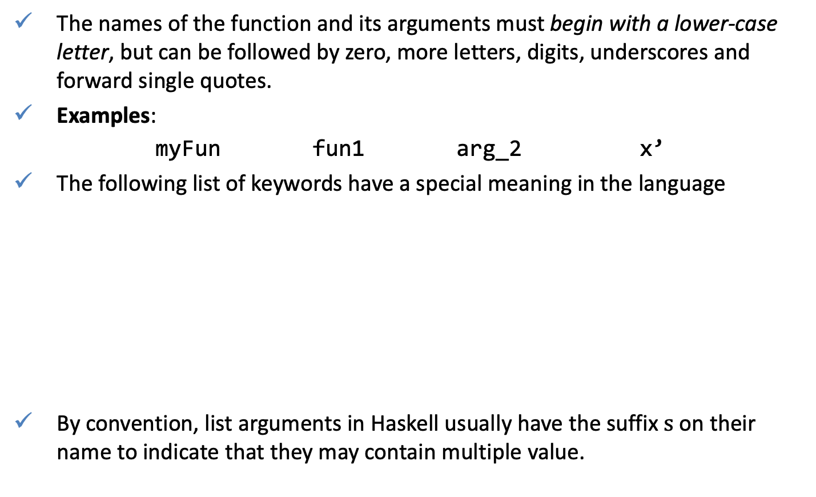
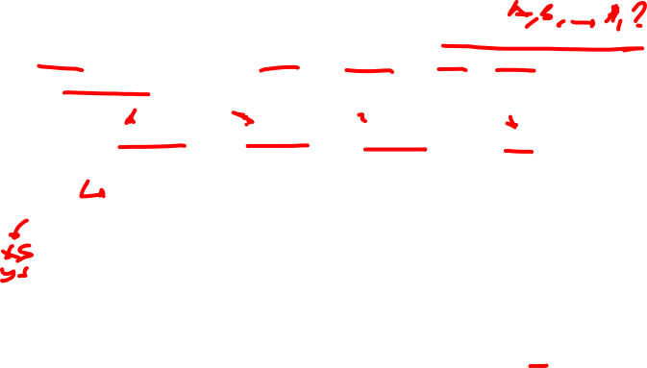
Haskell scripts: Naming requirements
The names of the function and its arguments must begin with a lower-case letter, but can be followed by zero, more letters, digits, underscores and forward single quotes.
Examples:
myFun fun1 arg_2 x’
The following list of keywords have a special meaning in the language
By convention, list arguments in Haskell usually have the suffix $s$ on their name to indicate that they may contain multiple value.
case | class | data | default | deriving
do | else | foreign | if | import
in | infix | infixl | infixr | instance
let | module | newtype | of | then
type | where

Slide 9
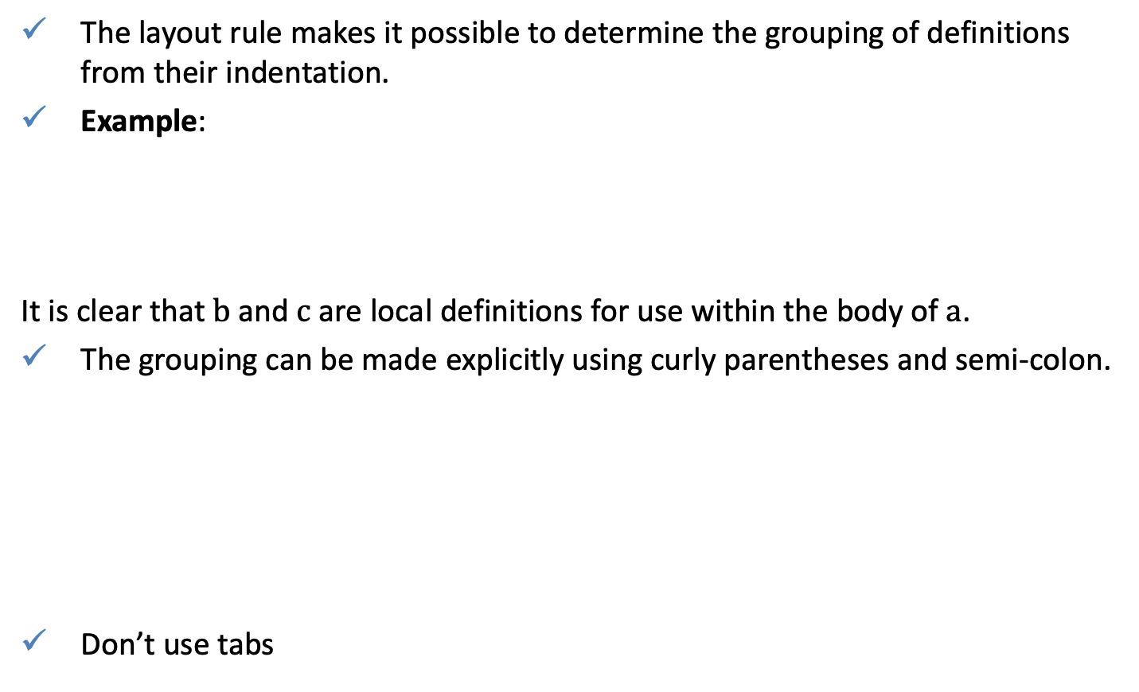
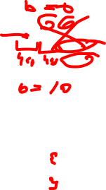
Haskell scripts: the layout rule
The layout rule makes it possible to determine the grouping of definitions from their indentation.
Example:
It is clear that $b$ and $c$ are local definitions for use within the body of $a$.
The grouping can be made explicitly using curly parentheses and semi-colon.
Don’t use tabs
a = b + c
where
b = 1
c = 2
d = a * 2
a = b + c
where{
b = 1;
c = 2};
d = a * 2

Slide 10

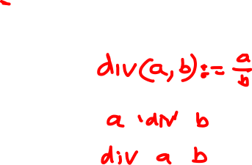
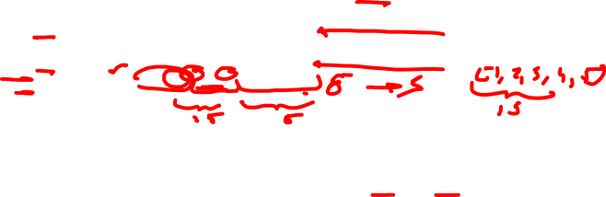
Haskell scripts: comments
Ordinary comments begin with the symbol $−−$
Nested comments begin and with the symbols $\{−$ and $−\}$ and may span multiple lines
-- Factorial of a positive integer:
factorial n = product [1..n]
-- Average of a list of integers:
average ns = sum ns `div` length ns
average ns = div (sum ns) (length ns)
{-
double x = x + x
quadruple x = double (double x)
-}

Slide 11
Exercise
The script below contains three syntactic errors. Correct these errors and then check that your script works properly using GHCi
The library function last selects the last element of a non-empty list;
  For example:
  Show how the function last could be defined in terms of the other library functions.
N = a “div” length xs
where
a = 10
xs = [1, 2, 3, 4, 5]
last [1, 2, 3, 4, 5] = 5
head (reverse [1, 2, 3, 4, 5])

