Slide 1
Lecture 3C: Functions and conditional expressions
COMP 1100

Slide 2
Acknowledgement of Country
I wish to acknowledge the traditional custodians of the land we are meeting on, the Ngunnawal people. I wish to acknowledge and respect their continuing culture and the contribution they make to the life of this city and this region. I would also like to acknowledge and welcome any other Aboriginal and Torres Strait Islander people who are enrolled in our courses.

Slide 3
Defining functions : new from old
One way to define a new function is simply by combining one or more exiting functions
Examples
Decide if an integer is even:
Split a list at the nth element
Reciprocation
Note: The class constraints in the types for even and recip above i.e. any integer types or fractional types can be applied respectively.
even :: Integral a => a -> Bool
even n = n `mod` 2 == 0
splitAt :: Int -> [a] -> ([a], [a])
splitAt n xs = (take n xs, drop n xs)
recip :: Fractional a => a -> a
recip n = 1/n

Slide 4
Control structures: Conditional expressions
Conditional expressions use logical expressions (condition) to choose between two results of the same type.
Example: the library function abs
Conditional expressions may be nested
Note: conditional expression must always have an else branch.
abs :: Int -> Int
abs n = if n >= 0 then n else -n
signum :: Int -> Int
signum n =
if n < 0 then
-1
else
if n == 0 then
0
else
1
if True then
if False then
1
else
2
if True then
if False then
1
else
2
?

Slide 5
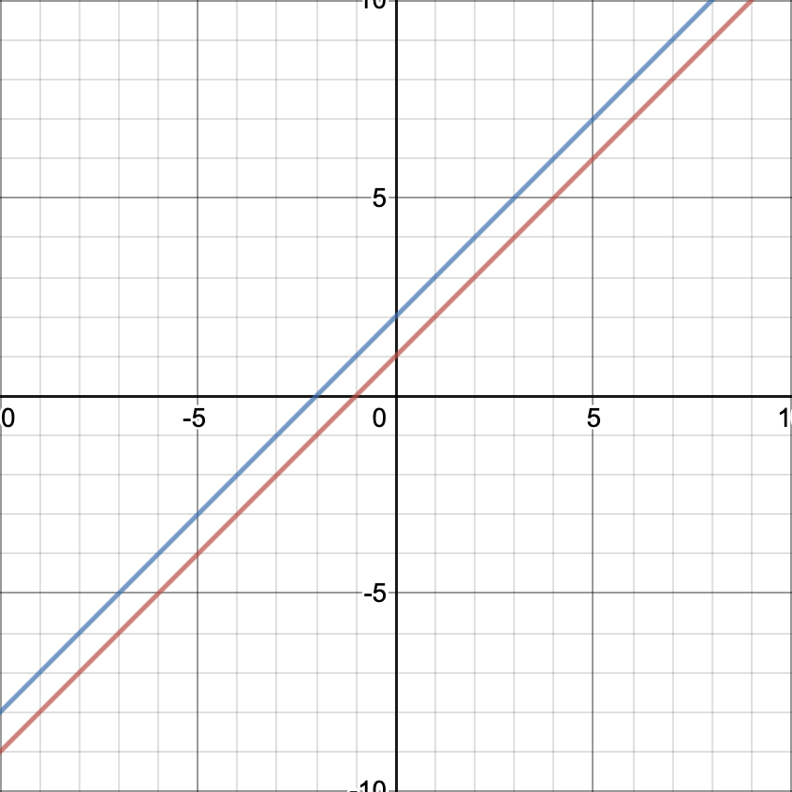
Improving on the line intersection
Previous version
Modify the program such that it handles parallel lines correctly using conditional expression and type Maybe.
type Line = (Double, Double, Double)
type Point = (Double, Double)
intersection :: Line -> Line -> Point
intersection (a, b, m) (c, d, n) = (
(m*d - b*n)/(a*d - c*b),
(n*a-m*c)/(a*d - c*b)
)
> l1 = (1,0,-1) :: Line
> l2 = (1,0,-2) :: Line
> intersection l1 l2
(NaN,Infinity)
type Line = (Double, Double, Double)
type Point = (Double, Double)
intersection :: Line -> Line -> Maybe Point
intersection (a, b, m) (c, d, n) =
if (a*d - c*b) == 0 then
Nothing
else
Just ( (m*d - b*n)/(a*d - c*b), (n*a-m*c)/(a*d - c*b) )
> l1 = (1,0,-1) :: Line
> l2 = (1,0,-2) :: Line
> intersection l1 l2
Nothing

Slide 6
Control structures : Guarded equations
Alternative to conditional expressions is guarded equations.
If the first guard is True then first result is chosen; otherwise if the second is True, then the second result is chosen and so on.
The symbol | is read such that, and the guard otherwise is defined in the standard prelude simply by otherwise = True.
abs :: Int -> Int
abs n | n >= 0 = n
| otherwise = -n
signum :: Int -> Int
signum n | n < 0 = -1
| n == 0 = 0
| otherwise = 1
signum :: Int -> Int
signum n =
if n < 0 then
-1
else
if n == 0 then
0
else
1
vs

Slide 7
Control structures : Guarded equations
The main benefit is that definitions with multiple guards are easier to read.
type Line = (Double, Double, Double)
type Point = (Double, Double)
intersection :: Line -> Line -> Maybe Point
intersection (a, b, m) (c, d, n) =
if (a*d - c*b) == 0 then
Nothing
else
Just ( (m*d - b*n)/(a*d - c*b), (n*a-m*c)/(a*d - c*b) )
type Line = (Double, Double, Double)
type Point = (Double, Double)
intersection :: Line -> Line -> Maybe Point
intersection (a, b, m) (c, d, n)
| (a*d - c*b) == 0 = Nothing
| otherwise = Just ( (m*d - b*n)/(a*d - c*b), (n*a-m*c)/(a*d - c*b) )

Slide 8
Roots of quadratic equations with guards
Previous version
With guards
-- Quadratic equation solver
-- ax^2 + bx + c = 0
-- INPUT: a, b, c
-- OUTPUT: x1 x2
roots :: (Float, Float, Float) -> (Float, Float)
roots (a, b, c) = (x1, x2)
where
x1 = ( - b + sqrt d) / (2 * a)
x2 = ( - b - sqrt d) / (2 * a)
d = b * b - 4 * a * c
roots :: (Float, Float, Float) -> (Float, Float)
roots (a, b, c)
| a == 0 = error "not quadratic"
| d < 0 = error "complex roots"
| otherwise = (x1, x2)
where
x1 = ( - b + sqrt d) / (2 * a)
x2 = ( - b - sqrt d) / (2 * a)
d = b * b - 4 * a * c

Slide 9
Control structures : Pattern matching
A sequence of syntactic expressions called patterns.
Pattern matching provides intuitive and simple function definitions:
If the first patten is matched then the first result is chosen, otherwise, if the second is matched, then the second is chosen, and so on.
not :: Bool -> Bool
not False = True
not True = False

Slide 10
Control structures : Pattern matching
Function with more than one argument can also be defined using pattern matching.
The library operator && that returns the conjunction
A simplified version using wildcard pattern _
The patterns for each argument are matched in order within each equation.
This version benefit from lazy evaluation: If the first argument is False, then the result False is return w/o the need to evaluate the second argument.
(&&) :: Bool -> Bool -> Bool
True && True = True
True && False = False
False && True = False
False && False = False
(&&) :: Bool -> Bool -> Bool
True && True = True
_ && _ = False

Slide 11
Control structures : Pattern matching
The prelude definition of &&
If the first argument is True, then the result is the value of the second argument and if the first argument is False, then the result is False.
A guarded version
(&&) :: Bool -> Bool -> Bool
True && b = b
False && _ = False
(&&) :: Bool -> Bool -> Bool
b && c | b == c = b
| otherwise = False

Slide 12
Pattern matching: Tuple patterns
A tuple patterns is itself a pattern, which matches any tuple of the same arity whose components all match the corresponding patterns in order.
fst :: (a, b) -> a -- left projection
fst (x, _) = x
snd :: (a, b) -> b -- right projection
snd (_, y) = y

Slide 13
Pattern matching: List patterns
A list of patterns is itself a pattern, which matches any list of the same length whose elements all match the corresponding patterns in order.
Lists are constructed one element at a time starting from [] using an operator : called cons that constructs a new by prepending a new element
Example: list [1, 2, 3] can be decomposed as
test :: [Char] -> Bool
test ['a',_,_] = True
test _ = False
[1, 2, 3]
= {list notation}
1 : [2, 3]
= {list notation}
1 : (2 : [3])
= {list notation}
1 : (2 : (3 : []))
equivalent to 1 : 2 : 3 : []

Slide 14
Pattern matching: List patterns
A more general version of the function test
The library functions head and tail that select and remove the first element of a non-empty list
Note: cons patterns must be parenthesized. Why?
Function application has higher priority than all other operators.
test :: [Char] -> Bool
test ('a':_) = True
test _ = False
head :: [a] -> a
head (x:_) = x
tail :: [a] -> [a]
tail (_:xs) = xs

Slide 15
Control structures : a case expression
A block of code is selected for specific values of the control variable. In case the variable has some value for which a case has not been set up, a catch-all block of code is invoked
Example: control variable
Example: a function return value as control variable
compare returns "LT" if the first argument is less than the second one, "EQ" if the arguments are equal, and "GT" if the first argument is greater.
letterToFruit :: Char -> String
letterToFruit fruit = case fruit of
'a' -> "apple"
'b' -> "banana"
'c' -> "cherry"
'd' -> "dragon fruit"
_ -> "hmm..?"
> letterToFruit 'a'
"apple"
> letterToFruit 'b'
"banana"
> letterToFruit 'c'
"cherry"
> letterToFruit 'e'
"hmm..?"
signum' :: Int -> Int
signum' n = case (compare n 0) of
LT -> -1
EQ -> 0
GT -> 1
> signum' (-5)
-1
> signum' (5)
1
> signum' (0)
0

Slide 16


Lambda $λ$ expression
Functions also can be constructed using lambda expressions: nameless functions.
The symbol $\backslash$ represents the Greek letter lambda, written as $λ$.
\x -> x + x
> (\x -> x + x) 2
4

Slide 17
Lambda $λ$ expression
Lambda expressions are useful in formalizing the meaning of curried function definitions.
add is a function that takes an integer x and return a function, which in turn takes another integer y and returns the result x + y.
Lambda expressions are useful when defining functions that return functions (not as result of currying)
Example: returns a constant function
add :: Int -> Int -> Int
add x y = x + y
add :: Int -> (Int -> Int)
add = \x -> (\y -> x + y)
const :: a -> b -> a
const x _ = x
const :: a -> (b -> a)
const x = \_ -> x
> const 6 7
6
> c = const 6
> c 7
6

Slide 18
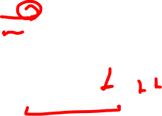
Lambda $λ$ expression
Lambda expressions can be useful to avoid having to name a function that is only referenced once in a program
Example:
odds :: Int -> [Int]
odds n = map f [0..n-1]
where f x = x * 2 + 1
> odds 5
[1,3,5,7,9]
odds :: Int -> [Int]
odds n = map (\x -> x*2 + 1) [0..n-1]

Slide 19
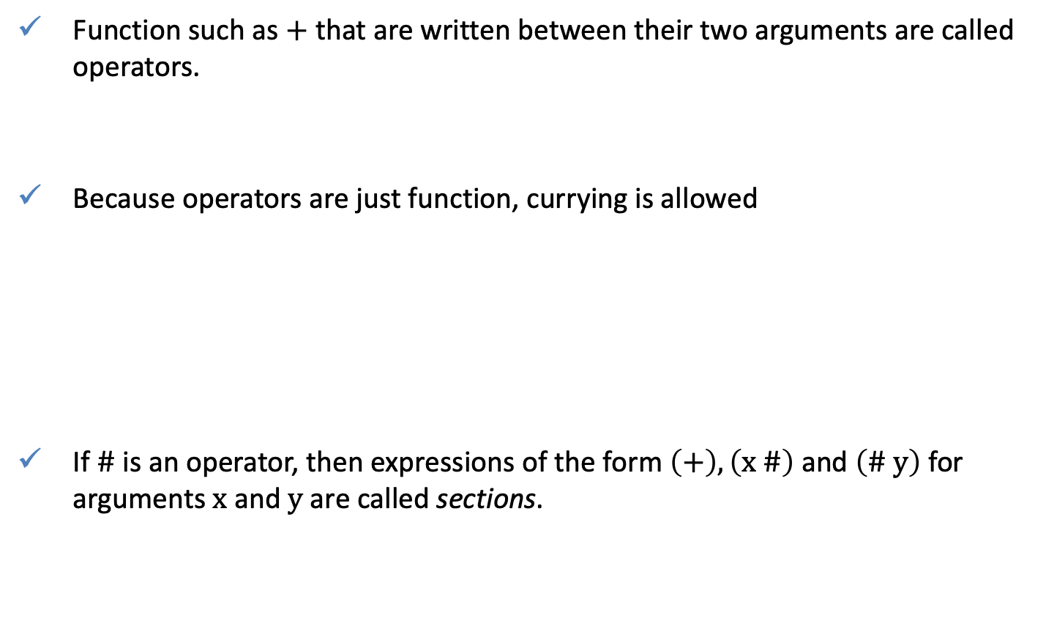
Operator sections
Function such as $+$ that are written between their two arguments are called operators.
Because operators are just function, currying is allowed
If $\#$ is an operator, then expressions of the form $\left(+\right),\left(x \#\right)$ and $\left(\# y\right)$ for arguments $x$ and $y$ are called sections.
1 + 2
(+) 1 2
> (1+) 2
3
> (+2) 1
3
> f = (1+)
> f 2
3
(#) = \x -> (\y -> x # y)
(x #) = \y -> x # y
(# y) = \x -> x # y

Slide 20
Operator sections: Primary applications
Can be used to construct a number of simple but useful functions
(+) Is the addition function \x -> (\y -> x + y)
(1+) Is the successor function \y -> 1 + y
(1/) Is the reciprocation function \y -> 1/y
(*2) Is the doubling function \x -> x*y
(/2) Is the halving function \x -> x/y
Are necessary when stating the type of operator
Necessary when using operators as arguments to other functions
(+) :: Int -> Int -> Int
length :: [a] -> Int
length = foldr (\x -> (+) 1) 0
sum :: [Int] -> Int
sum = foldl (+) 0
> length ['a', 'b', 'c', 'd', 'e']
5
> sum [1, 2, 3, 4, 5]
15

Slide 21
QUIZ
Using library functions , define a function halve :: [a] -> ([a], [a]) that splits an even-lengthed list into two halves. For example
Recall
> halve [1..10]
([1,2,3,4,5],[6,7,8,9,10])
splitAt :: Int -> [a] -> ([a], [a])
splitAt n xs = (take n xs, drop n xs)
halve :: [a] -> ([a], [a])
halve xs = (take (div (length xs) 2) xs, drop (div (length xs) 2) xs)
halve :: [a] -> ([a], [a])
halve xs = (take n xs, drop n xs)
where n = div (length xs) 2

Slide 22
QUIZ
Problem 1: In a similar way to
show how the disjunction operator || can be defined in four different ways using pattern matching.
(&&) :: Bool -> Bool -> Bool
True && True = True
True && False = False
False && True = False
False && False = False
(&&) :: Bool -> Bool -> Bool
True && True = True
_ && _ = False
(&&) :: Bool -> Bool -> Bool
True && b = b
False && _ = False
(&&) :: Bool -> Bool -> Bool
b && c | b == c = b
| otherwise = False

Slide 23
QUIZ
Problem 2: Show how the meaning of the following curried function definition can be formalized in terms of lambda expressions
Recall
mult :: Int -> Int -> Int -> Int
mult x y z = x * y * z
add :: Int -> Int -> Int
add x y = x + y
add :: Int -> (Int -> Int)
add = \x -> (\y -> x + y)

Slide 24
QUIZ
Problem 3. Implement function roots using
if else expression
case expression
pattern matching

