Slide 1
Lecture 4A List comprehensions
COMP 1100

Slide 2
Acknowledgement of Country
I wish to acknowledge the traditional custodians of the land we are meeting on, the Ngunnawal people. I wish to acknowledge and respect their continuing culture and the contribution they make to the life of this city and this region. I would also like to acknowledge and welcome any other Aboriginal and Torres Strait Islander people who are enrolled in our courses.

Slide 3
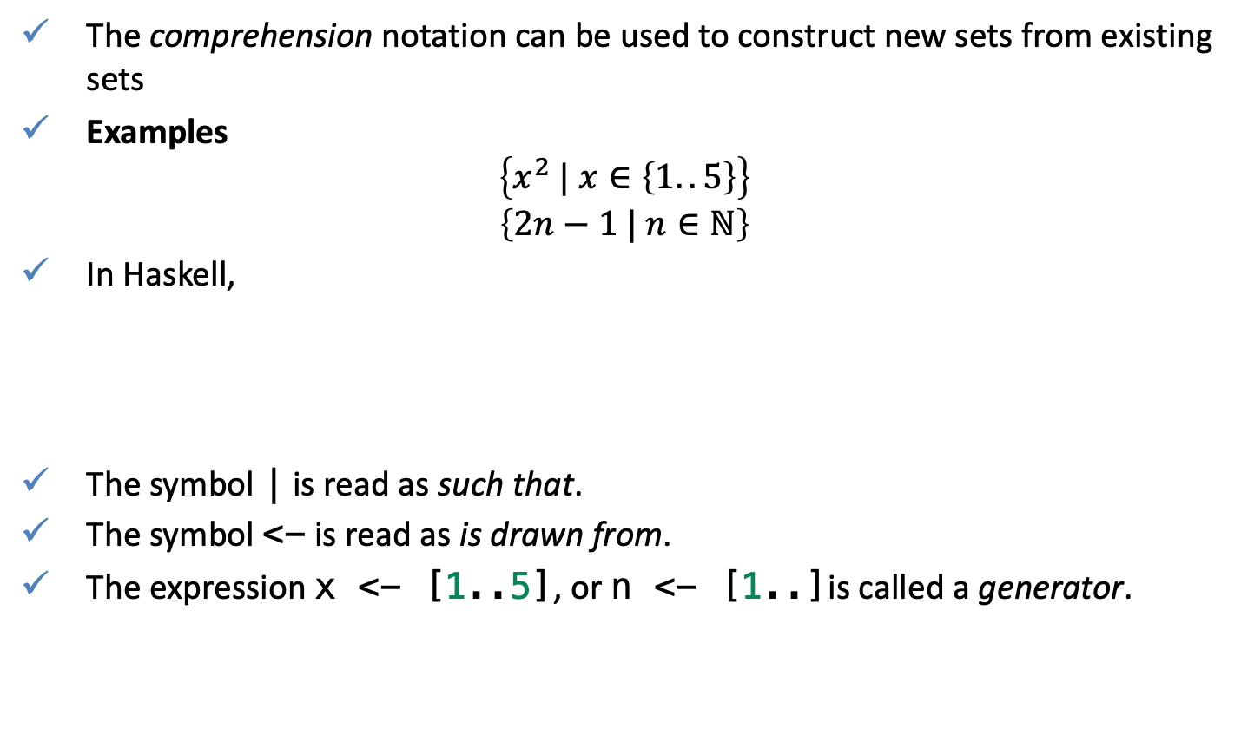
Basic concepts
The comprehension notation can be used to construct new sets from existing sets
Examples
$$\left\{x^{2} | x∈\left\{1..5\right\}\right\}$$
$$\left\{2n−1 | n∈ℕ\right\}$$
In Haskell,
The symbol | is read as such that.
The symbol <- is read as is drawn from.
The expression x <- [1..5], or n <- [1..]is called a generator.
[x^2 | x <- [1..5]]
[1,4,9,16,25]
[2*n - 1 | n <- [1..]]
[1,3,5,7,9,11,13,15,17,19,21,23,25,27,...]

Slide 4
Basic concepts
A list of comprehension can have more than one generator, with successive generators being separated by commas
Examples
An imperative language analogy
[(x,y) | x <- [1,2,3], y <- [4,5]]
[(1,4),(1,5),(2,4),(2,5),(3,4),(3,5)]
[(x,y) | y <- [4, 5], x <- [1,2,3]]
[(1,4),(2,4),(3,4),(1,5),(2,5),(3,5)]
Pseudocode
Pseudocode
for k = 1..3
for l = 4..5
[k, l]
end
end
for l = 4..5
for k = 1..3
[k, l]
end
end
[(1,4),(1,5),(2,4),(2,5),(3,4),(3,5)]
[(1,4),(2,4),(3,4),(1,5),(2,5),(3,5)]

Slide 5
Basic concepts
Later generators can also depend upon the values of variables from earlier generators
Example
An imperative language analogy
 | 1 | 2 | 3
1 | (1,1) | (1,2) | (1,3)
2 | (2,1) | (2,2) | (2,3)
3 | (3,1) | (3,2) | (3,3)
[(x,y) | x <- [1,2,3], y <- [x..3]]
[(1,1),(1,2),(1,3),(2,2),(2,3),(3,3)]
for x = 1:3
for l = x:3
[x, l]
end
end

Slide 6
Basic concepts
The library function concat concatenates a list of lists.
The wildcard pattern _ is useful in generators to discard certain elements from a list:
concat :: [[a]] -> [a]
concat xss = [x | xs <- xss, x <- xs]
>concat [['a', 'b', 'c'], ['d', 'e'], ['f'], []]
"abcdef"
>concat ["Hello ", "John"]
"Hello John"
firsts :: [(a,b)] -> [a]
firsts ps = [x | (x, _) <- ps]
length :: [a] -> Int
length xs = sum [1 | _ <- xs]
> firsts [(1,2), (2,3), (3,4)]
[1,2,3]
length [['a', 'b', 'c'], ['d', 'e'], ['f'], []]
4

Slide 7
Guards
List comprehensions can use guards (logical expressions) to filter the values produced by earlier generators.
If a guard is True, then the current values are retained
If a guard is False, then they are discarded
Example
Example
[x | x <- [1..10], even x]
[2,4,6,8,10]
guard (filter)
factors :: Int -> [Int]
factors n = [x | x <- [1..n], mod n x == 0]
factors 24
[1,2,3,4,6,8,12,24]
guard (filter)
factors 29
[1,29]

Slide 8
Guards: Prime numbers example
Definition: A prime number (or a prime) is a natural number greater than 1 that is not a product of two or more smaller natural numbers.
Note, that deciding that a number 24 is not prime, require any factor other than 1 or the number itself to be produced (2 in this example) - lazy evolution.
Using prime we can define a function that produces the list of all primes
prime :: Int -> Bool
prime n = factors n == [1,n]
> prime 24
False
> prime 29
True
primes :: Int -> [Int]
primes n = [x | x <- [2..n], prime x]
primes 29
[2,3,5,7,11,13,17,19,23,29]

Slide 9
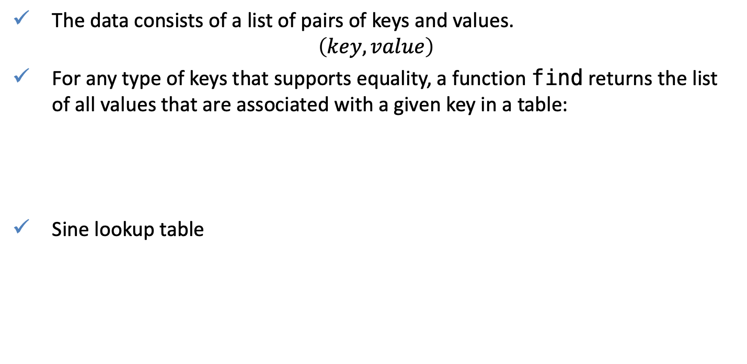
Guards: Lookup table
Definition: A lookup table is a data structure that replaces runtime computation with a simpler indexing operation.
The data consists of a list of pairs of keys and values.
$$\left(key, value\right)$$
For any type of keys that supports equality, a function find returns the list of all values that are associated with a given key in a table:
Sine lookup table
find :: Eq a => a -> [(a, b)] -> [b]
find k t = [v | (k', v) <- t, k == k']
find 'b' [('a', 1), ('b', 2), ('c', 3), ('b', 4)]
[2,4]
sinTable = [(0, 0), (0.1, 0.6), (0.2, 1.0), (0.3, 1.0), (0.4, 0.6), (0.5, 0), (0.6, -0.6), (0.7, -1), (0.8, -1), (0.9, -0.6), (1.0, 0)]
> find 0.5 sinTable
[0.0]
> find 0.2 sinTable
[1.0]
> find 0.1 sinTable
[0.6]
Notes:
https://tech.channable.com/posts/2019-03-13-how-we-made-haskell-search-strings-as-fast-as-rust.html

Slide 10
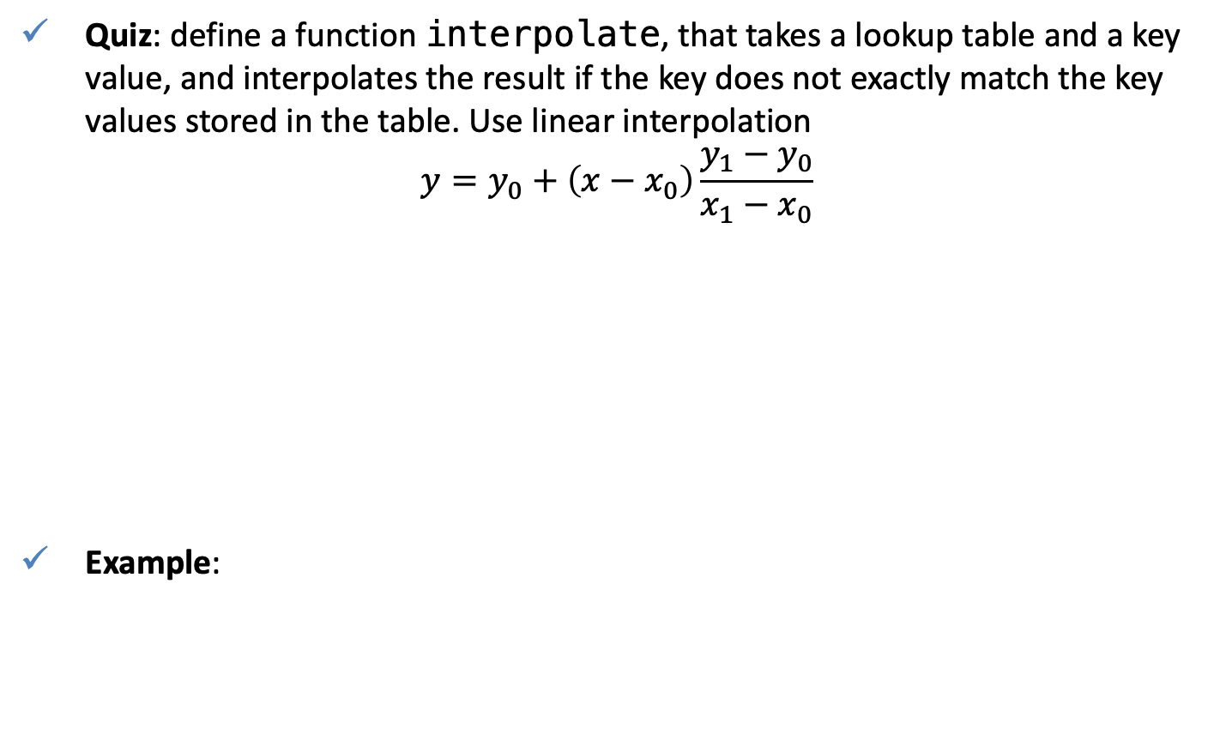
Quiz
Quiz: define a function interpolate, that takes a lookup table and a key value, and interpolates the result if the key does not exactly match the key values stored in the table. Use linear interpolation
$$y=y_{0}+\left(x−x_{0}\right)\frac{y_{1}−y_{0}}{x_{1}−x_{0}}$$
Example:
interpolate 0.21 sinTable
[1.0]

Slide 11
The zip Function
The function zip produces a new list of pairings from two existing lists until either of both lists are exhausted.
Example: Code a function that returns the list of pairs of adjacent elements
Example: Code a function that checks if a list is ordered
Note: deciding that a list is not sorted may not require the function sorted to produce all pairs of adjacent elements (e.g. a pair (3,2)).
:t zip
zip :: [a] -> [b] -> [(a, b)]
zip ['a', 'b', 'c'] [1, 2, 3, 4]
[('a',1),('b',2),('c',3)]
adjPairs :: [a] -> [(a,a)]
adjPairs xs = zip xs (tail xs)
adjPairs [1,2,3,4]
[(1,2),(2,3),(3,4)]
sorted :: Ord a => [a] -> Bool
sorted xs = and [x <= y | (x,y) <- adjPairs xs]
> sorted [1,2,3,4]
True
> sorted [1,3,2,4]
False

Slide 12
The zip Function: Example
Implement a function that returns the list of all positions at which a value occurs in a list
The function pairs each element with its position, and selects those positions at which the desired value occurs.
Note [0..] is notionally infinite, but under lazy evaluation only as many elements as required will be produced (not necessary equal to the number of elements in xs).
positions :: Eq a => a -> [a] -> [Int]
positions x xs = [i | (x', i) <- zip xs [0..], x == x']

Slide 13
String comprehensions
Recall that "abc" :: String is equivalent to ['a', 'b', 'c'] :: [Char].
Because stings are lists, any polymorphic function on lists can be used with strings
> take 3 "abcde"
"abc"
> "abcde" !! 2
'c'
> take 3 "abcde"
"abc"
> length "abcde"
5
> zip "abc" [1,2,3,4]
[('a',1),('b',2),('c',3)]

Slide 14
String comprehensions
List comprehensions can also be used to define functions on strings.
Examples
lowers :: String -> Int
lowers xs = length [x | x <- xs, x >= 'a' && x <= 'z']
count :: Char -> String -> Int
count x xs = length [x' | x' <- xs, x == x']
> lowers "Hello"
4
> count 'l' "Hello"
2

Slide 15
The Caesar cipher
To encode a string, Caesar simply replaced each letter in the string by the letter three places further down in the alphabet, wrapping around at the end of the alphabet .
More generally the specific shift factor of three can be replaced by any inetger between 1 and 25.
"haskell is fun"
"kdvnhoo lv ixq"

Slide 16
The Caesar cipher: Encoding and Decoding
Import a library that implements standard functions on characters.
Define a function let2int, that convers a lower-case letter between a and z into the corresponding integer between 0 and 25, and corresponding int2let that performs the opposite conversion
Functions ord :: Char -> Int, chr :: Int -> Char converts between characters and their Unicode numbers.
import Data.Char
let2int :: Char -> Int
let2int c = ord c - ord 'a'
int2let :: Int -> Char
int2let n = chr (ord 'a' + n)
> let2int 'a'
0
> int2let 0
'a'

Slide 17
The Caesar cipher: Encoding and Decoding
Define a function shift that applies a shift factor to a lower-case letter
shift :: Int -> Char -> Char
shift n c | isLower c = int2let ((let2int c + n) `mod` 26)
| otherwise = c
:t isLower
isLower :: Char -> Bool
> shift 3 'a'
'd'
> shift 3 'z'
'c'
> shift (-3) 'c'
'z'

Slide 18
The Caesar cipher: Encoding and Decoding
Using shift within a list comprehension, define a function that encodes
QUIZ: implement a decoding function
encode :: Int -> String -> String
encode n xs = [shift n x | x <- xs]
encode 3 "haskell is fun"
"kdvnhoo lv ixq"

Slide 19
Live coding
Function count, counts the number of occurrences of x' in a list
Use a list comprehension to implement a function that counts the number of times each element of a set s, occurs in a list l.
Example:
Test on
count :: Eq a => a -> [a] -> Int
count x xs = length [x' | x' <- xs, x == x']
hist ['a'..'z'] "Hello world!"
[0,0,0,1,1,0,0,0,0,0,0,3,0,0,2,0,0,1,0,0,0,0,1,0,0,0]
hist [0..9] [1,1,1,2,2,3,4,5,6,7,8,9,0]

Slide 20
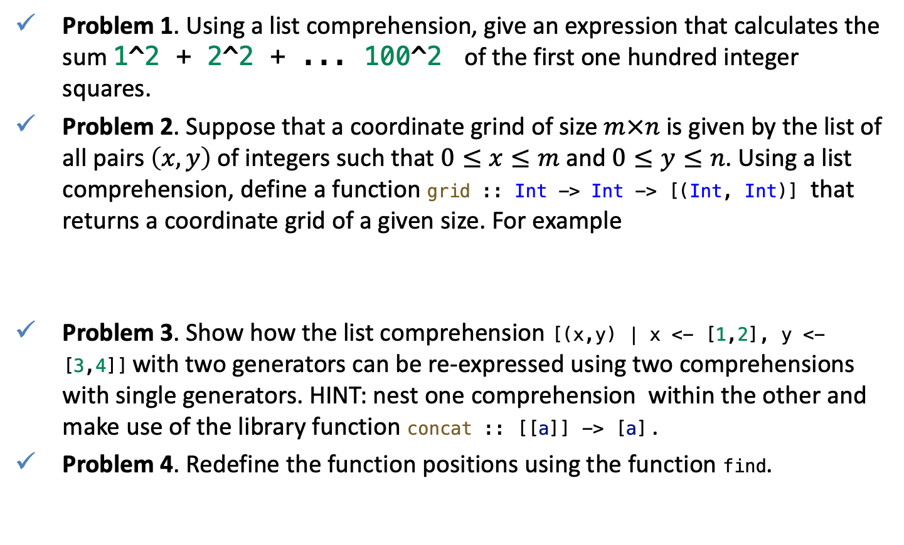
Quz
Problem 1. Using a list comprehension, give an expression that calculates the sum 1^2 + 2^2 + ... 100^2 of the first one hundred integer squares.
Problem 2. Suppose that a coordinate grind of size $m×n$ is given by the list of all pairs $\left(x,y\right)$ of integers such that $0≤x≤m$ and $0≤y≤n$. Using a list comprehension, define a function grid :: Int -> Int -> [(Int, Int)] that returns a coordinate grid of a given size. For example
Problem 3. Show how the list comprehension [(x,y) | x <- [1,2], y <- [3,4]] with two generators can be re-expressed using two comprehensions with single generators. HINT: nest one comprehension within the other and make use of the library function concat :: [[a]] -> [a] .
Problem 4. Redefine the function positions using the function find.
> grid 1 2
[(0,0), (0,1), (0,2), (1,0), (1,1), (1,2)]

