Slide 1
Lecture 6A
Basic IO
COMP 1100

Slide 2
Acknowledgement of Country
I wish to acknowledge the traditional custodians of the land we are meeting on, the Ngunnawal people. I wish to acknowledge and respect their continuing culture and the contribution they make to the life of this city and this region. I would also like to acknowledge and welcome any other Aboriginal and Torres Strait Islander people who are enrolled in our courses.

Slide 3





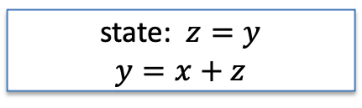






Pure functions vs Side effects
Pure functions
  The function takes the same value for the same arguments
    There is no sate;
    There are not inputs besides function arguments.
Examples of impure functions
  Deterministic function but with a state
  Nondeterministic
Initially $z=0$
$$x$$
state: $z=y$
$$y=x+z$$
$$y$$
$$1$$
$$1$$
$$1$$
different
$$2$$
$r$ random num. gen.
$$x$$
$$y=x+r$$
$$y$$

Slide 4

Pure functions vs Side effects
Side effects
  A function changes the state outside its own space
  Printing to the screen is not the same as returning a value
Examples of side effects
  Reading a record from a database
  Sending a message over the Internet
  Printing to the screen
main :: IO ()
main = putStrLn "Hello from Haskell!"
Hello from Haskell!
An action!

Slide 5
Pure functions
Pure functions: Advantages
  Easy to read: thanks to function composition
  Find bugs: function only depends on inputs
  Test: same inputs results in the outputs
  Make functions run in parallel.
Side effects: The functions run in parallel and share the state (side effect)
Function 1
State/shared memory
Function 2
Completed ?
Task n
Complete
Yes
Completed ?
Completed ?
Yes
Task n+1
No
Complete
Completed ?
Completed ?
No
Task n+2
No
The task is performed twice!
Complete
Complete
Task n+2

Slide 6
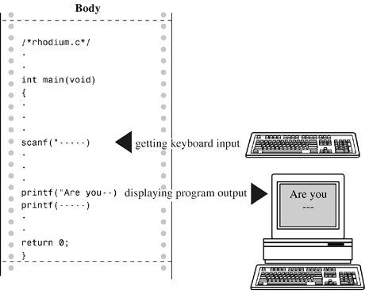
Pure functions and interactive programming
However w/o side effects (interaction with outside world) they are pretty useless.
The interactive approach makes programs more flexible;
inputs
Interactive program
outputs

Slide 7
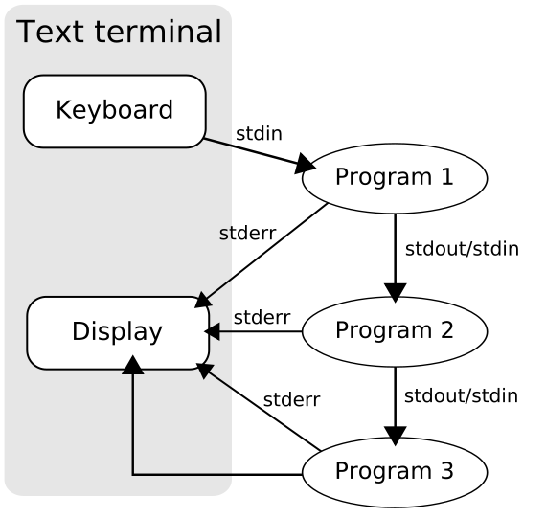
Standard streams
Standard streams are preconnected input and output channels between a computer program and its environment (typically a text terminal) when it begins execution.
  0. standard input (stdin),
  1. standard output (stdout),
  2. standard error (stderr).
File
pipelining:
redirecting:
stdin
ls /usr/local/lib | grep lib | grep "\.a"
ls /usr/local/lib > output.txt
grep main < hello.hs

Slide 8
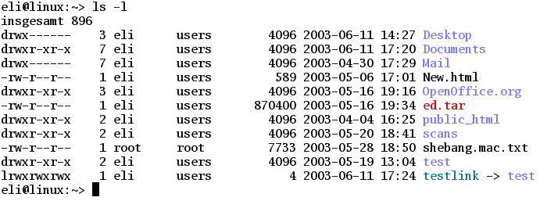
Standard input (stdin)
Standard input is data (often text) going into a program. The program requests data transfers by use of the read operation.
Not all programs require input.
For example, the ls program performs its operation without any stream data input.
List folders and files. No input passed.

Slide 9
Standard output (stdout)
Standard output is the stream where a program writes its output data. The program requests data transfer with the write operation.
Not all programs generate output.
For example
  the file rename command (mv) is silent on success.
  the ls program outputs list of files or folders.
Rename file. Take data from one file and write to another
$ mv file1.txt file2.txt
$

Slide 10
The solution
An interactive program is view as a pure function that takes the current state of the world as its argument, and produces a modified world as its results.
The notion of an interactive program can be represented by a function of type
which is abbreviated as IO.
inputs
Interactive program
outputs
world
modified world
type IO = World -> World

Slide 11
The solution
An interactive program may return a result value in addition to performing side effects.
Expressions of type IO a are called actions.
Example of actions:
  IO Char returns a character
  IO () return the empty tuple ()
Such actions are purely side-effecting that return no results.
type IO a = World -> (a, World)

Slide 12
The solution
Interactive programs may also require argument values, this behavior can already be achieved by exploiting currying.
Example: a program that takes a character and return an integer
Lastly, in reality the type IO a is provided as a primitive in Haskell, rather than being represented as a function type.
Char -> World -> (Int, World)
Char -> IO Int

Slide 13
Basic actions
Reads a character from the keyboard, echoes it to the screen, and returns the character as its result value.
Writes the character c to the screen, and returns no result value, represented by the empty tuple.
Returns the result v without performing any interaction with the user. It provides a bridge from pure expressions without side effects to impure actions with side effects.
getChar :: IO Char
getChar = ...
putChar :: Char -> IO
putChar c = ...
return :: a-> IO a
return v =...

Slide 14
Sequencing
A sequence of IO actions can be combined into a single composite action using the do notation
Each action is the sequence must begin in precisely the same column.
The expression vn <- actionN are called generators
The generator can be abbreviated by _ <- action1 if the result is not requited.
do v1 <- action1
v2 <- action2
.
.
.
vn <- actionN
return (f v1 v2 ... vn)

Slide 15
Sequencing: Example
An action that reads three characters, discards the second, and returns the first and third as a pair.
act :: IO (Char, Char)
act = do
x <- getChar
getChar
y <- getChar
return (x,y)
> act
123('1','3')
input
output

Slide 16
Main function
To turn a module into an executable, an operating system should know what is the starting point the executable.
Main function is usually the place where most side effects happen
main :: IO ()
main :: IO ()
main = do
.
.
.

Slide 17
Main function
Example: echo
Build
Test 1
Test 2: redirect output
main :: IO ()
main = do
x <- getChar
putChar x
main
ghc echo.hs
[1 of 1] Compiling Main ( echo.hs, echo.o )
Linking echo ...
./echo
Hello world!!!
Hello world!!!
^C
open hello.txt
./echo > hello.txt
Hello world!!!
^C

Slide 18
Main function
open echo_test.hs
Test 3: redirect input and output
./echo < echo.hs > echo_test.hs
io: <stdin>: hGetChar: end of file

Slide 19
Derived primitives
Use the tree basic actions and sequencing to define action primitives
getLine' :: IO String
getLine' = do
x <- getChar
if x == '\n' then
return []
else
do xs <- getLine’
return (x:xs)
> getLine
Hello world!!!
"Hello world!!!"

Slide 20
Derived primitives
putStr' :: String -> IO ()
putStr' [] = return ()
putStr' (x:xs) = do
          putChar x
          putStr' xs
>putStr' "Hello world!!!"
Hello world!!!*>
putStrLn' :: String -> IO ()
putStrLn' xs = do
putStr' xs
putChar '\n'
> putStrLn' "Hello world!!!"
Hello world!!!

Slide 21
Derived primitives
Define an action that prompts for a string to be entered from the keyboard, and displays it length:
strlen :: IO()
strlen = do
putStr "Enter a string: "
xs <- getLine
putStr "The string has "
putStr (show (length xs))
putStrLn " characters"
> strlen
Enter a string: Hello world!!!
The string has 14 characters

Slide 22
Reading command line arguments
io.hs
Test
import System.Environment
import Data.List
main = do
  args <- getArgs
  progName <- getProgName
  putStrLn "The arguments are:"
  printStrings args
  putStrLn "The program name is:"
  putStrLn progName
./io arg1 arg2 1 2
The arguments are:
arg1
arg2
1
2
printStrings :: [String] -> IO()
printStrings [] = return ()
printStrings (x:xs) = do
putStrLn x
printStrings xs
ghc io.hs
[1 of 1] Compiling Main ( io.hs, io.o )
Linking io ...

Slide 23
Quiz
Define an action adder :: IO () that reads a given number of integers from the keyboard, one per line, and display their sum. For example
Implement a program adder that reads a given number of integers from the command line, adds them up and prints to the console the sum. For example
> adder
How many number? 5
1
3
5
7
9
The total is 25
./adder 1 2 4
The sum is 7
Notes:
-- Problem 2 solution
import System.Environment
main = do
args <- getArgs
putStr "The sum is "
putStrLn (show (sum (stringsToInts args)))
stringsToInts :: [String] -> [Int]
stringsToInts [] = []
stringsToInts (x:xs) = [read x::Int] ++ stringsToInts xs

