Slide 1
Lecture 6B Hangman and The Game Of Life
COMP 1100

Slide 2
Acknowledgement of Country
I wish to acknowledge the traditional custodians of the land we are meeting on, the Ngunnawal people. I wish to acknowledge and respect their continuing culture and the contribution they make to the life of this city and this region. I would also like to acknowledge and welcome any other Aboriginal and Torres Strait Islander people who are enrolled in our courses.

Slide 3
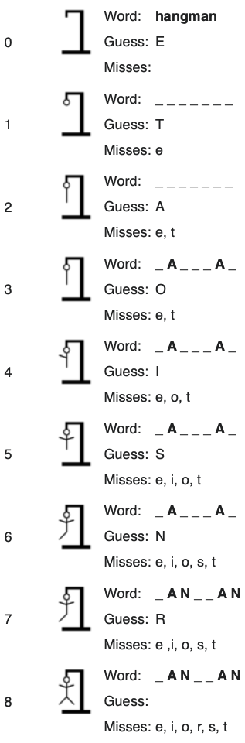
Hangman
One player secretly enters a word.
Another player then tries to deduce the word via a series of guesses.
For each guess, we indicate which letters in the secret word occur in the guess, and the game ends when the guess is correct
The implementation follows a top-down approach
import System.IO
hangman :: IO()
hangman = do
putStrLn "Think of a word:"
word <- sgetLine
putStrLn "Try to guess it:"
play word

Slide 4
Hangman
sgetLine is similar to getLine except that it echoes each character as a dash symbol '-’.
sgetLine :: IO String
sgetLine = do
x <- getCh
if x == '\n' then
do putChar x
return []
else
do putChar '-’
xs <- sgetLine
return (x:xs)

Slide 5
Hangman
The action getCh used in this definition reads a single character from the keyword without echoing it to the screen.
hSetEcho is part of module System.IO.
getCh :: IO Char
getCh = do
hSetEcho stdin False
x <- getChar
hSetEcho stdin True
return x

Slide 6
Hangman
play :: String -> IO ()
play word = do putStr "? "
guess <- getLine
if guess == word then
putStrLn "You got it!!"
else
do putStrLn (match word guess)
play word
match :: String -> String -> String
match xs ys = [if elem x ys then x else '-' | x <-xs]
> hangman
Think of a word:
--------
Try to guess it:
? Sydney
--n-e---
? Cairo
Ca---rra
? Canberra
You got it!!

Slide 7

Cellular automata
A cellular automaton consists of a regular grid of cells, each in one of a finite number of states, such as on and off .
For each cell, a set of cells called its neighborhood is defined relative to the specified cell.
An initial state (time t = 0) is selected by assigning a state for each cell.
A new generation is created (advancing $t$ by 1), according to some fixed rule.
neighbourhood

Slide 8
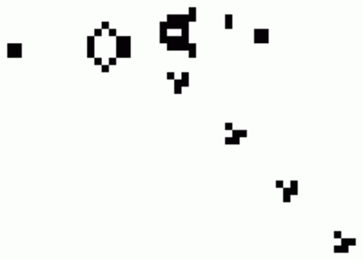
The Game of Life
The Game of Life is an example of a cellular automaton and a zero-player game, designed by John Conway.
John Horton Conway, 82, died of COVID-19.
https://www.youtube.com/watch?v=R9Plq-D1gEk
Conway designed the game to model population dynamics that behaves unpredictably.

Slide 9
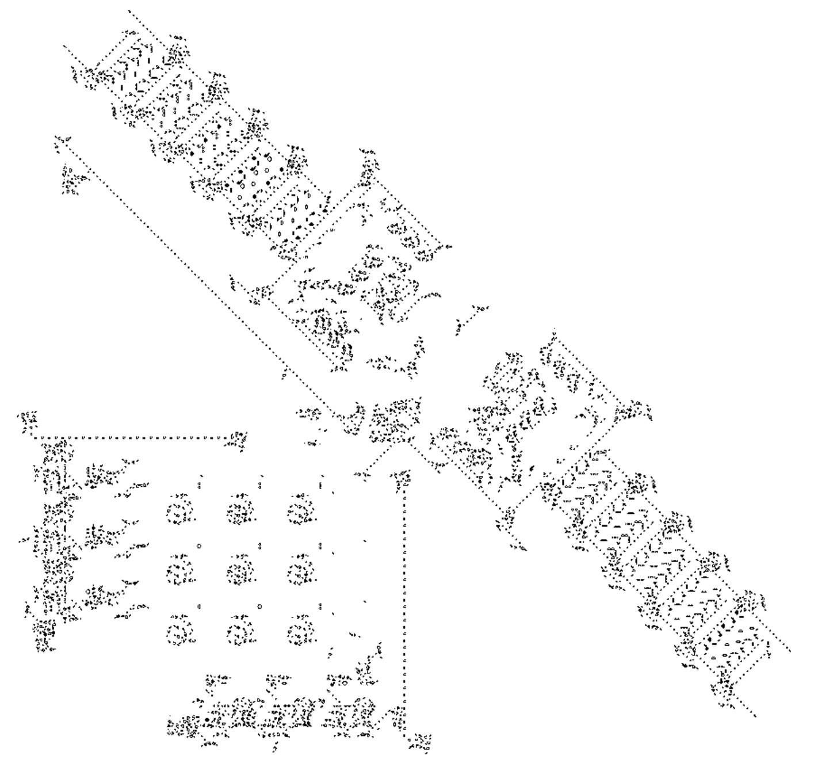
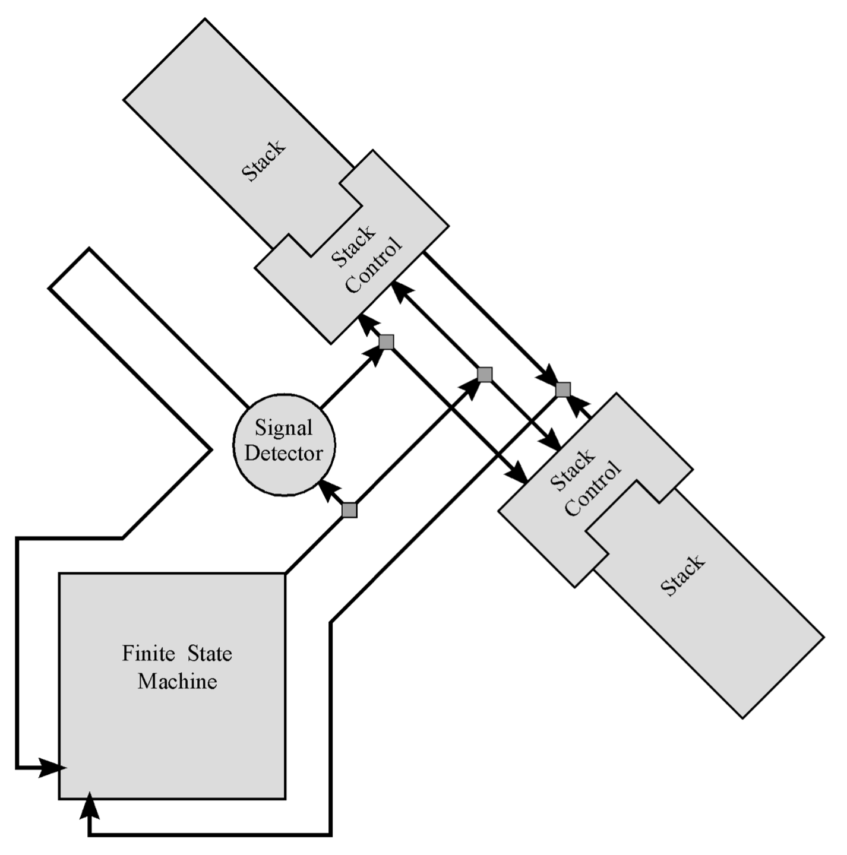
The Game of Life is Turing complete
https://uwe-repository.worktribe.com/output/822575/turing-machine-universality-of-the-game-of-life

Slide 10
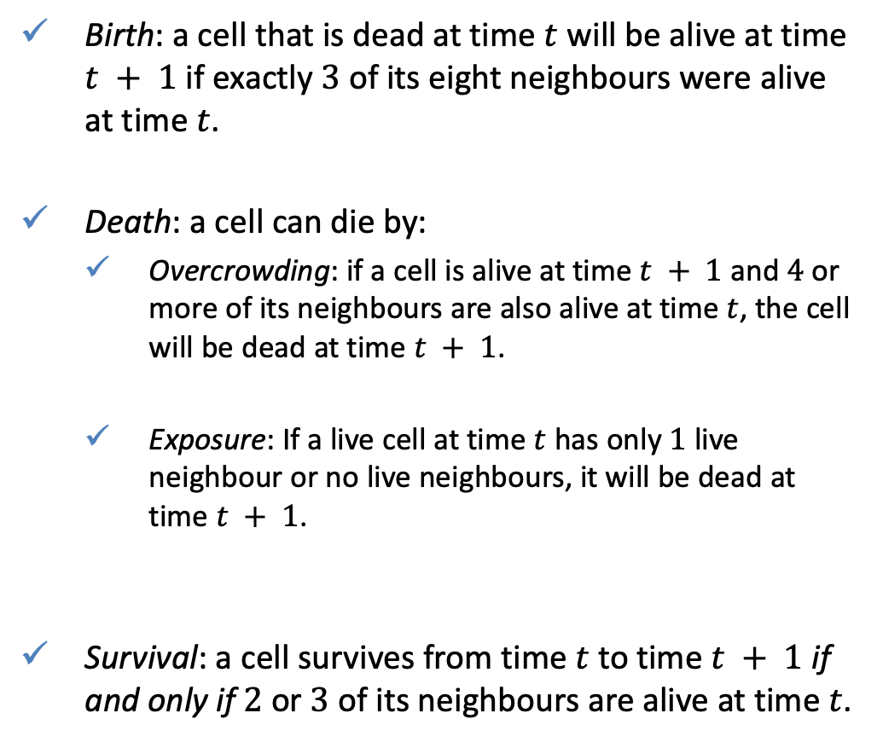
Rule of the game
Birth: a cell that is dead at time $t$ will be alive at time $t + 1$ if exactly $3$ of its eight neighbours were alive at time $t$.
Death: a cell can die by:
Overcrowding: if a cell is alive at time $t + 1$ and $4$ or more of its neighbours are also alive at time $t$, the cell will be dead at time $t + 1$.
Exposure: If a live cell at time $t$ has only $1$ live neighbour or no live neighbours, it will be dead at time $t + 1$.
Survival: a cell survives from time $t$ to time $t + 1$ if and only if $2$ or $3$ of its neighbours are alive at time $t$.

Slide 11

Implementation: Screen utilities
Define an action that clears the screen by displaying the appropriate control characters:
The position of each character on the screen is given by a pair (x,y) of positive integers, with (1,1) being the top-left corner.
cls :: IO()
cls = putStr "\ESC[2J"
(1,1)
(width,1)
type Pos = (Int, Int)
type Board = [Pos]
width :: Int
width = 80
height :: Int
height = 40
(1,height)

Slide 12
Implementation: Screen utilities
Define a function that displays a string at a given position by using control characters to move the cursor to the position
The library function sequence_ :: [IO a] -> IO () performs a list of actions in sequence, discarding their results values and returning not result.
writeat :: Pos -> String -> IO ()
writeat p xs = do putStr xs
goto p
goto :: Pos -> IO ()
goto (x,y) = putStr ("\ESC[" ++ show y ++ ";" ++ show x ++ "H")
showcells :: Board -> IO()
showcells board = sequence_ [writeat p "*" | p <- board]

Slide 13
Implementation : Game of Life
Decide whether the cell is alive (non-empty) or dead (empty)
-- Test if a cell is alive (non-empty)
isAlive :: Board -> Pos -> Bool
isAlive board p = elem p board
-- Test if a cell is empty
isEmpty :: Board -> Pos -> Bool
isEmpty board p = not (isAlive board p)

Slide 14
Implementation : Game of Life
Turn infinite plane (grid) into a closed space
wrap :: Pos -> Pos
wrap (x, y) = (((x - 1) `mod` width) + 1,
((y - 1) `mod` height) + 1)

Slide 15
Implementation : Game of Life
Define a function that returns the neighbors of a position
neighbs :: Pos -> [Pos]
neighbs (x, y) = [wrap (x - 1, y - 1),
wrap (x, y - 1),
wrap (x + 1, y - 1),
wrap (x - 1, y),
wrap (x + 1, y),
wrap (x - 1, y + 1),
wrap (x, y + 1),
wrap (x + 1, y + 1)]
liveneighbs :: Board -> Pos -> Int
liveneighbs board p = length
([alive | alive <- neighbs p, isAlive board alive])
 |  | p

Slide 16

Implementation : Game of Life
Survival: a cell survives from time $t$ to time $t + 1$ if and only if $2$ or $3$ of its neighbours are alive at time $t$.
Birth: a cell that is dead at time $t$ will be alive at time $t + 1$ if exactly $3$ of its eight neighbours were alive at time $t$.
survivors :: Board -> [Pos]
survivors board = [p | p <- board, elem (liveneighbs board p ) [2, 3]]
births :: Board -> [Pos]
births board = [(x,y) | x <- [1..width],
y <- [1..height],
isEmpty board (x,y),
liveneighbs board (x,y) == 3]

Slide 17
Implementation : Game of Life
The next generation of a board can now be produced by appending the list of survivors and the list of new births
Finally a function life kickstarts the game
nextgen :: Board -> Board
nextgen board = survivors board ++ births board
life :: Board -> IO ()
life board = do cls
showcells board
life (nextgen board)

Slide 18
Implementation : Game of Life
glider :: Board
glider = [(4, 2), (2, 3), (4, 3), (3, 4), (4, 4)]
blinker :: Board
blinker = [(2, 2), (2, 3), (2, 4)]
rPent :: Board
rPent = [(11, 12), (11, 13), (12, 11), (12, 12), (13, 12)]
https://www.conwaylife.com/wiki/R-pentomino
To run the game pass an initial patten as an argument
> life glider

Slide 19
QUIZ
Using getCh, define an action readLine :: IO String. That behaves in the same way as getLine, except that it also permits the the delete key to be used to remove characters.
HINT: the delete character is '\DEL', and the control character for moving the cursor back one space is '\b’.
Look up online different initial patterns for the Game of Life and test them

