Slide 1
Lecture 6C
Higher order functions
COMP 1100

Slide 2
Acknowledgement of Country
I wish to acknowledge the traditional custodians of the land we are meeting on, the Ngunnawal people. I wish to acknowledge and respect their continuing culture and the contribution they make to the life of this city and this region. I would also like to acknowledge and welcome any other Aboriginal and Torres Strait Islander people who are enrolled in our courses.

Slide 3
Basic concepts
Software reuse is a major goal of the software industry.
Polymorphic function is one approach to reuse the code.
Pattern of computation is the other
  Transform every element of a list in some way.
  Example: turn every alphabetic character into upper case
  Example: double every number in a list
  Combine the elements of a list using some operator.
  Example: Add together the elements of a numeric list.
To implement such general functions, the transformation (or operator) should be turned into a parameter of the general function.

Slide 4
Basic concepts
Functions with multiple arguments are defined in Haskell using the notation of currying.
It is also permissible to define functions that take functions as arguments
add :: Int -> Int -> Int
add x y = x + y
add :: Int -> (Int -> Int)
add = \x -> (\y -> x + y) -- return lambda function
twice :: (a -> a) -> a -> a
twice f x = f (f x)
> twice (*2) 3
12
> twice reverse [1,2,3]
[1,2,3]

Slide 5
Basic concepts: Partial application
Function could be partially applied with just one argument to build other useful functions.
We will narrow down the definition to only functions that takes other functions as arguments.
quadruple :: Int -> Int
quadruple = twice (*2)
identity :: [a] -> [a]
identity = twice reverse
> quadruple 2
8
> identity [1,2,3]
[1,2,3]
Definition: A function that takes a function as an argument or returns a function as a result is called a higher-order function.

Slide 6
Processing lists: map
Many functions call for all of the elements of a list to be transformed in some way – this we call mapping.
The function map applies a function to all elements of a list, and can be defined using a list comprehension
Input function
Input list
Output list
map :: (a -> b) -> [a] -> [b]
map f xs = [f x | x <- xs]
The output list is made up of elements from the output type of the function
The input list is made up of elements which we can apply the function to

Slide 7
Processing lists: map
More examples
doubleAll :: [Integer] -> [Integer]
doubleAll [] = []
doubleAll (x:xs) = 2*x : doubleAll xs
Using recursion
doubleAll :: [Integer] -> [Integer]
doubleAll xs = [2*x | x <- xs]
Using list comprehensions
doubleAll :: [Integer] -> [Integer]
doubleAll xs = map (*2) xs
Using list comprehensions
> map (+1) [1,3,5,7]
[2,4,6,8]
> map even [1,2,3,4]
[False,True,False,True]
> map reverse ["abc", "def", "ghi"]
["cba","fed","ihg"]

Slide 8
Processing lists: map
Important points:
  It is a polymorphic function that can be applied to lists of any type
  It can be applied to itself to process nested lists.
  The function map can also be defined using recursion
  The original definition using list comprehension is simpler, but this one is preferable for reasoning repurpose (see later lectures)
> map (map (+1)) [[1, 2, 3], [4, 5]]
[[2,3,4],[5,6]]
map (map (+1)) [[1, 2, 3], [4, 5]]
= {applying the outer map}
[map (+1) [1, 2, 3], map (+1) [4,5]]
= {applying the inner maps}
[[2,3,4],[5,6]]
map :: (a -> b) -> [a] -> [b]
map f [] = []
map f (x:xs) = f x : map f xs

Slide 9
Processing lists: filter
Function filter selects all elements of a list that satisfy a predicate, where a predicate (or property) is a function that returns a logical value.
Input function
Input list
Output list
filter :: (a -> Bool) -> [a] -> [b]
filter p xs = [x | x <- xs, p x]
The output list is made up of elements from the input list; this is also the input type of the function
The function is a property: it takes a list element to a Boolean

Slide 10
Processing lists: filter
Examples
> filter even [1..10]
[2,4,6,8,10]
> filter (> 5) [1..10]
[6,7,8,9,10]
> filter (/= ' ') "abc def ghi"
"abcdefghi"

Slide 11
Processing lists: filter
The function filter can be applied to lists of any type, and can be defined using recursion
filter :: (a -> Bool) -> [a] -> [a]
filter p [] = []
filter p (x:xs) | p x = x : filter p xs
| otherwise = filter p xs

Slide 12
Processing lists: map and filter
The functions are often used together, with filter being used to select certain elements from a list, each of which is then transformed using map.
sumsqreven :: [Int] -> Int
sumsqreven ns = sum (map (^2) (filter even ns))
sumsqreven [1,2,3,4,5,6]
56

Slide 13
Processing lists: other functions
Decide if all elements of a list satisfy a predicate:
Decide if any element of a list satisfy a predicate:
Select elements from a list while they satisfy a predicate:
Remove elements from a list while they satisfy a predicate
> all even [2, 4, 6, 8]
True
> any odd [2, 4, 6, 8]
False
> takeWhile even [2, 4, 6, 7, 8]
[2,4,6]
> dropWhile odd [1,3,5,6,7]
[6,7]

Slide 14
Combining zip and map
Recall the polymorphic zip function
What if we want to do something to two corresponding elements other than making a pair of them?
Hence the type of the function is
zip :: [a] -> [b] -> [(a,b)]
> zip [2,3,4] "Frank"
[(2,'F'),(3,'r'),(4,'a')]
zipWith f (x:xs) (y:ys) = f x y : zipWidth f xs ys
zipWith f _ _ = []
zipWith :: (a -> b -> c) -> [a] -> [b] -> [c]

Slide 15
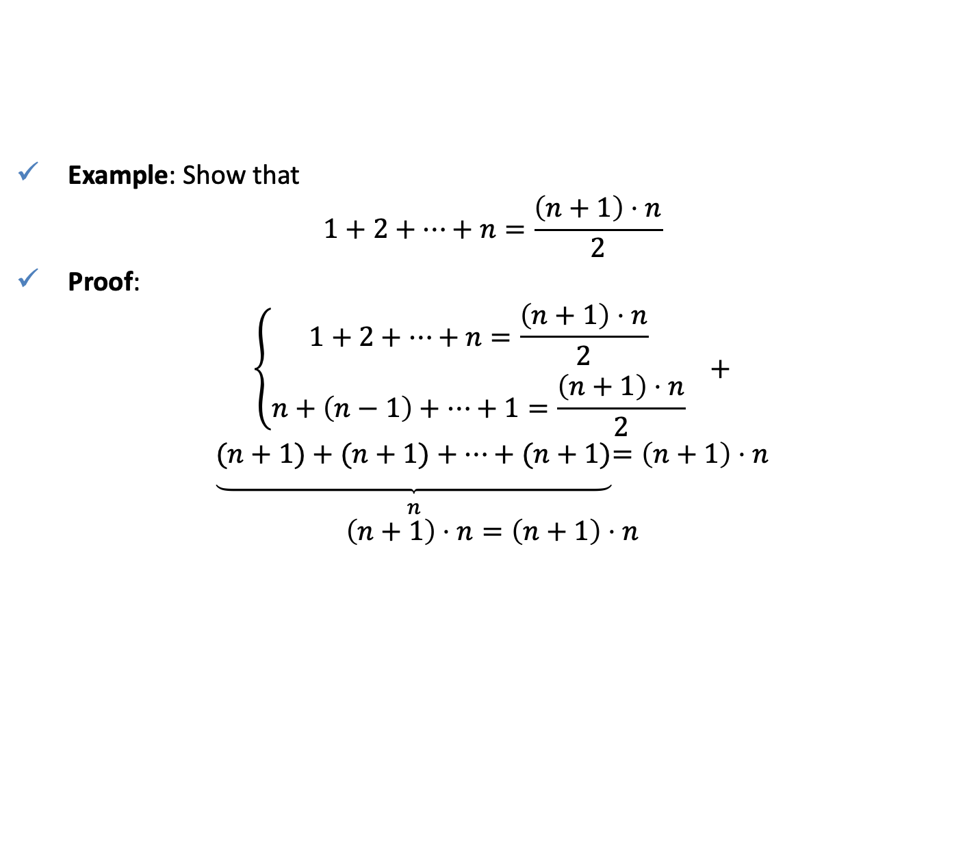
Combining zip and map
Example: Show that
$$1+2+…+n=\frac{\left(n+1\right)⋅n}{2}$$
Proof:
$$\left\{\begin{aligned}1+2+…+n=\frac{\left(n+1\right)⋅n}{2} \\ n+\left(n−1\right)+…+1=\frac{\left(n+1\right)⋅n}{2}\end{aligned} +\right.$$
$$\underset{\begin{aligned} \\ \\ \\ n\end{aligned}}{\underbrace{(n+1)+(n+1)+…+(n+1)}}=\left(n+1\right)⋅n$$
$$\left(n+1\right)⋅n=\left(n+1\right)⋅n$$
Lambda function
Lambda function
> (\n -> sum (zipWith (+) [1..n] [n,9..1])/2) 10 == (\n -> n*(n+1)/2) 10
True

Slide 16
The composition operator
The high-order library operator . Returns the composition of two functions as a single function, and can be defined as follows:
f . g is read as f composed with g.
f . g ≡ f (g x)
Composition can be used to simplify nested function application
Note that composition is associative: f . (g . h) = (f . g) . h
(.) :: (b -> c) -> (a -> b) -> (a -> c)
f . g = \x -> f (g x)
odd n = not (even n)
twice f x = f (f x)
sumsqreven ns = sum (map (^2) (filter even ns))
odd = not . even
twice = f . f
sumsqreven = sum . map (^2) . filter even

Slide 17
The application operator
Haskell allows us to write the application of a function f to an argument g i.e. f (g x) as
f $ g x
$ is defined as follows
There are two reason to use the application operator $ :
  The notation is a little clearer and it is shorter:
  The application operator can be used as a function
($) :: (a -> b) -> (a -> b)
($) = id
sumsqreven :: Integral a => [a] -> a
sumsqreven ns = sum (map (^2) (filter even ns))
sumsqreven :: Integral a => [a] -> a
sumsqreven ns = sum $ map (^2) (filter even ns)
> zipWith ($) [sum, product] [[1,2], [3, 4]]
[3,12]

Slide 18
Application and Composition
Function composition combines two functions
Function application combines a function and an argument (which can be a function).
Example: f has type Integer -> Bool then
  f.x means f composed with the function x; x therefore needs to of type a -> Integer for some type a.
  f x means f applied to the object x, so x must therefore be an integer.
  f $ x also means f applied to the object x, and so x must again be an integer.

Slide 19
QUIZ/The Game of Life
Load life.hs
Modify the function neighbs in such way that it uses map.
Modify the function liveneighbs in such way that it uses filter.
neighbs :: Pos -> [Pos]
neighbs (x, y) = [wrap (x - 1, y - 1),
wrap (x, y - 1),
wrap (x + 1, y - 1),
wrap (x - 1, y),
wrap (x + 1, y),
wrap (x - 1, y + 1),
wrap (x, y + 1),
wrap (x + 1, y + 1)]
liveneighbs :: Board -> Pos -> Int
liveneighbs board p = length ([alive | alive <- neighbs p, isAlive board alive])
Notes:
-- Solution 1
wrap :: Pos -> Pos
wrap (x, y) = (((x - 1) `mod` width) + 1,
((y - 1) `mod` height) + 1)
-- Solution 2
liveneighbs :: Board -> Pos -> Int
-- Use function composition, note there is only one argument has been passed
liveneighbs board = length . filter (isAlive board) . neighbs

