Slide 1
Lecture 7A Higher order functions: PART 2
COMP 1100

Slide 2
Acknowledgement of Country
I wish to acknowledge the traditional custodians of the land we are meeting on, the Ngunnawal people. I wish to acknowledge and respect their continuing culture and the contribution they make to the life of this city and this region. I would also like to acknowledge and welcome any other Aboriginal and Torres Strait Islander people who are enrolled in our courses.

Slide 3
Review
Two approaches to reuse the code
Polymorphic function
Pattern of computation
Transform every element of a list in some way.
Combine (reduce) the elements of a list using some operator:
foldr, foldl
map :: (a -> b) -> [a] -> [b]
map f xs = [f x | x <- xs]
> map (+1) [1,3,5,7]
[2,4,6,8]
filter :: (a -> Bool) -> [a] -> [b]
filter p xs = [x | x <- xs, p x]
> filter even [1..10]
[2,4,6,8,10]

Slide 4
map-reduce
MapReduce is a programming model and an associated implementation for processing and generating big data sets with a parallel, distributed algorithm on a cluster of computational nodes.
A MapReduce program is composed of a map function that performs filtering and sorting
reduce or fold functions perform a summary operation

Slide 5
The foldr function
Many functions that take a list as their argument can be defined using the following simple pattern of recursion on lists.
# is binary operator applied to the head of the list and the result recursively processing the tail.
Examples
f [] = v
f (x:xs) = x # f xs
sum [] = 0
sum (x:xs) = x + sum xs
product [] = 1
product (x:xs) = x * product xs
or [] = False
or (x: xs) = x || or xs
and [] = True
and (x:xs) = x && and xs
> and [True, False, True, True]
False

Slide 6
The foldr function
The higher-order library function foldr (abbreviating fold right) encapsulates this pattern of recursion for defining functions on lists, with the operator # and the value v as arguments.
The definitions could also include explicit list arguments, as in
sum :: Num a => [a] -> a
sum = foldr (+) 0
product :: Num a => [a] -> a
product = foldr (*) 1
or :: [Bool] -> Bool
or = foldr (||) False
and :: [Bool] -> Bool
and = foldr (&&) True
Implicit arguments
sum xs = foldr (+) 0 xs

Slide 7
The foldr function
The foldr function itself can be defined using recursion:
Any non-empty list is mapped by f taking the head of the list recursively until the tail is reached.
It is best to think of the behavior in a non-recursive manner, as simply replacing each cons operator in a list by the function and the empty list at the end by the value v.
foldr :: (a -> b -> b) -> b -> [a] -> b
foldr f v [] = v
foldr f v (x:xs) = f x (foldr f v xs)

Slide 8
The foldr function
Example: Applying foldr (+) 0 to
foldr can be used to define many more functions that might be expected.
foldr (+) 0
:
+
1 : (2 : (3 : []))
gives 1 + (2 + (3 + 0))
1
:
1
+
2
:
2
+
3
[]
3
0
length :: [a] -> Int
length [] = 0
length (_:xs) = 1 + length xs
1 : (2 : (3 : []))
gives 1 + (1 + (1 + 0))
foldr (\_ n -> 1 + n) 0
:
+
1
:
1
+
length :: [a] -> Int
length = foldr (\_ n -> 1 + n) 0
2
:
1
+
3
[]
1
0

Slide 9
The foldr function
Define the reverse function using explicit recursion
Applying reverse to the list
Define a function that adds a new element at the end of a list
reverse :: [a] -> [a]
reverse [] = []
reverse (x:xs) = reverse xs ++ [x]
1 : (2 : (3 : []))
gives (([] + [3]) ++ [2]) ++ [1]
snoc :: a -> [a] -> [a]
snoc x xs = xs ++ [x]
> snoc 4 [1,2,3]
[1,2,3,4]
where s is snoc
foldr snoc [] [1,2,3]
reverse :: [a] -> [a]
reverse xs = foldr snoc [] xs
:
s
=[3,2,1]
1
:
1
s
=[3,2]
2
:
2
s
=[3]
3
[]
3
[]

Slide 10
The foldr function
The name fold right reflects the use of an operator that is assumed to associate to the right.
Evaluating foldr (+) 0 [1,2,3] gives the result 1 + (2 + (3 + 0)) assuming the addition is associative to the right.
It is best to think of the behavior of foldr in a non-recursive manner
foldr (#) v [x0, x1,...,xn] = x0 # (x1 # (... (xn # v)... ))
foldr (#) v
:
#
=v
x0
:
x0
#
=v
...
:
...
#
=v
xn
[]
xn
v

Slide 11
The foldr function
Note the type signature
Since f is of type (a -> b -> b) another whole cohort of list functions can be defined
Example: Insertion sort
List of values of type a to be combined
Binary operation over type b
Starting value of type b
foldr :: (a -> b -> b) -> b -> [a] -> b
foldr f v [] = v
foldr f v (x:xs) = f x (foldr f v xs)
Result of type b
iSort :: Ord a => [a] -> [a]
iSort = foldr insert []
insert :: Ord a => a -> [a] -> [a]
insert x [] = [x]
insert x (y:ys)
| x <= y = x : y : ys
| otherwise = y : insert x ys
> iSort [4,3,1,6,4,8]
[1,3,4,4,6,8]

Slide 12
The foldl function
It is also possible to define recursive functions on lists using an operator that is assumed to associate to the left.
sum :: Num a => [a] -> a
sum = sum' 0
where
sum' v [] = v
sum' v (x:xs) = sum’ (v + x) xs
sum :: Num a => [a] -> a
sum xs = sum' 0 xs
where
sum' v [] = v
sum' v (x:xs) = sum’ (v + x) xs
sum [1, 2, 3]
= {applying sum}
sum' 0 [1,2,3]
= {applying sum'}
sum' (0 + 1) [2,3]
= {applying sum’}
sum' ((0 + 1) + 2) [3]
= {applying sum’}
sum' (((0 + 1) + 2) + 3) []
= {applying sum’}
(((0 + 1) + 2) + 3)
= {applying +}
6

Slide 13
The foldl function
Many functions on lists can be defined using the following simple pattern of recursion
The higher-order library function foldl encapsulates this pattern of recursion, with the operator # and the accumulator v as arguments.
QUIZ:
Implement the function product using foldl.
Implement the function or using foldl.
Implement the function and using foldl.
compare to the previous implementation
f v [] = v
f v (x:xs) = f (v # x) xs
f [] = v
f (x:xs) = x # f xs
sum :: Num a => [a] -> a
sum = foldl (+) 0
foldl (+) 0 [1, 2, 3]
:
v
+
:
v
+
1
3
2
:
v
+
2
v=
3
[]
0
1

Slide 14

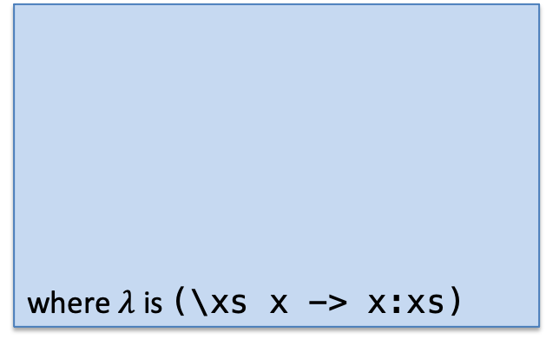





The foldl function
Example:
!When a function can be defined using both foldr and foldl, as in the above examples, the choice of which definition is preferable is usually made on grounds of efficiency and requires careful consideration!
length :: [a] -> Int
length = foldl (\n _ -> n + 1) 0
reverse :: [a] -> [a]
reverse = foldl (\xs x -> x:xs) []
where $λ$ is ($\text{\backslash }\text{xs} \text{x}\text{ −> }\text{x}\text{:}\text{xs}$)
foldl ($\text{\backslash }\text{xs} \text{x}\text{ −> }\text{x}\text{:}\text{xs}$)[] [1, 2, 3]
$$:$$
v= [3,2,1]
$$λ$$
1
$$:$$
v= [2,1]
$$λ$$
3
2
$$:$$
v= [1]
$$λ$$
2
3
[]
v=
[]
1

Slide 15
The foldl function
The function can be defined using recursion
It is best to think of the behavior of foldl in a non-recursive manner
foldl :: (a -> b -> a) -> a -> [b] -> a
foldl f v [] = v
foldl f v (x:xs) = foldl f (f v x) xs
foldl (#) v [x0, x1, ..., xn] = (... ((v # x0) # x1) ...) # xn
foldl (#) v
:
v=
#
x0
:
v=
#
xn
...
:
v=
#
...
xn
[]
v
x0

Slide 16


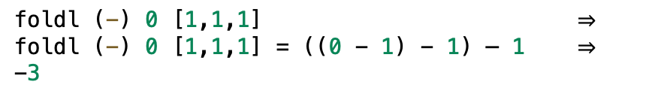
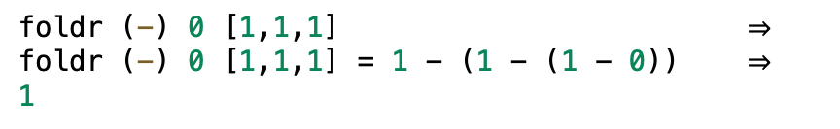
foldl vs foldr
foldl (#) v [x0, x1,...,xn] = (... ((v # x0) # x1) ...) # xn
foldr (#) v [x0, x1,...,xn] = x0 # (x1 # (... (xn # v)... ))
The functions foldl and foldr produce the same result if are applied to an associative, commutative operation.
Example: Since addition is commutative and associative we have
Example: Since subtraction is not commutative we have
foldl (+) 0 [1,1,1] $⇒$
3
> foldr (+) 0 [1,1,1] $⇒$
3
foldl (-) 0 [1,1,1] $⇒$
foldl (-) 0 [1,1,1] = ((0 - 1) - 1) – 1 $⇒$
-3
foldr (-) 0 [1,1,1] $⇒$
foldr (-) 0 [1,1,1] = 1 - (1 - (1 - 0)) $⇒$
1

