Slide 1
Lecture 7B: PART 3 Higher order functions
COMP 1100

Slide 2
Acknowledgement of Country
I wish to acknowledge the traditional custodians of the land we are meeting on, the Ngunnawal people. I wish to acknowledge and respect their continuing culture and the contribution they make to the life of this city and this region. I would also like to acknowledge and welcome any other Aboriginal and Torres Strait Islander people who are enrolled in our courses.

Slide 3
Binary string transmitter (BST)
The system consist of
an encoder
a channel
a decoder
A string of characters encoded as list of bits, represented by eight-bit binary numbers, concatenated and transmitted, that then decoded.
“abc”
encoder
[1,0,0,0,0,1,1,0,0,1,0,0,0,1,1,0,1,1,0,0,0,1,1,0]
decoder
“abc”
channel

Slide 4

BST : Base conversion
Example: the decimal number $2345$ can be understood as
$$2345=\left({10}^{3}⋅2\right)+\left({10}^{2}⋅3\right)+\left({10}^{1}⋅2\right)+\left({10}^{0}⋅5\right)$$
Example: the binary number $1101$ can be understood as
$$1101=\left(2^{3}⋅1\right)+\left(2^{2}⋅1\right)+\left(2^{1}⋅1\right)+\left(2^{0}⋅1\right)$$
To simplify the definition, we assume that binary numbers are written in reverse order.
$$1101=\left(2^{0}⋅1\right)+\left(2^{1}⋅0\right)+\left(2^{2}⋅1\right)+\left(2^{3}⋅1\right)$$

Slide 5
BST : Base conversion: bin2int
import Data.Char
type Bit = Int
bin2int :: [Bit] -> Int
bin2int bits = sum [w * b | (w, b) <- zip weights bits]
where weights = iterate (*2) 1
The higher order function iterate produces an infinite list by applying a function an increasing number of times to a value
iterate f x = [x, f x, f (f x), f (f (f x)),...]
> bin2int [1,0,1,1]
13

Slide 6
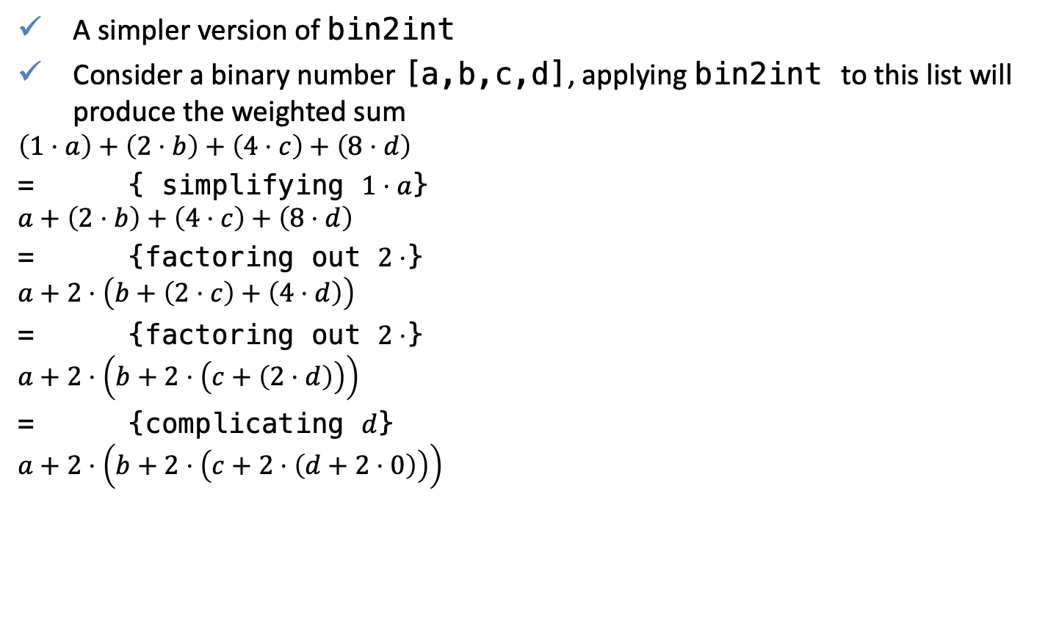
BST : Base conversion: bin2int
A simpler version of bin2int
Consider a binary number [a,b,c,d], applying bin2int to this list will produce the weighted sum
$$\left(1⋅a\right)+\left(2⋅b\right)+\left(4⋅c\right)+\left(8⋅d\right)$$
= { simplifying $1⋅a$}
$$a+\left(2⋅b\right)+\left(4⋅c\right)+\left(8⋅d\right)$$
= {factoring out $2⋅$}
$$a+2⋅\left(b+\left(2⋅c\right)+\left(4⋅d\right)\right)$$
= {factoring out $2⋅$}
$$a+2⋅\left(b+2⋅\left(c+\left(2⋅d\right)\right)\right)$$
= {complicating $d$}
$$a+2⋅\left(b+2⋅\left(c+2⋅\left(d+2⋅0\right)\right)\right)$$

Slide 7
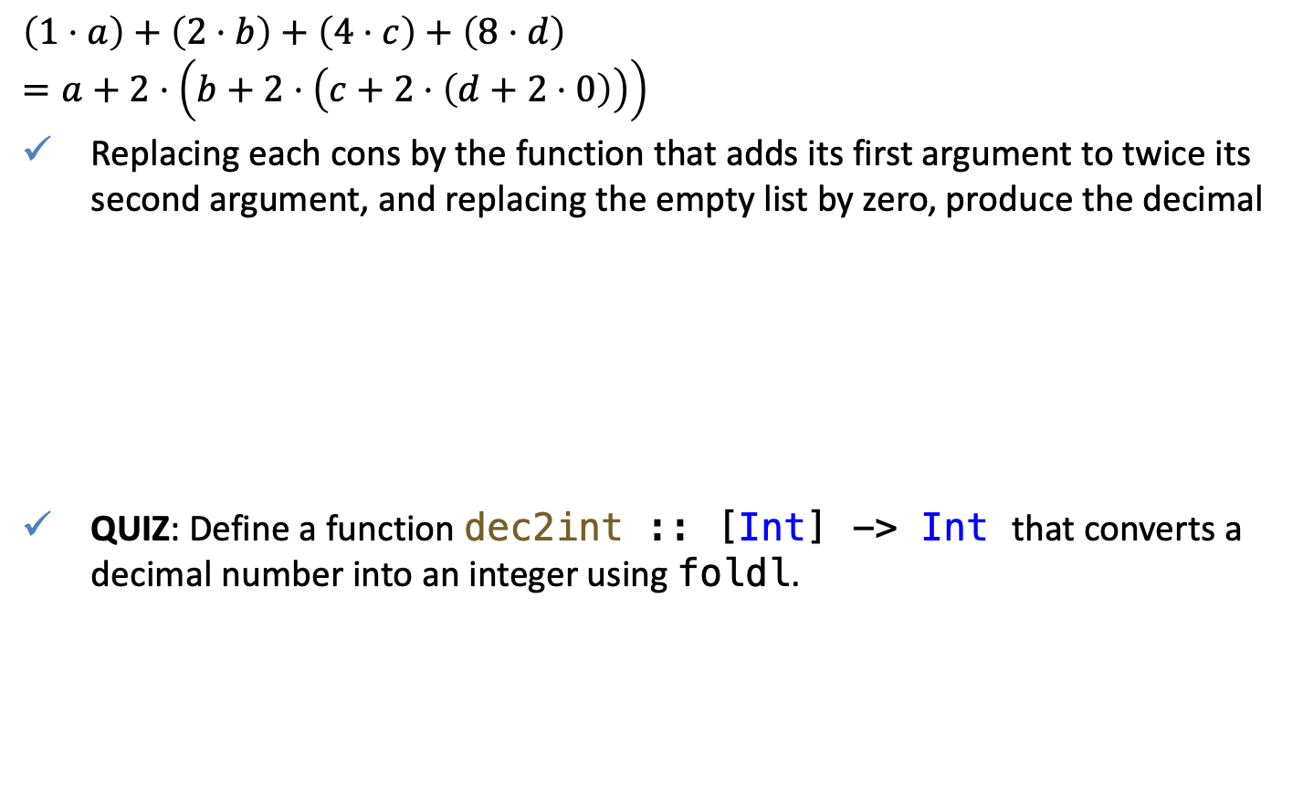
BST : Base conversion: bin2int
$$\left(1⋅a\right)+\left(2⋅b\right)+\left(4⋅c\right)+\left(8⋅d\right)$$
$$=a+2⋅\left(b+2⋅\left(c+2⋅\left(d+2⋅0\right)\right)\right)$$
Replacing each cons by the function that adds its first argument to twice its second argument, and replacing the empty list by zero, produce the decimal
QUIZ: Define a function dec2int :: [Int] -> Int that converts a decimal number into an integer using foldl.
bin2int :: [Bit] -> Int
bin2int = foldl (\x y -> x + 2*y) 0
Notes:
dec2int :: [Bit] -> Int
dec2int = foldl (\x y -> 10*x + y) 0

Slide 8
BST : Base conversion: int2bin
The opposite conversion can be achieved by repeatedly diving the integer by two and taking the remainder, until the integer become zero:
The sequence of remainder, 1011, provides the binary representation of the intger 13.
QUIZ: Define a function int2oct :: Int -> [Int] that converts a decimal number into an integer in the octal numeral system.
13 | divided by | 2 | = | 6 | remainder | 1
6 | divided by | 2 | = | 3 | remainder | 0
3 | divided by | 2 | = | 1 | remainder | 1
1 | divided by | 2 | = | 0 | remainder | 1
int2bin :: Int -> [Bit]
int2bin 0 = []
int2bin n = n `mod` 2 : int2bin (n `div` 2)
> int2bin 13
[1,0,1,1]
Notes:
int2oct :: Int -> [Int]
int2oct 0 = []
int2oct n = n `mod` 8 : int2oct (n `div` 8)

Slide 9
BST : Base conversion: make8
It is important to insure, that all binary numbers are of equal length (say 8 bits).
The library function repeat :: a -> [a] produces an infinite list of copies of a value.
make8 :: [Bit] -> [Bit]
make8 bits = take 8 (bits ++ repeat 0)
> make8 [1,0,1,1]
[1,0,1,1,0,0,0,0]

Slide 10
BST : Transmission
“abc”
encoder
[1,0,0,0,0,1,1,0,0,1,0,0,0,1,1,0,1,1,0,0,0,1,1,0]
decoder
“abc”
channel
encode :: String -> [Bit]
encode = concat . map (make8 . int2bin . ord)
encode "abc"
[1,0,0,0,0,1,1,0,0,1,0,0,0,1,1,0,1,1,0,0,0,1,1,0]
To decode a list of bits produced using encode, define a function chop8.
chop8 :: [Bit] -> [[Bit]]
chop8 [] = []
chop8 bits = take 8 bits : chop8 (drop 8 bits)
decode :: [Bit] -> String
decode = map (chr . bin2int) . chop8
> decode [1,0,0,0,0,1,1,0,0,1,0,0,0,1,1,0,1,1,0,0,0,1,1,0]
"abc"

Slide 11
BST : Transmission
“abc”
encoder
[1,0,0,0,0,1,1,0,0,1,0,0,0,1,1,0,1,1,0,0,0,1,1,0]
decoder
“abc”
channel
A function transmit simulate the transmission of a string of characters as a list of bits, using perfect communication channel
transmit :: String -> String
transmit = decode . channel . encode
channel :: [Bit] -> [Bit]
channel = id
> transmit "Hello world!"
"Hello world!"

Slide 12
QUIZ
Problem 1a. Modify the binary string transmitter to detect simple transmission errors using the concept of parity bits. That is, each eight-bit binary number produced during encoding is extended with a parity bit, set 1 if the number contains an odd number of 1s, and to 0 otherwise.
For 8-bit numbers, the 9th bit is checked that the parity is correct. Use the library function error error :: String -> a to display the given string as an error message and terminate the program. The polymorphic result type ensure that error can be used in any context.
Problem 1b. Test your new string transmitter using a faulty communication channel that forgets the first bit, which can be modelled using the tail function on list of its.
message |  |  |  | parity bit
1 | 0 | 1 | 1 | 1
0 | 0 | 1 | 1 | 0
0 | 1 | 0 | 1 | 0

Slide 13
Voting algorithms: First past the post
Voters cast their vote for a candidate of their choice, and the candidate who receives the most votes wins.
Example:
Define a function that counts the number of times that a given value occurs in a list, for any type whose values can be compared for equality.
votes :: [String]
votes = ["Red", "Blue", "Green", "Blue", "Blue", "Red"]
3
2
1
"Green"
"Blue"
"Red"
count :: Eq a => a -> [a] -> Int
count x = length . filter (== x)
> count "Red" votes
2

Slide 14
Voting algorithms: First past the post
The higher-order function filter can be used to remove duplicate value for a list
Combining count and rmdups and using list comprehension define a function that returns a first-past-the-post election
The sorting function sort :: Ord a => [a] -> [a] is provided in import Data.List.
rmdups :: Eq a => [a] -> [a]
rmdups [] = []
rmdups (x:xs) = x : filter (/= x) (rmdups xs)
hist :: Ord a => [a] -> [(a, Int)]
hist vs = sort [(v, count v vs) | v <- (rmdups vs)]
> hist votes
[("Green",1),("Red",2),("Blue",3)]
Notes:
result :: Ord a => [a] -> [(Int, a)]
result vs = sort [(count v vs, v) | v <- rmdups vs]

Slide 15
Voting algorithms: First past the post
Finally, the winner of an election can now be obtained simply by selecting the second component of the last result
Using function composition
Using function application
winner :: Ord a => [a] -> a
winner = snd . last . result
winner :: Ord a => [a] -> a
winner vs = snd $ last $ result vs
> winner votes
"Blue"

Slide 16
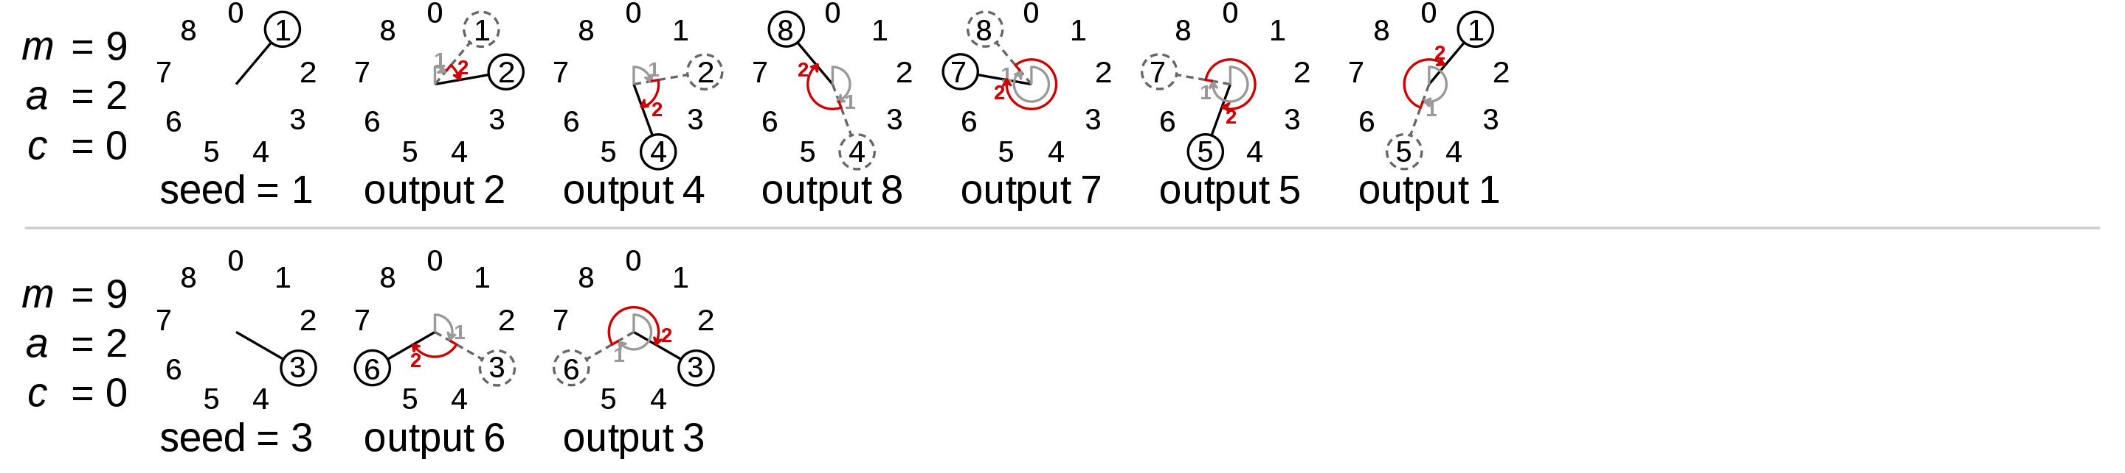


Random numbers generator
A random number generator (RNG) is a computational or physical device designed to generate a sequence of numbers or symbols that lack any pattern, i.e. appear random.
A linear congruential generator (LCG) is an algorithm that yields a sequence of pseudo-randomized numbers calculated with a discontinuous piecewise linear equation.
The generator is defined by recurrence relation
$X_{n+1}=\left(aX_{n}+c\right)\operatorname{mod}{m}$
$m, 0<m$ – the modulus
$a, 0<a<m$ – the “multiplier”
$c,$ $0≤c<m$ – the “increment”
$X_{0}, 0≤X_{0}<m$ – the “seed” of “state”
https://en.wikipedia.org/wiki/Linear_congruential_generator

Slide 17


Random numbers generator
The generator is defined by recurrence relation
$X_{n+1}=\left(aX_{n}+c\right)\operatorname{mod}{m}$
$m, 0<m$ – the modulus
$a, 0<a<m$ – the “multiplier”
$c,$ $0≤c<m$ – the “increment”
$X_{0}, 0≤X_{0}<m$ – the “seed” of “state”
rand :: Integer -> Integer -> [Integer]
rand n x_prev = case n of
0 -> [a * x_prev + c]
_ -> ((a * head x_next + c) `mod` m):x_next
where
x_next = rand (n - 1) x_prev
a = 25214903917::Integer
c = 11::Integer
m = (2^48)::Integer
> rand 5 0
[25707281917278,102626409374399,49720483695876,11718085204285,277363943098,11]
> map (\x -> x `mod` 2) (rand 10 2)
[1,0,1,0,1,0,1,0,1,0,1]

Slide 18
Java's java.util.Random
-- Java's java.util.Random
rand :: Integer -> Integer -> [Integer]
rand n x_prev = case n of
0 -> [output a * x_prev + c]
_ -> (output (a * head x_next + c) `mod` m):x_next
where
x_next = rand (n - 1) x_prev
output val = toInteger (shift val (-16))
a = 25214903917 ::Integer
c = 11 ::Integer
m = (2^48)::Integer
https://en.wikipedia.org/wiki/Linear_congruential_generator
> map (\x -> x `mod` 2) (rand 10 2)
[1,0,1,0,0,1,0,1,1,1,1]

Slide 19
Example: Rolling dice
Roll two dice 60 times each (note that different seeds values are used for every die)
Compute the histograms: We expect on average to have 10 rolls per each outcome
Sum the outcomes of two dice in each of 60 trials
Compute the histogram
> die1 = map (\x -> x `mod` 6 + 1) (rand 60 3)
> die1
[3,1,1,4,5,5,1,3,5,6,5,6,5,1,2,3,3,2,4,5,6,3,1,2,5,6,4,3,2,3,2,5,1,6,6,3,3,2,3,4,1,5,2,1,1,3,5,5,1,3,1,5,3,4,2,2,4,6,4,6,6]
> die2 = map (\x -> x `mod` 6 + 1) (rand 60 5)
> die2
[4,4,6,6,2,1,5,5,3,6,1,6,4,6,1,4,1,1,6,3,2,1,1,5,1,2,4,1,4,5,3,5,5,5,3,4,3,3,4,5,3,5,3,2,6,1,6,1,5,3,2,2,5,3,2,2,1,4,4,4,2]
> hist die1
[(1,11),(2,9),(3,13),(4,7),(5,12),(6,9)]
> hist die2
[(1,12),(2,9),(3,10),(4,11),(5,11),(6,8)]
> [d1 + d2 | (d1, d2)<- zip die1 die2]
[7,5,7,10,7,6,6,8,8,12,6,12,9,7,3,7,4,3,10,8,8,4,2,7,6,8,8,4,6,8,5,10,6,11,9,7,6,5,7,9,4,10,5,3,7,4,11,6,6,6,3,7,8,7,4,4,5,10,8,10,8]
> hist [d1 + d2 | (d1, d2)<- zip die1 die2]
[(2,1),(3,4),(4,7),(5,5),(6,10),(7,11),(8,10),(9,3),(10,6),(11,2),(12,2)]

Slide 20
QUIZ
Problem 1. Without looking at the definitions from the standard prelude, define the higher-order library function curry that convers a function on pairs into a curried function, and, conversely, the function uncurry that convers a curried function with two arguments into a function on pairs. HINT: first write down the types of the two functions.

