Slide 1
Lecture 7C Cabal and Testing
COMP 1100

Slide 2
Acknowledgement of Country
I wish to acknowledge the traditional custodians of the land we are meeting on, the Ngunnawal people. I wish to acknowledge and respect their continuing culture and the contribution they make to the life of this city and this region. I would also like to acknowledge and welcome any other Aboriginal and Torres Strait Islander people who are enrolled in our courses.

Slide 3
Package system
Cabal is the standard package system for Haskell software. It helps people to configure, build and install Haskell software and to distribute it easily to other users and developers.
Stack is a cross-platform build tool for Haskell that handles management of the toolchain, building and registering libraries, and more.

Slide 4
Cabal: Creating a new application
creating a palindrome-testing directory to hold the project files
initialize the package
$ mkdir palindrome-testing
$ cd palindrome-testing
$ cabal init -p palindrome-testing
Guessing dependencies...
Generating LICENSE...
Warning: unknown license type, you must put a copy in LICENSE yourself.
Generating Setup.hs...
Generating CHANGELOG.md...
Generating Main.hs...
Generating palindrome-testing.cabal...
Warning: no synopsis given. You should edit the .cabal file and add one.
You may want to edit the .cabal file and add a Description field.

Slide 5
Cabal: Creating a new application
Project files
CHANGELOG.md
Main.hs
Setup.hs
palindrome-testing.cabal
Revision history
Package’s code
The low-level Cabal interface
Project settings
Main.hs
module Main where
main :: IO ()
main = putStrLn "Hello, Haskell!"

Slide 6
Cabal: Running the application
build a target
run the executable
$ cabal build
Build profile: -w ghc-8.6.5 -O1
In order, the following will be built (use -v for more details):
- palindrome-testing-0.1.0.0 (exe:palindrome-testing) (configuration changed)
Configuring executable 'palindrome-testing' for palindrome-testing-0.1.0.0..
Warning: The 'license-file' field refers to the file 'LICENSE' which does not
exist.
Preprocessing executable 'palindrome-testing' for palindrome-testing-0.1.0.0..
Building executable 'palindrome-testing' for palindrome-testing-0.1.0.0..
[1 of 1] Compiling Main
$ cabal run
Up to date
Hello, Haskell!

Slide 7
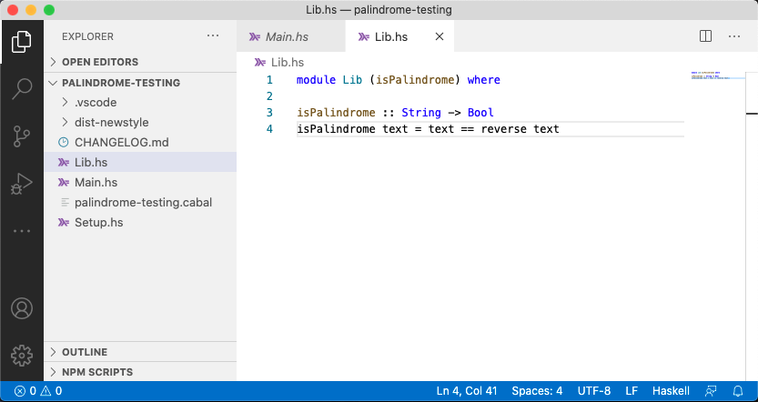
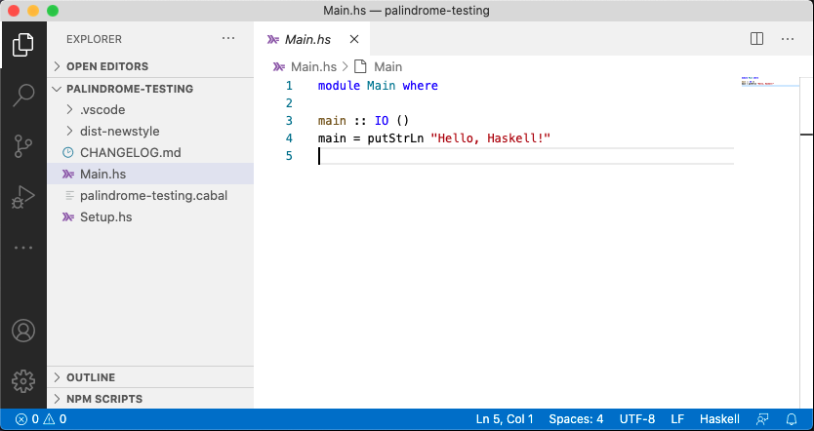
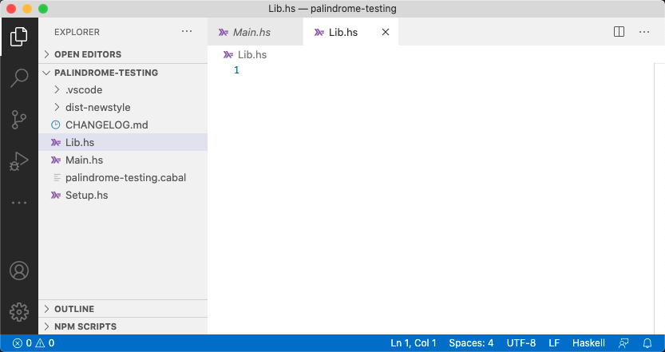
Cabal: Creating a Library
Open a folder with the cabal project in VSCode: File -> Open
Create a file Lib.hs, that will contain the module
Populate it with the code
Notes:
module Lib (isPalindrome) where
isPalindrome :: String -> Bool
isPalindrome text = text == reverse text

Slide 8
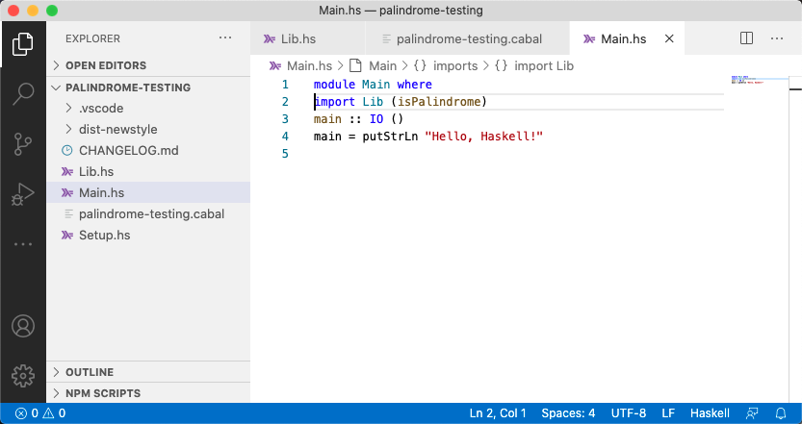
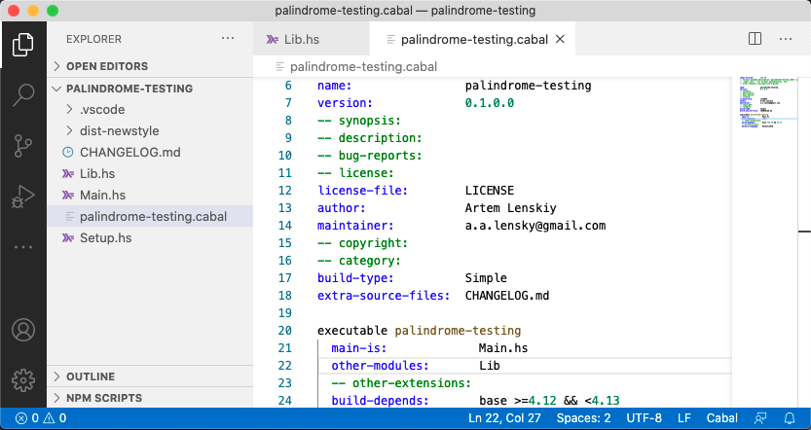
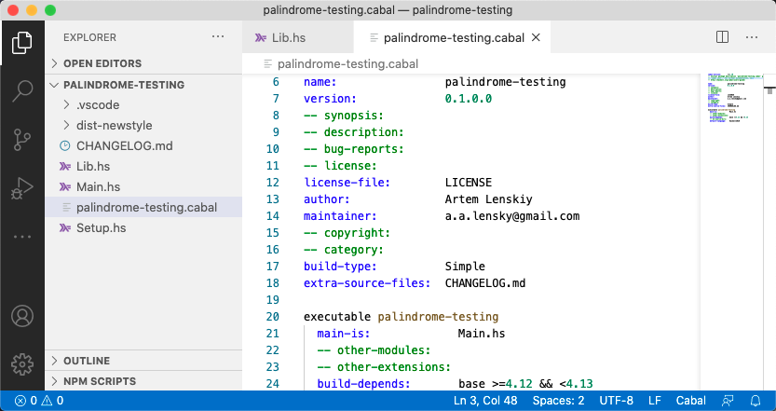
Cabal: Creating a Library
Update the settings file:
Import module Lib to Main.hs

Slide 9
Cabal: repl
To load all of the modules of the target into GHCi as interpreted bytecode use
cabal repl
Build profile: -w ghc-8.6.5 -O1
In order, the following will be built (use -v for more details):
- palindrome-testing-0.1.0.0 (exe:palindrome-testing) (configuration changed)
Configuring executable 'palindrome-testing' for palindrome-testing-0.1.0.0..
Warning: The 'license-file' field refers to the file 'LICENSE' which does not
exist.
Preprocessing executable 'palindrome-testing' for palindrome-testing-0.1.0.0..
GHCi, version 8.6.5: http://www.haskell.org/ghc/ :? for help
[1 of 2] Compiling Lib ( Lib.hs, interpreted )
[2 of 2] Compiling Main ( Main.hs, interpreted )
Ok, two modules loaded.
*Main>
*Main> isPalindrome "Hello"
False
*Main> isPalindrome "HallaH"
True

Slide 10
Program testing
Haskell as a compiler checks for
syntax errors (detects all of them)
some of the semantic errors
Most of logical errors cannot be detected, they are detected only when the program is executed.
Program testing helps
Saving debugging time, the tests helps finding bugs
Thinking about your code. To write tests a good understanding of functions is required.
Keeping your code modular i.e. split a function into smaller/simpler functions.
Writing documentation

Slide 11
Program testing
Types of program tests
Regression tests: code change has not adversely affected existing features
Performance tests: speed, response time, stability, reliability, scalability
Stress tests: determines the robustness of software by testing beyond the limits of normal operation.

Slide 12
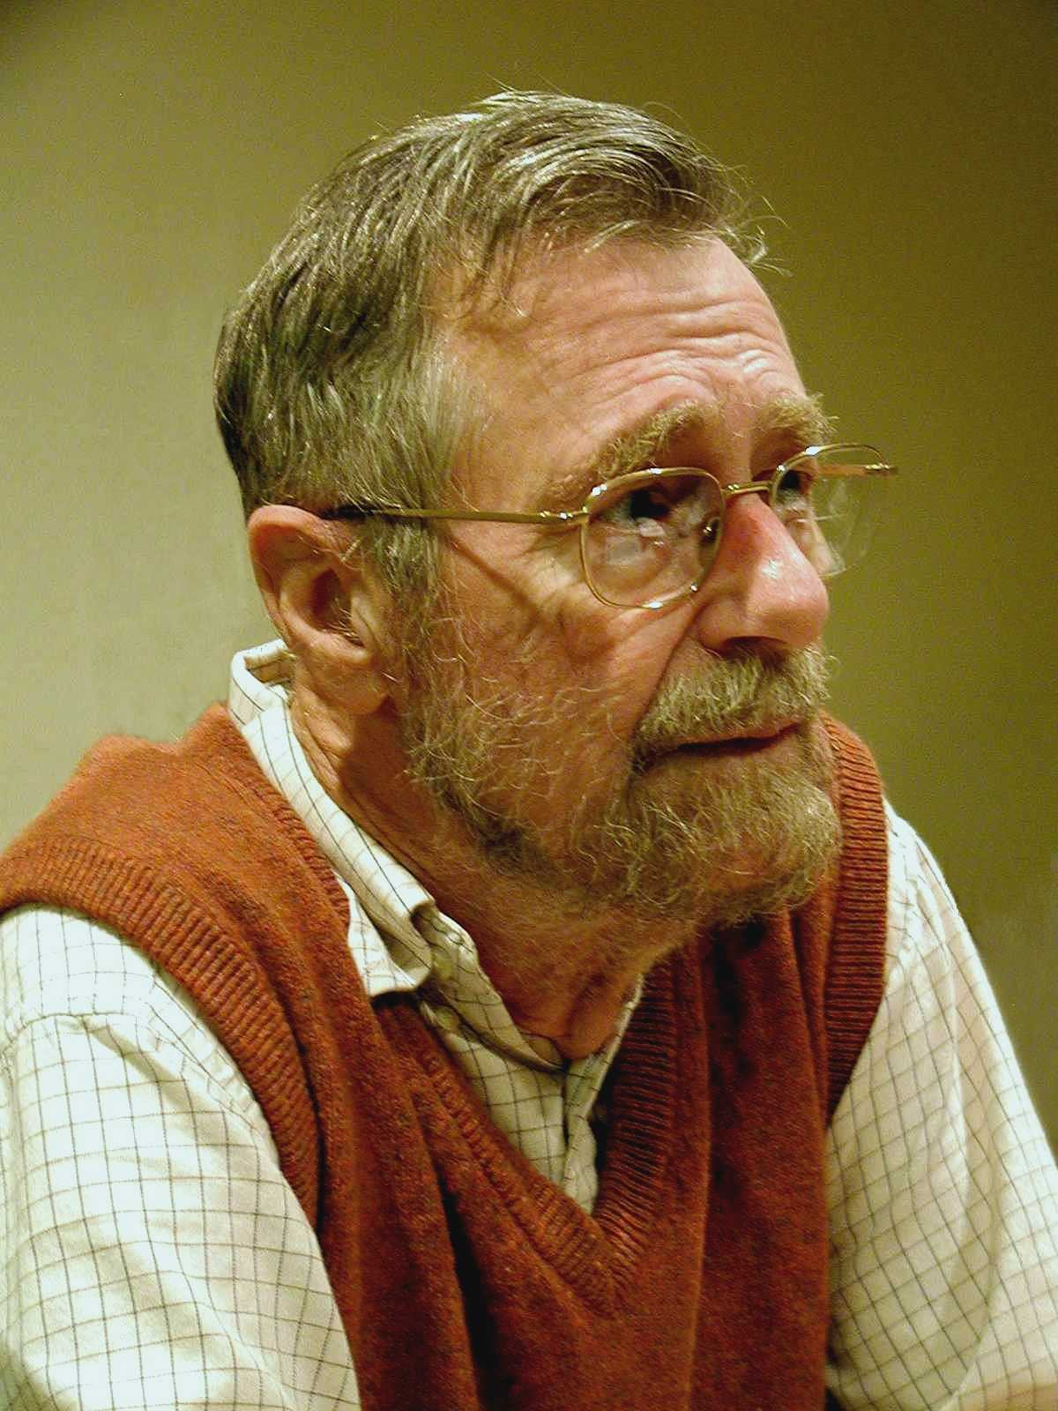
Program testing
Testing shows the presence, not the absence of bugs
- Edsger W. Dijkstra (1930-2002)
Edsger Wybe Dijkstra was one of the most influential members of computing science’s founding generation.
http://www.cs.utexas.edu/users/EWD/

Slide 13
Example: Testing isPalindrome
Lib.hs
isPalindrome :: String -> Bool
isPalindrome text = text == reverse text
Manual testing
Let’s fix it
And test again
$ cabal repl
*Main> isPalindrome "racecar"
True
*Main> isPalindrome "cat"
False
*Main> isPalindrome "racecar!"
False
We expect True
isPalindrome :: String -> Bool
isPalindrome text = cleanText == reverse cleanText
where cleanText = filter (not . (== '!')) text
*Main> isPalindrome "racecar!"
True

Slide 14
Example: Testing isPalindrome
As program grows in complexity, manually testing will not scale.
doctest is a small program, that checks examples in comments and test functions against them.
Lib.hs
essential
module Lib (isPalindrome) where
-- | Checks whether a string is palindrome or not
--
-- >>> isPalindrome ”racecar"
-- False
--
-- >>> isPalindrome ”racecar!"
-- True
--
-- >>> isPalindrome ”cat"
-- False
--
isPalindrome :: String -> Bool
isPalindrome text = cleanText == reverse cleanText
where cleanText = filter (not . (== '!')) text
Format: Indenting, other spacing, has to be perfect
$ doctest Lib.hs
Examples: 3 Tried: 3 Errors: 0 Failures: 0

Slide 15
Functions testing: Black Box vs White box
Black box testing involves writing tests without looking at the code
Motivated by the specification
Indeed, can be written before you write a line of code
White box testing involves writing tests motivated by the code
Be your own enemy - how can I break this code?

Slide 16
What makes a good ‘black box’ test?
Identify testing groups of inputs, and test a ‘typical’ representative of each of them.
These groups should collectively cover all possibilities.
The division should correspond to different choices the program will need to make
Should behave somehow similarly on inputs from the same group
Should behave somehow differently on inputs from different groups

Slide 17
What makes a good ‘black box’ test?
Pay particular attention to special cases
e.g. on the ‘boundaries’ between groups
Input that is somehow ‘extreme’, e.g. empty input.
These special cases should be tested individually.

Slide 18
What makes a good ‘black box’ test?
The function maxThree returns the maximum of three integers
It is reasonable to think that the size or sign of the integers will not be relevant, however their relative order is important.
all three values different;
all three values the same;
two items equal, the third different.
two values equal to the maximum, one other;
one value equal to the maximum, two others.
maxThree :: Int -> Int -> Int -> Int
6 4 1
6 6 6
2 6 6
2 2 6

Slide 19
What makes a good ‘black box’ test?
MaxThree.hs
module MaxThree where
-- | The function maxThree returns the maximum of three integer
--
-- >>> maxThree 6 4 1
-- 6
-- >>> maxThree 6 6 6
-- 6
-- >>> maxThree 2 6 6
-- 6
-- >>> maxThree 2 2 6
-- 6
--
maxThree :: Int -> Int -> Int -> Int
maxThree x y z
| x > y && x > z = x
| y > x && y > z = y
| otherwise = z
Block box
$ doctest MaxThree.hs
Examples: 4 Tried: 4 Errors: 0 Failures: 0

Slide 20
What makes a good ‘white box’ test?
Identify points where your program ”makes a choice” on input, and test a “typical” input for each possible choice
case, guards, etc.
base case vs step case of recursions
Focus particularly on inputs on the boundary between choices, or on any overlapping situations
Pay extra attention to _ and otherwise, which can sweep up many different situations
Example: Knowing the code implementation
We should be guided to the data 6 6 2 since the first two inputs are at the boundaries of the guards
x > y && x > z and y > x && y > z
maxThree :: Int -> Int -> Int -> Int
maxThree x y z
| x > y && x > z = x
| y > x && y > z = y
| otherwise = z

Slide 21
What makes a good ‘black box’ test?
MaxThree.hs
module MaxThree where
-- | The function maxThree returns the maximum of three integer
--
-- >>> maxThree 6 4 1
-- 6
-- >>> maxThree 6 6 6
-- 6
-- >>> maxThree 2 6 6
-- 6
-- >>> maxThree 2 2 6
-- 6
-- >>> maxThree 6 6 2
-- 6
--
maxThree :: Int -> Int -> Int -> Int
maxThree x y z
| x > y && x > z = x
| y > x && y > z = y
| otherwise = z
$ doctest MaxThree.hs
MaxThree.hs:13: failure in expression `maxThree 6 6 2'
expected: 6
but got: 2
^
Examples: 5 Tried: 5 Errors: 0 Failures: 1
White box

