Slide 1
Lecture 8A Cabal and Testing: part 2
COMP 1100

Slide 2
Acknowledgement of Country
I wish to acknowledge the traditional custodians of the land we are meeting on, the Ngunnawal people. I wish to acknowledge and respect their continuing culture and the contribution they make to the life of this city and this region. I would also like to acknowledge and welcome any other Aboriginal and Torres Strait Islander people who are enrolled in our courses.

Slide 3
Assertions and Unit test
Testing manually is tiresome, besides after every code modification, the testing procedure should be repeated.
If code has had substantial changes, the test become invalid.
doctest helps to automize this process to some extent, however doctest tests should be written as comments and often can lack flexibility.
Unit test and assertions are designed to validate that the software code performs as expected.

Slide 4
Assertion based testing
An assertion is a boolean expression at a specific point in a program which will be true unless there is a bug in the program
Benefits of Assertions
Make a statement about the effects of the code that is guaranteed to be true.
Limitations of Assertion
assertions may themselves contain errors
Failing to report a bug that exists.
Reporting an error when it does not exist.
assert ::Bool -> String -> String -> IO()
assert test passStatement failStatement = if test
then putStrLn passStatement
else putStrLn failStatement

Slide 5
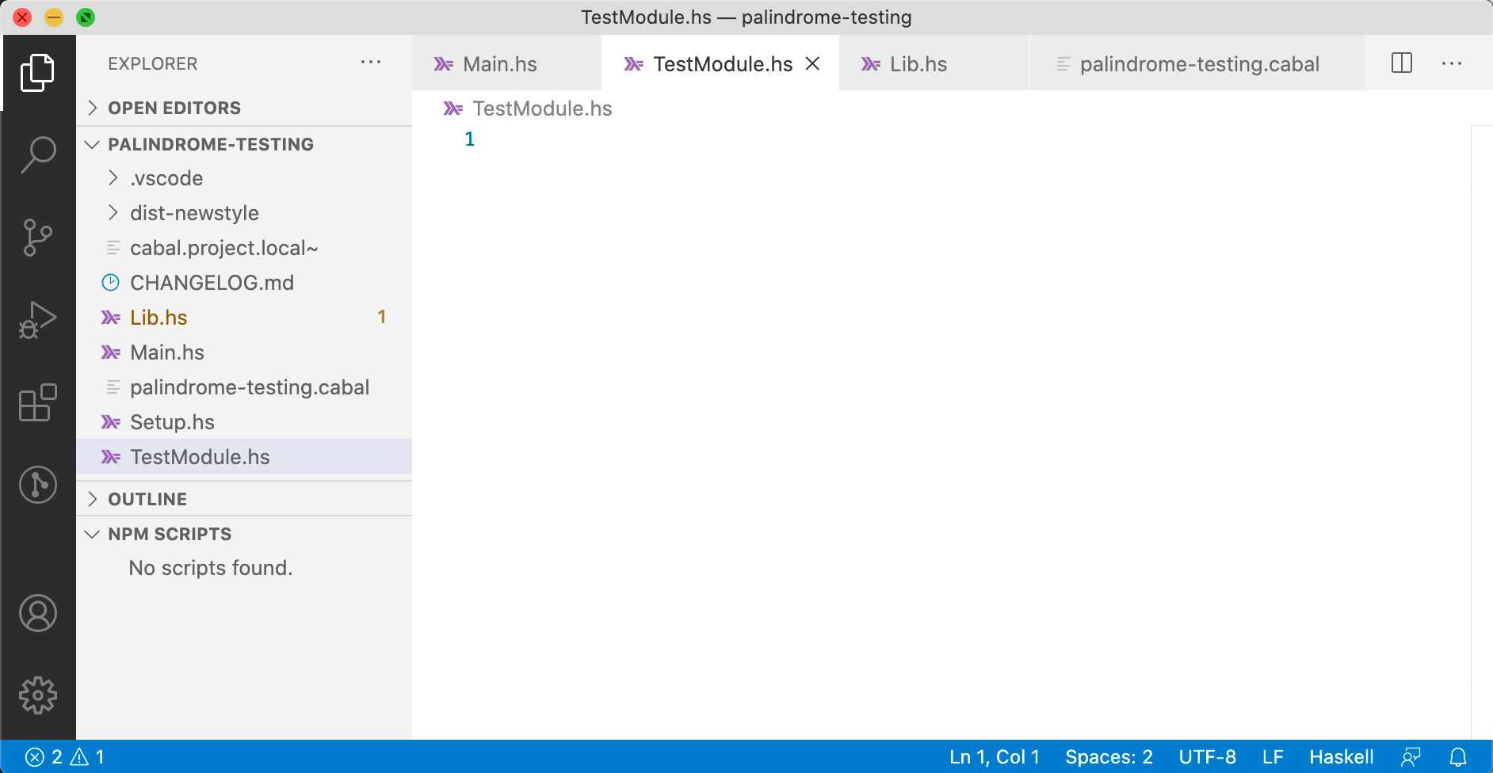
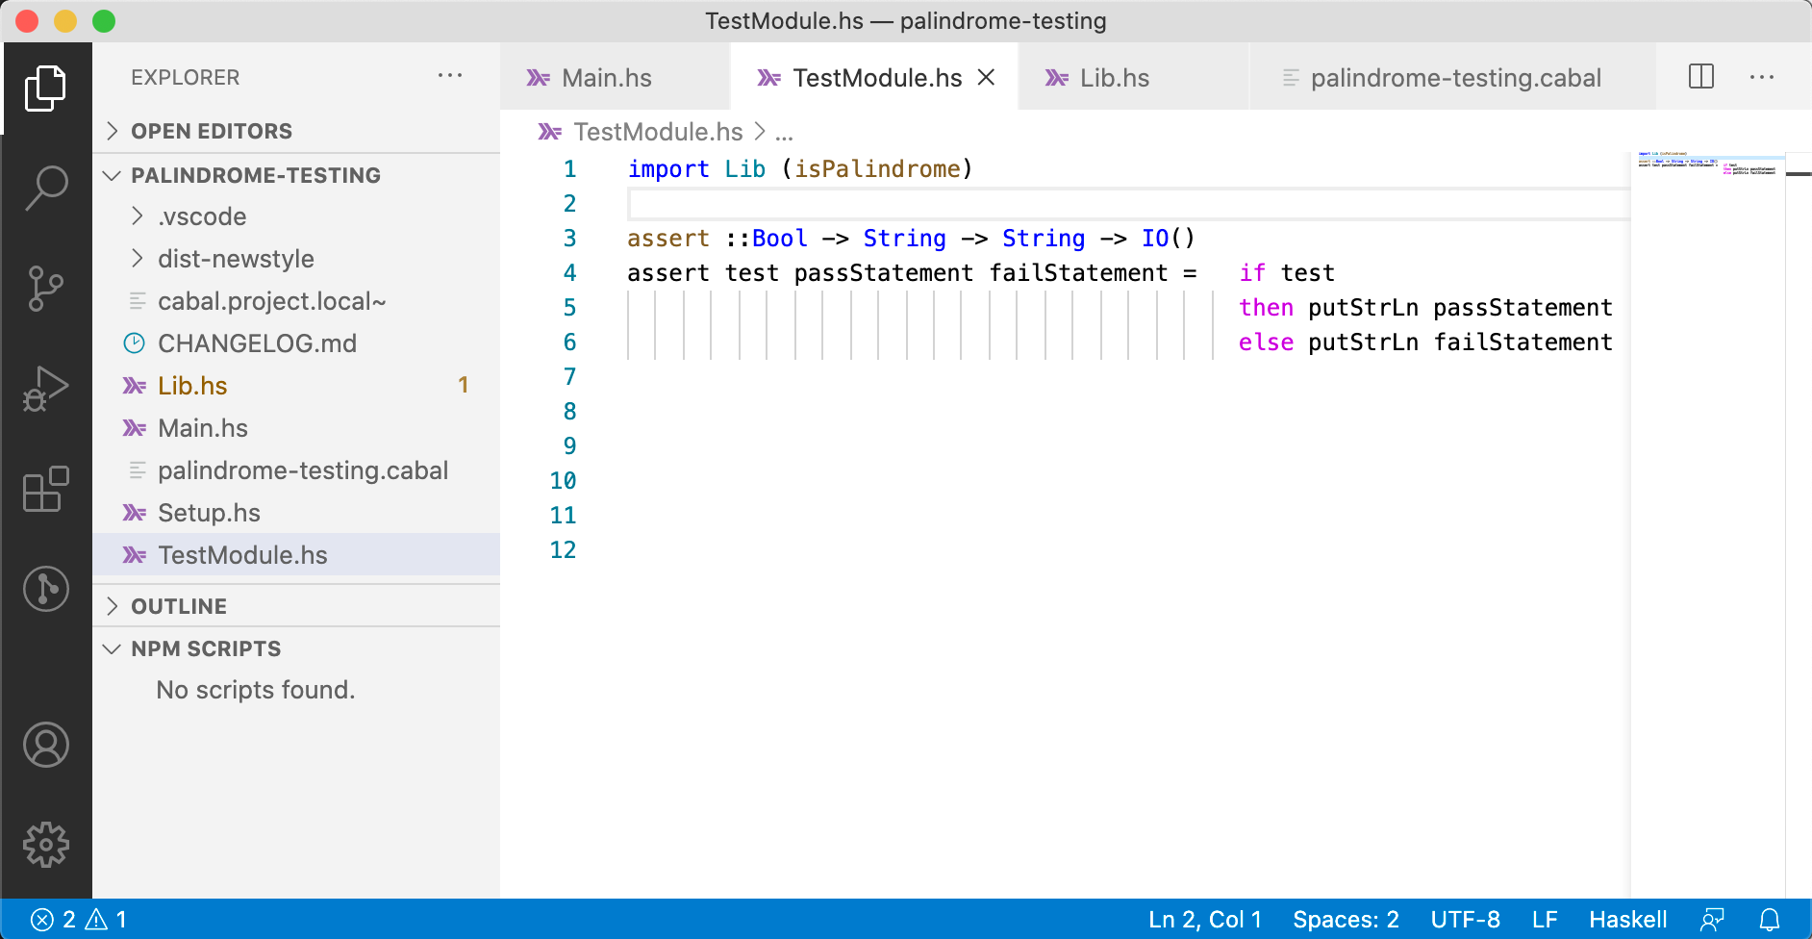
Assertion based testing
Often assertions are part of the main code, here we put the in a separate file
Create a file for keeping unit tests: TestModule.hs
Import the module/functions that will be tested
Define the function assert

Slide 6
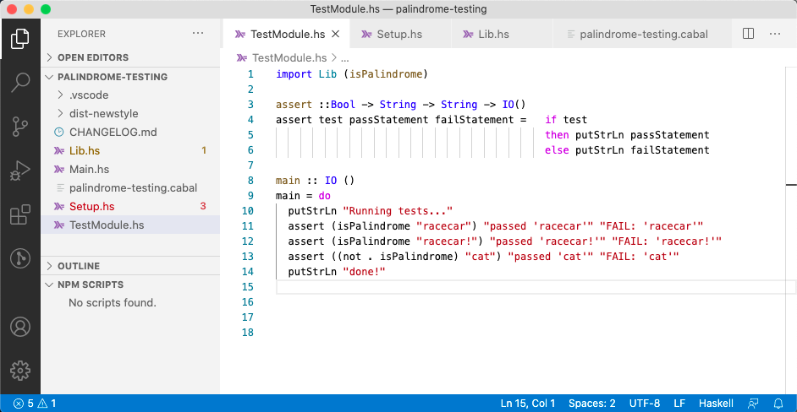
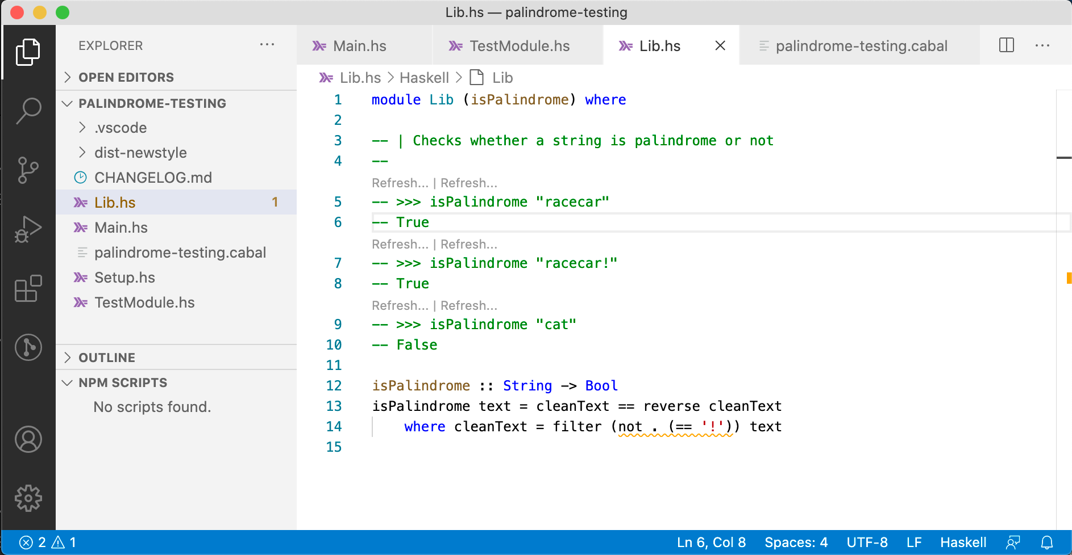
Writing unit tests and using Cabal
Recall doctests ($ doctest Lib.hs)
Convert doctests to tests using the function assert
Lib.hs
isPalindrome :: String -> Bool
isPalindrome text = cleanText == reverse cleanText
where cleanText = filter (not . (== '!')) text
Notes:
import Lib (isPalindrome)
assert ::Bool -> String -> String -> IO()
assert test passStatement failStatement = if test
then putStrLn passStatement
else putStrLn failStatement
main :: IO ()
main = do
putStrLn "Running tests..."
assert (isPalindrome "racecar") "passed 'racecar'" "FAIL: 'racecar'"
assert (isPalindrome "racecar!") "passed 'racecar!'" "FAIL: 'racecar!'"
assert ((not . isPalindrome) "cat") "passed 'cat'" "FAIL: 'cat'"
putStrLn "done!"

Slide 7
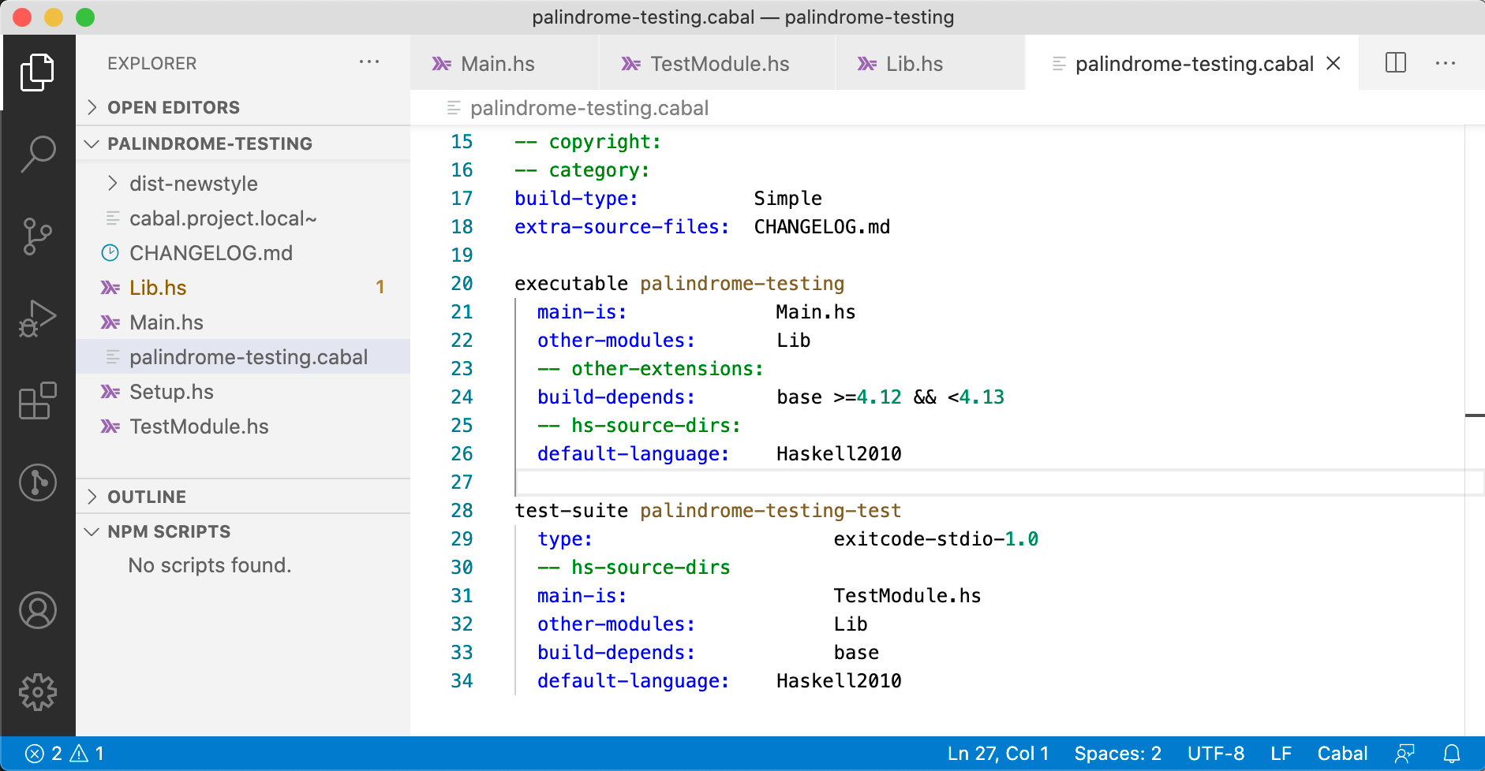
Writing unit tests and using Cabal
Modify the setting file palindrome-testing.cabal by adding the test-suite section

Slide 8
Writing unit tests and using Cabal
Test the program by running
$ cabal test
Build profile: -w ghc-8.6.5 -O1
In order, the following will be built (use -v for more details):
- palindrome-testing-0.1.0.0 (test:palindrome-testing-test) (configuration changed)
Configuring test suite 'palindrome-testing-test' for palindrome-testing-0.1.0.0..
Warning: The 'license-file' field refers to the file 'LICENSE' which does not
exist.
Preprocessing test suite 'palindrome-testing-test' for palindrome-testing-0.1.0.0..
Building test suite 'palindrome-testing-test' for palindrome-testing-0.1.0.0..
[1 of 2] Compiling Lib ( Lib.hs, .../Lib.o )
[2 of 2] Compiling Main ( TestModule.hs, .../palindrome-testing-test-tmp/Main.o )
Linking .../palindrome-testing-test ...
Running 1 test suites...
Test suite palindrome-testing-test: RUNNING...
Test suite palindrome-testing-test: PASS
Test suite logged to:
.../palindrome-testing-0.1.0.0-palindrome-testing-test.log
1 of 1 test suites (1 of 1 test cases) passed.

Slide 9
Writing unit tests and using Cabal
Run the following program to print results of the tests to the screen
$ cabal test --test-show-details=streaming
Build profile: -w ghc-8.6.5 -O1
In order, the following will be built (use -v for more details):
- palindrome-testing-0.1.0.0 (test:palindrome-testing-test) (first run)
Preprocessing test suite 'palindrome-testing-test' for palindrome-testing-0.1.0.0..
Building test suite 'palindrome-testing-test' for palindrome-testing-0.1.0.0..
Running 1 test suites...
Test suite palindrome-testing-test: RUNNING...
Running tests...
passed 'racecar’
passed 'racecar!’
passed ‘cat'
done!
Test suite palindrome-testing-test: PASS
Test suite logged to:
.../palindrome-testing-0.1.0.0-palindrome-testing-test.log
1 of 1 test suites (1 of 1 test cases) passed.

Slide 10
Unit test
Unit tests are sections of code in the program just to test the function. The test are often stored in a separate file, keeping the code clean.
The test code (function) could be isolated, revealing unnecessary dependencies.
Using an automation framework, criteria are coded up into the test to verify the correctness of the code.
Assertions are part of the main code while unit tests are not part of live code.
Tests are written before the code
Rely heavily on testing frameworks
All functions in the applications are tested

Slide 11
Properties testing QuickCheck
Going back to our example: isPalindrome
The following assertion if added, will fail
The solution would be to modify the function isPalindrome as
The fix feels unsatisfactory, as we know we have to think of a huge range of possible tests: race-car, :racecar:, racecar?
isPalindrome :: String -> Bool
isPalindrome text = cleanText == reverse cleanText
where cleanText = filter (not . (== '!')) text
assert (isPalindrome "racecar.") "passed 'racecar.'" "FAIL: 'racecar.'"
isPalindrome :: String -> Bool
isPalindrome text = cleanText == reverse cleanText
where cleanText = filter (not . (== '!','.')) text

Slide 12
Properties testing QuickCheck
Before diving into property testing, let’s clean up out library a bit.
Lib.hs
module Lib (isPalindrome,
preprocess) where
preprocess :: String -> String
preprocess text = filter (not . (`elem` ['!', '.'])) text
isPalindrome :: String -> Bool
isPalindrome text = cleanText == reverse cleanText
where cleanText = preprocess text
TestModule.hs
import Lib (isPalindrome)
main :: IO ()
main = do
putStrLn "Running tests..."
assert (isPalindrome "racecar") "passed ‘racecar'" "FAIL: ‘racecar'"
assert (isPalindrome "racecar!") "passed 'racecar!'" "FAIL: 'racecar!'"
assert ((not . isPalindrome) "cat") "passed 'cat'" "FAIL: 'cat'"
assert (isPalindrome "racecar.") "passed 'racecar.'" "FAIL: 'racecar.'"
assert (isPalindrome ”:racecar:") "passed ':racecar:'" "FAIL: ':racecar:'"
putStrLn "done!"

Slide 13
Properties testing QuickCheck
The goal is to test a certain property of the preprocess function:
preprocess is punctuation invariant (it does not care about whether the input string has punctuation or not)
We need a way to get a range of possible values to do the testing. This is where the QuickCheck library comes in.
prop_puncuationInvariant text = preprocess text == preprocess noPuncText
where noPuncText = filter (not . isPunctuation) text

Slide 14
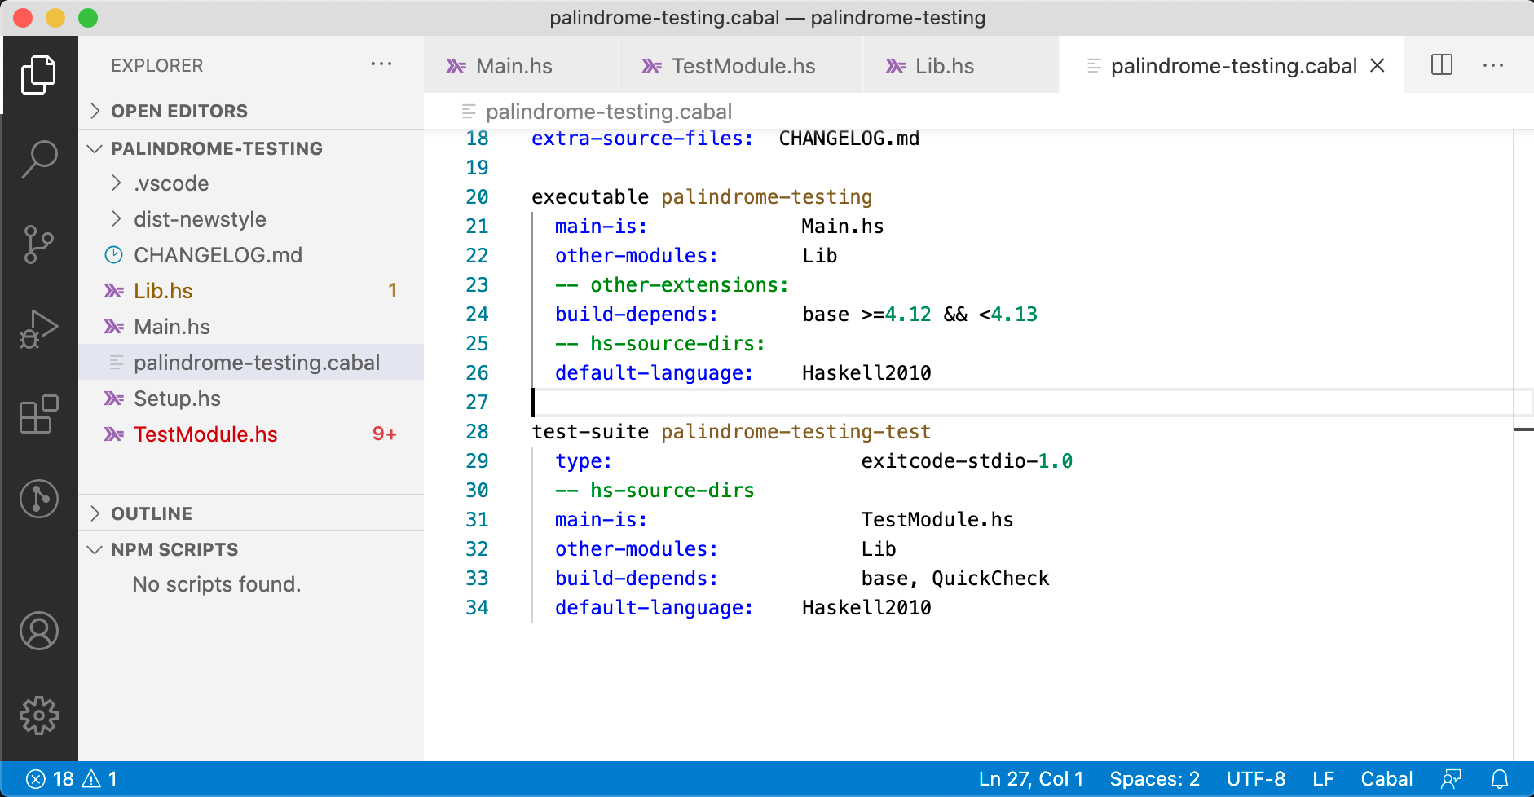
Introducing QuickCheck
QuickCheck(QC) supply properties that the code is supposed to uphold, and then QC automatically generates values and tests them on the functions.
Modify the setting file palindrome-testing.cabal by add QuickCheck to build-depends:

Slide 15
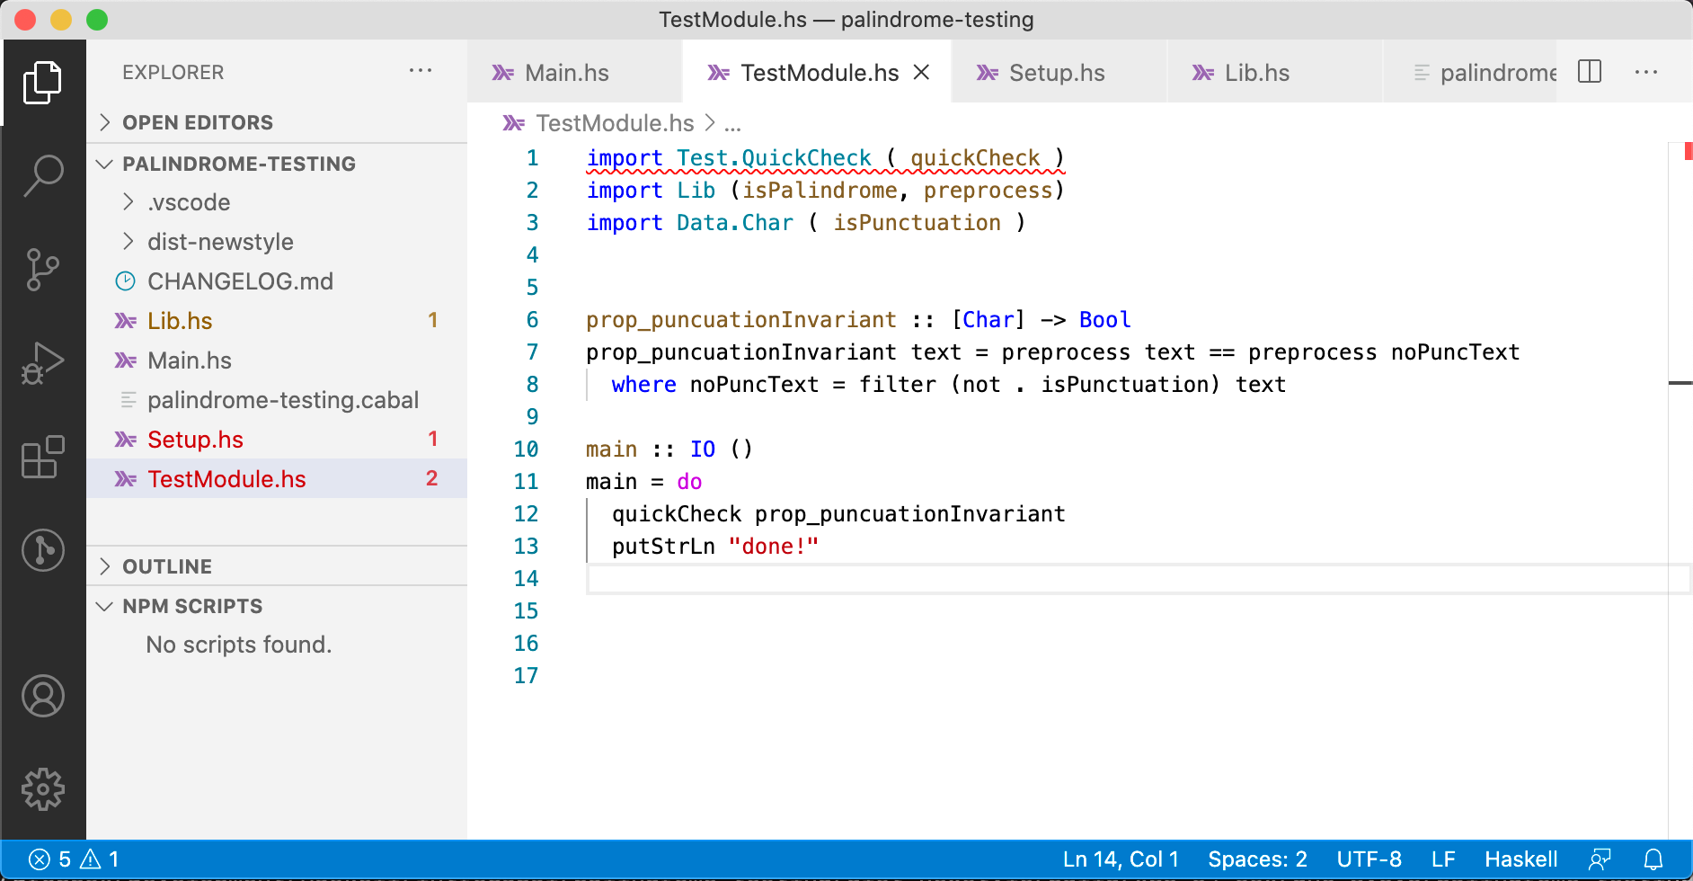
Introducing QuickCheck
Inlcude import Test.QuickCheck ( quickCheck ) at the top of TextModule.hs.
To use QC, the quickCheck function is invoked on the property inside the main.

Slide 16
Introducing QuickCheck
To test the properties run
QC tried “}” and failed, indeed because “}” in not removed by preprocess
$ cabal test --test-show-details=streaming
Build profile: -w ghc-8.6.5 -O1
In order, the following will be built (use -v for more details):
- palindrome-testing-0.1.0.0 (test:palindrome-testing-test) (first run)
Preprocessing test suite 'palindrome-testing-test' for palindrome-testing-0.1.0.0..
Building test suite 'palindrome-testing-test' for palindrome-testing-0.1.0.0..
[2 of 2] Compiling Main ( TestModule.hs,... /Main.o )
Linking palindrome-testing-test ...
Running 1 test suites...
Test suite palindrome-testing-test: RUNNING...
*** Failed! Falsified (after 11 tests and 4 shrinks):
"}"
done!
Test suite palindrome-testing-test: PASS
Test suite logged to:
.../palindrome-testing-0.1.0.0-palindrome-testing-test.log
1 of 1 test suites (1 of 1 test cases) passed.
preprocess :: String -> String
preprocess text = filter (not . (`elem` ['!', '.'])) text

Slide 17
Introducing QuickCheck
Let’s refactor the code the correct way, using isPunctuation
This time, a much happier response is received
QC tried 100 strings and the all passed.
module Lib (isPalindrome,
preprocess) where
import Data.Char ( isPunctuation )
preprocess :: String -> String
preprocess text = filter (not . isPunctuation) text
isPalindrome :: String -> Bool
isPalindrome text = cleanText == reverse cleanText
where cleanText = preprocess text
Running 1 test suites...
Test suite palindrome-testing-test: RUNNING...
+++ OK, passed 100 tests.
done!

Slide 18
Introducing QuickCheck
Is 100 tests enough ?
Let’s try 1,000
We’ve just written a single property test for isPalindrome, and replaced the need to write countless unit tests.
import Test.QuickCheck ( quickCheck, quickCheckWith, maxSuccess, stdArgs)
import Lib (isPalindrome, preprocess)
import Data.Char ( isPunctuation )
prop_puncuationInvariant :: [Char] -> Bool
prop_puncuationInvariant text = preprocess text == preprocess noPuncText
where noPuncText = filter (not . isPunctuation) text
main :: IO ()
main = do
quickCheckWith stdArgs {maxSuccess = 1000} prop_puncuationInvariant
putStrLn "done!"
Running 1 test suites...
Test suite palindrome-testing-test: RUNNING...
+++ OK, passed 1000 tests.
done!

Slide 19
Performance testing
GHC comes with a time and space profiling system, so that you can answer questions like
“why is my program so slow?”, or
“why is my program using so much memory?”
Profiling a program is a three-step process:
Re-compile your program for profiling with the –prof option
run the program to generate the profile by adding +RTS -p
Examine the generated profiling information, use the information to optimize your program, and repeat, as necessary.

Slide 20
Performance testing: Example
Fib.hs
main :: IO ()
main = print (fib 30)
fib :: (Ord a, Num a, Num p) => a -> p
fib n = if n < 2 then 1 else fib (n-1) + fib (n-2)
Occupies enormous amount of memory!
fib 6
fib 5
fib 4
fib 4
fib 3
fib 3
fib 2
fib 1
fib 0
Step 1:
Step 2:
Step 3 (next slide): open fib.prof
$ ghc -prof -fprof-auto -rtsopts Fib.hs
$ ./fib +RTS -p

Slide 21
Performance testing
Wed Sep 29 13:09 2020 Time and Allocation Profiling Report (Final)
temp +RTS -p -RTS
total time = 0.29 secs (287 ticks @ 1000 us, 1 processor)
total alloc = 517,016,368 bytes (excludes profiling overheads)
COST CENTRE MODULE SRC %time %alloc
fib Main Fib.hs:82:1-50 100.0 100.0
individual inherited
COST CENTRE MODULE SRC no. entries %time %alloc %time %alloc
MAIN MAIN <built-in> 115 0 0.0 0.0 100.0 100.0
CAF Main <entire-module> 229 0 0.0 0.0 100.0 100.0
main Main Fib.hs:5:1-21 230 1 0.0 0.0 100.0 100.0
fib Main Fib.hs:8:1-50 232 2692537 100.0 100.0 100.0 100.0
CAF GHC.Conc.Signal <entire-module> 209 0 0.0 0.0 0.0 0.0
CAF GHC.IO.Encoding <entire-module> 191 0 0.0 0.0 0.0 0.0
CAF GHC.IO.Encoding.Iconv <entire-module> 189 0 0.0 0.0 0.0 0.0
CAF GHC.IO.Handle.FD <entire-module> 180 0 0.0 0.0 0.0 0.0
CAF GHC.IO.Handle.Text <entire-module> 178 0 0.0 0.0 0.0 0.0
main Main Fib.hs:5:1-21 231 0 0.0 0.0 0.0 0.0
a break-down by cost centre of the most costly functions in the program
https://downloads.haskell.org/~ghc/latest/docs/html/users_guide/profiling.html

Slide 22
Quiz
Implement the factorial function
and test it using the following assertion: 0 < fact n , for all n > 0
Implement a program based on the function maxThree that returns the maximum of three integers (refer to last lecture)
and test it using QuickCheck library.
fact :: Int -> Int
fact n
| n > 1 = n * fact (n-1)
| otherwise = 1
maxThree :: Int -> Int -> Int -> Int
maxThree x y z
| x > y && x > z = x
| y > x && y > z = y
| otherwise = z

