Slide 1
Lecture 9A
Game trees (Unbeatable tic-tac-toe) : PART 1
COMP 1100

Slide 2
Acknowledgement of Country
I wish to acknowledge the traditional custodians of the land we are meeting on, the Ngunnawal people. I wish to acknowledge and respect their continuing culture and the contribution they make to the life of this city and this region. I would also like to acknowledge and welcome any other Aboriginal and Torres Strait Islander people who are enrolled in our courses.

Slide 3
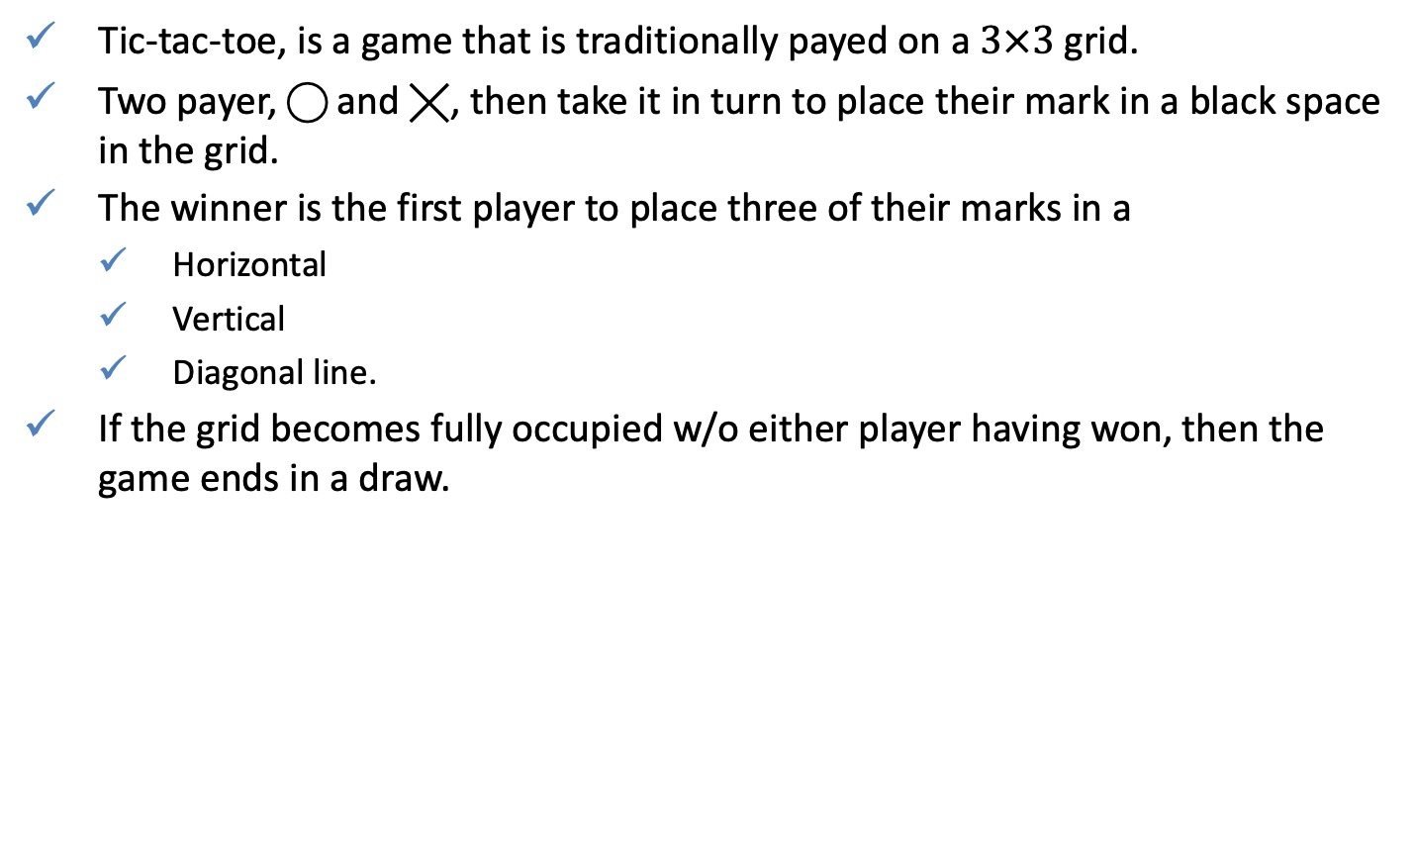
Introduction
Tic-tac-toe, is a game that is traditionally payed on a $3×3$ grid.
Two payer, ⃝ and ╳, then take it in turn to place their mark in a black space in the grid.
The winner is the first player to place three of their marks in a
  Horizontal
  Vertical
  Diagonal line.
If the grid becomes fully occupied w/o either player having won, then the game ends in a draw.
╳ | ⃝ | ⃝
⃝ | ╳ | ⃝
╳ | ╳ | ╳
⃝ | ⃝ | ╳
╳ | ╳ | ⃝
⃝ | ╳ | ⃝

Slide 4
Cabal Project
Create a project
Create source files
  TicTacToe.hs will contain functions to solve the count down problem
  TestModule.hs will contain functions to test the count down problem
$ mkdir tictactoe
$ cd tictactoe
$ cabal init
TicTacToe.hs
module TicTacToe where
...
TestModule.hs
import TicTacToe
assert ::Bool -> String -> String -> IO()
assert test passStatement failStatement = if test
  then putStrLn passStatement
  else putStrLn failStatement
main :: IO ()
main = do
putStrLn "Running tests...”
...

Slide 5
Cabal Project
Modify the setting file tictactoe.cabal
cabal-version: >=1.10
-- Initial package description ‘tictactoe.cabal' generated by 'cabal init'.
-- For further documentation, see http://haskell.org/cabal/users-guide/
name: tictactoe
version: 0.1.0.0
-- license:
license-file: LICENSE
author: User Name
maintainer: email@gmail.com
-- copyright:
build-type: Simple
extra-source-files: CHANGELOG.md
executable countdown
  main-is: Main.hs
  other-modules: TicTacToe
  -- other-extensions:
  build-depends: base >=4.12 && <4.13
  -- hs-source-dirs:
  default-language: Haskell2010
test-suite tictactoe-test
  type: exitcode-stdio-1.0
  main-is: TestModule.hs
  other-modules: TicTacToe
  build-depends: base, QuickCheck
  default-language: Haskell2010

Slide 6
Basic declaration
Import standard libraries
Create the tic-tac-tore grid type, and fix it to 3
A grid is a list of lists of player values each of length size. The deriving clause ensures that player values support the standard equality and ordering (by default O < B < X) operators and be displayed.
import Data.Char
import Data.List
import System.IO
size :: Int
size = 3
type Grid = [[Player]]
data Player = O | B | X deriving (Eq, Ord, Show)
g = [[B, O, O], [O, X, O], [X, X, X]] :: Grid

Slide 7
Basic declaration
The next player to move is given simply by swapping between O and X, with the case for the blank value B being included for completeness.
next :: Player -> Player
next O = X
next B = B
next X = O

Slide 8
Grid utilities
Define the empty grid by replicating the black player
A grid is full if all of its player values are non-blank, apply concat to flatten the grid to a single list.
To decide whose turn it is, compare the number of O‘s and X‘s in a flattened grid:
Note that turn empty = O means that we are assuming player O goes first
empty :: Grid empty = replicate size (replicate size B)
full :: Grid -> Bool
full = all (/= B) . concat
turn :: Grid -> Player
turn g = if os <= xs then O else X
where
    os = length (filter (== O) ps)
    xs = length (filter (== X) ps)
    ps = concat g

Slide 9
Grid utilities
What remains is to decide if the game has been won.
╳ | ⃝ | ⃝
⃝ | ╳ | ⃝
╳ | ╳ | ╳
╳ | ⃝ | ⃝
⃝ | ╳ | ⃝
╳ | ╳ | ⃝
⃝ | ⃝ | ⃝
⃝ | ╳ | ╳
╳ | ⃝ | ╳
wins :: Player -> Grid -> Bool
wins p g = any line (rows ++ cols ++ dias)
where
    line = all (== p)
    rows = g
    cols = transpose g
    dias = [diag g, diag (map reverse g)]
The function transpose :: [[a]] -> [[a]] is provided in Data.List, and reflects the grid about its main diagonal.
diag :: Grid -> [Player]
diag g = [g !! n !! n | n <- [0..size-1]]
won :: Grid -> Bool
won g = wins O g || wins X g

Slide 10

Displaying a grid
The function showRow converts a row to a list of strings, with a vertical bar of length three between each entry in the row.
The library function foldr1 behaves in a similar manner to foldr but can only be applied to nonempty lists (the last element in the list is the initial value).
While zipWith :: (a -> b -> c) -> [a] -> [b] -> [c] applies a function two corresponding elements in input lists.
showRow :: [Player] -> [String]
showRow = beside . interleave bar . map showPlayer
    where
      beside = foldr1 (zipWith (++))
      bar = replicate 3 "|"
["|","|","|"]
showPlayer :: Player -> [String]
showPlayer O = [" ", " O ", " "]
showPlayer B = [" ", " ", " "]
showPlayer X = [" ", " X ", " "]
> showRow [B,O,O]
[" | | "," | O | O "," | | "]
> putStrLn (unlines (showRow [B,O,O]))

Slide 11
Displaying a grid
Define a function for displaying a tic-tac-toe grid
The library function unlines :: [String] -> String joins all the strings together with a newline character at the end of each line.
g = [[B, O, O], [O, X, O], [X, X, X]] :: Grid
putGrid g
putGrid :: Grid -> IO()
putGrid =
  putStrLn . unlines . concat . interleave bar . map showRow
  where bar = [replicate ((size * 4) - 1) '-']
interleave :: a -> [a] -> [a]
interleave x [] = []
interleave x [y] = [y]
interleave x (y:ys) = y : x : interleave x ys

Slide 12
Displaying a grid (may skip)
g = [[B, O, O], [O, X, O], [X, X, X]] :: Grid
putGrid g
4
3
2
1
putGrid :: Grid -> IO()
putGrid =
  putStrLn . unlines . concat . interleave bar . map showRow
  where bar = [replicate ((size * 4) - 1) '-']
5
1
> map showRow g
[[" | | ", " | O | O "," | | "],
[" | | "," O | X | O "," | | "],
[" | | "," X | X | X "," | | "]]
> interleave bar (map showRow g)
[[" | | ", " | O | O "," | | "],
["-----------"],
[" | | "," O | X | O "," | | "],
["-----------"],
[" | | "," X | X | X "," | | "]]
3
> concat (interleave bar (map showRow g))
[" | | ", " | O | O ", " | | ",
"-----------",
" | | ", " O | X | O ", " | | ",
"-----------",
" | | ", " X | X | X ", " | | "]
2
4
> unlines (concat (interleave bar (map showRow g)))
" | | \n | O | O \n | | \n-----------\n | | \n O | X | O \n | | \n-----------\n | | \n X | X | X \n | | \n"
5
> putStrLn (unlines (concat (interleave bar (map showRow g))))

Slide 13
Making a move
Index each position in the grid by a natural number
A move is valid if the index is within the range and the position is blank.
0 | 1 | 2
3 | 4 | 5
6 | 7 | 8
concat
0 | 1 | 2 | 3 | 4 | 5 | 6 | 7 | 8
valid :: Grid -> Int -> Bool
valid g i = 0 <= i && i < size^2 && concat g !! i == B

Slide 14
Making a move
Define a function that applies a move to a grid
  A singleton list denotes success in applying the move
  The empty list denotes failure
  splitAt splits a list into two parts at a given index
  The function chop breaks a list into maximal segments of a given length
move :: Grid -> Int -> Player -> [Grid]
move g i p =
  if valid g i then [chop size (xs ++ [p] ++ ys)] else []
  where (xs, B:ys) = splitAt i (concat g)
remove B from the list, it is B because valid returned True (i.e. the position is blank)
> splitAt 4 (concat [[0,1,2], [3,4,5], [6,7,8]])
([0,1,2,3],[4,5,6,7,8])
chop :: Int -> [a] -> [[a]]
chop n [] = []
chop n xs = take n xs : chop n (drop n xs)

Slide 15
Reading a number
Define a function getNat that displays a prompt and reads a natural number from the keyboard.
The library Data.Char function isDigit :: Char -> Bool decides if a character is a numeric digit or not.
getNat :: String -> IO Int
getNat prompt = do putStr prompt
          xs <- getLine
          if xs /= [] && all isDigit xs then
          return (read xs)
          else
          do putStrLn "ERROR: Invalid number"
          getNat prompt
> getNat "Enter a number: "
Enter a number: 4
4

Slide 16
Human vs human
Implement tic-tac-toe for two human players using two mutually recursive functions.
The first function simply display the grid and invokes the second:
Functions cls and goto were defined for the game of life in previous lectures.
run :: Grid -> Player -> IO ()
run g p = do cls
  goto (1,1)
  putGrid g
  run' g p
cls :: IO()
cls = putStr "\ESC[2J"
goto :: (Int, Int) -> IO ()
goto (x,y) = putStr ("\ESC[" ++ show y ++ ";" ++ show x ++ "H")

Slide 17
Human vs human
The second function uses a series of guards to decide if the game is finished, and if not prompts the player for a move.
run' :: Grid -> Player -> IO ()
run' g p | wins O g = putStrLn "Player O wins!\n"
    | wins X g = putStrLn "Player X wins!\n"
    | full g = putStrLn "It's a draw!\n"
    | otherwise =
do i <- getNat (prompt p)
case move g i p of
[] -> do putStrLn "ERROR: Invalid move"
run' g p
[g']-> run g' (next p)
prompt :: Player -> String
prompt p = "Player " ++ show p ++ ", enter your move: "

Slide 18
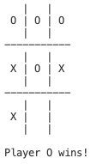
Human vs human
module Main where
import TicTacToe
main :: IO ()
main = run empty O
$ cabal run tictactoe

Slide 19
QUIZ
Problem 1. Modify the final program to:
  Let the user decide if they wish to play first or second;
  Allow the length of a winning line to also be changed.
Problem 2. Think of tests and add them to TestModule.hs and then test function properties.

