Slide 1
Lecture 10B Complexity
COMP 1100

Slide 2
Acknowledgement of Country
I wish to acknowledge the traditional custodians of the land we are meeting on, the Ngunnawal people. I wish to acknowledge and respect their continuing culture and the contribution they make to the life of this city and this region. I would also like to acknowledge and welcome any other Aboriginal and Torres Strait Islander people who are enrolled in our courses.

Slide 3
Efficiency
The best way to achieve efficiency is to find a decent algorithm for the problems (topic of algorithm design).
Efficiency in terms of
Time complexity
Space complexity
The complexity of an algorithm (in terms of time) is loosely speaking, the number of steps it takes to complete its task (as a function of the size of the input).
Space complexity measures the maximum amount of memory a computer needs in order to implement it.

Slide 4
Example: Bubble sorting
A sorting algorithm is an algorithm that puts elements of a list in a certain order.
The output must satisfy two conditions:
The output is in non-decreasing order (each element is no smaller than the previous element according to the desired total order)
The output is a permutation (reordering) of the input.
[ 6, 5, 3, 1, 8, 7, 2, 4 ]
[ 1, 2, 3, 4, 5, 6, 7, 8 ]

Slide 5
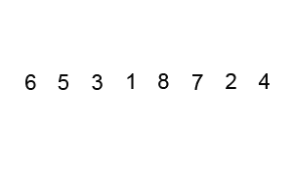
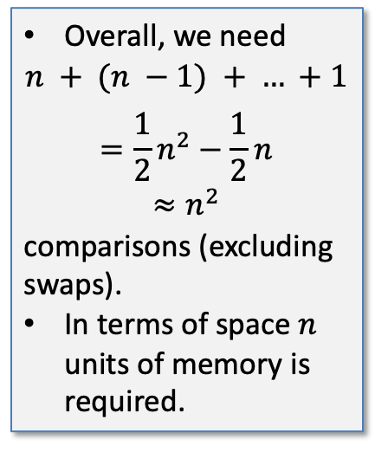



Example: Bubble sorting
Sort (6 5 3 1 8 7 2 4)
First Pass: ( 6 5 3 1 8 7 2 4 ) ( 5 6 3 1 8 7 3 4), Compares and swaps them. ( 5 6 3 1 8 7 2 4 ) ( 5 3 6 1 8 7 2 4 ), Swap since 6 > 3 ( 5 3 6 1 8 7 2 4 ) ( 5 3 1 6 8 7 2 4 ), Swap since 6 > 1 ( 5 3 1 6 8 7 2 4 ) ( 5 3 1 6 8 7 2 6 ), Does not swap them, (8 > 1),
( 5 3 6 1 8 7 2 4 ) ( 5 3 1 6 7 8 2 4 ), Swap since 8 > 7
( 5 3 6 1 7 8 2 4 ) ( 5 3 1 6 7 2 8 4 ), Swap since 8 > 2
( 5 3 6 1 7 2 8 4 ) ( 5 3 1 6 7 2 4 8 ), Swap since 8 > 4
Second Pass: ( 5 3 6 1 7 2 4 8 ) ( 3 5 6 1 7 2 4 8 ),
( 3 5 6 1 7 2 4 8 ) ( 3 5 6 1 7 2 4 8 ),
( 3 5 6 1 7 2 4 8 ) ( 3 5 1 6 7 2 4 8 ),
( 3 5 6 1 7 2 4 8 ) ( 3 5 1 1 7 2 4 8 ),
( 3 5 6 1 7 2 4 8 ) ( 3 5 1 1 2 7 4 8 ),
( 3 5 6 1 2 7 4 8 ) ( 3 5 1 1 2 4 7 8 ),
( 3 5 1 1 2 4 7 8 ) ( 3 5 1 1 7 2 7 8 ),
Third Pass:
( 3 5 1 1 2 4 7 8 ) ( 3 5 1 1 7 2 7 8 ),
Overall, we need
$$n + (n −1) + … +1$$
$$=\frac{1}{2}n^{2}−\frac{1}{2}n$$
$$≈n^{2}$$
comparisons (excluding swaps).
In terms of space $n$ units of memory is required.
$n$ comparisons
maximum
$n−1$ comparisons
Don’t need
to change
$$n−2$$
…

Slide 6


Example: Bubble sorting
bubblesort :: Ord a => [a] -> [a]
bubblesort s = case bubblesort' s of
t | t == s -> t -- the list is sorted
| otherwise -> bubblesort t -- run another pass
where bubblesort' (x1:x2:xs) | x1 > x2 = x2:(bubblesort' (x1:xs)) -- swap
-- don't swap
| otherwise = x1:(bubblesort' (x2:xs)) bubblesort' s = s -- n-th pass ends here
To time a function execution in ghci use
>:set +s
$$≈n^{2}$$
then
> bubblesort s
[1,1,2,......]
(21.54 secs, ,920,224 bytes)
$$n$$
Notes:
% Matlab code that plots the figure
n = [1024, 2048, 4096, 8192];
t = [0.4, 1.16, 4.84, 21.54];
coef = polyfit(n,t,2)
figure('color', 'white'), hold on;
plot(n, t, 'x:', 'linewidth', 4)
n_ = [1000:10000];
plot(n_, coef(1)*n_.^2 + coef(2)*n_ + coef(3), 'linewidth', 2)
xlabel('number of elements in the list');
ylabel('time');
legend({'true', 'approximated'})

Slide 7
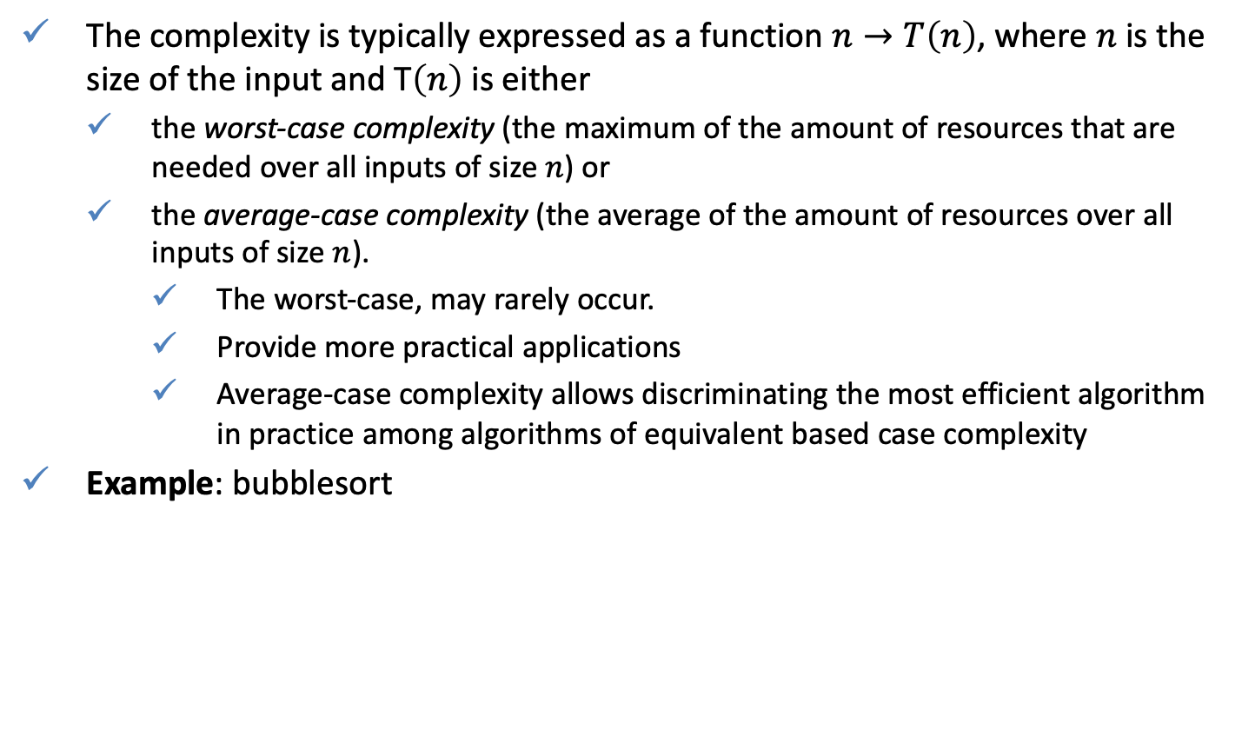
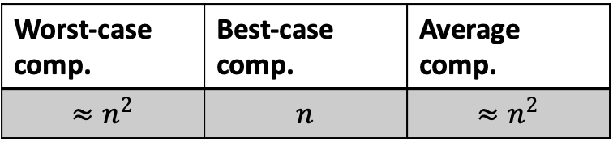
Complexity
The complexity is typically expressed as a function $n→T\left(n\right)$, where $n$ is the size of the input and T$\left(n\right)$ is either
the worst-case complexity (the maximum of the amount of resources that are needed over all inputs of size $n$) or
the average-case complexity (the average of the amount of resources over all inputs of size $n$).
The worst-case, may rarely occur.
Provide more practical applications
Average-case complexity allows discriminating the most efficient algorithm in practice among algorithms of equivalent based case complexity
Example: bubblesort
Worst-case comp. | Best-case comp. | Average comp.
$$≈n^{2}$$ | $$n$$ | $$≈n^{2}$$

Slide 8
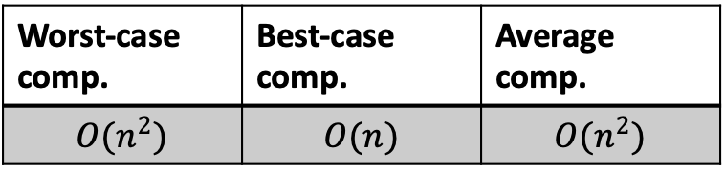

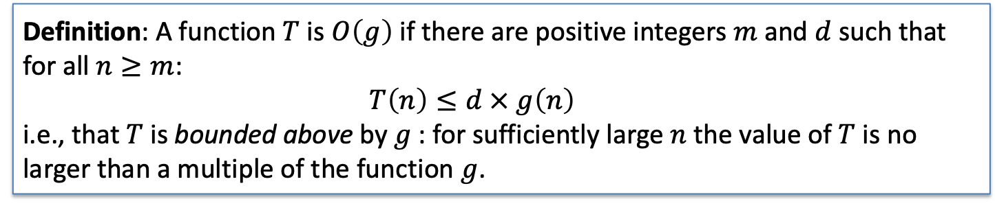
Complexity
Instead of using $≈$ or spelling out the whole complexity function (i.e. $\frac{1}{2}n^{2}−\frac{1}{2}n$ for bubblesort), “big Oh” notation is used.
Example:
Example: $f\left(n\right)=1+n+n^{2}$ and as $n→∞$ we have $O\left(g\left(n\right)\right), g\left(n\right)=n^{2}$.
Worst-case comp. | Best-case comp. | Average comp.
$$O(n^{2})$$ | $$O(n)$$ | $$O(n^{2})$$
Definition: A function $T$ is $O\left(g\right)$ if there are positive integers $m$ and $d$ such that for all $n≥m$:
$$T\left(n\right)≤d × g\left(n\right)$$
i.e., that $T$ is bounded above by $g$: for sufficiently large $n$ the value of $T$ is no larger than a multiple of the function $g$.

Slide 9
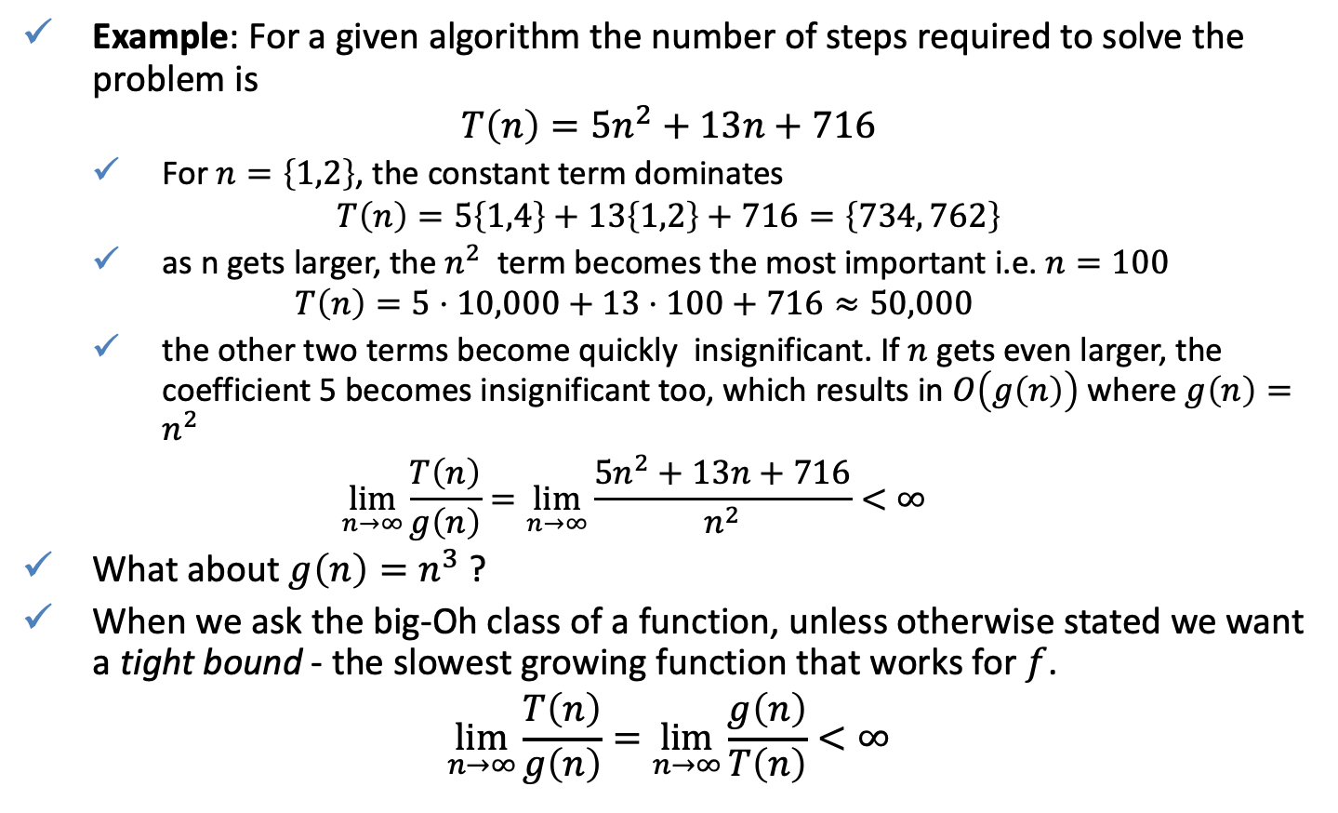
Complexity
Example: For a given algorithm the number of steps required to solve the problem is
$$T\left(n\right)=5n^{2}+13n+716$$
For $n=\left\{1,2\right\}$, the constant term dominates
$$T\left(n\right)=5\left\{1,4\right\}+13\left\{1,2\right\}+716=\left\{734, 762\right\}$$
as n gets larger, the $n^{2}$ term becomes the most important i.e. $n=100$
$$T\left(n\right)=5⋅10,000+13⋅100+716≈50,000$$
the other two terms become quickly insignificant. If $n$ gets even larger, the coefficient 5 becomes insignificant too, which results in $O\left(g\left(n\right)\right)$ where $g\left(n\right)=n^{2}$
$$\lim_{n→∞}{\frac{T\left(n\right)}{g\left(n\right)}}=\lim_{n→∞}{\frac{5n^{2}+13n+716}{n^{2}}}<∞$$
What about $g\left(n\right)=n^{3}$ ?
When we ask the big-Oh class of a function, unless otherwise stated we want a tight bound - the slowest growing function that works for $f$.
$$\lim_{n→∞}{\frac{T\left(n\right)}{g\left(n\right)}}=\lim_{n→∞}{\frac{g\left(n\right)}{T\left(n\right)}}<∞$$

Slide 10
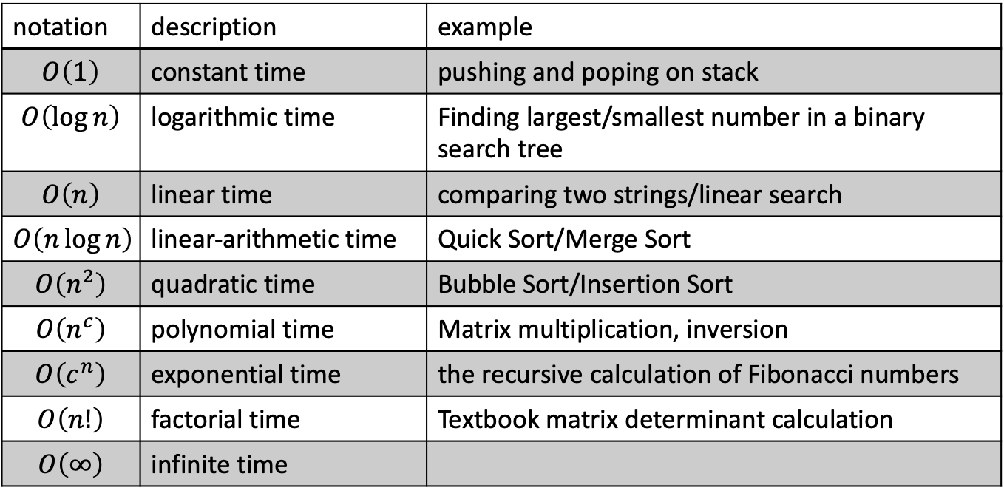
Standard complexity classes
notation | description | example
$$O\left(1\right)$$ | constant time | pushing and poping on stack
$$O\left(\log{n}\right)$$ | logarithmic time | Finding largest/smallest number in a binary search tree
$$O\left(n\right)$$ | linear time | comparing two strings/linear search
$$O\left(n\log{n}\right)$$ | linear-arithmetic time | Quick Sort/Merge Sort
$$O\left(n^{2}\right)$$ | quadratic time | Bubble Sort/Insertion Sort
$$O\left(n^{c}\right)$$ | polynomial time | Matrix multiplication, inversion
$$O\left(c^{n}\right)$$ | exponential time | the recursive calculation of Fibonacci numbers
$$O\left(n!\right)$$ | factorial time | Textbook matrix determinant calculation
$$O\left(∞\right)$$ | infinite time
Convention – unless otherwise stated, big O notation refers to the worst case.

Slide 11
Standard complexity classes
Notes:
f1 = @(n) 1
f2 = @(n) log(n)
f3 = @(n) n
f4 = @(n) n .* log(n)
f5 = @(n) n.^2
f6 = @(n) n.^3
f7 = @(n) 2.7.^n
f8 = @(n) factorial(n)
n = 1:.1:6;
figure('color', 'white'), hold on;
plot(n, ones(1,length(n)), '-', 'linewidth', 4, 'color', [0,0,0]);
plot(n, f2(n), '-', 'linewidth', 4);
plot(n, f3(n), '-', 'linewidth', 4);
plot(n, f4(n), '-', 'linewidth', 4);
plot(n, f5(n), '-', 'linewidth', 4);
plot(n, f6(n), '-', 'linewidth', 4);
plot(n, f7(n), '-', 'linewidth', 4);
plot([1:max(n)], f8([1:max(n)]), '-', 'linewidth', 4);
legend({'$O(1)$','$O(log(n))$','$O(n)$','$O(n \cdot log(n))$','$O(n^2)$','$O(n^c)$','$O(c^n)$','$O(n!)$'},'interpreter', 'latex', 'fontsize', 20)
xticklabels([]);
yticklabels([]);
xlabel('$n$','interpreter', 'latex', 'fontsize', 20)
ylabel('$O$','interpreter', 'latex', 'fontsize', 20)

Slide 12
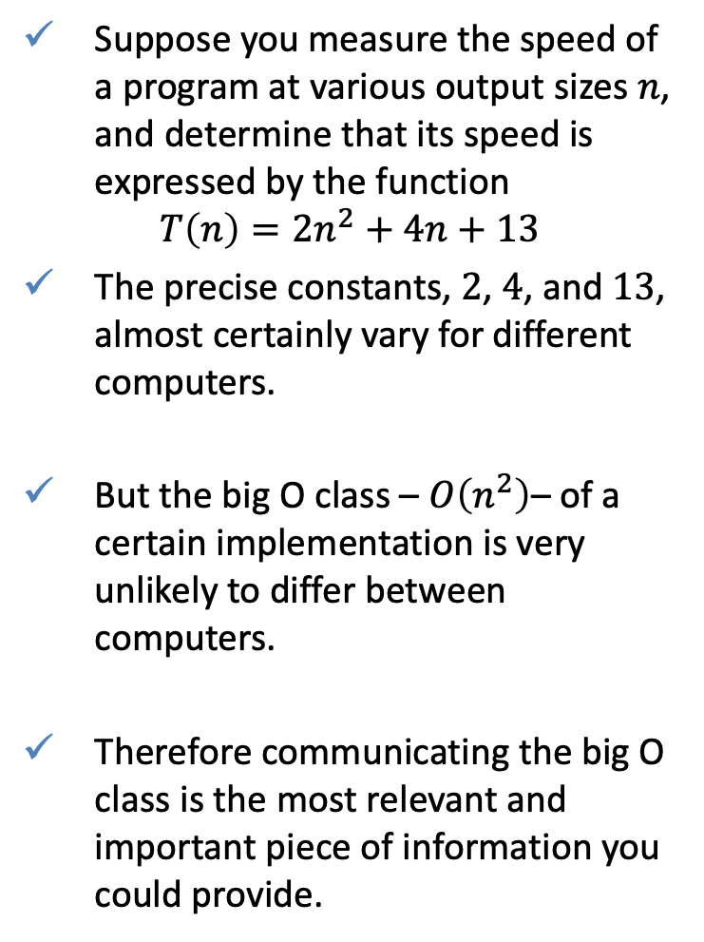
Significance to computing
Suppose you measure the speed of a program at various output sizes $n$, and determine that its speed is expressed by the function
$$T\left(n\right)=2n^{2}+4n+13$$
The precise constants, $2$, $4$, and $13$, almost certainly vary for different computers.
But the big O class – $O\left(n^{2}\right)$– of a certain implementation is very unlikely to differ between computers.
Therefore communicating the big O class is the most relevant and important piece of information you could provide.
Bubble sorting example

Slide 13

Best, worst and average case
Best case is the function $T_{b}\left(n\right)$ which performs the minimum number of steps on input data of $n$ elements.
Worst case is the function $T_{w}\left(n\right)$which performs the maximum number of steps on input data of size $n$.
Average case is the function $T_{a}\left(n\right)$which performs an average number of steps on input data of $n$ elements.

Slide 14


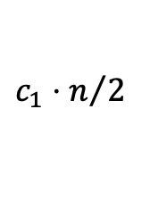

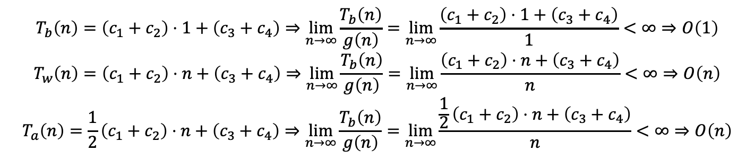





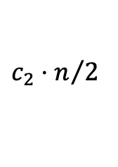


Example: Linear search
linsearch :: Eq a => a -> [a] -> Int
linsearch _ [] = -1
linsearch y xs = head [i | (x,i) <- zip xs [0..], y == x]
Number of operations
best
worst
average
linsearch 'c' ['a','b','c','d','e']
= {applying zip}
[(0,'a'),(1,'b'),(2,'c'),(3,'d'),(4,'e’)]
= {applying 'c' == ’a’ , 'c' == ‘b’ , 'c' == ‘e’}
[(2,'c')]
= {applying |}
[2]
= {applying head}
2
$$c_{1}⋅1$$
$$c_{1}⋅n$$
$$c_{1}⋅n/2$$
$$c_{2}⋅1$$
$$c_{2}⋅n$$
$$c_{2}⋅n/2$$
$$c_{3}⋅1$$
$$c_{3}$$
$$c_{3}$$
$$c_{3}⋅1$$
$$c_{4}$$
$$c_{4}$$
$$T_{b}\left(n\right)=\left(c_{1}+c_{2}\right)⋅1+\left(c_{3}+c_{4}\right)⇒\lim_{n→∞}{\frac{T_{b}\left(n\right)}{g\left(n\right)}}=\lim_{n→∞}{\frac{\left(c_{1}+c_{2}\right)⋅1+\left(c_{3}+c_{4}\right)}{1}}<∞⇒O\left(1\right)$$
$$T_{w}\left(n\right)=\left(c_{1}+c_{2}\right)⋅n+\left(c_{3}+c_{4}\right)⇒\lim_{n→∞}{\frac{T_{b}\left(n\right)}{g\left(n\right)}}=\lim_{n→∞}{\frac{\left(c_{1}+c_{2}\right)⋅n+\left(c_{3}+c_{4}\right)}{n}}<∞⇒O\left(n\right)$$
$$T_{a}\left(n\right)=\frac{1}{2}\left(c_{1}+c_{2}\right)⋅n+\left(c_{3}+c_{4}\right)⇒\lim_{n→∞}{\frac{T_{b}\left(n\right)}{g\left(n\right)}}=\lim_{n→∞}{\frac{\frac{1}{2}\left(c_{1}+c_{2}\right)⋅n+\left(c_{3}+c_{4}\right)}{n}}<∞⇒O\left(n\right)$$
Hence, the algorithms complexity under the worst-case and average-case analysis is $O\left(n\right)$ and the best case is $O\left(1\right)$.

Slide 15

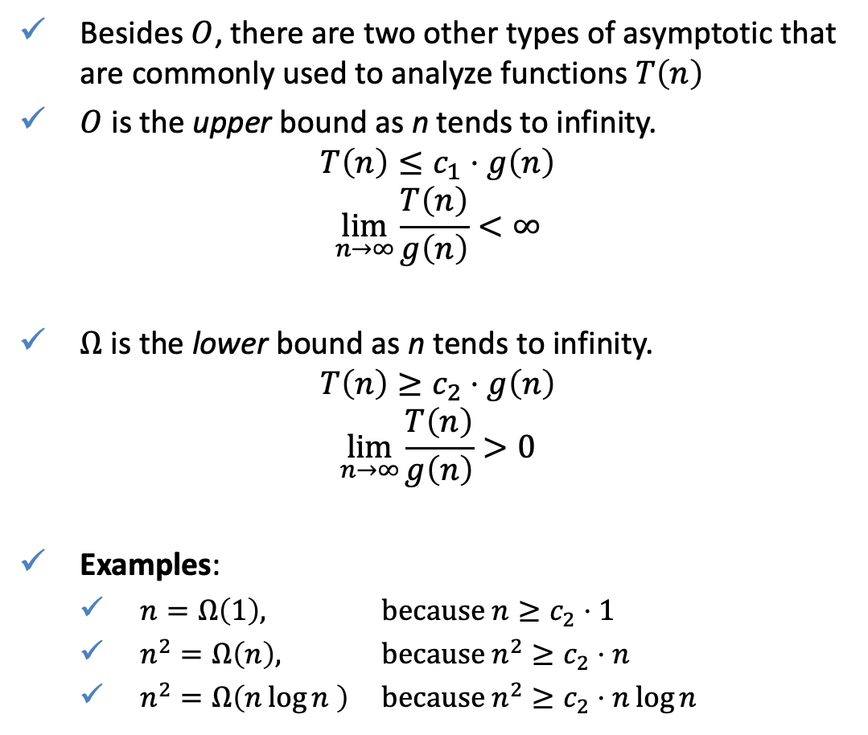



Big O, Big Omega, Big Theta
Besides $O$, there are two other types of asymptotic that are commonly used to analyze functions $T\left(n\right)$
$O$ is the upper bound as n tends to infinity.
$$T\left(n\right)≤c_{1}⋅g\left(n\right)$$
$$\lim_{n→∞}{\frac{T\left(n\right)}{g\left(n\right)}}<∞$$
$Ω$ is the lower bound as n tends to infinity.
$$T\left(n\right)≥c_{2}⋅g\left(n\right)$$
$$\lim_{n→∞}{\frac{T\left(n\right)}{g\left(n\right)}}>0$$
Examples:
$n=Ω\left(1\right),$ because $n≥c_{2}⋅1$
$n^{2}=Ω\left(n\right),$ because $n^{2}≥c_{2}⋅n$
$n^{2}=Ω\left(n\log{n} \right)$ because $n^{2}≥c_{2}⋅n\log{n}$
$$c_{1}⋅g\left(n\right)$$
$$T\left(n\right)$$
$$T\left(n\right)$$
$$c_{2}⋅g\left(n\right)$$

Slide 16

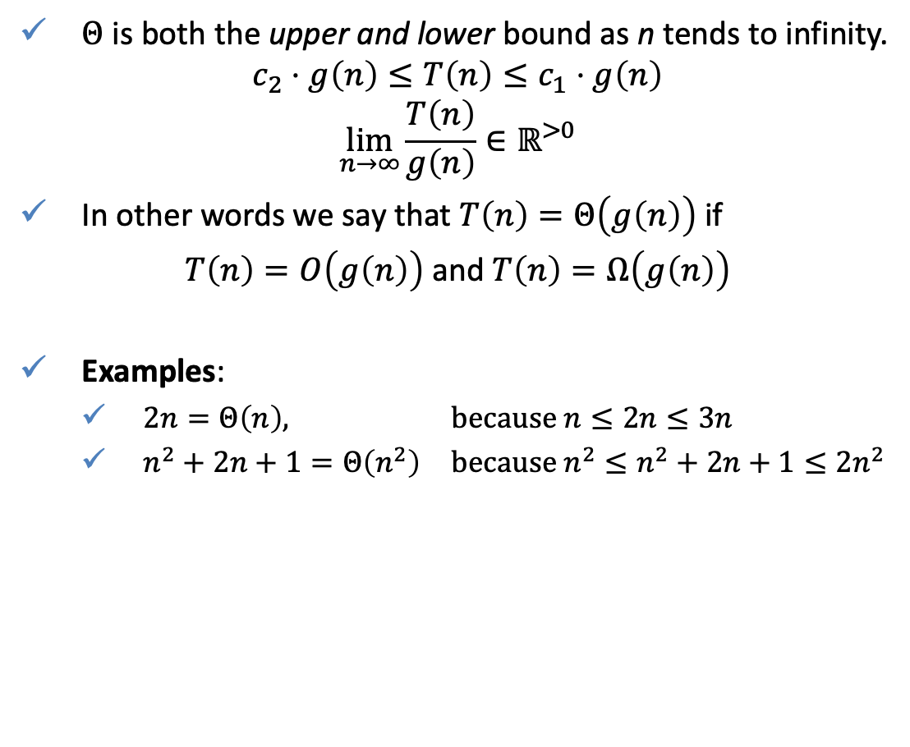


Big O, Big Omega, Big Theta
$Θ$ is both the upper and lower bound as n tends to infinity.
$$c_{2}⋅g\left(n\right)≤T\left(n\right)≤c_{1}⋅g\left(n\right)$$
$$\lim_{n→∞}{\frac{T\left(n\right)}{g\left(n\right)}}∈ℝ^{>0}$$
In other words we say that $T\left(n\right)=Θ\left(g\left(n\right)\right)$ if
$T\left(n\right)=O\left(g\left(n\right)\right)$ and $T\left(n\right)=Ω\left(g\left(n\right)\right)$
Examples:
$2n=Θ\left(n\right),$ because $n≤2n≤3n$
$n^{2}+2n+1=Θ\left(n^{2}\right)$ because $n^{2}≤n^{2}+2n+1≤2n^{2}$
$$c_{1}⋅g\left(n\right)$$
$$T\left(n\right)$$
$$c_{2}⋅g\left(n\right)$$

Slide 17
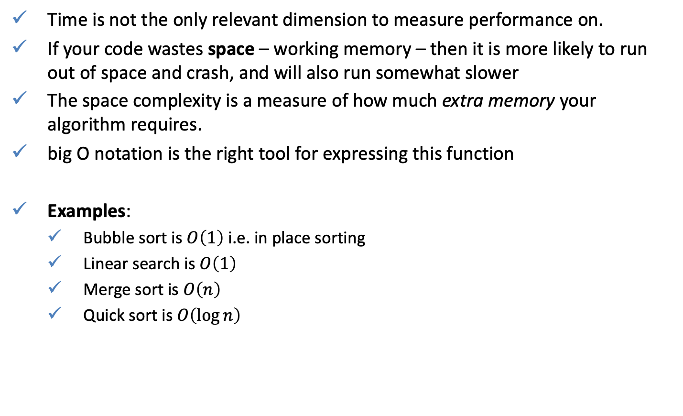
Space efficiency
Time is not the only relevant dimension to measure performance on.
If your code wastes space – working memory – then it is more likely to run out of space and crash, and will also run somewhat slower
The space complexity is a measure of how much extra memory your algorithm requires.
big O notation is the right tool for expressing this function
Examples:
Bubble sort is $O\left(1\right)$ i.e. in place sorting
Linear search is $O\left(1\right)$
Merge sort is $O\left(n\right)$
Quick sort is $O\left(\log{n}\right)$

Slide 18
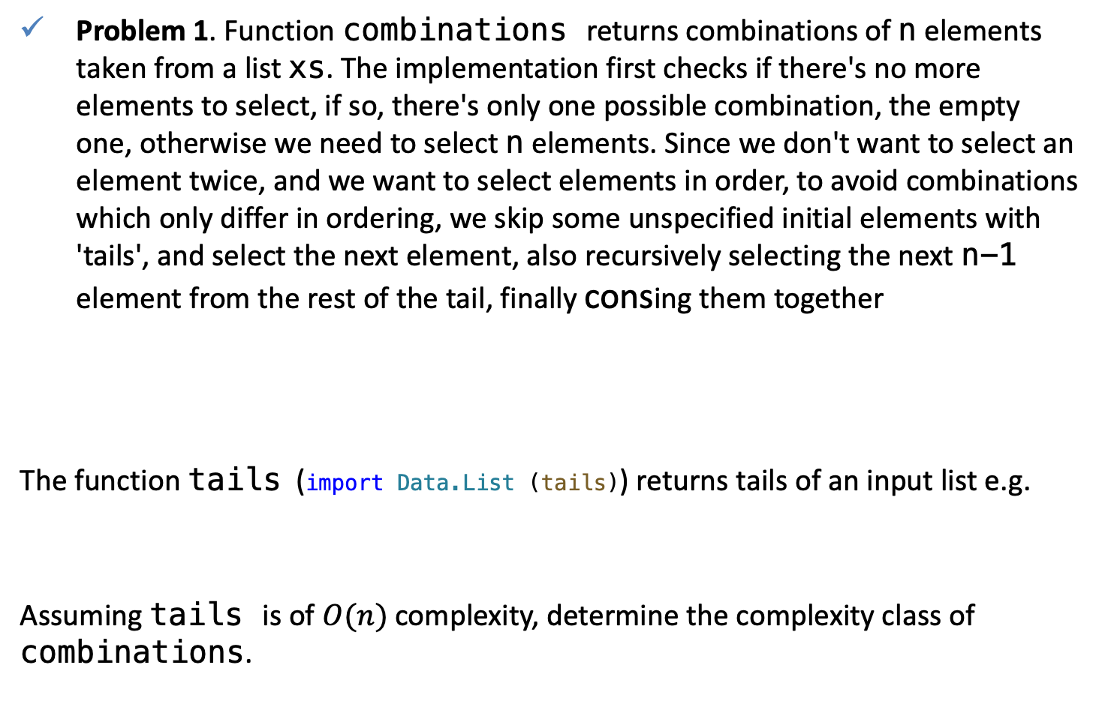
QUIZ
Problem 1. Function combinations returns combinations of n elements taken from a list xs. The implementation first checks if there's no more elements to select, if so, there's only one possible combination, the empty one, otherwise we need to select n elements. Since we don't want to select an element twice, and we want to select elements in order, to avoid combinations which only differ in ordering, we skip some unspecified initial elements with 'tails', and select the next element, also recursively selecting the next n-1 element from the rest of the tail, finally consing them together
The function tails (import Data.List (tails)) returns tails of an input list e.g.
Assuming tails is of $O(n)$ complexity, determine the complexity class of combinations.
combinations :: Int -> [a] -> [[a]]
combinations 0 _ = [ [] ]
combinations n xs = [ y:ys | y:xs' <- tails xs, ys <- combinations (n-1) xs']
>tails [1,2,3]
[[1,2,3],[2,3],[3],[]]
Notes:
https://wiki.haskell.org/99_questions/Solutions/26

