Slide 1
Lecture 10C
Searching and Sorting
COMP 1100

Slide 2
Acknowledgement of Country
I wish to acknowledge the traditional custodians of the land we are meeting on, the Ngunnawal people. I wish to acknowledge and respect their continuing culture and the contribution they make to the life of this city and this region. I would also like to acknowledge and welcome any other Aboriginal and Torres Strait Islander people who are enrolled in our courses.

Slide 3
Search
A search algorithm retrieves information stored within some data structure, or calculated in the search space of a problem domain, either with discrete or continuous values.
Examples of search problems are
  choosing the best move (say in checkers) to make next
  retrieving a record from a database by matching an (integer) identifier

Slide 4
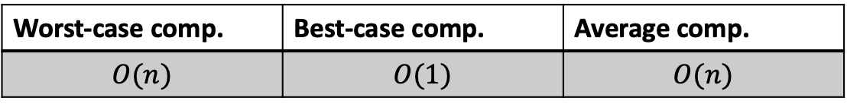
Linear Search
Search can be defined so long as the underlying data type is in Eq. But (==) might be an expensive operation.
Define a function that tests whether a value is an element of a list or not
linsearch :: Eq a => a -> [a] -> Int
linsearch _ [] = -1
linsearch y xs = head [i | (x,i) <- zip xs [0..], y == x]
Worst-case comp. | Best-case comp. | Average comp.
$$O(n)$$ | $$O(1)$$ | $$O(n)$$
linElem :: Eq a => a -> [a] -> Bool
linElem _ [] = False
linElem y xs = not (null [i | (x,i) <- zip xs [0..], y == x])

Slide 5
Search in a binary search tree
Binary search finds the position of a target value within a sorted array
Example: Find 7 in
1
1 | 3 | 4 | 6 | 7 | 8 | 10 | 13 | 14 | 18 | 19 | 21 | 24 | 37 | 40 | 45 | 71
2
4
3
14
6
24
3
8
19
40
1
4
7
10
18
21
37
45
13
71

Slide 6
Search in a binary search tree
Binary search
  Compares the target value to the middle element of the array.
  If they are not equal, the half in which the target cannot lie is eliminated and the search continues on the remaining half.
  If the search ends with the remaining half being empty, the target is not in the array.
Define a function that tests whether a value is an element of a list or not
data BSTree a = Null | Node (BSTree a) a (BSTree a)
binElem :: Ord a => a -> BSTree a -> Bool
binElem x tree = case tree of
Null -> False
Node left node right
    | x < node -> binElem x left
    | x == node -> True
    | otherwise -> binElem x right

Slide 7
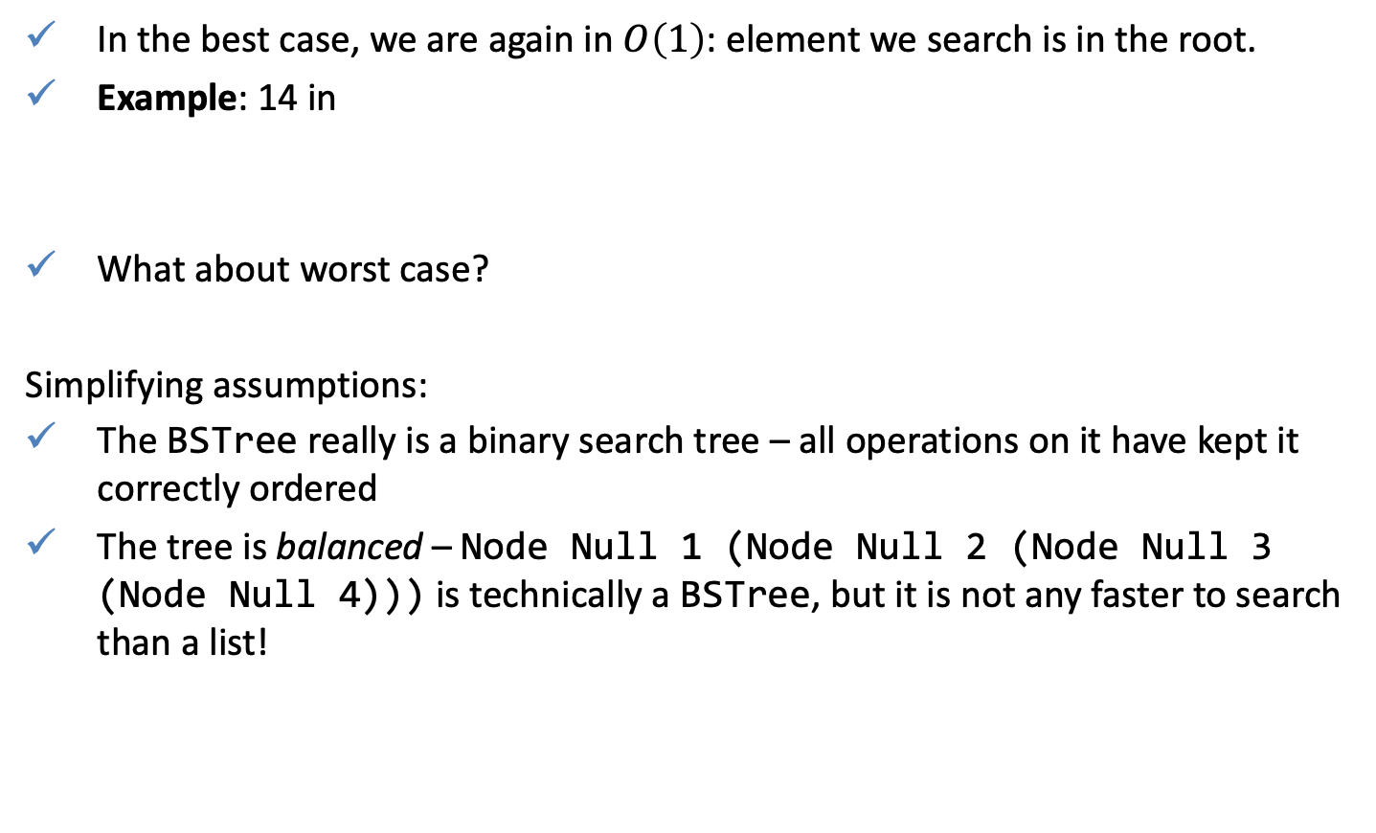
Search in a binary search tree
In the best case, we are again in $O\left(1\right)$: element we search is in the root.
Example: 14 in
What about worst case?
Simplifying assumptions:
The BSTree really is a binary search tree – all operations on it have kept it correctly ordered
The tree is balanced – Node Null 1 (Node Null 2 (Node Null 3 (Node Null 4))) is technically a BSTree, but it is not any faster to search than a list!
1
1 | 3 | 4 | 6 | 7 | 8 | 10 | 13 | 14 | 18 | 19 | 21 | 24 | 37 | 40 | 45 | 71
1
2
Not balanced
3
5
Notes:
4

Slide 8
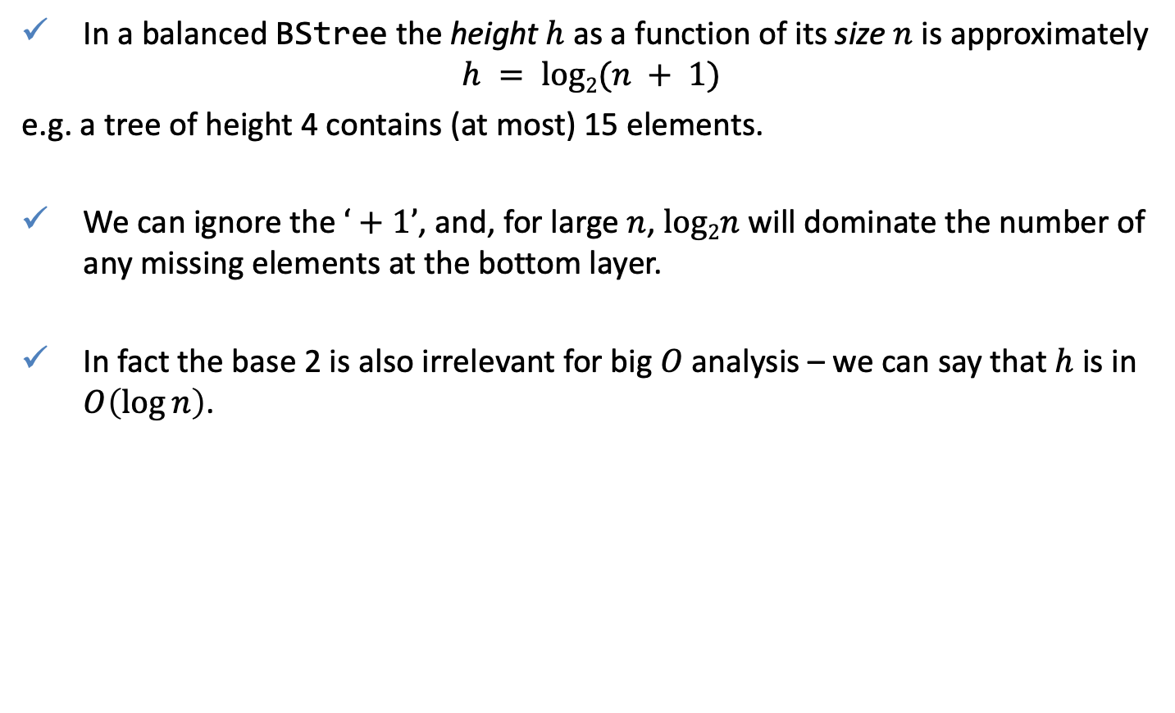
Height of a binary search tree
In a balanced BStree the height $h$ as a function of its size $n$ is approximately
$$h = log2(n + 1)$$
e.g. a tree of height 4 contains (at most) 15 elements.
We can ignore the $‘+1’$, and, for large $n$, $log2n$ will dominate the number of any missing elements at the bottom layer.
In fact the base 2 is also irrelevant for big $O$ analysis – we can say that $h$ is in $O\left(\log{n}\right)$.

Slide 9

Worst and average case analyses of binElem
In the worst case binsearch looks at one element for every layer of the tree, so it is in $O(\log{n})$.
1
1 | 3 | 4 | 6 | 7 | 8 | 10 | 13 | 14 | 18 | 19 | 21 | 24 | 37 | 40 | 45 | 71
2
3
4
14
6
24
3
8
19
40
1
4
7
10
18
21
37
45
13
71

Slide 10

Worst and average case analyses of binElem
The average height of an element in a tree can be approximated as $log2(n−1)$, so the average case analysis for search is again $O(\log{n})$.
15
Expected level
16

Slide 11
Compare linElem and binElem
> :set +s
> linElem 100000 [1.. 10000000000]
True
(0.15 secs, 28,076,408 bytes)
> linElem 1000000 [1.. 10000000000]
True
(0.26 secs, 280,073,672 bytes)
> linElem 10000000 [1.. 10000000000]
True
(2.63 secs, 2,800,073,672 bytes)
> linElem 100000000 [1.. 10000000000]
True
(26.41 secs, 28,000,073,672 bytes)
> :set +s
> binElem 100000 (buildBalanced 1 10000000000)
True
(0.00 secs, 103,640 bytes)
> binElem 1000000 (buildBalanced 1 10000000000)
True
(0.00 secs, 104,360 bytes)
> binElem 10000000 (buildBalanced 1 10000000000)
True
(0.00 secs, 100,328 bytes)
> binElem 100000000 (buildBalanced 1 10000000000)
True
(0.00 secs, 104,472 bytes)
Notes:
% Matlab code that plots the figure
n = [100000, 1000000, 10000000, 100000000];
%t = [0.4, 1.16, 4.84, 21.54];
%coef = polyfit(n,t,2)
t = log(n) / n(1);
f = @(B,x) B(1) .* log(x) + B(2)
coef = nlinfit(n, t, f, [1,1])
figure('color', 'white'), hold on;
plot(n, t, 'x:', 'linewidth', 4)
n_ = [100000:100000:110000000];
plot(n_, coef(1)*log(n_) + coef(2), 'linewidth', 2)
xlabel('number of elements in the list');
ylabel('time');
legend({'true', 'approximated'})

Slide 12
Compare linsearch and binsearch
buildBalanced :: Integral a => a -> a -> BSTree a
buildBalanced start end
  | start > end = Null
  | otherwise = Node (buildBalanced start (middle-1))
  middle
  (buildBalanced (middle+1) end)
where
middle = div (start + end) 2

Slide 13
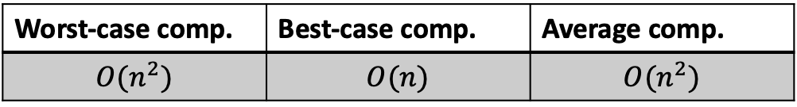
Sort
A sorting algorithm that puts elements of a list in a certain order. Sorted lists are much faster to search in.
The output of any sorting algorithm must satisfy two conditions:
  The output is in nondecreasing order
  The output is a permutation of the input.
Example: bubble sort complexity
Worst-case comp. | Best-case comp. | Average comp.
$$O(n^{2})$$ | $$O(n)$$ | $$O(n^{2})$$

Slide 14
Insertion Sort
Given a list [3,2,1,4] sort a list of numbers into ascending order.
Suppose the tail is sorted somehow to get [1,2,4]
Insert the head element 3 at the proper position in the sorted tail to get [1,2,3,4]
The tail is sorted ‘somehow’ by recursion, of course!

Slide 15
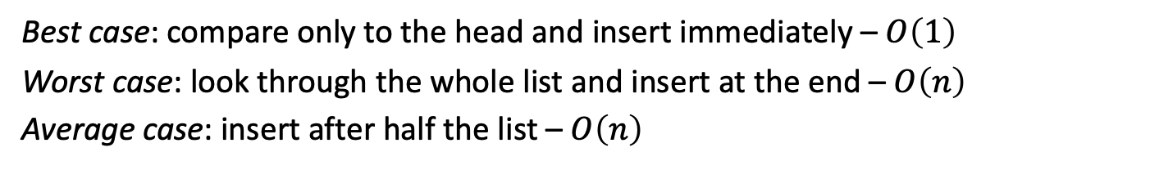
Insertion
A function that inserts a new element into a sorted list to give another sorted list
insert :: Ord a => a -> [a] -> [a]
insert x [] = [x]
insert x (y:ys) | x <= y = x:y:ys
| otherwise = y : insert x ys
> insert 3 [1,2,4,5]
[1,2,3,4,5]
insert 3 [1,2,4,5]
= {applying insert}
1 : insert 3 [2,4,5]
= {applying insert}
1 : 2 : insert 3 [4,5]
= {applying insert}
1 : 2 : 3 : [4,5]
= {list notation}
[1,2,3,4,5]
+ 1 operation: comparison
+ 1 operation: comparison
+ 1 operation: comparison
This case: 3 op-s out of 4
Best case: 1 op.
Wort case: 4 op-s out of 4
Best case: compare only to the head and insert immediately – $O\left(1\right)$
Worst case: look through the whole list and insert at the end – $O\left(n\right)$
Average case: insert after half the list – $O\left(n\right)$

Slide 16
Insertion Sort
Using insert we can define a function that implements insertion sort.
Any non-empty list is sorted by inserting its head into the list that results from sorting its tail.
iSort :: Ord a => [a] -> [a]
iSort [] = []
iSort (x:xs) = insert x (iSort xs)
iSort [3,2,1,4]
[1,2,3,4]
iSort [3,2,1,4]
= {applying iSort}
insert 3 (insert 2 (insert 1 (insert 4 [])))
= {applying insert}
insert 3 (insert 2 (insert 1 [4]))
= {applying insert}
insert 3 (insert 2 [1,4])
= {applying insert}
insert 3 [1,2,4]
= {applying insert}
[1,2,3,4]
Best case: the list is already sorted, so each element is put onto the head of the list immediately – $O(n)$

Slide 17
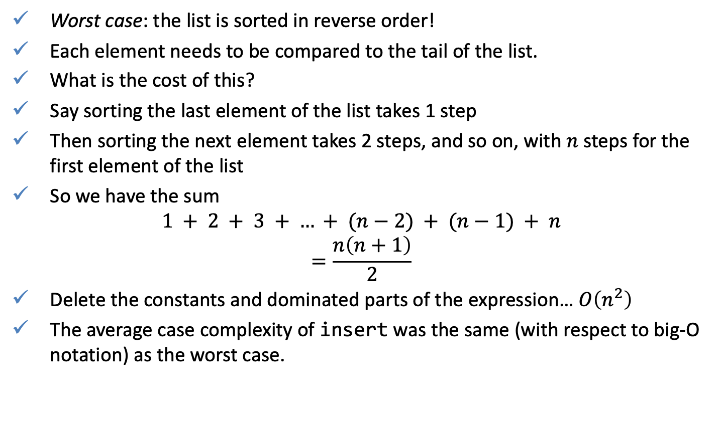
Complexity of Insertion Sort
Worst case: the list is sorted in reverse order!
Each element needs to be compared to the tail of the list.
What is the cost of this?
Say sorting the last element of the list takes 1 step
Then sorting the next element takes 2 steps, and so on, with $n$ steps for the first element of the list
So we have the sum
$$1 + 2 + 3 + … + (n−2) + (n−1) + n$$
$$=\frac{n\left(n+1\right)}{2}$$
Delete the constants and dominated parts of the expression… $O\left(n^{2}\right)$
The average case complexity of insert was the same (with respect to big-O notation) as the worst case.

Slide 18
Bubble sort VS Insertion sort
Insertion sort is memory efficient (only requires O(1) of additional memory space)
>:set +s
>s0 = (rand $! 10000) $! 0
>s1 = (rand $! 50000) $! 1
>s2 = (rand $! 100000) $! 2
>s3 = (rand $! 250000) $! 3
>s4 = (rand $! 500000) $! 4
>s5 = (rand $! 1000000) $! 5
>last (bubbleSort s0)
>last (bubbleSort s1)
>last (bubbleSort s2)
>last (bubbleSort s3)
>last (bubbleSort s4)
>last (bubbleSort s5)
>:set +s
>s0 = (rand $! 10000) $! 0
>s1 = (rand $! 50000) $! 1
>s2 = (rand $! 100000) $! 2
>s3 = (rand $! 250000) $! 3
>s4 = (rand $! 500000) $! 4
>s5 = (rand $! 1000000) $! 5
>last (iSort s0)
>last (iSort s1)
>last (iSort s2)
>last (iSort s3)
>last (iSort s4)
>last (iSort s5)
rand was implemented in previous lectures
Notes:
% Matlab code that plots Bubble sort results
n1 = [100, 500, 1000, 2500, 5000, 10000];
t1 = [0.01, 0.11, 0.29, 1.81, 7.41, 35.78];
s1 = [2878720, 84033920, 385349664, 2306721792, 9315169568, 37374473568]/10^9;
coef1 = polyfit(n1, t1, 2);
coef2 = polyfit(n1, s1, 2);
n_ = [min(n1):10:max(n1)];
figure('color', 'white'), hold on;
title('Bubblesort')
yyaxis left
ylabel('s');
plot(n1, t1, 'ob', 'linewidth', 4)
plot(n_, coef1(1)*n_.^2 + coef1(2)*n_ + coef1(3),'-b', 'linewidth', 2)
yyaxis right
ylabel('TB')
plot(n1, s1, 'or', 'linewidth', 4)
plot(n_, coef2(1)*n_.^2 + coef2(2)*n_ + coef2(3),'-r', 'linewidth', 2)
xlabel('n');
legend({'$$T(Sort(n))$$', '$$\hat{T}(Sort(n))$$','$$S(Sort(n))$$', '$$\hat{S}(Sort(n))$$'}, 'FontSize', 14, 'Location', 'best', 'Interpreter', 'Latex')
set(gca,'FontSize',14)
% Matlab code that plots Insertion sort results
n1 = [100, 500, 1000, 2500, 5000, 10000];
t1 = [0.01, 0.02, 0.06, 0.33, 1.37, 7];
s1 = [891160, 13954264, 56224800, 371178584, 1552665696, 6382606584]/10^9;
coef1 = polyfit(n1, t1, 2);
coef2 = polyfit(n1, s1, 2);
n_ = [min(n1):10:max(n1)];
figure('color', 'white'), hold on;
title('Insertion sort')
yyaxis left
ylabel('s');
plot(n1, t1, 'ob', 'linewidth', 4)
plot(n_, coef1(1)*n_.^2 + coef1(2)*n_ + coef1(3),'-b', 'linewidth', 2)
yyaxis right
ylabel('TB')
plot(n1, s1, 'or', 'linewidth', 4)
plot(n_, coef2(1)*n_.^2 + coef2(2)*n_ + coef2(3),'-r', 'linewidth', 2)
xlabel('n');
legend({'$$T(Sort(n))$$', '$$\hat{T}(Sort(n))$$','$$S(Sort(n))$$', '$$\hat{S}(Sort(n))$$'}, 'FontSize', 14, 'Location', 'best', 'Interpreter', 'Latex')
set(gca,'FontSize',14)

Slide 19
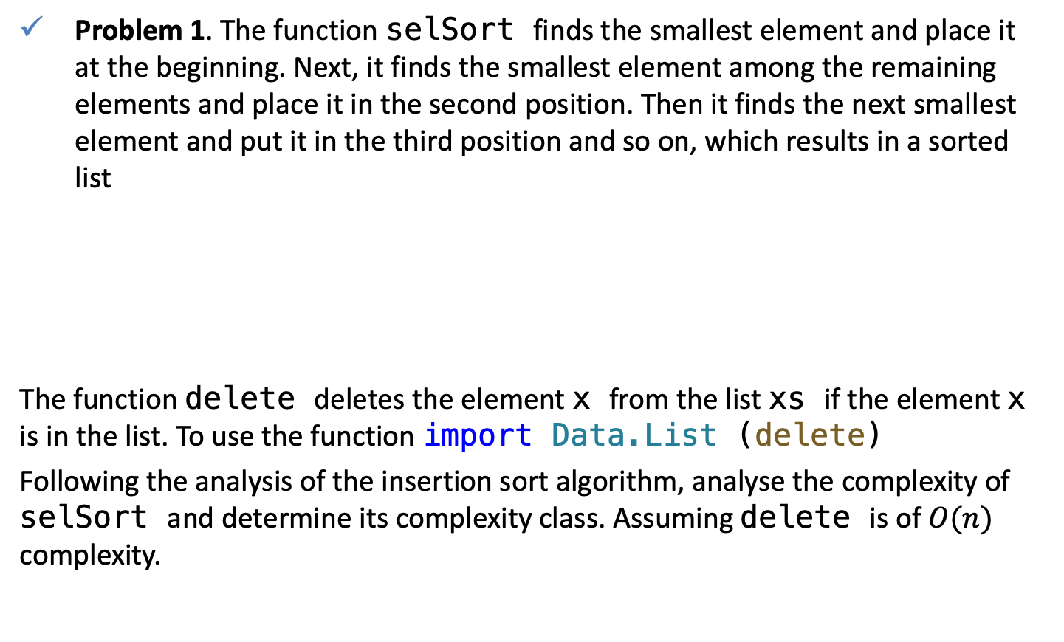
QUIZ
Problem 1. The function selSort finds the smallest element and place it at the beginning. Next, it finds the smallest element among the remaining elements and place it in the second position. Then it finds the next smallest element and put it in the third position and so on, which results in a sorted list
The function delete deletes the element x from the list xs if the element x is in the list. To use the function import Data.List (delete)
Following the analysis of the insertion sort algorithm, analyse the complexity of selSort and determine its complexity class. Assuming delete is of $O(n)$ complexity.
selSort :: (Ord a) => [a] -> [a]
selSort [] = []
selSort xs = selSort (delete x xs) ++ [x]
where x = maximum xs

Slide 20
QUIZ
Problem 2. Analyze the graphs and answer the questions:
  Which algorithm is the most memory efficient ?
  Which algorithm is the fastest?
  Which algorithm is worst in terms memory efficiency?
Notes:
% Matlab code that plots Selection sort results
n1 = [100, 500, 1000, 2500, 5000, 10000];
t1 = [0.005, 0.01, 0.03, 0.23, 0.82, 3.54];
s1 = [993480, 17725512, 89563288, 675426520, 2768001304, 11228058584]/10^9;
coef1 = polyfit(n1, t1, 2);
coef2 = polyfit(n1, s1, 2);
n_ = [min(n1):10:max(n1)];
figure('color', 'white'), hold on;
title('Selection sort')
yyaxis left
ylabel('s');
plot(n1, t1, 'ob', 'linewidth', 4)
plot(n_, coef1(1)*n_.^2 + coef1(2)*n_ + coef1(3),'-b', 'linewidth', 2)
yyaxis right
ylabel('TB')
plot(n1, s1, 'or', 'linewidth', 4)
plot(n_, coef2(1)*n_.^2 + coef2(2)*n_ + coef2(3),'-r', 'linewidth', 2)
xlabel('n');
legend({'$$T(Sort(n))$$', '$$\hat{T}(Sort(n))$$','$$S(Sort(n))$$', '$$\hat{S}(Sort(n))$$'}, 'FontSize', 14, 'Location', 'best', 'Interpreter', 'Latex')
set(gca,'FontSize',14)

