Slide 1
Lecture 11A
Divide and Conquer algorithms
Implementation aspects
COMP 1100

Slide 2
Acknowledgement of Country
I wish to acknowledge the traditional custodians of the land we are meeting on, the Ngunnawal people. I wish to acknowledge and respect their continuing culture and the contribution they make to the life of this city and this region. I would also like to acknowledge and welcome any other Aboriginal and Torres Strait Islander people who are enrolled in our courses.

Slide 3
Divide-and-Conquer Algorithm
A divide-and-conquer algorithm works by recursively breaking down a problem into two or more sub-problems of the same or related type, until these become simple enough to be solved directly.
Merge sort and quicksort are divide-and-conquer sorting algorithms

Slide 4
Merge Sort
Intuition: sorting a list is hard…
  But sorting a list of half the size would be easier (Divide)
  But it is easy to combine two sorted lists into one sorted list (Conquer)
38 | 27 | 43 | 3 | 9 | 82 | 10
divide
38 | 27 | 43 | 3
9 | 82 | 10
divide
38 | 27
43 | 3
9 | 82
10
merge
38
27
43
3
9
82
10
merge
27 | 38
3 | 43
9 | 82
10
merge
3 | 27 | 38 | 43
9 | 10 | 82
sorted
3 | 9 | 10 | 27 | 38 | 43 | 82

Slide 5
Merge
merge :: Ord a => [a] -> [a] -> [a]
merge list1 list2 = case (list1,list2) of
(list,[]) -> list
([],list) -> list
(x:xs,y:ys)
    | x <= y -> x : merge xs (y:ys)
    | otherwise -> y : merge (x:xs) ys
merge [9,82] [10]
= {applying merge}
= {applying (list1,list2)}
([9,82], [10])
= {applying (x:xs,y:ys)}
(9:(82:[]), 10:[])
= {applying x <= y and guard}
9 : merge (82:[]) (10:[])
= {applying merge}
= {applying (list1,list2)}
([82], [10])
= {applying (x:xs,y:ys)}
((82:[]), (10:[]))
= {applying x <= y and guard}
10 : merge (82:[]) ([])
= {applying merge}
= {applying (list1,list2)}
([82], [])
= {applying the base case}
((82:[]),[]) -> (82:[])
= {applying cons}
10:(82:[])
= {applying cons}
9:(10:(82:[]))
merge
9 | 82
10
9 <= 10
9
9 | 10 | 82
9 : merge (82:[]) (10:[])
1 comparison

Slide 6



Complexity of Merge
Assuming the two lists are of equal length, let $n$ be the list of the two combined.
Best case: one list contains elements all smaller than the other. Only need roughly $n/2$comparisons – $O\left(n\right)$
5 | 9
14 | 17
14 | 17
5 | 9
$n=4$ elements
5
9
14 | 17
5
14 | 17
9
$n/2=2$ compar.
5
9
[]
14 | 17
5
9
14 | 17
[]
5
9
14 | 17
5
9
14 | 17

Slide 7



Complexity of Merge
Worst case: Every element gets looked at, but we are always ‘dealing with’ one element per step – $O\left(n\right)$
Average case: since the best and the worst case are $O\left(n\right)$ so is the average case.
5 | 14
9 | 17
$n=4$ elements
5
14
9 | 17
5
9
14
17
$n−1$ compar.
5
9
14
[]
17
5
9
14
17

Slide 8
Merge Sort
mergeSort :: Ord a => [a] -> [a]
mergeSort list = case list of
  [] -> []
  [x] -> [x]
_ -> merge (mergeSort firstHalf) (mergeSort secondHalf)
where
    firstHalf = take half list
    secondHalf = drop half list
    half = div (length list) 2

Slide 9




Complexity of Merge Sort
Much like Insertion Sort, at every step Merge Sort is $O(n)$
  Length, Taking the first half, Taking the second half, Merging all $O(n)$
  At the next step there are twice as many mergesort, but each is working with a list only half the length, so still $O(n)$!
But how many steps are there?
We half the list lengths repeatedly, i.e. call on $n, n/2, …,16, 8, 4, 2$
merge
$$n$$
38
27
43
3
9
82
10
$$\frac{n}{2}$$
merge
27 | 38
3 | 43
9 | 82
10
$$\frac{n}{4}$$
merge
3 | 27 | 38 | 43
9 | 10 | 82
3 | 9 | 10 | 27 | 38 | 43 | 82

Slide 10




Complexity of Merge Sort
So if we started with length $7$, there would 3 steps =$\left\lceil log2(7)\right\rceil$
Cost of $O(n)$ per step times $O(log⁡n)$ steps = $O(n log⁡n)$
Best, worst, and average the same!
merge
$$n$$
38
27
43
3
9
82
10
$$\frac{n}{2}$$
merge
27 | 38
3 | 43
9 | 82
10
$$\frac{n}{4}$$
merge
3 | 27 | 38 | 43
9 | 10 | 82
3 | 9 | 10 | 27 | 38 | 43 | 82

Slide 11
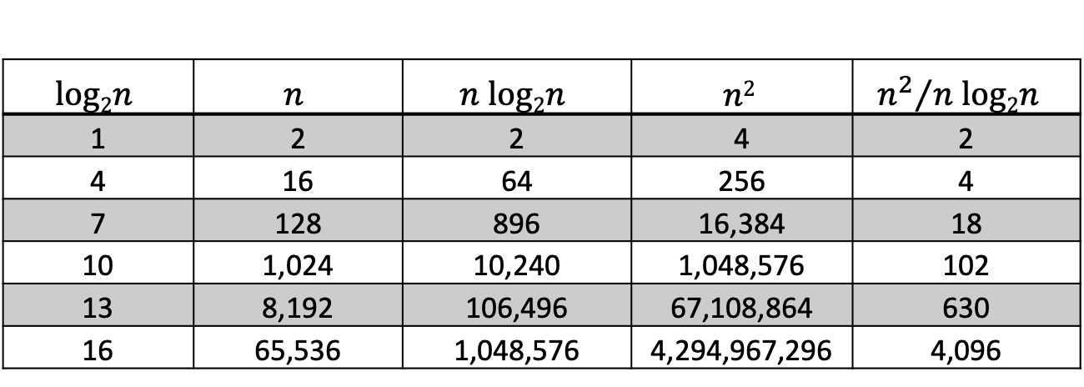
Comparison
$$log2n$$ | $$n$$ | $$n log2n$$ | $$n2$$ | $${n^{2}}/{n log2n }$$
1 | 2 | 2 | 4 | 2
4 | 16 | 64 | 256 | 4
7 | 128 | 896 | 16,384 | 18
10 | 1,024 | 10,240 | 1,048,576 | 102
13 | 8,192 | 106,496 | 67,108,864 | 630
16 | 65,536 | 1,048,576 | 4,294,967,296 | 4,096
Binary search
Linear search*
Merge sort
Quick sort*
Bubble sort*
Insertion sort*
Selection sort*
*average case

Slide 12
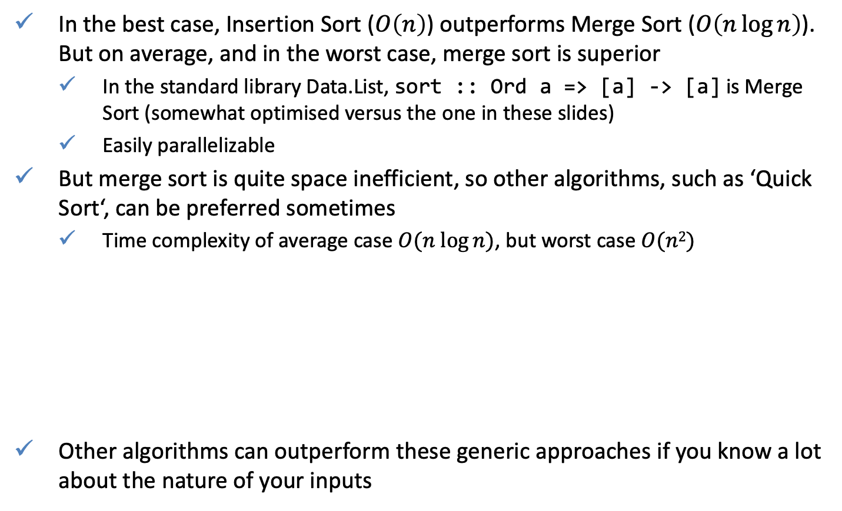
Comparison of Sorting Algorithms
In the best case, Insertion Sort ($O\left(n\right)$) outperforms Merge Sort ($O\left(n\log{n}\right)$). But on average, and in the worst case, merge sort is superior
  In the standard library Data.List, sort :: Ord a => [a] -> [a] is Merge Sort (somewhat optimised versus the one in these slides)
  Easily parallelizable
But merge sort is quite space inefficient, so other algorithms, such as ‘Quick Sort‘, can be preferred sometimes
  Time complexity of average case $O(n log⁡n)$, but worst case $O(n2)$
Other algorithms can outperform these generic approaches if you know a lot about the nature of your inputs
quickSort :: [Integer] -> [Integer]
quickSort [] = []
quickSort (x:xs) = quickSort smaller ++ [x] ++ quickSort larger
where
smaller = [a | a <- xs, a <= x]
larger = [b | b <- xs, b > x]

Slide 13
Merge and Quick sorts
>:set +s
>s0 = (rand $! 10000) $! 0
>s1 = (rand $! 50000) $! 1
>s2 = (rand $! 100000) $! 2
>s3 = (rand $! 250000) $! 3
>s4 = (rand $! 500000) $! 4
>s5 = (rand $! 1000000) $! 5
>last (mergeSort s0)
>last (mergeSort s1)
>last (mergeSort s2)
>last (mergeSort s3)
>last (mergeSort s4)
>last (mergeSort s5)
>:set +s
>s0 = (rand $! 10000) $! 0
>s1 = (rand $! 50000) $! 1
>s2 = (rand $! 100000) $! 2
>s3 = (rand $! 250000) $! 3
>s4 = (rand $! 500000) $! 4
>s5 = (rand $! 1000000) $! 5
>last (quickSort s0)
>last (quickSort s1)
>last (quickSort s2)
>last (quickSort s3)
>last (quickSort s4)
>last (quickSort s5)
Notes:
% Matlab code that plots Merge sort results
n1 = [10000, 50000, 100000, 250000, 500000, 1000000];
t1 = [0.1, 0.53, 1.22, 3.21, 6.65, 15.51];
s1 = [67369528, 373170448, 777791840, 2048925312, 4255939992, 8827934000]/10^9;
coef1 = polyfit(n1, t1, 1);
coef2 = polyfit(n1, s1, 1);
n_ = [min(n1):10:max(n1)];
figure('color', 'white'), hold on;
title('Merge sort')
yyaxis left
ylabel('s');
plot(n1, t1, 'ob', 'linewidth', 4)
plot(n_, coef1(1)*n_ + coef1(2),'-b', 'linewidth', 2)
yyaxis right
ylabel('TB')
plot(n1, s1, 'or', 'linewidth', 4)
plot(n_, coef2(1)*n_ + coef2(2),'-r', 'linewidth', 2)
xlabel('n');
legend({'$$T(Sort(n))$$', '$$\hat{T}(Sort(n))$$','$$S(Sort(n))$$', '$$\hat{S}(Sort(n))$$'}, 'FontSize', 14, 'Location', 'best', 'Interpreter', 'Latex')
set(gca,'FontSize',14)
% Matlab code that plots Quick sort results
n1 = [10000, 50000, 100000, 250000, 500000, 1000000];
t1 = [0.16, 0.77, 1.87, 3.45, 7.71, 17.09];
s1 = [64540512, 365182384, 706780848, 1866336792, 3950715848, 8203637024]/10^9;
coef1 = polyfit(n1, t1, 1);
coef2 = polyfit(n1, s1, 1);
n_ = [min(n1):10:max(n1)];
figure('color', 'white'), hold on;
title('Quick sort')
yyaxis left
ylabel('s');
plot(n1, t1, 'ob', 'linewidth', 4)
plot(n_, coef1(1)*n_ + coef1(2),'-b', 'linewidth', 2)
yyaxis right
ylabel('TB')
plot(n1, s1, 'or', 'linewidth', 4)
plot(n_, coef2(1)*n_ + coef2(2),'-r', 'linewidth', 2)
xlabel('n');
legend({'$$T(Sort(n))$$', '$$\hat{T}(Sort(n))$$','$$S(Sort(n))$$', '$$\hat{S}(Sort(n))$$'}, 'FontSize', 14, 'Location', 'best', 'Interpreter', 'Latex')
set(gca,'FontSize',14)

Slide 14
Implementation aspects:
Space VS Time
Recall the function subs (implemented in the lecture on the countdown)
subs is evaluated twice! (slow)
Consider a slightly different implementation
subs’ is evaluated once. (fast)
However, even thought subs (x:xs) constructs this list once it retains the expression in the memory (space leak) because its value is used again.
There is a fundamental dichotomy: to avoid doing something twice we have use up space to store the result of doing it once.
data Coin = Tail | Head deriving Show
> subs [Tail, Head]
[[],[Head],[Tail],[Tail,Head]]
set of all subsets (aka powerset)
subs :: [a] -> [[a]]
subs [] = [[]]
subs (x:xs) = (subs xs) ++ map (x:) (subs xs)
subs’ :: [a] -> [[a]]
subs [] = [[]]
subs’ (x:xs) = xss ++ map (x:) xss
where xss = subs’ xs

Slide 15
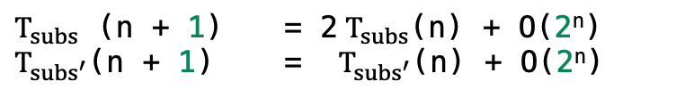
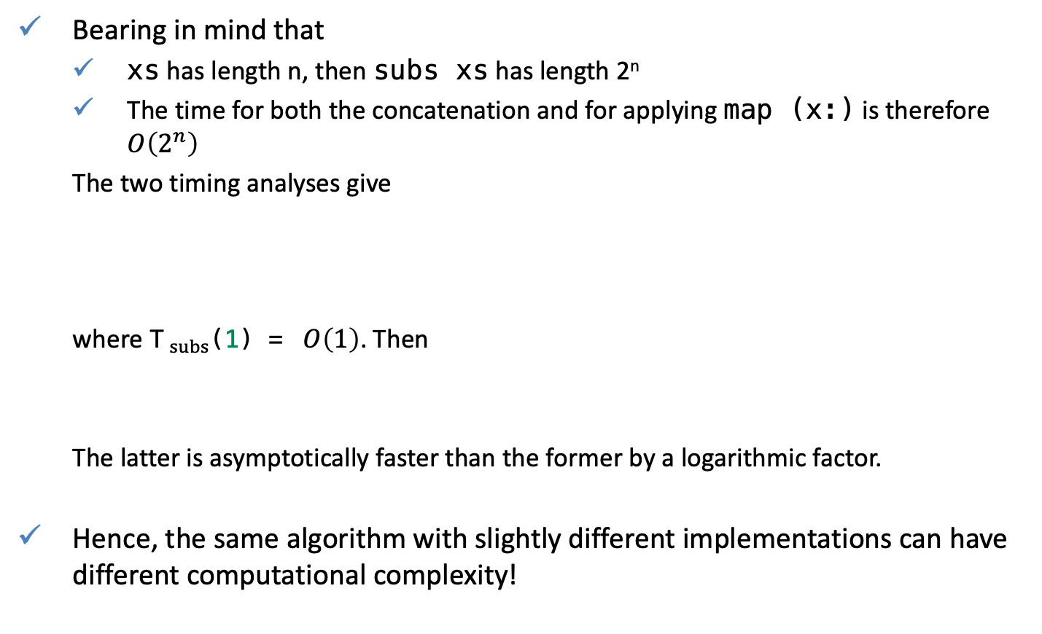
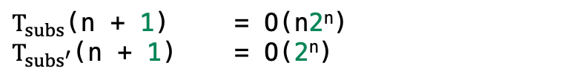
Complexity of subs vs subs’
Bearing in mind that
  xs has length n, then subs xs has length 2^{n}
  The time for both the concatenation and for applying map (x:) is therefore $O\left(2^{n}\right)$
  The two timing analyses give
  where T$_{subs}$(1) = $O\left(1\right)$. Then
  The latter is asymptotically faster than the former by a logarithmic factor.
Hence, the same algorithm with slightly different implementations can have different computational complexity!
$T_{subs}$ (n + 1) = 2 $T_{subs}$(n) + O(2^{n})
$T_{{subs}^{′}}$(n + 1) = $T_{{subs}^{′}}$(n) + O(2^{n})
$T_{subs}$(n + 1) = O(n2^{n})
$T_{{subs}^{′}}$(n + 1) = O(2^{n})

Slide 16
Implementation aspects
Consider the following two almost identical definitions
After evaluation of foo2, primes points to a list in which the first 5000 primes appear explicitly.
The second evaluation of foo2 5000 does not require these primes to be computed again.
Internally, primes now occupies at least 5000 units of space.
foo1 n = sum (take n primes)
where
  primes = [x | x <- [2..], divisors x == [x]]
  divisors x = [d | d <- [2..x], x `mod` d == 0]
foo2 n = sum (take n primes)
primes = [x | x <- [2..], divisors x == [x]]
divisors x = [d | d <- [2..x], x `mod` d == 0]
>:set +s
> foo1 5000
114455259
(53.58 secs, 31,253,803,616 bytes)
> foo1 5000
114455259
(53.14 secs, 31,253,803,616 bytes)
> foo2 5000
114455259
(45.44 secs, 26,790,568,400 bytes)
> foo2 5000
114455259
(0.00 secs, 800,112 bytes)

Slide 17
QUIZ
Problem 1: Following the mergesort analysis, analyse the complexity of quicksort.
Problem 2: Given the function combinations, find its algorithmic complexity, compare your results with the complexity you found in lecture 10B.
]
Problem 3: Following slide 13, compare the function sort implemented in Data.List to functions mergeSort and quickSort.
combinations :: Int -> [a] -> [[a]]
combinations 0 _ = [[]]
combinations _ [] = []
combinations n (x:xs) = (map (x:) (combinations (n-1) xs)) ++ (combinations n xs)

