Slide 1
Lecture 11C
Reasoning about programs
COMP 1100

Slide 2
Acknowledgement of Country
I wish to acknowledge the traditional custodians of the land we are meeting on, the Ngunnawal people. I wish to acknowledge and respect their continuing culture and the contribution they make to the life of this city and this region. I would also like to acknowledge and welcome any other Aboriginal and Torres Strait Islander people who are enrolled in our courses.

Slide 3
Induction on lists
Suppose we want to prove that some property p holds for all lists. Then the induction principle for lists states that it is sufficient to show that p holds for the empty list [], the base case, and that if p holds for any list xs, then it also holds for x:xs for any element x, the inductive case.
Example: Recall
Show that reverse is its own inverse
reverse :: [a] -> [a]
reverse [] = []
reverse (x:xs) = reverse xs ++ [x]
The base case
The recursive case
reverse (reverse [])
= {applying the inner reverse}
reverse []
= {applying reverse}
[]
reverse (reverse (x:xs))
= {applying the inner reverse}
reverse (reverse xs ++ [x])
= {distributivity (see next slide)}
reverse [x] ++ (reverse (reverse xs))
= {singleton list (see prev. lecture)}}
[x] ++ (reverse (reverse xs))
= {induction hypothesis}
[x] ++ xs
= {applying ++}
(x:xs)

Slide 4
Induction on lists
Prove that the distribution is contravariant:
Proof:
We used the fact that ++ is associative with [] as its identity.
reverse (xs ++ ys) = reverse ys ++ reverse xs
The base case
The recursive case
reverse ([] ++ ys)
= {applying ++}
reverse ys
= {identify for ++}
reverse ys ++ []
= {unapplying reverse}
reverse ys ++ reverse []
reverse ((x:xs) ++ ys)
= {applying ++}
reverse (x: (xs ++ ys))
= {applying reverse}
reverse (xs ++ ys) ++ [x]
= {induction hypothesis}
(reverse ys ++ reverse xs) ++ [x]
= {associativity of ++}
reverse ys ++ (reverse xs ++ [x])
= {unapplying the second reverse }
reverse ys ++ reverse (x:xs)

Slide 5
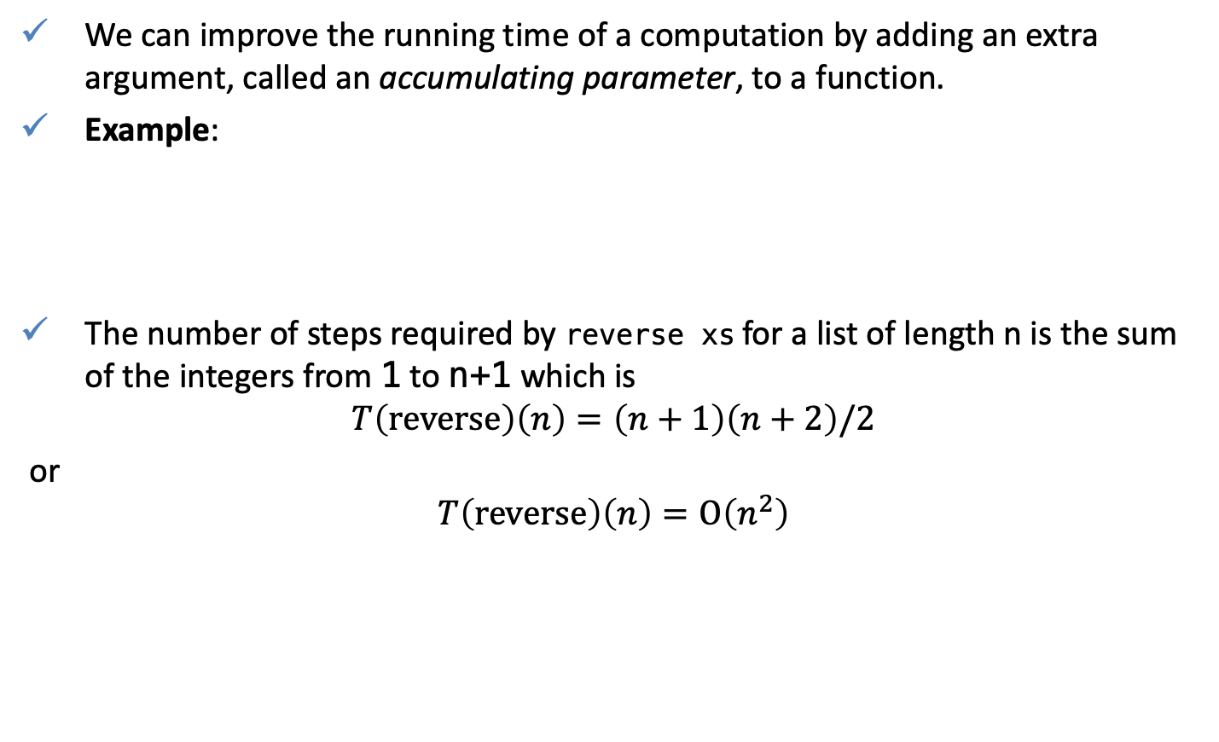
Reasoning to make the code faster
We can improve the running time of a computation by adding an extra argument, called an accumulating parameter, to a function.
Example:
The number of steps required by reverse xs for a list of length n is the sum of the integers from 1 to n+1 which is
$$T\left(reverse\right)\left(n\right)=\left(n+1\right)\left(n+2\right)/2$$
or
$$T\left(reverse\right)\left(n\right)=O\left(n^{2}\right)$$
reverse :: [a] -> [a]
reverse [] = []
reverse (x:xs) = reverse xs ++ [x]
(++) :: [a] -> [a] -> [a]
[] ++ ys = ys
(x:xs) ++ ys = x : (xs ++ ys)

Slide 6



Reasoning to make the code faster
reverse :: [a] -> [a]
reverse [] = []
reverse (x:xs) = reverse xs ++ [x]
(++) :: [a] -> [a] -> [a]
[] ++ ys = ys
(x:xs) ++ ys = x : (xs ++ ys)
For every reverse (++) is applied n times
reverse ['a','b','c’]
= {applying reverse}
reverse ['b', 'c’] ++ ['a']
= {applying reverse}
(reverse ['c’] ++ ['b']) ++ ['a']
= {applying reverse}
((reverse [] ++ ['c’]) ++ ['b']) ++ ['a']
= {applying reverse}
(([] ++ ['c’]) ++ ['b']) ++ ['a']
= {applying ++}
['c’, 'b', 'a']
['b', 'c’] ++ ['a']
= {applying ++}
'b' : (['c'] ++ ['a'])
= {applying ++}
'b' : (['c'] ++ ['a'])
= {applying ++}
'b' : ('c’: ([] ++ ['a']))
= {applying ++}
'b' : ('c': ['a'])
= {list notation}
['b', 'c', 'a']
$$O\left(n\right)$$
$$O\left(n\right)$$
$O\left(n^{2}\right)$

Slide 7
Reasoning to make the code faster
Consider the following implementation
It is clear that reverse xs = revcat xs ++ ys, so if we can obtain an efficient version of revcat we can obtain an efficient version of reverse.
Hence, an equivalent definition of revcat is
revcat :: [a] -> [a] -> [a]
revcat xs ys = reverse xs ++ ys
revcat [] ys
= {definition of revcat}
reverse [] ++ ys
= {definition of reverse}
[] ++ ys
= {definition of (++)}
ys
revcat (x:xs) ys
= {definition of revcat}
reverse (x:xs) ++ ys
= {definition of reverse}
(reverse xs ++ [x]) ++ ys
= {associativity of (++)}
reverse xs ++ ([x] ++ ys)
= {definition of (:)}
reverse xs ++ (x:ys)
= {definition of revcat}
revcat xs (x:ys)
revcat :: [a] -> [a] -> [a]
revcat [] ys = ys
revcat (x:xs) ys = revcat xs (x:ys)

Slide 8

Reasoning to make the code faster
Note that the definition for reverse does not refer to the original reverse function or append.
Example:
The number of reduction steps for a list of length n is n + 2 and hence
$$T_{reverse}\left(n\right)=T_{revcat}\left(n,0\right)=O\left(n\right)$$
reverse :: [a] -> [a]
reverse xs = revcat xs []
  reverse ['a','b','c']
= {applying reverse}
revcat ['a','b','c’] []
= {applying revcat}
revcat ['b','c'] ('a':[])
= {applying revcat}
revcat ['c'] ('b':('a':[]))
= {applying revcat}
revcat [] ('c':('b':('a':[])))
= {applying revcat}
('c':('b':('a':[])))

Slide 9
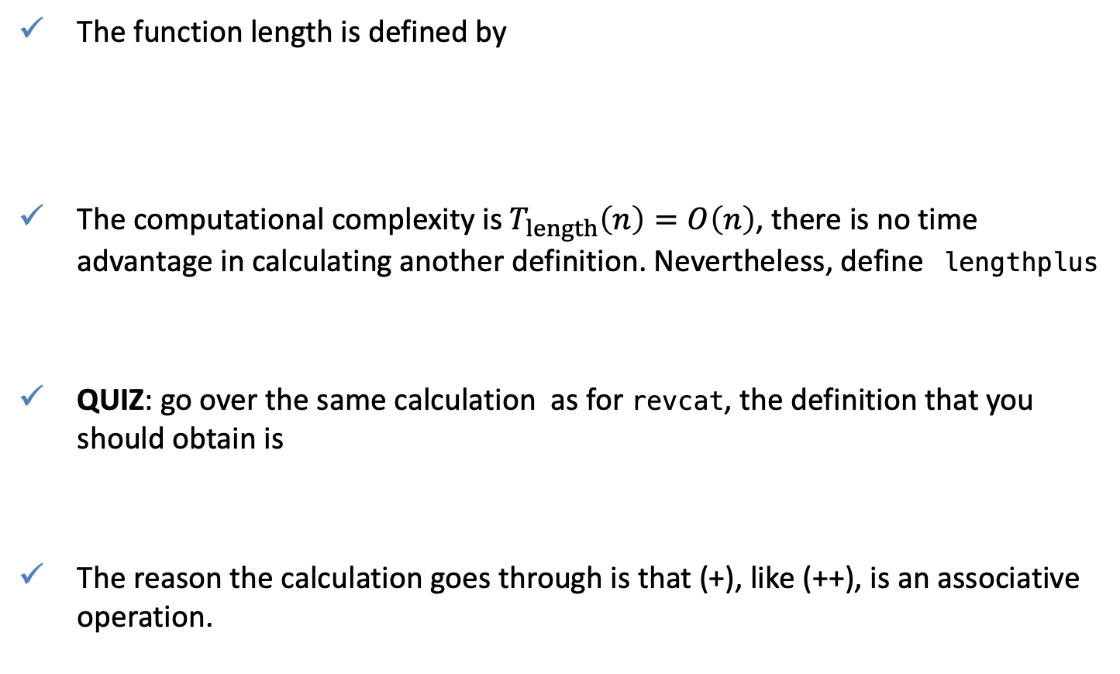
Reasoning to make the code memory efficient
The function length is defined by
The computational complexity is $T_{length}\left(n\right)=O\left(n\right)$, there is no time advantage in calculating another definition. Nevertheless, define lengthplus
QUIZ: go over the same calculation as for revcat, the definition that you should obtain is
The reason the calculation goes through is that (+), like (++), is an associative operation.
length :: [a] -> Int
length [] = 0
length (x:xs) = length xs + 1
lengthplus :: [a] -> Int -> Integer
lengthplus xs n = length xs + n
lengthplus [] n = n
lengthplus (x:xs) n = lengthplus xs (1 + n)

Slide 10
Reasoning to make the code memory efficient
Hence
or
can be written using foldl as
and by using foldl’ in place of foldl, the length of a list can be computed in constant space. That is how length is defined in Haskell’s prelude.
length xs = lengthplus xs 0
lengthplus [] 0 = 0
lengthplus (x:xs) n = lengthplus xs (1+n)
lengthplus xs 0 = foldl (\n x -> 1+n) 0 xs

Slide 11
Reasoning to make the code faster
Recall the flatten function , that converts a tree to a list
Because of the use of append, the function flatten is inefficient.
We seek to define a more general function, flatten’ , that combines the behaviors of the function flatten and ++.
that is our inductive hypothesis.
data Tree = Leaf Int | Node Tree Tree
flatten :: Tree -> [Int]
flatten (Leaf n) = [n]
flatten (Node l r) = flatten l ++ flatten r
flatten' t ns = flatten t ++ ns

Slide 12
Reasoning to make the code faster
Construct a definition for that satisfies the above equation as follows
Hence, we conclude that the definition
The original function can be then redefined as follows
The base case
The recursive case
flatten' (Leaf n) ns
= {specification of flatten’}
flatten (Leaf n) ++ ns
= {applying flatten}
[n] ++ ns
= {applying ++}
n : ns
flatten' (Node l r) ns
= {specification of flatten’}
(flatten l ++ flatten r) ++ ns
= {associativity of ++}
flatten l ++ (flatten r ++ ns)
= {induction hypothesis for l}
flatten' l (flatten r ++ ns)
= {induction hypothesis for r}
flatten' l (flatten r ns)
flatten' :: Tree -> [Int] -> [Int]
flatten' (Leaf n) ns = n:ns
flatten' (Node l r) ns = flatten' l (flatten' r ns)
flatten :: Tree -> [Int]
flatten t = flatten' t []

Slide 13
Quiz
Problem 1: Using the definitions
Verify the following two properties, by induction on xs:
HINT: the proofs are similar to those for the add function of last lecture.
Problem 2: Given the type declaration
Show that the number of leaves in such a tree is always one greater than the number of nodes, by induction on trees.
HINT: start by defining functions that count the number of leaves and nodes in a tree.
[] ++ ys = ys
(x:xs) ++ ys = x : (xs ++ ys)
xs ++ [] = xs
xs ++ (ys ++ zs) = (xs ++ ys) ++ zs
data Tree = Leaf Int | Node Tree Tree

