Slide 1
COMP 2120 / COMP 6120
REQUIREMENTS
Week:
2 of 12
A/Prof Alex Potanin and Dr Melina Vidoni

Slide 2
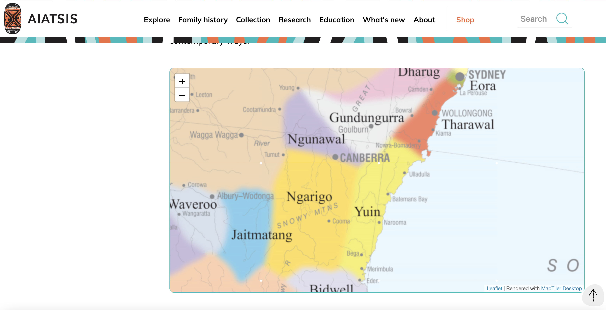
ANU Acknowledgment of Country
“We acknowledge and celebrate the First Australians on whose traditional lands we meet, and pay our respect to the elders past and present.”
https://aiatsis.gov.au/explore/map-indigenous-australia
Notes:
https://www.anu.edu.au/students/contacts/tjabal-indigenous-higher-education-centre
https://services.anu.edu.au/human-resources/respect-inclusion/anu-acknowledgment-of-country
https://www.indigenous.gov.au/contact-us/welcome_acknowledgement-country
https://aiatsis.gov.au/explore/map-indigenous-australia

Slide 3
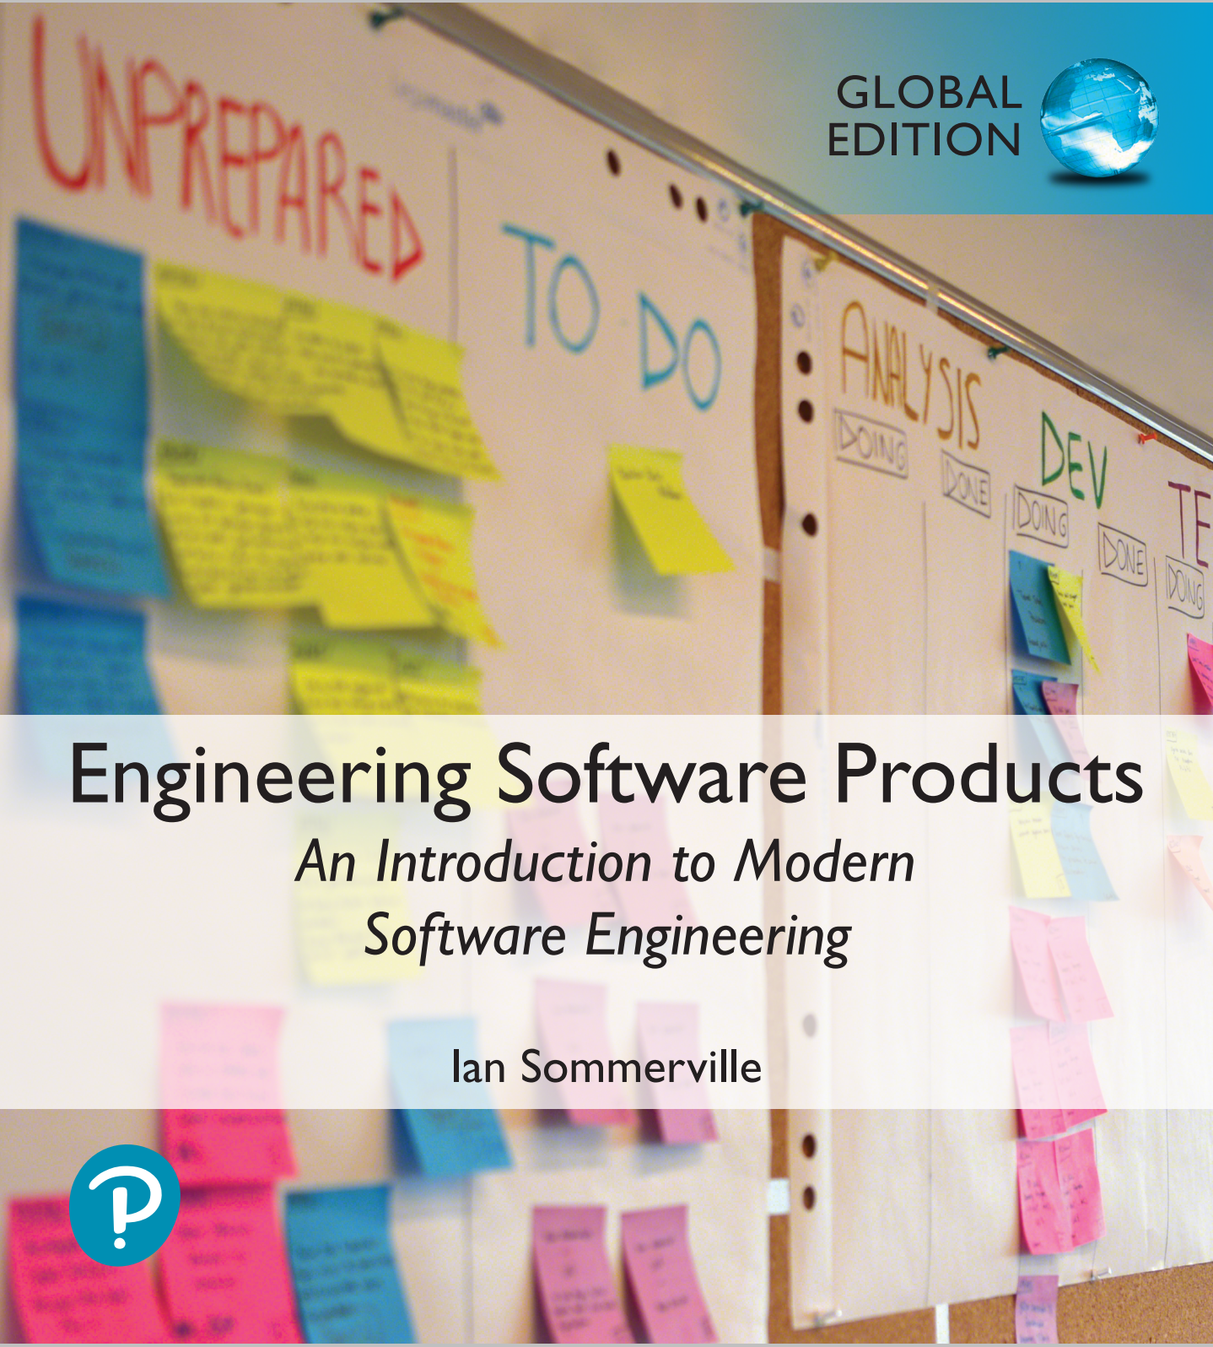
Personas
You need to have an understanding of your potential users to design features that they are likely to find useful and to design a user interface that is suited to them.
Personas are ‘imagined users’ where you create a character portrait of a type of user that you think might use your product.
  For example, if your product is aimed at managing appointments for dentists, you might create a dentist persona, a receptionist persona and a patient persona.
Personas of different types of user help you imagine what these users may want to do with your software and how it might be used. They help you envisage difficulties that they might have in understanding and using product features.

Slide 4
A Persona for a Primary School Teacher
Jack, a primary school teacher
Jack, age 32, is a primary school (elementary school) teacher in Ullapool, a large coastal village in the Scottish Highlands. He teaches children from ages 9-12. He was born in a fishing community north of Ullapool, where his father runs a marine fuels supply business and his mother is a community nurse. He has a degree in English from Glasgow University and retrained as a teacher after several years working as a web content author for a large leisure group.
Jack’s experience as a web developer means that he is confident in all aspects of digital technology. He passionately believes that the effective use of digital technologies, blended with face to face teaching, can enhance the learning experience for children. He is particularly interested in using the iLearn system for project-based teaching, where students work together across subject areas on a challenging topic.

Slide 5
Persona Descriptions
A persona should ‘paint a picture’ of a type of product user. They should be relatively short and easy-to-read.
You should describe their background and why they might want to use your product.
You should also say something about their educational background and technical skills.
These help you assess whether or not a software feature is likely to be useful, understandable and usable by typical product users.

Slide 6
Persona Descriptions

Slide 7
Table 3.2 Aspects of a persona description
Personalization
You should give them a name and say something about their personal circumstances. This is important because you shouldn’t think of a persona as a role but as an individual. It is sometimes helpful to use an appropriate stock photograph to represent the person in the persona. Some studies suggest that this helps project teams use personas more effectively.
Job-related
If your product is targeted at business, you should say something about their job and (if necessary) what that job involves. For some jobs, such as a teacher where readers are likely to be familiar with the job, this may not be necessary.
Education
You should describe their educational background and their level of technical skills and experience. This is important, especially for interface design.
Relevance
If you can, you should say why they might be interested in using the product and what they might want to do with it.

Slide 8
Emma, a history teacher
Emma, age 41, is a history teacher in a secondary school (high school) in Edinburgh. She teaches students from ages 12 to 18. She was born in Cardiff in Wales where both her father and her mother were teachers. After completing a degree in history from Newcastle University, she moved to Edinburgh to be with her partner and trained as a teacher. She has two children, aged 6 and 8, who both attend the local primary school. She likes to get home as early as she can to see her children, so often does lesson preparation, administration and marking from home.
Emma uses social media and the usual productivity applications to prepare her lessons, but is not particularly interested in digital technologies. She hates the virtual learning environment that is currently used in her school and avoids using it if she can. She believes that face-to-face teaching is most effective. She might use the iLearn system for administration and access to historic films and documents. However, she is not interested in a blended digital/face-to-face approach to teaching.

Slide 9
Elena, a school IT technician
Elena, age 28, is a senior IT technician in a large secondary school (high school) in Glasgow with over 2000 students. Originally from Poland, she has a diploma in electronics from Potsdam University. She moved to Scotland in 2011 after being unemployed for a year after graduation. She has a Scottish partner, no children, and hopes to develop her career in Scotland. She was originally appointed as a junior technician but was promoted, in 2014, to a senior post responsible for all the school computers.
Although not involved directly in teaching, Elena is often called on to help in computer science classes. She is a competent Python programmer and is a ‘power user’ of digital technologies. She has a long-term career goal of becoming a technical expert in digital learning technologies and being involved in their development. She wants to become an expert in the iLearn system and sees it as an experimental platform for supporting new uses for digital learning.

Slide 10
Persona Benefits
The main benefit of personas is that they help you and other development team members empathize with potential users of the software.
Personas help because they are a tool that allows developers to ‘step into the user’s shoes’.
  Instead of thinking about what you would do in a particular situation, you can imagine how a persona would behave and react.
Personas can help you check your ideas to make sure that you are not including product features that aren’t really needed.
They help you to avoid making unwarranted assumptions, based on your own knowledge, and designing an over-complicated or irrelevant product.

Slide 11
Deriving Personas
Personas should be based on an understanding of the potential product users, their jobs, their background and their aspirations.
You should study and survey potential users to understand what they want and how they might use the product.
From this data, you can then abstract the essential information about the different types of product user and use this as a basis for creating personas.
Personas that are developed on the basis of limited user information are called proto-personas.
  Proto-personas may be created as a collective team exercise using whatever information is available about potential product users. They can never be as accurate as personas developed from detailed user studies, but they are better than nothing.

Slide 12
Scenarios
A scenario is a narrative that describes how a user, or a group of users, might use your system.
There is no need to include everything in a scenario – the scenario isn’t a system specification.
It is simply a description of a situation where a user is using your product’s features to do something that they want to do.
Scenario descriptions may vary in length from two to three paragraphs up to a page of text.

Slide 13
Jack’s scenario: using the iLearn system for class projects
Fishing in Ullapool
Jack is a primary school teacher in Ullapool, teaching P6 pupils. He has decided that a class project should be focused around the fishing industry in the area, looking at the history, development and economic impact of fishing.
As part of this, students are asked to gather and share reminiscences from relatives, use newspaper archives and collect old photographs related to fishing and fishing communities in the area. Pupils use an iLearn wiki to gather together fishing stories and SCRAN (a history archive site) to access newspaper archives and photographs. However, Jack also needs a photo-sharing site as he wants students to take and comment on each others’ photos and to upload scans of old photographs that they may have in their families. He needs to be able to moderate posts with photos before they are shared, because pre-teen children can’t understand copyright and privacy issues.
Jack sends an email to a primary school teachers’ group to see if anyone can recommend an appropriate system. Two teachers reply and both suggest that he uses KidsTakePics, a photo-sharing site that allows teachers to check and moderate content. As KidsTakePics is not integrated with the iLearn authentication service, he sets up a teacher and a class account with KidsTakePics.
He uses the the iLearn setup service to add KidsTakePics to the services seen by the students in his class so that, when they log in, they can immediately use the system to upload photos from their phones and class computers.

Slide 14
Figure 3.5 Elements of a scenario description

Slide 15
Scenario elements
A brief statement of the overall objective.
  In Jack’s scenario, this is to support a class project on the fishing industry.
References to the personas involved (Jack) so that you can get information about the capabilities and motivation of that user.
Information about what is involved in doing the activity. For example, in Jack’s scenario this involves gathering reminiscences from relatives, accessing newspaper archives, etc.
An explanation of problems that can’t be readily addressed using the existing system.
  Young children don’t understand issues such as copyright and privacy, so photo sharing requires a site that a teacher can moderate to make sure that published images are legal and acceptable.
A description of one way that the identified problem might be addressed.
  In Jack’s scenario, the preferred approach is to use an external tool designed for school students.

Slide 16
Emma’s scenario
Emma’s scenario is different from Jack’s scenario in that it describes a common and well-understood process rather than something new.
Emma is an e-learning sceptic and she is not interested in innovative applications. She wants a system that will make her life easier and reduce the amount of routine administration that she has to do.
The scenario discusses how parts of the process (setting up an email group and web page) are automated by the iLearn system.

Slide 17
Table 3.6 Emma’s scenario: using iLearn for administration
Emma is teaching the history of the First World War to a class of 14 year olds (S3). A group of S3 students are visiting the historic World War One battlefields in northern France. She want to set up a ‘battlefields group’ where the students who are attending the trip can share their research about the places they are visiting as well as their pictures and thoughts about the visit.
From home, she logs onto the iLearn system system using her Google account credentials. Emma has two iLearn accounts – her teacher account and a parent account associated with the local primary school. The system recognises that she is a multiple account owner and asks her to select the account to be used. She chooses the teacher account and the system generates her personal welcome screen. As well as her selected applications, this also shows management apps that help teachers create and manage student groups.
Emma selects the ‘group management’ app, which recognizes her role and school from her identity information and creates a new group. The system prompts for the class year (S3) and subject (history) and automatically populates the new group with all S3 students who are studying history. She selects those students going on the trip and adds her teacher colleagues, Jamie and Claire, to the group.

Slide 18
Table 3.6 Emma’s scenario: using iLearn for administration
She names the group and confirms that it should be created. The app sets up an icon on her iLearn screen to represent the group, creates an email alias for the group and asks Emma if she wishes to share the group. She shares access with everyone in the group, which means that they also see the icon on their screen. To avoid getting too many emails from students, restricts sharing of the email alias to Jamie and Claire.
The group management app then asksEmma if she wishes to set up a group web page, wiki and blog. Emma confirms that a web page should be created and she types some text to be included on that page.
She then accesses flickr using the icon on her screen, logs in and creates a private group to share trip photos that students and teachers have taken. She uploads some of her own photos from previous trips and emails an invitation to join the photo-sharing group to the Battlefield email list. Emma uploads material from her own laptop that she has written about the trip to iLearn and shares this with the ‘Battlefields Group’. This action adds her documents to the web page and generates an alert to group members that new material is available.

Slide 19
Writing scenarios
Scenarios should always be written from the user’s perspective and based on identified personas or real users.
Your starting point for scenario writing should be the personas that you have created. You should normally try to imagine several scenarios from each persona.
Ideally, scenarios should be general and should not include implementation information.
  However, describing an implementation is often the easiest way to explain how a task is done.
It is important to ensure that you have coverage of all of the potential user roles when describing a system.

Slide 20
Table 3.7 Elena’s scenario: configuring the iLearn system
Elena has been asked by David, the head of the art department in her school, to help set up an iLearn environment for his department. David wants an environment that includes tools for making and sharing art, access to external websites to study artworks, and ‘exhibition’ facilities so that the students’ work can be displayed.
Elena’s starts by talking to art teachers to discover the tools that they recommend and the art sites that they use for studies. She also discovers that the tools they use and the sites they access vary according to the age of their students. Consequently, different student groups should be presented with a toolset that is appropriate for their age and experience.
Once she has established what is required, Elena logs into the iLearn system as an administrator and starts configuring the art environment using the iLearn setup service. She creates sub-environments for three age groups plus a shared environment that includes tools and sites that may be used by all students.
She drags and drops tools that are available locally and the URLs of external websites into each of these environments. For each of the sub-environments, she assigns an art teacher as its administrator so that they can refine the tool and web site selection that has been set up. She publishes the environments in ‘review mode’ and makes them available to the teachers in the art department.
After discussing the environments with the teachers, Elena shows them how to refine and extend the environments. Once they have agreed that the art environment is useful, it is released to all students in the school.

Slide 21
User involvement
It is easy for anyone to read and understand scenarios, so it is possible to get users involved in their development.
The best approach is to develop an imaginary scenario based on our understanding of how the system might be used then ask users to explain what you have got wrong.
They might ask about things they did not understand and suggest how the scenario could be extended and made more realistic.
Our experience was that users are not good at writing scenarios.
  The scenarios that they created were based on how they worked at the moment. They were far too detailed and the users couldn’t easily generalize their experience.

Slide 22
User stories
Scenarios are high-level stories of system use. They should describe a sequence of interactions with the system but should not include details of these interactions.
User stories are finer-grain narratives that set out in a more detailed and structured way a single thing that a user wants from a software system.
  As an author, I need a way to organize the book that I’m writing into chapters and sections.
This story reflects what has become the standard format of a user story:
  As a <role>, I <want | need> to <do something>
    As a teacher, I want to tell all members of my group when new information is available
A variant of this standard format adds a justification for the action:
  As a <role> I <want | need> to <do something> so that <reason>
    As a teacher, I need to be able to report who is attending a class trip so that the school maintains the required health and safety records.

Slide 23
User stories in planning
An important use of user stories is in planning.
  Many users of the Scrum method represent the product backlog as a set of user stories.
User stories should focus on a clearly defined system feature or aspect of a feature that can be implemented within a single sprint.
If the story is about a more complex feature that might take several sprints to implement, then it is called an epic.
  As a system manager, I need a way to backup the system and restore either individual applications, files, directories or the whole system.
  There is a lot of functionality associated with this user story. For implementation, it should be broken down into simpler stories with each story focusing on a single aspect of the backup system.

Slide 24
Figure 3.6 User stories from Emma’s scenario

Slide 25
Feature description using user stories
Stories can be used to describe features in your product that should be implemented.
Each feature can have a set of associated stories that describe how that feature is used.

Slide 26
Figure 3.7 User stories describing the Groups feature

Slide 27
Stories and scenarios
As you can express all of the functionality described in a scenario as user stories, do you really need scenarios?’
Scenarios are more natural and are helpful for the following reasons:
  Scenarios read more naturally because they describe what a user of a system is actually doing with that system. People often find it easier to relate to this specific information rather than the statement of wants or needs set out in a set of user stories.
  If you are interviewing real users or are checking a scenario with real users, they don’t talk in the stylized way that is used in user stories. People relate better to the more natural narrative in scenarios.
  Scenarios often provide more context - information about what the user is trying to do and their normal ways of working. You can do this in user stories, but it means that they are no longer simple statements about the use of a system feature.

Slide 28
Feature identification
Your aim in the initial stage of product design should be to create a list of features that define your product.
A feature is a way of allowing users to access and use your product’s functionality so the feature list defines the overall functionality of the system.
Features should be independent, coherent and relevant:
  Independence
  Features should not depend on how other system features are implemented and should not be affected by the order of activation of other features.
  Coherence
  Features should be linked to a single item of functionality. They should not do more than one thing and they should never have side-effects.
  Relevance
  Features should reflect the way that users normally carry out some task. They should not provide obscure functionality that is hardly ever required.

Slide 29
Figure 3.8 Feature design

Slide 30
Table 3.8 Knowledge required for feature design
User knowledge
You can use user scenarios and user stories to inform the team of what users want and how they might use it the software features.
Product knowledge
You may have experience of existing products or decide to research what these products do as part of your development process. Sometimes, your features have to replicate existing features in these products because they provide fundamental functionality that is always required.
Domain knowledge
This is knowledge of the domain or work area(e.g. finance, event booking) that your product aims to support. By understanding the domain, you can think of new innovative ways of helping users do what they want to do.
Technology knowledge
New products often emerge to take advantage of technological developments since their competitors were launched. If you understand the latest technology, you can design features to make use of it.

Slide 31
Figure 3.9 Factors in feature set design

Slide 32
Feature trade-offs
Simplicity and functionality
  You need to find a balance between providing a simple, easy-to-use system and including enough functionality to attract users with a variety of needs.
Familiarity and novelty
  Users prefer that new software should support the familiar everyday tasks that are part of their work or life. To encourage them to adopt your system, you need to find a balance between familiar features and new features that convince users that your product can do more than its competitors.
Automation and control
  Some users like automation, where the software does things for them. Others prefer to have control. You have to think carefully about what can be automated, how it is automated and how users can configure the automation so that the system can be tailored to their preferences.

Slide 33
Feature creep
Feature creep occurs when new features are added in response to user requests without considering whether or not these features are generally useful or whether they can be implemented in some other way.
Too many features make products hard to use and understand
There are three reasons why feature creep occurs:
  Product managers are reluctant to say ‘no’ when users ask for specific features.
  Developers try to match features in competing products.
  The product includes features to support both inexperienced and experienced users.

Slide 34
Figure 3.10 Avoiding feature creep

Slide 35
Feature derivation
Features can be identified directly from the product vision or from scenarios.
You can highlight phrases in narrative description to identify features to be included in the software.
  You should think about the features needed to support user actions, identified by active verbs, such as use and choose.

Slide 36
The iLearn system vision
FOR teachers and educators WHO need a way to help students use web-based learning resources and applications, THE iLearn system is an open learning environment THAT allows the set of resources used by classes and students to be easily configured for these students and classes by teachers themselves.
UNLIKE Virtual Learning Environments, such as Moodle, the focus of iLearn is the learning process itself, rather than the administration and management of materials, assessments and coursework. OUR product enables teachers to create subject and age-specific environments for their students using any web-based resources, such as videos, simulations and written materials that are appropriate

Slide 37
Features from the product vision
A feature that allows users to access and use existing web-based resources;
A feature that allows the system to exist in multiple different instantiations;
A feature that allows user configuration of the system to create a specific instantiation.

Slide 38
Table 3.10 Jack’s scenario with highlighted phrases
Jack is a primary school teacher in Ullapool, teaching P6 pupils. He has decided that a class project should be focused around the fishing industry in the area, looking at the history, development and economic impact of fishing.
As part of this, students are asked to gather and share reminiscences from relatives, use newspaper archives and collect old photographs related to fishing and fishing communities in the area. Students use an iLearn wiki to gather together fishing stories and SCRAN (a history archive) to access newspaper archives and photographs. However, Jack also needs a photo-sharing site as he wants pupils to take and comment on each others’ photos and to upload scans of old photographs that they may have in their families. He needs to be able to moderate posts with photos before they are shared, because pre-teen children can’t understand copyright and privacy issues.
Jack sends an email to a primary school teachers’ group, which he is a member of to see if anyone can recommend an appropriate system. Two teachers reply and both suggest that he uses KidsTakePics, a photo-sharing site that allows teachers to check and moderate content. As KidsTakePics is not integrated with the iLearn authentication service, he sets up a teacher and a class account with KidsTakePics.
He uses the the iLearn setup service to add KidsTakePics to the services seen by the students in his class so that when they log in, they can immediately use the system to upload photos from their phones and class computers.

Slide 39
Features from Jack’s scenario
A wiki for group writing.
Access to the SCRAN history archive. This is a shared national resource that provides access to historical newspaper and magazine articles for schools and universities.
Features to set up and access an email group.
A feature to integrate applications with the iLearn authentication service.

Slide 40
The feature list
The output of the feature identification process should be a list of features that you use for designing and implementing your product.
There is no need to go into a lot of detail about the features at this stage. You add detail when you are implementing the feature.
You can describe features using a standard input-action-output template by using structured narrative descriptions or by a set of user stories.

Slide 41
Figure 3.11 The iLearn authentication feature

Slide 42
Feature description using user stories
Description
As a system manager, I want to create and configure an iLearn environment by adding and removing services to/from that environment so that I can create environments for specific purposes.
As a system manager, I want to set up sub-environments that include a subset of services that are included in another environment.
As a system manager, I want to assign administrators to created environments.
As a system manager, I want to limit the rights of environment administrators so that they cannot accidentally or deliberately disrupt the operation of key services.
As a teacher, I want to be able to add services that are not integrated with the iLearn authentication system.
Constraints
The use of some tools may be limited for license reasons so there may be a need to access license management tools during configuration.
Comments
Based on Elena’s and Jack’s scenarios

Slide 43
Innovation and feature identification
Scenarios and user stories should always be your starting point for identifying product features.
  Scenarios tell you how users work at the moment. They don’t show how they might change their way of working if they had the right software to support them.
  Stories and scenarios are ‘tools for thinking’ and they help you gain an understanding of how your software might be used. You can identify a feature set from stories and scenarios.
User research, on its own, rarely helps you innovate and invent new ways of working.
You should also think creatively about alternative or additional features that help users to work more efficiently or to do things differently.

Slide 44
Key Points
A software product feature is a fragment of functionality that implements something that a user may need or want when using the product.
The first stage of product development is to identify the list of product features in which you identify each feature and give a brief description of its functionality.
Personas are ‘imagined users’ where you create a character portrait of a type of user that you think might use your product.
A persona description should ‘paint a picture’ of a typical product user. It should describe their educational background, technology experience and why they might want to use your product.
A scenario is a narrative that describes a situation where a user is accessing product features to do something that they want to do.

Slide 45
Key Points
A scenario is a narrative that describes a situation where a user is accessing product features to do something that they want to do.
Scenarios should always be written from the user’s perspective and should be based on identified personas or real users.
User stories are finer-grain narratives that set out, in a structured way, something that a user wants from a software system.
User stories may be used as a way of extending and adding detail to a scenario or as part of the description of system features.
The key influences in feature identification and design are user research, domain knowledge, product knowledge, and technology knowledge.
You can identify features from scenarios and stories by highlighting user actions in these narratives and thinking about the features that you need to support these actions.

Slide 46

Today’s Goals
Explain the importance and challenges of requirements in software engineering.
Explain how and why requirements articulate the relationship between a desired system and its environment. Identify assumptions.
Distinguish between and give examples of: functional and quality requirements; informal statements and verifiable requirements.
State quality requirements in measurable ways

Slide 47
Overly simplified definition.
Requirements say what the system will do
(and not how it will do it)

Slide 48
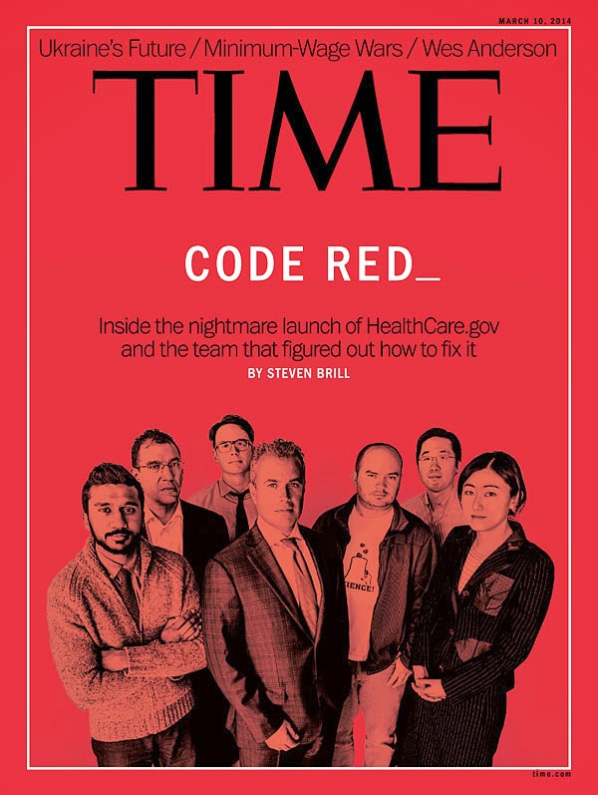
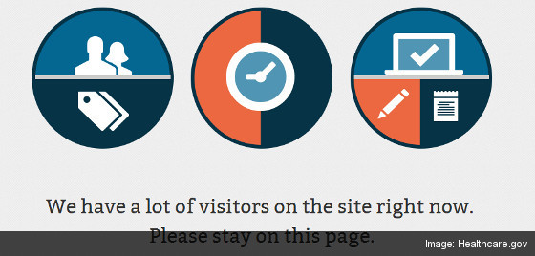
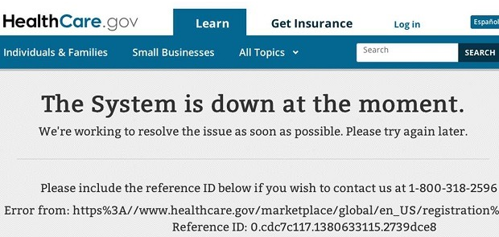
Healthcare.gov
Notes:
https://digital.hbs.edu/platform-rctom/submission/the-failed-launch-of-www-healthcare-gov/

Slide 49
Fred Brooks on Requirements
The hardest single part of building a software system is deciding precisely what to build.
No other part of the conceptual work is as difficult as establishing the detailed technical requirements ...
No other part of the work so cripples the resulting system if done wrong.
No other part is as difficult to rectify later.
— Fred Brooks

Slide 50
A Problem That Stands the Test of Time…
A 1994 survey of 8000 projects at 350 companies found: 31% of projects canceled before completed; 9% of projects delivered on time, within budget in large companies, 16% in small companies.
  Similar results reported since.
Causes:
  Incomplete requirements (13.1%)
  Lack of user involvement (12.4%)
  Lack of resources (10.6%)
  Unrealistic expectations (9.9%)
  Lack of executive support (9.3%)
  Changing requirements and specifications (8.7%)
  Lack of planning (8.1%)
  System no longer needed (7.5%)

Slide 51
WHY IS THIS HARD???

Slide 52

Communication Problem
Goal: figure out what should be built.
Express those ideas so that the correct thing is built.

Slide 53
Overall Problems
Involved subproblems?
Required functionality?
Nice to have functionality?
Expected qualities?
How fast to deliver at what quality for what price?
Notes:
Instructor simulates client; superficial requirements gathering leads to the wrong results; ideally have an example of each denial in there
Leads to all kinds of follow up questions about technical and quality expectations
let's say Tidbinbilla (https://www.tidbinbilla.act.gov.au/) needs a new ticket system. want to sell tickets online, have paperless tickets (smart phone) and have special requests as below -- assuming so far only paper tickets + will call (slow)
I'll suggest a system previously built for buses (Transport Canberra) with minor modifications (denial by prior knowledge)
You'll ask for special features, such as having discounts for specific weeks, for which I'll know exactly what tables in the database to modify without really listening to what exactly you want (denial by hacking)
Previously the city gave away free tickets to people in need, you ask for something similar. Or a lottery... Or special payment types. I'll
downplay the need; they should just give visa prepayed card to my system works (denial by abstraction).
You complain that it's annoying to check that everybody is out at the end of the day. I recommend we can just count this at the gate (denial by vagueness -- though the term is weird... it's essentially ignoring that
the real world does not behave like my counter necessarily)

Slide 54
Mini Break in Monday Lecture

Slide 55
Requirements in software projects

Slide 56
Less Simplified Definition:
Online Shopping
Stories: Scenarios, Use Cases, and user stories
  “After the customer submits the purchase information and the payment has been received, the order is fulfilled and shipped to the customer’s shipping address.”
Optative statements
  The system shall notify clients about their shipping status
Domain Properties and Assumptions
  Every product has a unique product code
  Payments will be received after authorization
Notes:
Note – “payment has been received” may not be part of *this* system, e.g., it may be an unshared action.

Slide 57
What is requirements engineering?
Knowledge acquisition – how to capture relevant detail about a system?
  Is the knowledge complete and consistent?
Knowledge representation – once captured, how do we express it most effectively?
  Express it for whom?
  Is it received consistently by different people?
You may sometimes see a distinction between the requirements definition and the requirements specification.

Slide 58
Functional Requirements
What the machine should do
  Input
  Output
  Interface
  Response to events
Criteria:
  Completeness: All requirements are documented
  Consistency: No conflicts between requirements
  Precision: No ambiguity in requirements

Slide 59
Quality/Non Functional Requirements
Specify not the functionality of the system, but the quality with which it delivers that functionality.
Can be more critical than functional requirements
  Can work around missing functionality
  Low-quality system may be unusable
(We’ll come back to these in a bit.)

Slide 60
Functional Requirements and
Implementation Bias
Requirements say what the system will do (and not how it will do it).
Why not “how”?

Slide 61
The World and the Machine

Slide 62
Environment and the Machine
Requirements
Domain Knowledge
Specifications
Computers
Software Programs
Environmental Domain
Machine Domain
monitored
variables
Input devices
(e.g. sensors)
input data
Environment
Software
controlled
variables
Output devices
(e.g. actuators)
output results
Pamela Zave & Michael Jackson, “Four Dark Corners of Requirements Engineering,”
ACM Transactions on Software Engineering and Methodology, 6(1): 1-30, 1997.
Notes:
Avoiding implementation bias.
The plane – is this a specification, or wholly in the machine domain? What is the relevance of systems v. software engineering? (RE is systems engineering)
The system is the environment + the machine.
We can talk about shared and unshared actions.

Slide 63
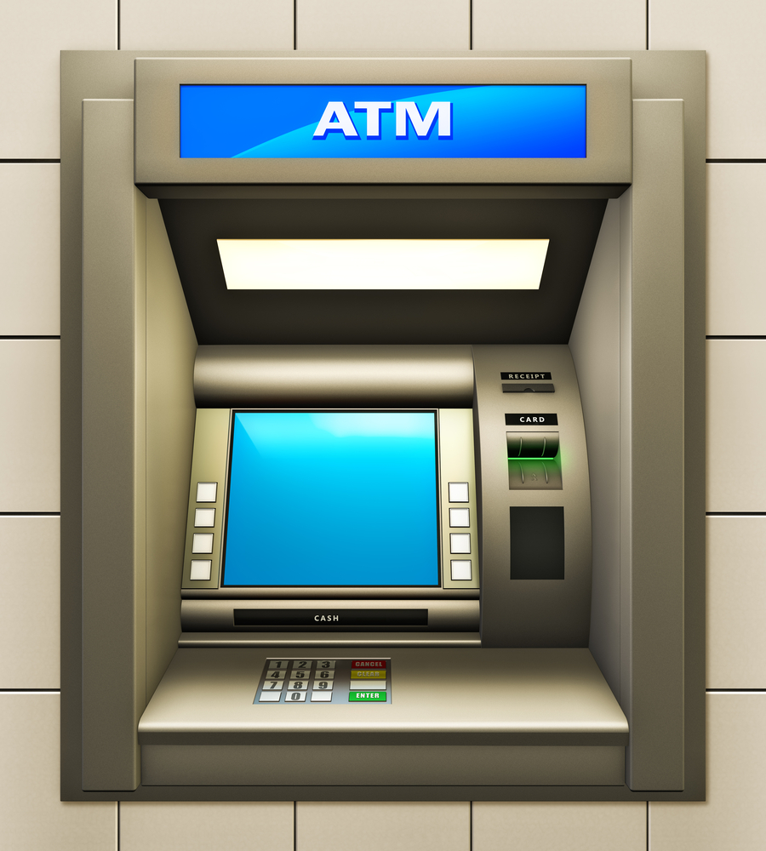
Actions of an ATM customer:
withdrawal-request(a, m)
Properties of the environment:
balance(b, p)
Actions of an ATM machine:
withdrawal-payout(a, m)
Properties of the machine:
expected-balance(b, p)
What other models of the world do machines maintain?
Notes:
Why is balance a property of the environment?
Many systems interact with balance, so who (or what) has the global view of these concurrent actions?
"Some requirements are not directly implementable because they are stated in terms of unshared phenomena. In the banking environment (Section 3.2), for example, there is a requirement (a withdrawal request leads to a withdrawal payout, provided that the requested amount does not exceed the current balance) stated in terms of the account balance. The only shared phenomena in this example are the action types deposit, withdrawal- request, and withdrawal-payout. Since the balance state component (a legal debt) exists in the environment and is not shared with the machine, the machine cannot directly implement this requirement.

Slide 64
Domain Knowledge
Refinement is the act of translating requirements into specifications (bridging the gap!)
Requirements: desired behavior (effect on the environment) to be realized by the proposed system.
Assumptions or domain knowledge: existing behavior that is unchanged by the proposed system.
  Conditions under which the system is guaranteed to operate correctly.
  How the environment will behave in response to the system’s outputs.
Notes:
Do I need to define specification?
Location-based models?
Behavioral models.
Inventory models.

Slide 65
Some gaps must remain…
Unshared actions cannot be accurately expressed in the machine
  People can jump over gates (enter without unlocking)
  People can steal or misplace inventory
Future requirements are also not directly implementable
  Phone system: “After all digits have been dialed, do ring-back, busy-tone or error-tone.”
  …how do you know the user is done dialing?

Slide 66
Implementation Bias

Slide 67
Requirements say what the system will do (and not how it will do it).
Why not “how”?
Notes:
PAUSE AND DISCUSS

Slide 68
Avoiding Implementation Bias
Requirements describe what is observable at the environment-machine interface.
Indicative mood describes the environment (as-is)
Optative mood to describe the environment with the machine (to-be).

Slide 69
This can be subtle…
“The dictionary shall be stored in a hash table” vs. “the software shall respond to requests within 5 seconds.”
Instead of “what” vs. “how”, ask “is this requirement only a property of the machine domain?”
Or is there some application domain phenomenon that justifies it?

Slide 70
Quality Requirements

Slide 71
Functional Requirements
What the machine should do
  Input
  Output
  Interface
  Response to events
Criteria
  Completeness: All requirements are documented
  Consistency: No conflicts between requirements
  Precision: No ambiguity in requirements

Slide 72
Quality/Non Functional Requirements
Specify not the functionality of the system, but the quality with which it delivers that functionality.
Can be more critical than functional requirements
  Can work around missing functionality
  Low-quality system may be unusable
Examples?

Slide 73
Here’s the thing …
Who is going to ask for a slow, inefficient, unmaintainable system?
A better way to think about quality requirements is as design criteria to help choose between alternative implementations.
Question becomes: to what extent must a product satisfy these requirements to be acceptable?

Slide 74
Quality Requirement
Quality of Service
Compliance
Architectural Constraint
Development Constraint
Accuracy
Safety
Security
Reliability
Performance
Interface
Installation
Distribution
Cost
Maintainability
Cost
Deadline
Variability
Confidentiality
Integrity
Availability
Time
Space
User
Device
Software
interaction
interaction
interoperability
Usability
Convenience
Selling videos on the web?
74

Slide 75
Expressing Quality Requirements
Requirements serve as contracts: they should be testable/falsifiable.
Informal goal: a general intention, such as ease of use.
  May still be helpful to developers as they convey the intentions of the system users.
Verifiable non-functional requirement: A statement using some measure that can be objectively tested.
Notes:
Non-functional requirements are sometimes difficult to state precisely; imprecise requirements may be difficult to verify.

Slide 76
Examples
Confidentiality requirement: A non-staff patron may never know which books have been borrowed by others.
Privacy requirement: The diary constraints of a participant may never be disclosed to other invited participants without his or her consent.
Integrity req: The return of book copies shall be encoded correctly and by library staff only.
Availability req: A blacklist of bad patrons shall be made available at any time to library staff. Information about train positions shall be available at any time to the vital station computer.

Slide 77
Examples
Informal goal: “the system should be easy to use by experienced controllers, and should be organized such that user errors are minimized.”
Verifiable non-functional requirement: “Experienced controllers shall be able to use all the system functions after a total of two hours training. After this training, the average number of errors made by experienced users shall not exceed two per day, on average.”

Slide 78
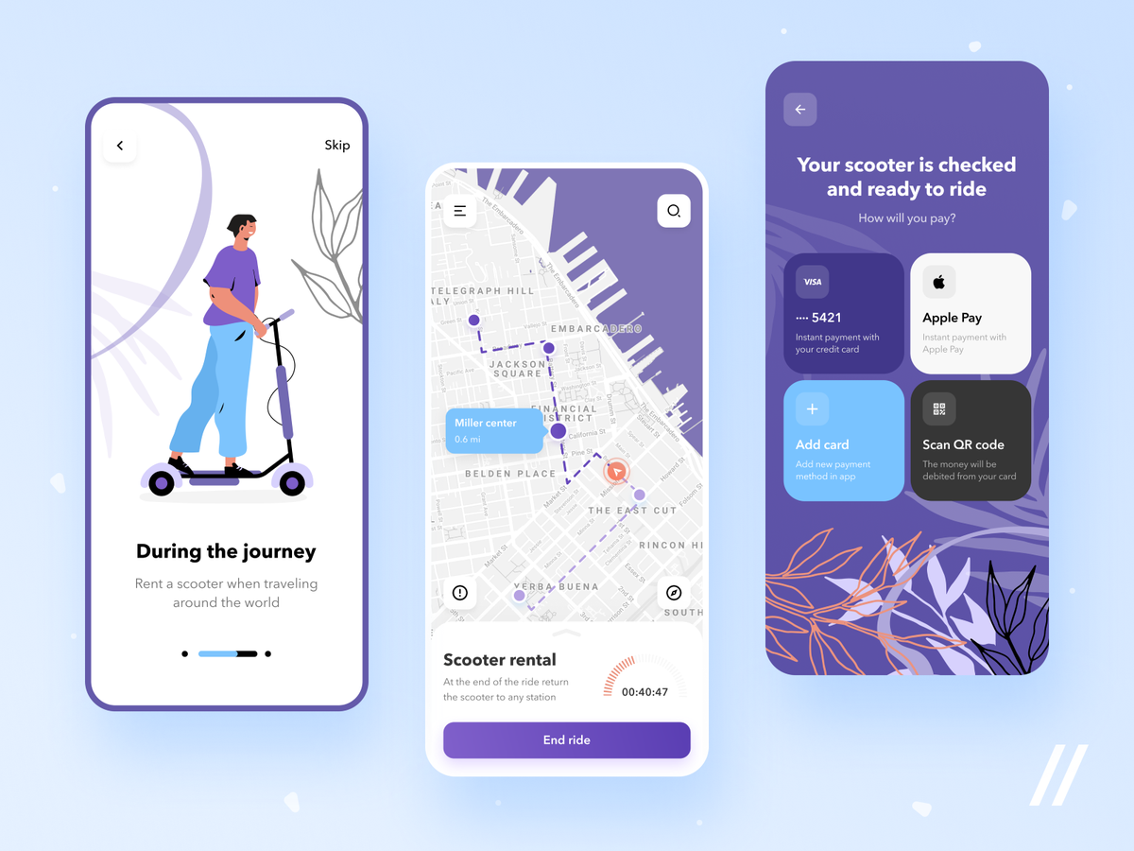
Exercise: back to simple
Let’s write some quality requirements!
Try to write an informal goal, and then turn it into a verifiable non-functional requirement.

Slide 79
Requirements Metrics
Property | Measure

Slide 80
Activities of Requirements Engineering

Slide 81
Typical Steps
Identify stakeholders
Understand the domain
  Analyze artifacts, interact with stakeholders
Discover the real needs
  Interview stakeholders
Explore alternatives to address needs

Slide 82
Question
Who is the system for?
Stakeholders:
  End users
  System administrators
  Engineers maintaining the system
  Business managers
  …who else?
Notes:
Stakeholders are the people who say it’s OK.
Further Reading: Van Lamsweerde A. Requirements engineering: From system goals to UML models to software. John Wiley & Sons; 2009. Chapter 1

Slide 83
Learning goals
Define and identify stakeholders.
Demonstrate basic proficiency in executing effective requirements interviews.
Evaluate risk for a product

Slide 84

Interviews
Notes:
Proceed as follows:
Before the interviews, become familiar with the problem, for example through content analysis of public information and other systems. Think about possible stakeholders, actors, quality attributes, user stories, and assumptions for an actual implementation. Be deliberate about who you want to interview. If you go into the interview unprepared, you are likely to miss important questions.
Make appointments for the interviews, and plan them beforehand. You should use the interviews to check your understanding of the problem and elicit additional requirements. Since some people you are interviewing are usually not in the software field, you'll have to work with them to figure out what information is important to build the application.
Conduct the interviews. We suggest you conduct most interviews in groups, but you may further divide roles as you prefer. Treat the interviewees and their time respectfully.
Take notes or if (and only if) the interviewee agrees, record the interview. Microphones in most smartphones and laptops are good enough, but we suggest you test recording upfront. It can be useful to partially transcribe an interview or at least its key points immediately afterward, while the knowledge is fresh.
Revise your understanding of the problem, based on the interview.
Share your insights within your team and synthesize requirements, resolving potential conflicts as far as possible. If there are conflicts you cannot resolve, make reasonable assumptions and document how you would resolve them in practice.
Complete the requirements document, filling in the specific sections indicated both within the template and below, in deliverables.
Reflect on your experience conducting the interview and the documents in a personal statement.

Slide 85
Interview Follow-up
Observations?
  Anything surprising? Unexpected?
  Confirmations of existing ideas?
  Generalizable knowledge?

Slide 86
Interview Tradeoffs
Strengths
  What stakeholders do, feel, prefer
  How they interact with the system
  Challenges with current systems
Weaknesses
  Subjective, inconsistencies
  Capturing domain knowledge
  Familiarity
  Technical subtlety
  Organizational issues, such as politics
  Hinges on interviewer skill

Slide 87
Interview Process
Identify stakeholder of interest and target information to be gathered.
Conduct interview.
  (structured/unstructured, individual/group)
Record + transcribe interview
Report important findings.
Check validity of report with interviewee.

Slide 88
Example: Identifying Problems
What problems do you run into in your day-to-day work? Is there a standard way of solving it, or do you have a workaround?
  Why is this a problem? How do you solve the problem today? How would you ideally like to solve the problem?
Keep asking follow-up questions (“What else is a problem for you?”, “Are there other things that give you trouble?”) for as long as the interviewee has more problems to describe.

Slide 89
Example: Identifying Problems
So, as I understand it, you are experiencing the following problems/needs (describe the interviewee’s problems and needs in your own words – often you will discover that you do not share the same image. It is very very common to not understand each other even if at first you think you do).
Just to confirm, have I correctly understood the problems you have with the current solution?
Are there any other problems you’re experiencing? If so, what are they?

Slide 90
Capturing v. Synthesizing
Engineers acquire requirements from many sources
  Elicit from stakeholders
  Extract from policies or other documentation
  Synthesize from above + estimation and invention
Because stakeholders do not always know what they want, engineers must…
  Be faithful to stakeholder needs and expectations
  Anticipate additional needs and risks
  Validate that “additional needs” are necessary or desired

Slide 91
Interview Advice
Get basic facts about the interviewee before (role, responsibilities, …)
Review interview questions before interview
Begin concretely with specific questions, proposals; work through prototype or scenario
  Relate to current system, if applicable.
Be open-minded; explore additional issues that arise naturally, but stay focused on the system.
Contrast with current system/alternatives. Explore conflicts and priorities
Plan for follow-up questions

Slide 92
Bonus: Guidelines for effective interviews
Identify the right interviewee sample for full coverage of issues
  different responsibilities, expertise, tasks, exposure to problems
Come prepared, to focus on right issue at right time
  background study first
  predesign a sequence of questions for this interviewee
Centre the interview on the interviewee’s work & concerns
Keep control over the interview
Make the interviewee feel comfortable
  Start: break ice, provide motivation, ask easy questions
  Consider the person too, not only the role
  Do always appear as a trustworthy partner

Slide 93
Bonus: Guidelines for effective interviews
Be focused, keep open-ended questions for the end
Be open-minded, flexible in case of unexpected answers
Ask why-questions without being offending
Avoid certain types of questions ...
  opinion or biased
  affirmative
  obvious or impossible answer for this interviewee
Edit & structure interview transcripts while still fresh in mind
  including personal reactions, attitudes, etc
Keep interviewee in the loop
  co-review interview transcript for validation & refinement

Slide 94
Prototypes, Mockups, Stories
Why? How to use?
Stakeholders:
  don’t always know what they want or how to articulate it, or how much things cost.
  have domain knowledge, may use jargon, or may leave out “obvious” requirements that aren’t obvious to a non-expert.
  can be hard to pin down
    Distributed, difficult to access, have hidden needs
    External to the system
Risk: Missing or hidden stakeholders, “requirements—delay—surprise!”
Risk: unidentified/unhandled conflicts.

Slide 95
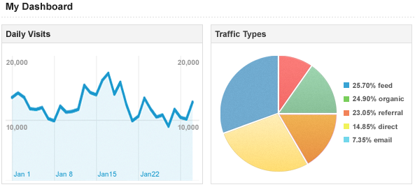
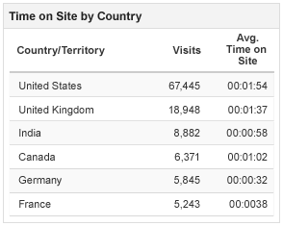
High- vs low- fidelity mockups
Notes:
Tradeofs

Slide 96
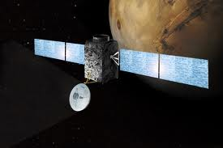
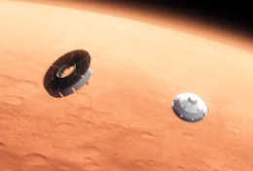
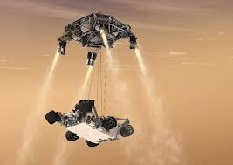
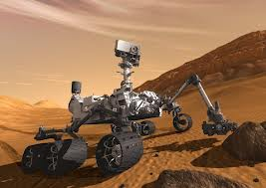
Storyboarding and scenarios
Notes:
Passive vs active
Making things explicit: who are the actors, what happens to them, how it happens, why, what if, what could go wrong
Scenario illustrates a typical sequence of interactions among components that meets an implicit objetcive
Structured form of storyboard covering who, what, and how
Two many uses: explaining how the system as is is running
Exploring how the system-to-be should be running
Ask specific questions, elicit objectives, generalize into models of desired behavior
Different types: positive vs. negative
Normal vs abnormal

Slide 97
Story
Who the players are
What happens to them
How it happens through specific episode
Why this happens
What if such and such an event occurs
What could go wrong as a consequence
Notes:
Passive vs active
Making things explicit: who are the actors, what happens to them, how it happens, why, what if, what could go wrong
Scenario illustrates a typical sequnce of interactions among components that meets an implicit objetcive
Structured form of storyboard covering who, what, and how
Two many uses: explaining how the system as is is running
Exploring how the system-to-be should be running
Ask specific questions, elicit objectives, generalize into models of desired behavior
Different types: positive vs. negative
Normal vs abnormal

Slide 98
Storyboards illustrate scenarios: a typical sequence of interaction among system components that meets an implicit objective.
  Storyboards explicitly cover at least who, what, and how.
Different types:
  Positive vs negative (should and should not happen)
  Normal vs abnormal
As part of elicitation:
  Learn about current or proposed system by walking through real-life or hypothetical sequences
  Can ask specific questions
  Elicit the underlying objectives, generalize into models of desired behaviors.
  Identify and resolve conflicts
Pluses: Concrete, support narrative description
Minuses: inherently partial.
Notes:
Passive vs active
Making things explicit: who are the actors, what happens to them, how it happens, why, what if, what could go wrong
Scenario illustrates a typical sequence of interactions among components that meets an implicit objetcive
Structured form of storyboard covering who, what, and how
Two many uses: explaining how the system as is is running
Exploring how the system-to-be should be running
Ask specific questions, elicit objectives, generalize into models of desired behavior
Different types: positive vs. negative
Normal vs abnormal

Slide 99
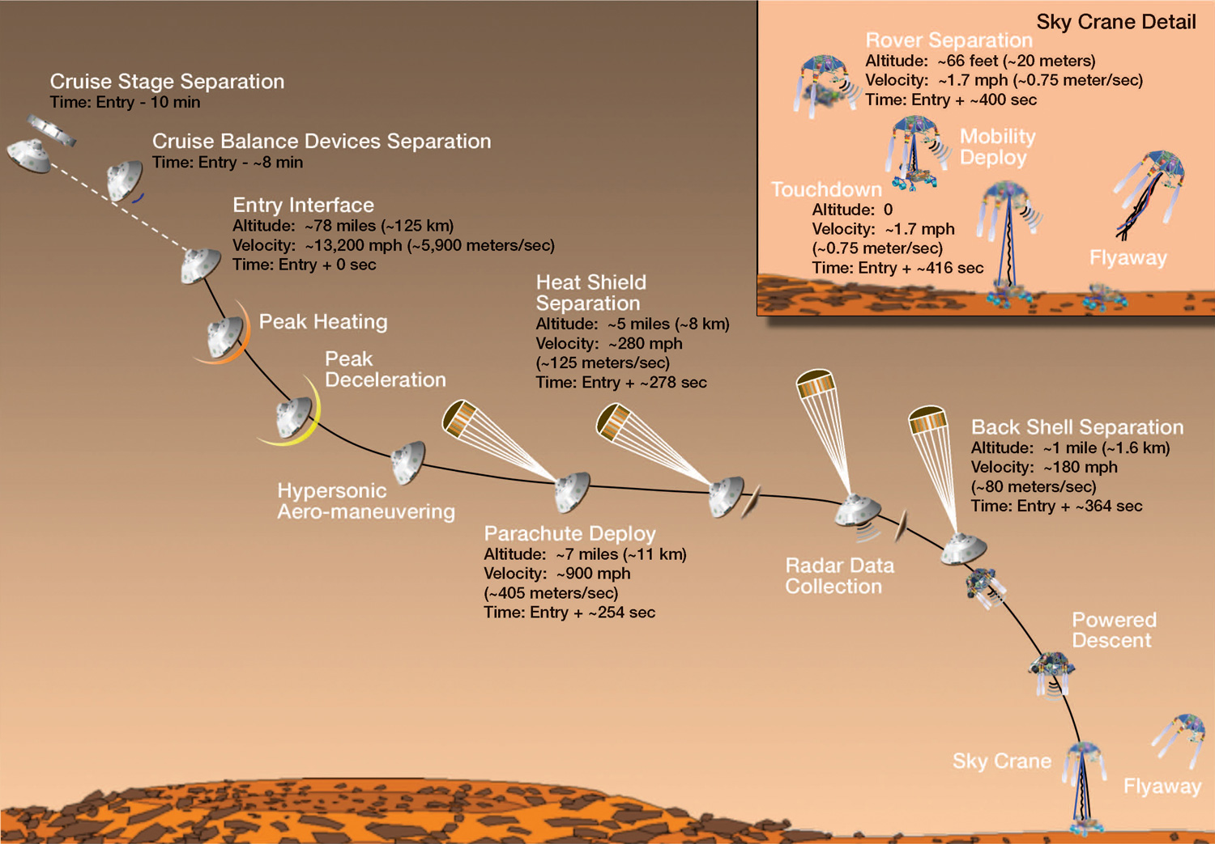

Slide 100
End of Monday Lecture/Start of Tuesday Lecture

Slide 101
ANU Acknowledgment of Country
“We acknowledge and celebrate the First Australians on whose traditional lands we meet, and pay our respect to the elders past and present.”
https://aiatsis.gov.au/explore/map-indigenous-australia
Notes:
https://www.anu.edu.au/students/contacts/tjabal-indigenous-higher-education-centre
https://services.anu.edu.au/human-resources/respect-inclusion/anu-acknowledgment-of-country
https://www.indigenous.gov.au/contact-us/welcome_acknowledgement-country
https://aiatsis.gov.au/explore/map-indigenous-australia

Slide 102
Resolving Conflicts

Slide 103
Types of inconsistency
Terminology clash: same concept named differently in different statements
  e.g. library management: “borrower” vs. “patron”
Designation clash: same name for different concepts in different statements
  e.g. “user” for “library user” vs. “library software user”
Structure clash: same concept structured differently in different statements
  e.g. “latest return date” as time point (e.g. Fri 5pm)
  vs. time interval (e.g. Friday)

Slide 104
Types of inconsistency
Strong conflict: statements not satisfiable together
  e.g. “participant constraints may not be disclosed to anyone else” vs. “the meeting initiator should know participant constraints”
Weak conflict (divergence): statements not satisfiable together under some boundary condition
  “patrons shall return borrowed copies within X weeks” vs “patrons shall keep borrowed copies as long as needed” contradict only if “needed>x weeks”

Slide 105
Handling inconsistencies
Terminology, designation, structure: Build glossary
Weak, strong conflicts: Negotiation required
  Cause: different objectives of stakeholders => resolve outside of requirements
  Cause: quality tradeoffs => explore preferences
Notes:
Examples: password security vs usability; confidentiality vs accountability; performance vs safety; maintainability vs cost

Slide 106
Requirements Traceability
Keep connections between requirements
What follows from what

Slide 107
Requirements prioritization
Cost, time, and other limits
Dependencies among requirements
Nice to have
Strategies to base on value contribution

Slide 108
Summary
Many solicitation strategies, including document analysis, interviews, and ethnography
Do not underestimate the challenge of interviews
Resolving conflicts
Using prototypes to enhance discussions and decision making
Many documentation strategies; our focus is on user stories

Slide 109
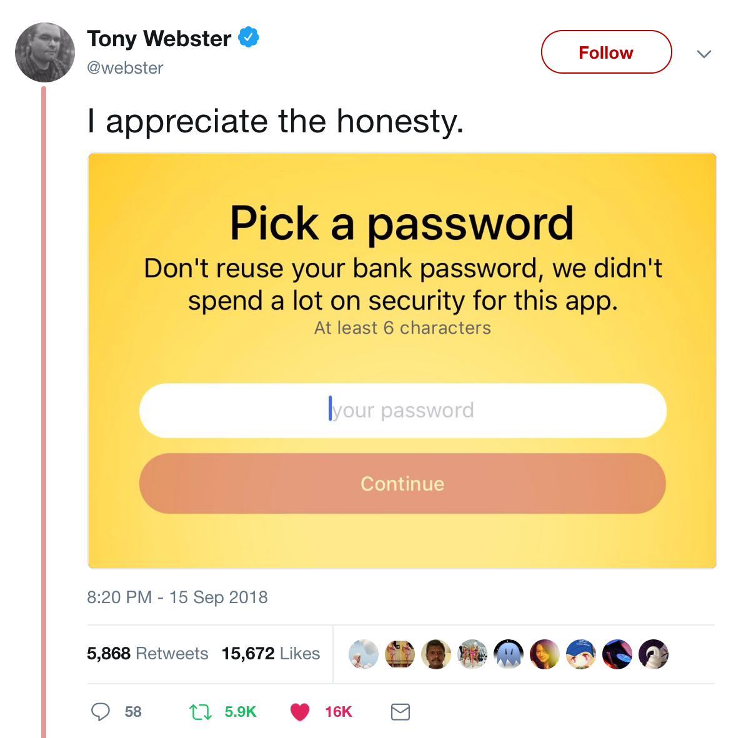
Risk

Slide 110
What are risks?
A risk is an uncertain factor that may result in a loss of satisfaction of a corresponding objective
For example…
  System delivers a radiation overdose to patients (Therac-25, Theratron-780)
  Medication administration record (MAR) knockout
  Premier Election Solutions vote-dropping “glitch”

Slide 111
How to assess the level of risk?
Risks consist of multiple parts:
  Likelihood of failure
  Negative consequences or impact of failure
  Causal agent and weakness (in advanced models)
Risk = Likelihood x Impact
Notes:
Identity theft (stealing a person’s credit card number) is a significant concern in the U.S. The NYTimes said it was the new cancer of the Internet.
What proportion of U.S. citizens experience identity theft? What is the severity? ($100, $500, $1000, >$5000)
JS&R: 11.6M people (about 3% or 1 in 30), $354 out-of-pocket, 12 hours; Ponemon: $204 per record, 3.7% consumer churn

Slide 112
The Swiss cheese model
Mixed
messages
Regulatory
narrowness
Responsibility
shifting
Incomplete
procedures
Production
pressures
Clumsy technology
Inadequate training
Attention distractions
Deferred maintenance
Institutional
Organization
Profession
& Team
Individual
Technical
Modified from Reason, 1999, by R.I. Crook
Notes:
The model is used to think about cascading and complex, inter-dependent failures. Originally introduced by James Reason, 1990.

Slide 113
Aviation failure impact categories
No effect – failure has no impact on safety, aircraft operation, or crew workload
Minor – failure is noticeable, causing passenger inconvenience or flight plan change
Major – failure is significant, causing passenger discomfort and slight workload increase
Hazardous – high workload, serious or fatal injuries
Catastrophic – loss of critical function to safely fly and land
DO-178b, Software Considerations in Airborne Systems and Equipment Certification, RTCA, 1992

Slide 114
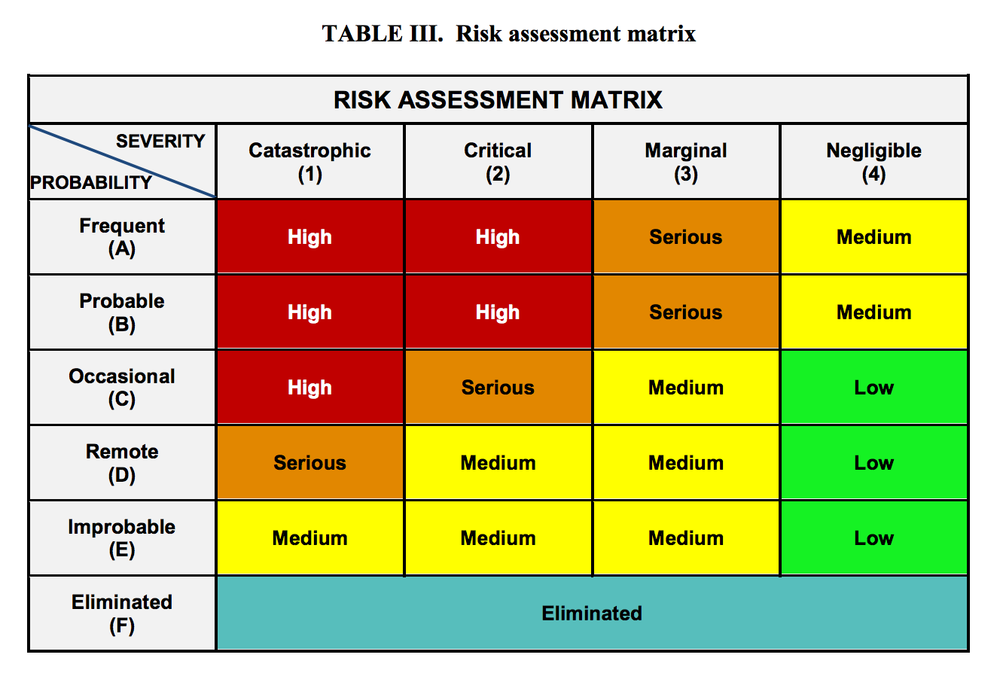
Risk assessment matrix
MIL-STD-882E
https://www.system-safety.org/Documents/MIL-STD-882E.pdf

Slide 115
DECIDE Model
Detect that the action necessary
Estimate the significance of the action
Choose a desirable outcome
Identify actions needed in order to achieve the chosen option
Do the necessary action to achieve change
Evaluate the effects of the action
https://www.faa.gov/regulations_policies/handbooks_manuals/aviation/media/FAA-H-8083-2.pdf

Slide 116
OODA Loop
By Patrick Edwin Moran - Own work, CC BY 3.0, https://commons.wikimedia.org/w/index.php?curid=3904554
Notes:
https://www.techtarget.com/searchcio/definition/OODA-loop#:~:text=The%20OODA%20loop%20(Observe%2C%20Orient,as%20more%20data%20becomes%20available.

Slide 117
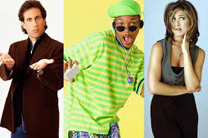
HISTORICAL DETOUR INTO UML (OR BACK INTO THE 1990’s)

Slide 118

Design and implementation
Software design and implementation is the stage in the software engineering process at which an executable software system is developed.
Software design and implementation activities are invariably inter-leaved.
  Software design is a creative activity in which you identify software components and their relationships, based on a customer’s requirements.
  Implementation is the process of realizing the design as a program.

Slide 119
Build or buy
In a wide range of domains, it is now possible to buy off-the-shelf systems (COTS) that can be adapted and tailored to the users’ requirements.
  For example, if you want to implement a medical records system, you can buy a package that is already used in hospitals. It can be cheaper and faster to use this approach rather than developing a system in a conventional programming language.
When you develop an application in this way, the design process becomes concerned with how to use the configuration features of that system to deliver the system requirements.

Slide 120
An object-oriented design process
Structured object-oriented design processes involve developing a number of different system models.
They require a lot of effort for development and maintenance of these models and, for small systems, this may not be cost-effective.
However, for large systems developed by different groups design models are an important communication mechanism.

Slide 121
Process stages
There are a variety of different object-oriented design processes that depend on the organization using the process.
Common activities in these processes include:
  Define the context and modes of use of the system;
  Design the system architecture;
  Identify the principal system objects;
  Develop design models;
  Specify object interfaces.
Process illustrated here using a design for a wilderness weather station.

Slide 122
System context and interactions
Understanding the relationships between the software that is being designed and its external environment is essential for deciding how to provide the required system functionality and how to structure the system to communicate with its environment.
Understanding of the context also lets you establish the boundaries of the system. Setting the system boundaries helps you decide what features are implemented in the system being designed and what features are in other associated systems.

Slide 123
Context and interaction models
A system context model is a structural model that demonstrates the other systems in the environment of the system being developed.
An interaction model is a dynamic model that shows how the system interacts with its environment as it is used.

Slide 124
System context for the weather station

Slide 125
Weather station use cases

Slide 126
Use case description—Report weather
System | Weather station
Use case | Report weather
Actors | Weather information system, Weather station
Description | The weather station sends a summary of the weather data that has been collected from the instruments in the collection period to the weather information system. The data sent are the maximum, minimum, and average ground and air temperatures; the maximum, minimum, and average air pressures; the maximum, minimum, and average wind speeds; the total rainfall; and the wind direction as sampled at five-minute intervals.
Stimulus | The weather information system establishes a satellite communication link with the weather station and requests transmission of the data.
Response | The summarized data is sent to the weather information system.
Comments | Weather stations are usually asked to report once per hour but this frequency may differ from one station to another and may be modified in the future.

Slide 127
Architectural design
Once interactions between the system and its environment have been understood, you use this information for designing the system architecture.
You identify the major components that make up the system and their interactions, and then may organize the components using an architectural pattern such as a layered or client-server model.
The weather station is composed of independent subsystems that communicate by broadcasting messages on a common infrastructure.

Slide 128
High-level architecture of the weather station

Slide 129
Architecture of data collection system

Slide 130
Object class identification
Identifying object classes is often a difficult part of object oriented design.
There is no 'magic formula' for object identification. It relies on the skill, experience
and domain knowledge of system designers.
Object identification is an iterative process. You are unlikely to get it right first time.

Slide 131
Approaches to identification
Use a grammatical approach based on a natural language description of the system.
Base the identification on tangible things in the application domain.
Use a behavioural approach and identify objects based on what participates in what behaviour.
Use a scenario-based analysis. The objects, attributes and methods in each scenario are identified.

Slide 132
Weather station object classes
Object class identification in the weather station system may be based on the tangible hardware and data in the system:
  Ground thermometer, Anemometer, Barometer
    Application domain objects that are ‘hardware’ objects related to the instruments in the system.
  Weather station
    The basic interface of the weather station to its environment. It therefore reflects the interactions identified in the use-case model.
  Weather data
    Encapsulates the summarized data from the instruments.

Slide 133
Weather station object classes

Slide 134
Design models
Design models show the objects and object classes and relationships between these entities.
There are two kinds of design model:
  Structural models describe the static structure of the system in terms of object classes and relationships.
  Dynamic models describe the dynamic interactions between objects.

Slide 135
Examples of design models
Subsystem models that show logical groupings of objects into coherent subsystems.
Sequence models that show the sequence of object interactions.
State machine models that show how individual objects change their state in response to events.
Other models include use-case models, aggregation models, generalisation models, etc.

Slide 136
Subsystem models
Shows how the design is organised into logically related groups of objects.
In the UML, these are shown using packages - an encapsulation construct. This is a logical model. The actual organisation of objects in the system may be different.

Slide 137
Sequence models
Sequence models show the sequence of object interactions that take place
  Objects are arranged horizontally across the top;
  Time is represented vertically so models are read top to bottom;
  Interactions are represented by labelled arrows, Different styles of arrow represent different types of interaction;
  A thin rectangle in an object lifeline represents the time when the object is the controlling object in the system.

Slide 138
Sequence diagram describing data collection

Slide 139
State diagrams
State diagrams are used to show how objects respond to different service requests and the state transitions triggered by these requests.
State diagrams are useful high-level models of a system or an object’s run-time behavior.
You don’t usually need a state diagram for all of the objects in the system. Many of the objects in a system are relatively simple and a state model adds unnecessary detail to the design.

Slide 140
Weather station state diagram

Slide 141
Interface specification
Object interfaces have to be specified so that the objects and other components can be designed in parallel.
Designers should avoid designing the interface representation but should hide this in the object itself.
Objects may have several interfaces which are viewpoints on the methods provided.
The UML uses class diagrams for interface specification but Java may also be used.

Slide 142
Weather Station Interfaces

Slide 143
Communication Diagram
1: lend(usr, itm)
1.1: match(usr)
John Smith
:User
:Library
:Librarian
1.3: create(usr, itm)
:Loan
{new}
emphasises the structural aspect of interactions
1.2 : find(itm)
{field}
1.2.1: match(itm)
Moby Dick
:Book
:Catalogue

Slide 144
Sequence Diagram
:Library
:Catalogue
:Book
:User
:Librarian
lend(usr, itm)
match(usr)
emphasises the time aspect of interactions
User
find(itm)
match(itm)
Item
Item
create(Item, User)
:Loan
{new}
Loan

Slide 145
State Diagram
useful for specifying reactive behaviour
entry / reserveCount := 0
NotReserved
reservation removed
[reserveCount = 1]
/ decrement reserveCount
title reservation
/ increment reserveCount
entry / “keep at counter”
exit / “item back on shelf”
Reserved
reservation removed
[reserveCount > 1]
title reservation
/ decrement reserveCount
/ increment reserveCount
should be internal!

Slide 146
State Diagram
entry / reserveCount := 0
NotReserved
internal transitions
title reservation
/ increment reserveCount
reservation removed
[reserveCount = 1]
/ decrement reserveCount
entry / “keep at counter”
title reservation / increment reserveCount
reservation removed [reserveCount > 1] / decrement reserveCount
exit / “item back on shelf”
Reserved

Slide 147


Slide 148
Reflection for the Group Assignments Wattle Quiz
[PROCESS]
At our first meeting, we developed an initial outline of our approach. This was followed by preparing a list of tasks which were required for implementing the X system. Next, we divided the tasks among ourselves and came up with a rough timeline of the process to be followed.”
[SCHEDULE]
“Although we managed to meet all the milestones and implement all the desired features, the exact dates for the same could not be followed towards the end.”
[PLANNING]
“Learning how to use API X took a little longer than expected, which caused a setback of a day; but overall we managed to complete the entire project before the deadline and adhered to the timeline.”
[TEAM WORK AND COMMUNICATION]
“We all agreed to use tool Y to keep in touch. We used it to announce when we started or completed individual tasks, current milestone statuses.. We also used Y to schedule a group meeting for the integration portion of our coding assignment”

Slide 149
Reflection for the Group Assignments Wattle Quiz
[PLANNING / PROCESS]
“Since I was interested in the planning, we decided as a team I would be in charge of documenting our progress.. It worked really well to have one person managing what needed to get done or who needed to do it, and ensuring a shared single vision and set of goals as a group. However, there exist negatives approaching things this way…I found that my teammates sometimes would rely on me too heavily.”
[TEAM WORK AND COMMUNICATION]
“An example of something that [would] work well is...issue tracking – something I asked them to do since first meeting. It’s easy to forget this information over time... If we had simply reminded ourselves on a regular basis, we would have had fewer problems forgetting these things.”
[PLANNING]
“People seemed to be annoyed because X “was not doing any work”. I believe X did the least amount of work, but we also assigned X the least amount of work. I wonder if this can all be traced back to the fact that X could not attend our first group meeting”

Slide 150
Reflection for the Group Assignments Wattle Quiz
[TEAMWORK]
“It helps to say ‘thank you’ before complaining about a teammate’s work. Only take conflict-inducing action if you think it is extremely important and are willing to follow up. Otherwise, you are wasting everyone’s time. Would we have treated each other differently if we had known we would be partnered up on more than just this assignment for the class?”
[TEAMWORK]
“two takeaways I had from this project are :
– It is best to present yourself as someone who is willing to help out, and do more than what was originally asked of you. This way, if people decline your offer to help out, they will be okay with the fact that you may not be working as hard as them at that point in time.
– Respect other people’s time and work, and take that into consideration when you decide to criticize their work or bring up issues. “

