Slide 1
COMP 2120 / COMP 6120
Microservices
Week:
5 of 12
A/Prof Alex Potanin and Dr Melina Vidoni

Slide 2
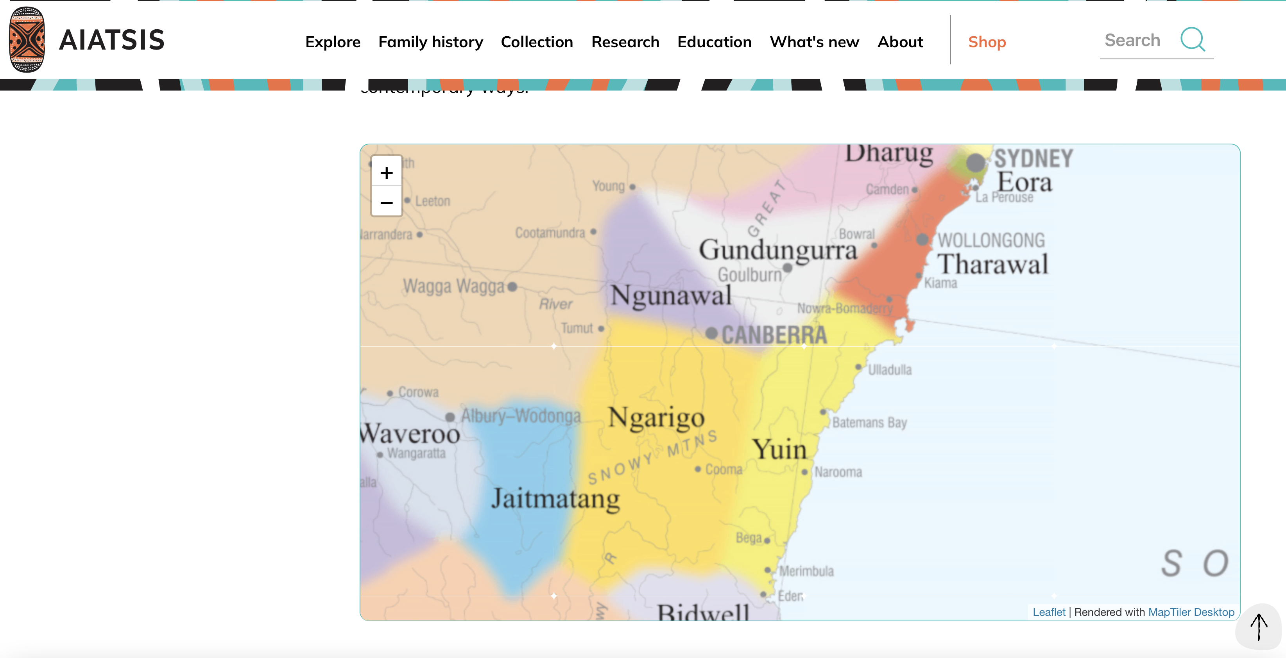
ANU Acknowledgment of Country
“We acknowledge and celebrate the First Australians on whose traditional lands we meet, and pay our respect to the elders past and present.”
https://aiatsis.gov.au/explore/map-indigenous-australia
Notes:
https://www.anu.edu.au/students/contacts/tjabal-indigenous-higher-education-centre
https://services.anu.edu.au/human-resources/respect-inclusion/anu-acknowledgment-of-country
https://www.indigenous.gov.au/contact-us/welcome_acknowledgement-country
https://aiatsis.gov.au/explore/map-indigenous-australia

Slide 3
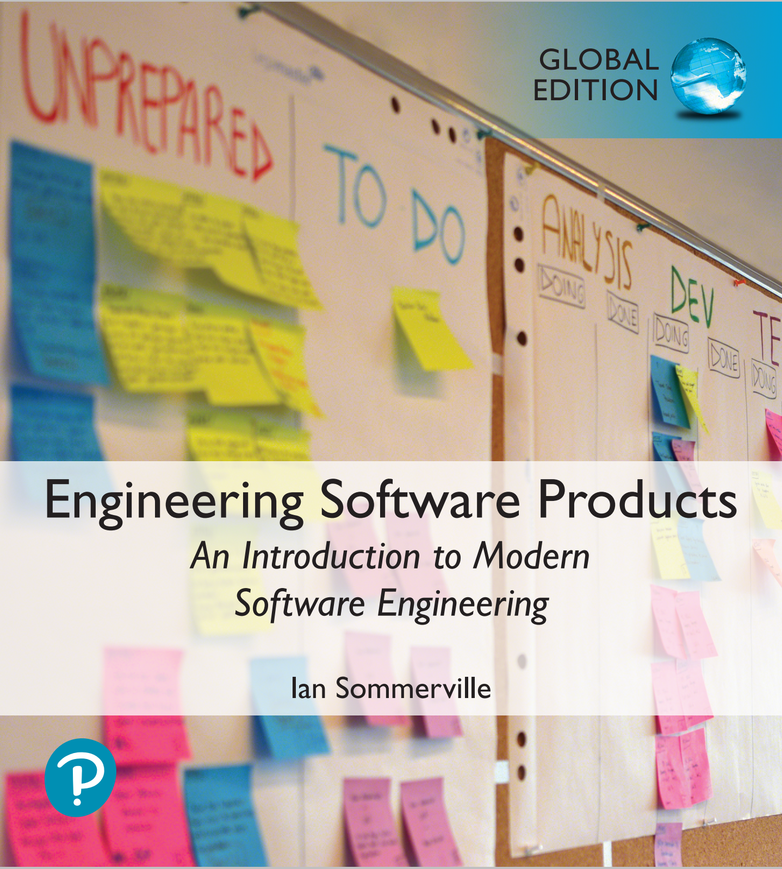
Software architecture
To create a reliable, secure and efficient product, you need to pay attention to architectural design which includes:
  its overall organization,
  how the software is decomposed into components,
  the server organization
  the technologies that you use to build the software.The architecture of a software product affects its performance, usability, security, reliability and maintainability.
There are many different interpretations of the term ‘software architecture’.
  Some focus on ‘architecture’ as a noun - the structure of a system and others consider ‘architecture’ to be a verb - the process of defining these structures.

Slide 4
The IEEE definition
of software architecture
Architecture is the fundamental organization of a software system embodied in its components, their relationships to each other and to the environment, and the principles guiding its design and evolution.

Slide 5
Software architecture and components
A component is an element that implements a coherent set of functionality or features.
Software component can be considered as a collection of one or more services that may be used by other components.
When designing software architecture, you don’t have to decide how an architectural element or component is to be implemented.
Rather, you design the component interface and leave the implementation of that interface to a later stage of the development process.

Slide 6
Access to services provided by software components

Slide 7
Why is architecture important?
Architecture is important because the architecture of a system has a fundamental influence on the non-functional system properties, shown on the next slide.
Architectural design involves understanding the issues that affect the architecture of your product and creating an architectural description that shows the critical components and their relationships.
Minimizing complexity should be an important goal for architectural designers.
  The more complex a system, the more difficult and expensive it is to understand and change.
  Programmers are more likely to make mistakes and introduce bugs and security vulnerabilities when they are modifying or extending a complex system…

Slide 8
Non-functional system quality attributes
Responsiveness
Does the system return results to users in a reasonable time?
Reliability
Do the system features behave as expected by both developers and users?
Availability
Can the system deliver its services when requested by users?
Security
Does the system protect itself and users’ data from unauthorized attacks and intrusions?
Usability
Can system users access the features that they need and use them quickly and without errors?
Maintainability
Can the system be readily updated and new features added without undue costs?
Resilience
Can the system continue to deliver user services in the event of partial failure or external attack?

Slide 9
The influence on architecture of system security
A centralized security architecture
In the Star Wars prequel Rogue One (https://en.wikipedia.org/wiki/Rogue_One), the evil Empire have stored the plans for all of their equipment in a single, highly secure, well-guarded, remote location. This is called a centralized security architecture. It is based on the principle that if you maintain all of your information in one place, then you can apply lots of resources to protect that information and ensure that intruders can’t get hold of it.
Unfortunately (for the Empire), the rebels managed to breach their security. They stole the plans for the Death Star, an event which underpins the whole Star Wars saga. In trying to stop them, the Empire destroyed their entire archive of system documentation with who knows what resultant costs. Had the Empire chosen a distributed security architecture, with different parts of the Death Star plans stored in different locations, then stealing the plans would have been more difficult. The rebels would have had to breach security in all locations to steal the complete Death Star blueprints.

Slide 10
Centralized security architectures
The benefits of a centralized security architecture are that it is easier to design and build protection and that the protected information can be accessed more efficiently.
However, if your security is breached, you lose everything.
If you distribute information, it takes longer to access all of the information and costs more to protect it.
If security is breached in one location, you only lose the information that you have stored there.

Slide 11
Shared database architecture
This slide shows a system with two components (C1 and C2) that share a common database.
  Assume C1 runs slowly because it has to reorganize the information in the database before using it.
  The only way to make C1 faster might be to change the database. This means that C2 also has to be changed, which may, potentially, affect its response time.
Notes:
Maintainability and performance

Slide 12
Multiple database architecture
This shows a different architecture used where each component has its own copy of the parts of the database that it needs.
  If one component needs to change the database organization, this does not affect the other component.
However, a multi-database architecture may run more slowly and may cost more to implement and change.
  A multi-database architecture needs a mechanism (component C3) to ensure that the data shared by C1 and C2 is kept consistent when it is changed.
Notes:
Maintainability and performance

Slide 13
Issues that influence
architectural decisions

Slide 14
The importance of
architectural design issues
Nonfunctional product characteristics
Nonfunctional product characteristics such as security and performance affect all users. If you get these wrong, your product will is unlikely to be a commercial success. Unfortunately, some characteristics are opposing, so you can only optimize the most important.
Product lifetime
If you anticipate a long product lifetime, you will need to create regular product revisions. You therefore need an architecture that is evolvable, so that it can be adapted to accommodate new features and technology.
Software reuse
You can save a lot of time and effort, if you can reuse large components from other products or open-source software. However, this constrains your architectural choices because you must fit your design around the software that is being reused.
Number of users
If you are developing consumer software delivered over the Internet, the number of users can change very quickly. This can lead to serious performance degradation unless you design your architecture so that your system can be quickly scaled up and down.
Software compatibility
For some products, it is important to maintain compatibility with other software so that users can adopt your product and use data prepared using a different system. This may limit architectural choices, such as the database software that you can use.

Slide 15
Trade off: Maintainability vs performance
System maintainability is an attribute that reflects how difficult and expensive it is to make changes to a system after it has been released to customers.
  You improve maintainability by building a system from small self-contained parts, each of which can be replaced or enhanced if changes are required.
In architectural terms, this means that the system should be decomposed into fine-grain components, each of which does one thing and one thing only.
  However, it takes time for components to communicate with each other. Consequently, if many components are involved in implementing a product feature, the software will be slower.

Slide 16
Trade off: Security vs usability
You can achieve security by designing the system protection as a series of layers (next slide).
  An attacker has to penetrate all of those layers before the system is compromised.
Layers might include system authentication layers, a separate critical feature authentication layer, an encryption layer and so on.
Architecturally, you can implement each of these layers as separate components so that if one of these components is compromised by an attacker, then the other layers remain intact.

Slide 17
Authentication layers

Slide 18
Usability issues
A layered approach to security affects the usability of the software.
  Users have to remember information, like passwords, that is needed to penetrate a security layer. Their interaction with the system is inevitably slowed down by its security features.
  Many users find this irritating and often look for work-arounds so that they do not have to re-authenticate to access system features or data.
To avoid this, you need an architecture:
  that doesn’t have too many security layers,
  that doesn’t enforce unnecessary security,
  that provides helper components that reduce the load on users.

Slide 19
Trade off: Availability vs time-to-market
Availability is particularly important in enterprise products, such as products for the finance industry, where 24/7 operation is expected.
The availability of a system is a measure of the amount of ‘uptime’ of that system.
  Availability is normally expressed as a percentage of the time that a system is available to deliver user services.
Architecturally, you achieve availability by having redundant components in a system.
  To make use of redundancy, you include sensor components that detect failure, and switching components that switch operation to a redundant component when a failure is detected.
Implementing extra components takes time and increases the cost of system development. It adds complexity to the system and therefore increases the chances of introducing bugs and vulnerabilities.

Slide 20
Architectural design questions
How should the system be organized as a set of architectural components, where each of these components provides a subset of the overall system functionality?
  The organization should deliver the system security, reliability and performance that you need.
How should these architectural components be distributed and communicate with each other?
What technologies should you use in building the system and what components should be reused?

Slide 21
Component organization
Abstraction in software design means that you focus on the essential elements of a system or software component without concern for its details.
At the architectural level, your concern should be on large-scale architectural components.
Decomposition involves analysing these large-scale components and representing them as a set of finer-grain components.
Layered models are often used to illustrate how a system is composed of components.

Slide 22
An architectural model of a document retrieval system

Slide 23
Architectural complexity
Complexity in a system architecture arises because of the number and the nature of the relationships between components in that system.
When decomposing a system into components, you should try to avoid unnecessary software complexity.
  Localize relationships
  If there are relationships between components A and B, these are easier to understand if A and B are defined in the same module.
  Reduce shared dependencies
  Where components A and B depend on some other component or data, complexity increases because changes to the shared component mean you have to understand how these changes affect both A and B.
It is always preferable to use local data wherever possible and to avoid sharing data if you can.

Slide 24
Examples of component relationships

Slide 25
Architectural design guidelines

Slide 26
Design guidelines and
layered architectures
Each layer is an area of concern and is considered separately from other layers.
  The top layer is concerned with user interaction, the next layer down with user interface management, the third layer with information retrieval and so on.
Within each layer, the components are independent and do not overlap in functionality.
  The lower layers include components that provide general functionality so there is no need to replicate this in the components in a higher level.
The architectural model is a high-level model that does not include implementation information.
  Ideally, components at level X (say) should only interact with the APIs of the components in level X-1. That is, interactions should be between layers and not across layers.

Slide 27
Cross-cutting concerns
Cross-cutting concerns are concerns that are systemic, that is, they affect the whole system.
In a layered architecture, cross-cutting concerns affect all layers in the system as well as the way in which people use the system.
Cross-cutting concerns are completely different from the functional concerns represented by layers in a software architecture.
Every layer has to take them into account and there are inevitably interactions between the layers because of these concerns.
The existence of cross-cutting concerns is the reason why modifying a system after it has been designed to improve its security is often difficult.

Slide 28
Cross-cutting concerns

Slide 29
Security as a cross-cutting concern
Security architecture
Different technologies are used in different layers, such as an SQL database or a Firefox browser. Attackers can try to use of vulnerabilities in these technologies to gain access.
Consequently, you need protection from attacks at each layer as well as protection, at lower layers in the system, from successful attacks that have occurred at higher-level layers.
If there is only a single security component in a system, this represents a critical system vulnerability. If all security checking goes through that component and it stops working properly or is compromised in an attack, then you have no reliable security in your system.
By distributing security across the layers, your system is more resilient to attacks and software failure (remember the Rogue One example earlier).

Slide 30
A generic layered architecture for a web-based application

Slide 31
Layer functionality in a web-based application
Browser-based or mobile user interface
A web browser system interface in which HTML forms are often used to collect user input. Javascript components for local actions, such as input validation, should also be included at this level. Alternatively, a mobile interface may be implemented as an app.
Authentication and UI management
A user interface management layer that may include components for user authentication and web page generation.
Application-specific functionality
An ‘application’ layer that provides functionality of the application. Sometimes, this may be expanded into more than one layer.
Basic shared services
A shared services layer, which includes components that provide services used by the application layer components.
Database and transaction management
A database layer that provides services such as transaction management and recovery. If your application does not use a database then this may not be required.

Slide 32
iLearn architectural design principles
Replaceability
It should be possible for users to replace applications in the system with alternatives and to add new applications. Consequently, the list of applications included should not be hard-wired into the system.
Extensibility
It should be possible for users or system administrators to create their own versions of the system, which may extend or limit the ’standard’ system.
Age-appropriate
Alternative user interfaces should be supported so that age-appropriate interfaces for students at different levels can be created.
Programmability
It should be easy for users to create their own applications by linking existing applications in the system.
Minimum work
Users who do not wish to change the system should not have to do extra work so that other users can make changes.

Slide 33
iLearn design principles
Our goal in designing the iLearn system was to create an adaptable, universal system that could be easily updated as new learning tools became available.
  This means that it must be possible to change and replace components and services in the system (principles (1) and (2)).
  Because the potential system users spanned an age range from 3 to 18, we needed to provide age-appropriate user interfaces and to make it easy to choose an interface (principle (3)).
  Principle (4) also contributes to system adaptability and principle (5) was included to ensure that this adaptability did not adversely affect users who did not require it.

Slide 34
Designing iLearn as
a service-oriented system
These principles led us to an architectural design decision that the iLearn system should be service-oriented.
Every component in the system is a service. Any service is potentially replaceable and new services can be created by combining existing services. Different services delivering comparable functionality can be provided for students of different ages.
Service integration
  Full integration Services are aware of and can communicate with other services through their APIs.
  Partial integration Services may share service components and databases but are not aware of and cannot communicate directly with other application services.
  Independent These services do not use any shared system services or databases and they are unaware of any other services in the system. They can be replaced by any other comparable service.

Slide 35
A layered architectural model of the iLearn system

Slide 36
Distribution architecture
The distribution architecture of a software system defines the servers in the system and the allocation of components to these servers.
Client-server architectures are a type of distribution architecture that is suited to applications where clients access a shared database and business logic operations on that data.
In this architecture, the user interface is implemented on the user’s own computer or mobile device.
  Functionality is distributed between the client and one or more server computers.

Slide 37
Client-server architecture

Slide 38
The model-view-controller pattern

Slide 39
Client-server communication
Client-server communication normally uses the HTTP protocol.
  The client sends a message to the server that includes an instruction such as GET or POST along with the identifier of a resource (usually a URL) on which that instruction should operate. The message may also include additional information, such as information collected from a form.
HTTP is a text-only protocol so structured data has to be represented as text. There are two ways of representing this data that are widely used, namely XML and JSON.
  XML is a markup language with tags used to identify each data item.
  JSON is a simpler representation based on the representation of objects in the Javascript language.

Slide 40
Multi-tier client-server architecture

Slide 41
Service-oriented architecture
Services in a service-oriented architecture are stateless components, which means that they can be replicated and can migrate from one computer to another.
Many servers may be involved in providing services
A service-oriented architecture is usually easier to scale as demand increases and is resilient to failure.

Slide 42
Service-oriented architecture

Slide 43
Issues in architectural choice
Data type and data updates
  If you are mostly using structured data that may be updated by different system features, it is usually best to have a single shared database that provides locking and transaction management. If data is distributed across services, you need a way to keep it consistent and this adds overhead to your system.
Change frequency
  If you anticipate that system components will be regularly changed or replaced, then isolating these components as separate services simplifies those changes.
The system execution platform
  If you plan to run your system on the cloud with users accessing it over the Internet, it is usually best to implement it as a service-oriented architecture because scaling the system is simpler.
  If your product is a business system that runs on local servers, a multi-tier architecture may be more appropriate.

Slide 44
Technology choices
Database
Should you use a relational SQL database or an unstructured NOSQL database?
Platform
Should you deliver your product on a mobile app and/or a web platform?
Server
Should you use dedicated in-house servers or design your system to run on a public cloud? If a public cloud, should you use Amazon, Google, Microsoft, or some other option?
Open source
Are there suitable open-source components that you could incorporate into your products?
Development tools
Do your development tools embed architectural assumptions about the software being developed that limit your architectural choices?

Slide 45
Database
There are two kinds of database that are now commonly used:
  Relational databases, where the data is organised into structured tables
  NoSQL databases, in which the data has a more flexible, user-defined organization.
Relational databases, such as MySQL, are particularly suitable for situations where you need transaction management and the data structures are predictable and fairly simple.
NoSQL databases, such as MongoDB, are more flexible and potentially more efficient than relational databases for data analysis.
  NoSQL databases allow data to be organized hierarchically rather than as flat tables and this allows for more efficient concurrent processing of ‘big data’.

Slide 46
Delivery platform
Delivery can be as a web-based or a mobile product or both
Mobile issues:
  Intermittent connectivity You must be able to provide a limited service without network connectivity.
  Processor power Mobile devices have less powerful processors, so you need to minimize computationally-intensive operations.
  Power management Mobile battery life is limited so you should try to minimize the power used by your application.
  On-screen keyboard On-screen keyboards are slow and error-prone. You should minimize input using the screen keyboard to reduce user frustration.
To deal with these differences, you usually need separate browser-based and mobile versions of your product front-end.
  You may need a completely different decomposition architecture in these different versions to ensure that performance and other characteristics are maintained.

Slide 47
Server
A key decision that you have to make is whether to design your system to run on customer servers or to run on the cloud.
For consumer products that are not simply mobile apps I think it almost always makes sense to develop for the cloud.
For business products, it is a more difficult decision.
  Some businesses are concerned about cloud security and prefer to run their systems on in-house servers. They may have a predictable pattern of system usage so there is less need to design your system to cope with large changes in demand.
An important choice you have to make if you are running your software on the cloud is which cloud provider to use.

Slide 48
Open source
Open source software is software that is available freely, which you can change and modify as you wish.
  The advantage is that you can reuse rather than implement new software, which reduces development costs and time to market.
  The disadvantages of using open-source software is that you are constrained by that software and have no control over its evolution.
The decision on the use of open-source software also depends on the availability, maturity and continuing support of open source components.
Open source license issues may impose constraints on how you use the software.
Your choice of open source software should depend on the type of product that you are developing, your target market and the expertise of your development team.

Slide 49
Development tools
Development technologies, such as a mobile development toolkit or a web application framework, influence the architecture of your software.
  These technologies have built-in assumptions about system architectures and you have to conform to these assumptions to use the development system.
The development technology that you use may also have an indirect influence on the system architecture.
  Developers usually favour architectural choices that use familiar technologies that they understand. For example, if your team have a lot of experience of relational databases, they may argue for this instead of a NoSQL database.

Slide 50
Software services
A software service is a software component that can be accessed from remote computers over the Internet. Given an input, a service produces a corresponding output, without side effects.
  The service is accessed through its published interface and all details of the service implementation are hidden.
  Services do not maintain any internal state. State information is either stored in a database or is maintained by the service requestor.
When a service request is made, the state information may be included as part of the request and the updated state information is returned as part of the service result.
As there is no local state, services can be dynamically reallocated from one virtual server to another and replicated across several servers.

Slide 51
Modern web services
After various experiments in the 1990s with service-oriented computing, the idea of ‘big’ Web Services emerged in the early 2000s.
These were based on XML-based protocols and standards such as SOAP for service interaction and WSDL for interface description.
Most software services don’t need the generality that’s inherent in the design of web service protocols.
Consequently, modern service-oriented systems, use simpler, ‘lighter weight’ service-interaction protocols that have lower overheads and, consequently, faster execution.

Slide 52
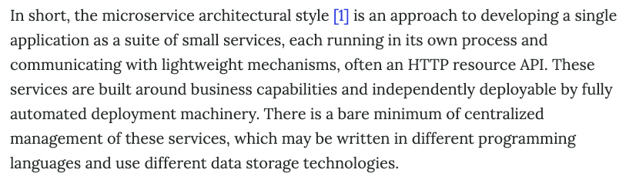
https://martinfowler.com/articles/microservices.html

Slide 53
Mini Break in Monday Lecture

Slide 54


Slide 55

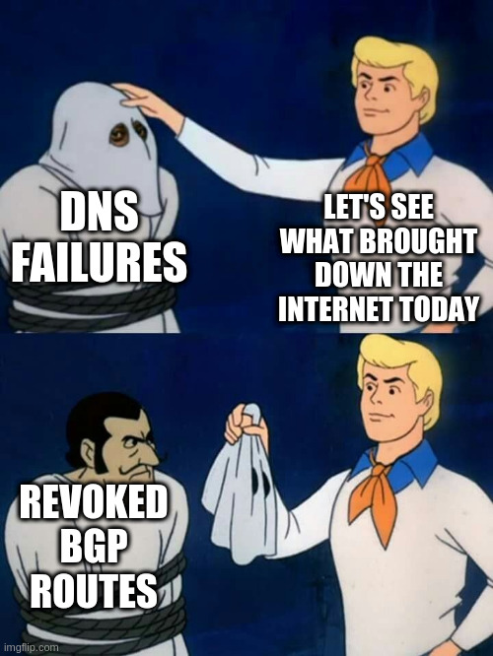

Notes:
https://en.wikipedia.org/wiki/Border_Gateway_Protocol#:~:text=The%20BGP%20defines%20the%20messages,The%20second%20state%20is%20Connect.

Slide 56
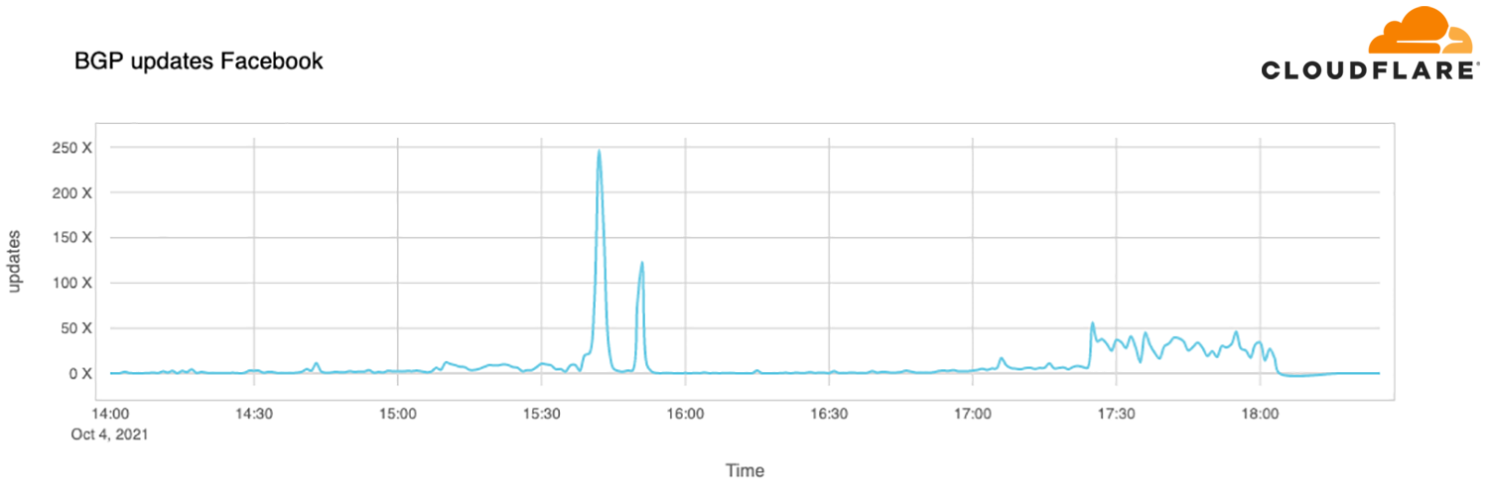
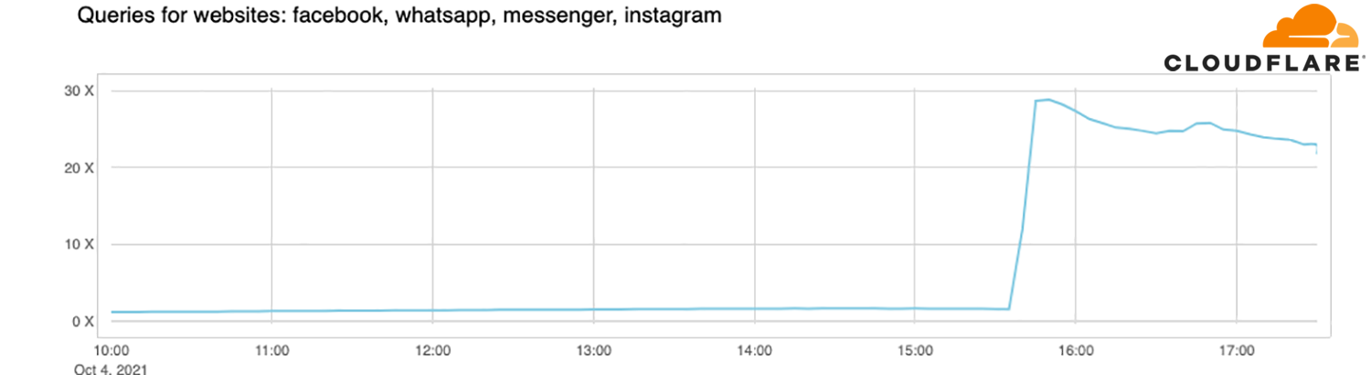
Facebook on Oct 4, 2021
Source: https://blog.cloudflare.com/october-2021-facebook-outage/

Slide 57
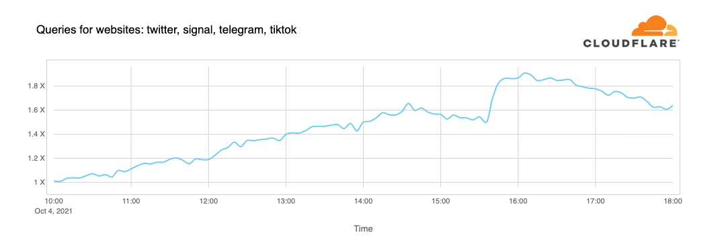
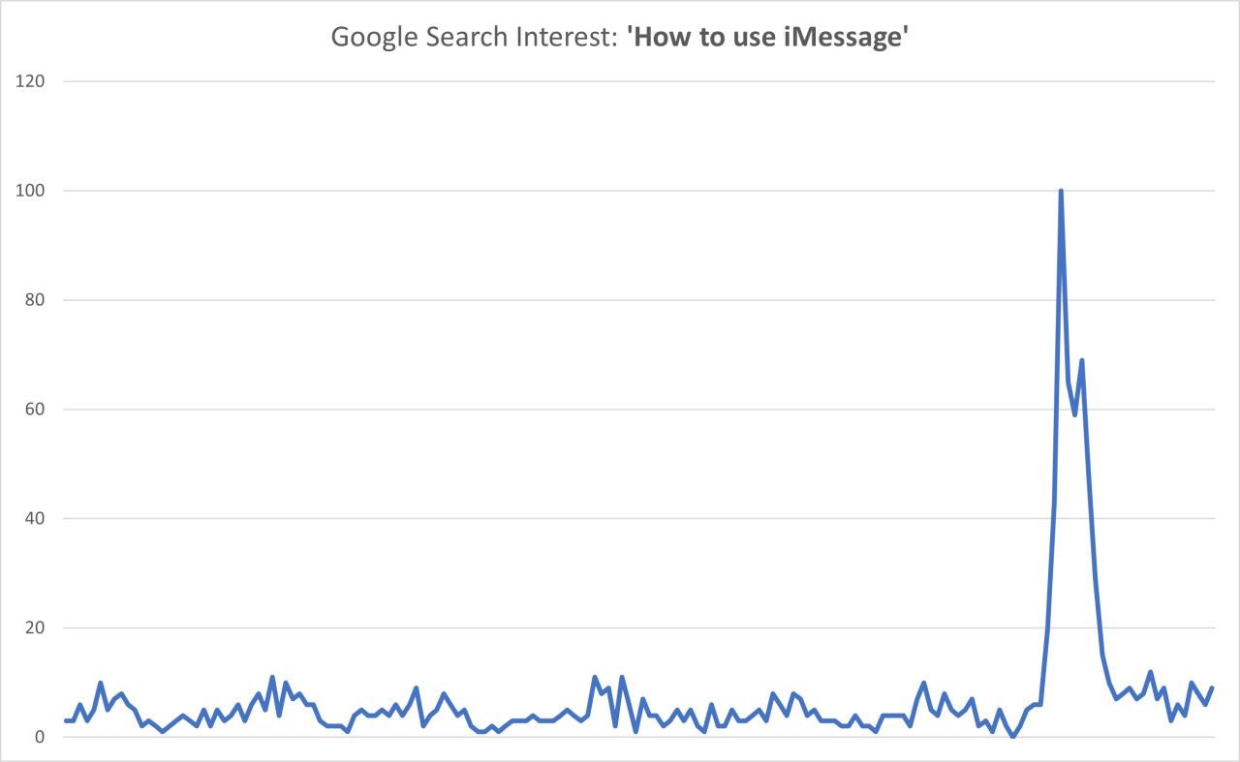
Facebook on Oct 4, 2021
Source: https://blog.cloudflare.com/october-2021-facebook-outage/
Some interesting insights about the dependency web of the Web:
https://www.synergylabs.org/yuvraj/docs/Kashaf_IMC2020_WebDep.pdf

Slide 58
MONOLITHS

Slide 59
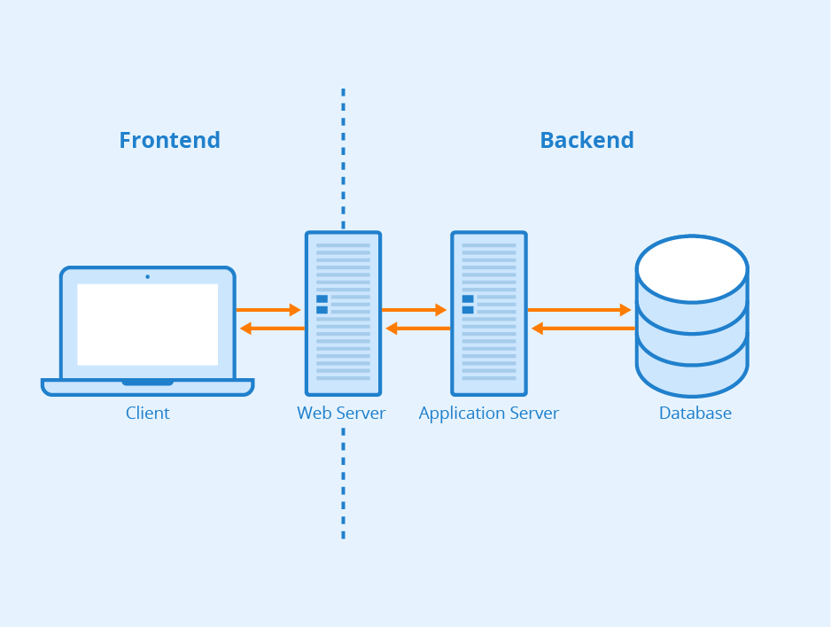
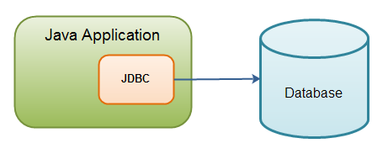
Monolithic styles
Source: https://www.seobility.net (CC BY-SA 4.0)

Slide 60
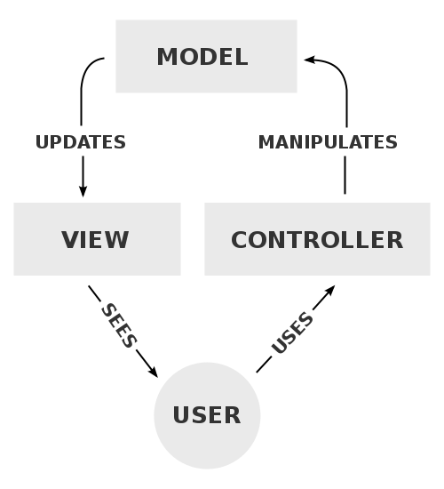
Monolithic styles: MVC Pattern

Slide 61
Monoliths
What are the consequences of this architecture? On:
Scalability
Reliability
Performance
Development
Maintainability
Evolution
Testability
Ownership
Data Consistency

Slide 62
Service-based architecture
Separation of concerns

Slide 63
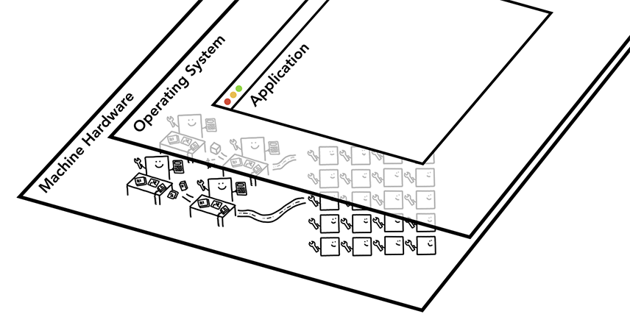
Web Browsers
Source: https://developers.google.com/web/updates/2018/09/inside-browser-part1 (CC BY 4.0)
Notes:
Many complex components in a multi-threaded process

Slide 64
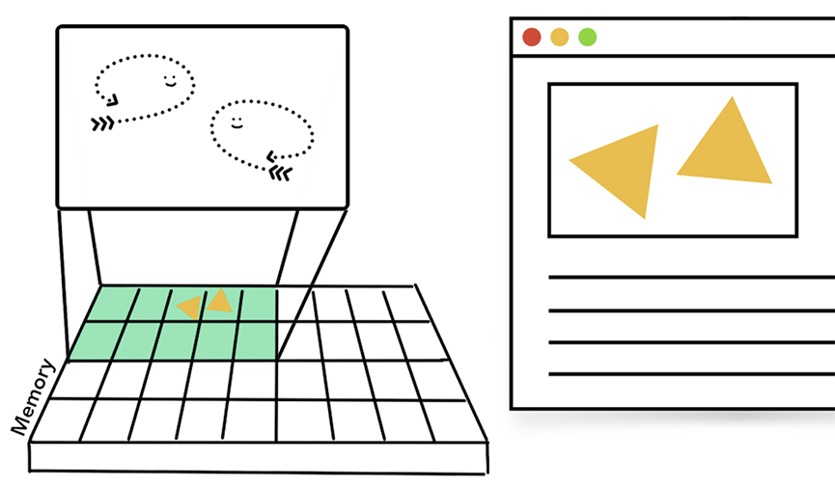
Browser: A multi-threaded process
Source: https://developers.google.com/web/updates/2018/09/inside-browser-part1 (CC BY 4.0)
Notes:
Many complex components in a multi-threaded process

Slide 65
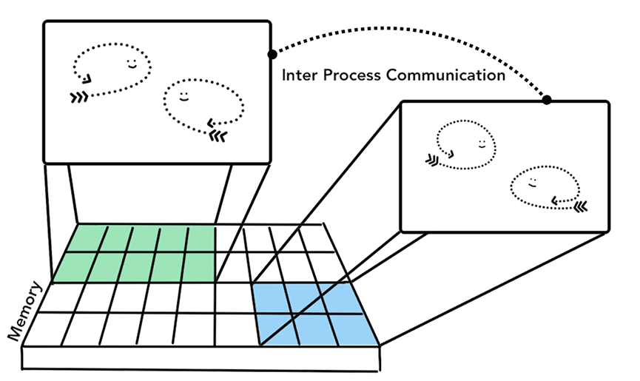
Multi-process browser with IPC
Source: https://developers.google.com/web/updates/2018/09/inside-browser-part1 (CC BY 4.0)
Notes:
Many complex components in a multi-threaded process

Slide 66
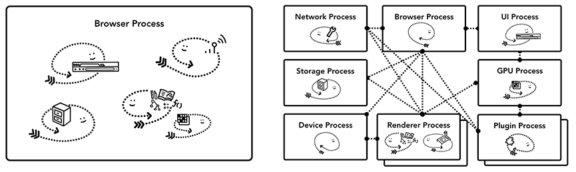
Browser Architectures
Source: https://developers.google.com/web/updates/2018/09/inside-browser-part1 (CC BY 4.0)

Slide 67
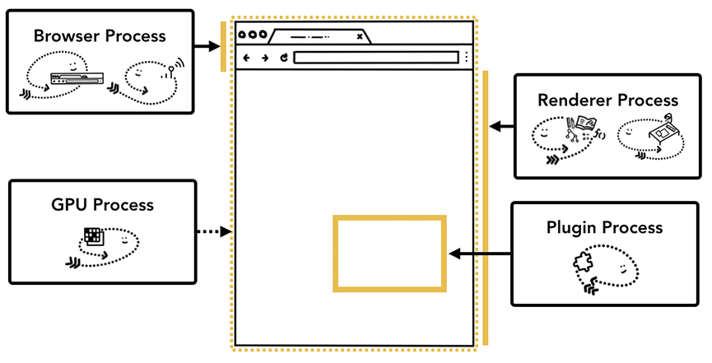
Service-based browser architecture
Source: https://developers.google.com/web/updates/2018/09/inside-browser-part1 (CC BY 4.0)

Slide 68
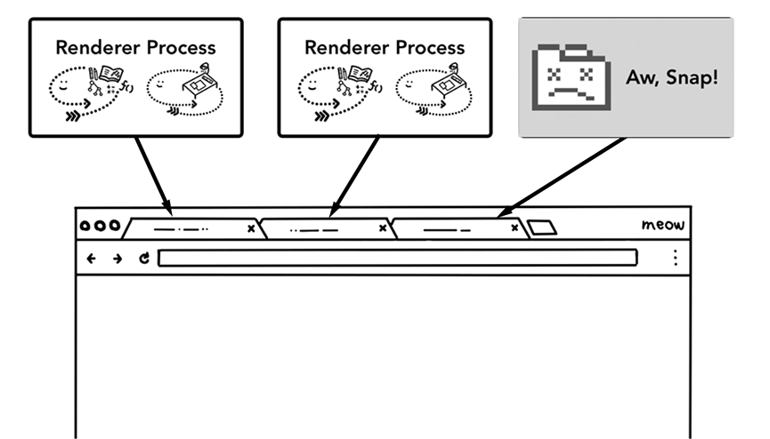
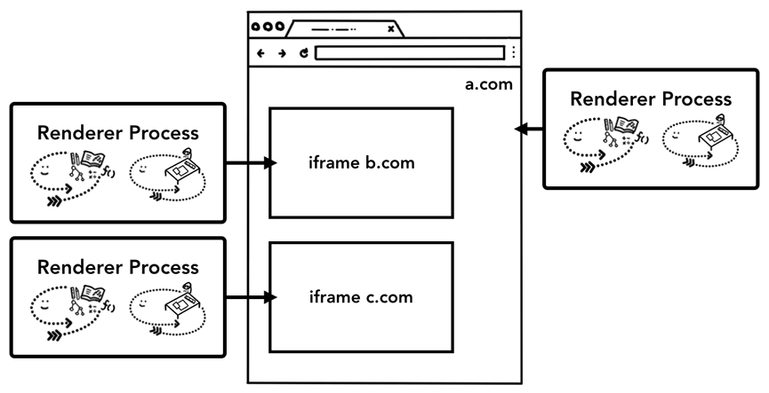
Service-based browser architecture
Source: https://developers.google.com/web/updates/2018/09/inside-browser-part1 (CC BY 4.0)
Notes:
Left: Failure resilience
Right: Isolation

Slide 69
Microservices
Taking it further

Slide 70

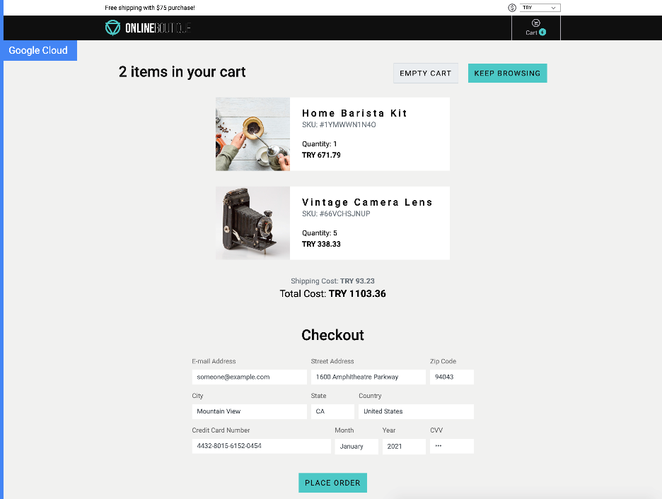
Hipster Shop User Interface
https://github.com/GoogleCloudPlatform/microservices-demo

Slide 71
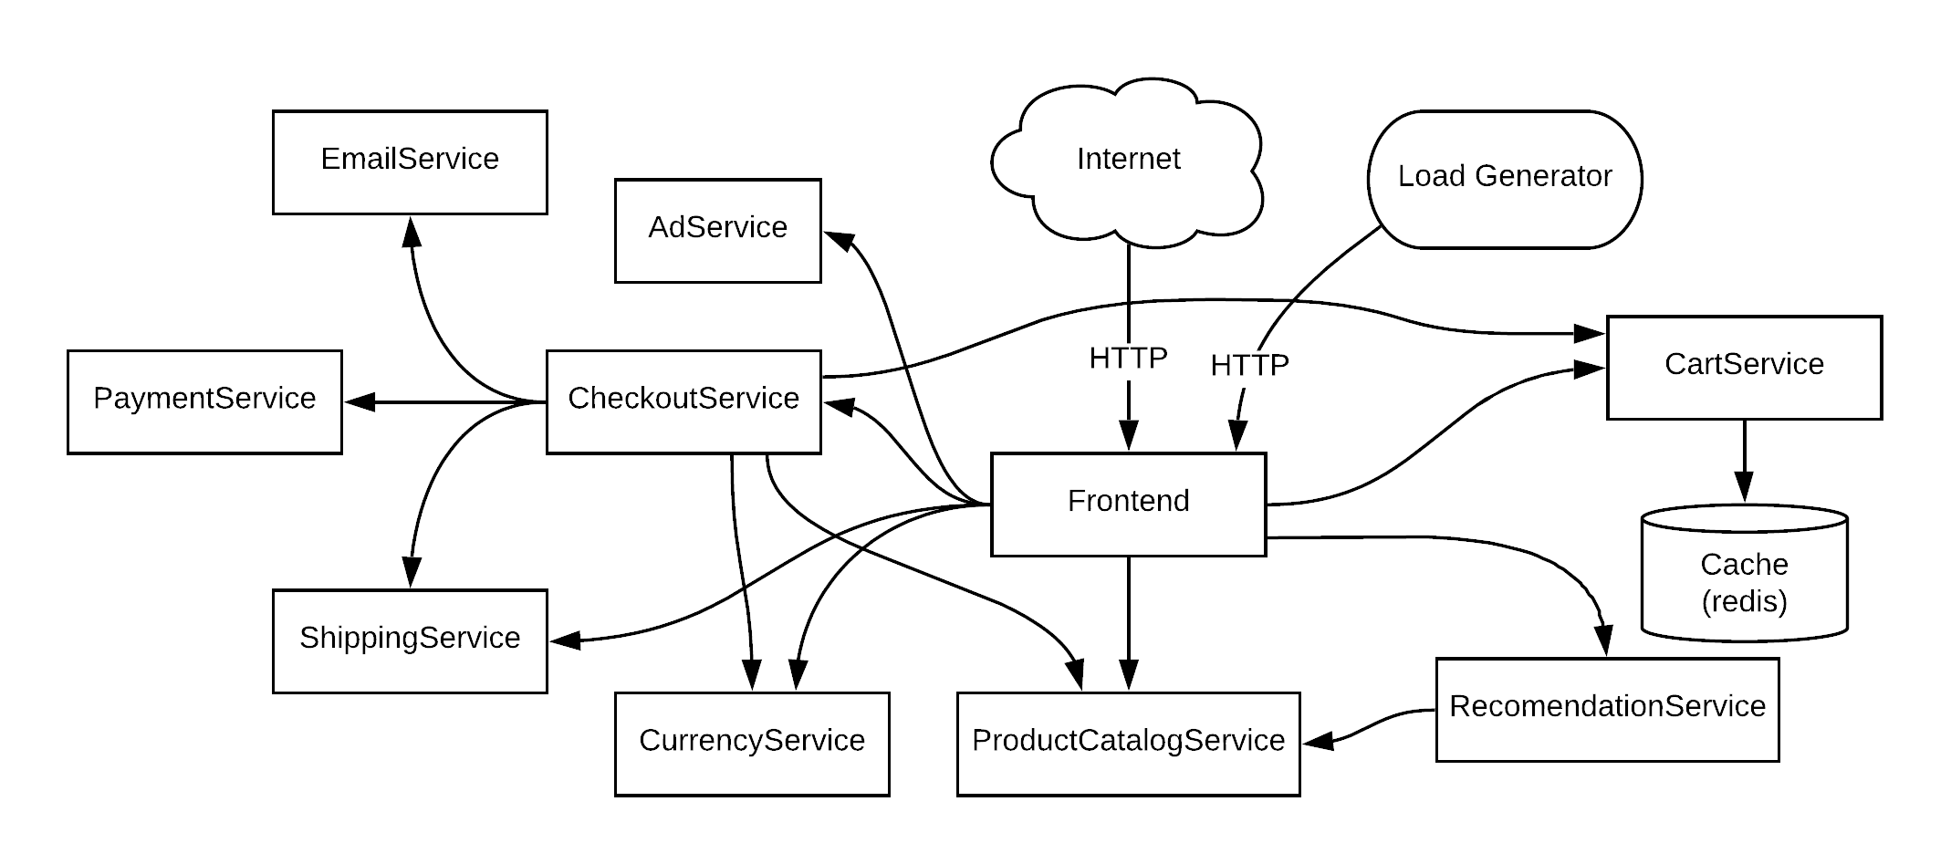
Hipster Shop Microservice Architecture
https://github.com/GoogleCloudPlatform/microservices-demo

Slide 72
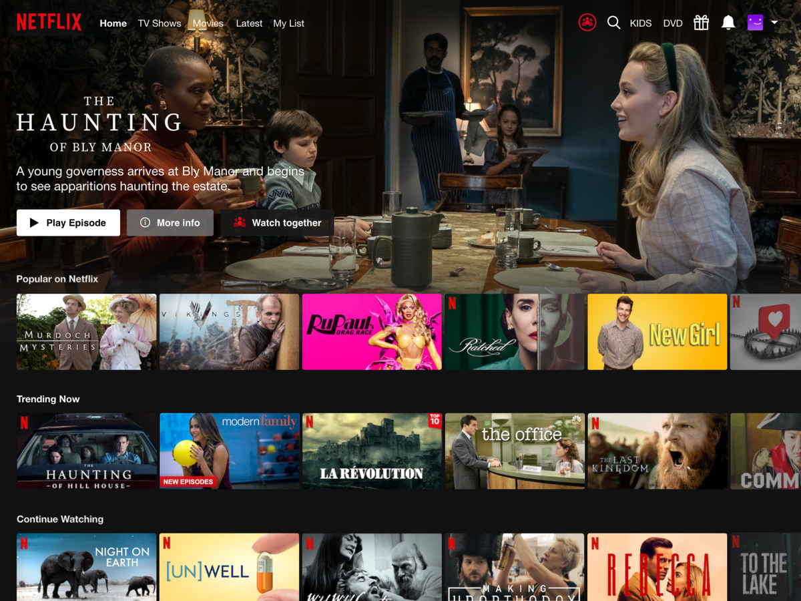
Netflix

Slide 73
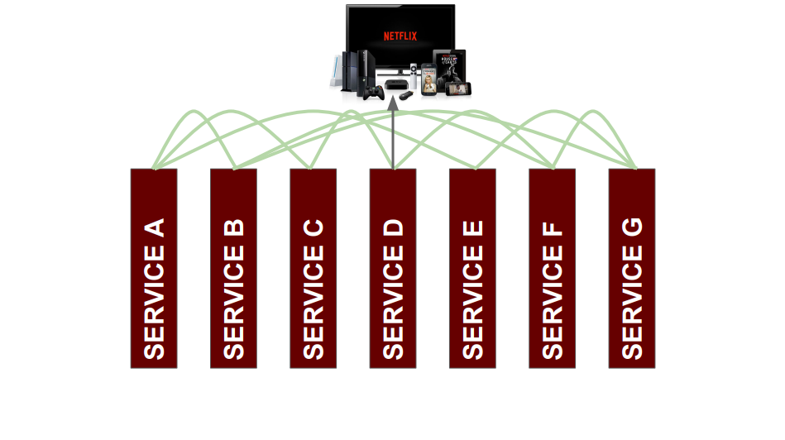
AppBoot
Bookmarks
Recommendations
My List
Metrics
(as of 2016)
Notes:
- Netflix popularized microservices.
- Solicit students to figure out what components could be microservices as part of Netflix (active learning – 10/15 minutes?)
Possibly look for Casey Rosenthal talk with animated microservice diagram thing from goto 2016??

Slide 74
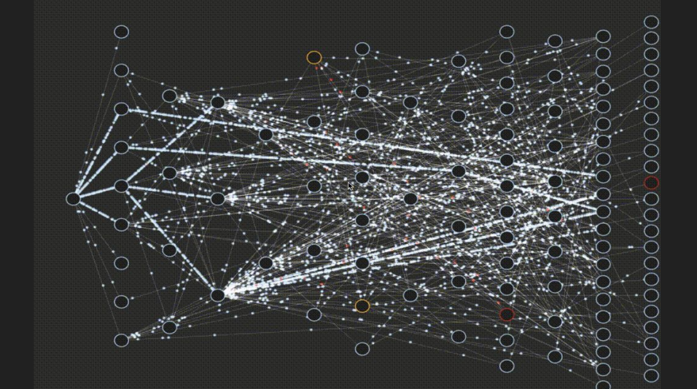
Netflix Microservices
(as of 2016)
https://www.youtube.com/watch?v=CZ3wIuvmHeM
Notes:
This is the reality

Slide 75




Who uses Microservices?

Slide 76
Microservices
What are the consequences of this architecture? On:
Scalability
Reliability
Performance
Development
Maintainability
Evolution
Testability
Ownership
Data Consistency

Slide 77
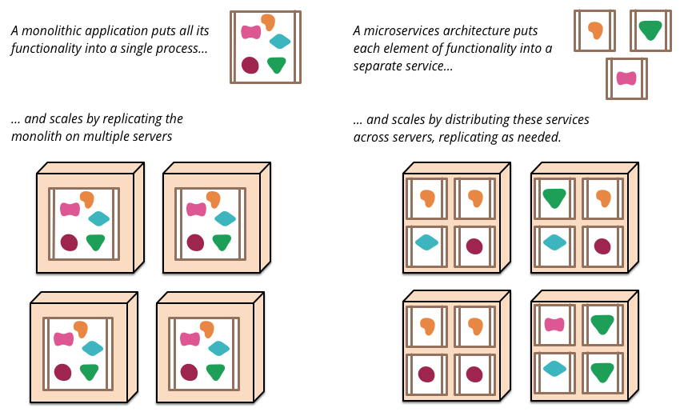
Scalability
Source: http://martinfowler.com/articles/microservices.html
Notes:
Microservices really don’t exist without cloud computing / elastic on-demand resizing

Slide 78
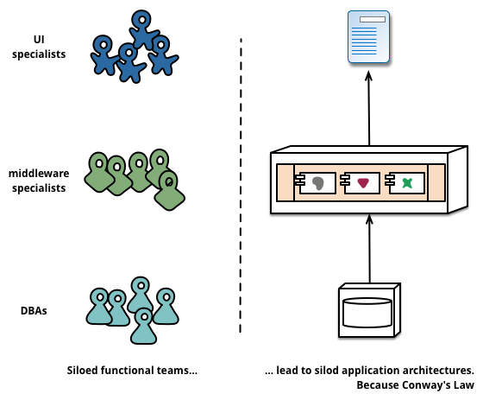
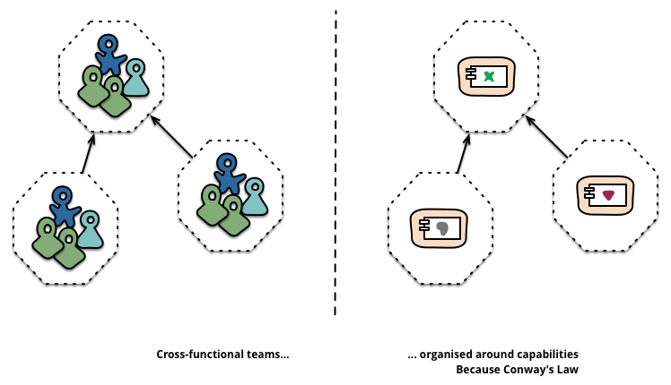
Team Organization (Conway’s Law)
“Products” not “Projects”
Source: http://martinfowler.com/articles/microservices.html
Notes:
Product teams are responsible for the entire lifecycle and delivery and continuous improvement

Slide 79
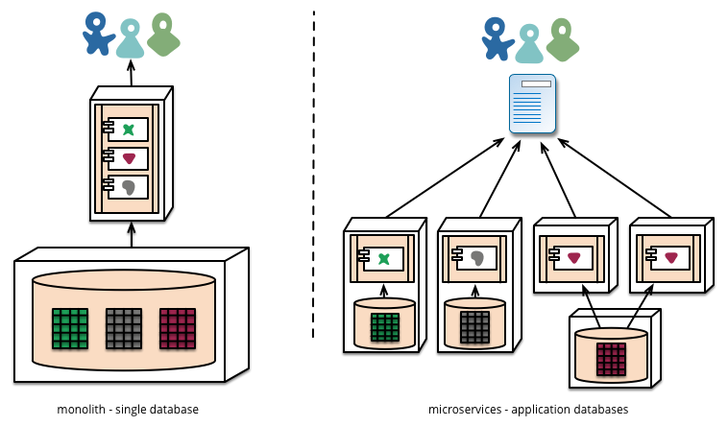
Data Management and Consistency
Source: http://martinfowler.com/articles/microservices.html
Notes:
Data may be separated.
CAP theory (Consistency XOR Availability when Partionted)
Gotta live with eventual consistency

Slide 80
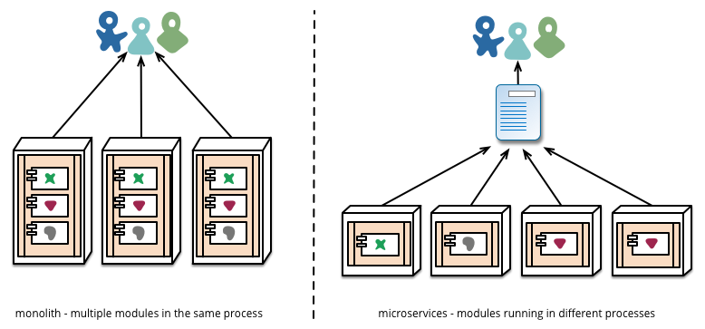
Deployment and Evolution
Source: http://martinfowler.com/articles/microservices.html
Notes:
Much easier to redeploy individual components when they are isolated in different processes or containers
Caveat: Changing interfaces is much much more complex (compare to refactoring code in a monolithic app). Requires versioning, backward-compatibility, managing consumer expectations (or specifying contracts), etc.

Slide 81
Microservices
Building applications as suite of small and easy to replace services
  fine grained, one functionality per service
  (sometimes 3-5 classes)
  composable
  easy to develop, test, and understand
  fast (re)start, fault isolation
  modelled around business domain
Interplay of different systems and languages
Easily deployable and replicable
Embrace automation, embrace faults
Highly observable

Slide 82
Technical Considerations
HTTP/REST/JSON/GRPC/etc. communication
Independent development and deployment
Self-contained services (e.g., each with own database)
  multiple instances behind load-balancer
Streamline deployment

Slide 83
Service Oriented Architectures
(SOA)
Service: self-contained functionality
Remote invocation, language-independent interface
Dynamic lookup possible
Often used to wrap
legacy systems
Service Registry
find
publish
Service Requestor
Service Provider
bind
call
Notes:
SOAP, WSDL

Slide 84
Service Oriented Architectures
(SOA) Microservice Architecture
Service: self-contained functionality
Language-independent interface
Dynamic lookup
Kubernetes
DNS
Lookup
Runs and
Assigns IP
HTTP/GRPC
Service A
(Container)
Service B
(Containers)
Notes:
SOAP, WSDL

Slide 85
Microservices overhead

Slide 86
Microservice challenges
Complexities of distributed systems
  network latency, faults, inconsistencies
  testing challenges
Resource overhead, RPCs
  Requires more thoughtful design (avoid ”chatty” APIs, be more coarse-grained)_
Shifting complexities to the network
Operational complexity
Frequently adopted by breaking down monolithic application
HTTP/REST/JSON communication
  Schemas?
Notes:
no free lunch
forward reference to testing (chaosmonkey) and process (continuous delivery)

Slide 87
Discussion of Microservices
Are they really “new”?
Do microservices solve problems, or push them down the line?
What are the impacts of the added flexibility?
Beware of the cult (HackerNews-driven development?)
“If you can’t build a well-structured monolith, what makes you think microservices is the answer?” – Simon Brown
Leads to more API design decisions
Notes:
“Cargo cult”: --- Chris Meiklejohn

Slide 88
SERVERLESS
Taking it to the extreme

Slide 89
Serverless (Functions-as-a-Service)
Instead of writing minimal services, write just functions
No state, rely completely on cloud storage or other cloud services
Pay-per-invocation billing with elastic scalability
Drawback: more ways things can fail, state is expensive
Examples:
AWS lambda, CloudFlare workers, Azure Functions
What might this be good for?
(New in 2019/20) Stateful Functions:
Azure Durable Entities, CloudFlare Durable Objects

Slide 90
Microservices
Microservices are small-scale, stateless, services that have a single responsibility. They are combined to create applications.
They are completely independent with their own database and UI management code.
Software products that use microservices have a microservices architecture.
If you need to create cloud-based software products that are adaptable, scalable and resilient then it is recommended that you design them around a microservices architecture.

Slide 91
A microservice example
System authentication
  User registration, where users provide information about their identity, security information, mobile (cell) phone number and email address.
  Authentication using UID/password.
  Two-factor authentication using code sent to mobile phone.
  User information management e.g. change password or mobile phone number.
  Reset forgotten password.
Each of these features could be implemented as a separate service that uses a central shared database to hold authentication information.
However, these features are too large to be microservices. To identify the microservices that might be used in the authentication system, you need to break down the coarse-grain features into more detailed functions.

Slide 92
Functional breakdown of authentication features

Slide 93
Authentication microservices

Slide 94
Characteristics of microservices
Self-contained
Microservices do not have external dependencies. They manage their own data and implement their own user interface.
Lightweight
Microservices communicate using lightweight protocols, so that service communication overheads are low.
Implementation-independent
Microservices may be implemented using different programming languages and may use different technologies (e.g. different types of database) in their implementation.
Independently deployable
Each microservice runs in its own process and is independently deployable, using automated systems.
Business-oriented
Microservices should implement business capabilities and needs, rather than simply provide a technical service.

Slide 95
Microservice communication
Microservices communicate by exchanging messages.
A message that is sent between services includes some administrative information, a service request and the data required to deliver the requested service.
Services return a response to service request messages.
  An authentication service may send a message to a login service that includes the name input by the user.
  The response may be a token associated with a valid user name or might be an error saying that there is no registered user.

Slide 96
Microservice characteristics
A well-designed microservice should have high cohesion and low coupling.
  Cohesion is a measure of the number of relationships that parts of a component have with each other. High cohesion means that all of the parts that are needed to deliver the component’s functionality are included in the component.
  Coupling is a measure of the number of relationships that one component has with other components in the system. Low coupling means that components do not have many relationships with other components.
Each microservice should have a single responsibility i.e. it should do one thing only and it should do it well.
  However, ‘one thing only’ is difficult to define in a way that’s applicable to all services.
  Responsibility does not always mean a single, functional activity.

Slide 97
Password management functionality

Slide 98
Microservice support code

Slide 99
Microservices architecture
A microservices architecture is an architectural style – a tried and tested way of implementing a logical software architecture.
This architectural style addresses two problems with monolithic applications
  The whole system has to be rebuilt, re-tested and re-deployed when any change is made. This can be a slow process as changes to one part of the system can adversely affect other components.
  As the demand on the system increases, the whole system has to be scaled, even if the demand is localized to a small number of system components that implement the most popular system functions.

Slide 100
Benefits of microservices architecture
Microservices are self-contained and run in separate processes.
In cloud-based systems, each microservice may be deployed in its own container. This means a microservice can be stopped and restarted without affecting other parts of the system.
If the demand on a service increases, service replicas can be quickly created and deployed. These do not require a more powerful server so ‘scaling-out’ is, typically, much cheaper than ’scaling up’.

Slide 101
A photo printing system for mobile
Imagine that you are developing a photo printing service for mobile devices. Users can upload photos to your server from their phone or specify photos from their Instagram account that they would like to be printed. Prints can be made at different sizes and on different media.
Users can chose print size and print medium. For example, they may decide to print a picture onto a mug or a T-shirt. The prints or other media are prepared and then posted to their home. They pay for prints either using a payment service such as Android or Apple Pay or by registering a credit card with the printing service provider.

Slide 102
A microservices architecture for a photo printing system

Slide 103
Microservices architecture - key design questions

Slide 104
Decomposition guidelines
Balance fine-grain functionality and system performance
  Single-function services mean that changes are limited to fewer services but require service communications to implement user functionality. This slows down a system because of the need for each service to bundle and unbundle messages sent from other services.
Follow the ‘common closure principle’
  Elements of a system that are likely to be changed at the same time should be located within the same service. Most new and changed requirements should therefore only affect a single service.
Associate services with business capabilities
  A business capability is a discrete area of business functionality that is the responsibility of an individual or a group. You should identify the services that are required to support each business capability.
Design services so that they only have access to the data that they need
  If there is an overlap between the data used by different services, you need a mechanism to propagate data changes to all services using the same data.

Slide 105
Service communications
Services communicate by exchanging messages that include information about the originator of the message, as well as the data that is the input to or output from the request.
When you are designing a microservices architecture, you have to establish a standard for communications that all microservices should follow. Some of the key decisions that you have to make are
  should service interaction be synchronous or asynchronous?
  should services communicate directly or via message broker middleware?
  what protocol should be used for messages exchanged between services?

Slide 106
Synchronous and asynchronous micro-
service interaction

Slide 107
Synchronous and asynchronous
interaction
In a synchronous interaction, service A issues a request to service B. Service A then suspends processing while B is processing the request.
It waits until service B has returned the required information before continuing execution.
In an asynchronous interaction, service A issues the request that is queued for processing by service B. A then continues processing without waiting for B to finish its computations.
Sometime later, service B completes the earlier request from service A and queues the result to be retrieved by A.
Service A, therefore, has to check its queue periodically to see if a result is available.

Slide 108
Direct and indirect service communication

Slide 109
Direct and indirect service communication
Direct service communication requires that interacting services know each other’s address.
The services interact by sending requests directly to these addresses.
Indirect communication involves naming the service that is required and sending that request to a message broker (sometimes called a message bus).
The message broker is then responsible for finding the service that can fulfil the service request.

Slide 110
Microservice data design
You should isolate data within each system service with as little data sharing as possible.
If data sharing is unavoidable, you should design microservices so that most sharing is ‘read-only’, with a minimal number of services responsible for data updates.
If services are replicated in your system, you must include a mechanism that can keep the database copies used by replica services consistent.

Slide 111
Inconsistency management
An ACID (Atomicity, Consistency, Isolation, Durability) transaction bundles a set of data updates into a single unit so that either all updates are completed or none of them are. ACID transactions are impractical in a microservices architecture.
The databases used by different microservices or microservice replicas need not be completely consistent all of the time.
Dependent data inconsistency
  The actions or failures of one service can cause the data managed by another service to become inconsistent.
Replica inconsistency
  There are several replicas of the same service that are executing concurrently. These all have their own database copy and each updates its own copy of the service data. You need a way of making these databases ‘eventually consistent’ so that all replicas are working on the same data.
Notes:
https://www.ibm.com/docs/en/cics-ts/5.4?topic=processing-acid-properties-transactions
In the context of transaction processing, the acronym ACID refers to the four key properties of a transaction: atomicity, consistency, isolation, and durability.

Slide 112
Eventual consistency
Eventual consistency is a situation where the system guarantees that the databases will eventually become consistent.
You can implement eventual consistency by maintaining a transaction log.
When a database change is made, this is recorded on a ‘pending updates’ log.
Other service instances look at this log, update their own database and indicate that they have made the change.

Slide 113
Using a pending transaction log

Slide 114
Service coordination
Most user sessions involve a series of interactions in which operations have to be carried out in a specific order.
This is called a workflow.
  An authentication workflow for UID/password authentication shows the steps involved in authenticating a user.
  In this example, the user is allowed 3 login attempts before the system indicates that the login has failed.

Slide 115
Authentication workflow

Slide 116
Orchestration and choreography

Slide 117
Failure types in a microservices system
Internal service failure
These are conditions that are detected by the service and can be reported to the service client in an error message. An example of this type of failure is a service that takes a URL as an input and discovers that this is an invalid link.
External service failure
These failures have an external cause, which affects the availability of a service. Failure may cause the service to become unresponsive and actions have to be taken to restart the service.
Service performance failure
The performance of the service degrades to an unacceptable level. This may be due to a heavy load or an internal problem with the service. External service monitoring can be used to detect performance failures and unresponsive services.

Slide 118
Timeouts and circuit breakers
A timeout is a counter that this associated with the service requests and starts running when the request is made.
Once the counter reaches some predefined value, such as 10 seconds, the calling service assumes that the service request has failed and acts accordingly.
The problem with the timeout approach is that every service call to a ‘failed service’ is delayed by the timeout value so the whole system slows down.
Instead of using timeouts explicitly when a service call is made, he suggests using a circuit breaker. Like an electrical circuit breaker, this immediately denies access to a failed service without the delays associated with timeouts.

Slide 119
Using a circuit breaker to cope with
service failure

Slide 120
RESTful services
The REST (REpresentational State Transfer) architectural style is based on the idea of transferring representations of digital resources from a server to a client.
  You can think of a resource as any chunk of data such as credit card details, an individual’s medical record, a magazine or newspaper, a library catalogue, and so on.
  Resources are accessed via their unique URI and RESTful services operate on these resources.
This is the fundamental approach used in the web where the resource is a page to be displayed in the user’s browser.
  An HTML representation is generated by the server in response to an HTTP GET request and is transferred to the client for display by a browser or a special-purpose app.

Slide 121
RESTful service principles
Use HTTP verbs
The basic methods defined in the HTTP protocol (GET, PUT, POST, DELETE) must be used to access the operations made available by the service.
Stateless services
Services must never maintain internal state. As I have already explained, microservices are stateless so fit with this principle.
URI addressable
All resources must have a URI, with a hierarchical structure, that is used to access sub-resources.
Use XML or JSON
Resources should normally be represented in JSON or XML or both. Other representations, such as audio and video representations, may be used if appropriate.

Slide 122
RESTful service operations
Create
Implemented using HTTP POST, which creates the resource with the given URI. If the resource has already been created, an error is returned.
Read
Implemented using HTTP GET, which reads the resource and returns its value. GET operations should never update a resource so that successive GET operations with no intervening PUT operations always return the same value.
Update
Implemented using HTTP PUT, which modifies an existing resource. PUT should not be used for resource creation.
Delete
Implemented using HTTP DELETE, which makes the resource inaccessible using the specified URI. The resource may or may not be physically deleted.

Slide 123
Road information system
Imagine a system that maintains information about incidents, such as traffic delays, roadworks and accidents on a national road network. This system can be accessed via a browser using the URL:
  https://trafficinfo.net/incidents/ (not a real link!)
Users can query the system to discover incidents on the roads on which they are planning to travel.
When implemented as a RESTful web service, you need to design the resource structure so that incidents are organized hierarchically.
  For example, incidents may be recorded according to the road identifier (e.g. A90), the location (e.g. stonehaven), the carriageway direction (e.g. north) and an incident number (e.g. 1). Therefore, each incident can be accessed using its URI:
  https://trafficinfo.net/incidents/A90/stonehaven/north/1 (not a real link!)

Slide 124
Incident description
Incident ID: A90N17061714391
Date: 17 June 2017
Time reported: 1439
Severity: Significant
Description: Broken-down bus on north carriageway. One lane closed. Expect delays of up to 30 minutes

Slide 125
Service operations
Retrieve
  Returns information about a reported incident or incidents. Accessed using the GET verb.
Add
  Adds information about a new incident. Accessed using the POST verb.
Update
  Updates the information about a reported incident. Accessed using the PUT verb.
Delete
  Deletes an incident. The DELETE verb is used when an incident has been cleared.

Slide 126
HTTP request and response processing

Slide 127
HTTP request and response message organization

Slide 128
XML and JSON descriptions
JSON
{
id: “A90N17061714391”,
“date”: “20170617”,
“time”: “1437”,
“road_id”: “A90”,
“place”: “Stonehaven”,
“direction”: “north”,
“severity”: “significant”,
“description”: “Broken-down bus on north carriageway. One lane closed. Expect delays of up to 30 minutes.”
}

Slide 129
XML and JSON descriptions
XML
<id>
A90N17061714391
</id>
<date>
20170617
</date>
<time>
1437
</time>
…
<description>Broken-down bus on north carriageway. One lane closed. Expect delays of up to 30 minutes.
</description>

Slide 130
A GET request and the associated
response

Slide 131
Service deployment
After a system has been developed and delivered, it has to be deployed on servers, monitored for problems and updated as new versions become available.
When a system is composed of tens or even hundreds of microservices, deployment of the system is more complex than for monolithic systems.
The service development teams decide which programming language, database, libraries and other support software should be used to implement their service. Consequently, there is no ‘standard’ deployment configuration for all services.
It is now normal practice for microservice development teams to be responsible for deployment and service management as well as software development and to use continuous deployment.
Continuous deployment means that as soon as a change to a service has been made and validated, the modified service is redeployed.

Slide 132
Deployment automation
Continuous deployment depends on automation so that as soon as a change is committed, a series of automated activities is triggered to test the software.
If the software ‘passes’ these tests, it then enters another automation pipeline that packages and deploys the software.
The deployment of a new service version starts with the programmer committing the code changes to a code management system such as Git.
This triggers a set of automated tests that run using the modified service. If all service tests run successfully, a new version of the system that incorporates the changed service is created.
Another set of automated system tests are then executed. If these run successfully, the service is ready for deployment.

Slide 133
A continuous deployment pipeline

Slide 134
Versioned services

Slide 135
Next Week: DevOps
Notes:
culture driving by rapid feedback
remove all friction/obstacles that hinder quick feedback and release cycles (approval, testing, deployment etc)
typical facets
integrate development and operations
consider configuration as first class artifact (check in and version), develop with final software stack, often in virtual environment
continuous deployment/delivery, multiple releases per day
consider operations aspect already in the early design
“agile system administration”
automation, measurement, sharing

Slide 136
Key Points
Software architecture is the fundamental organization of a system embodied in its components, their relationships to each other, and to the environment, and the principles guiding its design and evolution.
The architecture of a software system has a significant influence on non-functional system properties such as reliability, efficiency and security.
Architectural design involves understanding the issues that are critical for your product and creating system descriptions that shows components and their relationships.
The principal role of architectural descriptions is to provide a basis for the development team to discuss the system organization. Informal architectural diagrams are effective in architectural description because they are fast and easy to draw and share.
System decomposition involves analyzing architectural components and representing them as a set of finer-grain components.

Slide 137
Key Points
To minimize complexity, you should separate concerns, avoid functional duplication and focus on component interfaces.
Web-based systems often have a common layered structure including user interface layers, application-specific layers and a database layer.
The distribution architecture in a system defines the organization of the servers in that system and the allocation of components to these servers.
Multi-tier client-server and service-oriented architectures are the most commonly used architectures for web-based systems.
Making decisions on technologies such as database and cloud technologies are an important part of the architectural design process.

Slide 138
Key Points
A microservice is an independent and self-contained software component that runs in its own process and communicates with other microservices using lightweight protocols.
Microservices in a system can be implemented using different programming languages and database technologies.
Microservices have a single responsibility and should be designed so that they can be easily changed without having to change other microservices in the system.
Microservices architecture is an architectural style in which the system is constructed from communicating microservices. It is well-suited to cloud based systems where each microservice can run in its own container.
The two most important responsibilities of architects of a microservices system are to decide how to structure the system into microservices and to decide how microservices should communicate and be coordinated.

Slide 139
Key Points
Communication and coordination decisions include deciding on microservice communication protocols, data sharing, whether services should be centrally coordinated, and failure management.
The RESTful architectural style is widely used in microservice-based systems. Services are designed so that the HTTP verbs, GET, POST, PUT and DELETE, map onto the service operations.
The RESTful style is based on digital resources that, in a microservices architecture, may be represented using XML or, more commonly, JSON.
Continuous deployment is a process where new versions of a service are put into production as soon as a service change has been made. It is a completely automated process that relies on automated testing to check that the new version is of ‘production quality’.
If continuous deployment is used, you may need to maintain multiple versions of deployed services so that you can switch to an older version if problems are discovered in a newly-deployed service.

Slide 140
Key Points
Contrast the monolithic application design with a modular design based on microservices.
Reason about how architectural choices affect software quality and process attributes.
Reason about tradeoffs of microservices architectures.
Inspirations:
Martin Fowler (http://martinfowler.com/articles/microservices.html)
Josh Evans @ Netflix (https://www.youtube.com/watch?v=CZ3wIuvmHeM)
Matt Ranney @ Uber (https://www.youtube.com/watch?v=kb-m2fasdDY)
Christopher Meiklejohn & Filibuster (http://filibuster.cloud)
Notes:
Inspirations:
Martin Fowler (http://martinfowler.com/articles/microservices.html)
Josh Evans @ Netflix (https://www.youtube.com/watch?v=CZ3wIuvmHeM)
Matt Ranney @ Uber (https://www.youtube.com/watch?v=kb-m2fasdDY)
Christopher Meiklejohn & Filibuster (http://filibuster.cloud)

Slide 141
End of Monday Lecture/Start of Tuesday Lecture

Slide 142
ANU Acknowledgment of Country
“We acknowledge and celebrate the First Australians on whose traditional lands we meet, and pay our respect to the elders past and present.”
https://aiatsis.gov.au/explore/map-indigenous-australia
Notes:
https://www.anu.edu.au/students/contacts/tjabal-indigenous-higher-education-centre
https://services.anu.edu.au/human-resources/respect-inclusion/anu-acknowledgment-of-country
https://www.indigenous.gov.au/contact-us/welcome_acknowledgement-country
https://aiatsis.gov.au/explore/map-indigenous-australia

Slide 143


Slide 144

Source: https://xkcd.com/1425/
Notes:
Recognizing machine learning:
Both problems have clearly defined inputs and outputs
One can be implemented by a logical set of rules, the other is mostly pattern recognition

Slide 145


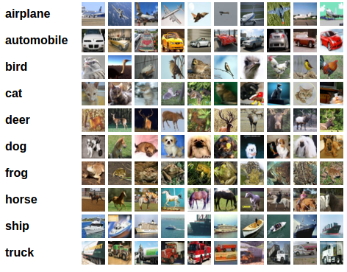

Machine Learning in One Slide
(Supervised)
Input
Input
Training
Output
Output
Model
“Bird”
“Bird”
Lots of labelled data
(Inputs, outputs)

Slide 146
Traditional Software Development
“It is easy. You just chip away the stone that doesn’t look like David.” –(probably not) Michelangelo
Notes:
Traditional development:
Start with abstract idea, apply constraints (the program code) until you achieve the desired goal.
This is the typical way of doing software development.
You know what the end goal should be.
e.g. sorting algorithm, spam algorithm
think: determinism vs. nondeterminism
What happens when something gets misclassified as not spam? (add the new rule, constraint, etc.)

Slide 147
ML Development
Observation
Hypothesis
Predict
Test
Reject or Refine Hypothesis
Notes:
Different from traditional software development:
- Do not know what the end outcome.
Closer to scientific process.
How would you know if a spam classifier was working correctly?
How would you know if the classifier was working sufficiently?

Slide 148
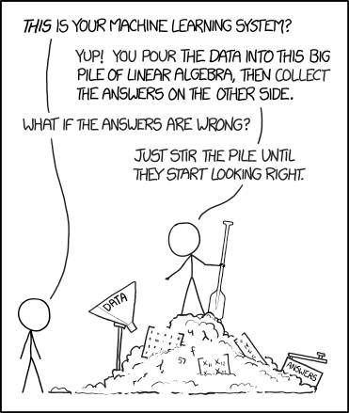
Black-box View of Machine Learning
Image: https://xkcd.com/1838/

Slide 149
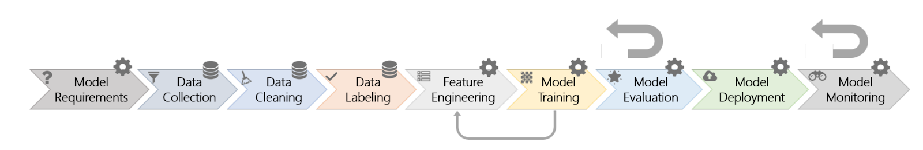
Microsoft’s view of Software Engineering
for ML
Source: “Software Engineering for Machine Learning: A Case Study” by Amershi et al. ICSE 2019
Notes:
From a Microsoft paper on software engineering on ML
Model monitoring: checking bounds, model drift w.r.t. approximate outputs
Compare to agile, sprint-based development, iterate, add feature, ship, forget about it

Slide 150
Three Fundamental Differences:
Data discovery and management
Customization and Reuse
No modular development of model itself
Notes:
Data discovery and management:
Fancy statistics
Compare contrast: development without data vs. development where data is required, data sets, ML, specifically.
Large dataset typically required to build useful algorithm.
Data cleaning, etc., part of the management phase of data discovery and management.
Customization and reuse:
Abstraction is typical reuse mechanism in traditional software development
Trained model for email spam, probably won’t apply for facebook or youtube comments.
Modular development of model:
Models typically need to be developed as single units
No “half-built” models, value comes from a finished component
Intermediate results in a model are usually not meaningful, so debugging requires a holistic approach

Slide 151
What challenges are there in building and deploying ML?

Slide 152

Notes:
More focused problem, less text, one language translation.
Seems like magic.
The challenge: making the actual translation happen.

Slide 153

Notes:
Real world effects, more noisy.
Where is this? (Replace with photo of Japan)
Which sign to translate?
Which language should be translated from?
Which language should be translated to?
Lots of challenges around making the ML magic work in the real world (not the ML magic itself.)
Application of the ML magic, assuming that the ML magic has already been done.

Slide 154

Notes:
How would this be applied to Google Glass?
Limited screen space.
Limited bandwidth.
Limited power usage.
No interface to change languages easily.

Slide 155
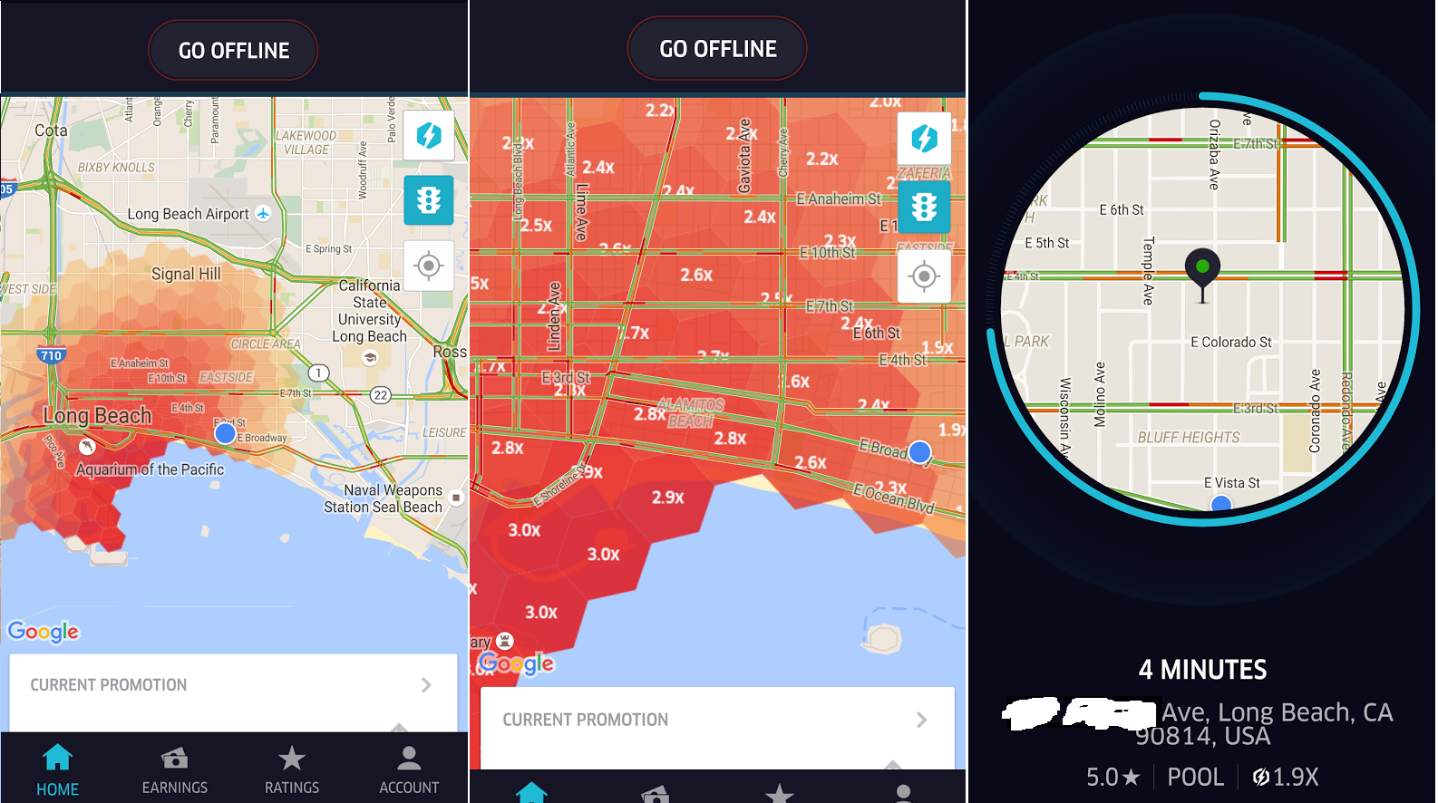
Notes:
Predict surge pricing so you can get drivers to the area ahead of time.
Surge = ratio of demand/supply.
Assume historical data.
Time
Historical data
Non-repeating, one time, events (e.g., baseball games, protest, whatever.)
Driver behavior
Weather
Feedback loop: reduce surges, causes the model to skew.

Slide 156
Machine Learning Pipeline

Slide 157
Typical ML Pipeline
Static
  Get labeled data (data collection, cleaning and, labeling)
  Identify and extract features (feature engineering)
  Split data into training and evaluation set
  Learn model from training data (model training)
  Evaluate model on evaluation data (model evaluation)
  Repeat, revising features
with production data
  Evaluate model on production data; monitor (model monitoring)
  Select production data for retraining (model training + evaluation)
  Update model regularly (model deployment)

Slide 158
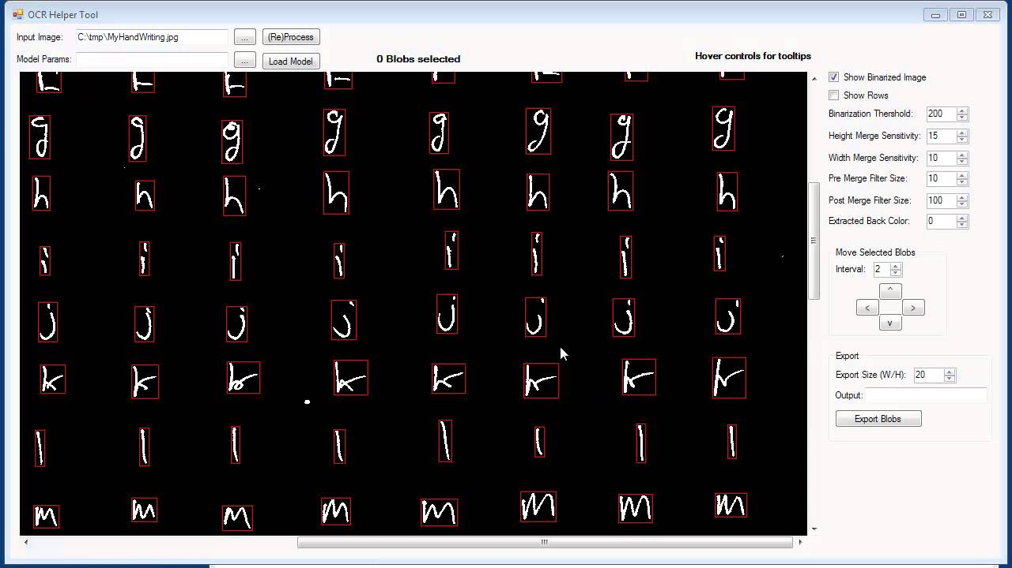
Example Data

Slide 159
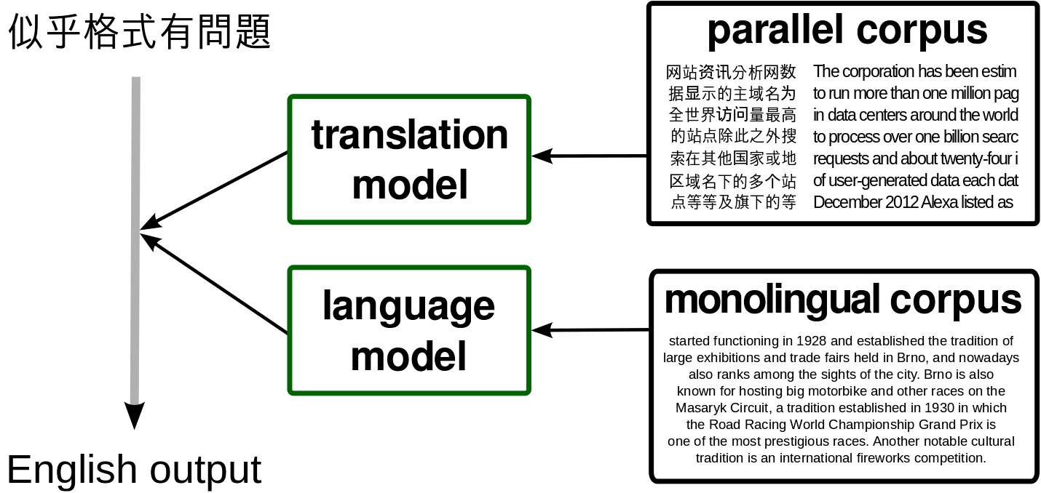
Learning Data

Slide 160
Feature Engineering
Identify parameters of interest that a model may learn on
Convert data into a useful form
Normalize data
Include context
Remove misleading things
Notes:
normalize: statistically normalize the data (0-1)
context: where the data is coming from
remove misleading things: outliers, etc., DNC in the training data, for instance.

Slide 161
Features?
Notes:
gps location of phone
characters
lines

Slide 162
Feature Extraction
In OCR/translation:
  Bounding boxes for text of interest
  Character boundaries
  Line segments for each character
  GPS location of phone (to determine likely source language)

Slide 163
Features?
Notes:
Translation is simpler than ride sharing : significantly more features

Slide 164
Feature Extraction
In surge prediction:
  Location and time of past surges
  Events
  Number of people traveling to an area
  Typical demand curves in an area
  Demand in other areas
  Weather
Notes:
Turning these into features that can be fed into an ML model:
events, how is this normalized, modeled? Binary or not, what else?
Number of people traveling, compared to what, average, max, etc?
Weather w.r.t. demand curves
Does demand in other areas impact this area? How?

Slide 165
Data Cleaning
Removing outliers
Normalizing data
Missing values
…

Slide 166
Learning
Build a predictor that best describes an outcome for the observed features
Notes:
Most important for ML magic, but less interesting in the SE4ML bits.

Slide 167
Evaluation
Prediction accuracy on learned data vs
Prediction accuracy on unseen data
  Separate learning set, not used for training
For binary predictors: false positives vs. false negatives, precision vs. recall
For numeric predictors: average (relative) distance between real and predicted value
For ranking predictors: top-K, etc.
Notes:
Recall penalizes for false negatives (correct selections)
Precision penalizes for false positives (incorrect selections)

Slide 168
Evaluation Data and Metrics?
Notes:
Without words in the training set
Words in the training set
Phrases in the training set with words in the training set
Possibility of right/wrong translation errors
BLEU scores (look it up), developed specially for evaluation translation (based on n-grams)
Can use machine learning itself to develop a good eval metric (ask humans to label translations on a good-bad scale)

Slide 169
Evaluation Data and Metrics?
Notes:
Is there a right answer?
Ground truth is hard to get, because it’s hard to model impact of prediction on the data itself
Business goals: maximize profit vs. increased ridership, could be opposing goals, could be unanswerable.

Slide 170
Learning and Evaluating in Production
Beyond static data sets, build telemetry
Design challenge: identify mistakes in practice
Use sample of live data for evaluation
Retrain models with sampled live data regularly
Monitor performance and intervene

Slide 171
Tradeoffs in ML models

Slide 172
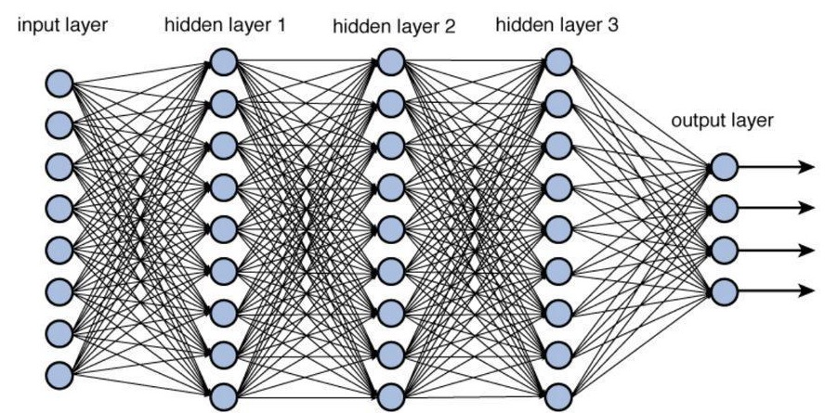
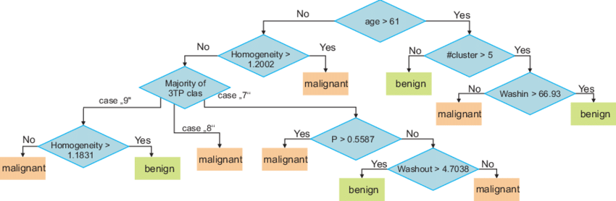
Understanding Capabilities and Tradeoffs
Deep Neural Networks
Decision Trees
Notes:
DNN: Fast (hardware specialized for training/eval), potentially high accuracy, can be refined in production (add new training data), but not easy to maintain / edit / explain
Decision trees: Slower but more human-friendly. Also helps with feature engineering, debugging, etc. Harder to react to changing data distributions.

Slide 173
ML Model Tradeoffs
Accuracy
Capabilities (e.g. classification, recommendation, clustering…)
Amount of training data needed
Inference latency
Learning latency; incremental learning?
Model size
Explainable? Robust?
…

Slide 174
System Architecture Considerations

Slide 175
Where should the model live?
Glasses
OCR Component
Phone
Translation Component
Cloud
Notes:
A: Where should the OCR component live?
B: Where should the translation component live?

Slide 176
Where should the model live?
Vehicle
Surge Prediction
Phone
Cloud
Notes:
C: Where should the surge prediction component live?

Slide 177
Considerations
How much data is needed as input for the model?
How much output data is produced by the model?
How fast/energy consuming is model execution?
What latency is needed for the application?
How big is the model? How often does it need to be updated?
Cost of operating the model? (distribution + execution)
Opportunities for telemetry?
What happens if users are offline?

Slide 178
Typical Designs
Static intelligence in the product
  difficult to update
  good execution latency
  cheap operation
  offline operation
  no telemetry to evaluate and improve
Client-side intelligence
  updates costly/slow, out of sync problems
  complexity in clients
  offline operation, low execution latency
Notes:
“Static” = devices not connected anywhere (e.g. smart washing machine?)

Slide 179
Typical Designs
Server-centric intelligence
  latency in model execution (remote calls)
  easy to update and experiment
  operation cost
  no offline operation
Back-end cached intelligence
  precomputed common results
  fast execution, partial offline
  saves bandwidth, complicated updates
Hybrid models

Slide 180
Other Considerations
Coupling of ML pipeline parts
Coupling with other parts of the system
Ability for different developers and analysists to collaborate
Support online experiments
Ability to monitor

Slide 181
Reactive Systems
Responsive
  consistent, high performance
Resilient
  maintain responsive in the face of failure, recovery, rollback
Elastic
  scale with varying loads

Slide 182
Common Design Strategies
Message-driven, lazy computation, functional programming
  asynchronous, message passing style
Replication, containment, supervision
  replicate and coordinate isolated components, e.g. with containers
Data streams, “infinite data”, immutable facts
  streaming technologies, data lakes
See “big data systems” and “cloud computing”

Slide 183
Making Decisions
What steps to take?
What information to collect?

Slide 184
Updating Models

Slide 185
Updating Models
Models are rarely static outside the lab
Data drift, feedback loops, new features, new requirements
When and how to update models?
How to version? How to avoid mistakes?

Slide 186
Latency and automation
vary widely
Heavily distributed
Server
serving
Models
other
features
(e.g weather)
logs
Data Stream
(e.g. Kafka)
Stream Processing
incremental
learning
archival
Data Lake
Analytics
(OLAP)
learning in nightly
batch processing

Slide 187
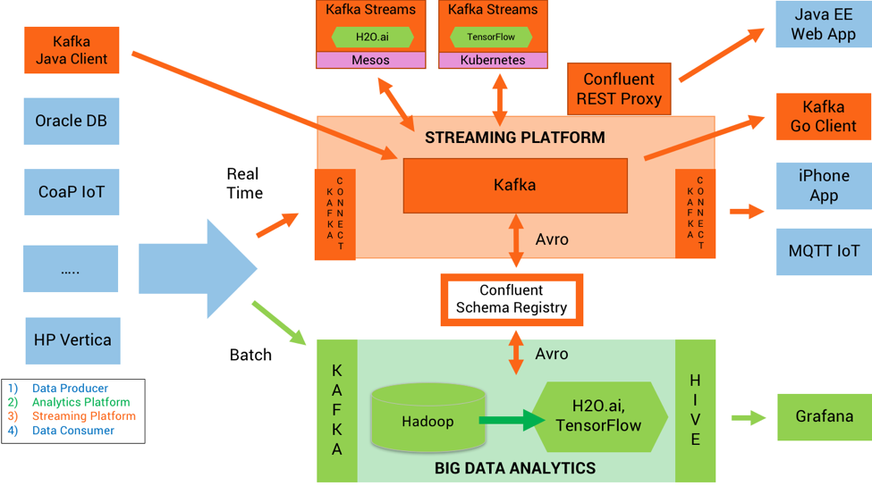

Slide 188
Update Strategy?
Notes:
A: How often should the OCR component be updated?
B: How often should the translation component be updated?

Slide 189
Update Strategy?

Slide 190
Planning for Mistakes

Slide 191
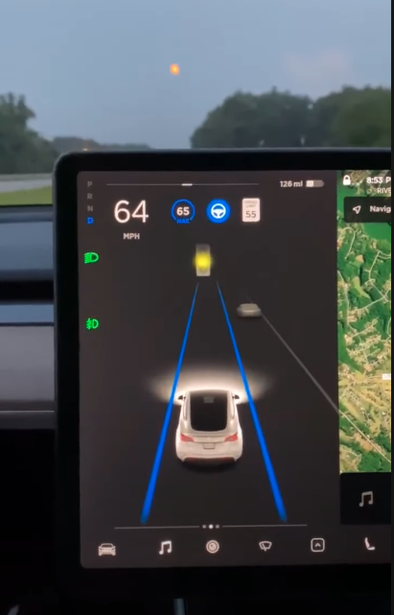
Mistakes will happen
No specification
ML components detect patterns from data (real and spurious)
Predictions are often accurate, but mistakes always possible
Mistakes are not predicable or explainable or similar to human mistakes
Plan for mistakes
Telemetry to learn about mistakes?
Notes:
E.g. Tesla detects moon as traffic light
Bias vs. mistakes, sometimes difficult to tell the difference between bias and mistakes

Slide 192
How Models can Break
System outage
Model outage
  model tested? deployment and updates reliable? file corrupt?
Model errors
Model degradation
  data drift, feedback loops

Slide 193
Hazard Analysis
Worst thing that can happen?
Backup strategy? Undoable? Nontechnical compensation?
Notes:
Netflix recommendations example

Slide 194
Mitigating Mistakes
Investigating in ML
  e.g., more training data, better data, better features, better engineers
Less forceful experience
  e.g., prompt rather than automate decisions, turn off
Adjust learning parameters
  e.g., more frequent updates, manual adjustments
Guardrails
  e.g., heuristics and constraints on outputs
Override errors
  e.g., hardcode specific results

Slide 195
Mistakes?
Notes:
A: What mistakes could happen?
B: What would you do to degrade if these mistakes happen?
C: What could you do to mitigate the effects of mistakes happening?

Slide 196
Mistakes?
Notes:
A: What mistakes could happen?
B: What would you do to degrade if these mistakes happen?
C: What could you do to mitigate the effects of mistakes happening?

Slide 197
Telemetry
Purpose:
  monitor operation
  monitor success (accuracy)
  improve models over time (e.g., detect new features)
Challenges:
  too much data – sample, summarization, adjustable
  hard to measure – intended outcome not observable? proxies?
  rare events – important but hard to capture
  cost – significant investment must show benefit
  privacy – abstracting data

Slide 198
Key Points
Identify differences between traditional software development and development of ML systems.
Understand the stages that comprise the typical ML development pipeline.
Identify challenges that must be faced within each stage of the typical ML development pipeline.
Notes:
Keep sheet of paper ready for in-class exercises

Slide 199
Key Points
Machine learning in production systems is challenging
Many tradeoffs in selecting ML components and in integrating them in larger system
Plan for updates
Manage mistakes, plan for telemetry

Slide 200
Quotes from this wonderful paper suggested by Mary Shaw:
  https://web.engr.oregonstate.edu/~burnett/Reprints/vlhcc16-ML-trialsTribulations.pdf

