Slide 1
COMP 2120 / COMP 6120 devops
Week:
6 of 12
A/Prof Alex Potanin and Dr Melina Vidoni

Slide 2
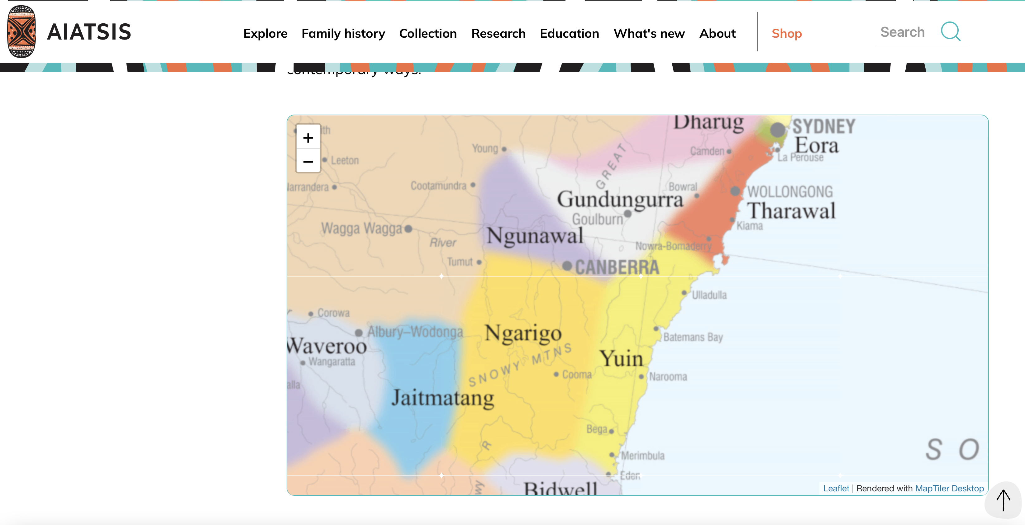
ANU Acknowledgment of Country
“We acknowledge and celebrate the First Australians on whose traditional lands we meet, and pay our respect to the elders past and present.”
https://aiatsis.gov.au/explore/map-indigenous-australia
Notes:
https://www.anu.edu.au/students/contacts/tjabal-indigenous-higher-education-centre
https://services.anu.edu.au/human-resources/respect-inclusion/anu-acknowledgment-of-country
https://www.indigenous.gov.au/contact-us/welcome_acknowledgement-country
https://aiatsis.gov.au/explore/map-indigenous-australia

Slide 3
DevOps Phases
Notes:
culture driven by rapid feedback
remove all friction/obstacles that hinder quick feedback and release cycles (approval, testing, deployment etc)
typical facets
integrate development and operations
consider configuration as first class artifact (check in and version), develop with final software stack, often in virtual environment
continuous deployment/delivery, multiple releases per day
consider operations aspect already in the early design
“agile system administration”
automation, measurement, sharing

Slide 4

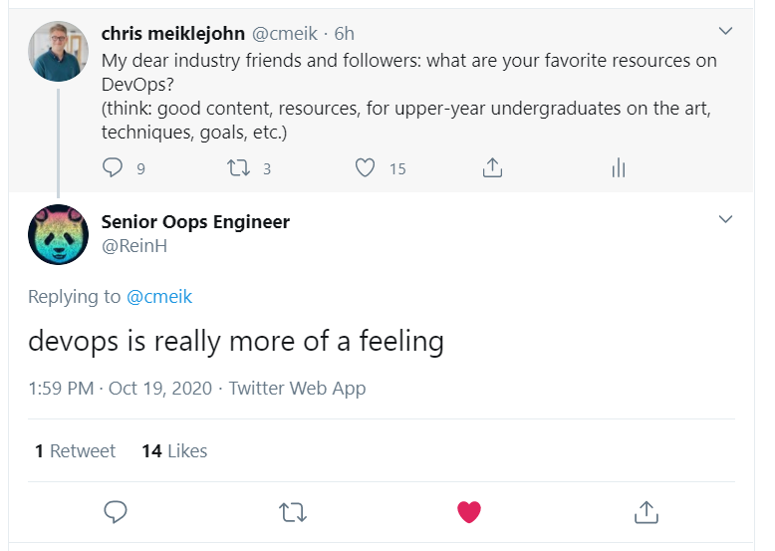
What is DevOps?
Bringing together two traditionally separate groups within software organizations
Development, typically measured on features completed, code shipped
Operations, typically measured through stability, reliability, availability
Benefits:
Increased Velocity: how quickly products and applications are pushed to release
Increased Quality: successful delivery of features and products
reference: https://www.youtube.com/watch?v=UbtB4sMaaNM

Slide 5
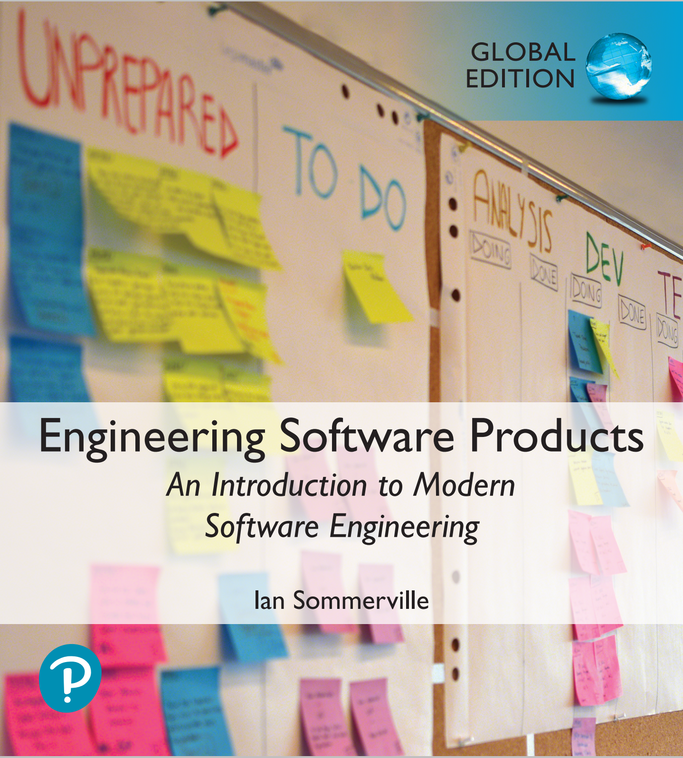
Software Support
Traditionally, separate teams were responsible for software development, software release and software support.
The development team passed over a ‘final’ version of the software to a release team. This team then built a release version, tested this and prepared release documentation before releasing the software to customers.
A third team was responsible for providing customer support.
  The original development team were sometimes also responsible for implementing software changes.
  Alternatively, the software may have been maintained by a separate ‘maintenance team’.

Slide 6
Development, release and support

Slide 7
DevOps
There are inevitable delays and overheads in the traditional support model.
To speed up the release and support processes, an alternative approach called DevOps (Development + Operations) has been developed.
Three factors led to the development and widespread adoption of DevOps:
  Agile software engineering reduced the development time for software, but the traditional release process introduced a bottleneck between development and deployment.
  Amazon re-engineered their software around services and introduced an approach in which a service was developed and supported by the same team. Amazon’s claim that this led to significant improvements in reliability was widely publicized.
  It became possible to release software as a service, running on a public or private cloud. Software products did not have to be released to users on physical media or downloads.

Slide 8
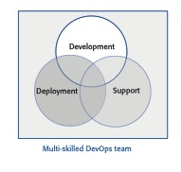
DevOps

Slide 9
DevOps principles
Everyone is responsible for everything
All team members have joint responsibility for developing, delivering and supporting the software.
Everything that can be automated should be automated
All activities involved in testing, deployment and support should be automated if it is possible to do so. There should be minimal manual involvement in deploying software.
Measure first, change later
DevOps should be driven by a measurement program where you collect data about the system and its operation. You then use the collected data to inform decisions about changing DevOps processes and tools.

Slide 10
Benefits of DevOps
Faster deployment
Software can be deployed to production more quickly because communication delays between the people involved in the process are dramatically reduced.
Reduced risk
The increment of functionality in each release is small so there is less chance of feature interactions and other changes causing system failures and outages.
Faster repair
DevOps teams work together to get the software up and running again as soon as possible. There is no need to discover which team were responsible for the problem and to wait for them to fix it.
More productive teams
DevOps teams are happier and more productive than the teams involved in the separate activities. Because team members are happier, they are less likely to leave to find jobs elsewhere.

Slide 11
Code management
During the development of a software product, the development team will probably create tens of thousands of lines of code and automated tests.
These will be organized into hundreds of files. Dozens of libraries may be used, and several, different programs may be involved in creating and running the code.
Code management is a set of software-supported practices that is used to manage an evolving codebase.
You need code management to ensure that changes made by different developers do not interfere with each other, and to create different product versions.
Code management tools make it easy to create an executable product from its source code files and to run automated tests on that product.

Slide 12
A code management problem
Alice and Bob worked for a company called FinanceMadeSimple and were team members involved in developing a personal finance product. Alice discovered a bug in a module called TaxReturnPreparation. The bug was that a tax return was reported as filed but, sometimes, it was not actually sent to the tax office. She edited the module to fix the bug. Bob was working on the user interface for the system and was also working on TaxReturnPreparation. Unfortunately, he took a copy before Alice had fixed the bug and, after making his changes, he saved the module. This overwrote Alice’s changes but she was not aware of this.
The product tests did not reveal the bug as it was an intermittent failure that depended on the sections of the tax return form that had been completed. The product was launched with the bug. For most users, everything worked OK. However, for a small number of users, their tax returns were not filed and they were fined by the revenue service. The subsequent investigation showed the software company was negligent. This was widely publicised and, as well as a fine from the tax authorities, users lost confidence in the software. Many switched to a rival product. FinanceMadeSimple failed and both Bob and Alice lost their jobs.

Slide 13
Code management and DevOps
Source code management, combined with automated system building, is essential for professional software engineering.
In companies that use DevOps, a modern code management system is a fundamental requirement for ‘automating everything’.
Not only does it store the project code that is ultimately deployed, it also stores all other information that is used in DevOps processes.
DevOps automation and measurement tools all interact with the code management system

Slide 14
Code management and DevOps

Slide 15
Code management fundamentals
Code management systems provide a set of features that support four general areas:
  Code transfer Developers take code into their personal file store to work on it then return it to the shared code management system.
  Version storage and retrieval Files may be stored in several different versions and specific versions of these files can be retrieved.
  Merging and branching Parallel development branches may be created for concurrent working. Changes made by developers in different branches may be merged.
  Version information Information about the different versions maintained in the system may be stored and retrieved

Slide 16
Code repository
All source code management systems have the general form shown on an earlier slide: with a shared repository and a set of features to manage the files in that repository:
  All source code files and file versions are stored in the repository, as are other artefacts such as configuration files, build scripts, shared libraries and versions of tools used.
  The repository includes a database of information about the stored files such as version information, information about who has changed the files, what changes were made at what times, and so on.
Files can be transferred to and from the repository and information about the different versions of files and their relationships may be updated.
  Specific versions of files and information about these versions can always be retrieved from the repository.

Slide 17
Features of code management systems
Version and release identification
Managed versions of a code file are uniquely identified when they are submitted to the system and can be retrieved using their identifier and other file attributes.
Change history recording
The reasons why changes to a code file have been made are recorded and maintained.
Independent development
Several developers can work on the same code file at the same time. When this is submitted to the code management system, a new version is created so that files are never overwritten by later changes.
Project support
All of the files associated with a project may be checked out at the same time. There is no need to check out files one at a time.
Storage management
The code management system includes efficient storage mechanisms so that it doesn’t keep multiple copies of files that have only small differences.

Slide 18
Git
In 2005, Linus Torvalds, the developer of Linux, revolutionised source code management by developing a distributed version control system (DVCS) called Git to manage the code of the Linux kernel.
This was geared to supporting large-scale open source development. It took advantage of the fact that storage costs had fallen to such an extent that most users did not have to be concerned with local storage management.
Instead of only keeping the copies of the files that users are working on, Git maintains a clone of the repository on every user’s computer

Slide 19
Repository cloning in Git

Slide 20
Benefits of distributed code management
Resilience
  Everyone working on a project has their own copy of the repository. If the shared repository is damaged or subjected to a cyberattack, work can continue, and the clones can be used to restore the shared repository. People can work offline if they don’t have a network connection.
Speed
  Committing changes to the repository is a fast, local operation and does not need data to be transferred over the network.
Flexibility
  Local experimentation is much simpler. Developers can safely experiment and try different approaches without exposing these to other project members. With a centralized system, this may only be possible by working outside the code management system.

Slide 21
Git repositories

Slide 22
Branching and merging
Branching and merging are fundamental ideas that are supported by all code management systems.
A branch is an independent, stand-alone version that is created when a developer wishes to change a file.
The changes made by developers in their own branches may be merged to create a new shared branch.
The repository ensures that branch files that have been changed cannot overwrite repository files without a merge operation.
  If Alice or Bob make mistakes on the branch they are working on, they can easily revert to the master file.
  If they commit changes, while working, they can revert to earlier versions of the work they have done. When they have finished and tested their code, they can then replace the master file by merging the work they have done with the master branch

Slide 23
Branching and merging

Slide 24
DevOps automation
By using DevOps with automated support, you can dramatically reduce the time and costs for integration, deployment and delivery.
Everything that can be, should be automated is a fundamental principle of DevOps.
As well as reducing the costs and time required for integration, deployment and delivery, process automation also makes these processes more reliable and reproducible.
Automation information is encoded in scripts and system models that can be checked, reviewed, versioned and stored in the project repository.

Slide 25
Aspects of DevOps automation
Continuous integration
Each time a developer commits a change to the project’s master branch, an executable version of the system is built and tested.
Continuous delivery
A simulation of the product’s operating environment is created and the executable software version is tested.
Continuous deployment
A new release of the system is made available to users every time a change is made to the master branch of the software.
Infrastructure as code
Machine-readable models of the infrastructure (network, servers, routers, etc.) on which the product executes are used by configuration management tools to build the software’s execution platform. The software to be installed, such as compilers and libraries and a DBMS, are included in the infrastructure model.
Notes:
NB! Terraform guest lecture tomorrow!

Slide 26
System integration
System integration (system building) is the process of gathering all of the elements required in a working system, moving them into the right directories, and putting them together to create an operational system.
Typical activities that are part of the system integration process include:
  Installing database software and setting up the database with the appropriate schema.
  Loading test data into the database.
  Compiling the files that make up the product.
  Linking the compiled code with the libraries and other components used.
  Checking that external services used are operational.
  Deleting old configuration files and moving configuration files to the correct locations.
  Running a set of system tests to check that the integration has been successful.

Slide 27
Continuous Integration (CI)
Continuous integration simply means that an integrated version of the system is created and tested every time a change is pushed to the system’s shared repository.
On completion of the push operation, the repository sends a message to an integration server to build a new version of the product
The advantage of continuous integration compared to less frequent integration is that it is faster to find and fix bugs in the system.
If you make a small change and some system tests then fail, the problem almost certainly lies in the new code that you have pushed to the project repo.
You can focus on this code to find the bug that’s causing the problem.

Slide 28
Continuous Integration (CI)

Slide 29
Breaking the build
In a continuous integration environment, developers have to make sure that they don’t ‘break the build’.
Breaking the build means pushing code to the project repository which, when integrated, causes some of the system tests to fail.
If this happens to you, your priority should be to discover and fix the problem so that normal development can continue.
To avoid breaking the build, you should always adopt an ‘integrate twice’ approach to system integration.
  You should integrate and test on your own computer before pushing code to the project repository to trigger the integration server

Slide 30
Local integration

Slide 31
System building
Continuous integration is only effective if the integration process is fast and developers do not have to wait for the results of their tests of the integrated system.
However, some activities in the build process, such as populating a database or compiling hundreds of system files, are inherently slow.
It is therefore essential to have an automated build process that minimizes the time spent on these activities.
Fast system building is achieved using a process of incremental building, where only those parts of the system that have been changed are rebuilt

Slide 32
Dependencies
Running a set of system tests depends on the existence of executable object code for both the program being tested and the system tests.
In turn, these depend on the source code for the system and the tests that are compiled to create the object code.
Figure on the right shows the dependencies involved in creating the object code for a source code files called Mycode.
An automated build system uses the specification of dependencies to work out what needs to be done. It uses the file modification timestamp to decide if a source code file has been changed.
Notes:
The modification date of the compiled code is after the modification date of the source code. The build system infers that no changes have been made to the source code and does nothing.
The modification date of the compiled code is before the modification date of the compiled code. The build system recompiles the source and replaces the existing file of compiled code with an updated version.
The modification date of the compiled code is after the modification date of the source code. However, the modification date of Classdef is after the modification date of the source code of Mycode. Therefore, Mycode has to be recompiled to incorporate these changes.

Slide 33
Continuous Delivery
and Deployment (CD)
Continuous integration means creating an executable version of a software system whenever a change is made to the repository. The CI tool builds the system and runs tests on your development computer or project integration server.
However, the real environment in which software runs will inevitably be different from your development system.
When your software runs in its real, operational environment bugs may be revealed that did not show up in the test environment.
Continuous delivery means that, after making changes to a system, you ensure that the changed system is ready for delivery to customers.
This means that you have to test it in a production environment to make sure that environmental factors do not cause system failures or slow down its performance.

Slide 34
Continuous Delivery
and Deployment (CD)

Slide 35
The deployment pipeline
After initial integration testing, a staged test environment is created.
This is a replica of the actual production environment in which the system will run.
The system acceptance tests, which include functionality, load and performance tests, are then run to check that the software works as expected. If all of these tests pass, the changed software is installed on the production servers.
To deploy the system, you then momentarily stop all new requests for service and leave the older version to process the outstanding transactions.
Once these have been completed, you switch to the new version of the system and restart processing.

Slide 36
Benefits of Continuous Deployment (CD)
Reduced costs
If you use continuous deployment, you have no option but to invest in a completely automated deployment pipeline. Manual deployment is a time-consuming and error-prone process. Setting up an automated system is expensive and time-consuming but you can recover these costs quickly if you make regular updates to your product.
Faster problem solving
If a problem occurs, it will probably only affect a small part of the system and it will be obvious what the source of that problem is. If you bundle many changes into a single release, finding and fixing problems is more difficult.
Faster customer feedback
You can deploy new features when they are ready for customer use. You can ask them for feedback on these features and use this feedback to identify improvements that you need to make.
A/B Testing and Canary Deployments
This is an option if you have a large customer base and use several servers for deployment. You can deploy a new version of the software on some servers and leave the older version running on others. You then use the load balancer to divert some customers to the new version while others use the older version. You can then measure and assess how new features are used to see if they do what you expect.

Slide 37
Infrastructure as Code
In an enterprise environment, there are usually many different physical or virtual servers (web servers, database servers, file servers, etc.) that do different things. These have different configurations and run different software packages.
It is therefore difficult to keep track of the software installed on each machine.
The idea of infrastructure as code was proposed as a way to address this problem. Rather than manually updating the software on a company’s servers, the process can be automated using a model of the infrastructure written in a machine-processable language.
Configuration Management (CM) tools such as Puppet can automatically install software and services on servers according to the infrastructure definition
Notes:
https://phoenixnap.com/blog/ansible-vs-terraform-vs-puppet

Slide 38
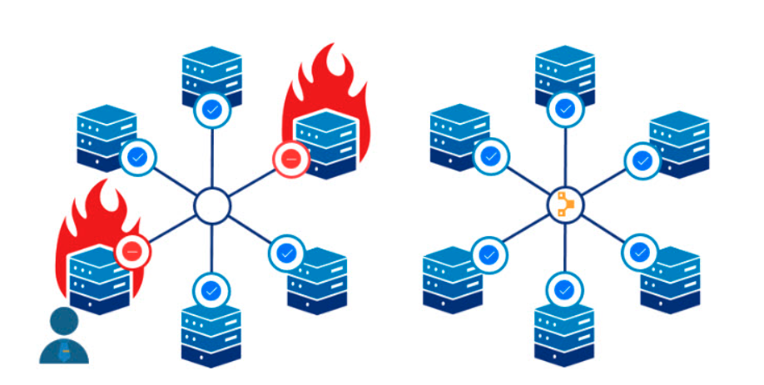
Infrastructure as Code (Puppet)
https://phoenixnap.com/blog/what-is-puppet
Notes:
Puppet (2005 onwards) is one of the oldest declarative desired state tools available. It is server/client-based, one which refreshes the state on clients via a catalog.
Puppet automates server configuration management and deployment. The software enables pulling strings and managing states on multiple systems at once, and the approach reduces manual setup and management of servers individually.
Puppet defines the desired state for the system rather than how to get there. The configuration applies to various platforms and devices and maintains the state across the infrastructure. Overall, there’s less need for system administrators to put out fires, allowing the DevOps team to implement new and better server solutions.

Slide 39
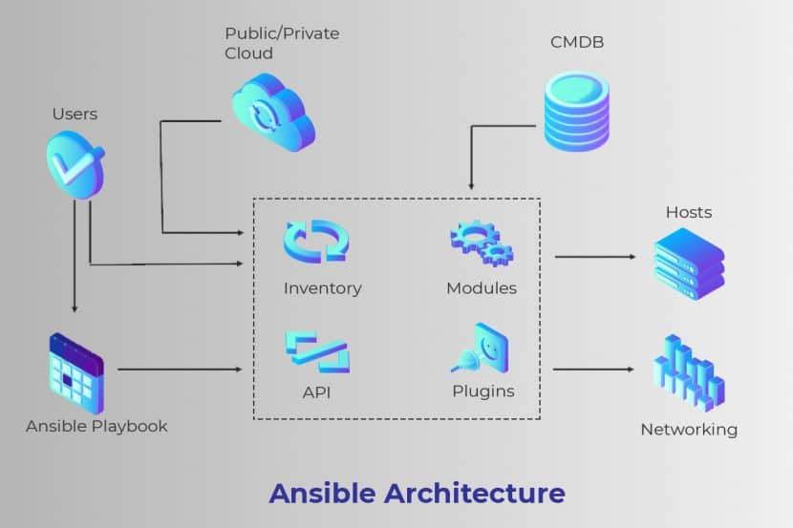
Infrastructure as Code (Ansible)
https://phoenixnap.com/blog/ansible-vs-terraform-vs-puppet
Notes:
Ansible (2012) can provision the latest cloud platforms, network devices, bare metal servers, virtualized hosts, and hypervisors reliably.
After completing bootstrapping, Ansible allows separate teams to connect nodes to the storage. It can add them to a load balancer, or any security patched or other operational tasks. This setup makes Ansible the perfect connecting tool for any process pipeline.
It aids in automatically taking bare infrastructure right through to daily management. Provisioning with Ansible, allows users to use a universal, human-readable automation language seamlessly across configuration management, application deployment, and orchestration.

Slide 40
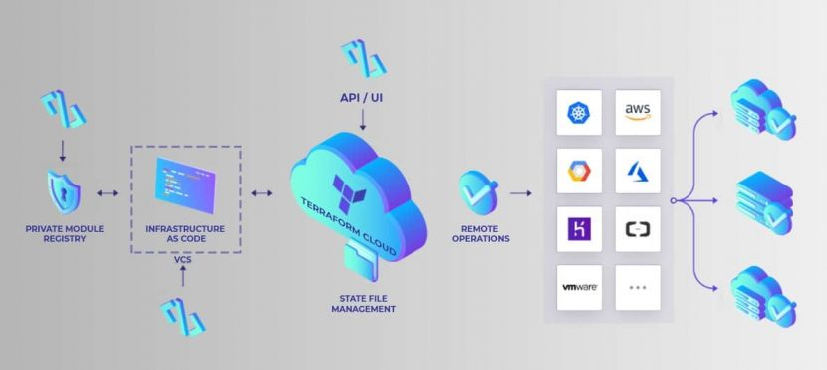
Infrastructure as Code (Terraform)
https://phoenixnap.com/blog/ansible-vs-terraform-vs-puppet
Notes:
Terraform (2014). There are certain behaviours not represented in Terraform’s existing declarative model. This setup adds a significant amount of uncertainty and complexity when using Terraform in the following ways:
The Terraform model is unable to model the actions of provisioners when it is part of a plan. It requires coordinating more details than what is necessary for normal Terraform usage to use provisioners successfully.
It requires additional measures such as granting direct network access to the user’s servers, installing essential external software, and issuing Terraform credentials for logging in.

Slide 41
Benefits of infrastructure as code
Defining your infrastructure as code and using a configuration management system solves two key problems of continuous deployment.
  Your testing environment must be exactly the same as your deployment environment. If you change the deployment environment, you have to mirror those changes in your testing environment.
  When you change a service, you have to be able to roll that change out to all of your servers quickly and reliably. If there is a bug in your changed code that affects the system’s reliability, you have to be able to seamlessly roll back to the older system.
The business benefits of defining your infrastructure as code are lower costs of system management and lower risks of unexpected problems arising when infrastructure changes are implemented.

Slide 42
Characteristics of infrastructure as code
Visibility
Your infrastructure is defined as a stand-alone model that can be read, discussed, understood and reviewed by the whole DevOps team.
Reproducibility
Using a configuration management tool means that the installation tasks will always be run in the same sequence so that the same environment is always created. You are not reliant on people remembering the order that they need to do things.
Reliability
The complexity of managing a complex infrastructure means that system administrators often make simple mistakes, especially when the same changes have to be made to several servers. Automating the process avoids these mistakes.
Recovery
Like any other code, your infrastructure model can be versioned and stored in a code management system. If infrastructure changes cause problems you can easily revert to an older version and reinstall the environment that you know works.

Slide 43

Containers
A container provides a stand-alone execution environment running on top of an operating system such as Linux.
The software installed in a Docker container is specified using a Dockerfile, which is, essentially, a definition of your software infrastructure as code.
You build an executable container image by processing the Dockerfile.
Using containers makes it very simple to provide identical execution environments.
  For each type of server that you use, you define the environment that you need and build an image for execution. You can run an application container as a test system or as an operational system; there is no distinction between them.
  When you update your software, you rerun the image creation process to create a new image that includes the modified software. You can then start these images alongside the existing system and divert service requests to them.

Slide 44
Mini Break in Monday Lecture

Slide 45
DevOps Measurement
After you have adopted DevOps, you should try to continuously improve your DevOps process to achieve faster deployment of better-quality software.
There are four types of software development measurement:
  Process measurement You collect and analyse data about your development, testing and deployment processes.
  Service measurement You collect and analyse data about the software’s performance, reliability and acceptability to customers.
  Usage measurement You collect and analyse data about how customers use your product.
  Business success measurement You collect and analyse data about how your product contributes to the overall success of the business.

Slide 46
Automating Measurement
As far as possible, the DevOps principle of automating everything should be applied to software measurement.
You should instrument your software to collect data about itself and you should use a monitoring system to collect data about your software’s performance and availability.
Some process measurements can also be automated.
  However, there are problems in process measurement because people are involved. They work in different ways, may record information differently and are affected by outside influences that affect the way they work.

Slide 47
Metrics used in the DevOps scorecard

Slide 48
Metrics scorecard
Payal Chakravarty from IBM suggests a practical approach to DevOps measurement based around a metrics scorecard with 9 metrics:
  These are relevant to software that is delivered as a cloud service. They include process metrics and service metrics
  For the process metrics, you would like to see decreases in the number of failed deployments, the mean time to recovery after a service failure and the lead time from development to deployment.
  You would hope to see increases in the deployment frequency and the number of lines of changed code that are shipped.
  For the service metrics, availability and performance should be stable or improving, the number of customer complaints should be decreasing, and the number of new customers should be increasing.

Slide 49
Metrics Trends (via Logging or Similar)

Slide 50
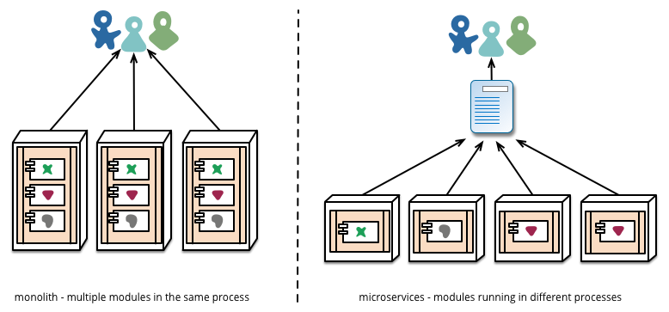
Deployment and Evolution
Source: http://martinfowler.com/articles/microservices.html
Notes:
Much easier to redeploy individual components when they are isolated in different processes or containers
Caveat: Changing interfaces is much much more complex (compare to refactoring code in a monolithic app). Requires versioning, backward-compatibility, managing consumer expectations (or specifying contracts), etc.

Slide 51

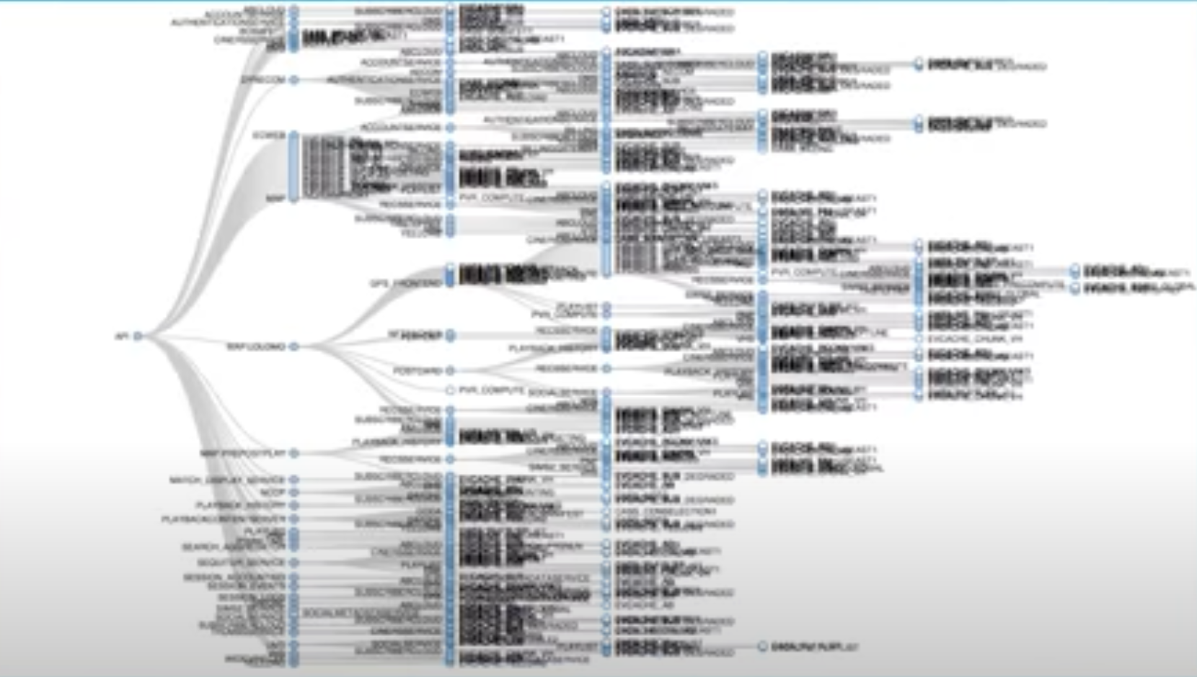
Netflix: Microservice Architecture
100s of microservices
1,000s of production changes per day
10,000s of virtual machines
100,000s of customer interactions per second
1,000,000s of metrics per minute (actually, 2 million)
81.5 million customers
10s of operations engineers
no single engineer knows the entire application
Activity
What were some of the challenges of
running a microservice architecture of this scale?
as of 2018, reference: https://www.youtube.com/watch?v=UTKIT6STSVM

Slide 52
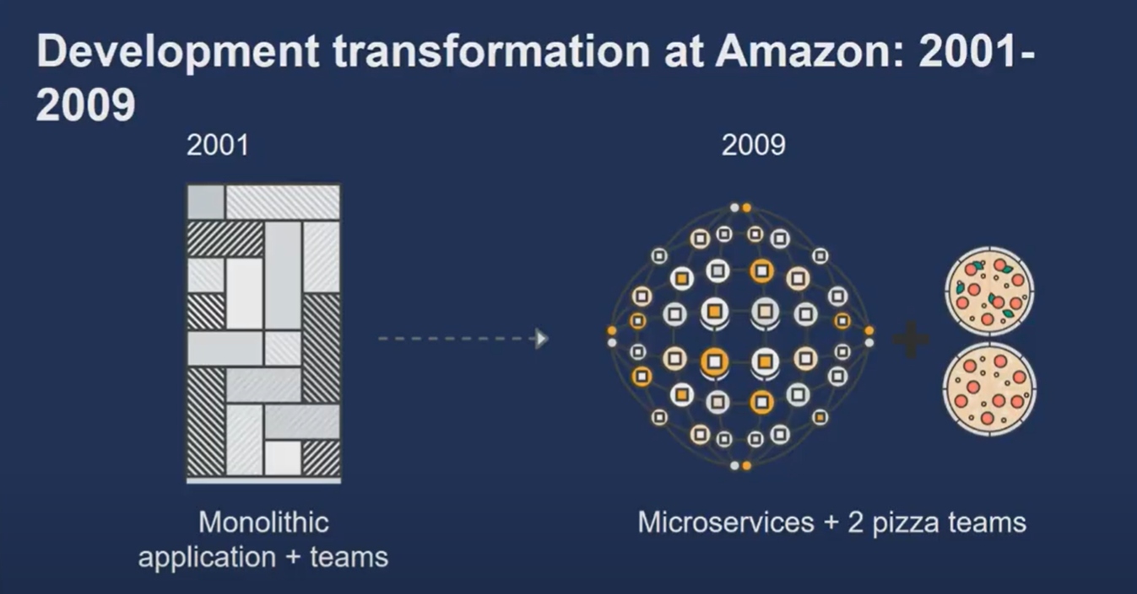
reference: https://www.youtube.com/watch?v=mBU3AJ3j1rg

Slide 53
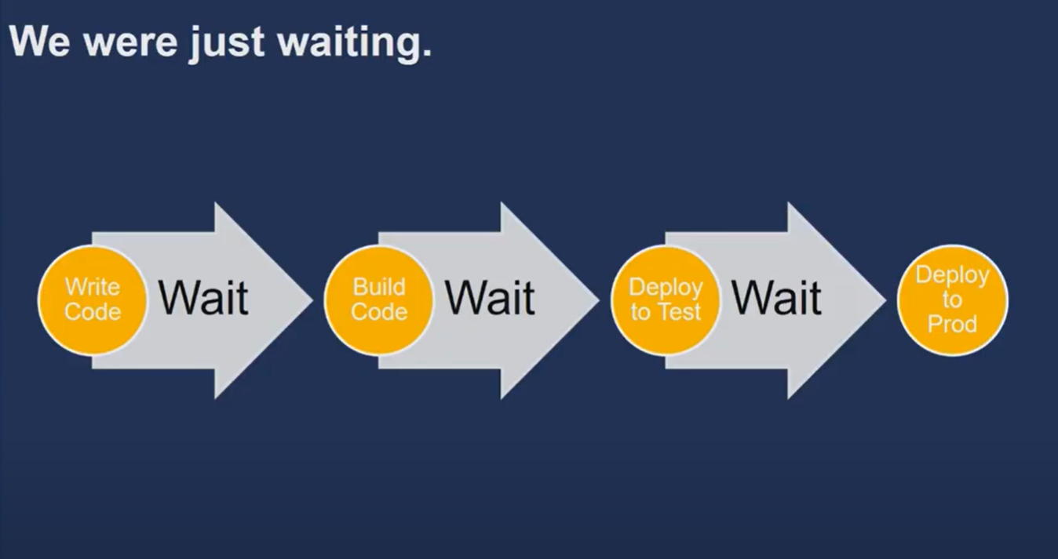
reference: https://www.youtube.com/watch?v=mBU3AJ3j1rg

Slide 54
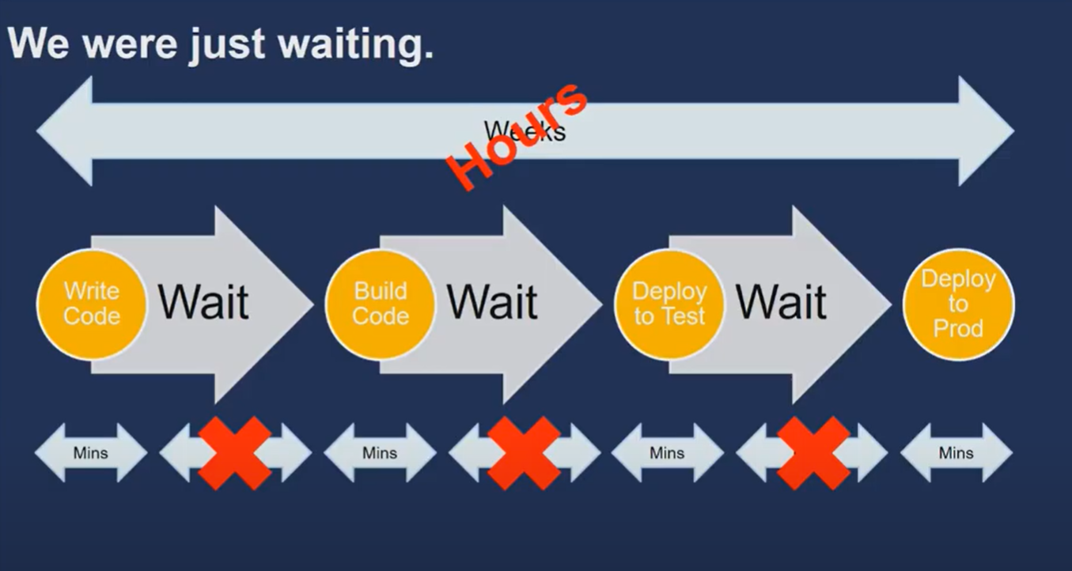
reference: https://www.youtube.com/watch?v=mBU3AJ3j1rg

Slide 55
How do we get to DevOps?
Goals:
Technological: Automated process for moving code from dev to release.
Starting with check-in, build, unit test, build artifact,
integration test, load test, as moves through stage to production,
finally, with monitoring and other telemetry.
Cultural: Building cohesive, multidisciplinary teams.
Typically, developers are the “first responders” when things go bad in production.
Sense of “ownership” by the developer all the way from inception to release.
reference: https://www.youtube.com/watch?v=UbtB4sMaaNM

Slide 56
What can it look like when it’s done?
Netflix Spinnaker (open-source CI/CD fully automated pipeline):
Takes code from code repository to production.
Allows developers to specify required tests.
Determines where, how code should be run in system (e.g., replication, placement.)
Supports canary deployments, traffic management.
Just publish the repo!
reference: https://www.youtube.com/watch?v=UTKIT6STSVM
5x
lower
change failure rate
440x
faster from commit to deploy
46x
more frequent deployments
44%
more time spent on new features and code
reference: Puppet State of the DevOps Report 2017

Slide 57
Exercise: DevOps Pipeline
Choices
Choices
Develop
Deploy
Build
Test
Monitor
Automate
Check in
Compilation
Run load tests
Style check
Build container images
Require Manual approval to advance
Peer review
Run integration tests
Run unit tests
Run penetration tests
Deploy to prod
Record errors

Slide 58
A Typical DevOps Pipeline
Develop
Build
Test
Deploy
Monitor
Check in
Style check
Run integration tests
Deploy to prod
Record errors
Peer review
Compilation
Run load tests
Run unit tests
Run penetration tests
Build container images
Require Manual approval to advance

Slide 59
What do we need to practice for DevOps?
Continuous Integration (CI)
Constant testing as code is checked-in/pushed to the repository (e.g., GH hooks, etc.)
Verify the build process works (i.e., parsing, compilation, code generation, etc.)
Verify unit tests pass, style checks pass, other static analysis tools.
Build artifacts
Continuous Delivery & Deployment (CD)
Moving build artifacts from test -> stage -> prod environments.
Environments always differ! (e.g., ENV, PII, data, etc.)
Gate code, if necessary, from advancing without manual approval.
Useful when initially transitioning applications into a modern DevOps pipeline.
reference: https://www.youtube.com/watch?v=mBU3AJ3j1rg

Slide 60
What do we need to practice for DevOps?
Infrastructure as Code
Required resources (e.g., cloud services, access policies, etc.) are created by code.
No UI provisioning, no manual steps (avoid: easy to forget, time consuming!)
“Immutable Infrastructure”
No update-in-place (e.g., SSH to server.)
Replace with new instances, decommission old instances.
Nothing to prod without it being in code, checked-in, versioned along side code!
Observability (Monitoring, Logging, Tracing, Metrics)
Be able to know how your application is running in production
Track and analyze low-level metrics on performance, resource allocation
Capture high-level metrics on application behavior
  What’s “normal”?
  What’s abnormal?
reference: https://www.youtube.com/watch?v=mBU3AJ3j1rg

Slide 61



CI/CD
Continuous Integration (CI)
Commit and check-in code frequently (always can squash later)
Commits build on previous commits (know precisely where the build breaks)
Automated feedback and testing on commits
Artifact creation (e.g., container images, WAR files, etc.)
Ensure code, supporting infrastructure, documentation are all versioned together
Continuous Deployment (CD)
Artifacts automatically shipped into test, stage, production environments
Prevents “manual” deployment, avoids “manual” steps, early detection of problems
Can be tied to a “manual” promotion technique to advance through environments
Multi-stage deployment with automatic rollback on failure detection
reference: https://www.youtube.com/watch?v=mBU3AJ3j1rg

Slide 62
Deploying CODE

Slide 63
Nightly Build
Build code and run smoke test (Microsoft 1995)
Benefits
  it minimizes integration risk
  It reduces the risk of low quality
  it supports easier defect diagnosis
  it improves morale

Slide 64
Ring Deployment: Microsoft
Commits flow out to rings, de-flight if issue
For example:
  Ring 0 => Team
  Ring 1 => Dogfood
  Ring 2 => Beta
  Ring 3 => Many
  Ring 4 => All
Windows 10 Insiders Program
  Dev Channel (weekly builds of Windows 10)
  Beta Channel (dev + validated updates by Microsoft)
  Release Preview Channel (highest quality, validated updates)

Slide 65
Rapid Release/Mozilla
If deployment requires on-prem deployment, say a web browser
There are four channels: Nightly, Alpha, Beta, Release Candidate
Code flows every 2 weeks to next channel, unless fast tracked by release engineer.
Involve corporate customer specific testing in testing (Practice also used by IBM, Redhat)
same for Windows Edge browser Insiders Program:
  Canary: nightly builds
  Dev: weekly builds
  Beta: 6 weeks

Slide 66
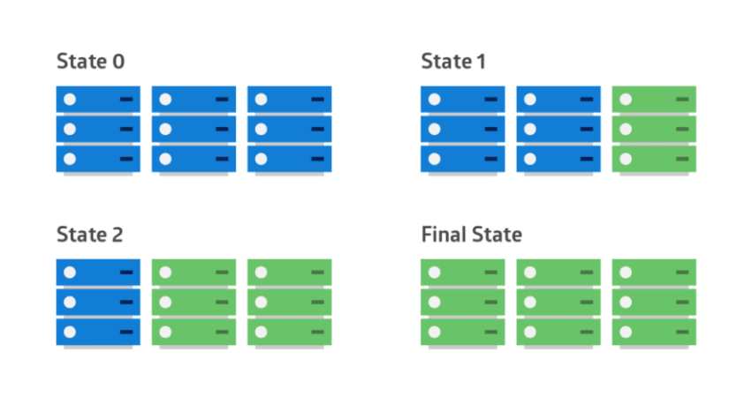
“Big bang” deployments
reference: https://dev.to/mostlyjason/intro-to-deployment-strategies-blue-green-canary-and-more-3a3

Slide 67
Fast to Deploy, Slow to Release
Chuck Rossi at Facebook: “Get your s*** in, fix it in production”
https://engineering.fb.com/2017/08/31/web/rapid-release-at-massive-scale/

Slide 68
Dark Launches at Instagram
Early: Integrate as soon as possible. Find bugs early. Code can run in production about 6 months before being publicly announced.
Often: Reduce friction. Try things out. See what works. Push small changes just to gather metrics, feasibility testing. Large changes just slow down the team. Do dark launches, to see what performance is in production, can scale up and down. "Shadow infrastructure" is too expensive, just do in production.
Incremental: Deploy in increments. Contain risk. Pinpoint issues.

Slide 69
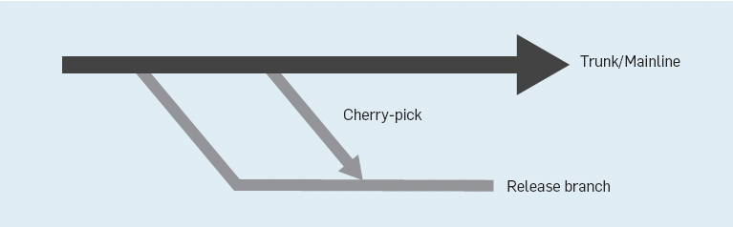
Facebook process (until 2016)
Release is cut Sunday 6pm
Stabilize until Tuesday, canaries, release. Tuesday push is 12,000 diffs.
Cherry pick: Push 3 times a day (Wed-Fri) 300-700 cherry picks / day.
reference: https://engineering.fb.com/2017/08/31/web/rapid-release-at-massive-scale/

Slide 70
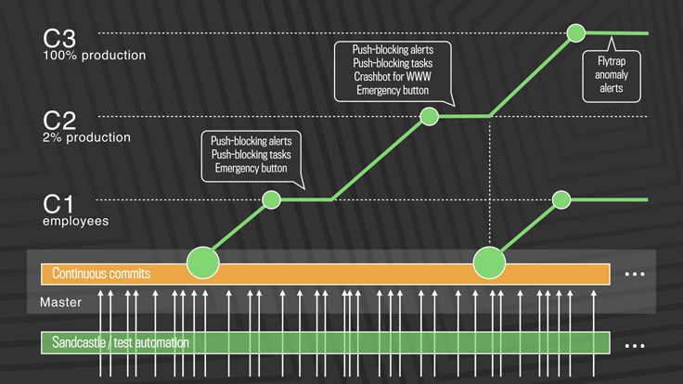
Facebook quasi-continuous release

Slide 71
Rolling deployments
reference: https://dev.to/mostlyjason/intro-to-deployment-strategies-blue-green-canary-and-more-3a3

Slide 72
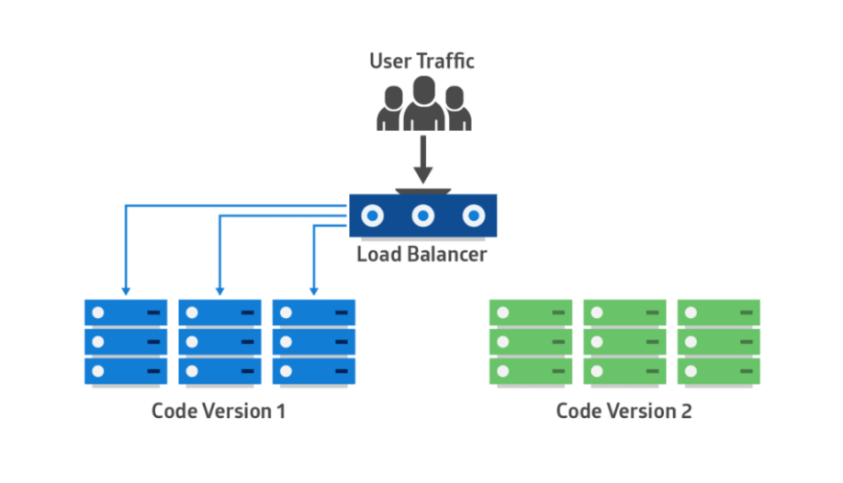
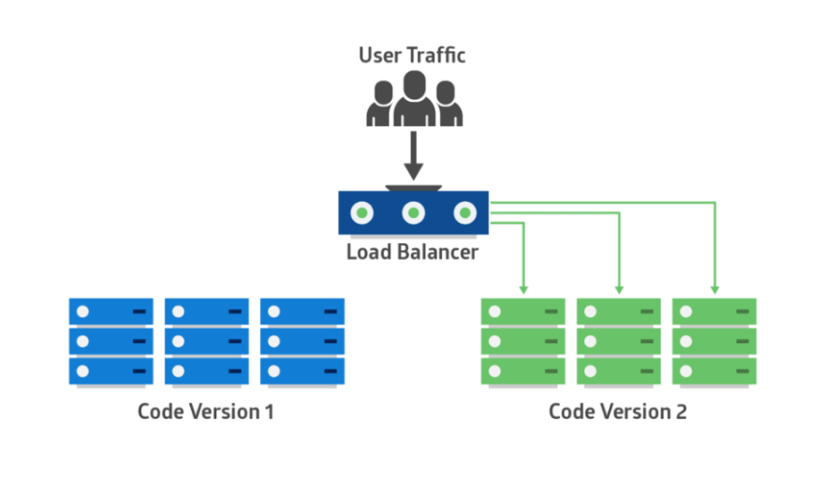
Red/Black (Blue/Green) deployments
reference: https://dev.to/mostlyjason/intro-to-deployment-strategies-blue-green-canary-and-more-3a3

Slide 73
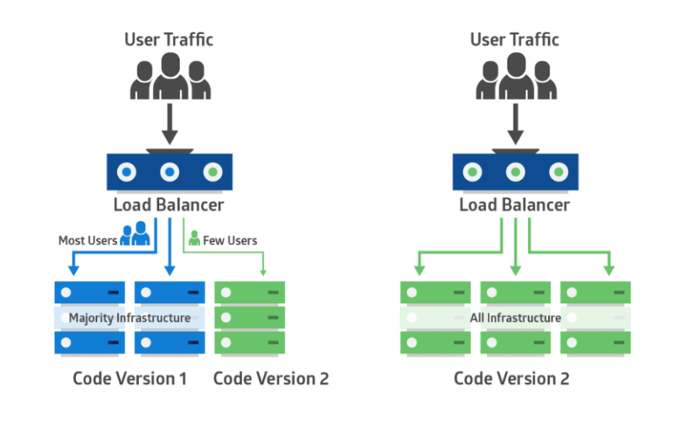
Canary deployments
https://dev.to/mostlyjason/intro-to-deployment-strategies-blue-green-canary-and-more-3a3

Slide 74
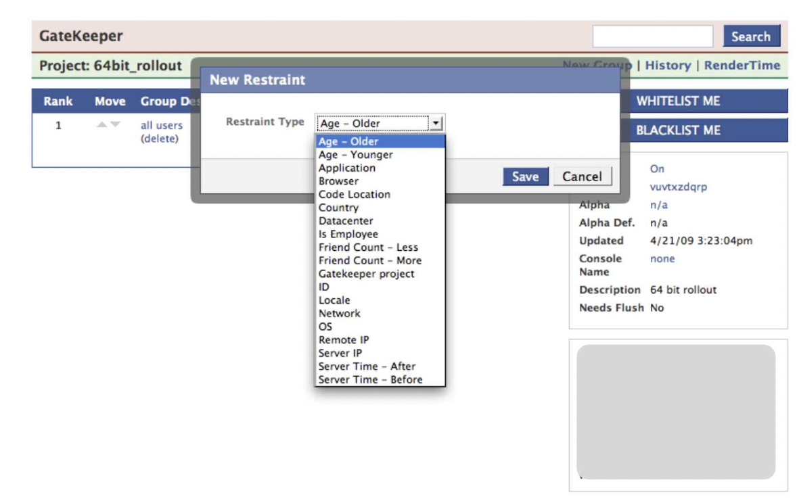
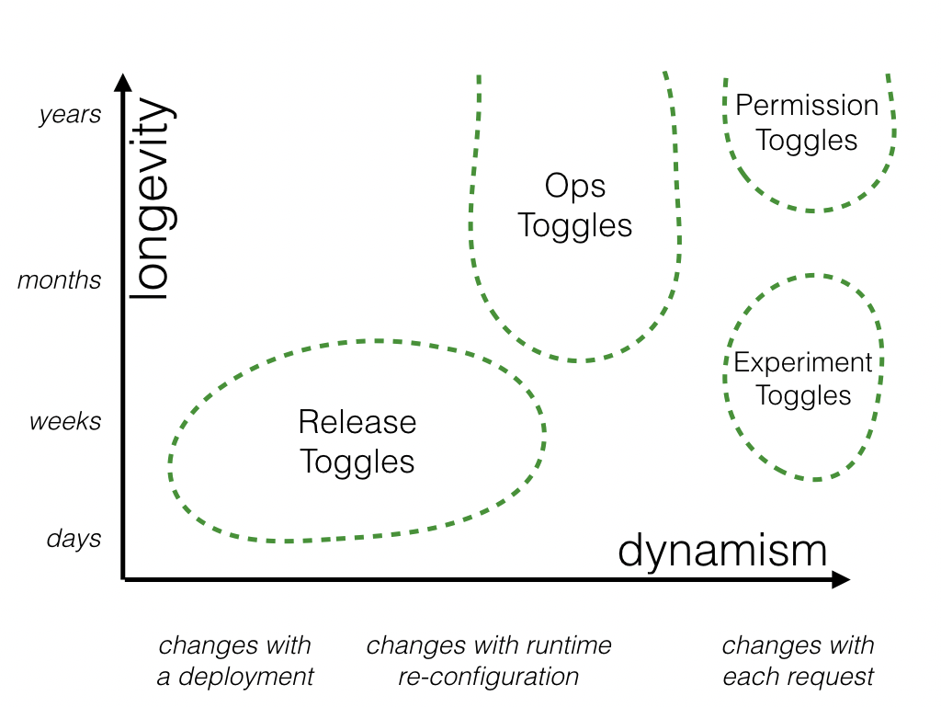
Feature Flags

Slide 75
Monitoring Production

Slide 76
What is Observability?
“As a philosophy, observability is our ability as developers to know and discover what is going on in our systems. In practice, it means adding telemetry to our systems in order to measure change and track workflows.”
The New Stack, “What is observability?” 28 Feb 2020
https://thenewstack.io/what-is-observability/

Slide 77
Observability: Dashboards
What’s happening now?
What does “normal” behavior look like?
What does it look like when something’s gone (or is going) wrong?
Can I correlate events to changes in the actual graphs?
reference: https://www.youtube.com/watch?v=mBU3AJ3j1rg

Slide 78
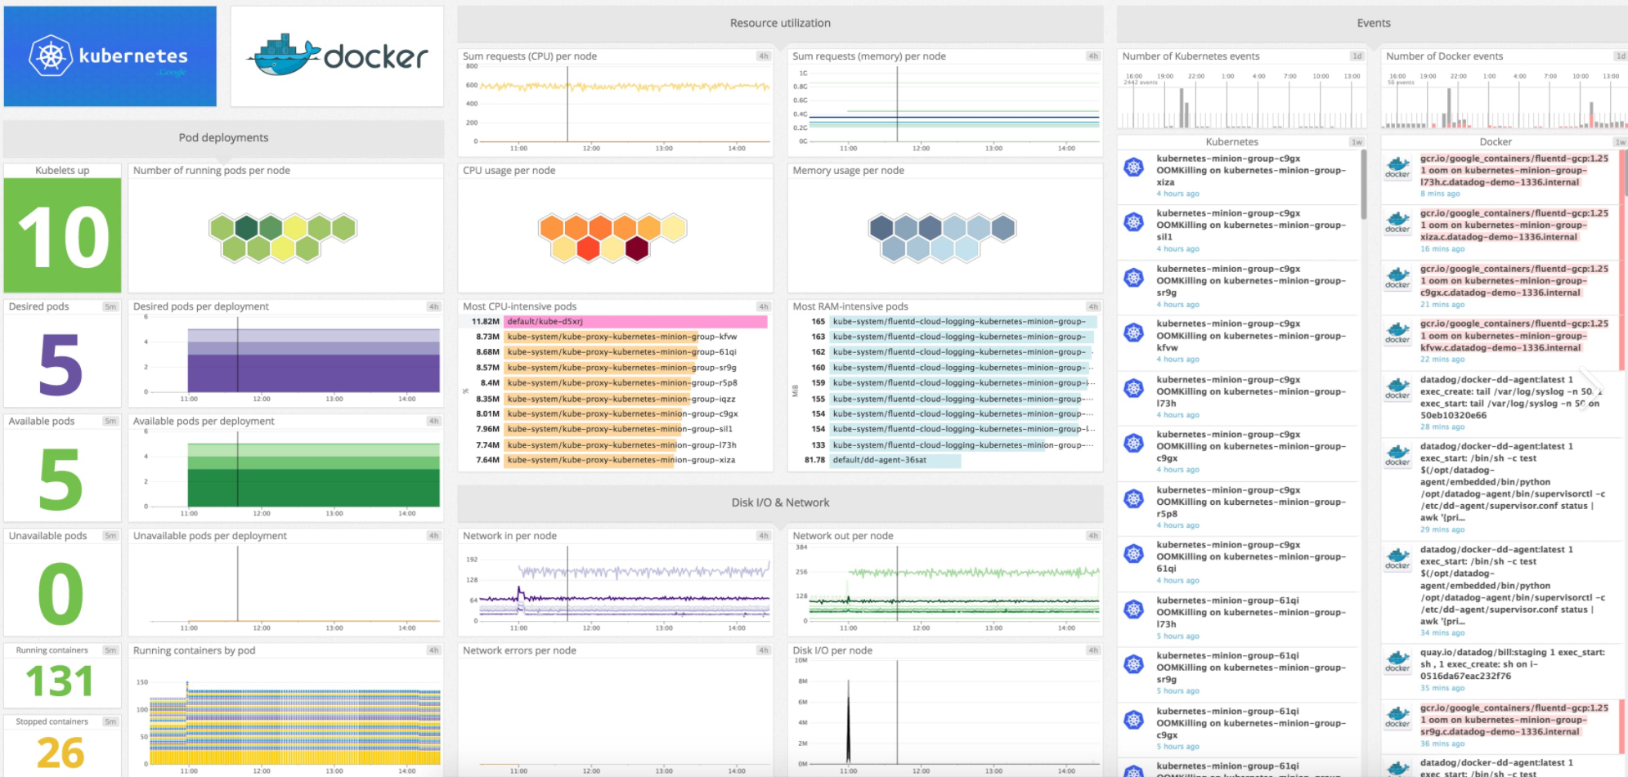
Observability: Dashboard Example
https://datadog-prod.imgix.net/img/blog/monitoring-kubernetes-with-datadog/kubernetes-dashboard.png?fit=max

Slide 79

Observability: Defining “Normal”
reference: https://www.youtube.com/watch?v=vq4QZ4_YDok

Slide 80
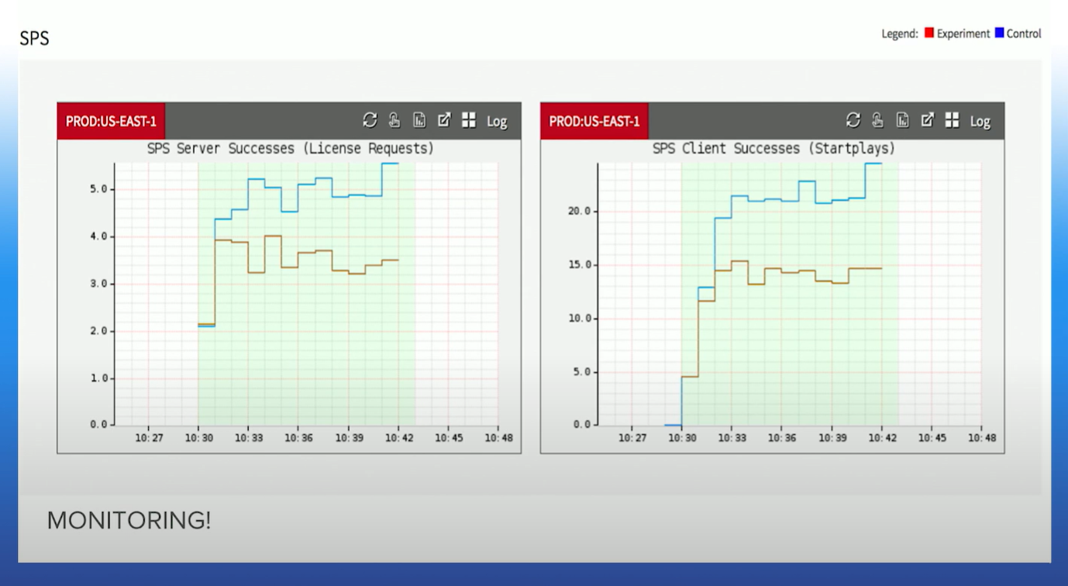
Observability:
When things aren’t “Normal”
Automatic rollback on high variance!
This is starting to sound awfully like a quality attribute….
reference: https://www.youtube.com/watch?v=qyzymLlj9ag

Slide 81
Continuous Integration

Slide 82
Process Roundup
Group Processes
Continuous Integration
  Code Review
  Pair/Mob Programming
Individual Processes
  Asking Questions
  How to run a meeting

Slide 83
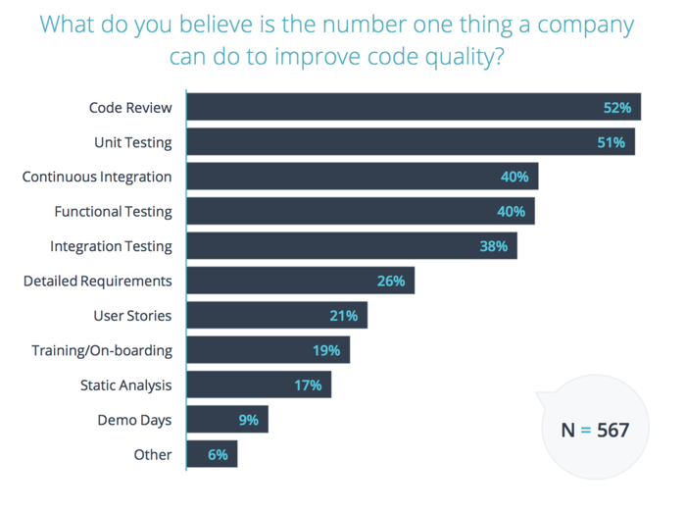
State of Code Review 2017

Slide 84





History of CI
(1999) Extreme Programming (XP) rule: “Integrate Often”
(2000) Martin Fowler posts “Continuous Integration” blog
(2001) First CI tool
(2005) Hudson/Jenkins
(2011) Travis CI
(2019) GitHub Actions

Slide 85
CI/CD Pipeline overview
Code Edit
Tests Run
Code Deployed
Code Merged

Slide 86


Github Flow
Remote Master
featureName
Master
featureName
Local Repo
Staging Area
Working Dir
https://docs.github.com/en/get-started/quickstart/github-flow

Slide 87





Sample CI Workflow
Create Pull Request
GitHub tells Travis CI build is mergeable
It builds and passes tests
Travis updates PR
PR is merged
https://docs.github.com/en/actions/migrating-to-github-actions/migrating-from-travis-ci-to-github-actions

Slide 88
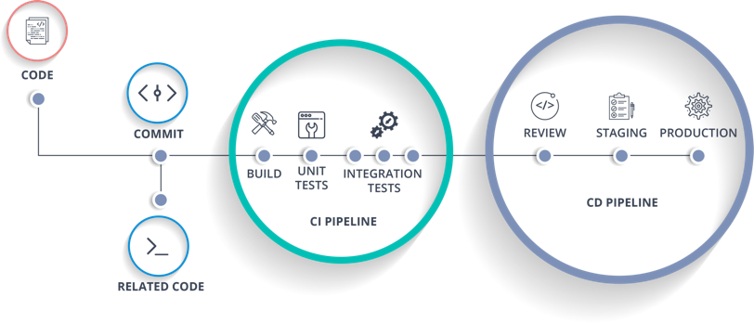
Example CI/CD Pipeline

Slide 89
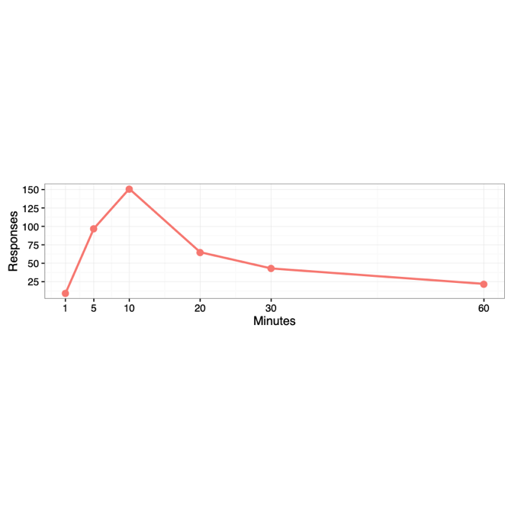
CI Research
“My favorite way of thinking about build time is basically, you have tea time, lunch time, or bedtime…”

Slide 90


DevOps: More Resources

Slide 91
Developers say:
CI helps us catch bugs earlier
CI makes us less worried about breaking our builds
CI lets us spend less time debugging
“[CI] does have a pretty big impact on [catching bugs]. It allows us to find issues even before they get into our main repo, ... rather than letting bugs go unnoticed, for months, and letting users catch them.”

Slide 92

Developers report:
Do developers on projects with CI give (more/similar/less) value to automated tests?

Slide 93

Developers report:
Do developers on projects with CI give (more/similar/less) value to automated tests?
Do projects with CI have (higher/similar/lower) test quality?

Slide 94

Developers report:
Do developers on projects with CI give (more/similar/less) value to automated tests?
Do projects with CI have (higher/similar/lower) test quality?
Do projects with CI have (higher/similar/lower) code quality?

Slide 95

Developers report:
Do developers on projects with CI give (more/similar/less) value to automated tests?
Do projects with CI have (higher/similar/lower) test quality?
Do projects with CI have (higher/similar/lower) code quality?
Are developers on projects with CI (more/similar/less) productive?

Slide 96
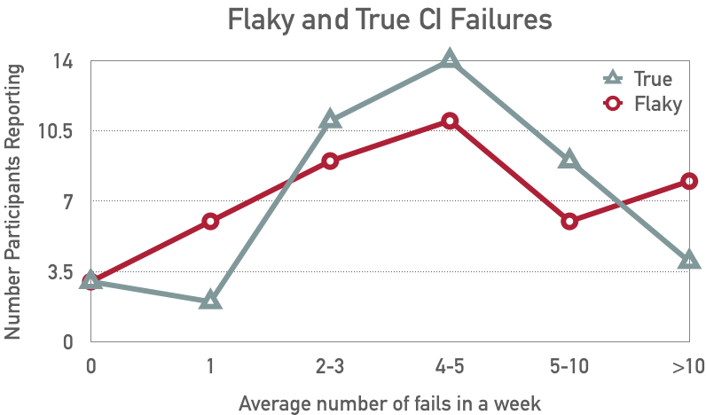
Challenge: Flaky Tests

Slide 97
Observation
Most of the benefits of CI come from running tests

Slide 98
Key Points
DevOps is the integration of software development and the management of that software once it has been deployed for use. The same team is responsible for development, deployment and software support.
The benefits of DevOps are faster deployment, reduced risk, faster repair of buggy code and more productive teams.
Source code management is essential to avoid changes made by different developers interfering with each other.
All code management systems are based around a shared code repository with a set of features that support code transfer, version storage and retrieval, branching and merging and maintaining version information.
Git is a distributed code management system that is the most widely used system for software product development. Each developer works with their own copy of the repository which may be merged with the shared project repository.

Slide 99
Key Points
Continuous integration means that as soon as a change is committed to a project repository, it is integrated with existing code and a new version of the system is created for testing.
Automated system building tools reduce the time needed to compile and integrate the system by only recompiling those components and their dependents that have changed.
Continuous deployment means that as soon as a change is made, the deployed version of the system is automatically updated. This is only possible when the software product is delivered as a cloud-based service.
Infrastructure as code means that the infrastructure (network, installed software, etc.) on which software executes is defined as a machine-readable model. Automated tools, such as Chef and Puppet, can provision servers based on the infrastructure model.
Measurement is a fundamental principle of DevOps. You may make both process and product measurements. Important process metrics are deployment frequency, percentage of failed deployments, and mean time to recovery from failure.

Slide 100
Key Points
Articulate the various purposes of a design document.
Use design documentation to ensure that the correct thing is being implemented.
Write useful, clear, high-quality design documentation.

Slide 101
Key Points
Understand process aspects of QA
Describe the tradeoffs of QA techniques
Select an appropriate QA technique for a given project and quality attribute
Decide the when and how much of QA
Overview of concepts how to enforce QA techniques in a process
Understand human and social challenges of adopting QA techniques
Understand how process and tool improvement can solve the dilemma between features and quality

Slide 102
End of Monday Lecture/Start of Tuesday Lecture

