Slide 1
Introduction to DevOps
Notes:
I hope you are well today. This is the first time I've done something like this so thank you for having me.
So today I'm going to give an introductory talk on DevOps.
I'll talk in a bit of detail about the elements and practices that comprise DevOps but there is a lot of content out there so if you find the topic interesting then I highly encourage you to pursue it further. I'll provide some recommendations at the end for learning paths and recommended readings.
I'll also perform a practical demonstration of some core devops concepts with some industry standard tooling which hopefully you will find interesting with the intent of showing how some of the theory behind DevOps is actually implemented in the real world.

Slide 2
Acknowledgment of Country
Notes:
I begin today by acknowledging the Ngunnawal people, Traditional Custodians of the land on which we gather today, and pay my respects to their Elders past and present.

Slide 3
Christian Townsend
Manager / Solutions Architect, Government Cyber at KPMG
Former DevOps/Operations Engineer at Nuance Communications
Passionate about:
Cloud Architecture
Infrastructure Management
Automation
Delivering high quality to customers
Notes:
So a bit about me and my recent experience. My name is Christian and I’m currently a Manager at KPMG in the Government Cyber division of management consulting.
My background is in software engineering. More specifically I’ve been heavily involved in cloud architecture and DevOps enablement both in my current role and previous role at Nuance.
At Nuance, I was contracted to Services Australia as a deployment engineer for their IVR software stack. I was there for about 2 and half years and then moved to KPMG.
DevOps was a great fit for me because I’m passionate about automation and implementing efficient processes both from a development perspective as well as operational.
After reading and learning more about DevOps, it really resonated with me because I've been in multiple roles where manual processes were the norm.
So to be exposed to ideas that seek to reduce inefficiencies and generally improve overall workflows was very refreshing and appealing.
Professionally, it enables you to be truly full stack, and not just from a technical perspective. It allows you to observe the end-to-end operation of software delivery which means being able to identify shortcomings in processes and come up with solutions to those problems, and generally just appreciate what it takes to deliver high quality software to your customers.
Just as important to me is the ability to frequently collaborate with multiple teams within the greater organisation.
It allows you to be surrounded by individuals with really diverse skill sets. So being in that kind of environment is really valuable if you’re passionate about continual learning and upskilling throughout your career.

Slide 4
What is DevOps?
Combination of:
Practices
Tools:
Planning
Building
Testing
Deploying
Monitoring
Culture shift – move from siloed teams to shared responsibility
Heavy focus on automation and feedback
DevOps adoption is a journey, not a step
Primary benefit is to frequently deploy high quality software releases
Notes:
So, what actually is DevOps?
You’ve most likely heard the term but to those who aren't in the industry it is a little vague and abstract.
Put simply, it’s a combination of specific development and operational practices and tools in action with a heavy focus on automation and feedback throughout the entire workflow.
It encourages a massive culture shift from siloed teams to shared responsibility, encouraging greater and more effective collaboration among teams, with the goal of creating greater outcomes for the customer.
Like Agile or other methodologies, an organisation can fully or partially adopt elements of DevOps, so it isn't an all or nothing concept.
It is a journey or an ongoing process rather than a step.
The primary and most impactful benefit of adopting DevOps is the ability to frequently deploy high quality software releases.

Slide 5
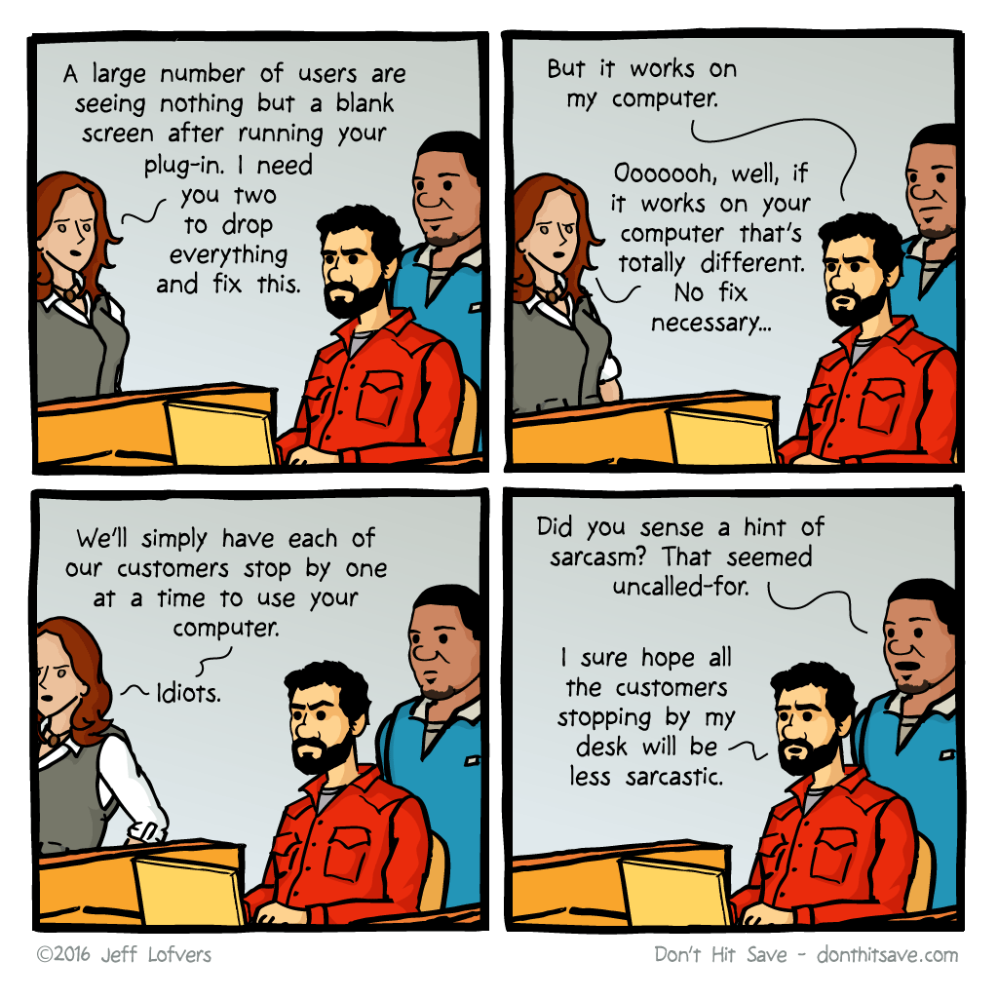
What problems is DevOps trying to solve?
Value deliverance
Reduced cycle time
Faster deployments
Reduced deployment failures
Faster recovery
Time to market
Notes:
So now that we’ve defined what DevOps is, what problems does it seek to resolve? Or what are we trying to improve upon with the implementation of DevOps?
Value deliverance. DevOps enabled organizations allow them to automate or remove repetitive or low value tasks, allowing higher value tasks to receive greater attention and therefore allowing innovation to flourish. So rather than work on something that requires little mental input, teams and individuals can work on creating new software functionality or work to improve the reliability of infrastructure. So tasks that deliver high value to the customer.
Reduced cycle time - increased productivity: By automating every portion of the workflow, we can increase the speed of software creation and transportation. So where value deliverance was concerned with delivering high quality outcomes to the customer. Reduced cycle time is concerned with frequently delivering high quality outcomes to the customer.
Reduced Deployment Failures: Implementing consistent and repeatable processes minimise the chance of a variation in workflow (Enabling easier standardization of deployments) and therefore reduce the chance of a deployment failure.
Faster Recovery: Smaller deployments, which refers to deployments containing fewer changes are inherently less risky, so we can recover quickly due to the limit in changes in the event of a failure. This is an important concept and ties in with continuous delivery which I'll be talking about later on.
Time to Market: If our teams can move with greater agility, it follows that time to market is reduced. We can utilise tools that can provide us with rapid feedback, enabling developers to focus solely on developing the functionality the customer wants and spending less time on menial tasks. Supporting this is of course the operations portion and being able to transport that development work into the customer’s environment as soon as possible.
Ultimately this increases the viability of the organisation in the industry if they are able to get off the ground and enter the market sooner.

Slide 6
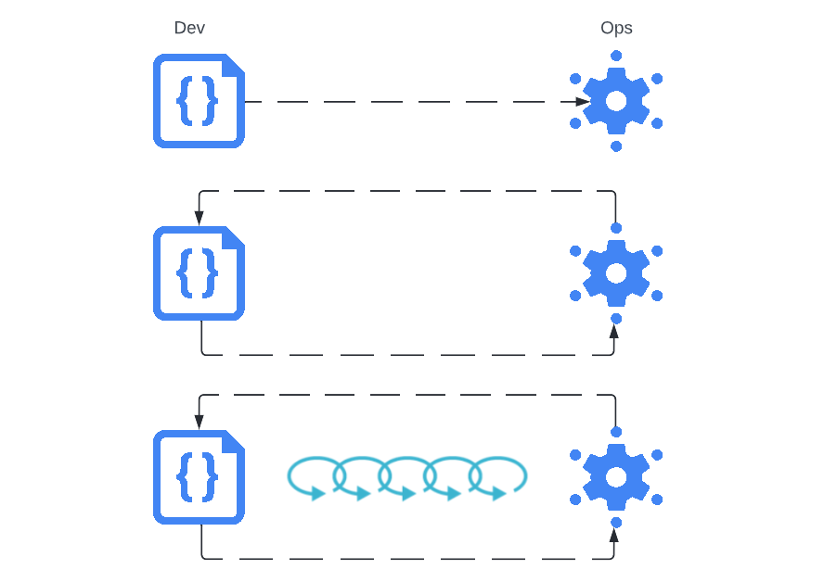
The Three Ways – the principles underpinning DevOps
The First Way: Flows/Systems Thinking
The Second Way: Amplify Feedback Loops
The Third Way: Culture of Continual Experimentation and Learning

Slide 7
The First Way - Flows/System Thinking
Emphasises the performance of the entire system
Limit work in progress
Make work visible
Do not pass defects downstream
Notes:
The first way - Flows/System thinking:
Emphasizes the performance of the entire system, not just a specific silo of work. Instead we need to consider left to right. In other words, from Dev to Ops to Customer in their entirety.
To support this, we need to limit Work in Progress so that cycle times are reduced and throughput is improved. This means completing work in small batches rather than having ongoing work that may remain in the pipeline for a long period of time. Limiting the work in progress makes it easier to identify inefficiencies in a team’s workflow.
A significant difference between technology and manufacturing value streams is that our work is intangible. To help us see where work is flowing well and where work is queued or stalled, we need to make work as visible as possible.
This can be done with effective use of various tools. With work being clearly visible, we can see what tasks team members are working on and what the complexity of the task is.
Visibility of work prevents us from focusing on the wrong areas for improvement. If we see that specific tasks take significantly longer than others, we should investigate if there is a resolution to this rather than spending effort on processes that are already operating optimally in comparison.
Do not pass known defects downstream. It is often more costly to address them later than to address them in the present.
Continually try to find ways to simplify and improve the workflow

Slide 8
The Second Way – Amplify Feedback Loops
Create high quality information flow throughout value stream
Feedback and Feedforward loops
Complex systems typically have a high degree of interconnectedness
Create feedback mechanisms where they are required
Notes:
The second way - Amplify Feedback Loops:
Still with the concept of enhancing the performance of an entire system, we can make our system of work safer by creating fast, frequent and high quality information flow throughout the value stream. In this case the information we want to amplify is feedback - not just from the customer but from all parties.
This includes feedback and feedforward loops. So look at the system as it is currently and how it can be improved and also the ability to plan for the future
Complex systems typically have a high degree of interconnectedness - failure is inherent and inevitable. Our systems must be designed with this consideration.
It isn't sustainable to simply detect issues should they arise. They should be swarmed by the required teams and resolved as soon as possible. So we need to amplify feedback on our system if it is not performing as we expect such that we can progress with implementing a resolution.
A great example of this in a non technical environment is at Toyota. Within their manufacturing process there are various stages where employees have the opportunity to pull on a cord (called the Andon cord) which would result in a sign board lighting up, indicating a suspected problem. Pulling on this cord essentially brings the entire production process to a halt.
By stopping the entire production process, it allows the problem to be identified at the root and resolved at the root rather than letting it get passed down the production line where it could remain unresolved or may require fixing at a greater cost. Because pulling on the cord stops the production processes, it creates a great sense of urgency, allowing the problem to receive the attention it requires in order to be resolved as soon as possible

Slide 9
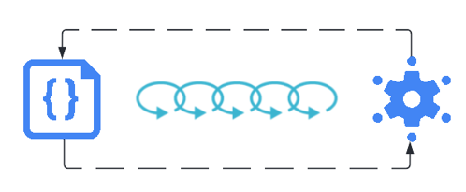
The Third Way – Continual Learning and Experimentation
Create a culture that fosters continual experimentation, and understanding that repetition is the prerequisite to mastery
Reserve time specifically for conducting such experiments
Transform local discoveries into global improvements
Promote injection of resilience into daily work
Notes:
The third way - Continual Learning and Experimentation
The third way is about creating a culture that fosters two things: continual experimentation, taking risks and learning from failure; and understanding that repetition and practice is the prerequisite to mastery.
Time should be reserved specifically to conduct these experiments as well as address accumulating technical debt.
Experimentation and taking risks are necessary activities to ensure we’re striving to improve even if it means going into unchartered territory.
When new learnings are discovered, they should be propagated throughout the rest of the organisation such that others can benefit. In other words, we want to encourage transforming local discoveries into global improvements.
Continuous learning also promotes the idea of injecting resilience patterns into daily work.
So an example of this is simulating failures and working toward improving key metrics for deployment.
Netflix actually accomplished this by inventing Chaos Monkey. Chaos Monkey is a piece of software that would be responsible for randomly terminating instances in production to ensure engineers had implemented their services to be resilient to instance failures.

Slide 10
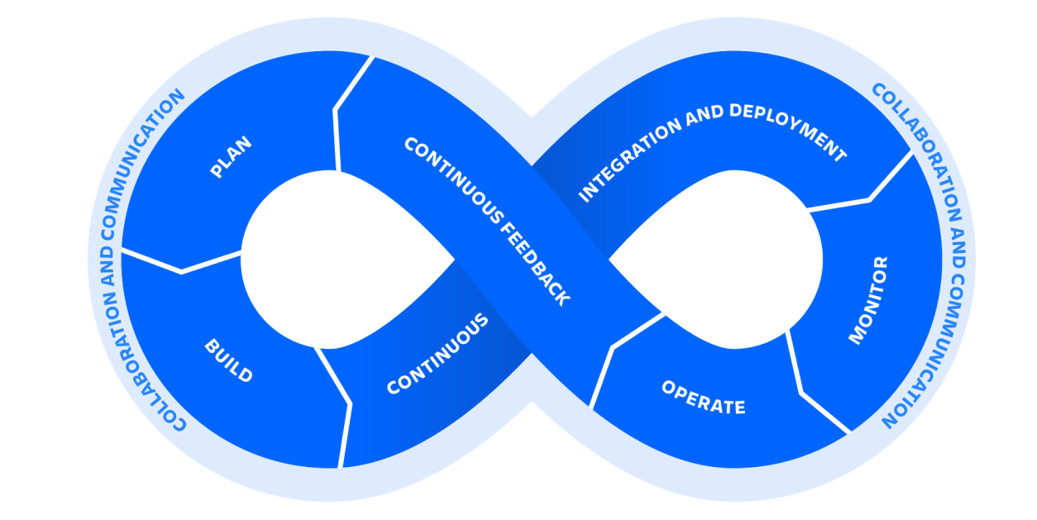
Supporting principles of DevOps
Collaboration
Automation
Continuous Integration
Continuous Delivery/Deployment
Continuous Monitoring
Continuous Improvement
Notes:
These principles I would say are encompassed within the three ways but are more specific and can be associated with practical implementations.

Slide 11
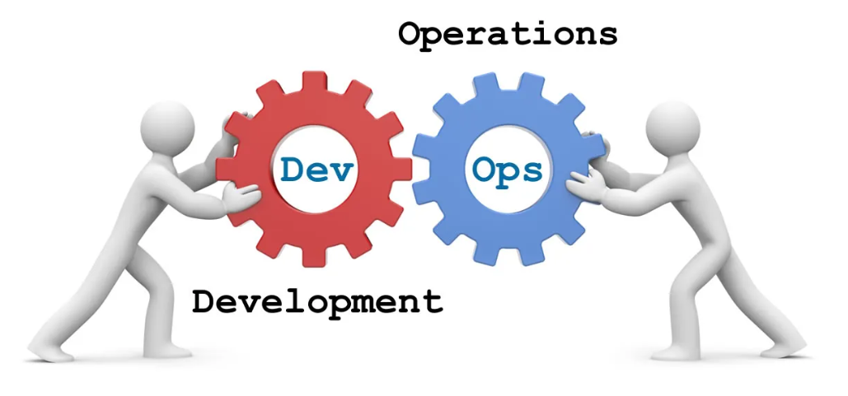
Collaboration
Teams traditionally worked in isolation (minimal collaboration)
Shared responsibility
Give teams greater autonomy
Separate failure from blame
Notes:
Traditionally, teams have worked in siloes with little or no collaboration. In short, development would hand off their work to ops for them to deal with the deployment and monitoring processes.
DevOps entails a culture in which the success or failure of a product is a shared responsibility of both Development and Operations. Both teams are expected to oversee the product over the course of its life rather than absolving themselves of any more responsibility once their portion is complete.
This mentality gives better visibility to all and allows both teams to see the challenges that each other faces.
For example, Developers may pair with an Operations engineer to go through the deployment process. When they witness the challenges that Operations face during this process, they can help identify ways to simplify the workflow. Similarly, when Operations understand the business goals of the customer, they can work with developers to assist in translating them into operational requirements. So generally preventing less ambiguity about what is required by the customer.
Ultimately, in both examples, we strive to provide a greater experience for the customer. The use of DevOps tooling and automation of the software delivery process forces collaboration by physically bringing together the workflows and responsibilities of development and operations.
When deployment processes are simplified and robust, deployment failures are reduced. When business goals are clearly articulated and translated into requirements, the customer receives what they were expecting.
Further, in order to reduce lead times, it is important that teams are enabled to work with autonomy. Making decisions and implementing changes to any phase of the pipeline should remove any cumbersome approval process. Instead, place teams and individuals within environments that are free of bureaucracy.
If we give teams access to sets of tools that allow them to make decisions with increased efficiency and clarity, we can remove the yellow tape that would have traditionally surrounded them.
This environment should also separate failure from blame. As mentioned previously, taking risks and experimenting can help an organisation stay innovative. If we don't have this kind of environment then we are potentially stunting organizational and individual growth.

Slide 12
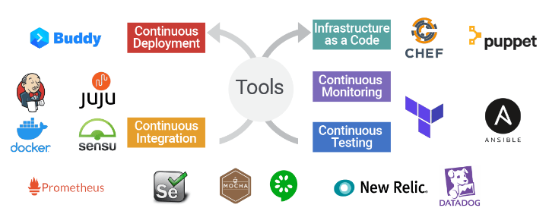
Automation
Automate everything
Repeatable Processes (simple and complex)
Consistent
Safer and more reliable
Allows time to be spent on other activities
Notes:
This supports the existence of the remaining principles as they all leverage automation in some capacity.
Automation allows us to create and implement consistent and repeatable processes that may be very simple or very complex in nature.
It also enables us to accelerate these processes and scale environments.
Automation minimizes the possibility of human error because you know it will always carry out processes the same way every time it executes.
Processes without or with minimal automation might exhibit a deployment engineer carrying out steps manually. If this engineer carries out this process frequently, it only increases the chance that they will eventually miss a deployment step and cause a critical outage or failure. This concept can be applied to all phases of the workflow and isn't just applicable to deployments.
So with Automation, we can limit the amount of deviation that could occur if the process were to be carried out manually.
Coming from an operations background where we would carry out manual releases every single week, I know firsthand of the pressure that comes with deploying software to a production environment that millions of people depend on.
Implementing automation both reduces deployment issues as well as alleviates stress and pressure from the deployment engineer.
Of course, we must ensure that we are sufficiently automating the task. When I say this, I am thinking of correct error handling and back out processes in the event something unexpected occurs. We will never be able to account for all possible issues that might occur, but we can account for most if the automation we implement is thoroughly designed.

Slide 13
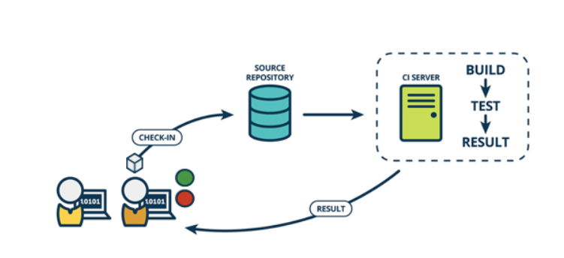
Continuous Integration
Commit to main branch
Robust testing regimes
Trunk based development
Reduce Developer coordination and associated overheads
Notes:
This principle refers to the practice of constantly committing code changes into the main branch of a project instead of creating separate branches to work on new features or resolve bugs.
Traditionally, and still a completely common practice today is to create a branch of a software project that is usually based on a stable release of that project.
The purpose for doing this is such that any new feature or bug that needs to be implemented or resolved, can be tested against this new branch and when that feature or bug fix is sufficiently tested, they can be pulled back into the main branch of the project.
During the time that these changes are being implemented, other developers may be working on other changes (for which they will also have their own branches). Some bugs or features might be tested before other developers’ changes, in which case they can be merged back into the main project while development continues on other changes.
Continuous Integration insists that all changes that are committed to the same branch will be tested and built upon commit. This is known as trunk based development.
These tests will then assert the correctness of the code before being integrated. For this reason, it is imperative that a set of thorough test cases are developed so the changes can be reliably evaluated against.
So why trunk based development? The primary benefit is the minimization of merge conflicts.
You might wonder how developers work on new features in a trunk based development model. And they do this by using feature flags which wrap new functionality in an active code path which can then be activated at a later time.
While it is true that an initial overhead may be incurred to establish such a pipeline, the benefits will be realised very quickly.
Developers will no longer need to coordinate with each other to merge their changes.
This extends to other teams such as operations and product teams within the organisation. Operations engineers will know there is only one build they need to be handling instead of having to search and find specific builds that include the changes the customer is expecting.
I can remember working as a deployment engineer, we might have had 3 or 4 versions of the same package that contained different changes that would be released according to a predefined timeline. The associated overhead of trying to determine which was the one that needed to be deployed at a given time was stressful and made us heavily reliant on checking the code commit message as well as the code itself when really this is something that could have been avoided with trunk based development.
The communication overhead of a non-CI environment can quickly enable desynchronisation among teams and result in back and forth where clarification might be required. Slower releases and a higher failure rate are just two potential results of this.

Slide 14
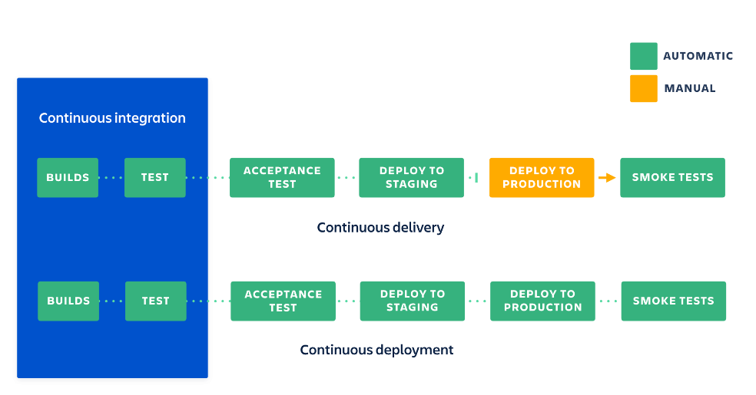
Continuous Delivery and Deployment
Deploy to production frequently (daily)
Develop and Deploy in small batches
Rollbacks are less impactful
Easier to troubleshoot issues with deployment/code
Customer receives improvements more regularly
Developers see their work deployed more regularly
Notes:
As you might have already guessed, this refers to the organisation’s ability to continuously deliver software changes to a production environment in a consistent and reliable manner.
From a workflow point of view, it follows directly on from Continuous Integration - in that, when code has been successfully integrated, a build containing that change can be deployed automatically to a test or production environment.
The core idea here is to deploy as frequently as possible, in small batches rather than performing a weekly release that contains many changes. In the event of a deployment failure, rolling back will be far less impactful if you’re only reverting a small number of changes.
Similarly, if issues are recognised after the deployment, it makes troubleshooting them much easier due to the limited scope of what could be contributing to the issue.
Continuous Deployment is the next iteration in that its goal is to automate the entire production deployment pipeline process rather than requiring manual input prior to a production deployment. You can see the difference on the slide.
Arguably the greatest benefit of continuous deployment is the customer’s ability to continuously see improvements that are being applied rather than seeing them monthly or quarterly for example. The visibility that they have where they are constantly being served with a greater end product is invaluable. Again, this ties in with making the work as visible as possible.

Slide 15
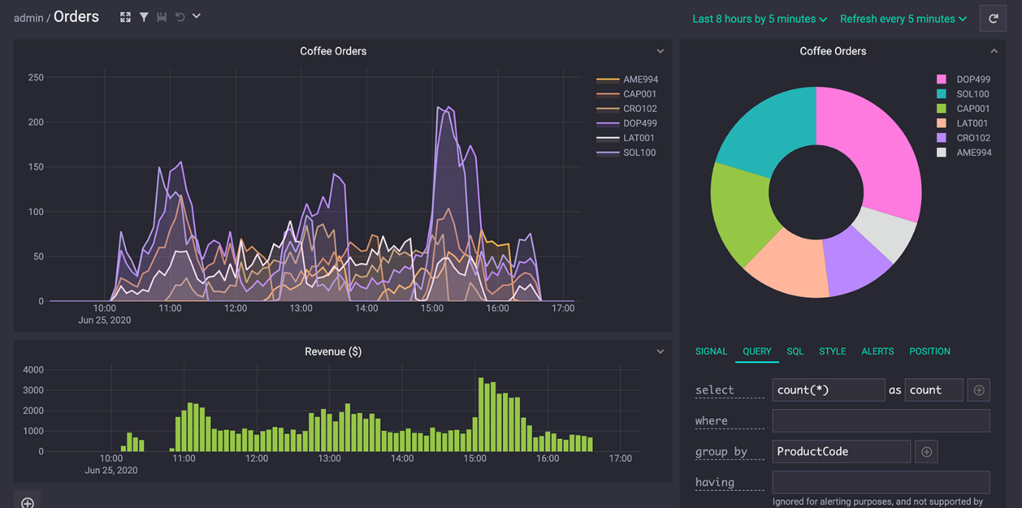
Continuous Monitoring
Analyse performance of software:
What is normal behaviour? What is abnormal behaviour?
It is critical to configure key metrics:
Hardware usage, User usage, Log telemetry
Proactively respond to potential issues
Enables customer to operate with minimal downtime
Notes:
This follows directly after continuous deployment.
Continuous Monitoring is the practice of analysing how an organizations software is performing and automatically providing feedback to operations with this information.
This information can then be assessed in any number of ways and used to make further improvements to the software or system.
Critical to this practice is configuring key metrics and telemetry to measure the software against.
A simple example of this may be just measuring CPU and Memory usage and configuring notifications to send when a specific threshold has been exceeded. So with this mechanism in place, we can get an early indication on if additional hardware resources might be required in order to prevent slowness or a crash in the system.
More granular monitoring may include simulating requests that are considered mission critical for them to be operating. If response codes other than 200 are returned then these could be reported on and returned to operations for analysis.
Other information like user usage can also be reported on and allow us to gauge exactly how the platform is being used. So if new functionality was recently implemented, we can use analytics to determine if and how it is being used.
Like with continuous integration, the configuration of these health checks need to be thoroughly configured to ensure we’re reporting on the activity we’re actually interested in. We do not want to report on false positives or return false negatives. We need to know what normal behaviour looks like and what does the system look like when something has gone wrong? Is it possible to correlate deployments with a change in the systems behaviour?
The primary goal of this practice is to identify issues with what is being monitored as soon as possible and have them resolved.
And as mentioned already, this practice should not be isolated to the application but the entire stack that the application is run on. So application layer and infrastructure layer telemetry should be configured.
With continuous monitoring, we also minimize system downtime as we are constantly checking the health of the entire system and raising the alarm early if it is required.
The relationship with the end customer is then enhanced by enabling them to operate with minimal downtime and greater performance, safeguarding against revenue loss or credibility.

Slide 16
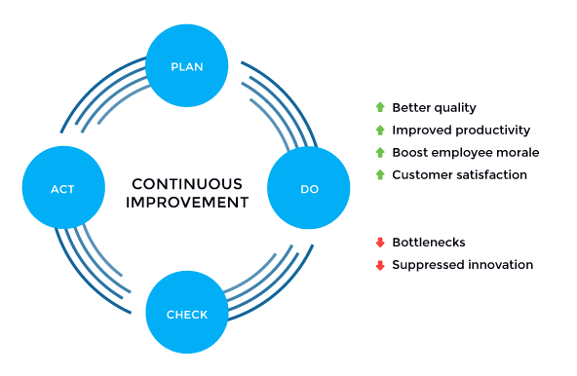
Continuous Improvement
Notes:
It’s the practice of focusing on experimentation, minimizing waste, and optimizing for speed, cost, and ease of delivery. I spoke about this briefly when referring to the Third Way.
This ties in with receiving constant feedback from all stakeholders and addressing it in a manner that results in greatest value deliverance for the customer.
Improving the activities within an organisation might be done by enhancing the rollback procedure within the deployment pipeline so that it can execute with greater autonomy.
Improving skills could mean getting individuals and teams certified in the use of a specific tool that is critical to the operation.
And improving the quality of the application could be by developing improved test cases for continuous integration, ensuring higher quality code that is being integrated and delivered to the customer.
Experimentation is encouraged. If a certain portion of the workflow isn't working for some, block out time and work to implement a solution that improves the workflow.
Essentially, remember the idea of systems thinking and seek to resolve any kind of bottleneck that may exist in any phase of the pipeline, no matter its size.

Slide 17
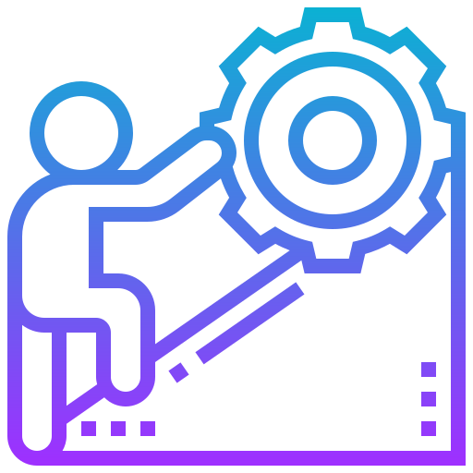
The challenges
Initial effort
Dealing with legacy systems
Unique skill set required
Culture shift as well as technical shift
Notes:
While there are many benefits to adopting a DevOps practice, it does require substantial effort to establish. And this might be the single biggest deterrent for an organisation.
Dealing with legacy systems and migrating to new tool sets can be a massive job and might require a large amount of initial capital to get the ball rolling.
Additionally, given it is a relatively new concept, it can be difficult to employ teams and individuals with the right skill sets to implement the core practices.
So for an organization with many applications that may require automation in some capacity, this would present a huge challenge to overcome.
Not only is there a technical shift involved, but also a culture shift.
DevOps requires a fundamental change in organizational culture and structure in order to be successful.
This can be a challenge for many organizations, particularly those that are larger and more traditional in their approach. Where a startup could transition to DevOps enabled workflow in a matter of months, it might take several years for a large corporation to do the same.
These are just general considerations organisations should think about when considering moving to a DevOps enabled workflow.

Slide 18
Story Time
Notes:
Now i'm going to briefly talk about a project I was brought onto when I first joined KPMG
I'm going to highlight a few key areas where we were able to implement some elements of DevOps
I was brought onto a team that had created a full stack web application hosted with Azure. My role was to migrate the application from Azure based stack to AWS (Amazon Web Services). The primary reason for this was to prepare the application to be in a state that was ready for production.
And so AWS had the right set of services that we could utilize to achieve this.

Slide 19
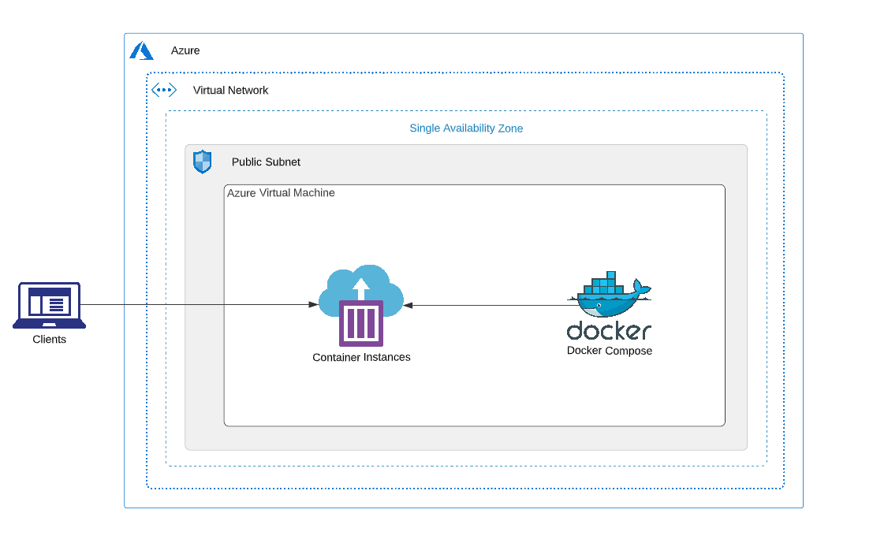
The Previous Architecture
Notes:
As you can see on the screen, I've provided a simplified diagram of the architecture
Almost immediately you can identify some core issues with this architecture
Does anyone want to maybe take a go at highlighting one of them?
There isn't high availability, there isn't scalability
If you’re not already familiar, high availability simply refers to the applications ability to remain operational in the event of a catastrophic failure.
So the best example I can give is when a whole data center fails. With high availability, the application should be configured to be running in geographically distinct data centers to accommodate for this.
The fastest recovery if this architecture were to fail would be to restore a copy of the Virtual Machine’s volume (if one exists) to a virtual machine in a different data center.
Of course if there are specific networking and security requirements, that would also need to be performed manually.
Scalability refers to the application’s ability to scale to the demands being placed on it.
For example, when the application is receiving greater than normal traffic loads, it should scale up to handle the increased demand being placed on it. If we didn't scale, the system has the possibility of becoming slow or even crashing completely. Potentially causing revenue loss and damage to reputation.
Conversely we want to scale the application down if the traffic is lower than normal.
Because cloud computing is a pay as you go offering, we dont want to pay for computing resources we arent fully utilising. So with scalability we can implement a cost effective way in which to run our application.
So when I was brought onto this project those were the two core shortcomings that myself and the greater team recognised and decided to address.
It also gave us the opportunity to leverage some relatively new technology that would allow us to quickly provision and deprovision cloud resources completely, making it more cost effective than constantly having the cloud resources running and waiting to be used.
To support this, we needed to create new build and release pipelines specifically for the infrastructure.
This isn't something that is visible in the diagram but was imperative for establishing continuous integration and continuous delivery.
Having had experience in developing similar pipelines previously, I was able to leverage that knowledge on this engagement.
I'll talk more about this shortly.

Slide 20
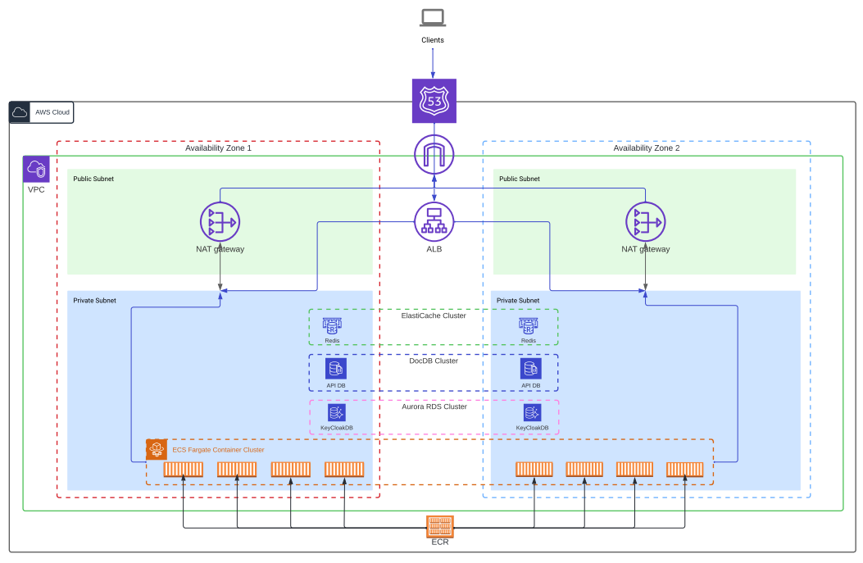
The New Architecture
Notes:
So what you see on screen now is the new architecture that was developed to address the shortcomings identified in the previous architecture.
You will notice we migrated to AWS. Without going into too much detail, this decision was made given the various offering comparisons made between AWS and Azure. In essence, we wanted to leverage as many managed services as we could to minimize overhead.
It is simplified for ease of viewing
With this architecture you can tell straight away that we have addressed the issue of high availability
Our application now runs within two geographically distinct data centers.
From a design point of view, you could increase the redundancy even further by replicating the application onto a third data center.
For critical applications that people depend on, this may be a necessity in order to mitigate failures.
Less obvious yet still present is the function of scalability.
In the new architecture we harnessed an elastic container service.
This service can utilize serverless technology. Serverless is where we do not need to deploy or configure the compute resources we require. They are provisioned automatically based on predefined definitions.
In our example, we have multiple unique containers running in each availability zone, which receive load balanced traffic. If the containers consistently exceed CPU or Memory thresholds, a new container is spawned.
So now we’ve added another compute resource in an effort to distribute the load even further with the ultimate goal of reducing hardware utilisation.
Conversely, when these hardware thresholds are not being exceeded, the containers have been configured to terminate given their lack of usage.
So our new solution is both highly available and utilising cost effective scaling technology.

Slide 21
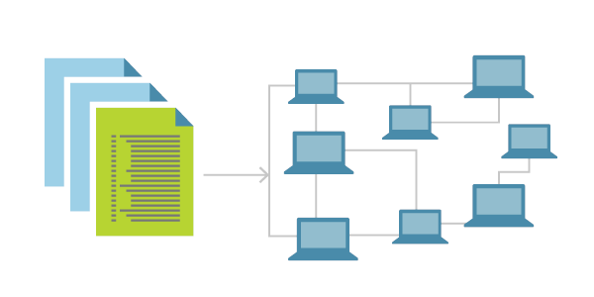
Infrastructure as Code (IaC)
Describe and implement our cloud infrastructure using code
Creates a layer of abstraction between declaration and implementation (human readable)
Consistent
Repeatable
Can be automated
Version controlled
Notes:
But what if the application is not being used at all and we have all of these services running?
You may ask why that would ever be the case and I will provide two examples yet I am sure there are more.
When initially developing this architecture and modifying it to adapt it to our requirements, we did not want to have to go through and keep deleting, editing and adding through the AWS user interface. We did not want this to be a part of our workflow.
Additionally, if this web application is only actively used at specific periods during the year, we don't need to have it running at all. As you can see in the architecture, we’re harnessing more services which in turn results in higher costs. If we don't need these, they should be terminated.
What if we could automate provisioning and deprovisioning of all the required cloud resources in order for the application to run?
This is where Infrastructure as Code comes in.
Infrastructure as Code allows us to describe and implement our cloud infrastructure using human readable code rather than manually implementing it via the user interface of a given cloud provider.
This brings us back to one of the core principles of DevOps in that a once manual process can now be automated.
Not only is it automated but it is consistent and repeatable. Given we are working with code, it can also be version controlled.
So any updates to the configuration are easily visible throughout its lifetime.
Though there was initial overhead to get it configured and working as expected, we can now harness all of the benefits it offers.
Additionally, we have essentially bundled our infrastructure together into a neat little package. This is great because now we can include it as a part of the offering. Maybe in the future the architecture will be self managed by the customer, or we may get new customers rapidly. Now if that were the case they can easily provision the resources they need simply by executing the code.
We were able to do all of this using Terraform

Slide 22
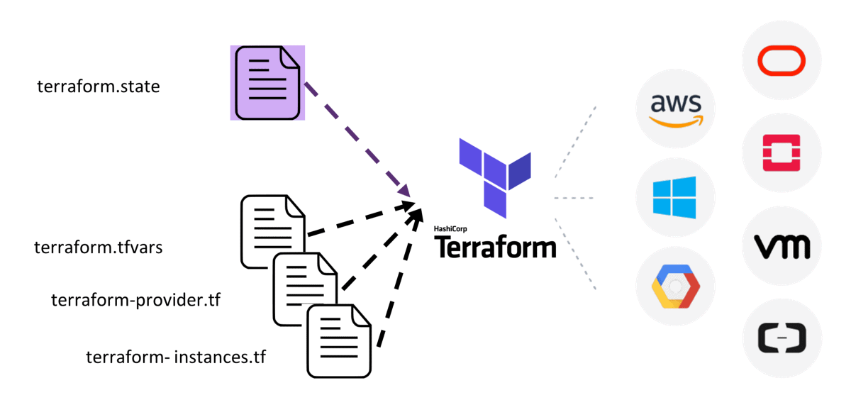
Terraform
IaC tool
Created by HashiCorp
Open source
Declarative
“Cloud agnostic”
Notes:
Terraform is a product of HashiCorp who are a San francisco based software company.
It is an open source declarative Infrastructure as Code tool.
There are quite a few IaC tools out there today such as Ansible
The main motivation behind choosing Terraform is because
I already had experience with it
It is easy to learn
It is well supported in that there is plenty of documentation and example usages throughout.
It is also described as being cloud agnostic which means it is compatible with many cloud providers such as AWS, Azure, Google Cloud Platform and so on.
Resource declarations will differ from one provider to the next but they are all supported by the HashiCorp configuration language which is what you will see shortly.
It is cloud agnostic in the sense that it doesn't have a one-to-one relationship the way Cloud formation has to AWS or ARM templates to Azure for example.

Slide 23
IaC Demonstration
Notes:
So now I'll perform a demonstration of Infrastructure as Code in action whilst also providing a practical implementation of continuous integration and continuous delivery.

Slide 24
Recommendations
Reading:
The DevOps Handbook: How to Create World-Class Agility, Reliability, and Security in Technology Organisations
Learning Pathway:
DevOps Roadmap: https://roadmap.sh/devops
Good luck!
Notes:
~2 mins

Slide 25
Thank you

Slide 26
©2022 KPMG, an Australian partnership and a member firm of the KPMG global organisation of independent member firms affiliated with KPMG International Limited, a private English company limited by guarantee. All rights reserved.
The KPMG name and logo are trademarks used under license by the independent member firms of the KPMG global organisation.
The information contained in this document is of a general nature and is not intended to address the objectives, financial situation or needs of any particular individual or entity. It is provided for information purposes only and does not constitute, nor should it be regarded in any manner whatsoever, as advice and is not intended to influence a person in making a decision, including, if applicable, in relation to any financial product or an interest in a financial product. Although we endeavour to provide accurate and timely information, there can be no guarantee that such information is accurate as of the date it is received or that it will continue to be accurate in the future. No one should act on such information without appropriate professional advice after a thorough examination of the particular situation.
To the extent permissible by law, KPMG and its associated entities shall not be liable for any errors, omissions, defects or misrepresentations in the information or for any loss or damage suffered by persons who use or rely on such information (including for reasons of negligence, negligent misstatement or otherwise).
Liability limited by a scheme approved under Professional Standards Legislation.
Document Classification: KPMG Confidential

