Slide 1
COMP 2120 / COMP 6120 testing
Week:
8 of 12
A/Prof Alex Potanin and Dr Melina Vidoni

Slide 2
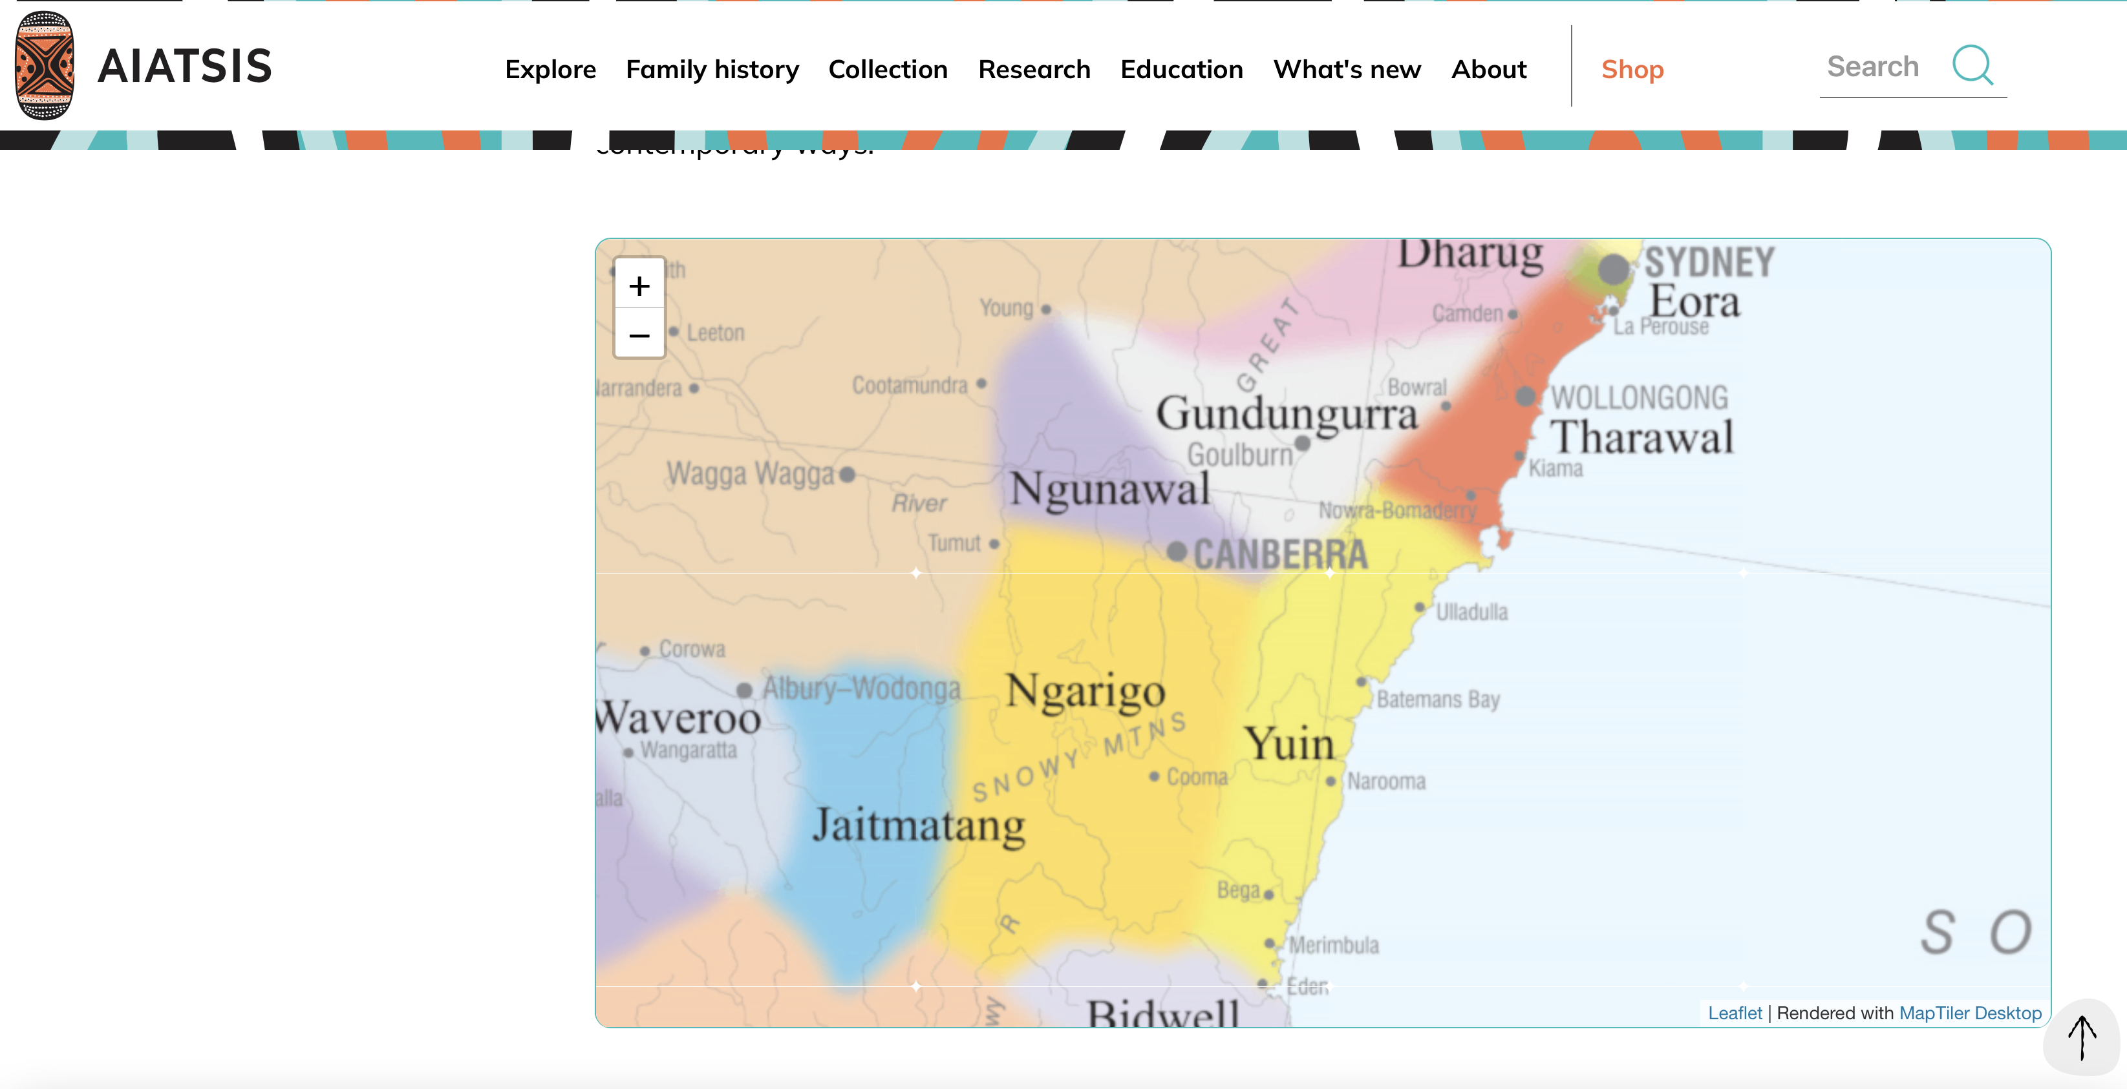
ANU Acknowledgment of Country
“We acknowledge and celebrate the First Australians on whose traditional lands we meet, and pay our respect to the elders past and present.”
https://aiatsis.gov.au/explore/map-indigenous-australia
Notes:
https://www.anu.edu.au/students/contacts/tjabal-indigenous-higher-education-centre
https://services.anu.edu.au/human-resources/respect-inclusion/anu-acknowledgment-of-country
https://www.indigenous.gov.au/contact-us/welcome_acknowledgement-country
https://aiatsis.gov.au/explore/map-indigenous-australia

Slide 3
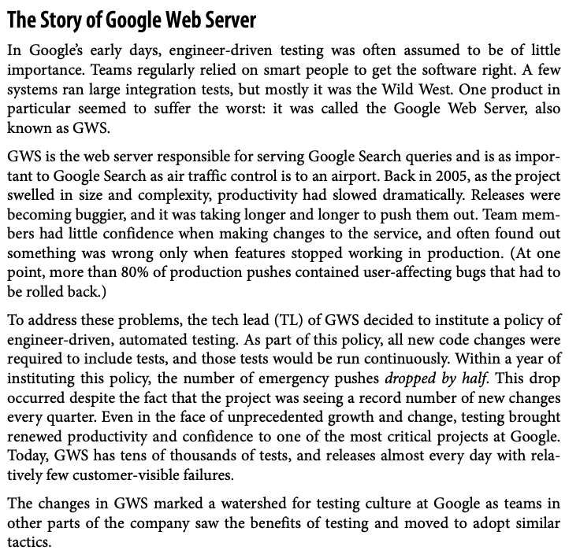

Slide 4
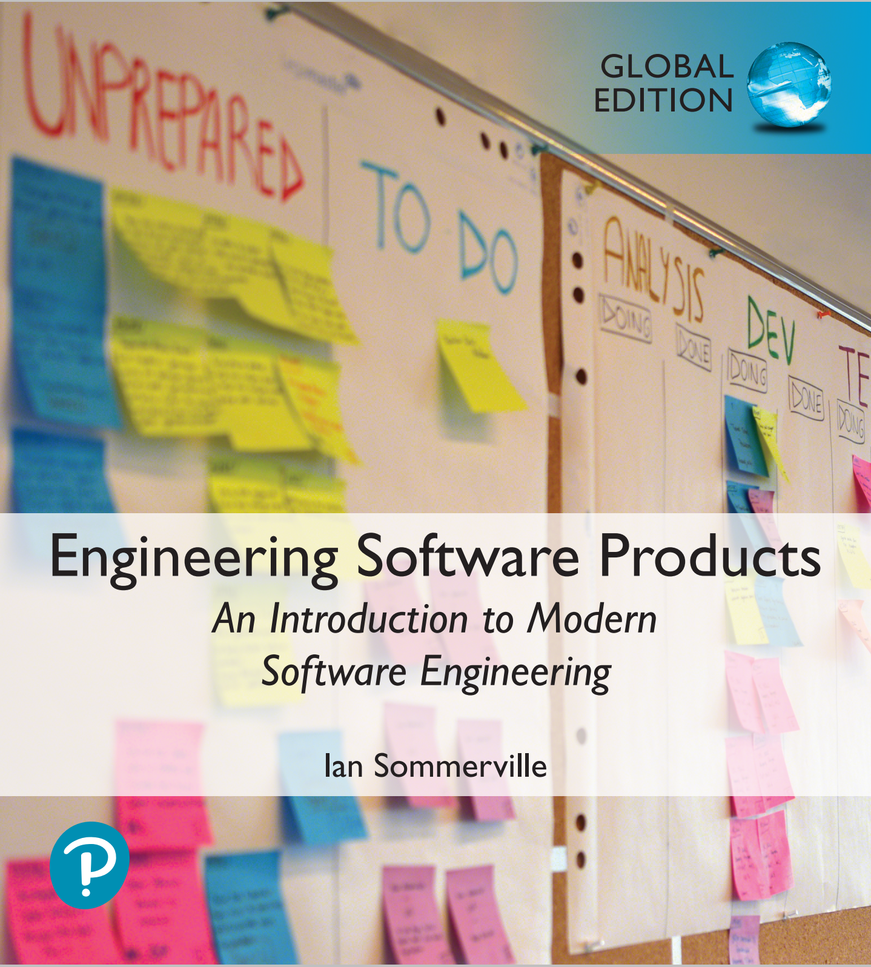
Software testing
Software testing is a process in which you execute your program using data that simulates user inputs.
You observe its behaviour to see whether or not your program is doing what it is supposed to do.
  Tests pass if the behaviour is what you expect. Tests fail if the behaviour differs from that expected.
  If your program does what you expect, this shows that for the inputs used, the program behaves correctly.
If these inputs are representative of a larger set of inputs, you can infer that the program will behave correctly for all members of this larger input set.

Slide 5
Program bugs
If the behaviour of the program does not match the behaviour that you expect, then this means that there are bugs in your program that need to be fixed.
There are two causes of program bugs:
  Programming errors You have accidentally included faults in your program code. For example, a common programming error is an ‘off-by-1’ error where you make a mistake with the upper bound of a sequence and fail to process the last element in that sequence.
  Understanding errors You have misunderstood or have been unaware of some of the details of what the program is supposed to do. For example, if your program processes data from a file, you may not be aware that some of this data is in the wrong format, so your program doesn’t include code to handle this.

Slide 6
Types of testing
Functional testing
Test the functionality of the overall system. The goals of functional testing are to discover as many bugs as possible in the implementation of the system and to provide convincing evidence that the system is fit for its intended purpose.
User testing
Test that the software product is useful to and usable by end-users. You need to show that the features of the system help users do what they want to do with the software. You should also show that users understand how to access the software’s features and can use these features effectively.
Performance and load testing
Test that the software works quickly and can handle the expected load placed on the system by its users. You need to show that the response and processing time of your system is acceptable to end-users. You also need to demonstrate that your system can handle different loads and scales gracefully as the load on the software increases.
Security testing
Test that the software maintains its integrity and can protect user information from theft and damage.

Slide 7
Functional testing
Functional testing involves developing a large set of program tests so that, ideally, all of a program’s code is executed at least once.
The number of tests needed obviously depends on the size and the functionality of the application.
For a business-focused web application, you may have to develop thousands of tests to convince yourself that your product is ready for release to customers.
Functional testing is a staged activity in which you initially test individual units of code. You integrate code units with other units to create larger units then do more testing.
The process continues until you have created a complete system ready for release.

Slide 8
Functional testing

Slide 9
Functional testing processes
Unit testing
The aim of unit testing is to test program units in isolation. Tests should be designed to execute all of the code in a unit at least once. Individual code units are tested by the programmer as they are developed.
Feature testing
Code units are integrated to create features. Feature tests should test all aspects of a feature. All of the programmers who contribute code units to a feature should be involved in its testing.
System testing
Code units are integrated to create a working (perhaps incomplete) version of a system. The aim of system testing is to check that there are no unexpected interactions between the features in the system. System testing may also involve checking the responsiveness, reliability and security of the system. In large companies, a dedicated testing team may be responsible for system testing. In small companies, this is impractical, so product developers are also involved in system testing.
Release testing
The system is packaged for release to customers and the release is tested to check that it operates as expected. The software may be released as a cloud service or as a download to be installed on a customer’s computer or mobile device. If DevOps is used, then the development team are responsible for release testing otherwise a separate team has that responsibility.

Slide 10
Unit testing
As you develop a code unit, you should also develop tests for that code.
A code unit is anything that has a clearly defined responsibility. It is usually a function or class method but could be a module that includes a small number of other functions.
Unit testing is based on a simple general principle:
  If a program unit behaves as expected for a set of inputs that have some shared characteristics, it will behave in the same way for a larger set whose members share these characteristics.
To test a program efficiently, you should identify sets of inputs (equivalence partitions) that will be treated in the same way in your code.
The equivalence partitions that you identify should not just include those containing inputs that produce the correct values. You should also identify ‘incorrectness partitions’ where the inputs are deliberately incorrect.

Slide 11
Equivalence partitions

Slide 12
A name checking function
def namecheck (s):
# Checks that a name only includes alphabetic characters, - or
# a single quote. Names must be between 2 and 40 characters long
# quoted strings and -- are disallowed
namex = r"^[a-zA-Z][a-zA-Z-']{1,39}$"
if re.match (namex, s):
if re.search ("'.*'", s) or re.search ("--", s):
return False
else:
return True
else:
return False

Slide 13
Equivalence partitions for
the name checking function
Correct names 1
The inputs only includes alphabetic characters and are between 2 and 40 characters long.
Correct names 2
The inputs only includes alphabetic characters, hyphens or apostrophes and are between 2 and 40 characters long.
Incorrect names 1
The inputs are between 2 and 40 characters long but include disallowed characters.
Incorrect names 2
The inputs include allowed characters but are either a single character or are more than 40 characters long.
Incorrect names 3
The inputs are between 2 and 40 characters long but the first character is a hyphen or an apostrophe.
Incorrect names 4
The inputs include valid characters, are between 2 and 40 characters long, but include either a double hyphen, quoted text or both.

Slide 14
Unit testing guidelines (1)
Test edge cases
If your partition has upper and lower bounds (e.g. length of strings, numbers, etc.) choose inputs at the edges of the range.
Force errors
Choose test inputs that force the system to generate all error messages. Choose test inputs that should generate invalid outputs.
Fill buffers
Choose test inputs that cause all input buffers to overflow.
Repeat yourself
Repeat the same test input or series of inputs several times.

Slide 15
Unit testing guidelines (2)
Overflow and underflow
If your program does numeric calculations, choose test inputs that cause it to calculate very large or very small numbers.
Don’t forget null and zero
If your program uses pointers or strings, always test with null pointers and strings. If you use sequences, test with an empty sequence. For numeric inputs, always test with zero.
Keep count
When dealing with lists and list transformation, keep count of the number of elements in each list and check that these are consistent after each transformation.
One is different
If your program deals with sequences, always test with sequences that have a single value.

Slide 16
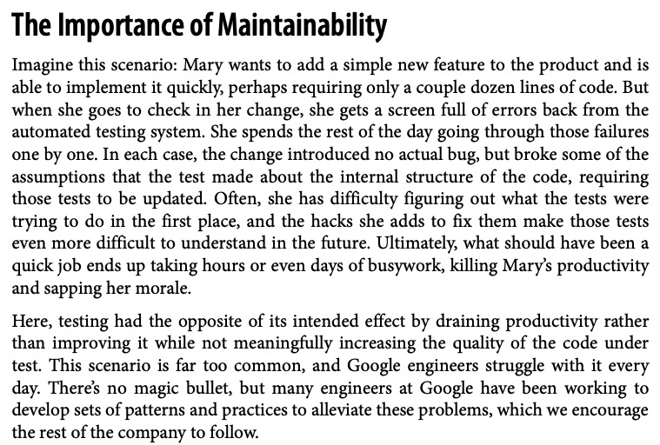
But, remember…

Slide 17
Feature testing
Features have to be tested to show that the functionality is implemented as expected and that the functionality meets the real needs of users.
  For example, if your product has a feature that allows users to login using their Google account, then you have to check that this registers the user correctly and informs them of what information will be shared with Google.
  You may want to check that it gives users the option to sign up for email information about your product.
Normally, a feature that does several things is implemented by multiple, interacting, program units.
These units may be implemented by different developers and all of these developers should be involved in the feature testing process.

Slide 18
Types of feature test
Interaction tests
  These test the interactions between the units that implement the feature. The developers of the units that are combined to make up the feature may have different understandings of what is required of that feature.
  These misunderstandings will not show up in unit tests but may only come to light when the units are integrated.
  The integration may also reveal bugs in program units, which were not exposed by unit testing.
Usefulness tests
  These test that the feature implements what users are likely to want.
  For example, the developers of a login with Google feature may have implemented an opt-out default on registration so that users receive all emails from a company. They must expressly choose what type of emails that they don’t want.
  What might be preferred is an opt-in default so that users choose what types of email they do want to receive.

Slide 19
User stories for the sign-in with Google feature
User registration
As a user, I want to be able to login without creating a new account so that I don’t have to remember another login id and password.
Information sharing
As a user, I want to know what information you will share with other companies. I want to be able to cancel my registration if I don’t want to share this information.
Email choice
As a user, I want to be able to choose the types of email that I’ll get from you when I register for an account.

Slide 20
Feature tests for sign-in with Google
Initial login screen
Test that the screen displaying a request for Google account credentials is correctly displayed when a user clicks on the ‘Sign-in with Google’ link. Test that the login is completed if the user is already logged in to Google.
Incorrect credentials
Test that the error message and retry screen is displayed if the user inputs incorrect Google credentials.
Shared information
Test that the information shared with Google is displayed, along with a cancel or confirm option. Test that the registration is cancelled if the cancel option is chosen.
Email opt-in
Test that the user is offered a menu of options for email information and can choose multiple items to opt-in to emails. Test that the user is not registered for any emails if no options are selected.

Slide 21
System and release testing
System testing involves testing the system as a whole, rather than the individual system features.
System testing should focus on four things:
  Testing to discover if there are unexpected and unwanted interactions between the features in a system.
  Testing to discover if the system features work together effectively to support what users really want to do with the system.
  Testing the system to make sure it operates in the expected way in the different environments where it will be used.
  Testing the responsiveness, throughput, security and other quality attributes of the system.

Slide 22
Scenario-based testing
The best way to systematically test a system is to start with a set of scenarios that describe possible uses of the system and then work through these scenarios each time a new version of the system is created.
Using the scenario, you identify a set of end-to-end pathways that users might follow when using the system.
An end-to-end pathway is a sequence of actions from starting to use the system for the task, through to completion of the task.

Slide 23
Choosing a holiday destination
Andrew and Maria have a two year old son and a four month old daughter. They live in Scotland and they want to have a holiday in the sunshine. However, they are concerned about the hassle of flying with young children. They decide to try a family holiday planner product to help them choose a destination that is easy to get to and that fits in with their childrens’ routines.
Maria navigates to the holiday planner website and selects the ‘find a destination’ page. This presents a screen with a number of options. She can choose a specific destination or can choose a departure airport and find all destinations that have direct flights from that airport. She can also input the time band that she’d prefer for flights, holiday dates and a maximum cost per person.
Edinburgh is their closest departure airport. She chooses ‘find direct flights’. The system then presents a list of countries that have direct flights from Edinburgh and the days when these flights operate. She selects France, Italy, Portugal and Spain and requests further information about these flights. She then sets a filter to display flights that leave on a Saturday or Sunday after 7.30am and arrive before 6pm.
She also sets the maximum acceptable cost for a flight. The list of flights is pruned according to the filter and is redisplayed. Maria then clicks on the flight she wants. This opens a tab in her browser showing a booking form for this flight on the airline’s website.

Slide 24
End-to-end pathways
User inputs departure airport and chooses to see only direct flights. User quits.
User inputs departure airport and chooses to see all flights. User quits.
User chooses destination country and chooses to see all flights. User quits.
User inputs departure airport and chooses to see direct flights. User sets filter specifying departure times and prices. User quits.
User inputs departure airport and chooses to see direct flights. User sets filter specifying departure times and prices. User selects a displayed flight and clicks through to airline website. User returns to holiday planner after booking flight.

Slide 25
Release testing
Release testing is a type of system testing where a system that’s intended for release to customers is tested.
The fundamental differences between release testing and system testing are:
  Release testing tests the system in its real operational environment rather than in a test environment. Problems commonly arise with real user data, which is sometimes more complex and less reliable than test data.
  The aim of release testing is to decide if the system is good enough to release, not to detect bugs in the system. Therefore, some tests that ‘fail’ may be ignored if these have minimal consequences for most users.
Preparing a system for release involves packaging that system for deployment (e.g. in a container if it is a cloud service) and installing software and libraries that are used by your product. You must define configuration parameters such as the name of a root directory, the database size limit per user and so on.

Slide 26
Test automation
Automated testing is based on the idea that tests should be executable.
An executable test includes the input data to the unit that is being tested, the expected result and a check that the unit returns the expected result.
You run the test and the test passes if the unit returns the expected result.
Normally, you should develop hundreds or thousands of executable tests for a software product.

Slide 27
Test methods for an interest calculator
# TestInterestCalculator inherits attributes and methods from the class
# TestCase in the testing framework unittest
class TestInterestCalculator (unittest.TestCase):
# Define a set of unit tests where each test tests one thing only
# Tests should start with test_ and the name should explain what is being tested
def test_zeroprincipal (self):
#Arrange - set up the test parameters
p = 0; r = 3; n = 31
result_should_be = 0
#Action - Call the method to be tested
interest = interest_calculator (p, r, n)
#Assert - test what should be true
self.assertEqual (result_should_be, interest)
def test_yearly_interest (self):
#Arrange - set up the test parameters
p = 17000; r = 3; n = 365
#Action - Call the method to be tested
result_should_be = 270.36
interest = interest_calculator (p, r, n)
#Assert - test what should be true
self.assertEqual (result_should_be, interest)

Slide 28
Automated tests
It is good practice to structure automated tests into three parts:
  Arrange You set up the system to run the test. This involves defining the test parameters and, if necessary, mock objects that emulate the functionality of code that has not yet been developed.
  Action You call the unit that is being tested with the test parameters.
  Assert You make an assertion about what should hold if the unit being tested has executed successfully. In program on the previous slide, we use assertEquals, which checks if its parameters are equal.
If you use equivalence partitions to identify test inputs, you should have several automated tests based on correct and incorrect inputs from each partition.

Slide 29
Executable tests for the
namecheck function
import unittest
from RE_checker import namecheck
class TestNameCheck (unittest.TestCase):
def test_alphaname (self):
self.assertTrue (namecheck ('Sommerville'))
def test_doublequote (self):
self.assertFalse (namecheck ("Thisis'maliciouscode'"))
def test_namestartswithhyphen (self):
self.assertFalse (namecheck ('-Sommerville'))
def test_namestartswithquote (self):
self.assertFalse (namecheck ("'Reilly"))
def test_nametoolong (self):
self.assertFalse (namecheck ('Thisisalongstringwithmorethen40charactersfrombeginningtoend'))
def test_nametooshort (self):
self.assertFalse (namecheck ('S'))
def test_namewithdigit (self):
self.assertFalse (namecheck('C-3PO'))
def test_namewithdoublehyphen (self):
self.assertFalse (namecheck ('--badcode'))

Slide 30
Executable tests for the
namecheck function
def test_namewithhyphen (self):
self.assertTrue (namecheck ('Washington-Wilson'))
def test_namewithinvalidchar (self):
self.assertFalse (namecheck('Sommer_ville'))
def test_namewithquote (self):
self.assertTrue (namecheck ("O'Reilly"))
def test_namewithspaces (self):
self.assertFalse (namecheck ('Washington Wilson'))
def test_shortname (self):
self.assertTrue ('Sx')
def test_thiswillfail (self):
self.assertTrue (namecheck ("O Reilly"))

Slide 31
Code to run unit tests from files
import unittest
loader = unittest.TestLoader()
#Find the test files in the current directory
tests = loader.discover('.')
#Specify the level of information provided by the test runner
testRunner = unittest.runner.TextTestRunner(verbosity=2)
testRunner.run(tests)

Slide 32
The test pyramid

Slide 33
Automated feature testing
Generally, users access features through the product’s graphical user interface (GUI).
However, GUI-based testing is expensive to automate so it is best to design your product so that its features can be directly accessed through an API and not just from the user interface.
The feature tests can then access features directly through the API without the need for direct user interaction through the system’s GUI.
Accessing features through an API has the additional benefit that it is possible to re-implement the GUI without changing the functional components of the software.

Slide 34
Feature editing through an API

Slide 35
System testing
System testing, which should follow feature testing, involves testing the system as a surrogate user.
As a system tester, you go through a process of selecting items from menus, making screen selections, inputting information from the keyboard and so on.
You are looking for interactions between features that cause problems, sequences of actions that lead to system crashes and so on.
Manual system testing, when testers have to repeat sequences of actions, is boring and error-prone. In some cases, the timing of actions is important and is practically impossible to repeat consistently.
  To avoid these problems, testing tools have been developed that can record a series of actions and automatically replay these when a system is retested

Slide 36
Interaction recording and playback

Slide 37
Test-driven development
Test-driven development (TDD) is an approach to program development that is based around the general idea that you should write an executable test or tests for code that you are writing before you write the code.
It was introduced by early users of the Extreme Programming agile method, but it can be used with any incremental development approach.
Test-driven development works best for the development of individual program units and it is more difficult to apply to system testing.
Even the strongest advocates of TDD accept that it is challenging to use this approach when you are developing and testing systems with graphical user interfaces.

Slide 38
Test-driven development

Slide 39
Stages of test-driven development (1)
Identify partial implementation
Break down the implementation of the functionality required into smaller mini-units. Choose one of these mini-units for implementation.
Write mini-unit tests
Write one or more automated tests for the mini-unit that you have chosen for implementation. The mini-unit should pass these tests if it is properly implemented.
Write a code stub that will fail test
Write incomplete code that will be called to implement the mini-unit. You know this will fail.
Run all existing automated tests
All previous tests should pass. The test for the incomplete code should fail.

Slide 40
Stages of test-driven development (2)
Implement code that should cause the failing test to pass
Write code to implement the mini-unit, which should cause it to operate correctly
Rerun all automated tests
If any tests fail, your code is probably incorrect. Keep working on it until all tests pass.
Refactor code if necessary
If all tests pass, you can move on to implementing the next mini-unit. If you see ways of improving your code, you should do this before the next stage of implementation.

Slide 41
Benefits of test-driven development
It is a systematic approach to testing in which tests are clearly linked to sections of the program code.
  This means you can be confident that your tests cover all of the code that has been developed and that there are no untested code sections in the delivered code. In my view, this is the most significant benefit of TDD.
The tests act as a written specification for the program code. In principle at least, it should be possible to understand what the program does by reading the tests.
Debugging is simplified because, when a program failure is observed, you can immediately link this to the last increment of code that you added to the system.
It is argued that TDD leads to simpler code as programmers only write code that’s necessary to pass tests. They don’t over-engineer their code with complex features that aren’t needed.

Slide 42
Sommerville’s reasons for not using TDD
TDD discourages radical program change
I found that I was reluctant to make refactoring decisions that I knew would cause many tests to fail. I tended to avoid radical program change for this reason.
I focused on the tests rather than the problem I was trying to solve
A basic principle of TDD is that your design should be driven by the tests you have written. I found that I was unconsciously redefining the problem I was trying to solve to make it easier to write tests. This meant that I sometimes didn’t implement important checks, because it was difficult to write tests in advance of their implementation.
I spent too much time thinking about implementation details rather than the programming problem
Sometimes when programming, it is best to step back and look at the program as a whole rather than focusing on implementation details. TDD encourages a focus on details that might cause tests to pass or fail and discourages large-scale program revisions.
It is hard to write ‘bad data’ tests
Many problems involving dealing with messy and incomplete data. It is practically impossible to anticipate all of the data problems that might arise and write tests for these in advance. You might argue that you should simply reject bad data but this is sometimes impractical.

Slide 43
Security testing
Security testing aims to find vulnerabilities that may be exploited by an attacker and to provide convincing evidence that the system is sufficiently secure.
The tests should demonstrate that the system can resist attacks on its availability, attacks that try to inject malware and attacks that try to corrupt or steal users’ data and identity.
Comprehensive security testing requires specialist knowledge of software vulnerabilities and approaches to testing that can find these vulnerabilities.

Slide 44
Risk-based security testing
A risk-based approach to security testing involves identifying common risks and developing tests to demonstrate that the system protects itself from these risks.
You may also use automated tools that scan your system to check for known vulnerabilities, such as unused HTTP ports being left open.
Based on the risks that have been identified, you then design tests and checks to see if the system is vulnerable.
It may be possible to construct automated tests for some of these checks, but others inevitably involve manual checking of the system’s behaviour and its files.

Slide 45
Examples of security risks
Unauthorized attacker gains access to a system using authorized credentials
Authorized individual accesses resources that are forbidden to them
Authentication system fails to detect unauthorized attacker
Attacker gains access to database using SQL poisoning attack
Improper management of HTTP session
HTTP session cookies revealed to attacker
Confidential data are unencrypted
Encryption keys are leaked to potential attackers

Slide 46
Risk analysis
Once you have identified security risks, you then analyze them to assess how they might arise. For example, for the first risk two slides earlier (unauthorized attacker) there are several possibilities:
  The user has set weak passwords that can be guessed by an attacker.
  The system’s password file has been stolen and passwords discovered by attacker.
  The user has not set up two-factor authentication.
  An attacker has discovered credentials of a legitimate user through social engineering techniques.
You can then develop tests to check some of these possibilities.
  For example, you might run a test to check that the code that allows users to set their passwords always checks the strength of passwords.

Slide 47
Mini Break in Monday Lecture

Slide 48
Remember Code Reviews?
Code reviews involve one or more people examining the code to check for errors and anomalies and discussing issues with the developer.
If problems are identified, it is the developer’s responsibility to change the code to fix the problems.
Code reviews complement testing. They are effective in finding bugs that arise through misunderstandings and bugs that may only arise when unusual sequences of code are executed.
Many software companies insist that all code has to go through a process of code review before it is integrated into the product codebase.

Slide 49
Code reviews

Slide 50
Code review activities (1)
Setup review
The programmer contacts a reviewer and arranges a review date.
Prepare code
The programmer collects the code and tests for review and annotates them with information for the reviewer about the intended purpose of the code and tests.
Distribute code/tests
The programmer sends code and tests to the reviewer.
Check code
The reviewer systematically checks the code and tests against their understanding of what they are supposed to do.
Write review report
The reviewer annotates the code and tests with a report of the issues to be discussed at the review meeting.

Slide 51
Code review activities (2)
Discussion
The reviewer and programmer discuss the issues and agree on the actions to resolve these.
Make to-do list
The programmer documents the outcome of the review as a to-do list and shares this with the reviewer.
Make code changes
The programmer modifies their code and tests to address the issues raised in the review.

Slide 52
Part of a checklist for
a Python code review
Are meaningful variable and function names used? (General)
Meaningful names make a program easier to read and understand.
Have all data errors been considered and tests written for them? (General)
It is easy to write tests for the most common cases but it is equally important to check that the program won’t fail when presented with incorrect data.
Are all exceptions explicitly handled? (General)
Unhandled exceptions may cause a system to crash.
Are default function parameters used? (Python)
Python allows default values to be set for function parameters when the function is defined. This often leads to errors when programmers forget about or misuse them.
Are types used consistently? (Python)
Python does not have compile-time type checking so it it is possible to assign values of different types to the same variable. This is best avoided but, if used, it should be justified.
Is the indentation level correct? (Python)
Python uses indentation rather than explicit brackets after conditional statements to indicate the code to be executed if the condition is true or false. If the code is not properly indented in nested conditionals this may mean that incorrect code is executed.

Slide 53
Intro to QA and Testing (TAKE 2 ☺)
Michael Hilton and Rohan Padhye

Slide 54
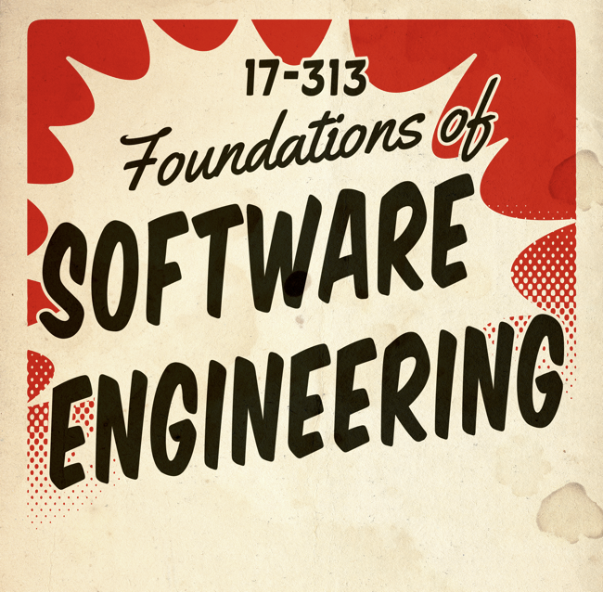
What is Testing???
What is testing?
  Execution of code on sample inputs in a controlled environment
Principle goals:
  Validation: program meets requirements, including quality attributes.
  Defect testing: reveal failures.
Other goals:
  Reveal bugs (main goal)
  Assess quality (hard to quantify)
  Clarify the specification, documentation
  Verify contracts
Notes:
We’ve mentioned Quality Assurance (QA) and Software Testing many times in this class, but what do we really mean by software testing? What is it, why should we do it, what should test, how should one write tests, when should you run tests, and what are the limitations of testing? We’ll explore all that today.

Slide 55
What is Testing???
What can we test for? (Software quality attributes)
  What can we not test for?
Why should we test? What does testing achieve?
  What does testing not achieve?
When should we test?
  And where should we run the tests?
What should we test?
  What CAN we test?
How should we test?
  How many ways can you test the sort() function?
How good are our tests?
  How to measure test quality?
Notes:
Instructor tip: Only include the subsequent question slides and not their following “answer” slides in the PDF posted to the website before class, so that students actually attempt to think for themselves.

Slide 56
What can we run (automated) tests for?
(Software Quality attributes)
Notes:
Possible examples:
Correctness
Performance
Reliability
Security (maybe?)
Maintainability (!!!!!!!!! indirect effect)

Slide 57
What can we not (easily) test for?
(Software Quality attributes)
Notes:
Can’t prove correctness or other quality attributes over all cases; can only measure a sample
Only as good as the tests you write – will come back to Oracle Problem
Testing does not validate specifications / requirements

Slide 58
Things we might try to test
Program/system functionality:
  Execution space (white box).
  Input or requirements space (black box).
The expected user experience (usability).
  GUI testing, A/B testing
The expected performance envelope (performance, reliability, robustness, integration).
  Security, robustness, fuzz, and infrastructure testing.
  Performance and reliability: soak and stress testing.
  Integration and reliability: API/protocol testing

Slide 59
Software Errors
Functional errors
Performance errors
Deadlock
Race conditions
Boundary errors
Buffer overflow
Integration errors
Usability errors
Robustness errors
Load errors
Design defects
Versioning and configuration errors
Hardware errors
State management errors
Metadata errors
Error-handling errors
User interface errors
API usage errors
…

Slide 60
Why should we test?
(What does testing help us achieve?)
Notes:
Improve software quality attributes, yes. But how?
Expected answer: ensure that our software meets requirements, is correct, etc.
Thinking deeper: real value in testing is in preventing bugs or quality degradations from being accidentally introduced in the future
Testing also helps us bridge the gap between a declarative view of the system (i.e., requirements) and an imperative view (i.e., implementation). Testing provides redundancy.
Testing helps uncover unexpected behaviors that can’t be identified by reading source code

Slide 61
Value of Testing
[Low bar] Ensure that our software meets requirements, is correct, etc.
Preventing bugs or quality degradations from being accidentally introduced in the future
Helps uncover unexpected behaviors that can’t be identified by reading source code
Increased confidence in changes (“will I break the internet with this commit?”)
Bridges the gap between a declarative view of the system (i.e., requirements) and an imperative view (i.e., implementation) by means of redundancy.
Tests are executable documentation; increases code maintainability
Forces writing testable code <-> checks software design

Slide 62
What are the limitations of testing?
(What does testing not achieve?)
Notes:
Can’t prove correctness or other quality attributes over all cases; can only measure a sample
Only as good as the tests you write – will come back to Oracle Problem
Testing does not validate specifications / requirements

Slide 63
Limitations of Testing
"Testing shows the presence, not the absence of bugs.”
-Edsger W. Dijkstra
Testing doesn’t really give any formal assurances
Writing tests is hard, time consuming
Knowing if your tests are good enough is not obvious
Executing tests can be expensive, especially as software complexity and configuration space grows
  Full test suite for a single large app can take several days to run
Halting Problem

Slide 64
When should we test?
(And where should we run the tests?)
Notes:
At release time? After every code change? After writing new code? Before writing new code? Before/after merging? In production?

Slide 65
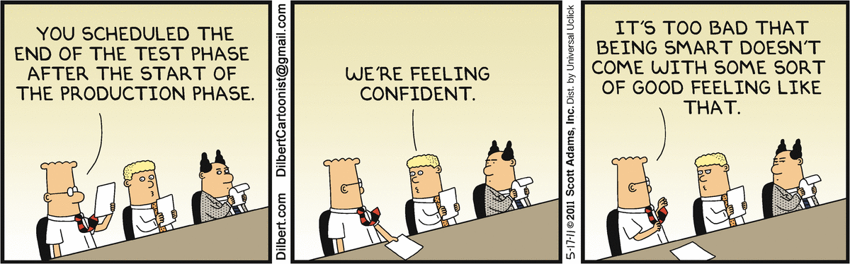

Slide 66
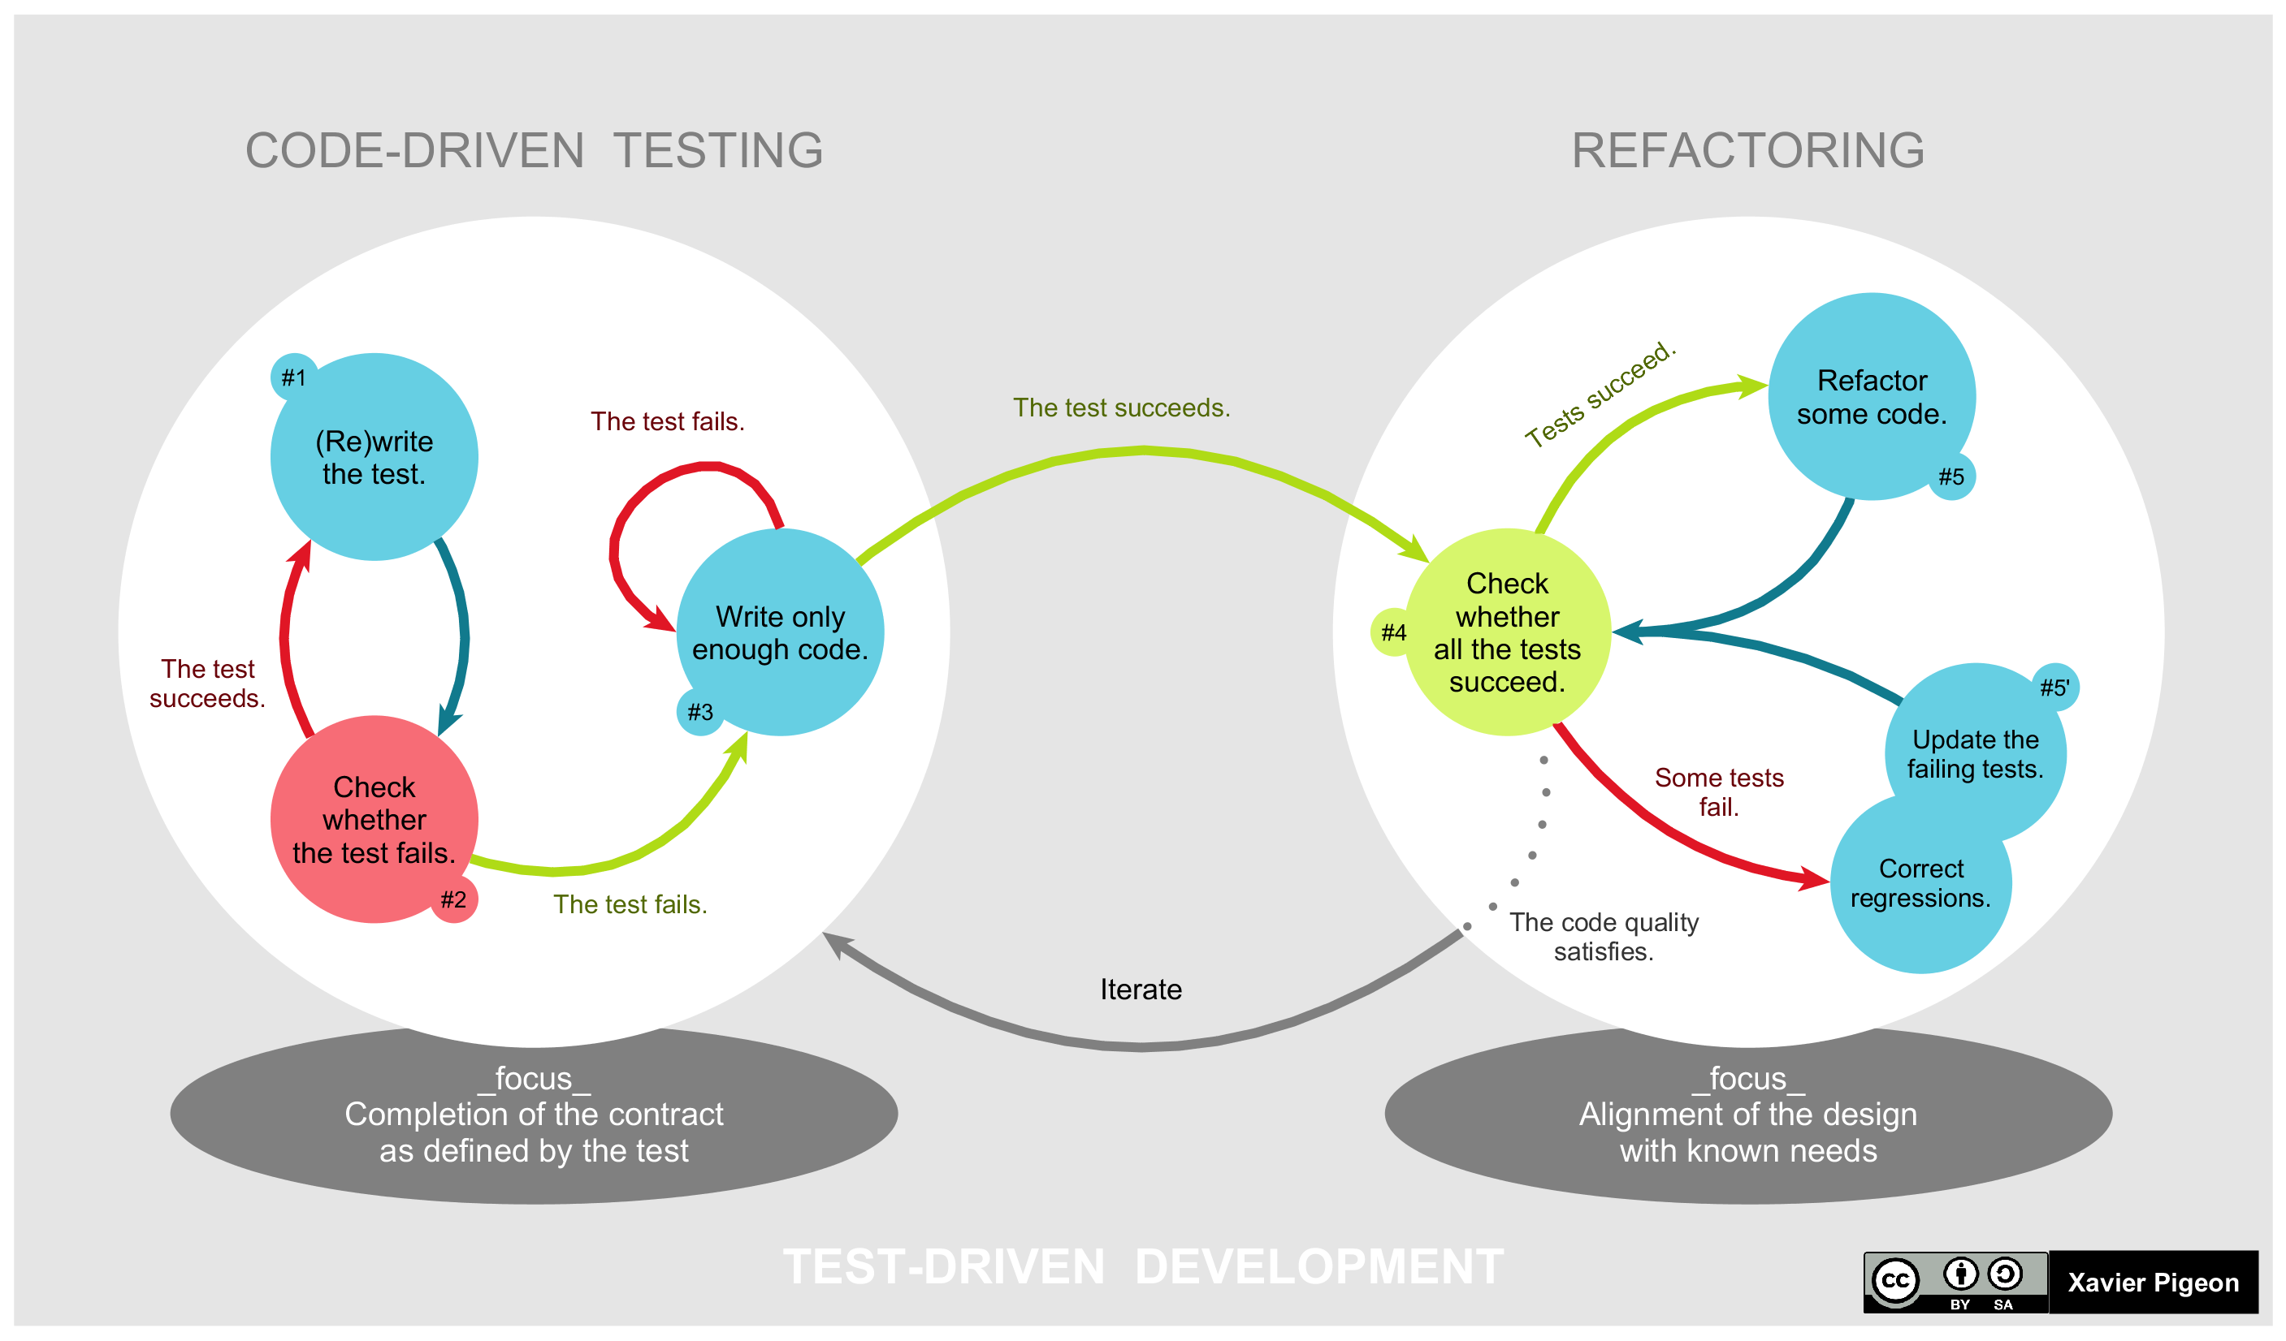
Test Driven Development (TDD)
Tests first!
Popular agile technique
Write tests as specifications before code
Never write code without a failing test
Claims:
  Design approach toward testable design
  Think about interfaces first
  Avoid unneeded code
  Higher product quality
  Higher test suite quality
  Higher overall productivity
Notes:
TDD principles can also be applied to code contribution guidelines (e.g. do not commit without accompanying tests; tests must fail on old version and pass on new version)

Slide 67
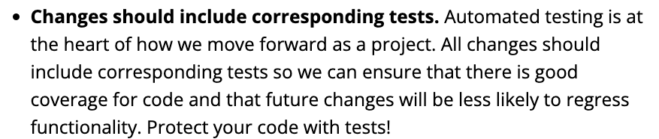
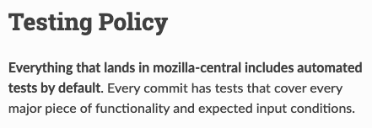
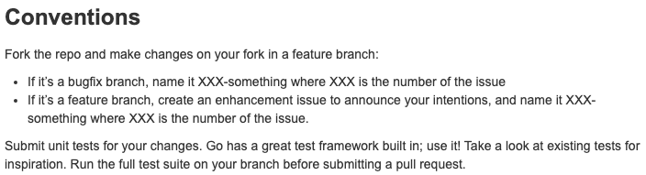
Common bar for contributions
Chromium
Firefox
Docker

Slide 68
Regression testing
Usual model:
  Introduce regression tests for bug fixes, etc.
  Compare results as code evolves
    Code1 + TestSet → TestResults1
    Code2 + TestSet → TestResults2
  As code evolves, compare TestResults1 with TestResults2, etc.
Benefits:
  Ensure bug fixes remain in place and bugs do not reappear.
  Reduces reliance on specifications, as <TestSet,TestResults1> acts as one.

Slide 69
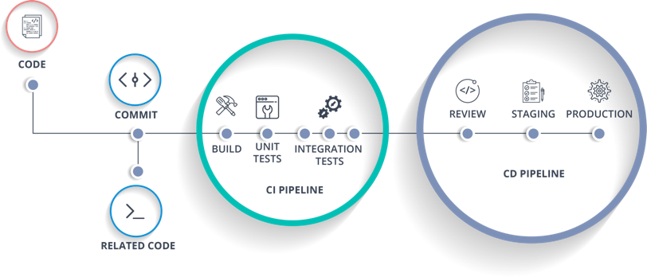
Continuous Integration

Slide 70
What should we test?
(What CAN we test?)
Notes:
What should be the granularity of testing?
Functions? Classes? Modules? Features? Software design? Software architecture?
Code? Data? Scripts? Other artifacts?
Can we test requirements / specification?

Slide 71
Testing Levels
Unit testing
Integration testing
System testing
Notes:
Unit testing is white box
System testing is black box
Integration testing blurs the line and sometimes hard to define
Unit on single process (no I/O), integration on single node (no network), E2E can be distributed but that’s costly
Testing in production provides real data but comes with risks

Slide 72
Testing Levels
Unit testing
  Code level, E.g. is a function implemented correctly?
  Does not require setting up a complex environment
Integration testing
  Do components interact correctly? E.g. a feature that cuts across client and server.
  Usually requires some environment setup, but can abstract/mock out other components that are not being tested (e.g. network)
System testing
  Validating the whole system end-to-end (E2E)
  Requires complete deployment in a staging area, but fake data
Testing in production
  Real data but more risks
Notes:
Unit testing is white box
System testing is black box
Integration testing blurs the line and sometimes hard to define
Unit on single process (no I/O), integration on single node (no network), E2E can be distributed but that’s costly
Testing in production provides real data but comes with risks

Slide 73
What’s a good distribution of test levels?
E2E
Integration
Unit
E2E
Integration
Unit
Notes:
Right side is an anti-pattern: easier to write E2E tests, but they are slow and takes longer for defects to be identified and debugged
Also bad: hourglass shape (lots of E2E and unit tests but few integration tests)
Left side is good: Lots of unit tests,

Slide 74
How good are our tests?
(How can we measure test quality?)

Slide 75
Code Coverage
Line coverage
Statement coverage
Branch coverage
Instruction coverage
Basic-block coverage
Edge coverage
Path coverage
…
‘X’ coverage = Number of ‘X’ executed / Total number of ‘X’ in program

Slide 76
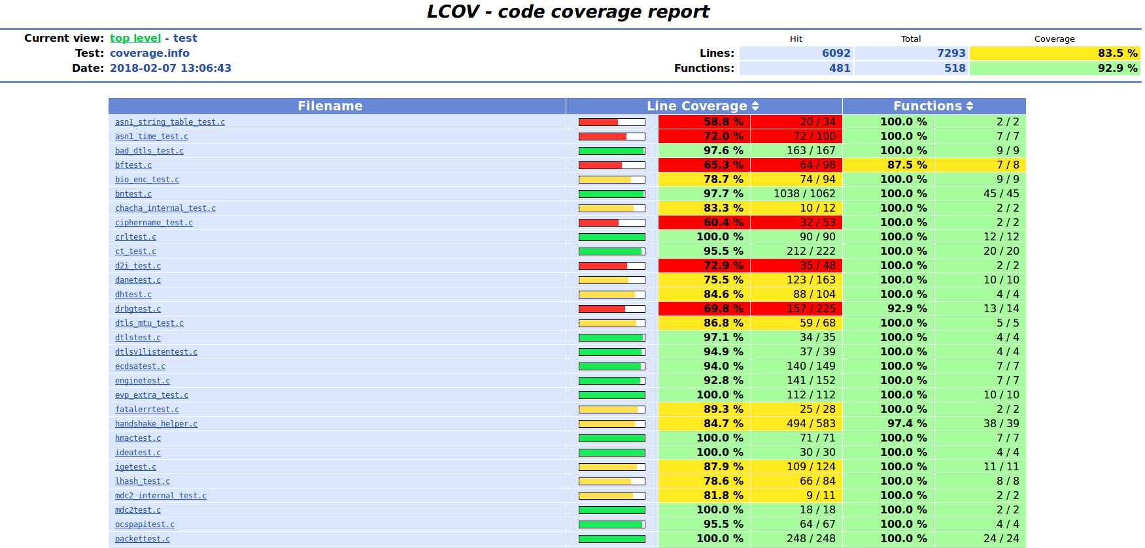
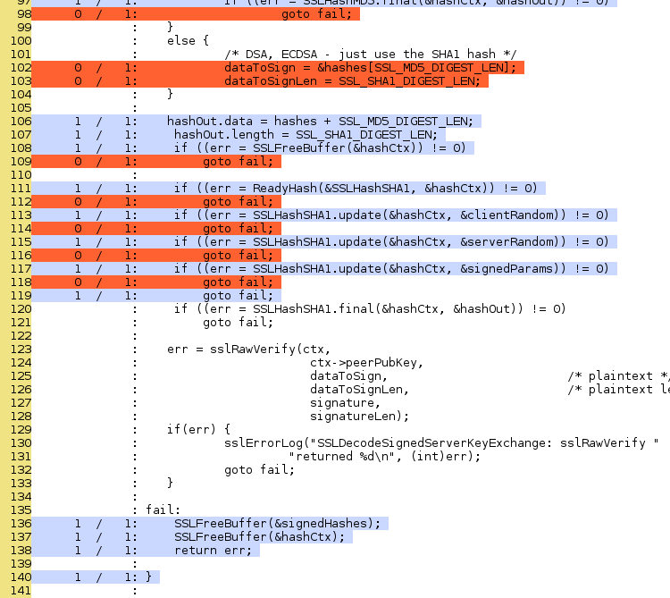
Code Coverage
Notes:
Measure quality of test inputs
Track fuzzing progress
Use as guide for tuning heuristics (more seeds, better mutations, etc.)
Tools: gcov, lcov
Granularity: line coverage, stmt coverage, branch coverage

Slide 77
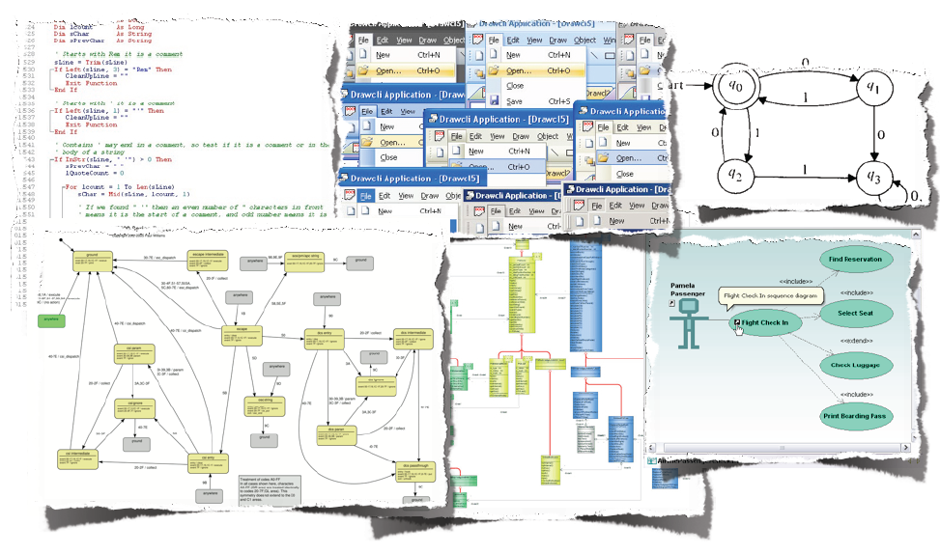
We can measure coverage on almost anything
A. Zeller, Testing and Debugging Advanced course, 2010
Notes:
We can measure coverage on any artifact produced during software development, e.g., structural coverage of source code, coverage of input space, coverage of complex inputs - e.g., grammar based, coverage of specification, coverage of test models, coverage of requirements, coverage of GUI elements, ...EXAMPLES THAT YOU REMEMBER?

Slide 78
Beware of coverage chasing
Recall: issues with metrics and incentives
Also: Numbers can be deceptive
  100% coverage != exhaustively tested
“Coverage is not strongly correlated with suite effectiveness”
  Based on empirical study on GitHub projects [Inozemtseva and Holmes, ICSE’14]
Still, it’s a good low bar
  Code that is not executed has definitely not been tested

Slide 79
Coverage of what?
Distinguish code being tested and code being executed
Library code >>>> Application code
  Can selectively measure coverage
All application code >>> code being tested
  Not always easy to do this within an application
Notes:
E.g. testing a button click on a web page or other GUI app will probably run 10s of thousands of code (e.g. browser, JS, or Android app framework)

Slide 80
Coverage != Outcome
What’s better, tests that always pass or tests that always fail?
Tests should ideally be falsifiable. Boundary determines specification
Ideally:
  Correct implementations should pass all tests
  Buggy code should fail at least one test
  Intuition behind mutation testing
What if tests have bugs?
  Pass on buggy code or fail on correct code
Even worse: flaky tests
  Pass or fail on the same test case nondeterministically
What’s the worst type of test?

Slide 81
How should we test?

Slide 82
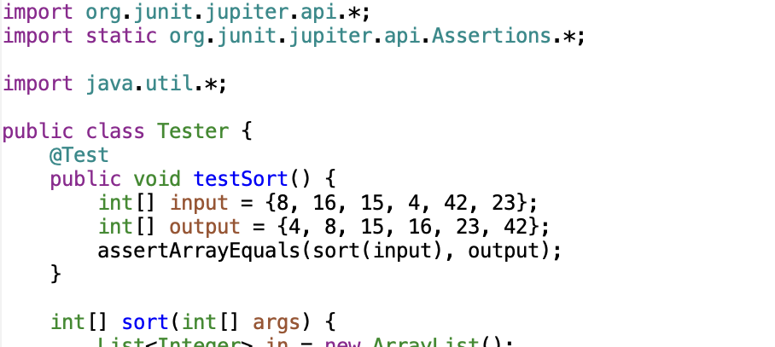
JUnit
Popular unit-testing framework for Java
Easy to use
Tool support available (Maven, Gradle, etc.)
Can be used as design mechanism
Notes:
import org.junit.jupiter.api.*;
import static org.junit.jupiter.api.Assertions.*;
import java.util.*;
public class Tester {
@Test
public void testSort() {
int[] input = {8, 16, 15, 4, 42, 23};
int[] output = {4, 8, 15, 16, 23, 42};
assertArrayEquals(sort(input), output);
}
int[] sort(int[] args) {
List<Integer> in = new ArrayList();
for (int i : args) in.add(i);
Collections.sort(in);
int[] out = new int[args.length];
for (int i = 0; i < out.length; i++) out[i] = in.get(i);
return out;
}
}
alex@kanga TestingExamples % cat compile.sh
#!/bin/sh
javac -cp junit-platform-console-standalone-1.9.1.jar Tester.java
alex@kanga TestingExamples % cat run.sh
#!/bin/sh
java -jar junit-platform-console-standalone-1.9.1.jar --class-path . --scan-class-path

Slide 83
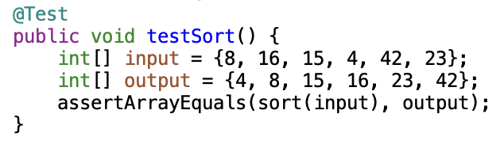
Basic Elements of a Test
Tests usually need an input and expected output.
More generally, a test environment, a test harness, and a test oracle
  Environment: Resources needed to execute a family of tests
  Harness: Triggers execution of a test case (aka entry point)
  Oracle: A mechanism for determining whether a test was successful
Notes:
Environment could be: set-up a server, VM, docker, database, import libraries, etc.
Harness could be: Boilerplate code to issue a request, query, command, or simply creating objects and invoking public functions. May involve mocks.
Oracle could be: explicit asserts or implicit (shouldn’t throw run-time errors)

Slide 84
Test Design principles
Use public APIs only
Clearly distinguish inputs, configuration, execution, and oracle
Be simple; avoid complex control flow such as conditionals and loops
Tests shouldn’t need to be frequently changed or refactored
  Definitely not as frequently as the code being tested changes

Slide 85
Anti-patterns
Snoopy oracles
  Relying on implementation state instead of observable behavior
  E.g. Checking variables or fields instead of return values
Brittle tests
  Overfitting to special-case behavior instead of general principle
  E.g. hard-coding message strings instead of behavior
Slow tests
  Self-explanatory (beware of heavy environments, I/O, and sleep())
Flaky tests
  Tests that pass or fail nondeterministically
  Often because of reliance on random inputs, timing (e.g. sleep(1000)), availability of external services (e.g. fetching data over the network in a unit test), or dependency on order of test execution (e.g. previous test sets up global variables in certain way)

Slide 86
Test Strategies
Michael Hilton and Rohan Padhye
Notes:
Source code for live demo: https://github.com/CMU-313/sort-tests

Slide 87
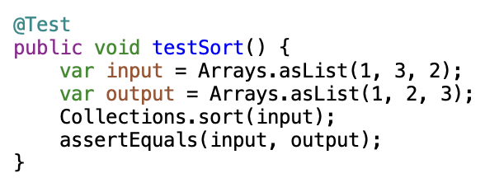
Basic Unit Test for Sort
What are some interesting values to test?
  List tuples <input, output, reason>
Is this test good enough?
Notes:
Take suggestions from students but don’t show the BoundaryValueTest first.

Slide 88
Black-box & Specification-Based Testing
Test cases are often designed based on behavioral equivalence classes.
  Assumption: if test passes for one value => test will pass for all values in the equivalence class.
Systematic tests can be drawn from specification.
  For example: A year is a leap year if:
    the year is divisible by 4;
    and the year is not divisible by 100;
      except when the year is divisible by 400
  Tests:
    assert isLeapYear(1945) == false
    assert isLeapYear(1944) == true
    assert isLeapYear(1900) == false
    assert isLeapYear(2000) == true

Slide 89
Boundary-Value Testing
Aim: Test for cases that are at the “boundary” of equivalence classes in the specification.
  Small change in input moves it from one class to another.
  Example: Testing a function divide(int a, int b)
    One boundary may be at `a == b`
Edge case: One of many parameters are at the boundary
  E.g. for divide: a=0, b=42 or a=42, b = 0
  E.g. for sort: list contains duplicates, list is empty
Corner case: Combination of parameters are at the boundary
  E.g. for divide: a=0, b=0
Notes:
Maybe draw a rectangle on the board to emphasize edge-case and corner-case testing.
Show live demo of boundary tests after this.

Slide 90
White-box or Structural Testing
Aim: Test for cases that exercise various program elements (e.g. functions, lines, statements, branches)
Key idea: If you don’t execute some code, you can’t find bugs in that code. So, let’s execute all the code.
Which one do you think is harder: black-box boundary-value testing or white-box structural testing?

Slide 91
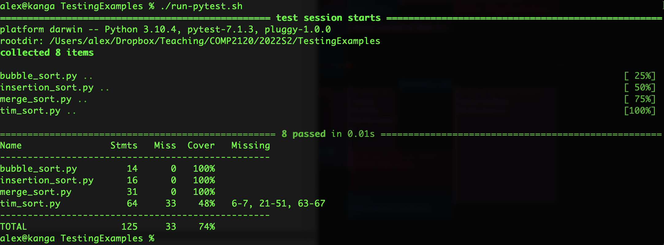
Coverage of the Basic Unit Test
Notes:
After showing this slide, switch to demo: try to increase TimSort coverage by identifying that a list with size > 32 is needed. Maybe get values from students to show hard it is to create an input-output example.

Slide 92
Coverage != Completeness
But the basic unit test worked well
for Merge and otherSort….
Notes:
Switch to demo. Show how even the initial test gets full coverage on Quicksort.

Slide 93
Mutation Testing
Key idea: Inject bugs in the program by mutating the source code.
Ideally: at least one test should fail on the mutated program (= catch bug).
  If this happens, the mutant is said to be “killed”.
  If all tests continue to pass under the mutated program, then the mutant is said to “survive”.
  Mutation score = (mutants killed) / (total mutants). This is a better predictor of bug-finding capability than coverage.
Competent programmer assumption: programs are mostly correct, except for very small errors.
  Shows that tests are falsifiable at the boundary of implementation (as opposed to boundary of specification).

Slide 94
Mutation Testing
Sample mutations include:
  Change ‘a + b’ to ‘a – b’
  Change ‘if (a > b)’ to ‘if (a >= b)’ or ‘if(b > a)’
  Change ‘i++’ to ‘i—’
  Replace integer variables with 0
  Change ‘return x’ to ‘return True’ (or some other constant)
  Delete lines containing void method calls (e.g. ‘x.setFoo(1)’)
  … and many more
Over time, standard list of mutators curated by researchers
Pitest is a popular mutation testing tool for Java (pitest.org)

Slide 95
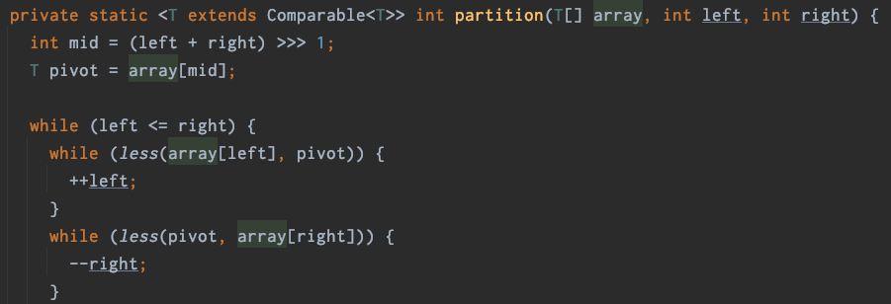
Mutation Testing
Nice idea but has several limitations:
  Equivalent mutations: Modifications that do not affect program semantics (e.g. affecting the pivot in Quicksort).
  Needs a pretty complete test oracle: Otherwise, some genuine bugs may never be caught. We’ll come back to this point later.
  Expensive to run. N mutants require N test executions. Program testing costs scale quadratically (because N also grows with size).
Notes:
Consider changing `pivot = array[mid]` to `pivot = array[0]`. No tests will fail.

Slide 96
Test Oracles
Obvious in some applications (e.g. “sort()”) but more challenging in others (e.g. “encrypt()” or UI-based tests)
Lack of good oracles can limit the scalability of testing. Easy to generate lots of input data, but not easy to validate if output (or other program behavior) is correct.
Fortunately, we have some tricks.

Slide 97
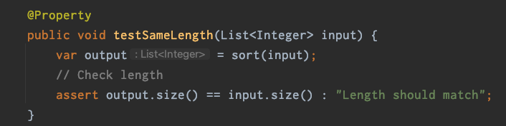
Property-Based Testing
Intends to validate invariants that are always true of a computed result.
  E.g. if testing a list-reversing function called `rev`, then we have the invariant: `rev(rev(list)).equals(list)`
Key idea: Can now easily scale testing to very large data sets, either hand-written or automatically generated, without the need for hard-coding expected outputs completely.

Slide 98
Differential Testing
If you have two implementations of the same specification, then their output should match on all inputs.
  E.g. `timSort(x).equals(quickSort(x))` → should always be true
  Special case of a property test, with a free oracle.
If a differential test fails, at least one of the two implementations is wrong.
  But which one?
  If you have N > 2 implementations, run them all and compare. Majority wins (the odd one out is buggy).
Differential testing works well when testing programs that implement standard specifications such as compilers, browsers, SQL engines, XML/JSON parsers, media players, etc.
  Not feasible in general
Notes:
Switch to demo, and show class DifferentialTest
Single diff test: no need to specify expected output
Differential property-based test: no need to specify input, output, or oracle! (the property/oracle is implicit in differential testing)

Slide 99
Regression Testing
Differential testing through time (or versions, say V1 and V2).
Assuming V1 and V2 don’t add a new feature or fix a known bug, then f(x) in V1 should give the same result as f(x) in V2.
Key Idea: Assume the current version is correct. Run program on current version and log output. Compare all future versions to that output.
Notes:
Show demo of RegressionTest --- output hashCode is taken.

Slide 100


Slide 101
Google’s Testing on the Toilet
https://testing.googleblog.com/search/label/TotT

Slide 102
What Happens Next Week (Week 9)
Work with your TUTOR to pick Open Source Project and Issue(s) to work on for GA3 and get them pre-approved.

Slide 103
Key Points
The aim of program testing is to find bugs and to show that a program does what its developers expect it to do.
Four types of testing that are relevant to software products are functional testing, user testing, load and performance testing and security testing.
Unit testing involves testing program units such as functions or class methods that have a single responsibility. Feature testing focuses on testing individual system features. System testing tests the system as a whole to check for unwanted interactions between features and between the system and its environment.
Identifying equivalence partitions, in which all inputs have the same characteristics, and choosing test inputs at the boundaries of these partitions, is an effective way of finding bugs in a program.
User stories may be used as a basis for deriving feature tests.
Test automation is based on the idea that tests should be executable. You develop a set of executable tests and run these each time you make a change to a system.

Slide 104
Key Points
The structure of an automated unit test should be arrange-action-assert. You set up the test parameters, call the function or method being tested, and make an assertion of what should be true after the action has been completed.
Test-driven development is an approach to development where executable tests are written before the code. Code is then developed to pass the tests.
A disadvantage of test-driven development is that programmers focus on the detail of passing tests rather than considering the broader structure of their code and algorithms used.
Security testing may be risk driven where a list of security risks is used to identify tests that may identify system vulnerabilities.
Code reviews are an effective supplement to testing. They involve people checking the code to comment on the code quality and to look for bugs.

Slide 105
Key Points
Most tests that you will write will be muuuuuuch more complex than testing a sort function.
Need to set up environment, create objects whose methods to test, create objects for test data, get all these into an interesting state, test multiple APIs with varying arguments, etc.
Many tests will require mocks (i.e., faking a resource-intensive component).
General principles of many of these strategies still apply:
  Writing tests can be time consuming
  Determining test adequacy can be hard (if not impossible)
  Test oracles are not easy
  Advanced test strategies have trade-offs (high costs with high returns)

Slide 106
Key Points
Identify the scope and limitations of software testing
Appreciate software testing as a methodology to use automation in improving software quality
Estimate the costs of testing and discuss trade-offs of running tests at different times in the software development lifecycle
Measure the quality of software tests and define test adequacy criteria
Enumerate different levels of testing such as unit testing, integration testing, system testing, and testing in production
Describe the principles of test-driven development
Outline design principles for writing good tests
Recognize and avoid testing anti-patterns

Slide 107
Key Points
Enumerate various strategies for picking test cases, such as:
  Specification-based testing
  Boundary-value testing
  Structural testing
  Property testing
  Regression testing
  Differential testing
  Property-based testing
  Mutation testing

