Slide 1
COMP 2120 / COMP 6120 architecture
Week:
11 of 12
A/Prof Alex Potanin and Dr Melina Vidoni

Slide 2
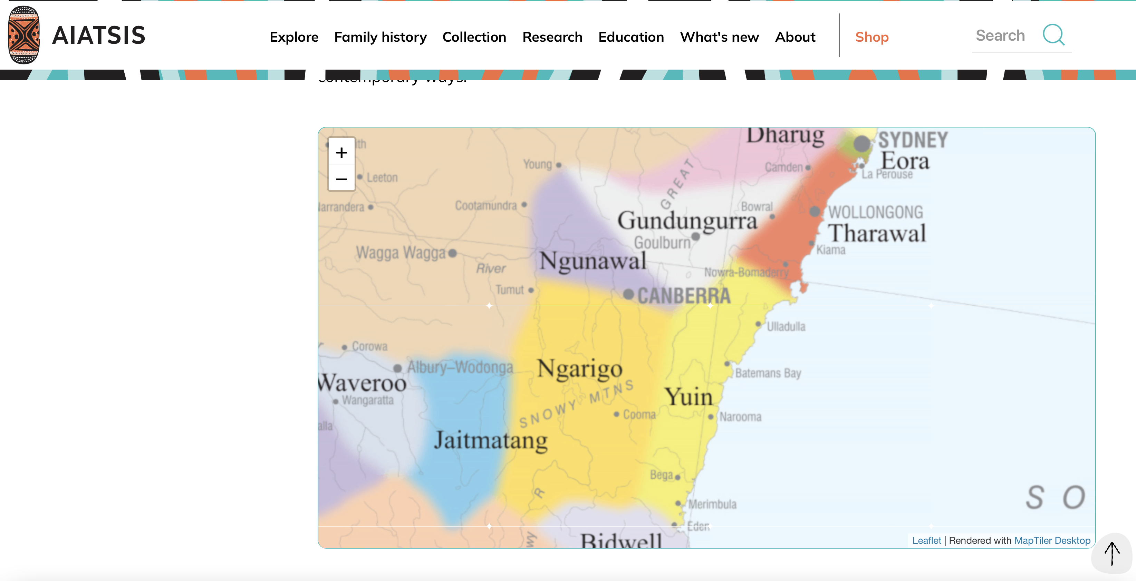
ANU Acknowledgment of Country
“We acknowledge and celebrate the First Australians on whose traditional lands we meet, and pay our respect to the elders past and present.”
https://aiatsis.gov.au/explore/map-indigenous-australia
Notes:
https://www.anu.edu.au/students/contacts/tjabal-indigenous-higher-education-centre
https://services.anu.edu.au/human-resources/respect-inclusion/anu-acknowledgment-of-country
https://www.indigenous.gov.au/contact-us/welcome_acknowledgement-country
https://aiatsis.gov.au/explore/map-indigenous-australia

Slide 3
Architecture

Slide 4

Software architecture
To create a reliable, secure and efficient product, you need to pay attention to architectural design which includes:
  its overall organization,
  how the software is decomposed into components,
  the server organization
  the technologies that you use to build the software. The architecture of a software product affects its performance, usability, security, reliability and maintainability.
There are many different interpretations of the term ‘software architecture’.
  Some focus on ‘architecture’ as a noun - the structure of a system, and others consider ‘architecture’ to be a verb - the process of defining these structures.

Slide 5
The IEEE definition of
software architecture
Architecture is the fundamental organization of a software system embodied in its components, their relationships to each other and to the environment, and the principles guiding its design and evolution.

Slide 6
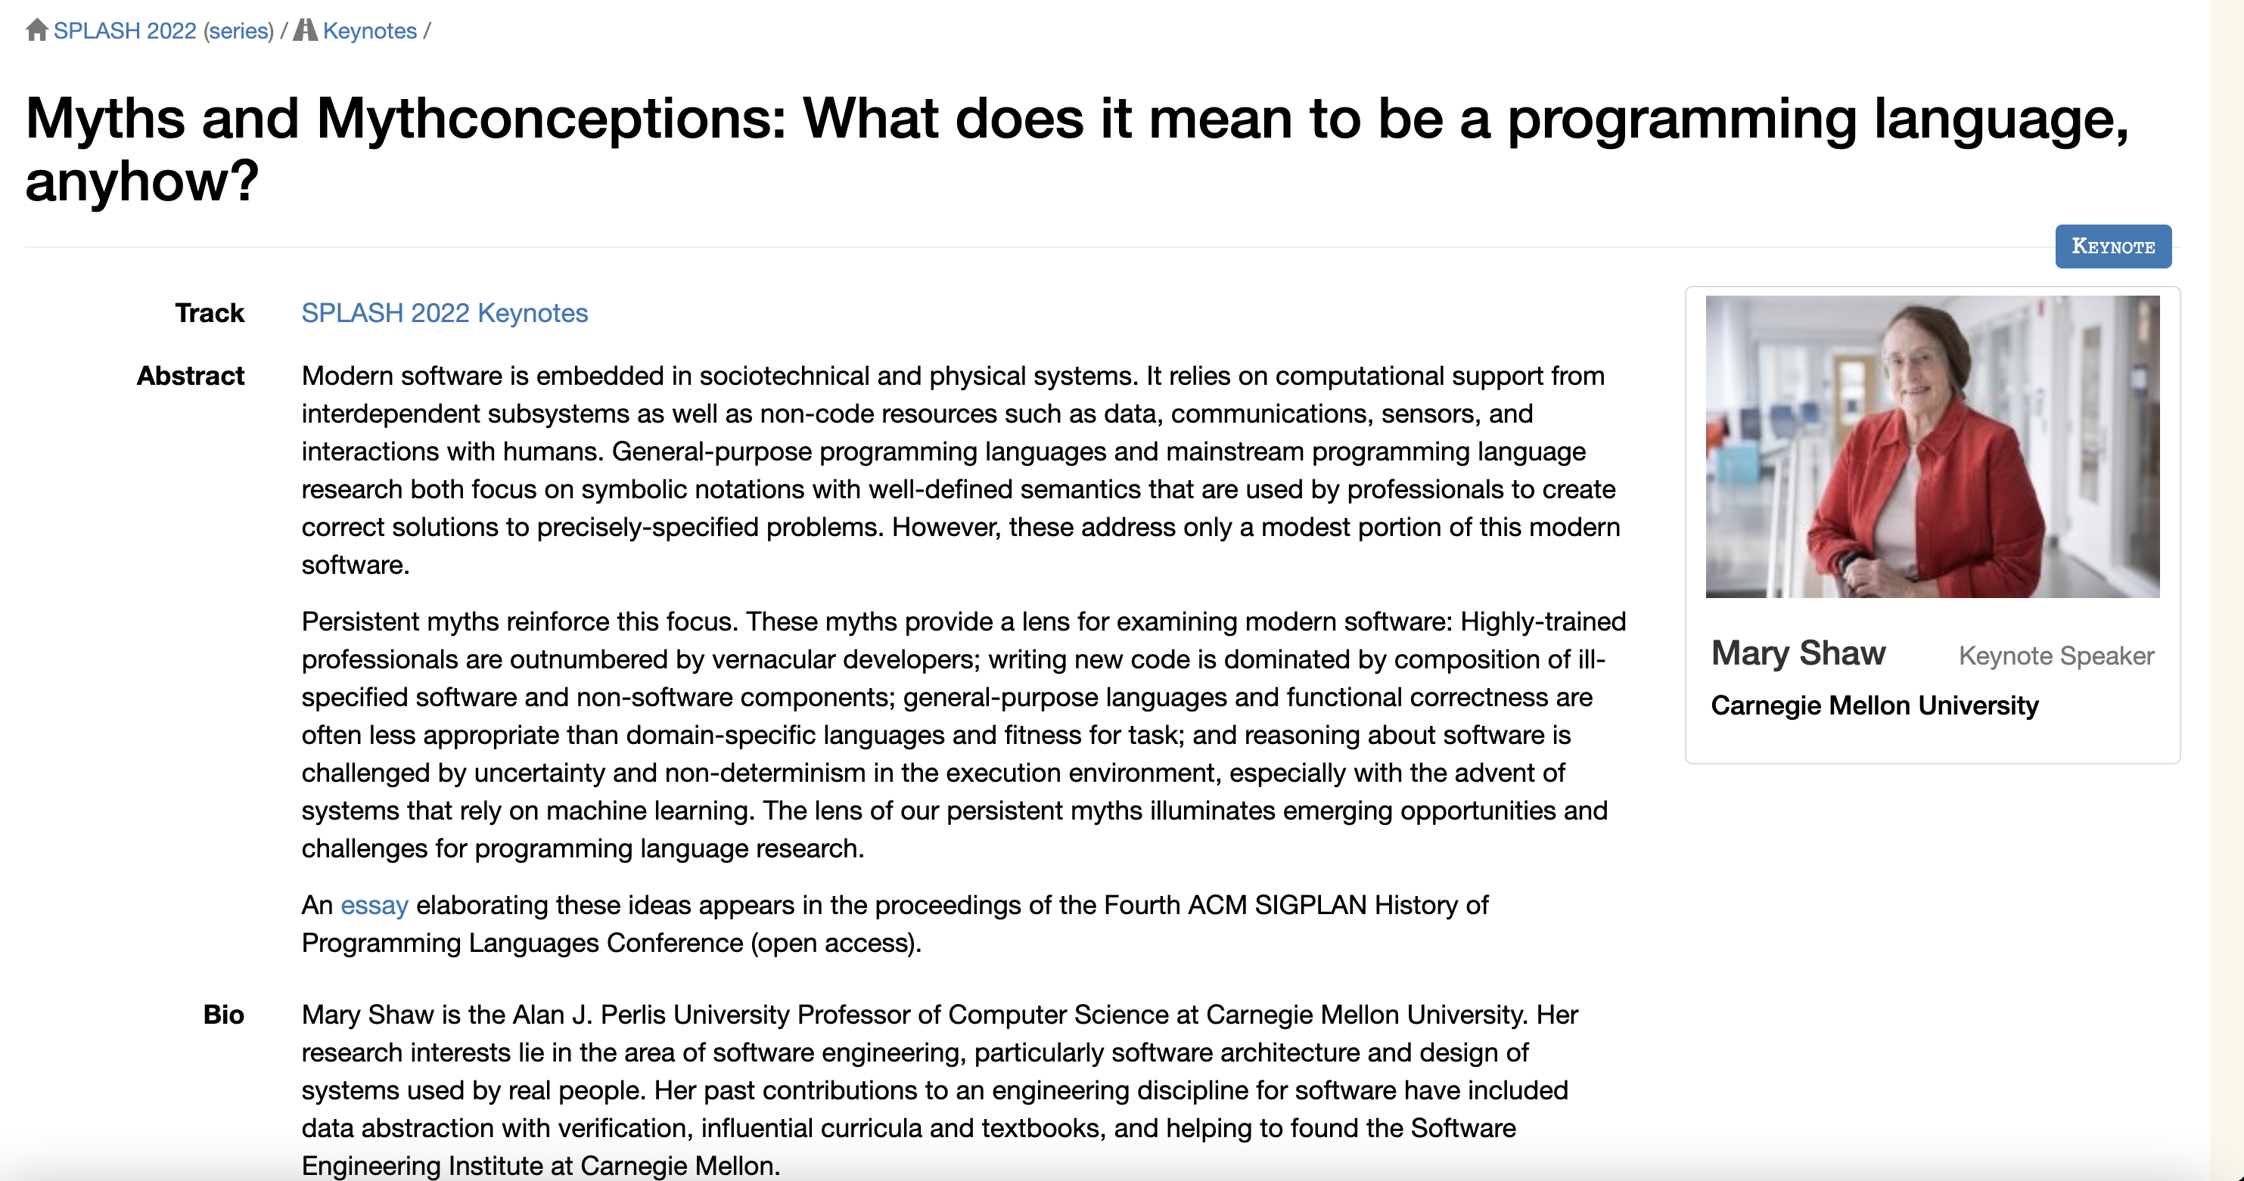
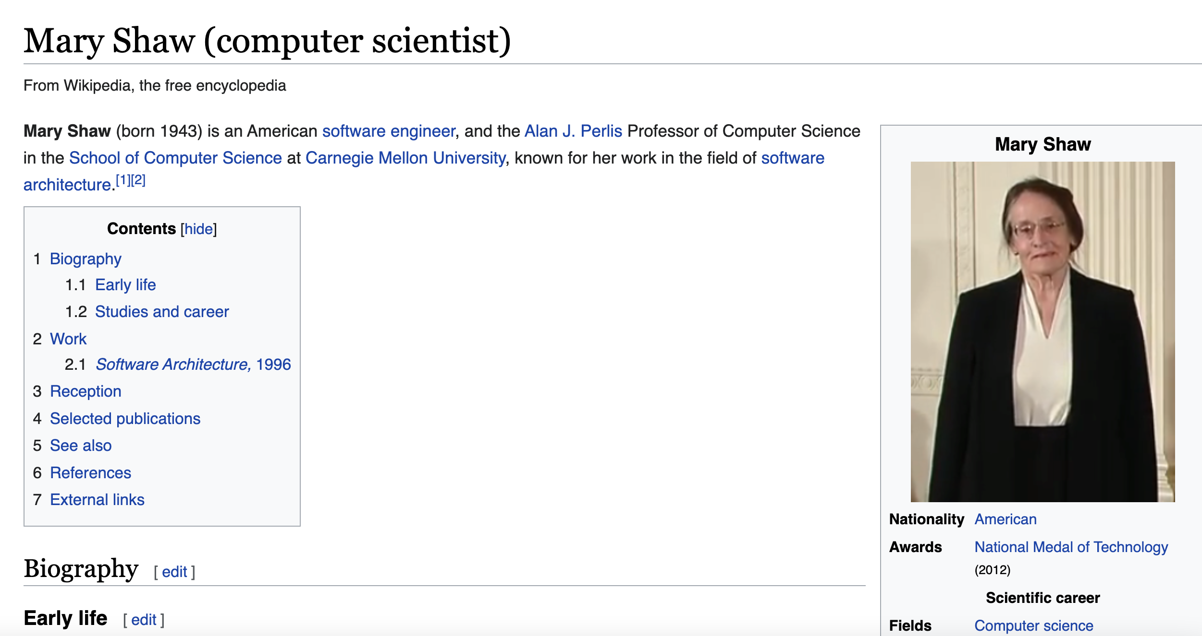
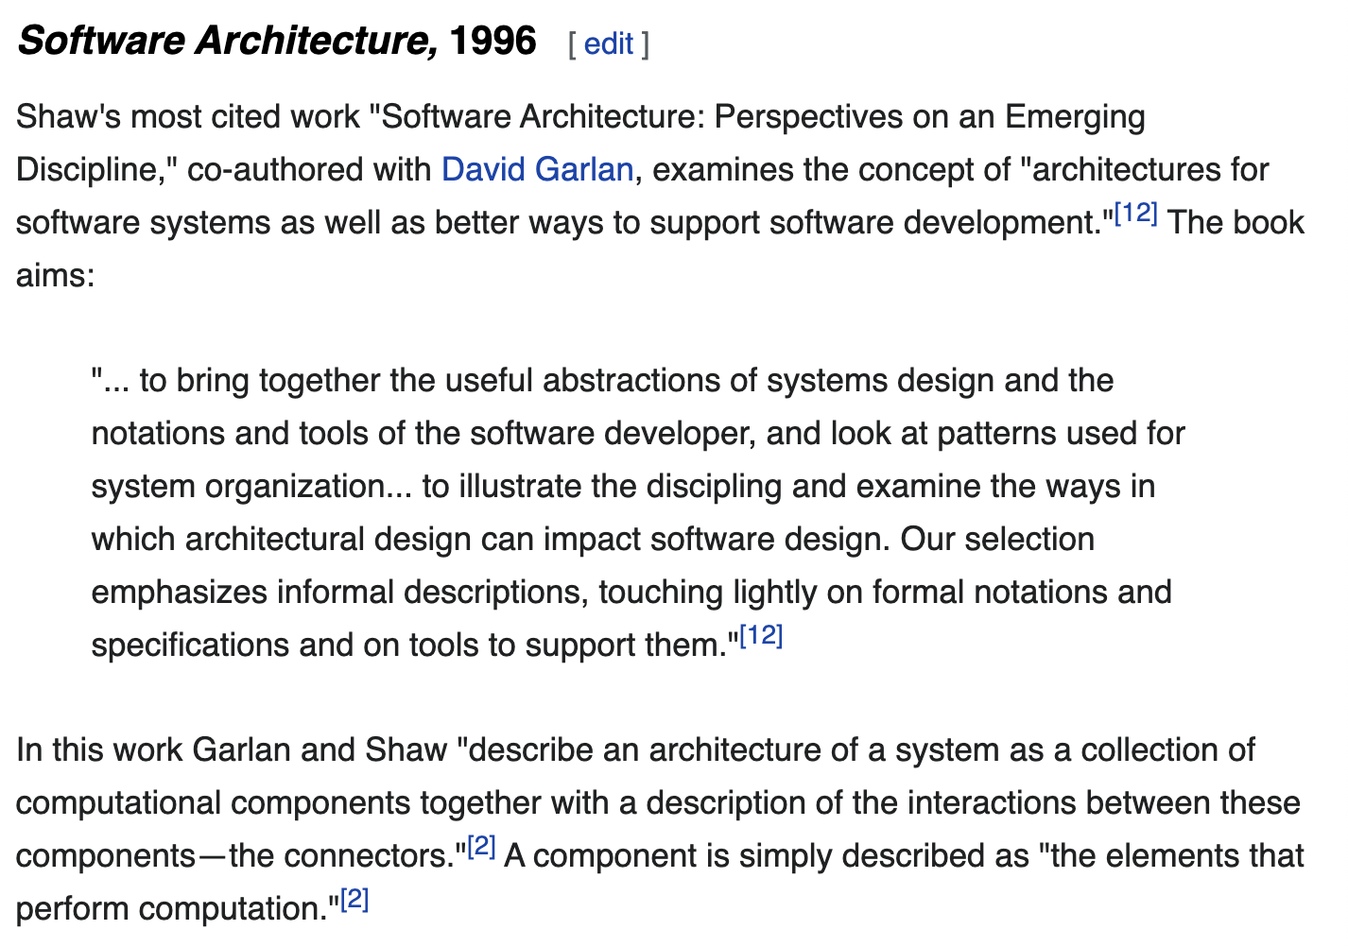
Mary Shaw
https://en.wikipedia.org/wiki/Mary_Shaw_(computer_scientist)

Slide 7
Software architecture and components
A component is an element that implements a coherent set of functionality or features.
Software component can be considered as a collection of one or more services that may be used by other components.
When designing software architecture, you don’t have to decide how an architectural element or component is to be implemented.
Rather, you design the component interface and leave the implementation of that interface to a later stage of the development process.

Slide 8
Access to services provided by software components

Slide 9
Why is architecture important?
Architecture is important because the architecture of a system has a fundamental influence on the non-functional system properties (see the next slide).
Architectural design involves understanding the issues that affect the architecture of your product and creating an architectural description that shows the critical components and their relationships.
Minimizing complexity should be an important goal for architectural designers.
  The more complex a system, the more difficult and expensive it is to understand and change.
  Programmers are more likely to make mistakes and introduce bugs and security vulnerabilities when they are modifying or extending a complex system.

Slide 10
Non-functional system quality attributes
Responsiveness
Does the system return results to users in a reasonable time?
Reliability
Do the system features behave as expected by both developers and users?
Availability
Can the system deliver its services when requested by users?
Security
Does the system protect itself and users’ data from unauthorized attacks and intrusions?
Usability
Can system users access the features that they need and use them quickly and without errors?
Maintainability
Can the system be readily updated and new features added without undue costs?
Resilience
Can the system continue to deliver user services in the event of partial failure or external attack?

Slide 11
The influence on architecture of system security
A centralized security architecture
In the Star Wars prequel Rogue One (https://en.wikipedia.org/wiki/Rogue_One), the evil Empire have stored the plans for all of their equipment in a single, highly secure, well-guarded, remote location. This is called a centralized security architecture. It is based on the principle that if you maintain all of your information in one place, then you can apply lots of resources to protect that information and ensure that intruders can’t get hold of it.
Unfortunately (for the Empire), the rebels managed to breach their security. They stole the plans for the Death Star, an event which underpins the whole Star Wars saga. In trying to stop them, the Empire destroyed their entire archive of system documentation with who knows what resultant costs. Had the Empire chosen a distributed security architecture, with different parts of the Death Star plans stored in different locations, then stealing the plans would have been more difficult. The rebels would have had to breach security in all locations to steal the complete Death Star blueprints.

Slide 12
Centralized security architectures
The benefits of a centralized security architecture are that it is easier to design and build protection and that the protected information can be accessed more efficiently.
However, if your security is breached, you lose everything.
If you distribute information, it takes longer to access all of the information and costs more to protect it.
If security is breached in one location, you only lose the information that you have stored there.

Slide 13
Maintainability and performance
Next slide shows a system with two components (C1 and C2) that share a common database.
  Assume C1 runs slowly because it has to reorganize the information in the database before using it.
  The only way to make C1 faster might be to change the database. This means that C2 also has to be changed, which may, potentially, affect its response time.
The slide after the next shows a different architecture is used where each component has its own copy of the parts of the database that it needs.
  If one component needs to change the database organization, this does not affect the other component.
However, a multi-database architecture may run more slowly and may cost more to implement and change.
  A multi-database architecture needs a mechanism (component C3) to ensure that the data shared by C1 and C2 is kept consistent when it is changed.

Slide 14
Shared database architecture

Slide 15
Multiple database architecture

Slide 16
Issues that influence
architectural decisions

Slide 17
The importance of
architectural design issues
Nonfunctional product characteristics
Nonfunctional product characteristics such as security and performance affect all users. If you get these wrong, your product will is unlikely to be a commercial success. Unfortunately, some characteristics are opposing, so you can only optimize the most important.
Product lifetime
If you anticipate a long product lifetime, you will need to create regular product revisions. You therefore need an architecture that is evolvable, so that it can be adapted to accommodate new features and technology.
Software reuse
You can save a lot of time and effort, if you can reuse large components from other products or open-source software. However, this constrains your architectural choices because you must fit your design around the software that is being reused.
Number of users
If you are developing consumer software delivered over the Internet, the number of users can change very quickly. This can lead to serious performance degradation unless you design your architecture so that your system can be quickly scaled up and down.
Software compatibility
For some products, it is important to maintain compatibility with other software so that users can adopt your product and use data prepared using a different system. This may limit architectural choices, such as the database software that you can use.

Slide 18
Trade off: Maintainability vs performance
System maintainability is an attribute that reflects how difficult and expensive it is to make changes to a system after it has been released to customers.
  You improve maintainability by building a system from small self-contained parts, each of which can be replaced or enhanced if changes are required.
In architectural terms, this means that the system should be decomposed into fine-grain components, each of which does one thing and one thing only.
  However, it takes time for components to communicate with each other. Consequently, if many components are involved in implementing a product feature, the software will be slower.

Slide 19
Trade off: Security vs usability
You can achieve security by designing the system protection as a series of layers (next slide).
  An attacker has to penetrate all of those layers before the system is compromised.
Layers might include system authentication layers, a separate critical feature authentication layer, an encryption layer and so on.
Architecturally, you can implement each of these layers as separate components so that if one of these components is compromised by an attacker, then the other layers remain intact.

Slide 20
Authentication layers

Slide 21
Usability issues
A layered approach to security affects the usability of the software.
  Users have to remember information, like passwords, that is needed to penetrate a security layer. Their interaction with the system is inevitably slowed down by its security features.
  Many users find this irritating and often look for work-arounds so that they do not have to re-authenticate to access system features or data.
To avoid this, you need an architecture:
  that doesn’t have too many security layers,
  that doesn’t enforce unnecessary security,
  that provides helper components that reduce the load on users.

Slide 22
Trade off: Availability vs time-to-market
Availability is particularly important in enterprise products, such as products for the finance industry, where 24/7 operation is expected.
The availability of a system is a measure of the amount of ‘uptime’ of that system.
  Availability is normally expressed as a percentage of the time that a system is available to deliver user services.
Architecturally, you achieve availability by having redundant components in a system.
  To make use of redundancy, you include sensor components that detect failure, and switching components that switch operation to a redundant component when a failure is detected.
Implementing extra components takes time and increases the cost of system development. It adds complexity to the system and therefore increases the chances of introducing bugs and vulnerabilities.

Slide 23
Architectural design questions
How should the system be organized as a set of architectural components, where each of these components provides a subset of the overall system functionality?
  The organization should deliver the system security, reliability and performance that you need.
How should these architectural components be distributed and communicate with each other?
What technologies should you use in building the system and what components should be reused?

Slide 24
Component organization
Abstraction in software design means that you focus on the essential elements of a system or software component without concern for its details.
At the architectural level, your concern should be on large-scale architectural components.
Decomposition involves analysing these large-scale components and representing them as a set of finer-grain components.
Layered models are often used to illustrate how a system is composed of components.

Slide 25
An architectural model of a document retrieval system

Slide 26
Architectural complexity
Complexity in a system architecture arises because of the number and the nature of the relationships between components in that system.
When decomposing a system into components, you should try to avoid unnecessary software complexity.
  Localize relationships
  If there are relationships between components A and B, these are easier to understand if A and B are defined in the same module.
  Reduce shared dependencies
  Where components A and B depend on some other component or data, complexity increases because changes to the shared component mean you have to understand how these changes affect both A and B.
It is always preferable to use local data wherever possible and to avoid sharing data if you can.

Slide 27
Examples of component relationships

Slide 28
Architectural design guidelines

Slide 29
Design guidelines and
layered architectures
Each layer is an area of concern and is considered separately from other layers.
  The top layer is concerned with user interaction, the next layer down with user interface management, the third layer with information retrieval and so on.
Within each layer, the components are independent and do not overlap in functionality.
  The lower layers include components that provide general functionality so there is no need to replicate this in the components in a higher level.
The architectural model is a high-level model that does not include implementation information.
  Ideally, components at level X (say) should only interact with the APIs of the components in level X-1. That is, interactions should be between layers and not across layers.

Slide 30
Cross-cutting concerns
Cross-cutting concerns are concerns that are systemic, that is, they affect the whole system.
In a layered architecture, cross-cutting concerns affect all layers in the system as well as the way in which people use the system.
Cross-cutting concerns are completely different from the functional concerns represented by layers in a software architecture.
Every layer has to take them into account and there are inevitably interactions between the layers because of these concerns.
The existence of cross-cutting concerns is the reason why modifying a system after it has been designed to improve its security is often difficult.

Slide 31
Cross-cutting concerns

Slide 32
Security as a cross-cutting concern
Security architecture
Different technologies are used in different layers, such as an SQL database or a Firefox browser. Attackers can try to use of vulnerabilities in these technologies to gain access.
Consequently, you need protection from attacks at each layer as well as protection, at lower layers in the system, from successful attacks that have occurred at higher-level layers.
If there is only a single security component in a system, this represents a critical system vulnerability. If all security checking goes through that component and it stops working properly or is compromised in an attack, then you have no reliable security in your system.
By distributing security across the layers, your system is more resilient to attacks and software failure (remember the Rogue One example earlier).

Slide 33
A generic layered architecture for a web-based application

Slide 34
Layer functionality in a web-based application
Browser-based or mobile user interface
A web browser system interface in which HTML forms are often used to collect user input. Javascript components for local actions, such as input validation, should also be included at this level. Alternatively, a mobile interface may be implemented as an app.
Authentication and UI management
A user interface management layer that may include components for user authentication and web page generation.
Application-specific functionality
An ‘application’ layer that provides functionality of the application. Sometimes, this may be expanded into more than one layer.
Basic shared services
A shared services layer, which includes components that provide services used by the application layer components.
Database and transaction management
A database layer that provides services such as transaction management and recovery. If your application does not use a database then this may not be required.

Slide 35
iLearn architectural design principles
Replaceability
It should be possible for users to replace applications in the system with alternatives and to add new applications. Consequently, the list of applications included should not be hard-wired into the system.
Extensibility
It should be possible for users or system administrators to create their own versions of the system, which may extend or limit the ’standard’ system.
Age-appropriate
Alternative user interfaces should be supported so that age-appropriate interfaces for students at different levels can be created.
Programmability
It should be easy for users to create their own applications by linking existing applications in the system.
Minimum work
Users who do not wish to change the system should not have to do extra work so that other users can make changes.

Slide 36
iLearn design principles
Our goal in designing the iLearn system was to create an adaptable, universal system that could be easily updated as new learning tools became available.
  This means that it must be possible to change and replace components and services in the system (principles (1) and (2)).
  Because the potential system users spanned an age range from 3 to 18, we needed to provide age-appropriate user interfaces and to make it easy to choose an interface (principle (3)).
  Principle (4) also contributes to system adaptability and principle (5) was included to ensure that this adaptability did not adversely affect users who did not require it.

Slide 37
Designing iLearn as
a service-oriented system
These principles led us to an architectural design decision that the iLearn system should be service-oriented.
Every component in the system is a service. Any service is potentially replaceable and new services can be created by combining existing services. Different services delivering comparable functionality can be provided for students of different ages.
Service integration
  Full integration Services are aware of and can communicate with other services through their APIs.
  Partial integration Services may share service components and databases but are not aware of and cannot communicate directly with other application services.
  Independent These services do not use any shared system services or databases and they are unaware of any other services in the system. They can be replaced by any other comparable service.

Slide 38
A layered architectural model of the iLearn system

Slide 39
Distribution architecture
The distribution architecture of a software system defines the servers in the system and the allocation of components to these servers.
Client-server architectures are a type of distribution architecture that is suited to applications where clients access a shared database and business logic operations on that data.
In this architecture, the user interface is implemented on the user’s own computer or mobile device.
  Functionality is distributed between the client and one or more server computers.

Slide 40
Client-server architecture

Slide 41
The model-view-controller pattern

Slide 42
Client-server communication
Client-server communication normally uses the HTTP protocol.
  The client sends a message to the server that includes an instruction such as GET or POST along with the identifier of a resource (usually a URL) on which that instruction should operate. The message may also include additional information, such as information collected from a form.
HTTP is a text-only protocol so structured data has to be represented as text. There are two ways of representing this data that are widely used, namely XML and JSON.
  XML is a markup language with tags used to identify each data item.
  JSON is a simpler representation based on the representation of objects in the Javascript language.

Slide 43
Multi-tier client-server architecture

Slide 44
Service-oriented architecture
Services in a service-oriented architecture are stateless components, which means that they can be replicated and can migrate from one computer to another.
Many servers may be involved in providing services
A service-oriented architecture is usually easier to scale as demand increases and is resilient to failure.

Slide 45
Service-oriented architecture

Slide 46
Issues in architectural choice
Data type and data updates
  If you are mostly using structured data that may be updated by different system features, it is usually best to have a single shared database that provides locking and transaction management. If data is distributed across services, you need a way to keep it consistent and this adds overhead to your system.
Change frequency
  If you anticipate that system components will be regularly changed or replaced, then isolating these components as separate services simplifies those changes.
The system execution platform
  If you plan to run your system on the cloud with users accessing it over the Internet, it is usually best to implement it as a service-oriented architecture because scaling the system is simpler.
  If your product is a business system that runs on local servers, a multi-tier architecture may be more appropriate.

Slide 47
Technology choices
Database
Should you use a relational SQL database or an unstructured NOSQL database?
Platform
Should you deliver your product on a mobile app and/or a web platform?
Server
Should you use dedicated in-house servers or design your system to run on a public cloud? If a public cloud, should you use Amazon, Google, Microsoft, or some other option?
Open source
Are there suitable open-source components that you could incorporate into your products?
Development tools
Do your development tools embed architectural assumptions about the software being developed that limit your architectural choices?

Slide 48
Database
There are two kinds of database that are now commonly used:
  Relational databases, where the data is organised into structured tables
  NoSQL databases, in which the data has a more flexible, user-defined organization.
Relational databases, such as MySQL, are particularly suitable for situations where you need transaction management and the data structures are predictable and fairly simple.
NoSQL databases, such as MongoDB, are more flexible and potentially more efficient than relational databases for data analysis.
  NoSQL databases allow data to be organized hierarchically rather than as flat tables and this allows for more efficient concurrent processing of ‘big data’.

Slide 49
Delivery platform
Delivery can be as a web-based or a mobile product or both
Mobile issues:
  Intermittent connectivity You must be able to provide a limited service without network connectivity.
  Processor power Mobile devices have less powerful processors, so you need to minimize computationally-intensive operations.
  Power management Mobile battery life is limited so you should try to minimize the power used by your application.
  On-screen keyboard On-screen keyboards are slow and error-prone. You should minimize input using the screen keyboard to reduce user frustration.
To deal with these differences, you usually need separate browser-based and mobile versions of your product front-end.
  You may need a completely different decomposition architecture in these different versions to ensure that performance and other characteristics are maintained.

Slide 50
Server
A key decision that you have to make is whether to design your system to run on customer servers or to run on the cloud.
For consumer products that are not simply mobile apps I think it almost always makes sense to develop for the cloud.
For business products, it is a more difficult decision.
  Some businesses are concerned about cloud security and prefer to run their systems on in-house servers. They may have a predictable pattern of system usage so there is less need to design your system to cope with large changes in demand.
An important choice you have to make if you are running your software on the cloud is which cloud provider to use.

Slide 51
Open source
Open source software is software that is available freely, which you can change and modify as you wish.
  The advantage is that you can reuse rather than implement new software, which reduces development costs and time to market.
  The disadvantages of using open-source software is that you are constrained by that software and have no control over its evolution.
The decision on the use of open-source software also depends on the availability, maturity and continuing support of open source components.
Open source license issues may impose constraints on how you use the software.
Your choice of open source software should depend on the type of product that you are developing, your target market and the expertise of your development team.

Slide 52
Development tools
Development technologies, such as a mobile development toolkit or a web application framework, influence the architecture of your software.
  These technologies have built-in assumptions about system architectures and you have to conform to these assumptions to use the development system.
The development technology that you use may also have an indirect influence on the system architecture.
  Developers usually favour architectural choices that use familiar technologies that they understand. For example, if your team have a lot of experience of relational databases, they may argue for this instead of a NoSQL database.

Slide 53
Key Points
Software architecture is the fundamental organization of a system embodied in its components, their relationships to each other, and to the environment, and the principles guiding its design and evolution.
The architecture of a software system has a significant influence on non-functional system properties such as reliability, efficiency and security.
Architectural design involves understanding the issues that are critical for your product and creating system descriptions that shows components and their relationships.
The principal role of architectural descriptions is to provide a basis for the development team to discuss the system organization. Informal architectural diagrams are effective in architectural description because they are fast and easy to draw and share.
System decomposition involves analyzing architectural components and representing them as a set of finer-grain components.

Slide 54
Key Points
To minimize complexity, you should separate concerns, avoid functional duplication and focus on component interfaces.
Web-based systems often have a common layered structure including user interface layers, application-specific layers and a database layer.
The distribution architecture in a system defines the organization of the servers in that system and the allocation of components to these servers.
Multi-tier client-server and service-oriented architectures are the most commonly used architectures for web-based systems.
Making decisions on technologies such as database and cloud technologies are an important part of the architectural design process.

Slide 55
Mini Break in Monday Lecture

Slide 56
Security

Slide 57
Software security
Software security should always be a high priority for product developers and their users.
If you don’t prioritize security, you and your customers will inevitably suffer losses from malicious attacks.
In the worst case, these attacks could can put product providers out of business.
  If their product is unavailable or if customer data is compromised, customers are liable to cancel their subscriptions.
Even if they can recover from the attacks, this will take time and effort that would have been better spent working on their software.

Slide 58
Types of security threat

Slide 59
System infrastructure stack

Slide 60
Security management
Authentication and authorization
You should have authentication and authorization standards and procedures that ensure that all users have strong authentication and that they have properly access permissions properly. This minimizes the risk of unauthorized users accessing system resources.
System infrastructure management
Infrastructure software should be properly configured and security updates that patch vulnerabilities should be applied as soon as they become available.
Attack monitoring
The system should be regularly checked for possible unauthorized access. If attacks are detected, it may be possible to put resistance strategies in place that minimize the effects of the attack.
Backup
Backup policies should be implemented to ensure that you keep undamaged copies of program and data files. These can then be restored after an attack.

Slide 61
Operational security
Operational security focuses on helping users to maintain security. User attacks try to trick users into disclosing their credentials or accessing a website that includes malware such as a key-logging system.
Operational security procedures and practices
  Auto-logout, which addresses the common problem of users forgetting to logout from a computer used in a shared space.
  User command logging, which makes it possible to discover actions taken by users that have deliberately or accidentally damaged some system resources.
  Multi-factor authentication, which reduces the chances of an intruder gaining access to the system using stolen credentials.

Slide 62
Injection attacks
Injection attacks are a type of attack where a malicious user uses a valid input field to input malicious code or database commands.
These malicious instructions are then executed, causing some damage to the system. Code can be injected that leaks system data to the attackers.
Common types of injection attack include buffer overflow attacks and SQL poisoning attacks.

Slide 63
SQL poisoning attacks
SQL poisoning attacks are attacks on software products that use an SQL database.
They take advantage of a situation where a user input is used as part of an SQL command.
A malicious user uses a form input field to input a fragment of SQL that allows access to the database.
The form field is added to the SQL query, which is executed and returns the information to the attacker.

Slide 64
Cross-site scripting attacks
Cross-site scripting attacks are another form of injection attack.
An attacker adds malicious Javascript code to the web page that is returned from a server to a client and this script is executed when the page is displayed in the user’s browser.
The malicious script may steal customer information or direct them to another website.
  This may try to capture personal data or display advertisements.
  Cookies may be stolen, which makes a session hijacking attack possible.
As with other types of injection attack, cross-site scripting attacks may be avoided by input validation.

Slide 65
Cross-site scripting attack

Slide 66
Session hijacking attacks
When a user authenticates themselves with a web application, a session is created.
  A session is a time period during which the user’s authentication is valid. They don’t have to re-authenticate for each interaction with the system.
  The authentication process involves placing a session cookie on the user’s device
Session hijacking is a type of attack where an attacker gets hold of a session cookie and uses this to impersonate a legitimate user.
There are several ways that an attacker can find out the session cookie value including cross-site scripting attacks and traffic monitoring.
  In a cross-site scripting attack, the installed malware sends session cookies to the attackers.
  Traffic monitoring involves attackers capturing the traffic between the client and server. The session cookie can then be identified by analysing the data exchanged.

Slide 67
Actions to reduce the
likelihood of hacking
Traffic encryption
Always encrypt the network traffic between clients and your server. This means setting up sessions using https rather than http. If traffic is encrypted it is harder to monitor to find session cookies.
Multi-factor authentication
Always use multi-factor authentication and require confirmation of new actions that may be damaging. For example, before a new payee request is accepted, you could ask the user to confirm their identity by inputting a code sent to their phone. You could also ask for password characters to be input before every potentially damaging action, such as transferring funds.
Short timeouts
Use relatively short timeouts on sessions. If there has been no activity in a session for a few minutes, the session should be ended and future requests directed to an authentication page. This reduces the likelihood that an attacker can access an account if a legitimate user forgets to log off when they have finished their transactions.

Slide 68
Denial of service attacks
Denial of service attacks are attacks on a software system that are intended to make that system unavailable for normal use.
Distributed denial of service attacks (DDOS) are the most common type of denial of service attacks.
  These involve distributed computers, that have usually been hijacked as part of a botnet, sending hundreds of thousands of requests for service to a web application. There are so many service requests that legitimate users are denied access.
Other types of denial of service attacks target application users.
  User lockout attacks take advantage of a common authentication policy that locks out a user after a number of failed authentication attempts. Their aim is to lock users out rather than gain access and so deny the service to these users.
  Users often use their email address as their login name so if an attacker has access to a database of email addresses, he or she can try to login using these addresses.
If you don’t lock accounts after failed validation, then attackers can use brute-force attacks on your system. If you do, you may deny access to legitimate users.

Slide 69
Brute force attacks
Brute force attacks are attacks on a web application where the attacker has some information, such as a valid login name, but does not have the password for the site.
The attacker creates different passwords and tries to login with each of these. If the login fails, they then try again with a different password.
  Attackers may use a string generator that generates every possible combination of letters and numbers and use these as passwords.
  To speed up the process of password discovery, attackers take advantage of the fact that many users choose easy-to-remember passwords. They start by trying passwords from the published lists of the most common passwords.
Brute force attacks rely on users setting weak passwords, so you can circumvent them by insisting that users set long passwords that are not in a dictionary or are common words.

Slide 70
Authentication
Authentication is the process of ensuring that a user of your system is who they claim to be.
You need authentication in all software products that maintain user information, so that only the providers of that information can access and change it.
You also use authentication to learn about your users so that you can personalize their experience of using your product.

Slide 71
Authentication approaches

Slide 72
Authentication methods
Knowledge-based authentication
  The user provides secret, personal information when they register with the system. Each time they log on, the system asks them for this information.
Possession-based authentication
  This relies on the user having a physical device (such as a mobile phone) that can generate or display information that is known to the authenticating system. The user inputs this information to confirm that they possess the authenticating device.
Attribute-based authentication is based on a unique biometric attribute of the user, such as a fingerprint, which is registered with the system.
Multi-factor authentication combines these approaches and requires users to use more than one authentication method.

Slide 73
Weaknesses of password-password-based authentication
Insecure passwords
Users choose passwords that are easy to remember. However, it is also easy for attackers to guess or generate these passwords, using either a dictionary or a brute force attack.
Phishing attacks
Users click on an email link that points to a fake site that tries to collect their login and password details.
Password reuse
Users use the same password for several sites. If there is a security breach at one of these sites, attackers then have passwords that they can try on other sites.
Forgotten passwords
Users regularly forget their passwords so that you need to set up a password recovery mechanism to allow these to be reset. This can be a vulnerability if users’ credentials have been stolen and attackers use it to reset their passwords.

Slide 74
Federated identity
Federated identity is an approach to authentication where you use an external authentication service.
‘Login with Google’ and ‘Login with Facebook’ are widely used examples of authentication using federated identity.
The advantage of federated identity for a user is that they have a single set of credentials that are stored by a trusted identity service.
Instead of logging into a service directly, a user provides their credentials to a known service who confirms their identity to the authenticating service.
They don’t have to keep track of different user ids and passwords. Because their credentials are stored in fewer places, the chances of a security breach where these are revealed is reduced.

Slide 75
Federated identity

Slide 76
Authorization
Authentication involves a user proving their identity to a software system.
Authorization is a complementary process in which that identity is used to control access to software system resources.
  For example, if you use a shared folder on Dropbox, the folder’s owner may authorize you to read the contents of that folder, but not to add new files or overwrite files in the folder.
When a business wants to define the type of access that users get to resources, this is based on an access control policy.
This policy is a set of rules that define what information (data and programs) is controlled, who has access to that information and the type of access that is allowed

Slide 77
Access control policies
Explicit access control policies are important for both legal and technical reasons.
  Data protection rules limit the access the personal data and this must be reflected in the defined access control policy. If this policy is incomplete or does not conform to the data protection rules, then there may be subsequent legal action in the event of a data breach.
  Technically, an access control policy can be a starting point for setting up the access control scheme for a system.
  For example, if the access control policy defines the access rights of students, then when new students are registered, they all get these rights by default.

Slide 78
Access control lists
Access control lists (ACLs) are used in most file and database systems to implement access control policies.
Access control lists are tables that link users with resources and specify what those users are permitted to do.
  For example, for this book I would like to be able to set up an access control list to a book file that allows reviewers to read that file and annotate it with comments. However, they are not allowed to edit the text or to delete the file.
If access control lists are based on individual permissions, then these can become very large. However, you can dramatically cut their size by allocating users to groups and then assigning permissions to the group

Slide 79
Access control lists

Slide 80
Encryption
Encryption is the process of making a document unreadable by applying an algorithmic transformation to it.
A secret key is used by the encryption algorithm as the basis of this transformation. You can decode the encrypted text by applying the reverse transformation.
Modern encryption techniques are such that you can encrypt data so that it is practically uncrackable using currently available technology.
However, history has demonstrated that apparently strong encryption may be crackable when new technology becomes available.
If commercial quantum systems become available, we will have to use a completely different approach to encryption on the Internet.

Slide 81
Encryption and decryption

Slide 82
Symmetric encryption
In a symmetric encryption scheme, the same encryption key is used for encoding and decoding the information that is to be kept secret.
If Alice and Bob wish to exchange a secret message, both must have a copy of the encryption key. Alice encrypts the message with this key. When Bob receives the message, he decodes it using the same key to read its contents.
The fundamental problem with a symmetric encryption scheme is securely sharing the encryption key.
If Alice simply sends the key to Bob, an attacker may intercept the message and gain access to the key. The attacker can then decode all future secret communications.

Slide 83
Symmetric encryption

Slide 84
Asymmetric encryption
Asymmetric encryption, does not require secret keys to be shared.
An asymmetric encryption scheme uses different keys for encrypting and decrypting messages.
Each user has a public and a private key. Messages may be encrypted using either key but can only be decrypted using the other key.
Public keys may be published and shared by the key owner. Anyone can access and use a published public key.
However, messages can only be decrypted by the user’s private key so is only readable by the intended recipient

Slide 85
Asymmetric encryption

Slide 86
Encryption and authentication
Asymmetric encryption can also be used to authenticate the sender of a message by encrypting it with a private key and decrypting it with the corresponding public key.
Say Alice wants to send a message to Bob and she has a copy of his public key.
However, she is not sure whether or not the public key that she has for Bob is correct and she is concerned that the message may be sent to the wrong person.
Private/public key encryption can be used to verify Bob’s identity.
  Bob uses his private key to encrypt a message and sends this to Alice. If it can be decrypted using Bob’s public key, then Alice has the correct key.

Slide 87
Encryption for authentication

Slide 88
TLS and digital certificates
The https protocol is a standard protocol for securely exchanging texts on the web. It is the standard http protocol plus an encryption layer called TLS (Transport Layer Security). This encryption layer is used for 2 things:
  to verify the identity of the web server;
  to encrypt communications so that they cannot be read by an attacker who intercepts the messages between the client and the server
TLS encryption depends on a digital certificate that is sent from the web server to the client.
  Digital certificates are issued by a certificate authority (CA), which is a trusted identity verification service.
  The CA encrypts the information in the certificate using their private key to create a unique signature. This signature is included in the certificate along with the public key of the CA. To check that the certificate is valid, you can decrypt the signature using the CA’s public key.

Slide 89
Digital certificates
Subject information
Information about the company or individual whose web site is being visited. Applicants apply for a digital certificate from a certificate authority who checks that the applicant is a valid organization.
Certificate authority information
Information about the certificate authority (CA) who has issued the certificate.
Certificate information
Information about the certificate itself, including a unique serial number and a validity period, defined by start and end dates.
Digital signature
The combination of all of the above data uniquely identifies the digital certificate. The signature data is encrypted with the CA’s private key to confirm that the data is correct. The algorithm used to generate the digital signature is also specified.
Public key information
The public key of the CA is included along with the key size and the encryption algorithm used. The public key may be used to decrypt the digital signature.

Slide 90
Using symmetric
and asymmetric
encryption in TLS

Slide 91
TLS explained
The digital certificate that the server sends to the client includes the server’s public key. The server also generates a long random number, encrypts it using its private key and sends this to the client.
The client can then decrypt this using the server’s public key and, in turn, generates its own long random number. It encrypts this number using the server’s public key and sends it to the server, which decrypts the message using its private key. Both client and server then have two long random numbers.
The agreed encryption method includes a way of generating an encryption key from these numbers. The client and server independently compute the key that will be used to encrypt subsequent messages using a symmetric approach.
All client-server traffic is encrypted and decrypted using that computed key. There is no need to exchange the key itself.

Slide 92
Data encryption
As a product provider you inevitably store information about your users and, for cloud-based products, user data.
Encryption can be used to reduce the damage that may occur from data theft. If information is encrypted, it is impossible, or very expensive, for thieves to access and use the unencrypted data.
  Data in transit.
  When transferring the data over the Internet, you should always use the https rather than the http protocol to ensure encryption.
  Data at rest.
  If data is not being used, then the files where the data is stored should be encrypted so that theft of these files will not lead to disclosure of confidential information.
  Data in use
  The data is being actively processed. Encrypting and decrypting the data slows down the system response time. Implementing a general search mechanism with encrypted data is impossible.

Slide 93
Encryption levels

Slide 94
Key management
Key management is the process of ensuring that encryption keys are securely generated, stored and accessed by authorized users.
Businesses may have to manage tens of thousands of encryption keys so it is impractical to do key management manually and you need to use some kind of automated key management system (KMS).
Key management is important because, if you get it wrong, unauthorized users may be able to access your keys and so decrypt supposedly private data. Even worse, if you lose encryption keys, then your encrypted data may be permanently inaccessible.
A key management system (KMS) is a specialized database that is designed to securely store and manage encryption keys, digital certificates and other confidential information.

Slide 95
Using a KMS for encryption management

Slide 96
Long-term key storage
Business may be required by accounting and other regulations to keep copies of all of their data for several years.
  For example, in the UK, tax and company data has to be maintained for at least six years, with a longer retention period for some types of data. Data protection regulations may require that this data be stored securely, so the data should be encrypted.
To reduce the risks of a security breach, encryption keys should be changed regularly. This means that archival data may be encrypted with a different key from the current data in your system.
Therefore, key management systems must maintain multiple, timestamped versions of keys so that system backups and archives can be decrypted if required.

Slide 97
Privacy
Privacy is a social concept that relates to the collection, dissemination and appropriate use of personal information held by a third-party such as a company or a hospital.
The importance of privacy has changed over time and individuals have their own views on what degree of privacy is important.
Culture and age also affect peoples’ views on what privacy means.
  Younger people were early adopters of the first social networks and many of them seem to be less inhibited about sharing personal information on these platforms than older people.
  In some countries, the level of income earned by an individual is seen as a private matter; in others, all tax returns are openly published.

Slide 98
Business reasons for privacy
If you are offering a product directly to consumers and you fail to conform to privacy regulations, then you may be subject to legal action by product buyers or by a data regulator. If your conformance is weaker than the protection offered by data protection regulations in some countries, you won’t be able to sell your product in these countries.
If your product is a business product, business customers require privacy safeguards so that they are not put at risk of privacy violations and legal action by users.
If personal information is leaked or misused, even if this is not seen as a violation of privacy regulations, this can lead to serious reputational damage. Customers may stop using your product because of this.

Slide 99
Data protection laws
In many countries, the right to individual privacy is protected by data protection laws.
These laws limit the collection, dissemination and use of personal data to the purposes for which it was collected.
  For example, a travel insurance company may collect health information so that they can assess their level of risk. This is legal and permissible.
  However, it would not be legal for those companies to use this information to target online advertising of health products, unless their users had given specific permission for this.

Slide 100
Data protection laws

Slide 101
Data protection principles (1)
Awareness and control
Users of your product must be made aware of what data is collected when they are using your product, and must have control over the personal information that you collect from them.
Purpose
You must tell users why data is being collected and you must not use that data for other purposes.
Consent
You must always have the consent of a user before you disclose their data to other people.
Data lifetime
You must not keep data for longer than you need to. If a user deletes their account, you must delete the personal data associated with that account.

Slide 102
Data protection principles (2)
Secure storage
You must maintain data securely so that it cannot be tampered with or disclosed to unauthorized people.
Discovery and error correction
You must allow users to find out what personal data that you store. You must provide a way for users to correct errors in their personal data.
Location
You must not store data in countries where weaker data protection laws apply unless there is an explicit agreement that the stronger data protection rules will be upheld.

Slide 103
Privacy policy
You should to establish a privacy policy that defines how personal and sensitive information about users is collected, stored and managed.
Software products use data in different ways, so your privacy policy has to define the personal data that you will collect and how you will use that data.
Product users should be able to review your privacy policy and change their preferences regarding the information that you store.
Your privacy policy is a legal document and it should be auditable to check that it is consistent with the data protection laws in countries where your software is sold.
Privacy policies should not be expressed to users in a long ‘terms and conditions’ document that, in practice, nobody reads.
The GDPR now require software companies to include a summary of their privacy policy, written in plain language rather than legal jargon, on their website.

Slide 104
Key Points
Security is a technical concept that relates to a software system’s ability to protect itself from malicious attacks that may threaten its availability, the integrity of the system and/or its data, and the theft of confidential information.
Common types of attack on software products include injection attacks, cross-site scripting attacks, session hijacking attacks, denial of service attacks and brute force attacks.
Authentication may be based on something a user knows, something a user has, or some physical attribute of the user.
Federated authentication involves devolving responsibility for authentication to a third-party such as Facebook or Google, or to a business’s authentication service.
Authorization involves controlling access to system resources based on the user’s authenticated identity. Access control lists are the most commonly-used mechanism to implement authorization.
Symmetric encryption involves encrypting and decrypting information with the same secret key. Asymmetric encryption uses a key pair – a private key and a public key. Information encrypted using the public key can only be decrypted using the private key.

Slide 105
Key Points
A major issue in symmetric encryption is key exchange. The TLS protocol, which is used to secure web traffic, gets around this problem by using asymmetric encryption for transferring information used to generate a shared key.
If your product stores sensitive user data, you should encrypt that data when it is not in use.
A key management system (KMS) stores encryption keys. Using a KMS is essential because a business may have to manage thousands or even millions of keys and may have to decrypt historic data that was encrypted using an obsolete encryption key.
Privacy is a social concept that relates to how people feel about the release of their personal information to others. Different countries and cultures have different ideas on what information should and should not be private.
Data protection laws have been made in many countries to protect individual privacy. They require companies who manage user data to store it securely, to ensure that it is not used or sold without the permission of users, and to allow users to view and correct personal data held by the system.

Slide 106
End of Monday Lecture/Start of Tuesday Lecture

Slide 107


Slide 108
Wyvern: Security via Programming Language Design
A/Prof Alex Potanin
Notes:
Abstract: In this talk I will provide motivation behind security- and usability- first approach to language design and implementation. I will also give two specific examples of how Wyvern helps software implementers: (1) type-specific languages, and (2) capabilities and effects for modules. Offline, I would be happy to expand on the current ongoing work around formal semantics for Wyvern including (1) type members and decidability, and (2) abstract effect members.

Slide 109
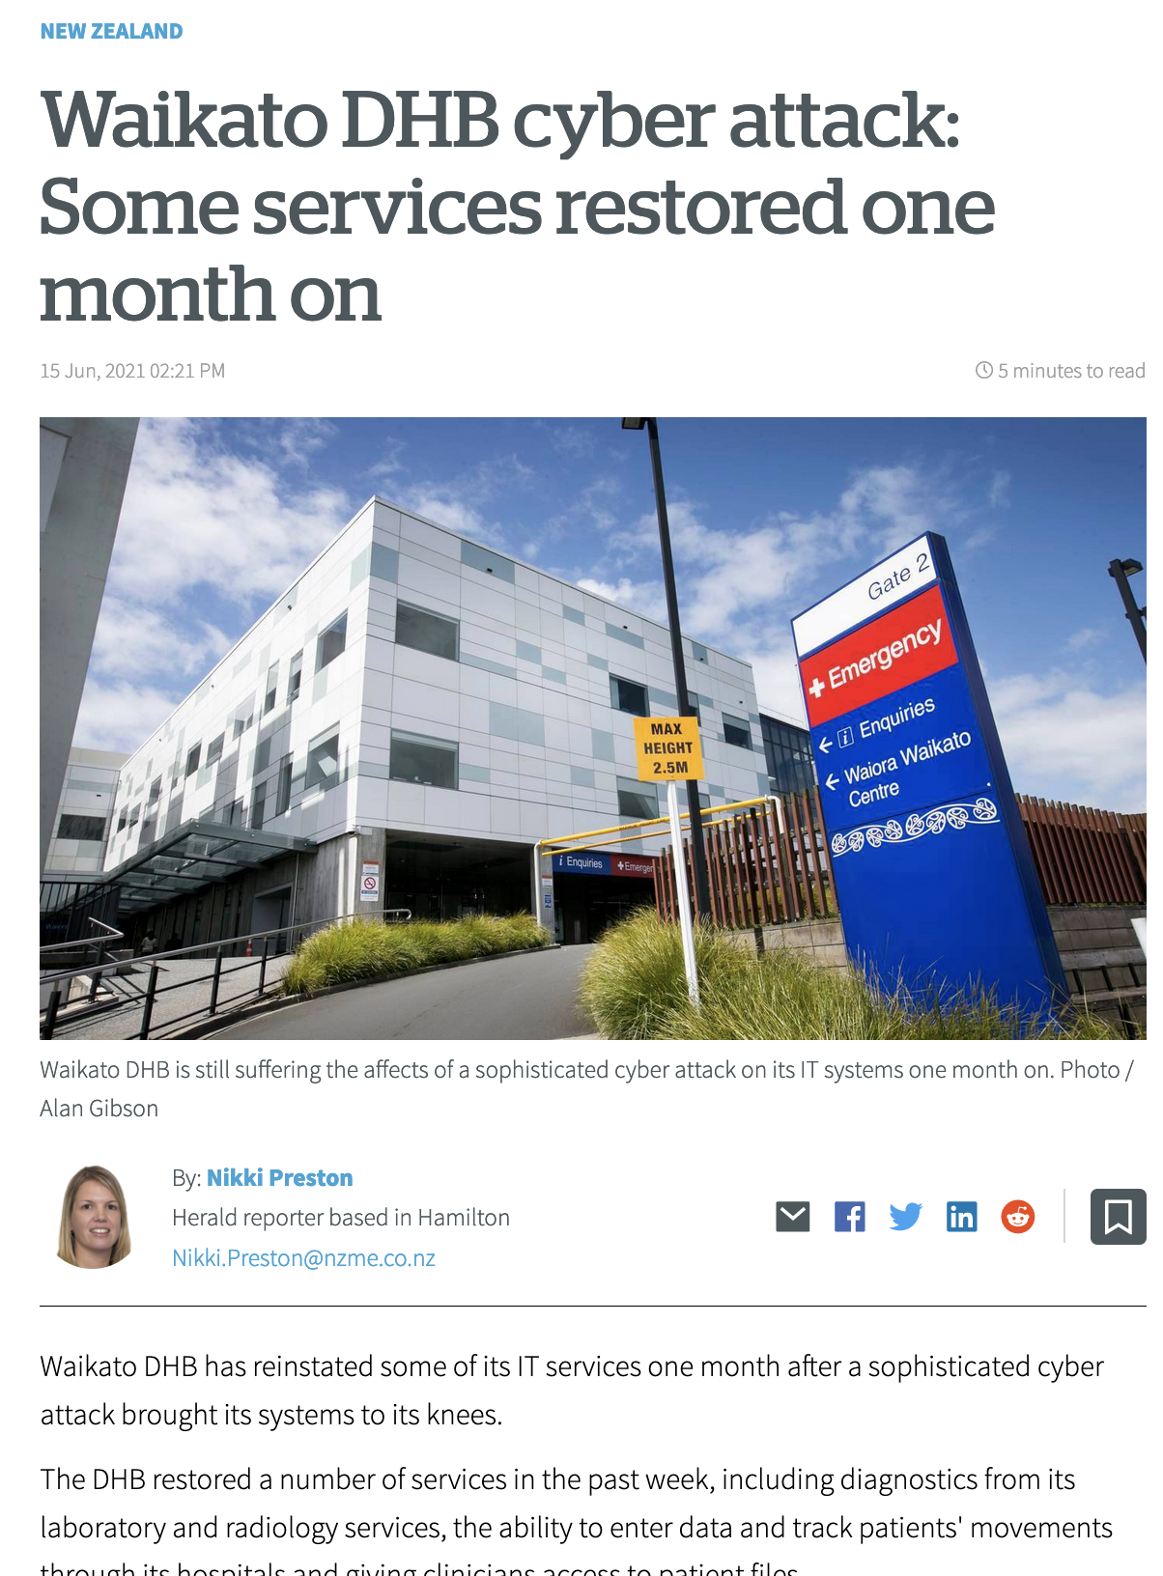
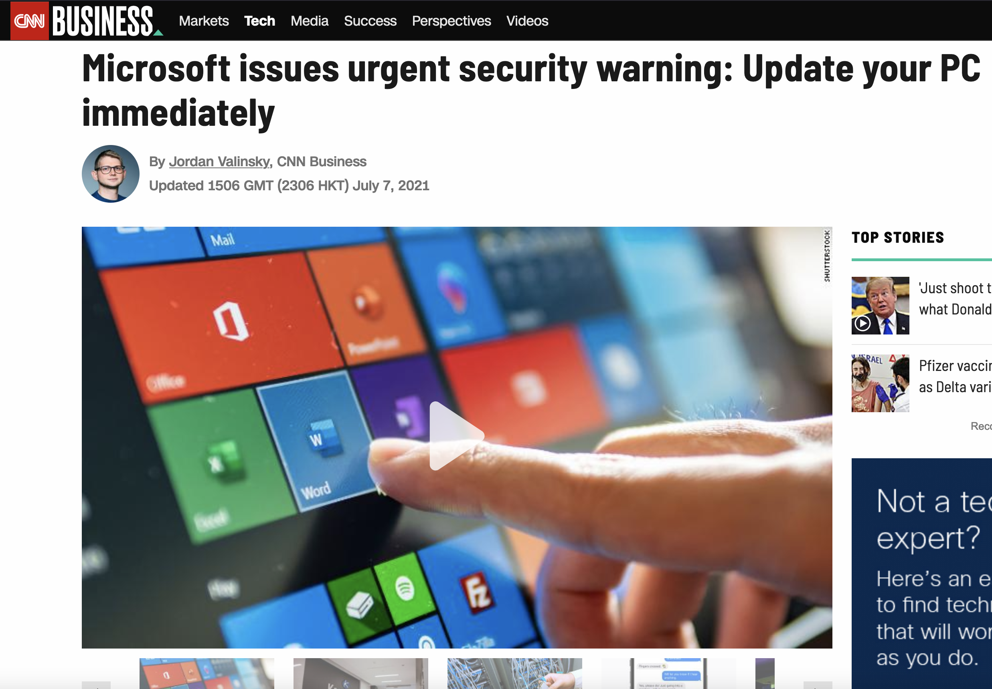
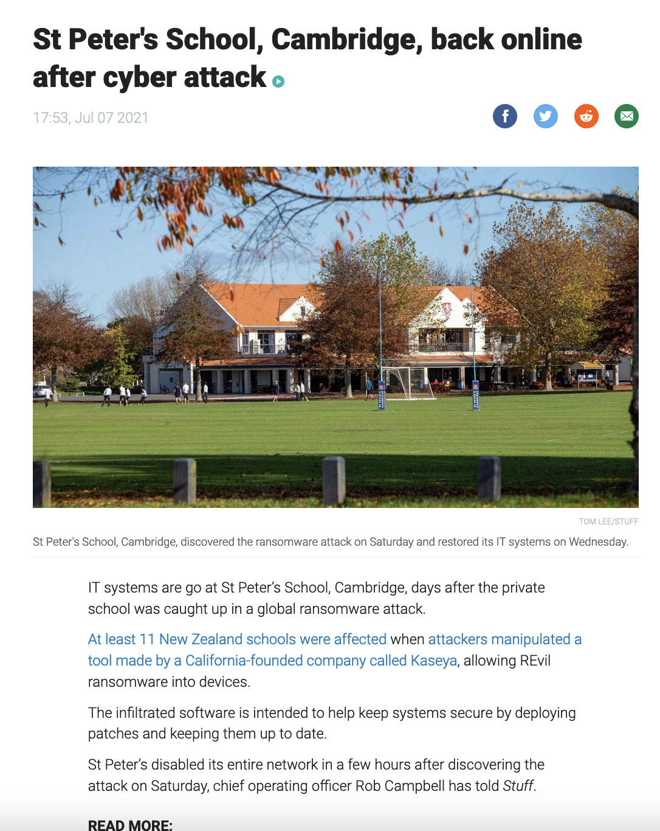
Software Security is a Big Problem

Slide 110
Why Systems are Vulnerable?
We “know” how to code securely
  Follow the rules: CERT, Oracle, …
  Technical advances: types, memory safety
But we still fail too often!
Root causes
  Coding instead of engineering
  Human limitations
  Unusable tools

Slide 111




Our Approach:
Usable Architecture-Based Security
Secure systems development
Engineering:
An architecture/design perspective
Usability:
A human perspective
$$λ$$
Formal Modelling:
A mathematical perspective
Notes:
Architecture: "the set of principal design decisions about the system" [Garlan and Shaw 1996; Taylor et al. 2009]. Typically large in scope.
Image Credits: Padlock (https://ya-webdesign.com/download.html), Auckland Harbour Bridge (http://www.aucklandmuseum.com/collections-research/collections/record/am_library-photography-30209 taken in 1959), Usability (http://www.clipartpanda.com/clipart_images/usability-can-t-save-the-world-7748931).

Slide 112

The Wyvern Programming Language
Designed for security and productivity from the ground up
General purpose, but emphasising web, mobile, and IoT apps
http://wyvernlang.github.io/
Notes:
Wyvern is a new programming language designed from the ground up to support highly productive development of secure software systems. While the language is general purpose, we are especially interested in emerging application areas such as the web, mobile devices, and the internet of things.

Slide 113



The Wyvern Programming Language
But you might ask: “Isn’t there a trade-off between security and productivity?
What is Wyvern’s secret sauce?
Security
Productivity
Notes:
Achieving high productivity and high security simultaneously may seem daunting, as there are clear tradeoffs between existing approaches that have been taken to achieve these goals. For example, we could seek to increase security by fully specifying a program's intended behaviour and security properties and then verifying the code against that specifications, but this could be achieved only at very high cost in programmer time. The key insight of Wyvern is that we can leapfrog current languages both in productivity and security by providing better support for expressing and enforcing large-scale design.

Slide 114
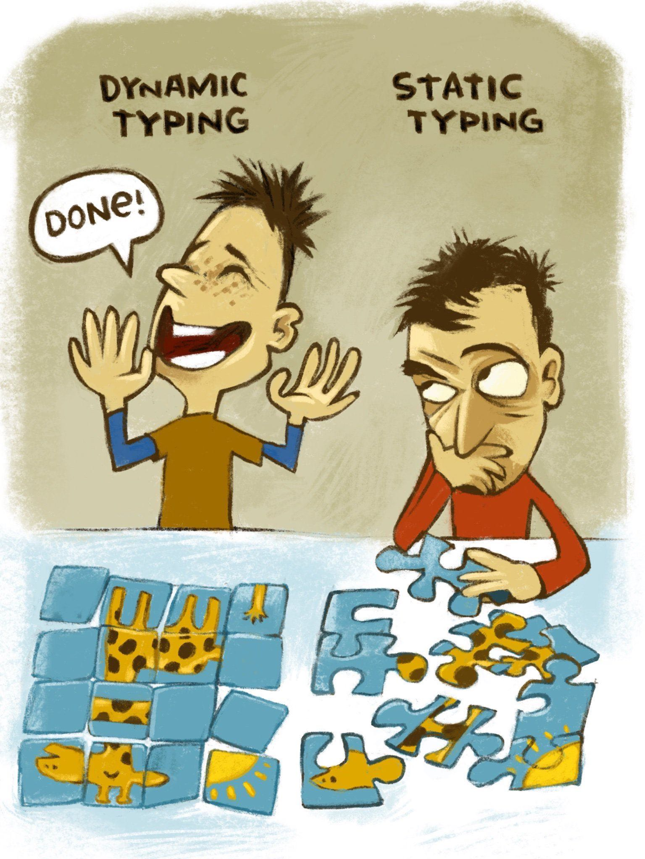

Slide 115
Shifting the Trade-off Curve
Better expressing and enforcing design
could fundamentally shift the trade-off curve.
Security
Productivity
Notes:
Of course this is all notional. In fact there are good reasons to think Java may be more productive than Python for larger programs or programs that use a lot of libraries. This is also just 2 dimensions in a multidimensional space. The point is that there are inherent tradeoffs based on current language technology, and research can change that.

Slide 116
The Wyvern Programming Language
Design goals
  Sound, modern language design
    Type- and memory- safe, mostly functional, advanced module system
  Incorporate usability principles
  Security mechanisms built in

Slide 117
Hello, world!
require stdout
stdout.print(“Hello, world!\n”)

Slide 118
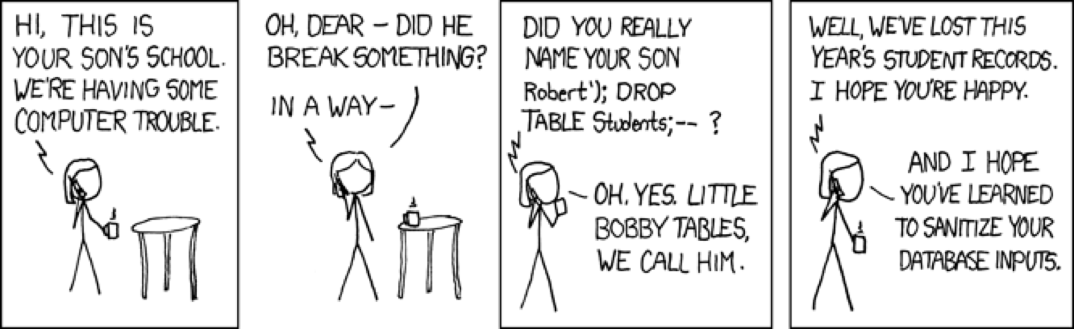
SQL Command Injection

Slide 119

SQL Injection: a Solved Problem?
PreparedStatement s = connection.prepareStatement(
“SELECT * FROM Students WHERE name = ?;”);
s.setString(1, userName);
s.executeQuery();
Evaluation:
Usability: unnatural, verbose
Design: string manipulation captures domain poorly
Language semantics: largely lost – just strings
  No type checking, IDE services, …
Prepare a statement with a hole
Fill the hole securely
$$λ$$

Slide 120
Wyvern: Usable Secure Programming
Introduces a domain-specific language (DSL) on the next indented lines
SQL query in Wyvern
connection.executeQuery(~)
SELECT * FROM Students WHERE name = {studentName}
Claim: the secure version more natural and more usable
  no empirical evaluation, but can be a project!
Semantically rich DSL. Can provide type checking, syntax highlighting, autocomplete, …
Safely incorporates dynamic data – as data, not a command
Notes:
NB! Omar et al. [ICSE 2012] shows benefits of similar DSL IDE plugins.

Slide 121

Technical Challenge: Syntax Conflicts
$$λ$$
Language extensions as libraries has been tried before
  Example: SugarJ/Sugar* [Erdweg et al, 2010; 2013]
import XML, HTML
val snippet = ~
How do I <b>parse</b> this example?
Is it XML or HTML?

Slide 122
Syntax Conflicts: Wyvern Solution
metadata keyword indicates we are importing syntax, not just a library
import metadata XML, HTML
val snippet : XML = ~
How do I <b>parse</b> this example?
No ambiguity: the compiler loads the unique parser associated with the expected type XML
Syntax of language completely unrestricted – indentation separates from host language

Slide 123

$$λ$$
Technical Challenge: Semantics
Q: Is it safe to run custom parser at compiler time?
A: Yes – immutability types used to ensure imported metadata is purely functional, has no network access, etc.
import metadata SQL
val connection = SQL.connect(...)
val studentName = input(...)
connection.executeQuery(~)
SELECT * FROM Students WHERE name = {studentName}
Language definition includes custom type checker – can verify query against database schema
SQL extension has access to variables and their types in Wyvern host language

Slide 124
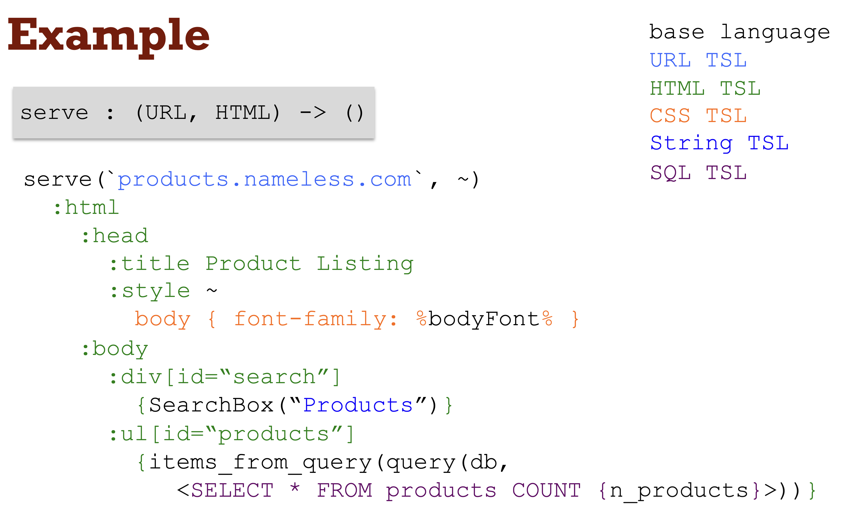

Slide 125
Our Approach:
Usable Architecture-Based Security
DSL support in Wyvern
Engineering:
Express design in domain-specific way
Usability:
Natural syntax, enabling IDE support
$$λ$$
Formal Modelling:
Type safety, variable hygiene, conflict-free extensions

Slide 126
An Old Idea: Layered Architectures
Lowest layer: an unsafe, low-level library
Middle layer: a higher-level framework
Top layer: the application
Code must obey strict layering
Many variants:
  Secure networking framework
  Safe SQL-access library
  Replicated storage library
RQ: Can we use capabilities to enforce layered resource access?
[Dijkstra 1968]
Application Code
Safe high-level framework
Unsafe low-level library

Slide 127
Architecture:
Principle of Least Privilege
“Every module must be able to access only the resources necessary for its legitimate purpose.” [Saltzer & Schroeder 75]
All other application code
Safe SQL DSL Library
String-based SQL Library

Slide 128
Module Linking as Architecture
require db.stringSQL
application.run()
To access external resources like a database, main requires a capability from the run-time system. A capability is an unforgeable token controlling access to a resource.
stringSQL

Slide 129
Module Linking as Architecture
We can import code modules, but they have no ambient authority to access resources (cf Newspeak). sqlApplication cannot access the database by itself.
require db.stringSQL
import db.safeSQL
import app.sqlApplication
val sql = safeSQL(stringSQL)
val application = sqlApplication(sql)
application.run()
safeSQL
stringSQL
We must instantiate a sqlApplication object, passing it the resources it needs. We pass only a capability to the safe library.

Slide 130
Module Linking as Architecture
module def sqlApplication(safeSQL : db.SafeSQL)
def run() : Int
// application code
require db.stringSQL
import db.safeSQL
import app.sqlApplication
val sql = safeSQL(stringSQL)
val application = sqlApplication(sql)
application.run()
module def safeSQL(strSQL : db.StringSQL)
// implement ADT in terms of strings
sqlApplication
safeSQL
stringSQL

Slide 131
How Hard to Link it All Up?
Provides access to OS resource
Most Wyvern modules don’t have state, can be freely imported
Statically tracked: stateful modules/objects and resource types
type SetM
resource type Set
def add(v : Int)
def isMember(v : Int) : Bool
def makeSet() : Set
module setM : SetM
module def client(aFile : File)
import setM ...
resource types capture state or system access: other types do not
  Useful design documentation; e.g. MapReduce tasks should be stateless
  Supports powerful equational reasoning, safe concurrency, etc.
resource type File
def write(s : String)
Type of modules is pure; no static state. Objects created by module may be stateful resources, though.
Resources must be passed in; pure modules can just be imported.

Slide 132
Our Approach:
Usable Architecture-Based Security
Effects are in a longer version of this talk ☺
Capabilities (and Effects*) in Wyvern
Engineering:
Architectural restrictions on resource use
Usability:
Bound effects based on architecture
$$λ$$
Formal Modelling:
Effect- and capability- safety, effect bounds

Slide 133

Questions?

