Slide 1
COMP 2120 / COMP 6120 open source
Week:
12 of 12
A/Prof Alex Potanin and Dr Melina Vidoni

Slide 2
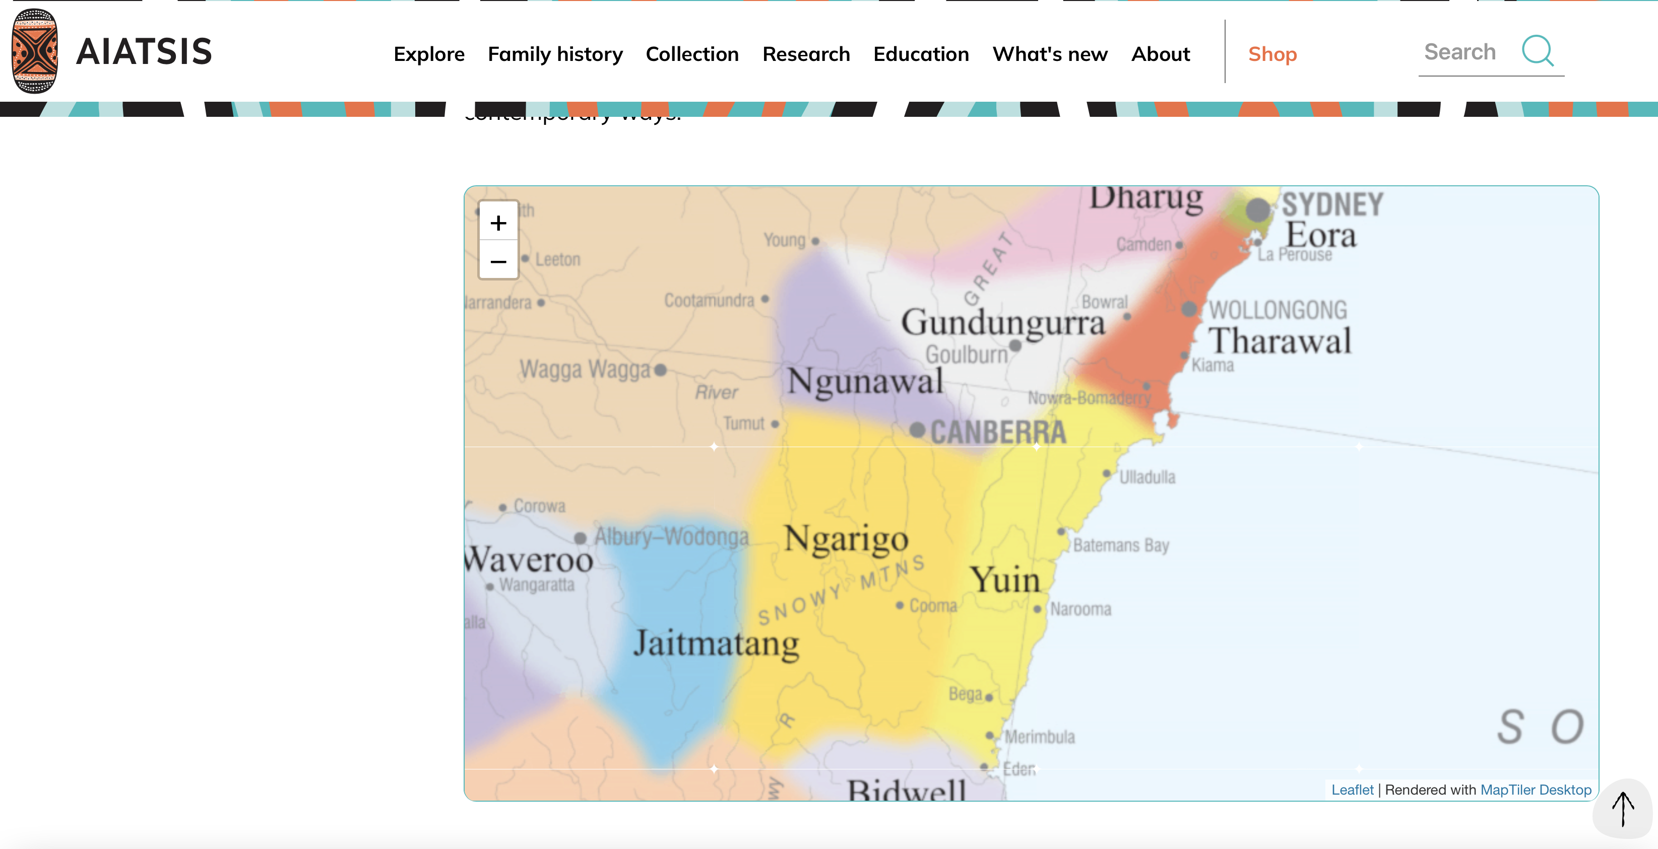
ANU Acknowledgment of Country
“We acknowledge and celebrate the First Australians on whose traditional lands we meet, and pay our respect to the elders past and present.”
https://aiatsis.gov.au/explore/map-indigenous-australia
Notes:
https://www.anu.edu.au/students/contacts/tjabal-indigenous-higher-education-centre
https://services.anu.edu.au/human-resources/respect-inclusion/anu-acknowledgment-of-country
https://www.indigenous.gov.au/contact-us/welcome_acknowledgement-country
https://aiatsis.gov.au/explore/map-indigenous-australia

Slide 3
Open source development
Open source development is an approach to software development in which the source code of a software system is published and volunteers are invited to participate in the development process
Its roots are in the Free Software Foundation (www.fsf.org), which advocates that source code should not be proprietary but rather should always be available for users to examine and modify as they wish.
Open source software extended this idea by using the Internet to recruit a much larger population of volunteer developers. Many of them are also users of the code.

Slide 4
Open source systems
The best-known open source product is, of course, the Linux operating system which is widely used as a server system and, increasingly, as a desktop environment.
Other important open source products are Java, the Apache web server and the mySQL database management system.

Slide 5
Open source issues
Should the product that is being developed make use of open source components?
Should an open source approach be used for the software’s development?

Slide 6
Open source business
More and more product companies are using an open source approach to development.
Their business model is not reliant on selling a software product but on selling support for that product.
They believe that involving the open source community will allow software to be developed more cheaply, more quickly and will create a community of users for the software.

Slide 7
Open source licensing
A fundamental principle of open-source development is that source code should be freely available, this does not mean that anyone can do as they wish with that code.
Legally, the developer of the code (either a company or an individual) still owns the code. They can place restrictions on how it is used by including legally binding conditions in an open source software license.
Some open source developers believe that if an open source component is used to develop a new system, then that system should also be open source.
Others are willing to allow their code to be used without this restriction. The developed systems may be proprietary and sold as closed source systems.

Slide 8
License models
The GNU General Public License (GPL). This is a so-called ‘reciprocal’ license that means that if you use open source software that is licensed under the GPL license, then you must make that software open source.
The GNU Lesser General Public License (LGPL) is a variant of the GPL license where you can write components that link to open source code without having to publish the source of these components.
The Berkley Standard Distribution (BSD) License. This is a non-reciprocal license, which means you are not obliged to re-publish any changes or modifications made to open source code. You can include the code in proprietary systems that are sold.

Slide 9
License management
Establish a system for maintaining information about open-source components that are downloaded and used.
Be aware of the different types of licenses and understand how a component is licensed before it is used.
Be aware of evolution pathways for components.
Educate people about open source.
Have auditing systems in place.
Participate in the open source community.

Slide 10
“Free as in free speech.”

Slide 11
Open Source
aka Free Software
aka Free and Open Source Software

Slide 12
Open Source

Slide 13
Free Software vs Open Source
Free software origins (70-80s ~Stallman)
Cultish Political goal
Software part of free speech
free exchange, free modification
proprietary software is unethical
security, trust
GNU project, Linux, GPL license
Open source (1998 ~ O'Reilly)
Rebranding without political legacy
Emphasis on internet and large dev./user involvement
Openness toward proprietary software/coexist
(Think: Netscape becoming Mozilla)
Notes:
Most programs that meet the requirements of one are both: Free and Open Source Software (FOSS)
Differ mainly on focus (free software – user rights, sell once; open source – community benefits, other licenses acceptable)
Some sources will ignore the differences and then they are the same thing
Free software wants to remain independent and not get forced into open source. Open source wants to be seen as encompassing free software.
Is Free Software the same as Open Source?
Free Software Foundation (which he started) says otherwise
Open Source Initiative says they are the same
Why would each

Slide 14
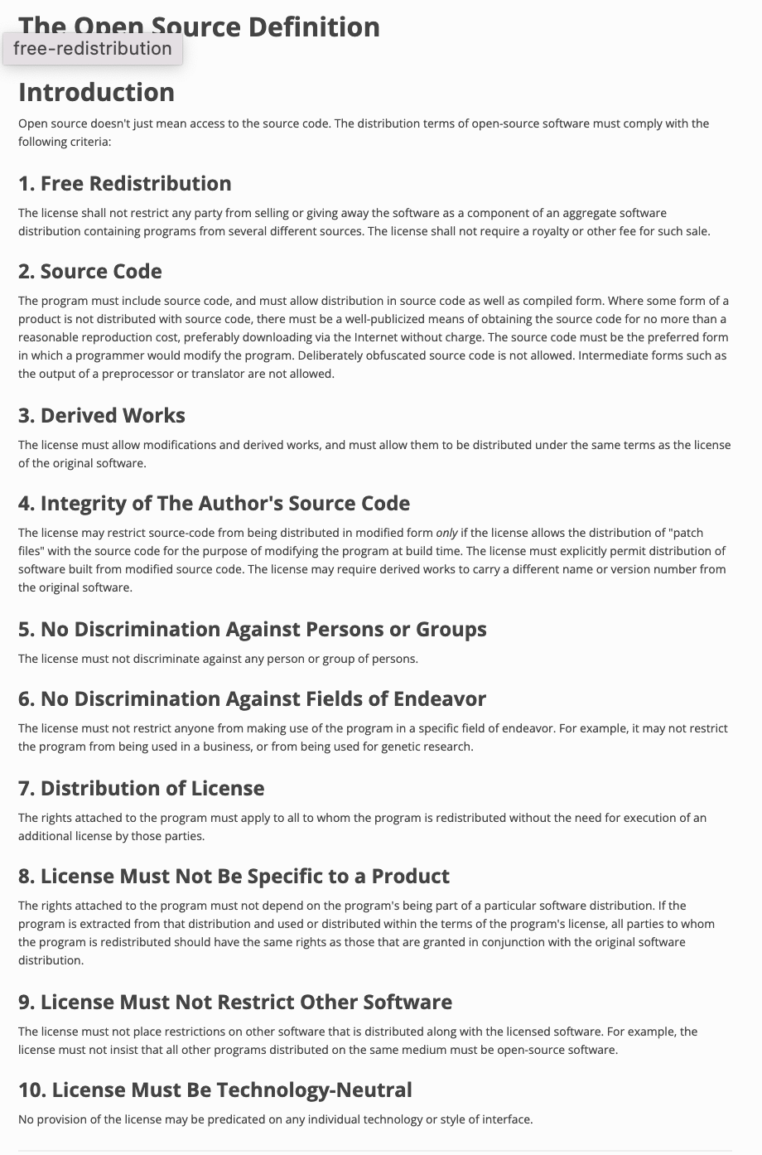
Free Software vs
Open Source
The freedom to run the program as you wish, for any purpose (freedom 0).
The freedom to study how the program works, and change it so it does your computing as you wish (freedom 1). Access to the source code is a precondition for this.
The freedom to redistribute copies so you can help your neighbor (freedom 2).
The freedom to distribute copies of your modified versions to others (freedom 3). By doing this you can give the whole community a chance to benefit from your changes. Access to the source code is a precondition for this.

Slide 15
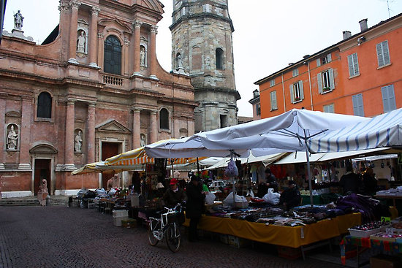
The Cathedral and the Bazaar
Notes:
Cathedral (closed source)
Top-down design with focus on planning
Bazaar (open source)
Organic bottom-up movement
Code always public over internet
Linux/Fetchmail stories

Slide 16
https://www.tesla.com/blog/all-our-patent-are-belong-you

Slide 17
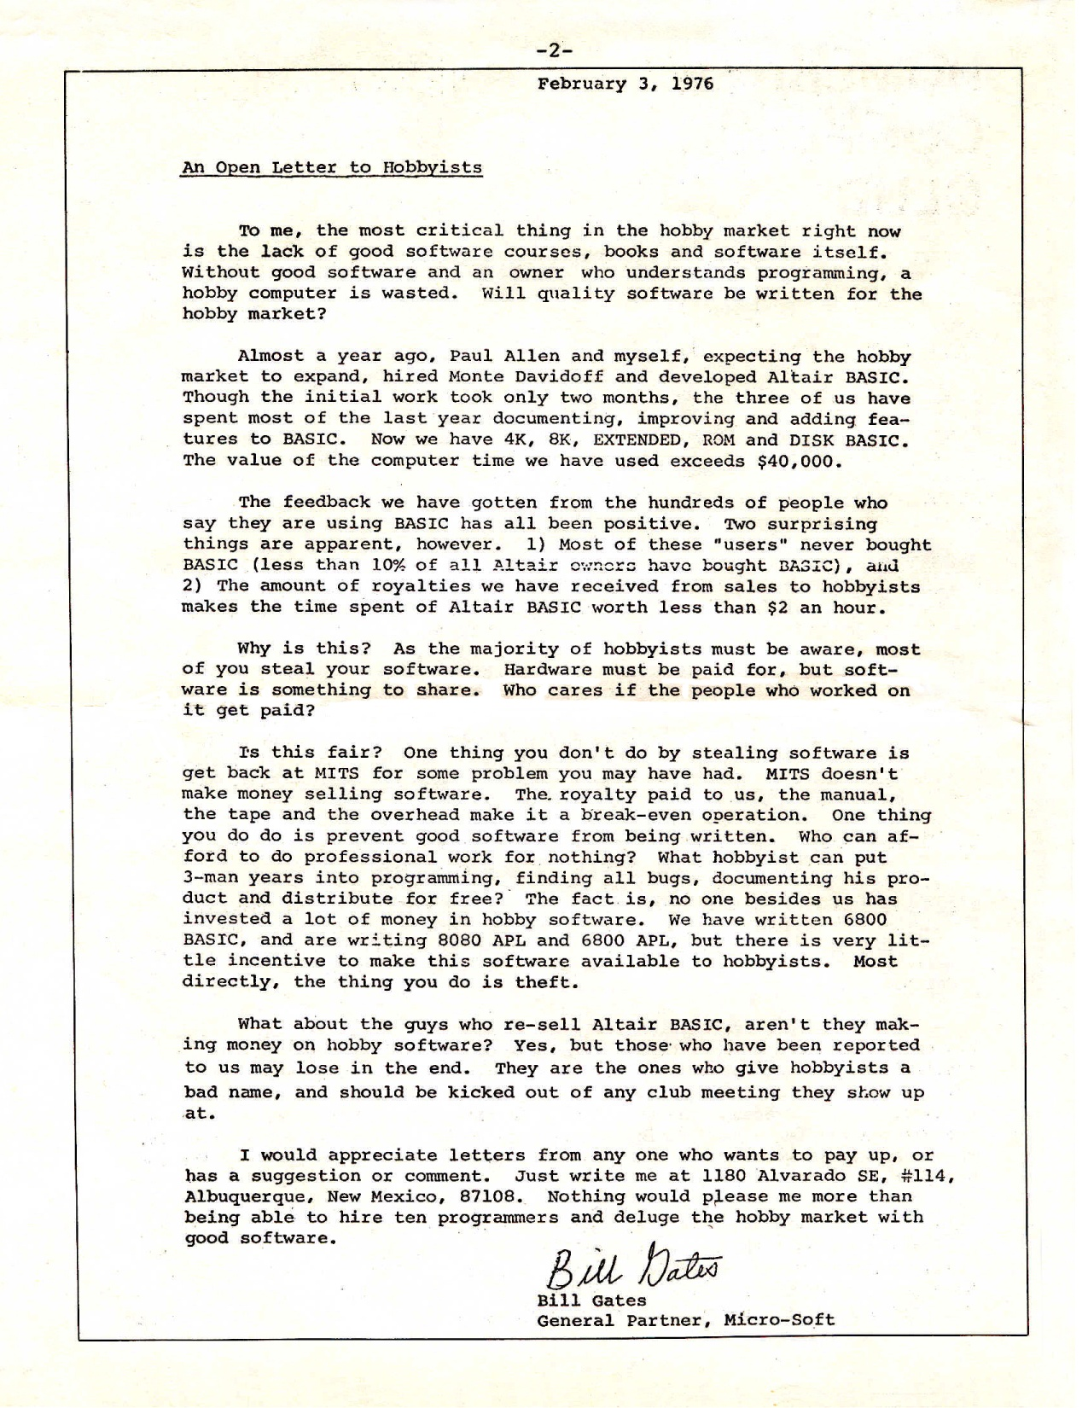
Tables have turned
Notes:
Why? Microsoft is moving towards cloud services --- Azure and Office 365. 20% of the OS systems on Azure are linux. Azure is the only proprietary cloud out there (AWS, Google, OpenStack are all Linux). Also supporting lots of other things and parts of .Net. Its Android patents still provide way more in profits than Windows phone. By 2011, 5th largest contributor the kernel (making sure Linux could work with HyperV).
https://en.wikipedia.org/wiki/Open_Letter_to_Hobbyists

Slide 18
Risks of not open sourcing something?

Slide 19
Understanding Licenses NOTE: IANAL (I am not a lawyer)

Slide 20
Why learn about licenses?
Companies will avoid certain licenses – commonly the copyleft licenses
Specific licenses may provide competitive advantages
You may eventually want to release open source software or become more involved in an open source project

Slide 21
Open Source Licenses
Software | Percentage
MIT License | 24%
GNU General Public License (GPL) 2.0 | 23%
Apache License 2.0 | 16%
GNU General Public License (GPL) 3.0 | 9%
BSD License 2.0 (3-clause, New or Revised) License | 6%
GNU Lessor General Public License (LGPL) 2.1 | 5%
Artistic License (Perl) | 4%
GNU Lesser General Public License (LGPL) 3.0 | 2%
Microsoft Public License | 2%
Eclipse Public License | 2%
List from: https://www.blackducksoftware.com/resources/data/top-20-open-source-licenses

Slide 22
GNU General Public License: The Copyleft License
Nobody should be restricted by the software they use. There are four freedoms that every user should have:
the freedom to use the software for any purpose,
the freedom to change the software to suit your needs,
the freedom to share the software with your friends and neighbors, and
the freedom to share the changes you make.
Code must be made available
Any modifications must be relicensed under the same license (copyleft)

Slide 23
GPL 2.0 and 3.0 – Addresses
free software problems
2.0 - Court ruling cannot nullify the license and if a court decision and this license contradict in distribution requirements, then the software cannot be distributed
3.0 – patent grant and prevent Tivoization
Not compatible with each other; Can’t copyleft both at the same time – phrase: “GLP Version 3 or any later version”
Notes:
Patent Grant – users are able to use any patent held by the contributor of the project if the project uses the patent. Users are able to distribute and sell the software free of charge. Tivoization – releasing the software but restricting the hardware to only run authorized versions of the software. Tivo did this but having the hardware check for a Tivo digital signature.

Slide 24
Why would projects choose one license
over another?
[From http://choosealicense.com/licenses/]
Notes:
Pass out MIT license or use slide
Ask class which license would a researcher want to use and why?
Which license would a small business want to use and why?
Mention Microsoft created their open source licenses – which is pretty permissive but demonstrates that larger companies may want to address other issues – for there most permissive license, only the source code is copyleft. You can use the open source program in a proprietary program as long as you only use the binaries.

Slide 25
Dual License Business Model
Released as GPL which requires a company using the open source product to open source it’s application
Or companies can pay $2,000 to $10,000 annually to receive a copy of MySQL with a more business friendly license

Slide 26
Risk: Incompatible Licenses
Sun open sourced OpenOffice, but when Sun was acquired by Oracle, Oracle temporarily stopped the project.
Many of the community contributors banded together and created LibreOffice
Oracle eventually released OpenOffice to Apache
LibreOffice changed the project license so LibreOffice can copy changes from OpenOffice but OpenOffice cannot do the same due to license conflicts

Slide 27
MIT License
Must retain copyright credit
Software is provided as is
Authors are not liable for software
No other restrictions

Slide 28
LGPL
Software must be a library
Similar to GPL but no copyleft requirement

Slide 29
BSD License
No liability and provided as is.
Copyright statement must be included in source and binary
The copyright holder does not endorse any extensions without explicit written consent

Slide 30
Apache License
Apache
Similar to GPL with a few differences
Not copyleft
Not required to distribute source code
Does not grant permission to use project’s trademark
Does not require modifications to use the same license

Slide 31
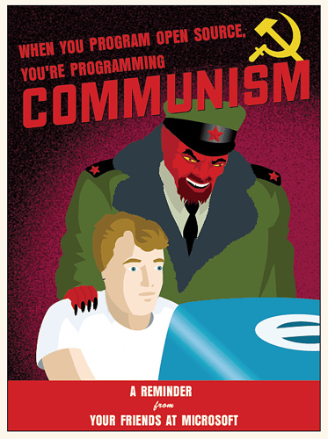
Perception:
Anarchy
Demagoguery
Ideology
Altruism
Many eyes

Slide 32
Dependency Management & Versioning
Michael Hilton and Rohan Padhye

Slide 33
Left-pad (March 22, 2016)
Notes:
Thousands of JS builds around the world broke simultaneously, including high-profile projects such as React
Somewhere something down the line depended on “left-pad”

Slide 34
Left-pad (March 22, 2016)
Notes:
Thousands of JS builds around the world broke simultaneously, including high-profile projects such as React
Somewhere something down the line depended on “left-pad”

Slide 35
Left-pad (Docs)
Notes:
What is left-pad? It’s a library to pad a string with spaces or zeros on the left to make it fit a particular width

Slide 36
Left-pad (Source Code)
Notes:
That’s it. That’s the entire of left-pad. Thousands of projects depended on this package.

Slide 37
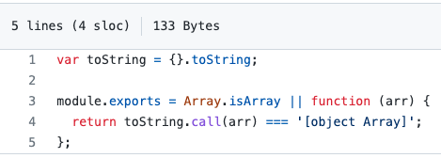
See also: isArray

Slide 38
Dependency Management
It’s hard
It’s mostly a mess (everywhere)
But it’s critical to modern software development

Slide 39
What is a Dependency?
Core of what most build systems do
“Compile” and “Run Tests” is just a fraction of their job
Examples: Maven, Gradle, NPM, Bazel, …
Foo->Bar: To build Foo, you may need to have a built version of Bar
Dependency Scopes:
Compile: Foo uses classes, functions, etc. defined by Bar
Runtime: Foo uses an abstract API whose implementation is provided by Bar (e.g. logging, database, network or other I/O)
Test: Foo needs Bar only for tests (e.g. JUnit, mocks)
Internal vs. External Dependencies
Is Bar also built/maintained by your org or is it pulled from elsewhere using a package manager?

Slide 40
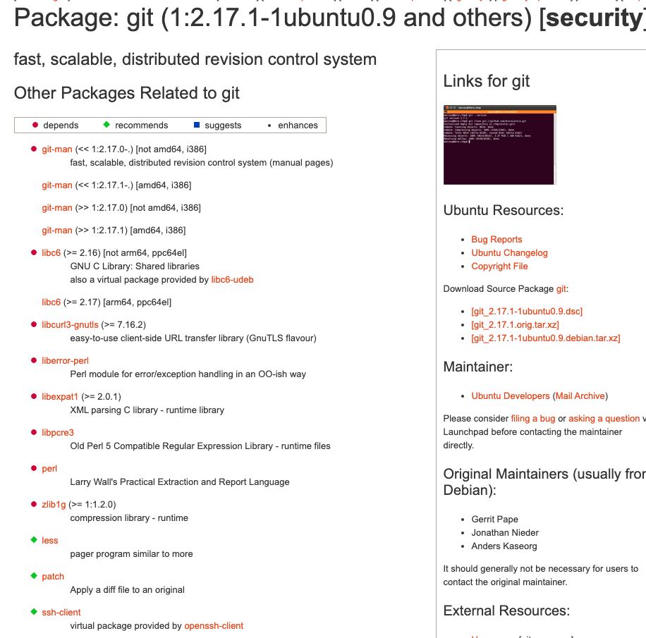
Dependencies: Example
Notes:
Mayan-EDMS depends on Django, PyPDF, JSON, etc.
“apt install git” will also pull in GNU C library, Perl, “patch”, “SSL client, Zlib (compression library), and others

Slide 41
Transitive Dependencies
Should Git be able to use exports of libSSL (e.g. certificate management) or zLib (e.g. gzip compression)?
libSSL
Git
SSH-client
zLib
Notes:
Running example from: https://packages.ubuntu.com/bionic/git

Slide 42
Diamond Dependencies
What are some problems when multiple intermediate dependencies have the same transitive dependency?
SSH-Client
Git
libSSL
libHTTP
Generally, can also be across levels
Git
zLib
SSH-Client
libSSSL
libHTTP

Slide 43
Diamond Dependencies
What are some problems when multiple intermediate dependencies have the same transitive dependency?
SSH-Client 1.7.6
libSSL 1.0.2
Git 2.17.1
libHTTP 2.14
libSSL 1.1

Slide 44
Resolutions to the Diamond Problem
Duplicate it!
Doesn’t work with static linking (e.g. C/C++), but may be doable with Java (e.g. using ClassLoader hacking or package renaming)
Values of types defined by duplicated libraries cannot be exchanged across
Ban transitive dependencies; just use a global list with one version for each
Challenge: Keeping things in sync with latest
Challenge: Deciding which version of transitive deps to keep
Newest version (keep everything at latest)
Requires ordering semantics
Intermediate dependency may break with update to transitive
Oldest version (lowest denominator)
Also requires ordering semantics
Sacrifices new functionality
Oldest non-breaking version / Newest non-breaking version
Requires faith in tests or semantic versioning contract

Slide 45
Semantic Versioning
Widely used convention for versioning releases
E.g. 1.2.1, 3.1.0-alpha-1, 3.1.0-alpha-2, 3.1.0-beta-1, 3.1.0-rc1
Format: {MAJOR} . {MINOR} . {PATCH}
Each component is ordered (numerically, then lexicographically; release-aware)
1.2.1 < 1.10.1
3.1.0-alpha-1 < 3.1.0-alpha-2 < 3.1.0-beta-1 < 3.1.0-rc1 < 3.1.0
Contracts:
MAJOR updated to indicate breaking changes
Same MAJOR version => backward compatibility
MINOR updated for additive changes
Same MINOR version => API compatibility (important for linking)
PATCH updates functionality without new API
Ninja edit; usually for bug fixes

Slide 46
https://semver.org/
Notes:
Versioning document is itself versioned!!!

Slide 47
Dependency Constraints
E.g. Declare dependency on ”Bar > 2.1”
Bar 2.1.0, 2.1.1, 2.2.0, 2.9.0, etc. all match
2.0.x does NOT match
3.0.x does NOT match
Diamond dependency problem can be resolved using SAT solvers
E.g. Foo 1.0.0 depends on “Bar >= 2.1” and “Baz 1.8.x”
Bar 2.1.0 depends on “Qux [1.6, 1.7]”
Bar 2.1.1 depends on “Qux 1.7.0”
Baz 1.8.0 depends on “Qux 1.5.x”
Baz 1.8.1 depends on “Qux 1.6.x”
Find an assignment such that all dependencies are satisfied
Solution: Use Bar 2.1.0, Baz 1.8.1, and Qux 1.6.{latest}

Slide 48
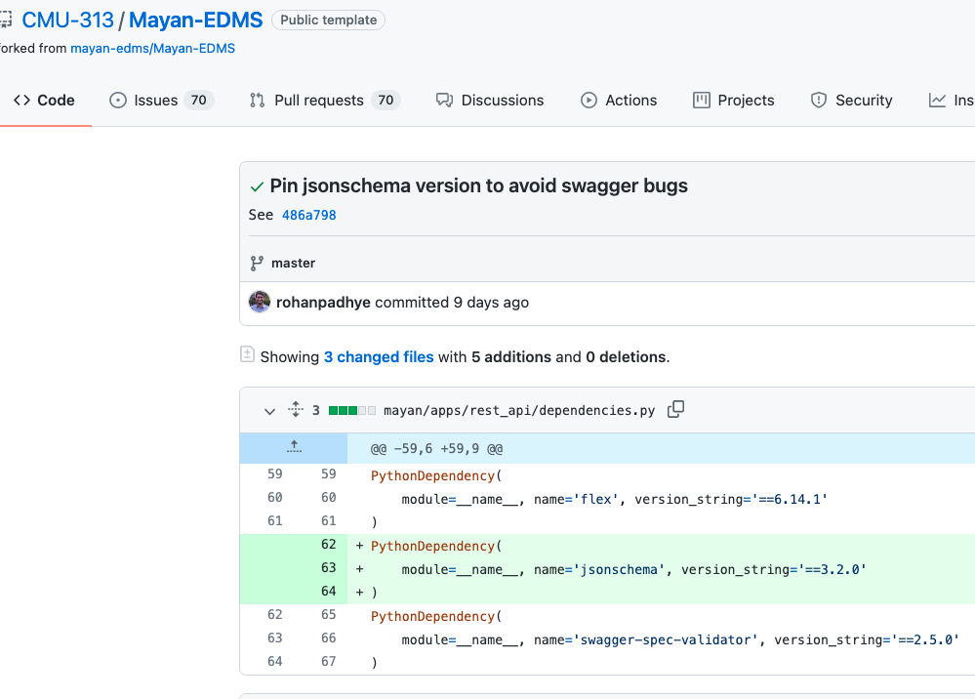
Semantic Versioning Contracts
Largely trusting developers to maintain them
Constrained/range dependencies can cause unexpected build failures
Automatic validation of SemVer is hard
Notes:
Mayan-EDMS: Build that worked during HW2 (two months ago) suddenly started failing on the same commit last week when we were prepping for HW5
Turns out “jsonschema” version was not constrained, and the new version breaks the Mayan build
Solution: Fix jsonschema version to an old version
It probably broke a semver contract

Slide 49
Cyclic Dependencies
A very bad thing
Avoid at all costs
Sometimes unavoidable or intentional
E.g. GCC is written in C (needs a C compiler)
E.g. Apache Maven uses the Maven build system
E.g. JDK tested using JUnit, which requires the JDK to compile
A
B

Slide 50
Cyclic Dependencies
Bootstrapping: Break cycles over time
Assume older version exists in binary (pre-built form)
Step 1: Build A using an older version of B
Step 2: Build B using new (just built) version of A
Step 3: Rebuild A using new (just built) version of B
Now, both A and B have been built with new versions of their dependencies
Doesn’t work if both A and B need new features of each other at the same time (otherwise Step 1 won’t work)
Assumes incremental dependence on new features
How was the old version built in the first place? (it’s turtles all the way down)
Assumption: cycles did not exist in the past
Successfully applied in compilers (e.g. GCC is written in C)

Slide 51
Dependency Reliability
Availability
Remember left-pad?
Many orgs will mirror package repositories
Security
Will you let strangers execute arbitrary code on your laptop?
Think about this every time you do “pip install” or “npm install” or “apt-get upgrade” or “brew upgrade” or whatever (esp. with sudo)
Scary, right? Who are you trusting? Why?
Typo squatting
“pip install numpi”

Slide 52
Week 12 Group Presentations!

Slide 53
Key points
When developing software, you should always consider the possibility of reusing existing software, either as components, services or complete systems.
Configuration management is the process of managing changes to an evolving software system. It is essential when a team of people are cooperating to develop software.
Most software development is host-target development. You use an IDE on a host machine to develop the software, which is transferred to a target machine for execution.
Open source development involves making the source code of a system publicly available. This means that many people can propose changes and improvements to the software.

Slide 54
Key Points
Understand the terminology “free software” and explain open source culture and principles.
Express an educated opinion on the philosophical/political debate between open source and proprietary principles.

Slide 55
Key Points
Dependency management is hard.

Slide 56
Mini Break in Monday Lecture

Slide 57
Autonomous Vehicle Study

Slide 58
Autonomous Vehicle Study
See the “bike prediction” and “side pass” features from the videos (https://www.youtube.com/watch?v=XAQeL8eflT0 and https://www.youtube.com/watch?v=BXNDUtNZdM4 )
What part of the software is responsible for implementing this feature?
Source: https://github.com/ApolloAuto/apollo
Doxygen: https://hidetoshi-furukawa.github.io/apollo-doxygen/index.html
Notes:
After playing around with the source code and not seeing anything interesting, give students a handout of 6 arch diagrams and ask them to circle components that implement this feature. Students should do this exercise in teams of 3-4.
1. For the Apollo case study, start with asking a specific question that requires diving into the source code to answer (e.g. “what file implements the side pass features?”). Otherwise, students will lead you to docs anyway.
2. Make sure that students do the Apollo diagrams assignment in groups of at least 2 (pref 3-4), so that they have a discussion

Slide 59
Apollo Software Stack

Slide 60
Apollo Software Architecture
Source: https://github.com/ApolloAuto/apollo/blob/v6.0.0/docs/specs/Apollo_5.5_Software_Architecture.md

Slide 61
Apollo Hardware Architecture
Source: https://github.com/ApolloAuto/apollo/blob/v6.0.0/README.md

Slide 62
Apollo Hardware/Vehicle Overview
Source: https://github.com/ApolloAuto/apollo/blob/v6.0.0/README.md

Slide 63
Apollo Perception Module

Slide 64
Apollo ML Models
Source: Zi Peng, Jinqiu Yang, Tse-Hsun (Peter) Chen, and Lei Ma. 2020. A First Look at the Integration of Machine Learning Models in Complex Autonomous Driving Systems: A Case Study on Apollo. In Proceedings of the 28th ACM Joint European Software Engineering Conference and Symposium on the Foundations of Software Engineering (ESEC/FSE ’20), https://doi.org/10.1145/ 3368089.3417063

Slide 65
Apollo Software Architecture
Source: https://github.com/ApolloAuto/apollo/blob/v6.0.0/docs/specs/Apollo_5.5_Software_Architecture.md

Slide 66
Feature Evolution (Software Stack View)
Source: https://github.com/ApolloAuto/apollo

Slide 67
ExerCIse: update to lidar module
Notes:
What components would change? Which teams would be interested? What tests need to be run again?

Slide 68
Feature Evolution (Software Stack View)
Source: https://github.com/ApolloAuto/apollo

Slide 69
Software Architecture
The software architecture of a program or computing system is the structure or structures of the system, which comprise software elements, the externally visible properties of those elements, and the relationships among them.
[Bass et al. 2003]
Note: this definition is ambivalent to whether the architecture is known, or whether it’s any good!
Notes:
First, architecture defines software elements and embodies information about how they relate to each other; omits info about elements that does not pertain to their interaction.
An architecture is foremost an abstraction of a system that suppresses details of elements that do not affect how they use, are used by, relate to, or interact with other elements.
In nearly all modern systems, elements interact with each other by means of interfaces that partition details about an element into public and private parts. Architecture is concerned with the public side of this division; private details-those having to do solely with internal implementation-are not architectural.
"Externally visible" properties are those assumptions other elements can make of an element, such as its provided services, performance characteristics, fault handling, shared resource usage, and so on. Let's look at some of the implications of this definition in more detail.
The behavior of each element is part of the architecture insofar as that behavior can be observed or discerned from the point of view of another element. Such behavior is what allows elements to interact with each other, which is clearly part of the architecture.
(This is another reason that the box-and-line drawings that are passed off as architectures are not architectures at all.)
One set of structures used to describe a system is its implementation modules or units.
Static: focuses on the way the system's functionality is divided up and (often) assigned to implementation teams.
Another set of structures describe the way elements interact more explicitly.
E.g., consider a set of parallel processes that is described in terms of sequential behavior, interactions, and synchronization mechanisms.
Both convey architectural information, do not necessarily describe all interesting relationships/elements in the system.

Slide 70
Levels of Abstraction
Requirements
high-level “what” needs to be done
Architecture (High-level design)
high-level “how”, mid-level “what”
OO-Design (Low-level design, e.g. design patterns)
mid-level “how”, low-level “what”
Code
low-level “how”
Notes:
Functional req: final grade is computed using the grade type allocation (hw, me, fe)
Non-functional req: Students should be able to know their grades within 1 week of submission
OOD: why would we feel confident that grades are distributed on time? (i.e., submission and grading reporting as separate sub-systems)

Slide 71
Design vs. Architecture
Design Questions
How do I add a menu item in Eclipse?
How can I make it easy to add menu items in Eclipse?
What lock protects this data?
How does Google rank pages?
What encoder should I use for secure communication?
What is the interface between objects?
Architectural Questions
How do I extend Eclipse with a plugin?
What threads exist and how do they coordinate?
How does Google scale to billions of hits per day?
Where should I put my firewalls?
What is the interface between subsystems?
Notes:
The best definitions don’t tell us what architecture actually is!

Slide 72
Objects
Model
Notes:
Dahl and Nygaard introduced Simula, for discrete event systems, that influenced C++ and other OOPLs

Slide 73
Design Patterns
Factory
View
Observer
Model
/ Subject
Controller
Command
Notes:
It wasn’t until the widespread adoption of C++ after the early 80’s that we could reflect on design patterns.
Recall the online grade system… Factory: pass in an Instructor, get the appropriate view

Slide 74
Design Patterns
Factory
View
Observer
Model
/ Subject
Controller
Command

Slide 75
Design Patterns
Factory
View
/
/
Observer
Model
/ Subject
Controller
Command
/
/

Slide 76
Architecture
Factory
View
/
/
Observer
Model
/ Subject
Controller
Command
/
/

Slide 77
Architecture
Factory
View
Observer
Model
/ Subject
Controller
Command

Slide 78
Architecture
Notes:
Sub-systems: scheduling, submission, grading, grade reporting

Slide 79
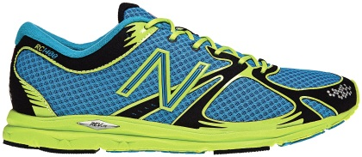
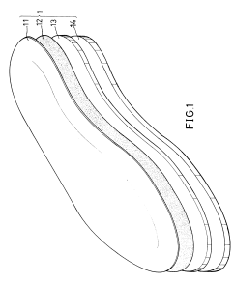
Architecture Disentangled
Architecture as structures and relations
(the actual system)
Architecture as documentation
(representations of the system)
Architecture as (design) process
(activities around the other two)
Notes:
Q: can someone tell me what architecture is, in their own words?
Process is meta to both: how to choose the system structures, how to choose documentation approach

Slide 80
Why Document Architecture?
Blueprint for the system
Artifact for early analysis
Primary carrier of quality attributes
Key to post-deployment maintenance and enhancement
Documentation speaks for the architect, today and 20 years from today
As long as the system is built, maintained, and evolved according to its documented architecture
Support traceability.

Slide 81
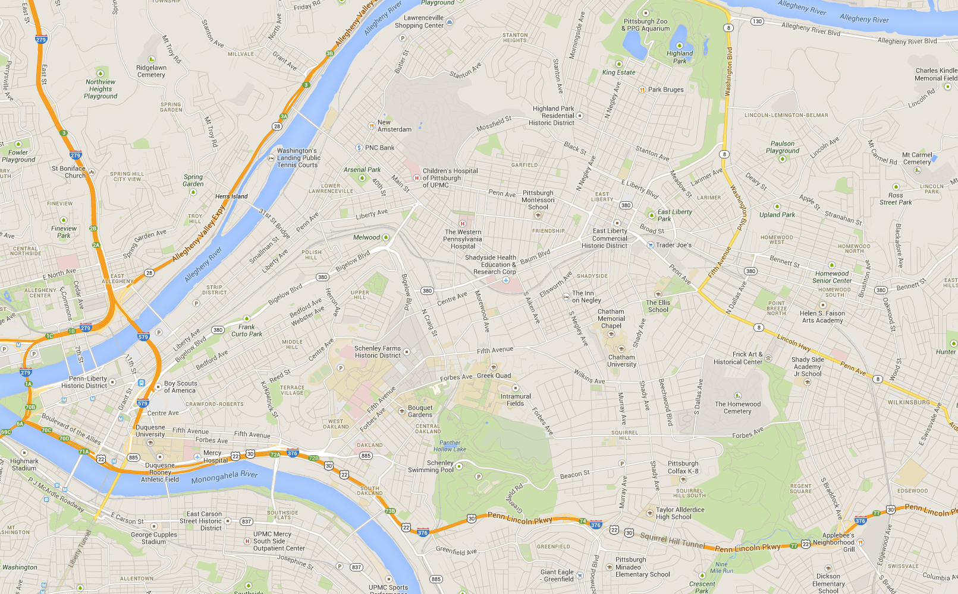

Slide 83
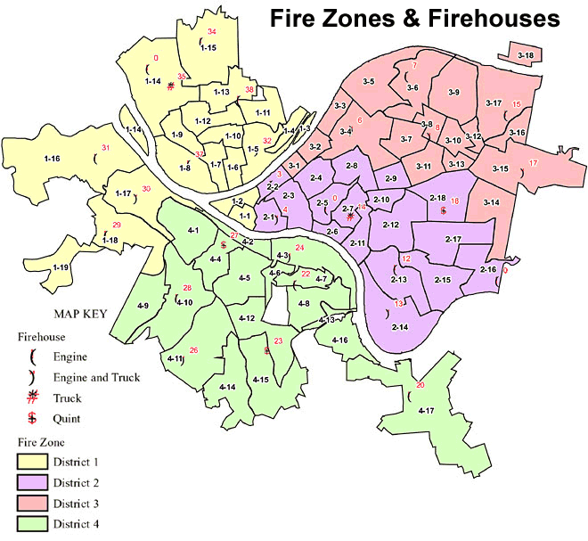
Notes:
Fire zones and fire houses

Slide 84
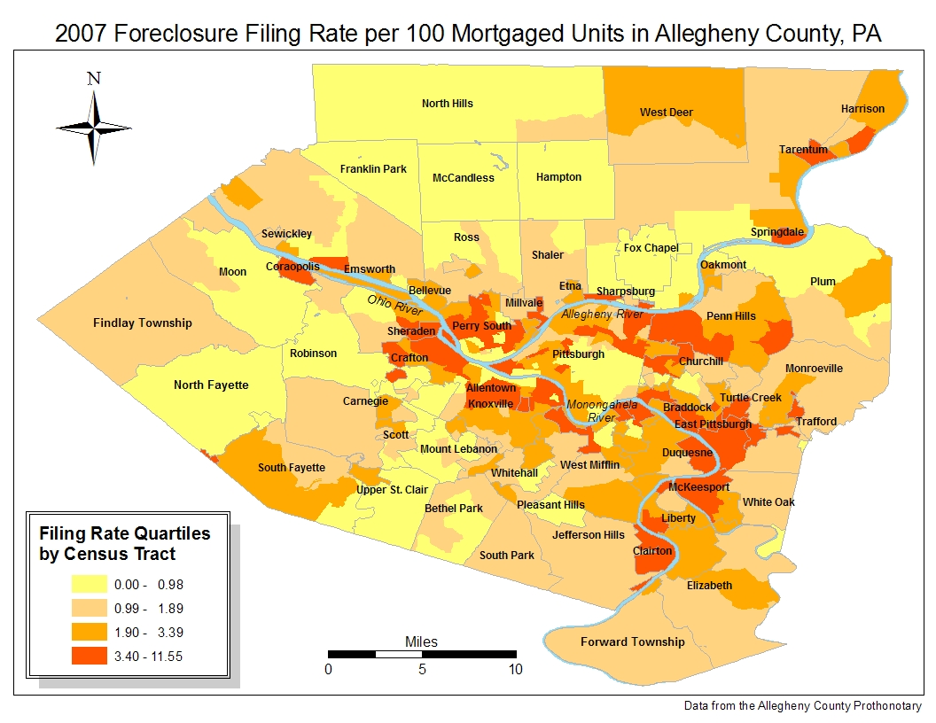
Notes:
Foreclosure filing rate

Slide 85
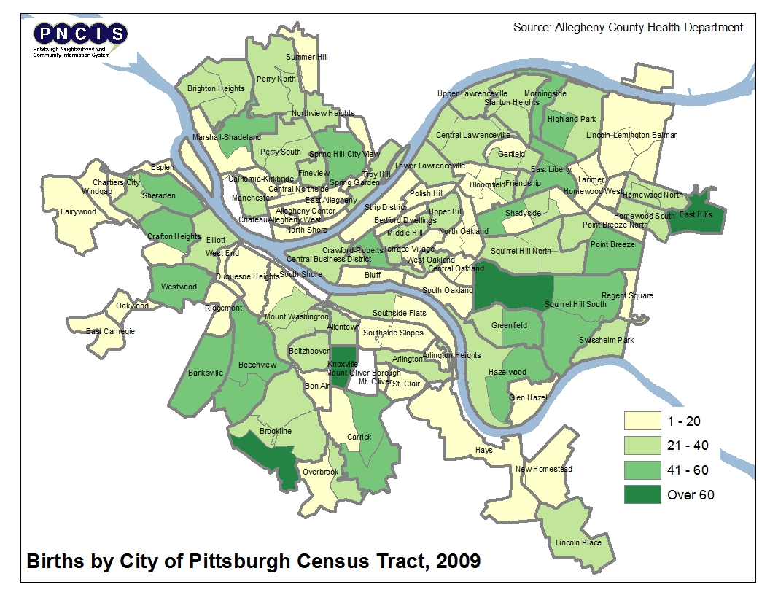
Notes:
Birth rate

Slide 86
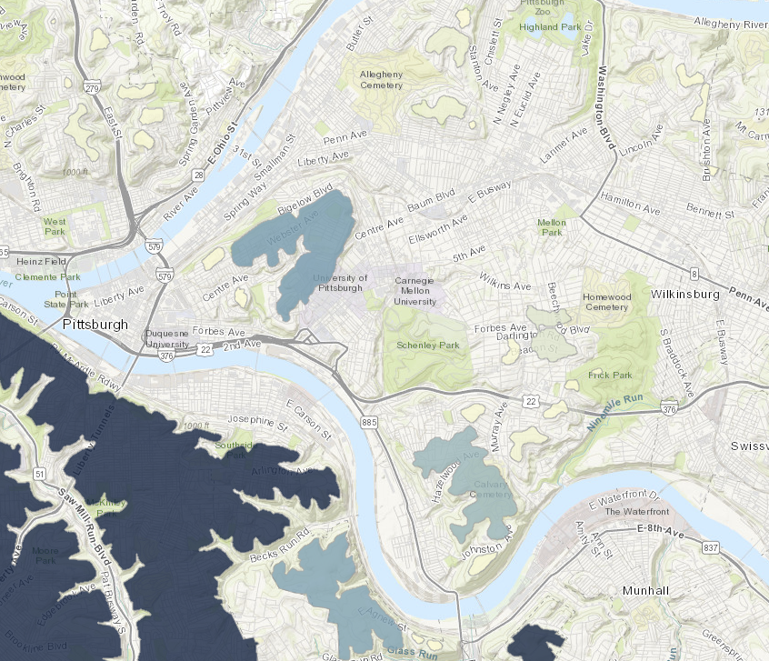

Slide 87
Common Views in Documenting Software Architecture
Static View
Modules (subsystems, structures) and their relations (dependencies, …)
Dynamic View
Components (processes, runnable entities) and connectors (messages, data flow, …)
Physical View (Deployment)
Hardware structures and their connections

Slide 88
Views and Purposes
Every view should align with a purpose
Different views are suitable for different reasoning aspects (different quality goals), e.g.,
Performance
Extensibility
Security
Scalability
…

Slide 89
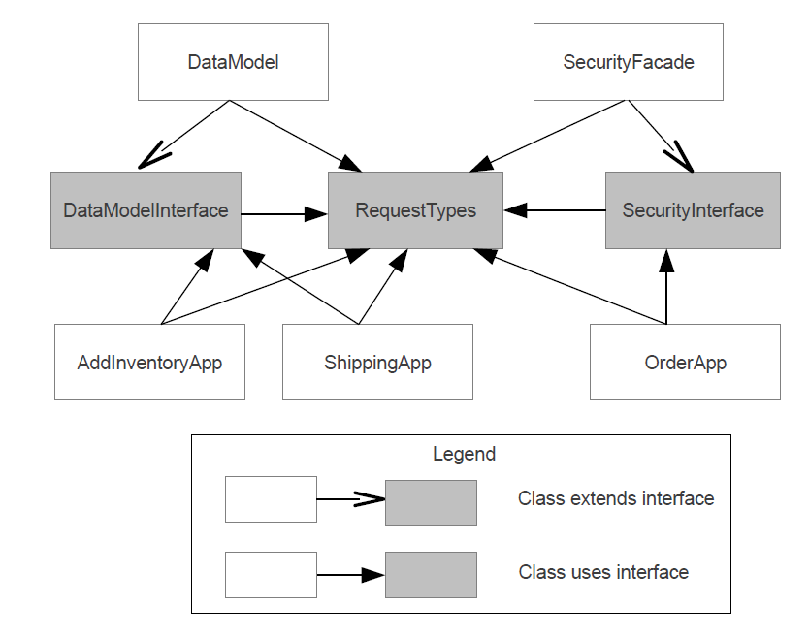

Slide 90
Orders
Inventory
Users
Data Model
Security Facade
AddInventoryApp
Shipping App
Order App

Slide 91
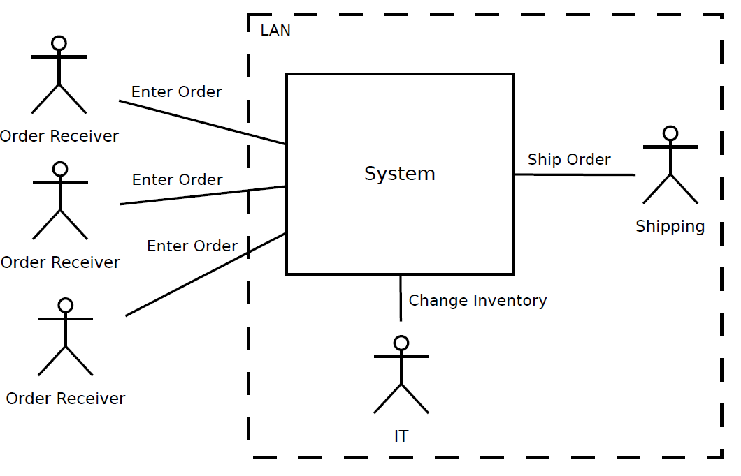

Slide 92
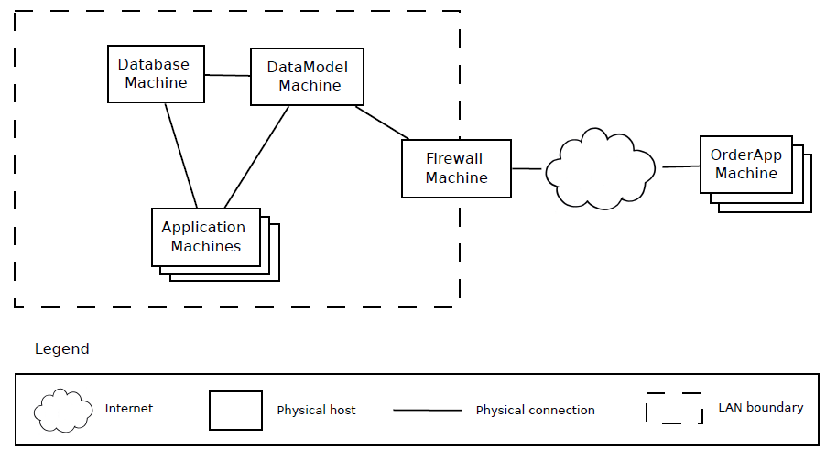

Slide 93
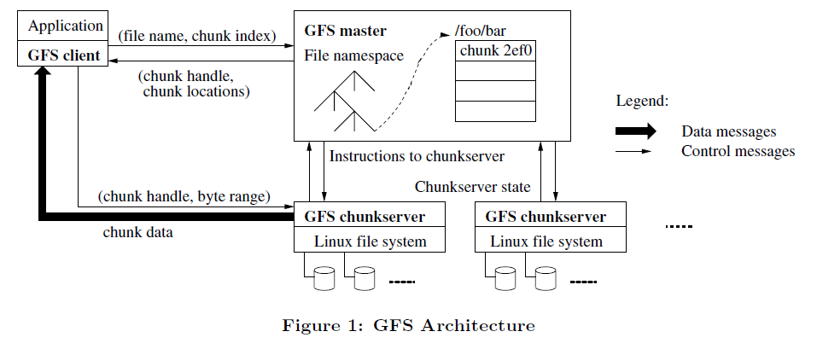
Ghemawat, Sanjay, Howard Gobioff, and Shun-Tak Leung. "The Google file system." ACM SIGOPS operating systems review. Vol. 37. No. 5. ACM, 2003.

Slide 94
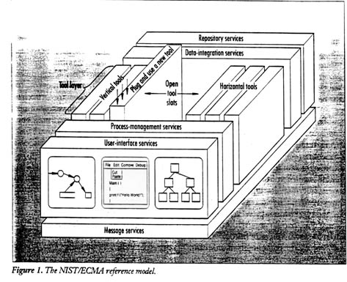
Examples of Architecture Descriptions

Slide 95
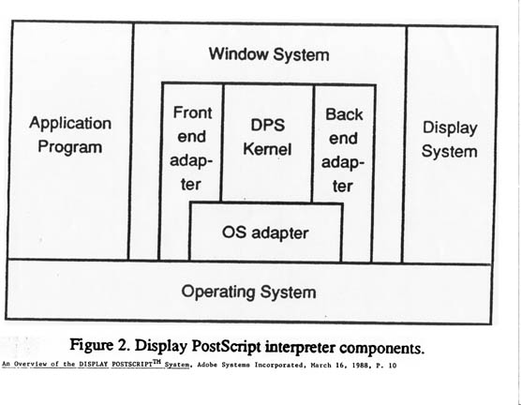

Slide 96
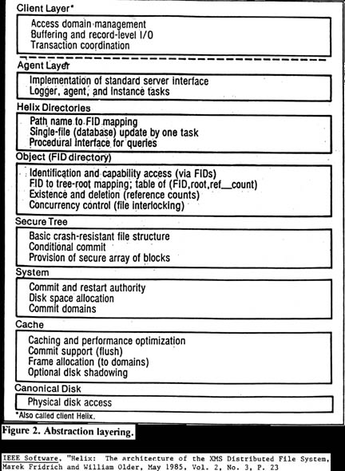

Slide 97
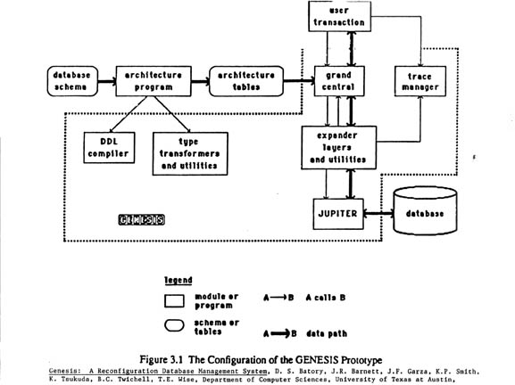

Slide 98
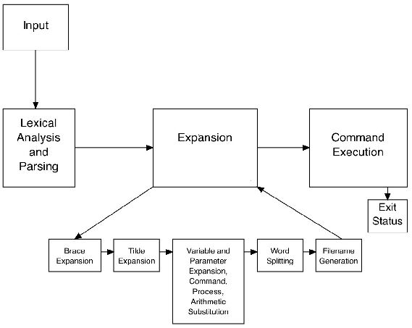
Bash Component Architecture
Example source:
http://www.aosabook.org

Slide 99
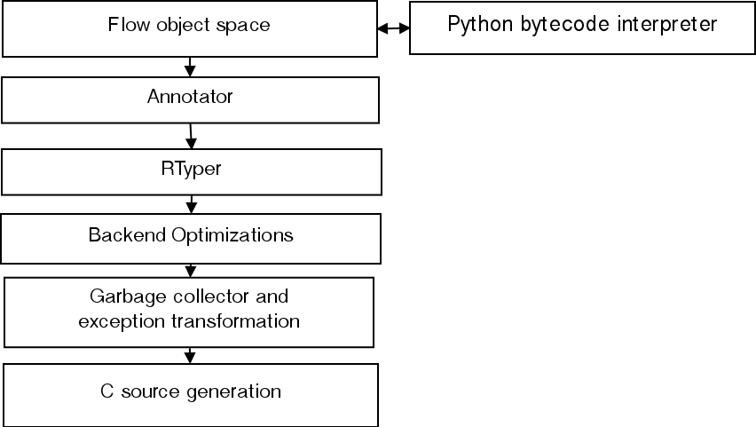
The RPython Translator, Translation steps
Example source:
http://www.aosabook.org

Slide 100
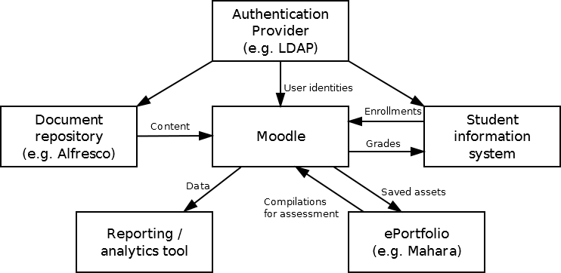
Moodle: Typical university systems architecture – Key subsystems
Example source:
http://www.aosabook.org

Slide 101
Selecting a Notation
Suitable for purpose
Often visual for compact representation
Usually boxes and arrows
UML possible (semi-formal), but possibly constraining
Note the different abstraction level – Subsystems or processes, not classes or objects
Formal notations available
Decompose diagrams hierarchically and in views

Slide 102
What is Wrong Today?
In practice today’s documentation consists of
Ambiguous box-and-line diagrams
Inconsistent use of notations
Confusing combinations of viewtypes
Many things are left unspecified:
What kind of elements?
What kind of relations?
What do the boxes and arrows mean?
What is the significance of the layout?
Notes:
Viewtypes: remember first architecture

Slide 103
Guidelines: Avoiding Ambiguity
Always include a legend
Define precisely what the boxes mean
Define precisely what the lines mean
Don't mix viewtypes unintentionally
Recall: Module (classes), C&C (components)
Supplement graphics with explanation
Very important: rationale (architectural intent)
Do not try to do too much in one diagram
Each view of architecture should fit on a page
Use hierarchy

Slide 104
Design Documents
Code review before there is code
Collaborative (Google Docs)
Ensure various concerns are covered, such as: security implications, internationalization, storage requirements, and privacy concerns.
A good design doc should cover:
Goals of the design
Implementation strategy
propose key design decisions with an emphasis on their individual tradeoffs

Slide 105
Design Documents
Best design docs suggest design goals, and cover alternative designs, documenting the strengths and weaknesses of each.

Slide 106
Key Points
Understand the abstraction level of architectural reasoning
Appreciate how software systems can be viewed at different abstraction levels
Distinguish software architecture from (object-oriented) software design
Use notation and views to describe the architecture suitable to the purpose
Document architectures clearly, without ambiguity

Slide 107
Key Points
Articulate the various purposes of a design document.
Use design documentation to ensure that the correct thing is being implemented.
Write useful, clear, high-quality design documentation.

Slide 108
Examples: SourceGraph RFCs
https://about.sourcegraph.com/handbook/communication/rfcs

Slide 110
When to use an RFC:
You want to frame a problem and propose a solution.
You want thoughtful feedback from team members on our globally-distributed remote team.
You want to surface an idea, tension, or feedback.
You want to define a project or design brief to drive project collaboration.
You need to surface and communicate around a highly cross-functional decision with our formal decision-making process.

Slide 111
Don’t use an RFC when:
You want to discuss personal or sensitive topics one-on-one with another team member.
You want to make a decision to change something where you are the decider. In the vast majority of cases, creating an RFC to explain yourself will be overkill. RFCs should only be used if a decision explicitly requires one of the bullets in the previous page.

Slide 112
RFC Labels
WIP: The author is still drafting the RFC and it’s not ready for review.
Review: The Review label is used when the RFC is ready for comments and feedback.
Approved: When the RFC is for the purpose of making a decision, the Approved label indicates that the decision has been made.
Implemented: When the RFC is for the purpose of making a decision, the Implemented label indicates that the RFC’s proposal has been implemented.
Closed: When the RFC is for the purpose of collaboration or discussion but not necessarily to make a decision or propose a specific outcome that will eventually become Implemented, the Closed label indicates that the RFC is no longer an active collaborative artifact.
Abandoned: When the RFC is for the purpose of making a decision, and there are no plans to move forward with the RFC’s proposal, the Abandoned label indicates that the RFC has been purposefully set aside.

Slide 113
Observe sourceGraph Design Docs
Docs are publicly available:
https://drive.google.com/drive/folders/1zP3FxdDlcSQGC1qvM9lHZRaHH4I9Jwwa
Notes:
https://docs.google.com/document/d/1MpcUDvtBMg2IcYOGGAGNwBZCUljlDMyvqm5UdzMqoOg/edit
+++ https://docs.google.com/document/d/1xXlN6eXBGLWA1px5rqfG6cLUJ-23h1-02KEJv_QpnwE/edit
https://docs.google.com/document/d/1kyx3PIee2EYbAKeKLT92CPqDnOZLU9v7WE9G_zJy7_o/edit
https://docs.google.com/document/d/1ym5c8G5JcrFf5s0QXJqQKBcZRziVAZZsxWdcUJ7Ukfw/edit#heading=h.sxjamvl1uyzk
https://docs.google.com/document/d/1KjV9pNkwCwqzV5ugW6Bn0eQDZw2L8lVuWaaf7IvVYgQ/edit

