Slide 1
  Constructing a System Knowledge Graph of User Tasks and Failures from Bug Reports to Support Soap Opera Testing
  Yanqi Su¹, Zheming Han¹, Zhenchang Xing^{1, 3}, Xin Xia², Xiwei Xu³, Liming Zhu^{3, 4}, Qinghua Lu³
  ¹Australian National University, ²Huawei , ³Data61, CSIRO, ⁴University of New South Wales
Notes:
Hello everyone.
My name is Yanqi. I am a Ph.D. student from the Australian National University.
It’s my great honor to be here to introduce our recent research work, Constructing a system knowledge graph of user tasks and failures from bug reports to support soap opera testing.

Slide 2
Agenda
01 | Motivation
02 | Approach
03 | Evaluation
04 | Conclusion and future work
Notes:
I will introduce this work in the following four parts.

Slide 3
Agenda
01 | Motivation
02 | Approach
03 | Evaluation
04 | Conclusion and future work
Notes:
Firstly, motivation

Slide 4
Motivation
Software Testing
Automated Software Testing
Manual Software Testing
Complementary
Scripted Testing
Exploratory Testing
pre-designed
In spite of a great deal of research focusing on test automation, manual software testing is unlikely to be replaced by automated testing in the foreseeable future.
On the fly
repetitive
varying
mechanical
creative
Notes:
https://www.atlassian.com/continuous-delivery/software-testing
https://www.perforce.com/blog/alm/what-is-exploratory-testing#:~:text=Exploratory%20testing%20allows%20you%20to,didn't%20do%20that%3F%E2%80%9D
Software testing can be divided into two parts, automated software testing and manual software testing.
Automated software testing contains scripted testing, which is pre-designed, repetitive and mechanical.
Manual software testing includes exploratory testing, the characteristics of it are on the fly, varying and creative.
Based on the characteristics of them, they are complementary to each other.
Besides, from a huge number of research work, although a great deal of research focusing on test automation, manual software testing is unlikely to be replaced by automated testing in the foreseeable future.
Make an analogy,
Think of scripted testing as taking a train. It's on rails. It will never deviate from that path.
Exploratory testing is more like driving a car. Your general goal is to get from point A to B, but you can take any path and deviation that catches your eye along the way.

Slide 5
Motivation
In parallel
test-related learning
test design
test execution
test result interpretation
Exploratory Testing
Exploratory testing has been shown to be effective at system testing level
Principles and guidelines have been proposed for performing and managing exploratory testing
No tools to support
Notes:
Exploratory testing treats test-related learning, test design, test execution, and test result interpretation as supportive activities that run in parallel.
Althought exploratory testing has been shown to be effective at system testing level, principles and guidelines have been proposed for performing and managing exploratory testing, no tools to support it.

Slide 6
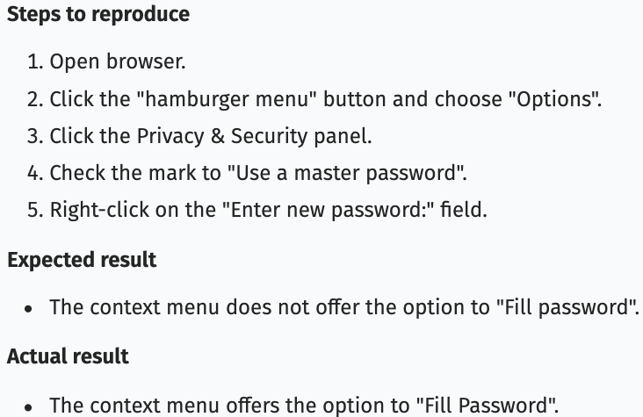


Motivation
How to support Exploratory Testing?
Bug Reports
Steps to Reproduce
reflect real-life system use
Expected/Actual Results
summarize what to attend for result interpretation and past failures
Notes:
But how to support exploratory testing?
We found bug reports contain useful information for supporting exploratory testing.
S2Rs reflect real-life system use, which can guide us how to do exploratory testing based on scenarios.
ERs and ARs summarize what goes wrong in the past, which can give us hints on finding bugs during exploratory testing.

Slide 7

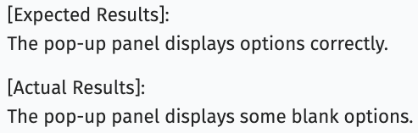
Bug 1572445
Motivation
Bug Reports as a Knowledge Source of User Tasks and Failures to support Exploratory Testing
Steps to Reproduce -> Scenarios
Bug 1764683
Notes:
Therefore, we use bug reports as a knowledge source of user tasks and failures to support exploratory testing.
For example, the steps to reproduce of this bug describes the scenario on setting a master password.

Slide 8
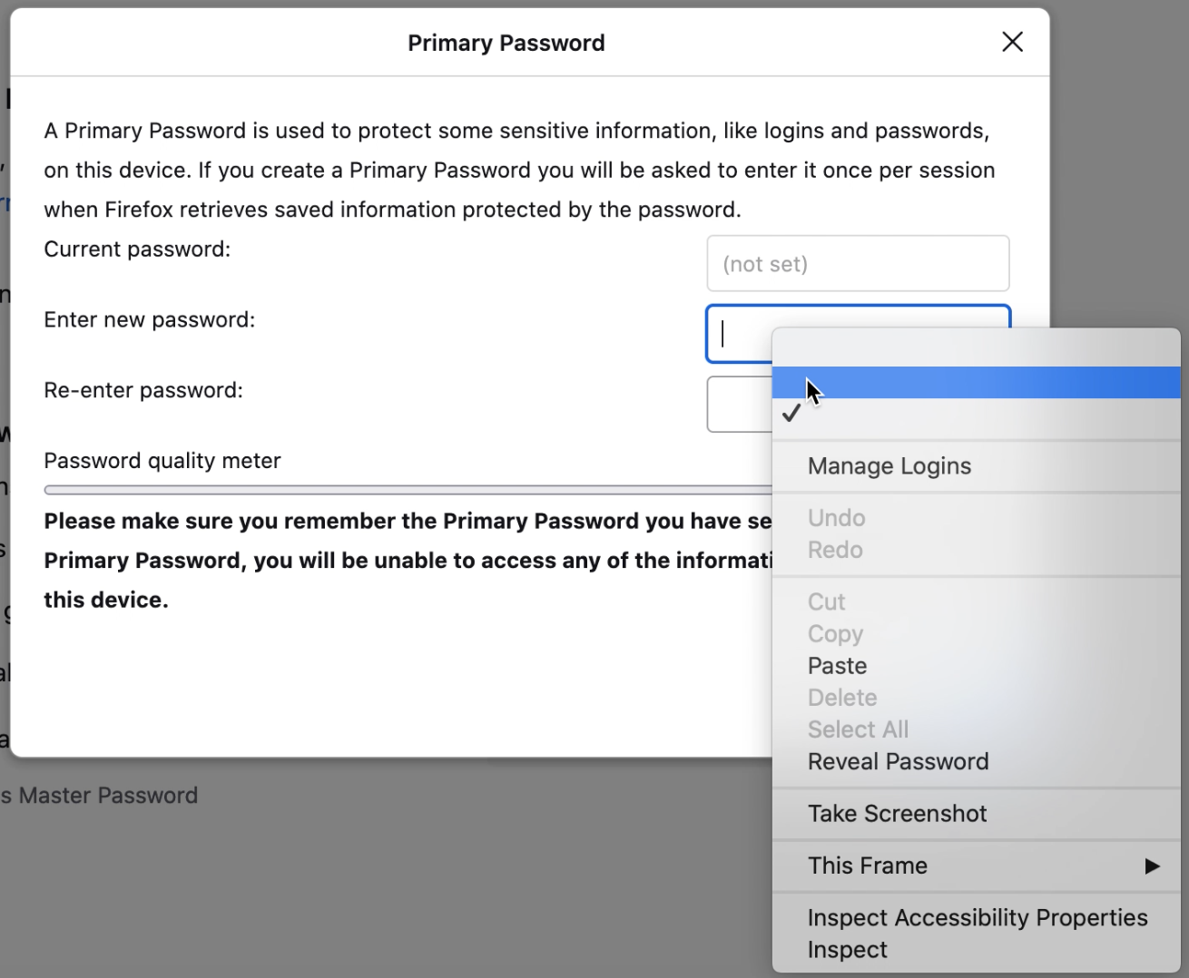
Bug 1572445
Motivation
Bug Reports as a Knowledge Source of User Tasks and Failures to support Exploratory Testing
Steps to Reproduce -> Scenarios
Bug 1764683
Notes:
By using this scenario, we find another new bug, namely when right-click on the “Enter new password:” field, the pop-up panel displays some blank options.

Slide 9
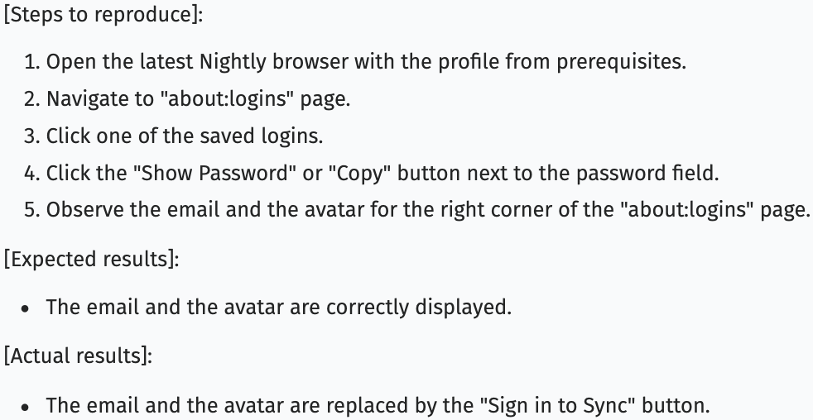
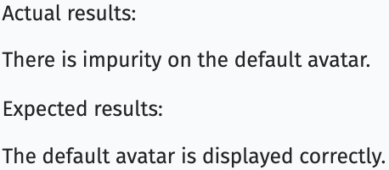
Bug 1570945
Motivation
Bug Reports as a Knowledge Source of User Tasks and Failures to support Exploratory Testing
Steps to Reproduce -> Scenarios
Expected/Actual Results -> Oracles
Bug 1744772
Notes:
Besides steps to reproduce, expected results and actual results also play an important role.
It can guide us where to focus.
For instance, the expected results and actual results of this bug is about whether the email and avatar can be displayed correctly.

Slide 10
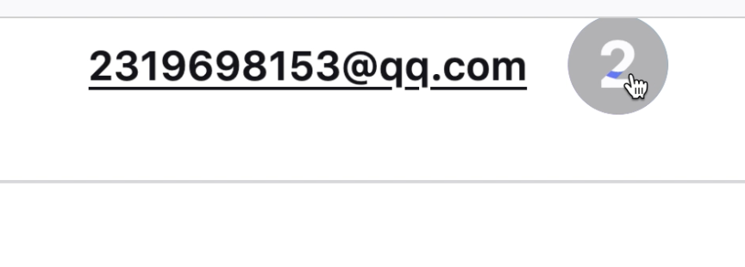
Motivation
2021-08-20--firefox-93.0a1
2021-12-07--firefox-94.0.2
Bug Reports as a Knowledge Source of User Tasks and Failures to support Exploratory Testing
Steps to Reproduce -> Scenarios
Expected/Actual Results -> Oracles
Bug 1744772
Notes:
From this hint, we observe the avatar and find there is impurity on the default avatar, a new bug found.
Note that this obvious bug exists more than three months until we found it.

Slide 11
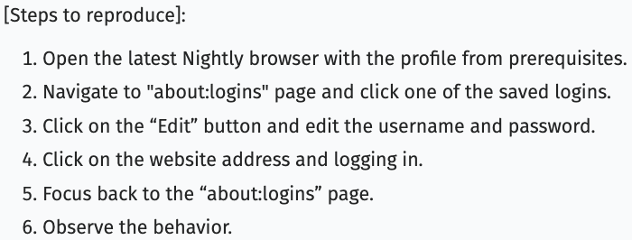
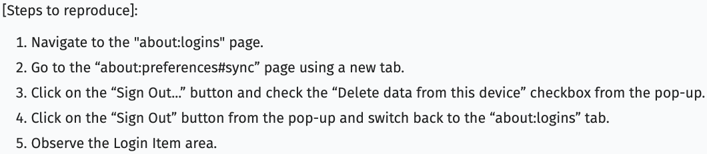
Motivation
Bug Reports
Bug Reports
Scenario Level Dramas
Common steps
Bug 1575516
Bug 1678633
Notes:
Moreover, after observing a number of bug reports, we found that some bug reports contain common steps.
By these common steps, we can get some new scenarios.
For example, these two bug reports have two common steps.

Slide 12
Motivation
Bug Reports
Bug Reports
Scenario Level Dramas
Bug 1575516
Common steps
Bug 1575516
Bug 1678633
Bug 1678633
Bug 1764756
Notes:
By appending the scenario of them, a soap opera is created

Slide 13
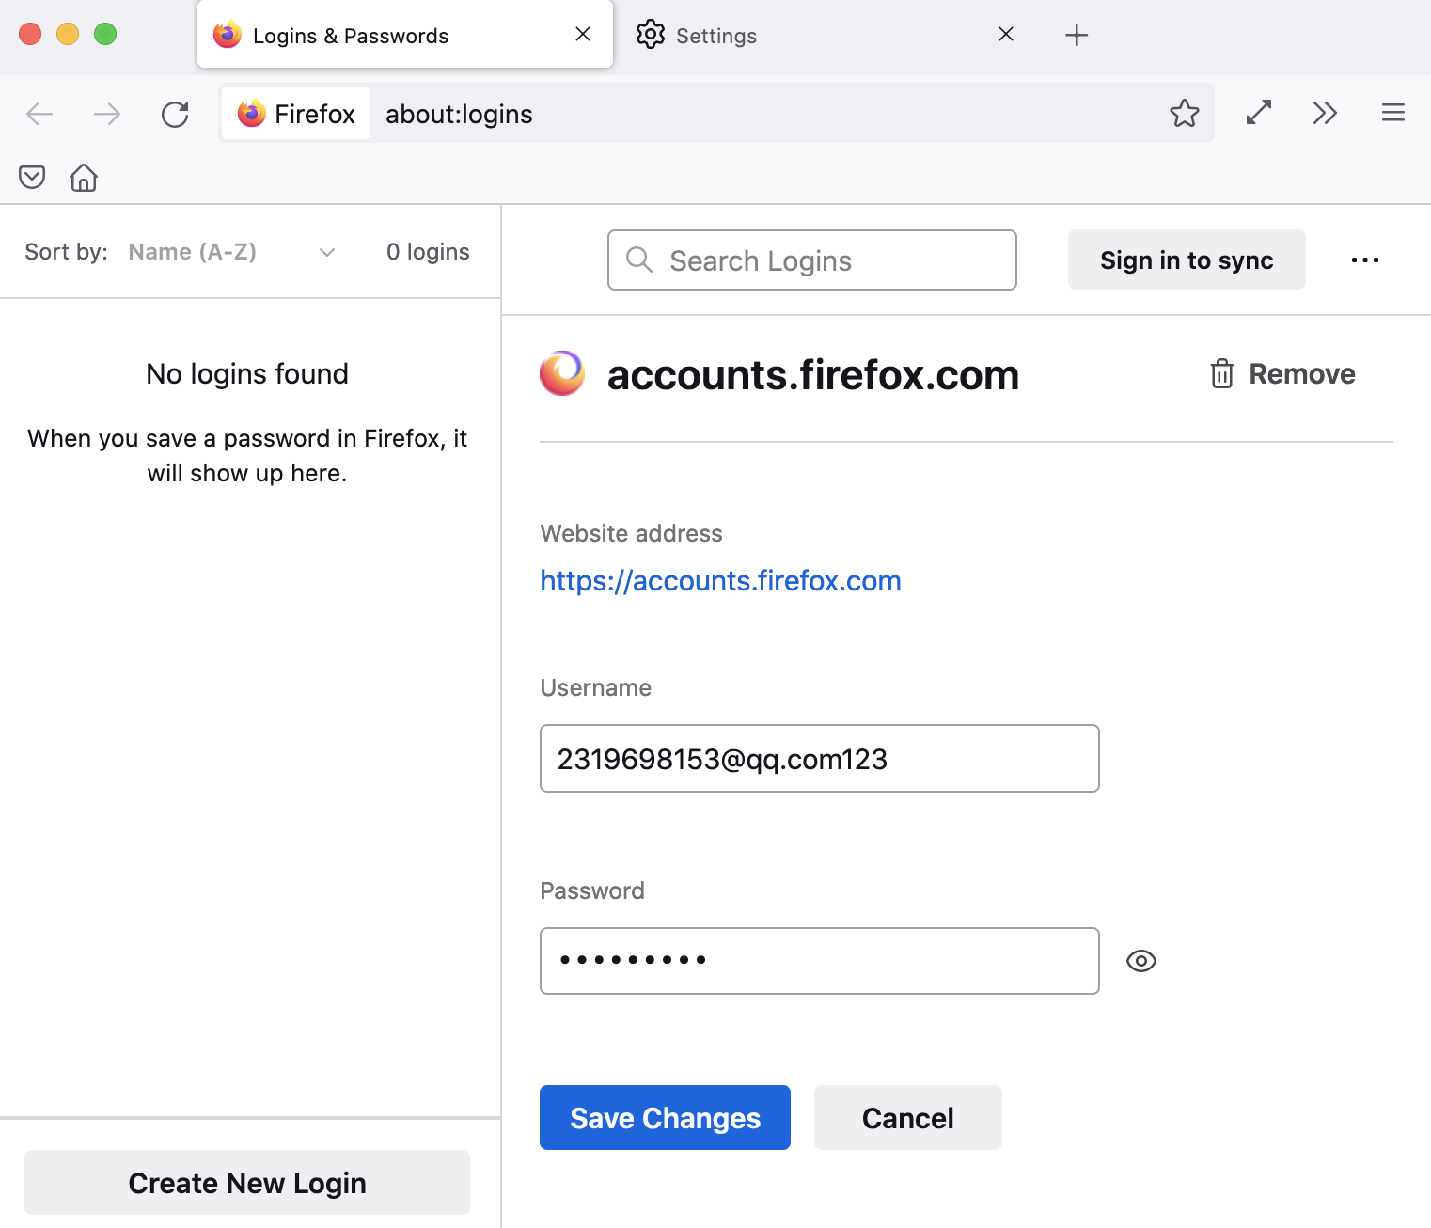
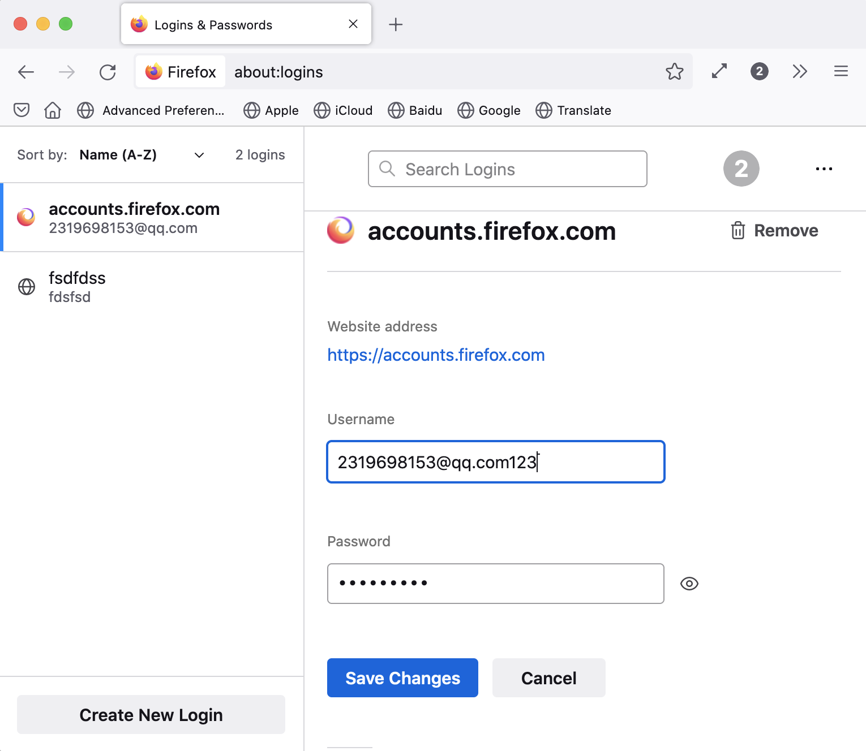
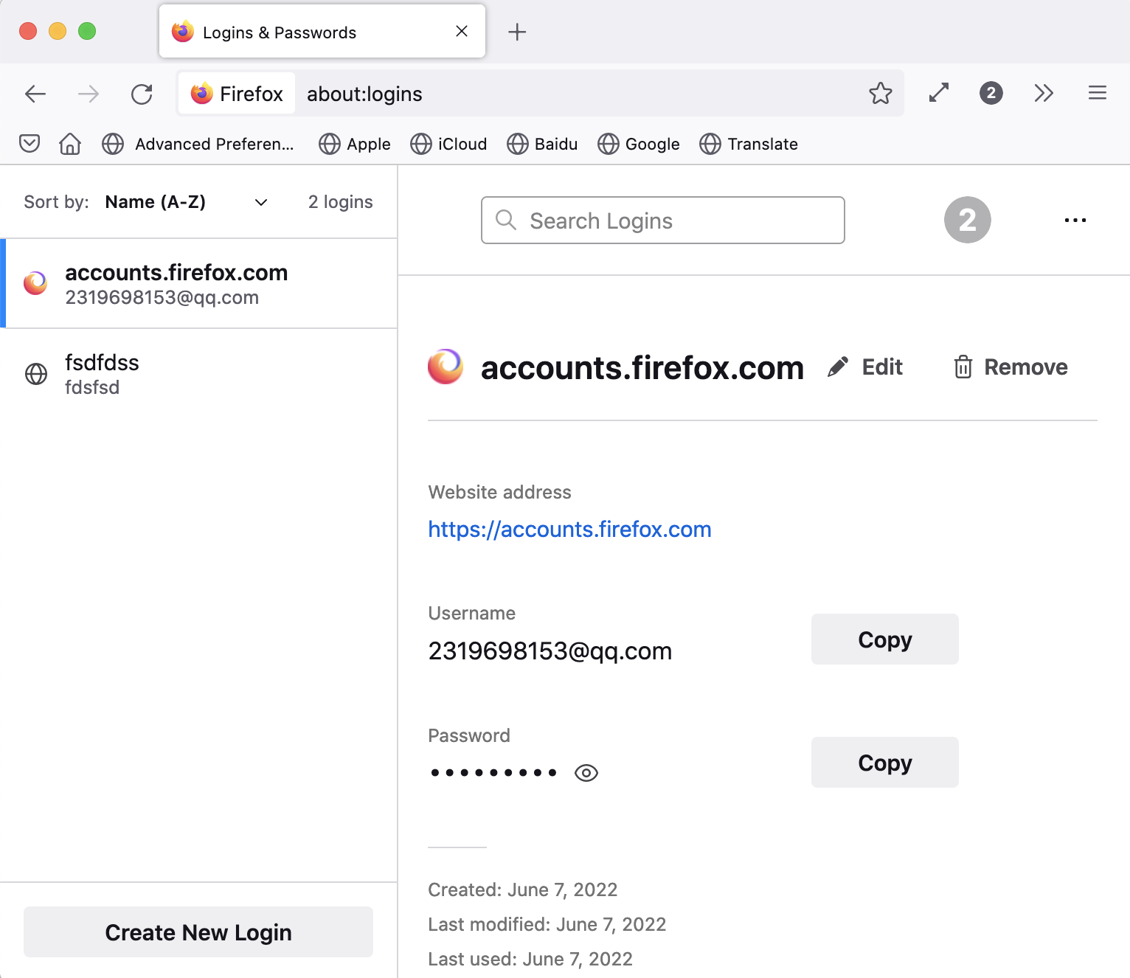
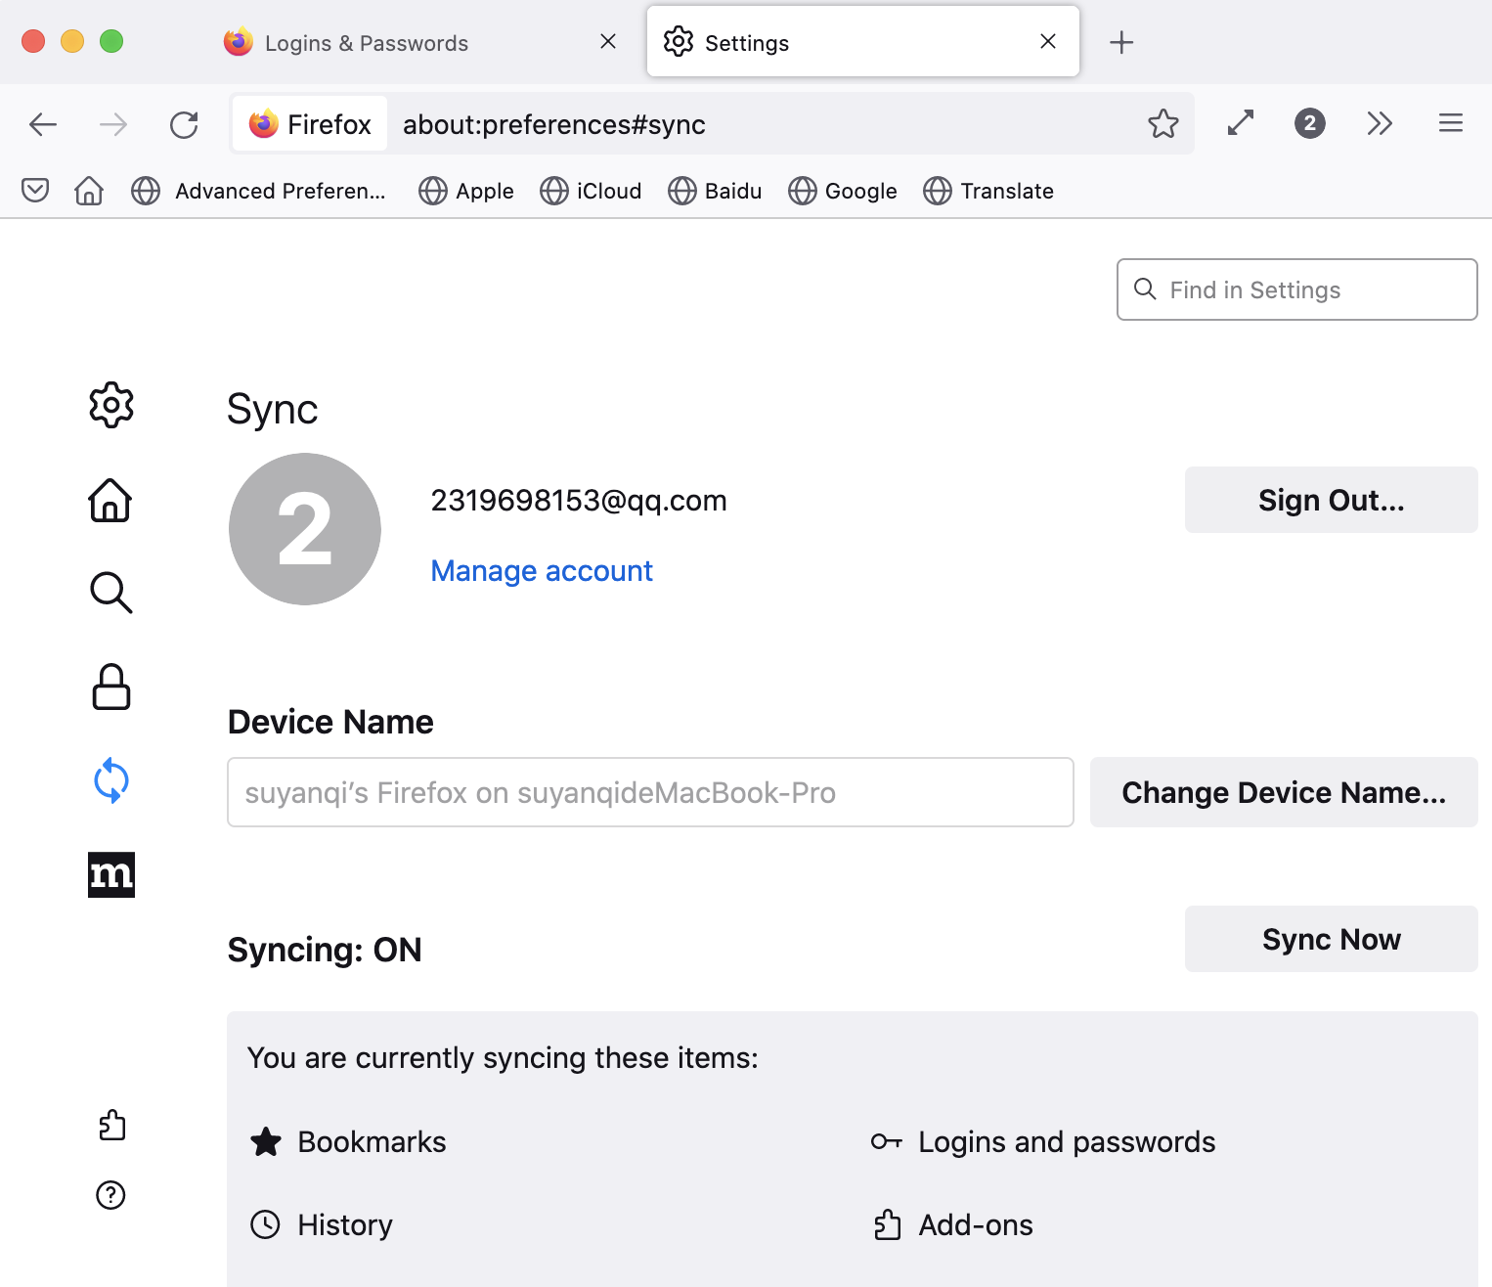
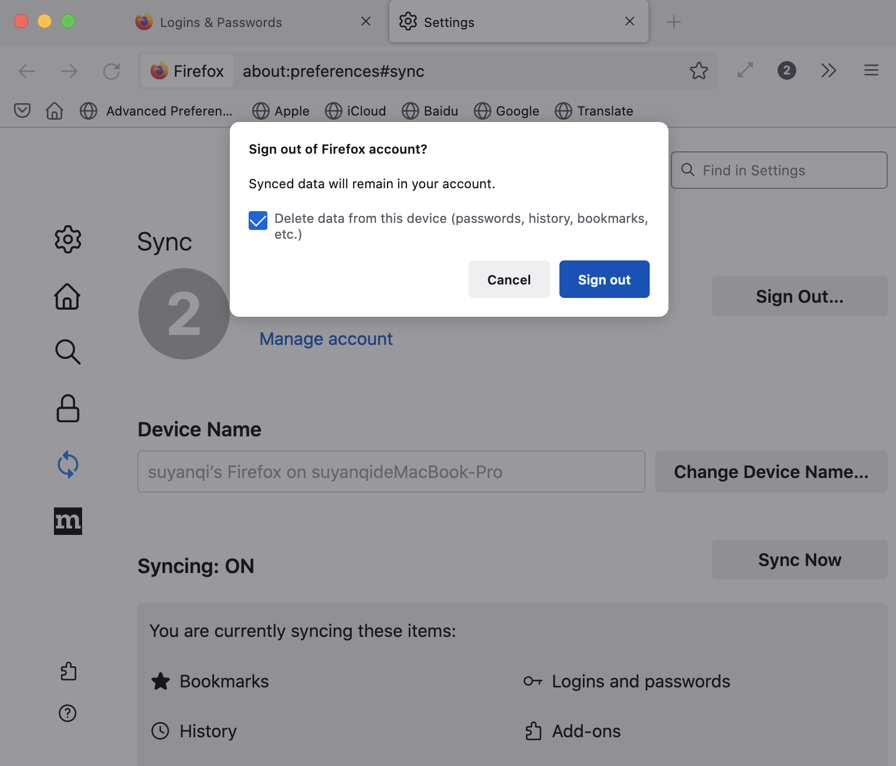

Motivation
Bug 1575516
Bug 1678633
Edit mode is still open after "Remove All Logins" on another tab
thanks for reporting this bug and attaching video, good catch!
Bug 1764756
Sign out and delete data from this device
Go to the about:preferences#sync using a new tab
Edit one of the saved logins without saving
Navigate to about:logins
Switch back to about:logins
Notes:
From this soap opera generated from the two bugs, we found a new security bug (i.e., Edit mode is still open after "Remove All Logins" on another tab).
The Mozilla developer commented on this bug “thanks for reporting this bug and attaching video, good catch!”.

Slide 14
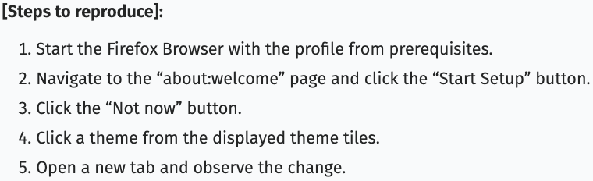
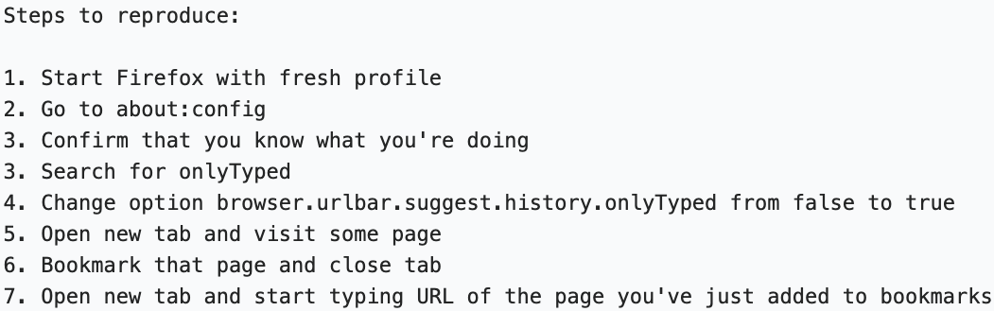
Motivation
Bug Reports
Bug Reports
Step Level Dramas
Common steps
Bug 1766384
Bug 1689304
Bug 1301830
Notes:
Besides directly combining scenarios from two bugs having common steps, combining steps based on common steps can also construct some new soap operas for testing.
Such as, a step-level soap opera is created by the common step ”open a new tab” by combing the step 1,2,3,4,5 with step 5, 6, 7.

Slide 15
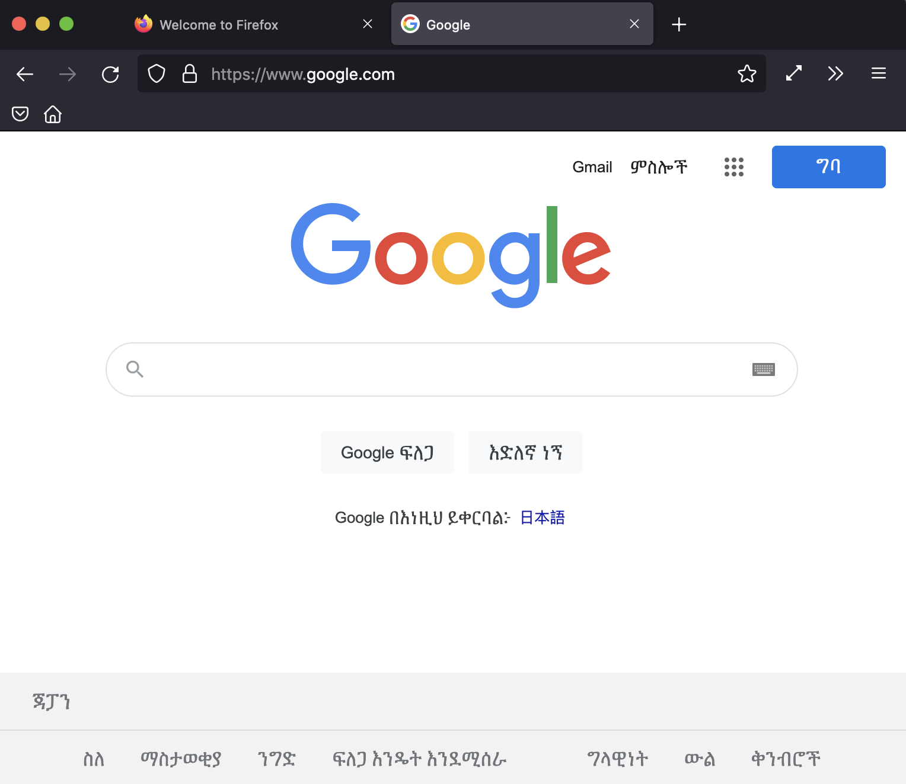
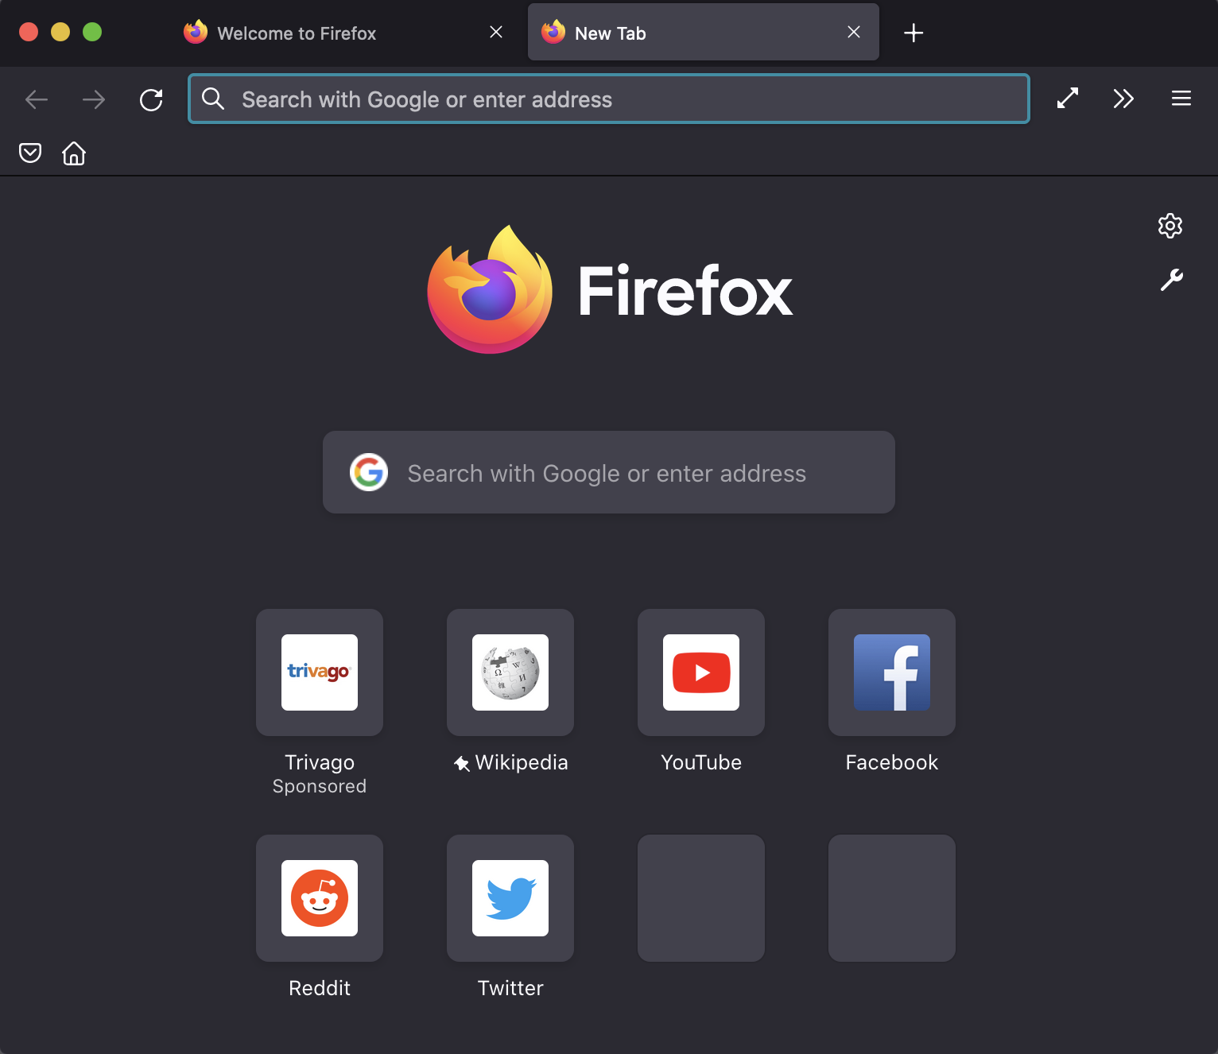
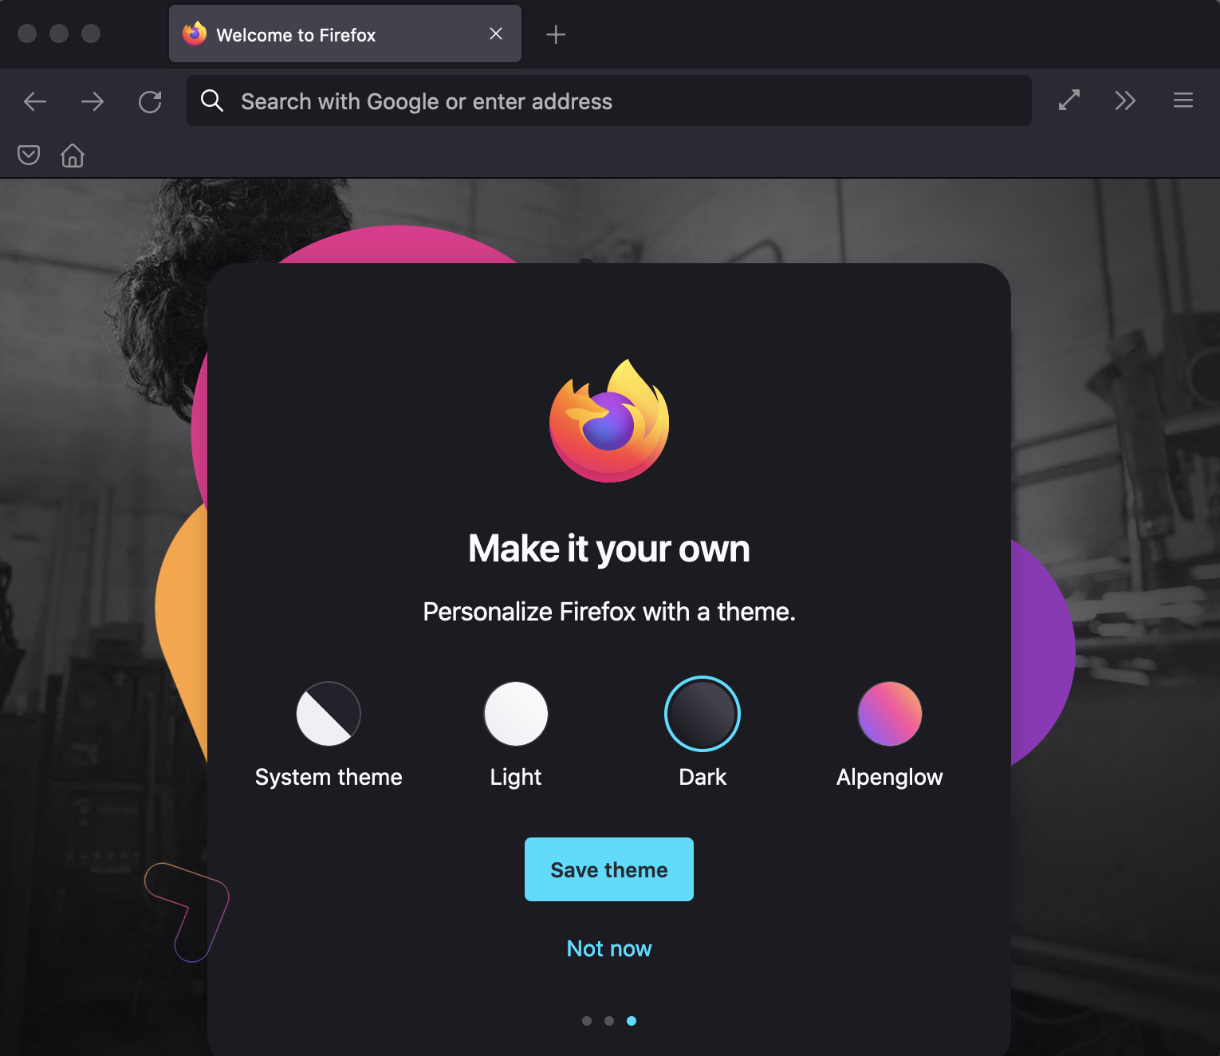
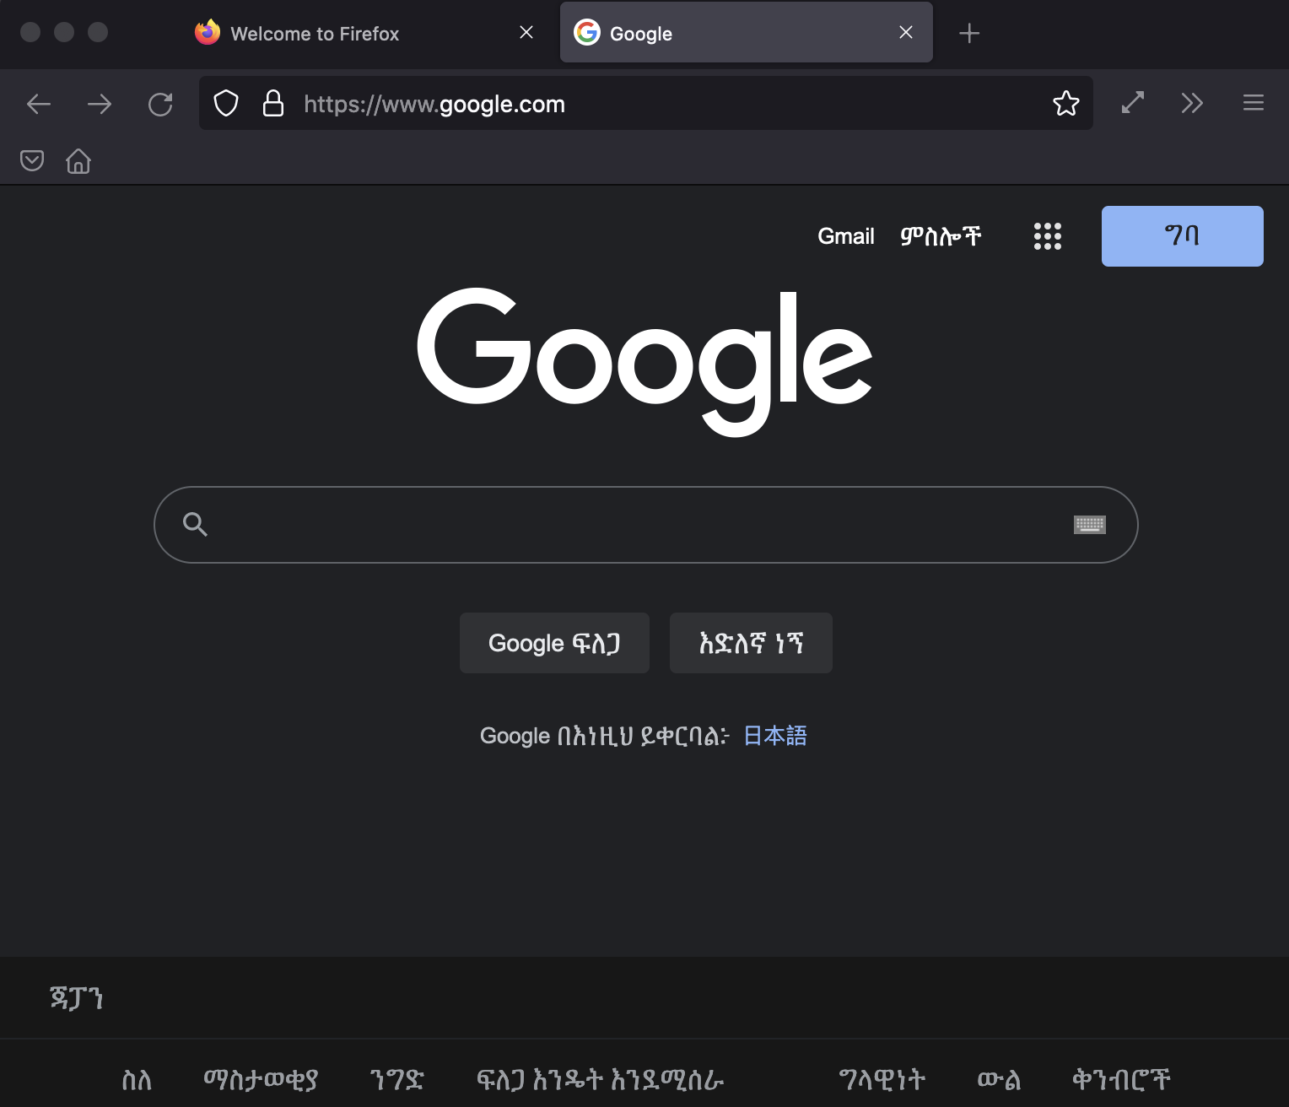
Motivation
Step Level Dramas
Bug 1766384
After Firefox's theme changed Google's theme does not change right away.
Visit some page
Open a new tab
Select a theme from about:welcome
Close tab and revisit the page
Notes:
The step-level test scenario reveals a new usability bug, namely, after Firefox’s theme changed, google’s theme doesn’t change right away.

Slide 16
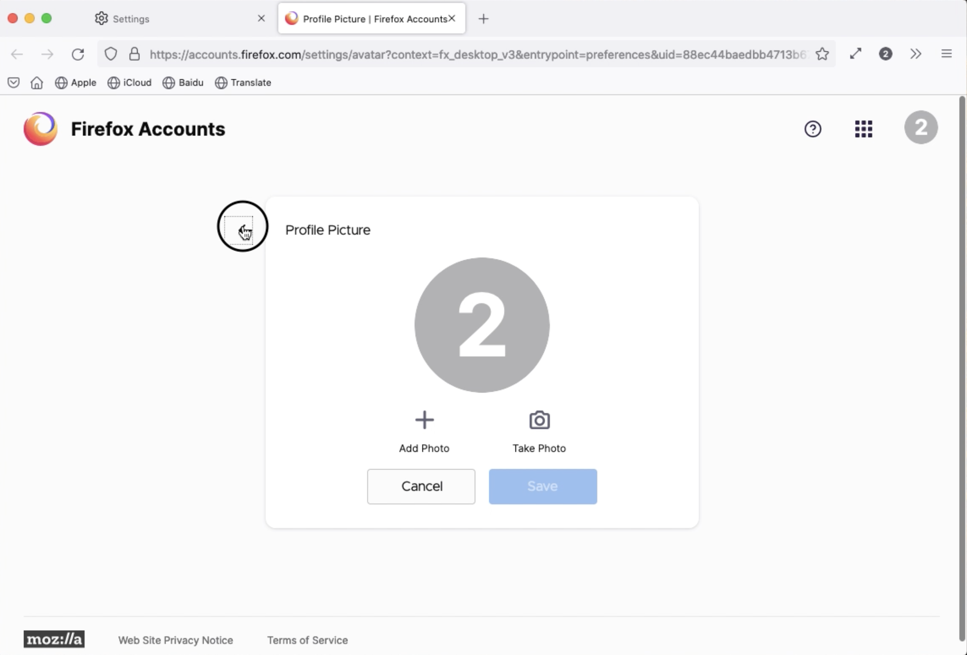
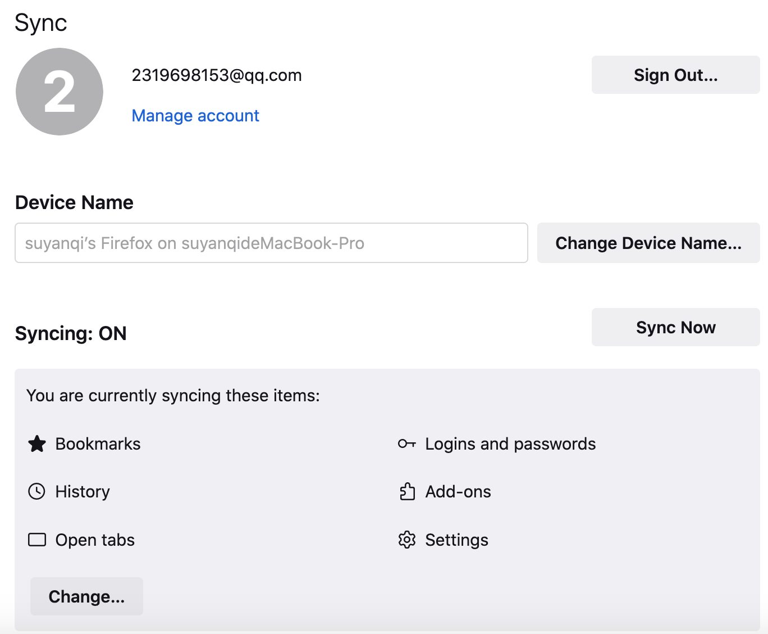
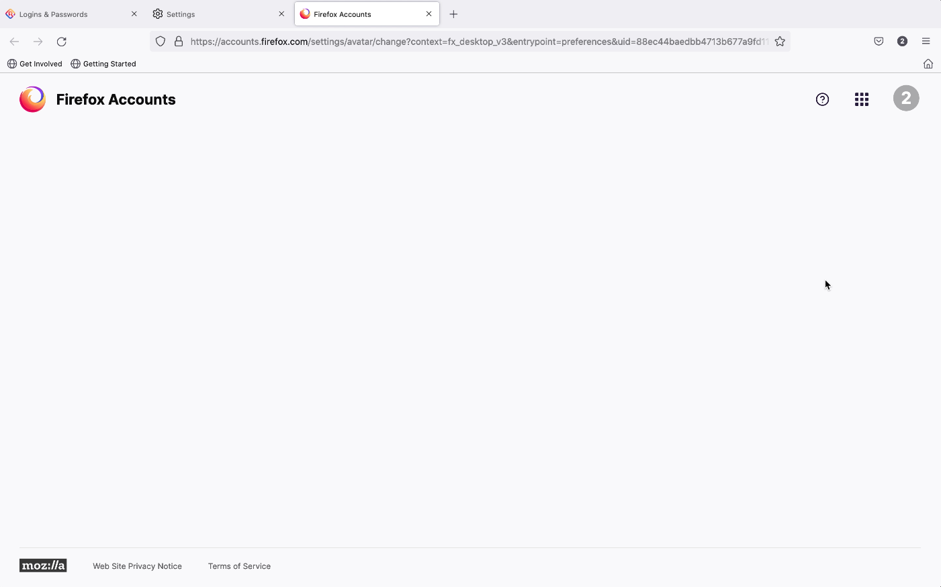
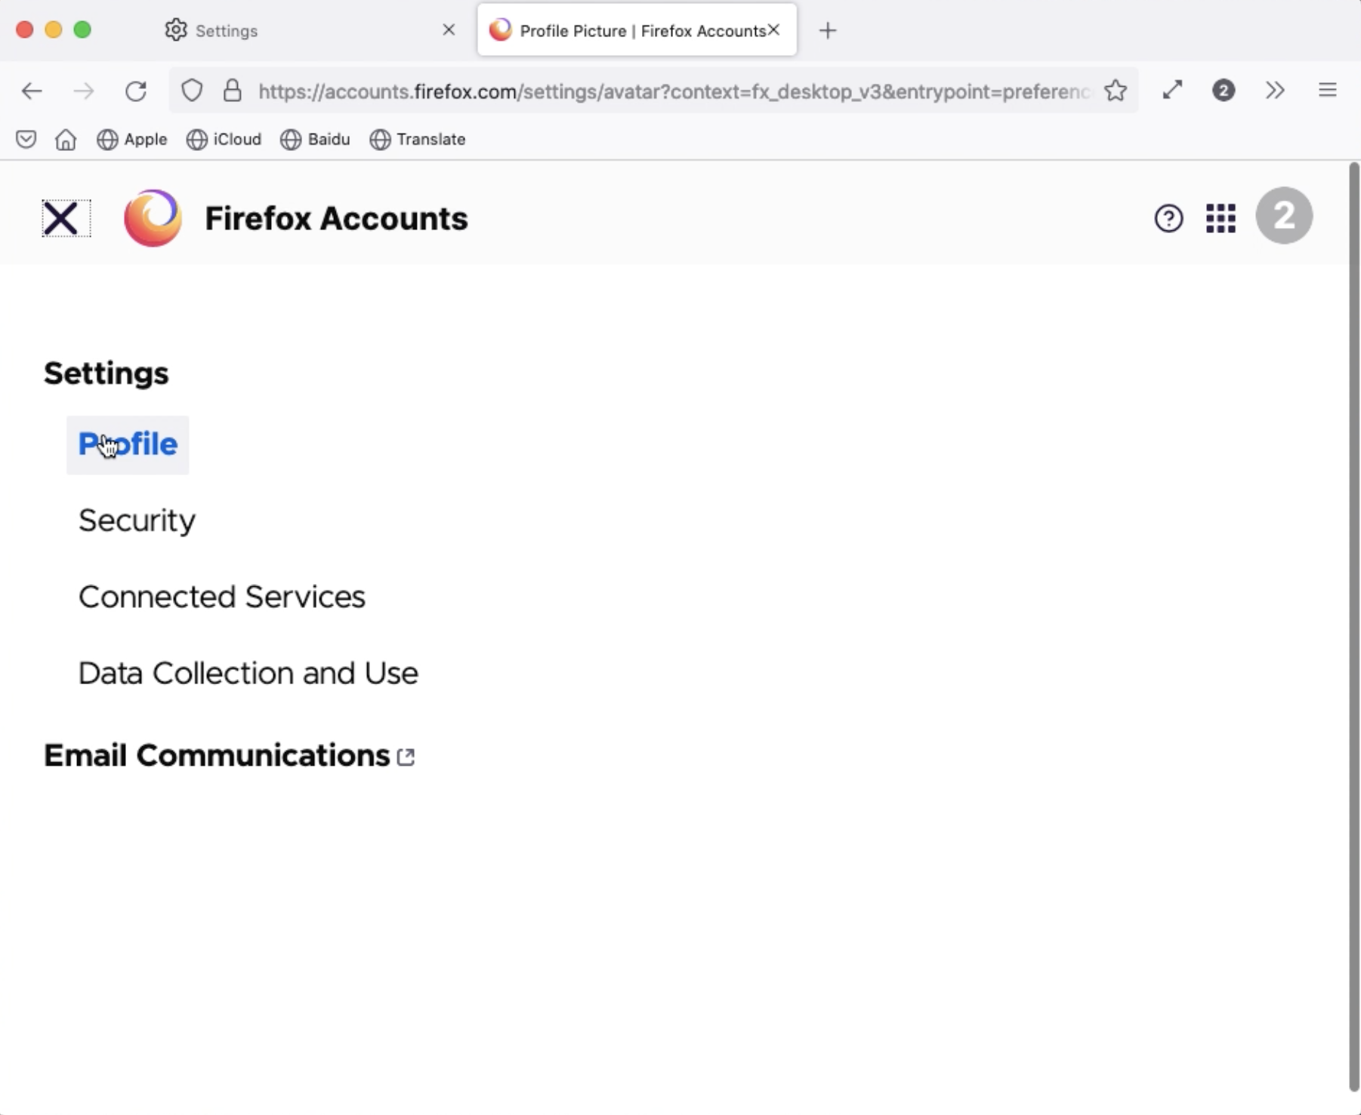
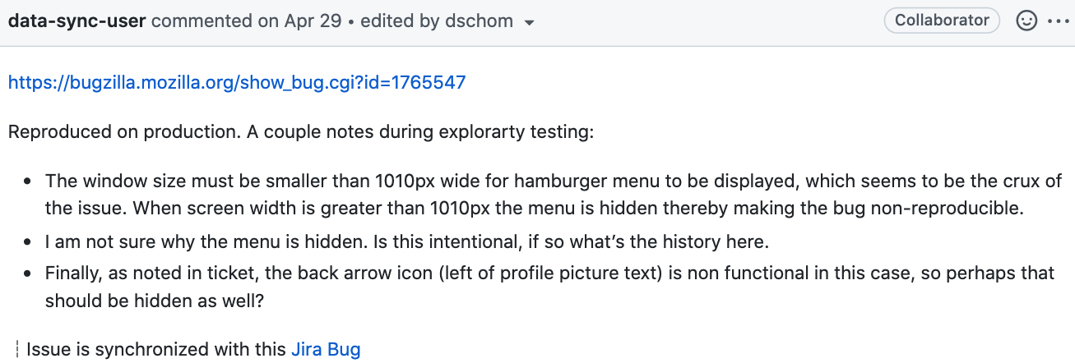
Motivation
Drama after Drama
Bug 1288688
Says: click "Manage Account"
Bug 1746357
We found: a blank page shown after clicking the avatar icon
Bug 1762634
Developer found: Avatar change URL is out of date
Bug 1765542
We found: the “back” button has no response
Bug 1765547
We found: “Site navigation menu” not work
Issue 12695
Developer did exploratory testing
Notes:
Exploratory testing is not an one-off activity. Instead, experiences and bugs from exploratory testing may lead to more exploratory testing which reveals more bugs.
For example, this is the procedure of bugs finding from us, Mozilla developers and even Mozilla testers by using exploratory testing.
Furthermore, these new found bugs provide additional rich test scenarios and can be merged and reused for testing.
For example, the S2Rs in the Bug says “click "Manage Account”.
From previous exploratory testing, she assumes the “Manage Account” button and the avatar would have the same effect.
Thus, she clicks the avatar icon instead.
A new bug, namely a blank page shown after clicking the avatar icon on “about:preferences#sync” page, is found.
Inspired by this Bug, the Mozilla developer found another new bug (i.e., Avatar change URL is out of date).
After our reported Bug is fixed, the author checked how it is fixed.
Now, clicking the avatar icon navigates to the “Change profile picture” page. Then, she wanted to go back by using the “back” button, but no response. Another new bug was found and reported.
Since the “back” button has no response, she tried to return to the previous page by using the “Site navigation menu”, which does not work either. This new bug is reported.
Then, the Mozilla tester did exploratory testing based on bugs we reported, which leads to important notes on the bugs and possible resolutions.

Slide 17
Agenda
01 | Motivation
02 | Approach
03 | Evaluation
04 | Conclusion and future work

Slide 18
Agenda
01 | Motivation
02 | Approach
03 | Evaluation
04 | Conclusion and future work
Notes:
Inspired by our motivation findings, we propose an approach based on the knowledge graph to support exploratory testing.

Slide 19
Approach
Notes:
We construct a novel system knowledge graph (KG) of user tasks and failures from bug reports and use this knowledge graph to support system-level soap opera testing of interactive systems through the GUI.

Slide 20
Approach
System KG Construction
KG Meta-Model Design
The static part captures application concepts and how these concepts are represented and operated in user-system interaction
The dynamic part captures user task workflows and outcomes
Notes:
The system knowledge graph consists of two parts, the static part and the dynamic part.
The static part captures application concepts and how these concepts are represented and operated in user-system interaction.
The dynamic part captures user task workflows and outcomes.

Slide 21
Approach
System KG Construction
Constructing Static Part
KG Meta-Model Design
Manual Categories Definition
Manual Action Definition
Automatic Concept Extraction
Commonly used GUI elements: radio button, drop down menu, checkbox, button, text field, text, panel, key
Notes:
For the static part construction, firstly we define the categories manually.

Slide 22
Approach
System KG Construction
Constructing Static Part
KG Meta-Model Design
Manual Categories Definition
Manual Action Definition
Automatic Concept Extraction
Commonly used GUI elements: radio button, drop down menu, checkbox, button, text field, text, panel, key
web-browser specific GUI elements: hyperlink reference, web page, app
category for the concepts not included in the 11 main categories: Others
Notes:
Namely, commonly used GUI elements and web-browser specific GUI elements.
“Others” is the category for concepts not included in these categories,

Slide 23
Approach
System KG Construction
Constructing Static Part
KG Meta-Model Design
Manual Categories Definition
Manual Action Definition
Automatic Concept Extraction
summarize 29 types of common user actions and their expression variants:
e.g., click (click on), go to (navigate to, access, visit), open (start, launch), type (enter, fill)
Notes:
Secondly, we summarize the common user actions and their expression variants.

Slide 24

Approach
System KG Construction
Constructing Static Part
KG Meta-Model Design
Manual Categories Definition
Manual Action Definition
Automatic Concept Extraction
<key, value>
<performance-use-recommended-settings-checkbox, Use recommended performance settings>
Configuration files
Regular Expressions
Bug Reports
e.g., "Saved Logins..." , [Saved Logins...], “TAB”
Notes:
Lastly, we extract concepts from bug reports and configuration files automatically by using rules and regular expressions.

Slide 25
Approach
System KG Construction
Constructing Static Part
KG Meta-Model Design
Manual Categories Definition
Manual Action Definition
Automatic Concept Extraction
<key, value>
Embed concepts by SBERT
Compute cosine similarity
If Cos-sim (concept_b, top-1 concept_c) >= 0.85, as synonym
Else: as a new application concept, e.g. ‘about:logins’
Configuration files
Merge concepts
Regular Expressions
Bug Reports
Notes:
Then, merge concepts by using cosine similarity.

Slide 26
Approach
System KG Construction
Constructing Static Part
KG Meta-Model Design
Manual Categories Definition
Manual Action Definition
Automatic Concept Extraction
<key, value>
Configuration files
Merge concepts
Get the category for the new concept from bug report
Replace the concept by its placeholder
Do the dependency parsing by spaCy
Aggregate candidate categories and sort them by frequencies
Select the candidate category with the highest frequency
Match the candidate category with standard category
Regular Expressions
Bug Reports
Notes:
We also get the category for the new concept from bug reports.
Until now, the static part construction is finished.

Slide 27
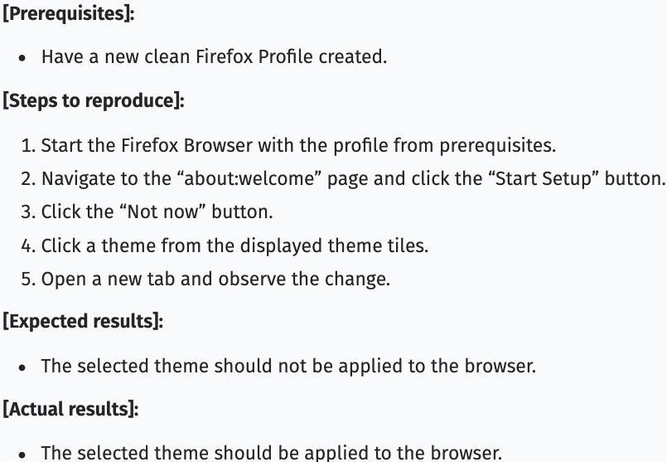
Approach
System KG Construction
as-is
Constructing Static Part
KG Meta-Model Design
Constructing Dynamic Part
Manual Categories Definition
Scenario Extraction
Step Normalization
Manual Action Definition
Step Splitting
Automatic Concept Extraction
Step Clustering
Entity Linking
as-is
as-is
Notes:
For the dynamic part construction, we extract preconditions, steps to reproduce, expected results and actual results from bug reports.
Then, we further preprocess the steps to reproduces by step normalization, step splitting and step clustering.

Slide 28
Approach
System KG Construction
Constructing Static Part
KG Meta-Model Design
Constructing Dynamic Part
Manual Categories Definition
Scenario Extraction
Step Normalization
Manual Action Definition
Step Splitting
Automatic Concept Extraction
Step Clustering
Entity Linking
Split S2R text into steps by line changes and sentence splitting using spaCy
Remove serial number or bullets of steps
Replace concepts and URLs by placeholder
Discard content within parenthesis to simplify the sentence parsing
After the step splitting, we change placeholders back to corresponding concepts and URLs.
Notes:
For step normalization, we split S2R test into steps by line changes and sentence spltting by using spaCy and so on.

Slide 29
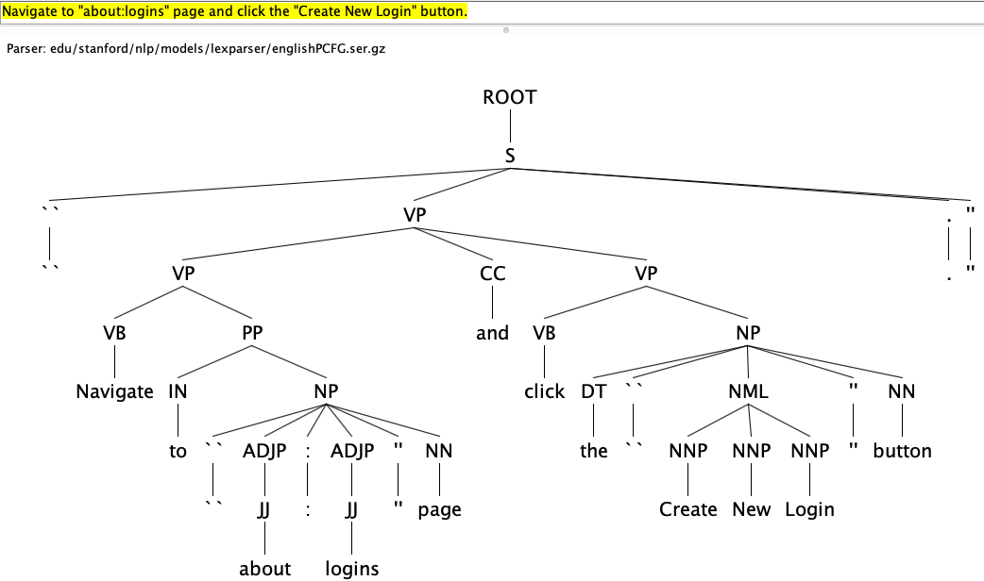
Approach
System KG Construction
Constructing Static Part
KG Meta-Model Design
Constructing Dynamic Part
Manual Categories Definition
Scenario Extraction
Step Normalization
Manual Action Definition
Step Splitting
Automatic Concept Extraction
Step Clustering
Entity Linking
“Navigate to "about:logins" page and click the "Create New Login" button.”
Notes:
After step normalization, we found that some steps still contain two operations.
Then, we split these Steps into Atomic Steps by using the parse tree.

Slide 30
Approach
System KG Construction
Constructing Static Part
KG Meta-Model Design
Constructing Dynamic Part
Manual Categories Definition
Scenario Extraction
Step Normalization
Manual Action Definition
Step Splitting
Automatic Concept Extraction
Step Clustering
Entity Linking
“Navigate to "about:logins" page and click the "Create New Login" button.”
“Navigate to "about:logins" page
click the "Create New Login" button.”

Slide 31
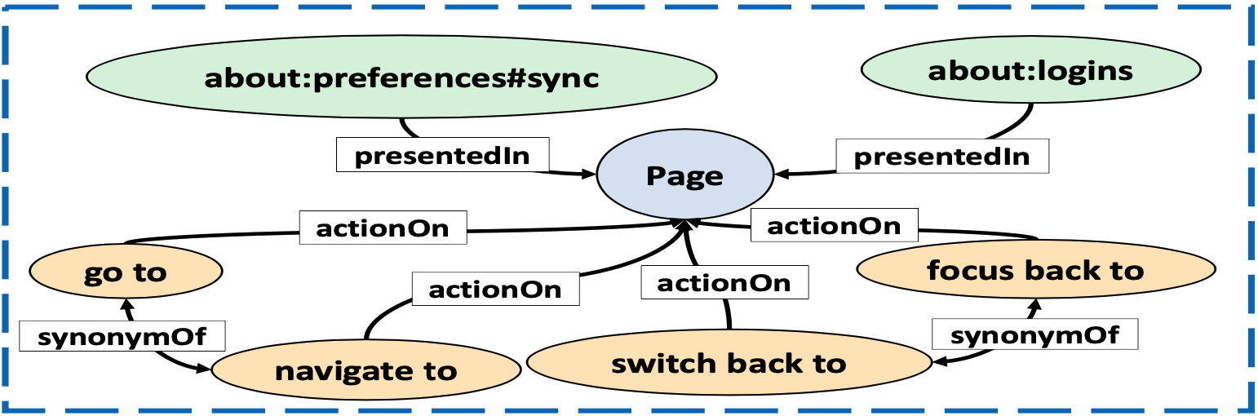
Approach
System KG Construction
Constructing Static Part
KG Meta-Model Design
Constructing Dynamic Part
Manual Categories Definition
Scenario Extraction
Step Normalization
Manual Action Definition
Step Splitting
Automatic Concept Extraction
Step Clustering
Entity Linking
Switch back to the about:logins tab.
Focus back to the about:logins page.
Open a new tab.
Open new tab
Notes:
Different bug reports may have the same steps expressed in different ways.
For step clustering, we combine two clustering methods.
For the steps having both linked concepts and actions, we cluster them by the concept and the action. For example, “switch back to the about:logins tab.” and “Focus back to the about:logins page”.

Slide 32
Approach
System KG Construction
Constructing Static Part
KG Meta-Model Design
Constructing Dynamic Part
Manual Categories Definition
Scenario Extraction
Step Normalization
Manual Action Definition
Step Splitting
Automatic Concept Extraction
Step Clustering
Entity Linking
Switch back to the about:logins tab.
Focus back to the about:logins page.
Open a new tab.
Open new tab
Fast Clustering algorithm
Notes:
For other steps, we cluster them by the fast clustering algorithm.

Slide 33
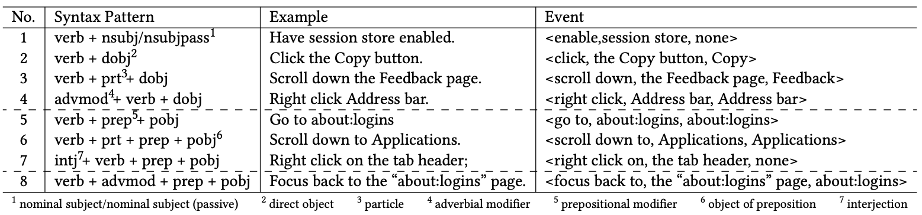
Approach
System KG Construction
Constructing Static Part
KG Meta-Model Design
Constructing Dynamic Part
Manual Categories Definition
Scenario Extraction
Step Normalization
Manual Action Definition
Step Splitting
Automatic Concept Extraction
Step Clustering
Entity Linking
about:logins
hasConcept
presentedIn
presentedIn
Step: Navigate to the about:logins page.
Page
actionOn
Navigate to
hasAction
Notes:
Lastly, we connect the dynamic part with the static part by entity linking.
Given a step, we identify the concept and action involved in the step and link the step with the concept and action in the static part.
To that end, we extract the event tuple <action, target, concept> from the step by eight grammar patterns, as shown in the table.
Until now, the system knowledge graph construction is finished.

Slide 34
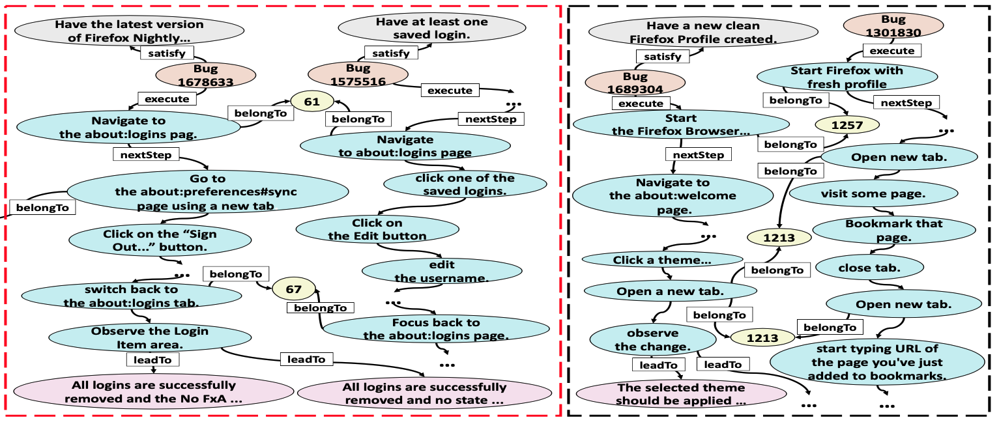
Approach
System KG Construction
Constructing Static Part
KG Meta-Model Design
Constructing Dynamic Part
Manual Categories Definition
Scenario Extraction
Step Normalization
Manual Action Definition
Step Splitting
Automatic Concept Extraction
Step Clustering
Entity Linking
Soap Opera Test Generation
Relevant Bug Reports Finding
Test Scenario Generation
Seed Bug Report
Notes:
Based on the system knowledge graph, soap opera test scenarios can be generated.
For the seed bug report, we find its relevant bug reports based on the common steps, namely steps belong to the same cluster.

Slide 35
Approach
System KG Construction
Constructing Static Part
KG Meta-Model Design
Constructing Dynamic Part
Manual Categories Definition
Scenario Extraction
Step Normalization
Manual Action Definition
Step Splitting
Automatic Concept Extraction
Step Clustering
Entity Linking
Soap Opera Test Generation
Relevant Bug Reports Finding
Test Scenario Generation
Seed Bug Report

Slide 36
Approach
Scenario-level
System KG Construction
Step-level
Constructing Static Part
KG Meta-Model Design
Constructing Dynamic Part
Manual Categories Definition
Scenario Extraction
Step Normalization
Manual Action Definition
Step Splitting
Automatic Concept Extraction
Step Clustering
Entity Linking
Soap Opera Test Generation
Relevant Bug Reports Finding
Test Scenario Generation
Seed Bug Report
Notes:
Next, we generate soap opera test scenarios based on the seed bug report and one of the relevant bug reports.
We construct test scenarios at two levels, namely scenario level and step level.

Slide 37

Approach
System KG Construction
Constructing Static Part
KG Meta-Model Design
Constructing Dynamic Part
Manual Categories Definition
Scenario Extraction
Step Normalization
Manual Action Definition
Step Splitting
Automatic Concept Extraction
Step Clustering
Entity Linking
Soap Opera Test Generation
Relevant Bug Reports Finding
Test Scenario Generation
Seed Bug Report
Test Scenarios
Notes:
Then, by the scenario-level and step-level test scenario generation, we get a set of test scenarios based on the seed bug report.

Slide 38
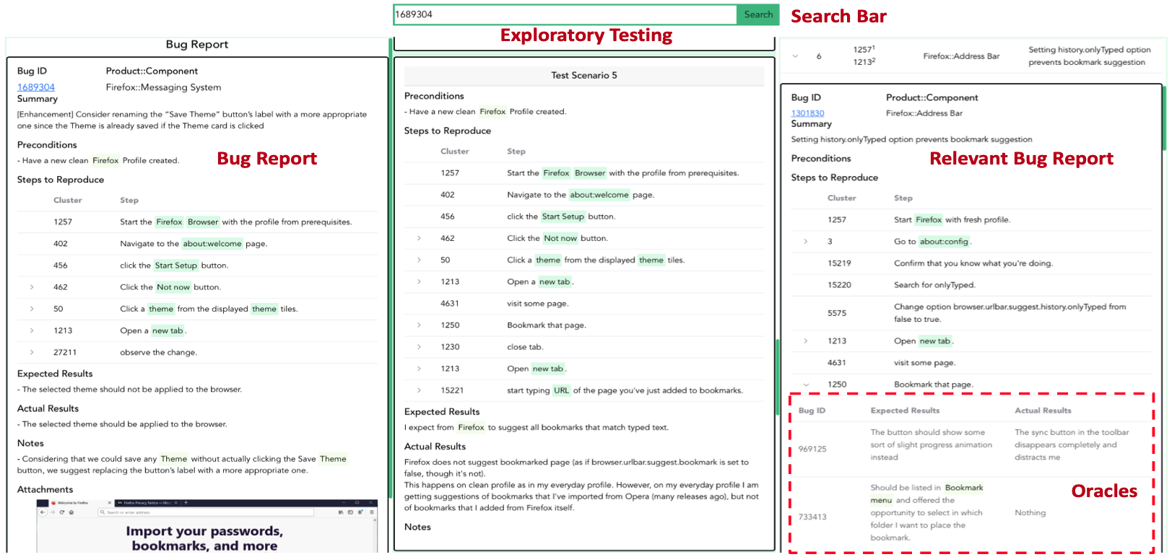
Approach
Tool demo
Notes:
We deploy the system knowledge graph in an online exploratory testing tool. This tool implements our soap opera testing generation approach.
As shown in the Figure, the tool consists of four panels, namely Search Bar, Bug Report, Relevant Bug Reports and Exploratory Testing.

Slide 39
Agenda
01 | Motivation
02 | Approach
03 | Evaluation
04 | Conclusion and future work

Slide 40
Agenda
01 | Motivation
02 | Approach
03 | Evaluation
04 | Conclusion and future work
Notes:
So, how about the effectiveness of our approach?

Slide 41

Evaluation
  Dataset
…
…
Data Filtering
having the S2Rs, EBs and OBs
remove the bug having steps with more than 64 tokens
remove the bug having more than 20 steps
62,226 bugs
25,939 bugs
Notes:
We get more than sixty thousand Firefox bugs from the Mozilla Bugzilla and do data filtering.
Finally, we get around 20 thousand bug reports to construct our system knowledge graph.
From data observation, we find that if one step has too many tokens, the step tends to describe too many operations in one sentence. Such sentences are too complex to be parsed using existing NLP tools.
Moreover, for bugs with more than 20 steps, the S2Rs section is more likely to be a stack trace or log rather than user steps for some tasks.

Slide 42
Evaluation
  Research questions
What is the intrinsic quality of the system knowledge graph constructed from bug reports?
How useful is the soap opera testing tool in helping the testers do soap opera testing?
How is the quality of soap opera test scenarios generated from the system knowledge graph?
Notes:
We set three research questions
To answer these questions, we do a large scale of experiments

Slide 43
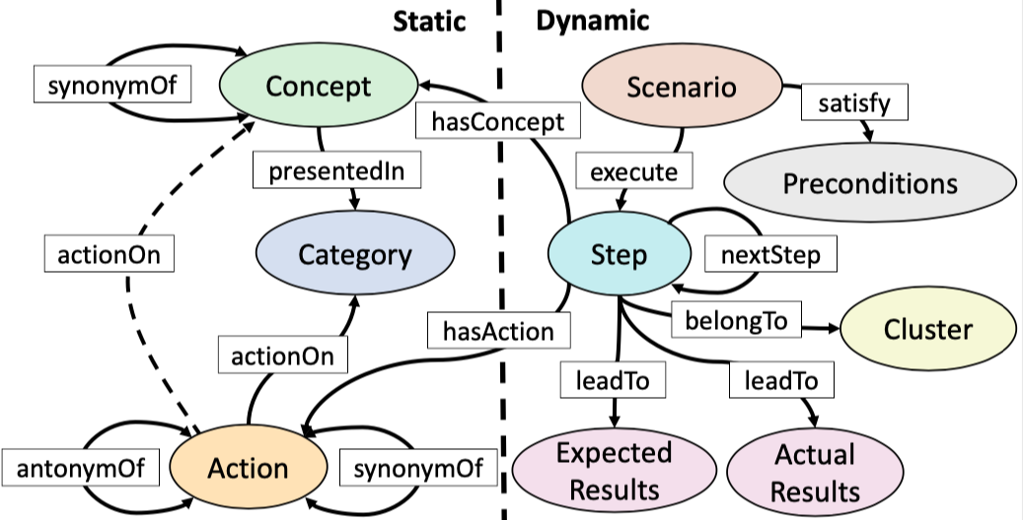
Evaluation
  Intrinsic Quality of KG (RQ1)
3109
25,939
1,170
12
112,497
69,795
50
25,939
25,939
Notes:
For RQ1, the quality of knowledge graph.
As the system knowledge graph involves a large number of entities and relations, we use a statistical sampling method.
Two of the authors first independently evaluate the quality of the system knowledge graph and discuss the inconsistencies in the results and finally reach an agreement.
, namely sampling the minimal number of entities or relations in the knowledge graph to ensure the estimated accuracy in the samples has the error margin 0.05 at 95% confidence level.
After finishing all the evaluation, they discuss the inconsistencies in the results and finally reach an agreement.
Based on the final decisions, we compute the accuracy of sampled entities and relations or use the Likert Scale to evaluate the effectiveness of step clustering.

Slide 44
Evaluation
  Intrinsic Quality of KG (RQ1)
Automatic Concept Extraction
 | Concept | Category | <Concept, synonymOf, Concept>
Sample Num | 384 | 384 | 328
Accuracy | 0.979 | 0.906 | 0.835
<“Create New Login”, presentedIn, text>
<“Create New Login”, presentedIn, button>
Add an attribute to further distinguish concepts
Notes:
We randomly sample concepts and their relations from the static part to evaluate the performance of concept extraction and category identification.
Furthermore, we get all concept pairs to evaluate the quality of their relations

Slide 45
Evaluation
  Intrinsic Quality of KG (RQ1)
Automatic Concept Extraction
 | Concept | Category | <Concept, synonymOf, Concept>
Sample Num | 384 | 384 | 328
Accuracy | 0.979 | 0.906 | 0.835
<“Tools”, synonymOf, “More tools”>
Context information from bug reports could help to reduce such errors
Notes:
The accuracy of them are shown in the table.

Slide 46
Evaluation
  Intrinsic Quality of KG (RQ1)
Scenario Extraction
 | Compound Step Splitting
Sample Num | 384
Accuracy | 0.773
some poorly written sentences in bug reports cannot be parsed correctly
the limitations of compound sentence splitting patterns for complex sentences
Notes:
As for the scenario extraction, first, we randomly sample steps to validity the quality of step splitting by accuracy.
The accuracy of compound step splitting is shown in the table.
The suboptimal performance of compound step splitting is due to some poorly written sentences in bug reports cannot be parsed correctly and the limitations of compound sentence splitting patterns for complex sentences.

Slide 47
Evaluation
  Intrinsic Quality of KG (RQ1)
Scenario Extraction
 | Compound Step Splitting
Sample Num | 384
Accuracy | 0.773
clustering based on cosine similarities may cluster some steps with many overlapping words but semantic differences into one cluster
erroneously linked concepts or actions in some steps may result in irrelevant steps in a cluster
Step Clustering Likert
Notes:
Second, we extract 384 clusters with at least two steps for evaluating the effectiveness of step clustering by the Likert Scale, which 1 is the worst and 5 is the best.
The result is shown in the Figure.

Slide 48
Evaluation
  Intrinsic Quality of KG (RQ1)
Entity Linking
 | hasConcept | hasAction
Sample Num | 384 | 384
Accuracy | 0.786 | 0.914
bug reports written by bug reporters with diverse writing habits
misidentify some common expressions as concepts
the step “observe the performance.” in Bug 1588767
<performance, presentedIn, text>
take the context of step into consideration to further improve the accuracy of concept linking
Notes:
For the entity linking, 384 steps with links to concepts and actions are sampled for estimating the accuracy of hasConcept and hasAction relations.

Slide 49
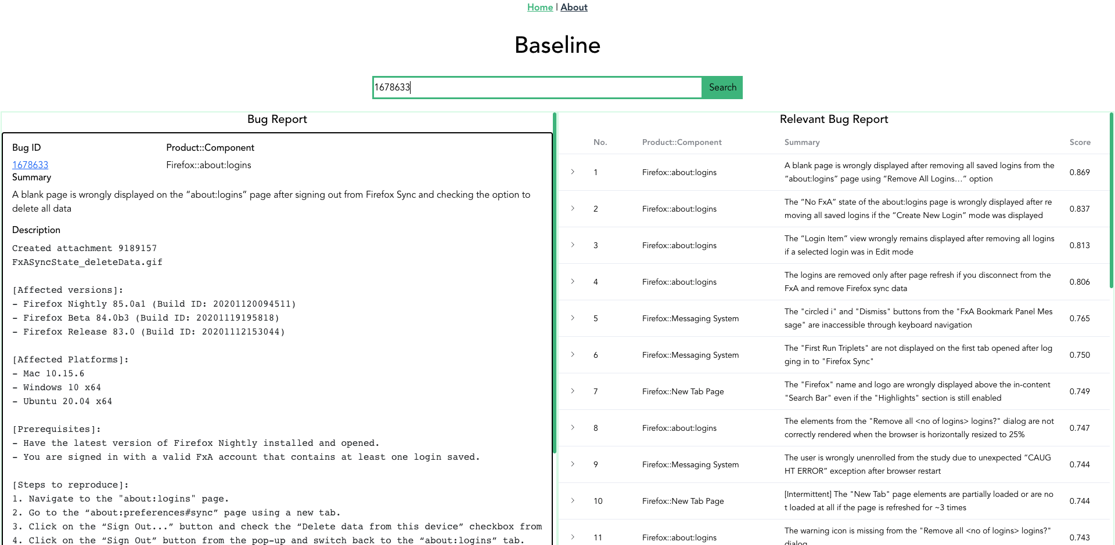
Evaluation
  Usefulness for Soap Opera Testing (RQ2)
Baseline: rank relevant bug reports according to the SBERT-based cosine similarity between the seed bug and other bugs
Notes:
For RQ2, we perform a user study for evaluating the usefulness of our soap opera testing tool for supporting exploratory testing.
The baseline tool ranks relevant bug reports according to the SBERT-based cosine similarity between the seed bug and other bugs.

Slide 50

Evaluation
  Usefulness for Soap Opera Testing (RQ2)
Experimental Group
Pre-survey:
1 2 3 4 5
6 7 8 9 10
Control Group
Notes:
We get 10 students and divide them into two groups, experimental group and control group according to the pre-study survey.

Slide 51
Evaluation
  Usefulness for Soap Opera Testing (RQ2)
Experimental Group
Task:
1 2 3 4 5
6 7 8 9 10
Control Group

Slide 52

Evaluation
  Usefulness for Soap Opera Testing (RQ2)
Task:
Experimental Group
2 seed bugs
1 2 3 4 5
SYSKG
Soap Opera Testing: 5 seed bugs
Find as many new bugs as possible in 2 hours
6 7 8 9 10
Baseline
Control Group
Notes:
Participants perform soap opera testing on the Firefox (Desktop) browser aiming at finding as many new bugs as possible in 2 hours, for participants in the experimental group supported by our tool and for participants in the control group supported by the baseline.

Slide 53
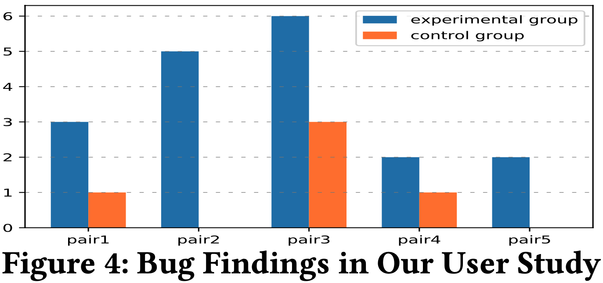
Evaluation
  Usefulness for Soap Opera Testing (RQ2)
18 bugs
5 bugs
Result:
For participants with the same seed bugs, they found different bugs (only 2 bugs are duplicate among the 23 bugs found by the two groups). This shows an excellent advantage of exploratory testing for exploring new scenarios and finding diverse bugs
Notes:
As shown in the Figure, participants in the experimental group find 18 new bugs.
For participants in the control group, 5 bugs have been found.

Slide 54
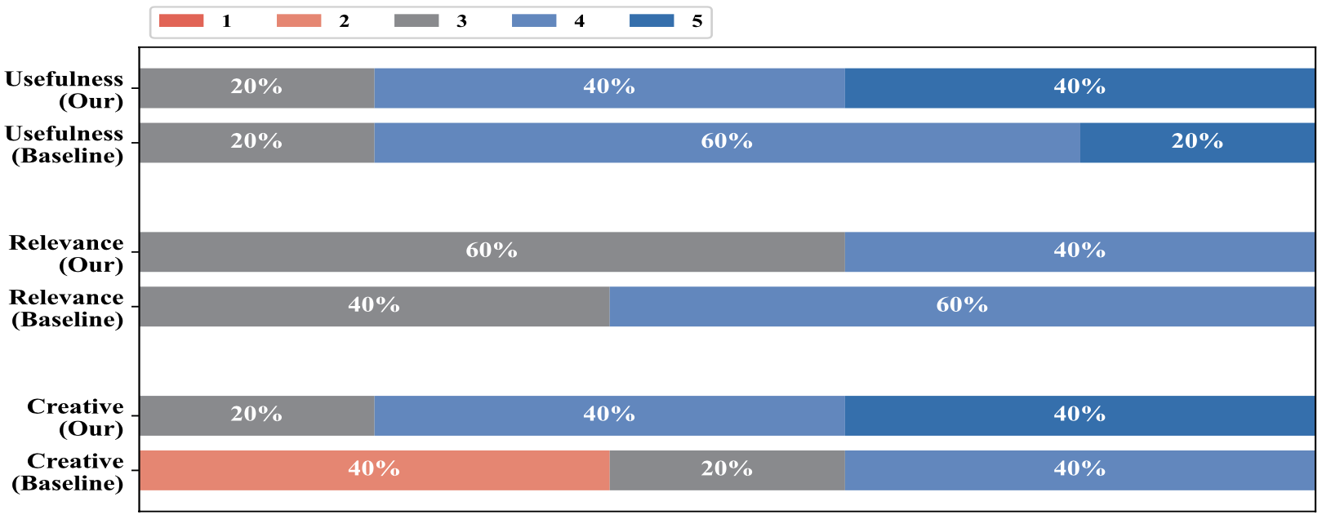
Evaluation
  Usefulness for Soap Opera Testing (RQ2)
Tool Comparision (5-point Likert)
Post-survey:
the seed bug and relevant bugs have some relevance (depth) but still keep some difference (breadth). This difference is important for finding new bugs
Notes:
we conduct a post-survey, which involves three aspects, namely the usefulness of tools, relevance about seed bug and relevant bugs, whether tools inspire creative thinking or exploring more steps during testing.
The result is shown in the figure.
From the post-survey, the relevance about seed bug and relevant bugs of our approach is worse than the baseline.
But the participants in the experimental group reflect that, in our approach, the seed bug and relevant bugs have some relevance (depth) but still keep some difference (breadth).
This difference is important for finding new bugs

Slide 55
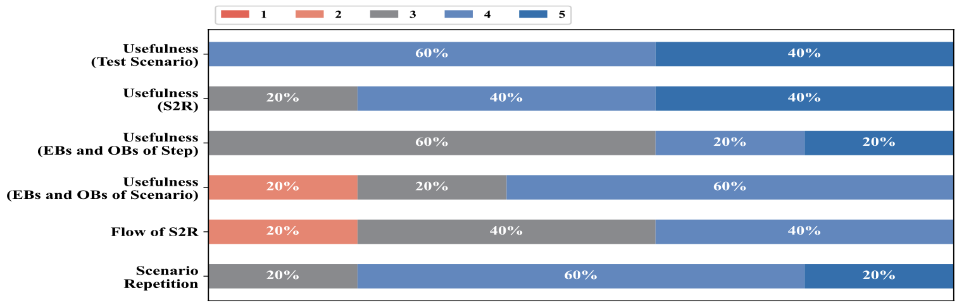
Evaluation
  Quality of Generated Test Scenarios (RQ3)
Test Scenario Quality (5-points Likert Scale)
Result:
The soap opera embedded in test scenarios can help to reveal hidden bugs in depth, not superficial ones
for the detail level of test scenarios generation, need to take the experience of tester into consideration, namely the familiarity with the software under test and testing expertise
Notes:
To assess the quality of test scenarios generated by our approach and their effectiveness for supporting soap opera testing, we conduct a follow-up survey for the experimental group.
The participants were asked to evaluate the test scenarios by using the 5-point Likert Scale from the three aspects: usefulness, flow of S2Rs and scenario repetition.
From the figure, all of the participants think that the generated test scenarios are useful and helpful for their exploratory testing.

Slide 56
Evaluation
  Quality of Generated Test Scenarios (RQ3)
Test Scenario Quality (5-points Likert Scale)
Result:
play a great role in finding bugs, as providing important hints for recognizing bugs
the information overload problem in this part affects its effectiveness, namely some steps having too many EBs and OBs attached

Slide 57
Agenda
01 | Motivation
02 | Approach
03 | Evaluation
04 | Conclusion and future work

Slide 58
Agenda
01 | Motivation
02 | Approach
03 | Evaluation
04 | Conclusion and future work
Notes:
In conclusion

Slide 59
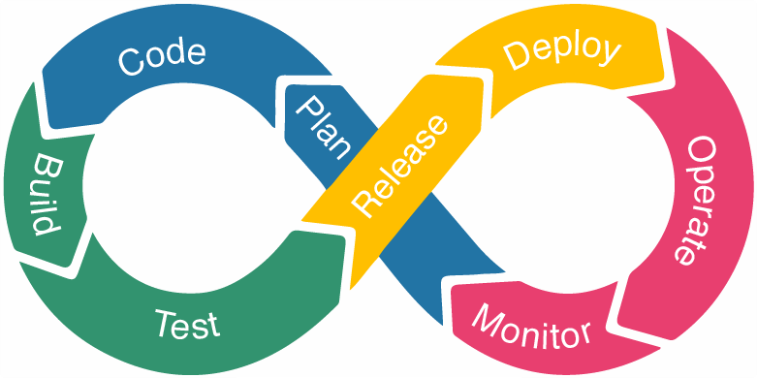
and future work
Conclusion
Present an automatic approach for generating soap opera test scenarios, which is built on a novel system knowledge graph of user tasks and failures extracted from the textual context of bug reports
Demonstrate the usefulness of our soap opera test generation method for effective and efficient exploratory testing
Report 64 bugs for Firefox, many of which have been confirmed and fixed. Some of these bugs ignite more discussions within the Mozilla team about some fundamental system design, usability and security issues
Enhance our KG construction with more robust information extraction methods
Improve our test scenario generation and presentation inspired by our user study
SYSKG far more powerful than shown:
  support concept-based searching through static part
  assist in the writing of bug reports
  the generation of user manuals
  In short, the SYSKG can be spread all over the software life cycle, finally assisting DevOps (combines software development and IT operations) for shortening the systems development life cycle and providing continuous delivery (CD) with high software quality.
Notes:
We present an automatic approach for generating soap opera test scenarios to support exploratory testing.
We demonstrate the usefulness of our approach and reported 64 bugs for Firefox.
For our future work, we list some directions here.
https://www.perfecto.io/

Slide 60
Thank you
Notes:
OK, that’s all
Thank you for your attention.

Slide 61
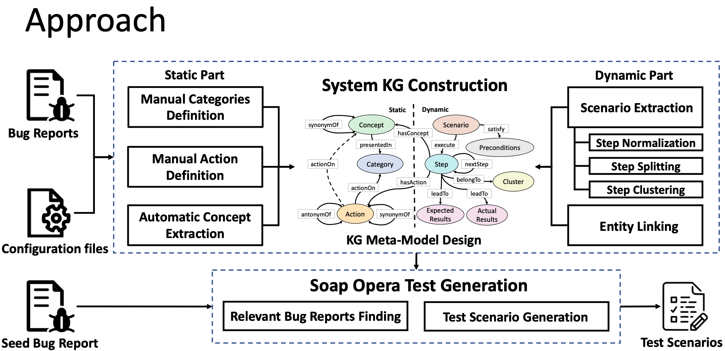
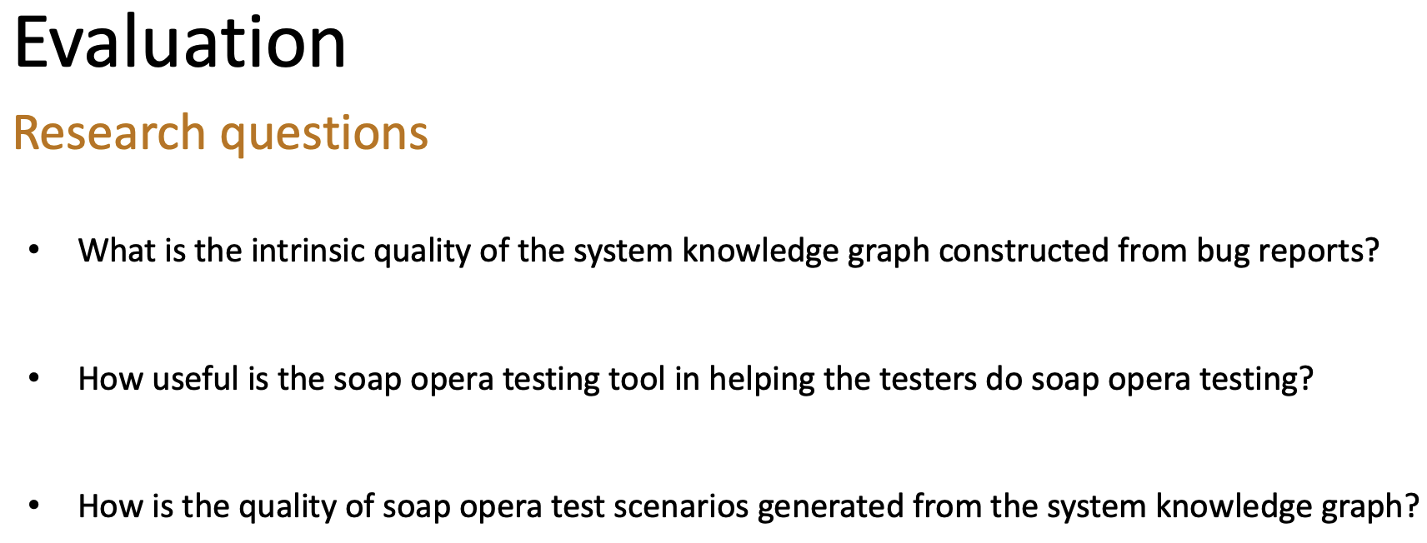
Q&A
Notes:
Any questions?

