Slide 1
Proving Obliviousness of Probabilistic Algorithms with Formal Verification
Pengbo Yan
Work with (my Supervisors): Toby Murray, Thuan Pham, Robert Sison, Olya Ohrimenko

Slide 2
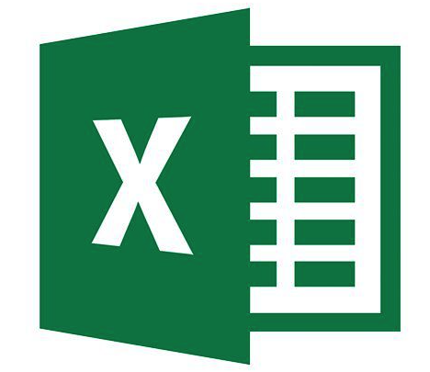
Motivation
Data
Differential Privacy, …
Browser
Data analysis, …
Internet
Encryption, Protocol correctness, …
Man-in-the-middle attack, …
Server
Memory safety
Buffer overflow, …
Defender
Attacker
Software
Obliviousness, …
Memory
Side-channel attack, …
My Focus
CPU

Slide 3
Side-channel Attack
Memory
Cache
Defend: Oblivious algorithms
(Memory access pattern independent with secrets)
Inferring victim’s
memory access pattern
Victim’s program
with some secrets
Attacker’s program
CPU

Slide 4
Background: (Deterministic) Obliviousness
Suppose there is an array storing the number of failed subjects of every students and a straightforward program will increment the number duly
Deterministic Obliviousness: same memory access pattern, O(N)
Probabilistic Obliviousness:
- same distribution of the memory access pattern.
- path ORAM, O(logN), complicated
Student 0 | Student 1 | Student 2 | Student 3 | Student 4 | …
??? | ??? | ??? -> ??? | ??? | ??? | …

Slide 5
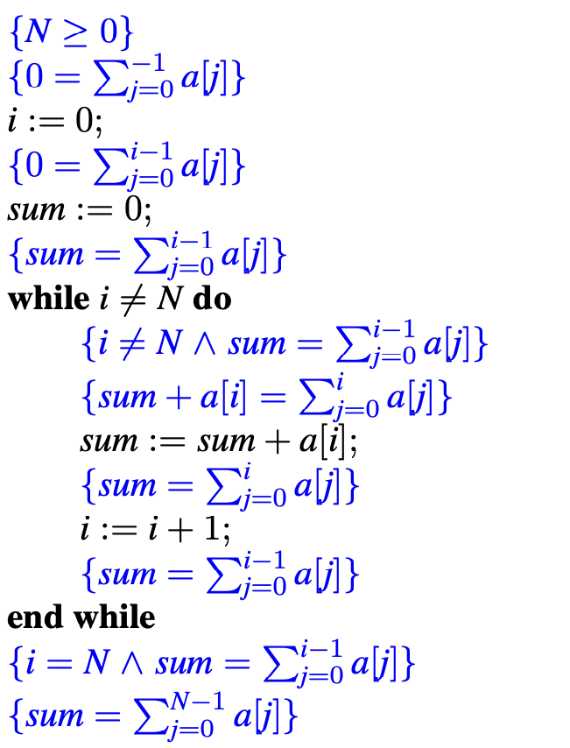
Background: Formal verification
To prove a program satisfying some properties
Different formal verification logics for different kind of properties
(e.g., Hoare Logic, Separation Logic, Relational Logics)
Probabilistic properties are relatively difficult to prove

Slide 6
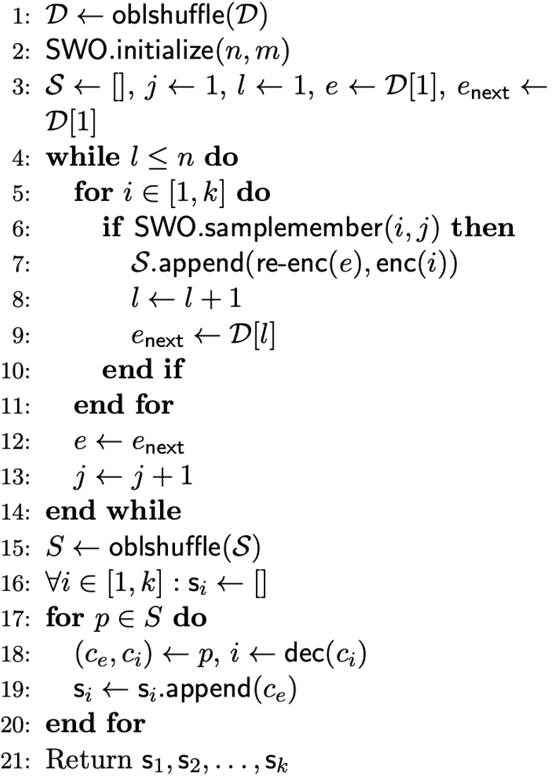
Aim and Challenge
Oblivious sampling algorithm
(Sajin Sasy and Olga Ohrimenko. 2019.)
(1) Negligible failure probability
(2) Random loop
(3) IF branch on sensitive data
(4) Dynamic random choice
(which produce (5) independent
distribution)

Slide 7
Contribution(1)
Verification by approximation
Target Algorithm
(with Negligible failure probability)
Approximated version
(no failure probability)
1. Negligible statistical distance
3. Conclusion:
Statistical secrecy
2. Verification of obliviousness

Slide 8
Contribution(2)
Combining classical reasoning and probabilistic reasoning to verify the perfect approximation
- developed a new formal verification logic

Slide 9
Contribution(3)
Verified several probabilistic oblivious algorithms:
- Path ORAM
- Oblivious Sampling Algorithm
- the Melbourne Shuffle
- Path Oblivious Heap

Slide 10
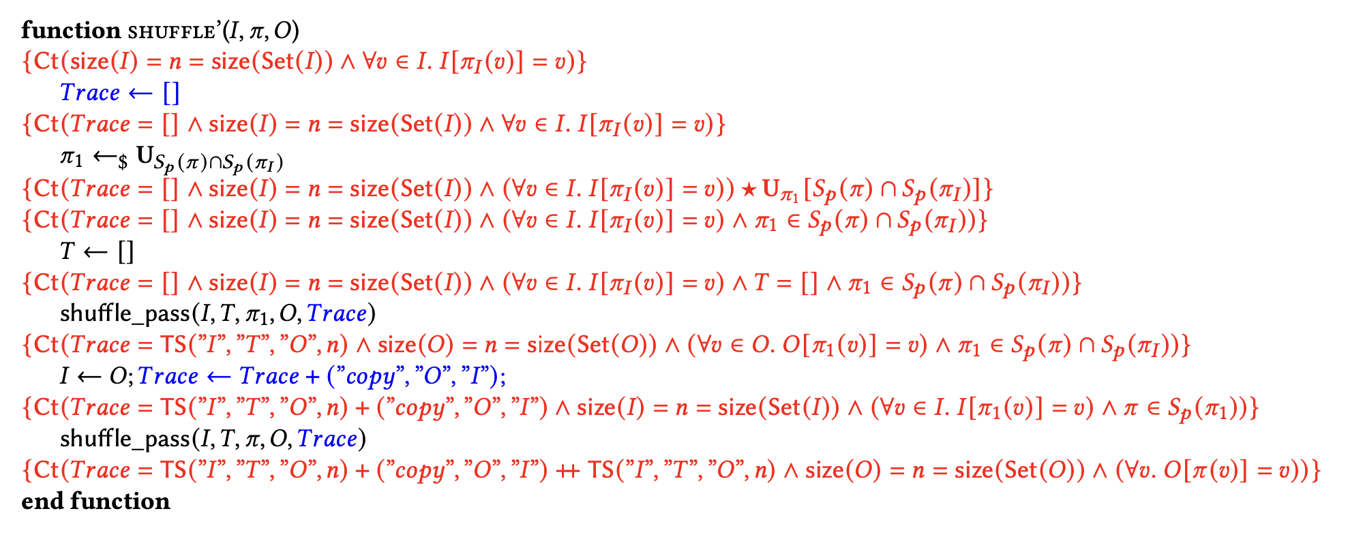
Part of Verification of the Melbourne shuffle

